Slide 1
IBM University Engagement Project Submission
“Exploring the Power of Agentic AI with IBM Granite and LangFlow”

Slide 2

Project Tile – 9705576008
Domain of Project – Education
Student Name | Recent Passport Photo | Email ID | Mobile number [WhatsApp]
MATTA NITHYA REDDY |  | vinnyreddy0719@gmail.com | 9705576008

Slide 3
Problem Statement
Problem Statement: Interview Trainer Agent
The Challenge
Preparing for job interviews can be difficult for students and job seekers due to a lack of structured guidance, role-specific preparation materials, and practical interview experience. Many candidates struggle with HR questions, technical assessments, behavioral scenarios, and understanding industry expectations.
The Objective
Build an AI-powered Interview Trainer Agent that helps users prepare effectively for interviews by providing personalized guidance based on their job role, experience level, and interview requirements. The solution should:
○ HR Interview Preparation – Provide common HR questions along with sample answers and response strategies.
○ Technical Interview Preparation – Generate technical questions related to the user's domain and skill set.
○ Role-Based Question Generation – Deliver interview questions tailored to specific job roles such as Software Developer, Data Analyst, and others.
○ Sample Answers & Guidance – Offer model answers and tips to improve response quality.
○ Interview Tips & Best Practices – Share practical advice on communication, confidence, body language, and preparation techniques.
○ Knowledge-Based Retrieval (RAG) – Retrieve relevant interview content from the knowledge base for accurate responses.
○ AI-Powered Assistance – Use IBM Granite Models to generate intelligent, context-aware interview preparation guidance.
○ Interactive User Experience – Enable users to interact naturally and receive personalized interview support.

Slide 4
Technology Used
Technology | Purpose
IBM watsonx.ai | Provides the AI platform for building and managing the Interview Trainer solution.
IBM Granite Models | Generates intelligent interview questions, sample answers, and interview guidance.
Retrieval-Augmented Generation (RAG) | Retrieves relevant interview content from the knowledge base for accurate responses.
IBM watsonx Orchestrate | Creates and manages the AI agent and user interactions.
Microsoft Excel Dataset | Stores HR questions, technical questions, role-based questions, and interview tips.
AI Agent | Provides personalized interview preparation and guidance through natural language conversations.

Slide 5
Proposed Solution
Proposed Solution: AI-Powered Interview Trainer Agent
The Interview Trainer Agent is an AI-powered interview preparation assistant built using IBM watsonx Orchestrate, IBM watsonx.ai, IBM Granite Models, and Retrieval-Augmented Generation (RAG).
The solution helps students and job seekers prepare for interviews by providing personalized interview questions, sample answers, and preparation guidance.
Core Components
HR Interview Module – Provides common HR interview questions along with sample answers and response strategies.
Technical Interview Module – Generates technical questions related to programming, databases, operating systems, networking, and other technical subjects.
Role-Based Interview Module – Delivers interview questions tailored to specific job roles such as Software Developer.
Knowledge Base (RAG Engine) – Retrieves relevant interview questions, answers, and preparation tips from the uploaded dataset.
Interview Tips Module – Provides guidance on communication skills, confidence building, resume preparation, and interview best practices.
Key Features
○ HR Interview Preparation
○ Technical Interview Preparation
○ Role-Based Question Generation
○ Sample Answers and Explanations
○ Interview Preparation Tips
○ Knowledge-Based Retrieval (RAG)
○ AI-Powered Personalized Guidance
○ Interactive Chat-Based Experience
Outcome
Helps users improve interview readiness, build confidence, strengthen communication skills, and perform better in HR, technical, and role-specific interviews.

Slide 6
IBM watsonx Orchestrate Components Used -
1) User Query
Captures user requests such as HR interview preparation, technical questions, role-based questions, and interview tips.
2) Interview Trainer Agent
Analyzes user queries and determines the most relevant interview content to provide.
3) Knowledge Base
Stores structured information including:
HR Questions & Sample Answers
Technical Questions & Answers
Role-Based Questions
Interview Tips
4) RAG (Retrieval-Augmented Generation)
Retrieves relevant interview content from the uploaded knowledge base to improve response accuracy.
5) IBM Granite Model
Processes retrieved information and generates intelligent, context-aware interview guidance and answers.
6) Response Generation
Provides:
Interview Questions
Sample Answers
Interview Tips
Role-Specific Guidance
Personalized Interview Preparation

Slide 7
Orchestrate workflow -
User Query
Interview Trainer Agent
Knowledge Base + RAG Retrieval
IBM Granite Model Processing
Generated Output:
• HR Interview Questions
• Technical Questions
• Role-Based Questions
• Sample Answers
• Interview Tips
• Personalized Guidance
User Response

Slide 8
System Architecture blueprint
👨‍🎓 Candidate / Student
↓
💬 Chat Interface
↓
🤖 Interview Trainer Agent (IBM watsonx Orchestrate)
↓
📚 Knowledge Base
(HR_Questions.xlsx
Technical_Questions.xlsx
Role_Based_Questions.xlsx
Interview_Tips.xlsx)
↓
🔎 RAG (Retrieval-Augmented Generation)
↓
🧠 IBM Granite Model
↓
📋 Personalized Interview Preparation
↓
📊 HR Questions + Technical Questions
+ Role-Based Questions + Interview Tips
↓
✅ Interview Ready Candidate

Slide 9
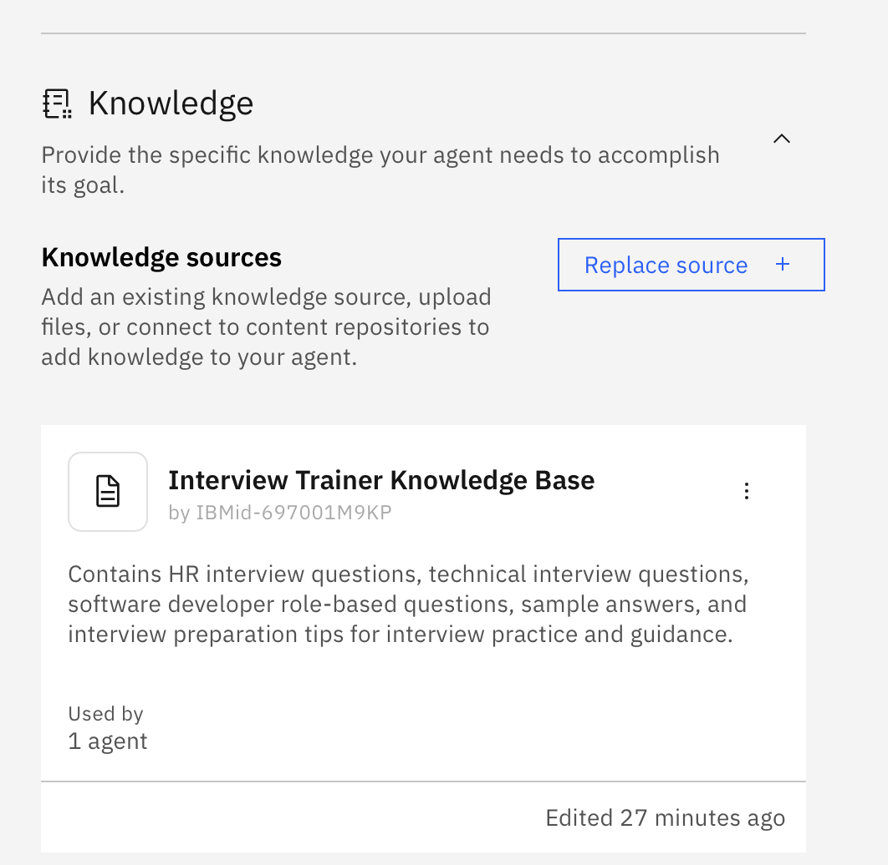
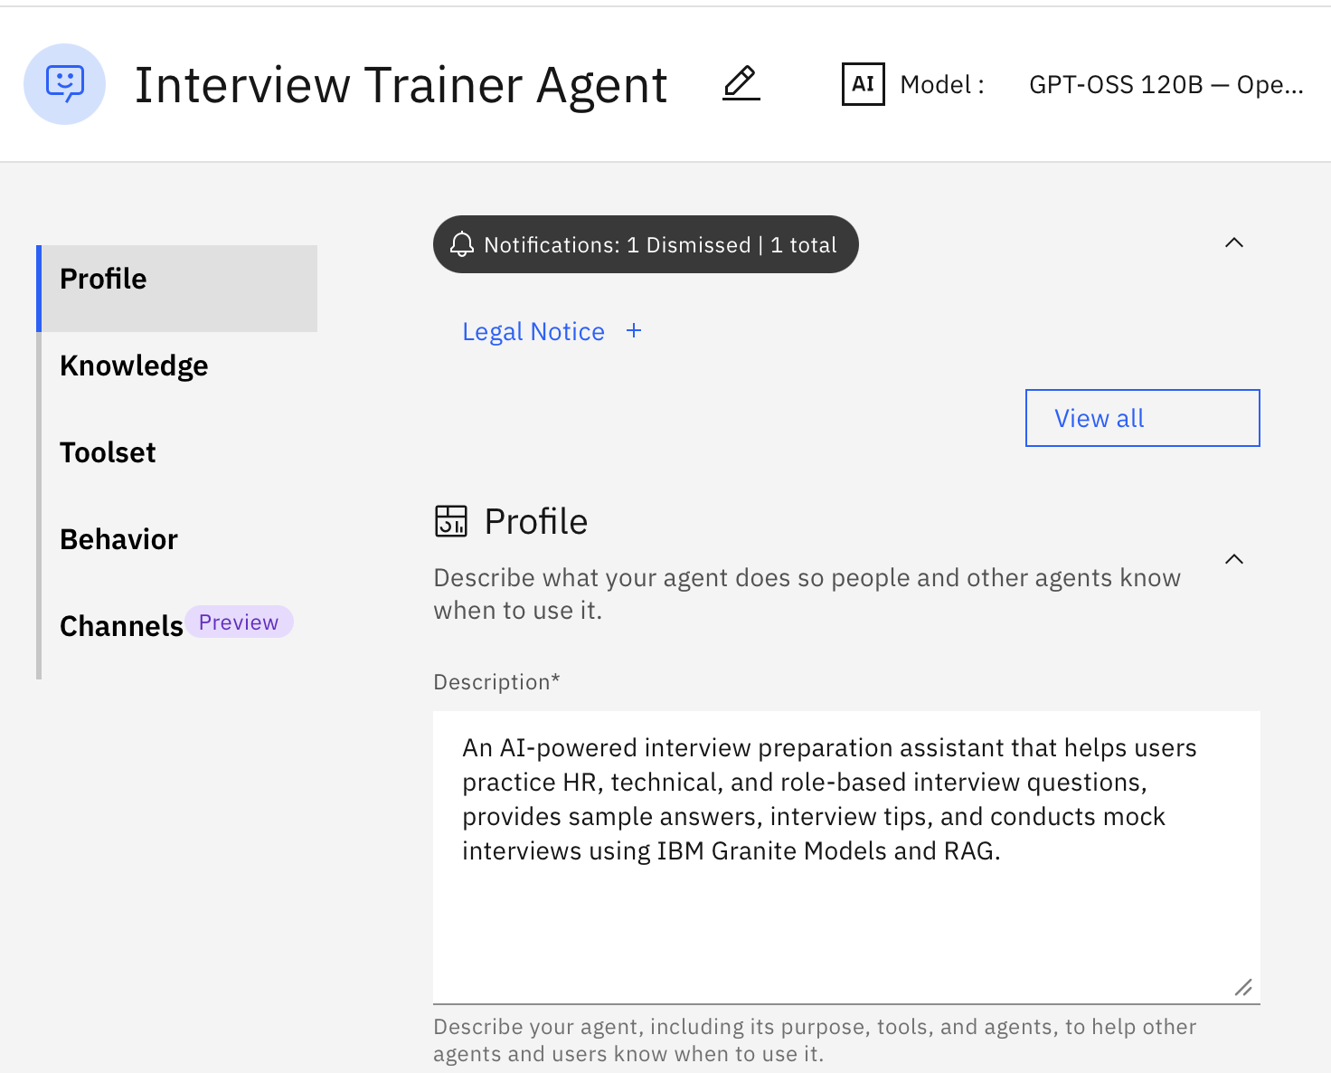
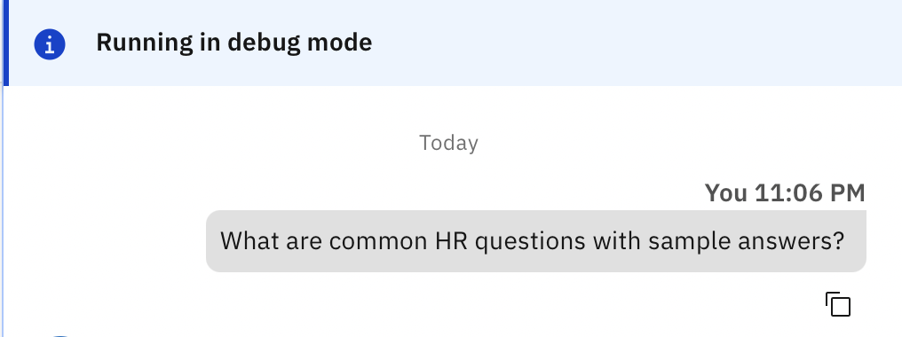
Results and Outputs:
Agent Configuration
Knowledge Base Setup
User Input
Generated Learning Path

Slide 10
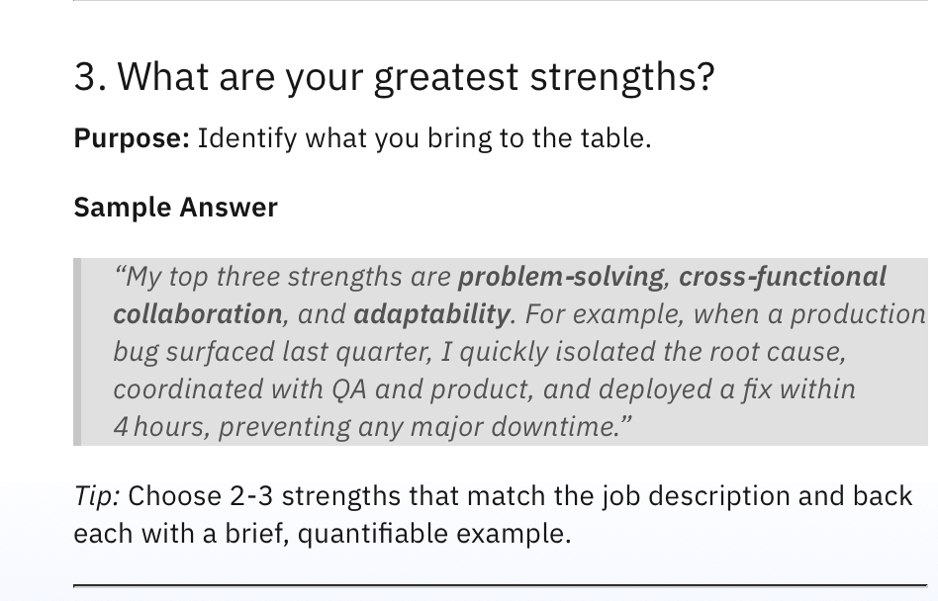
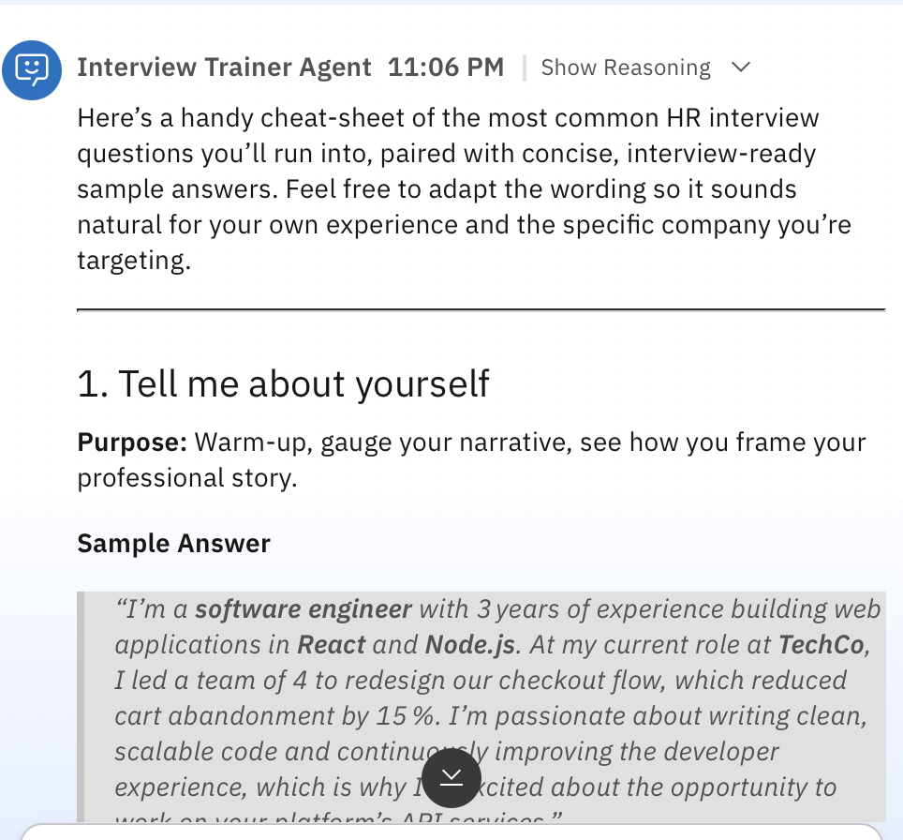
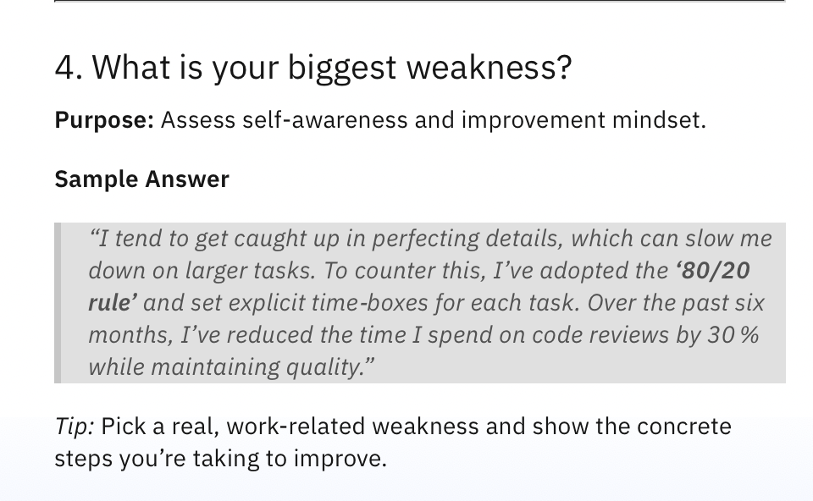
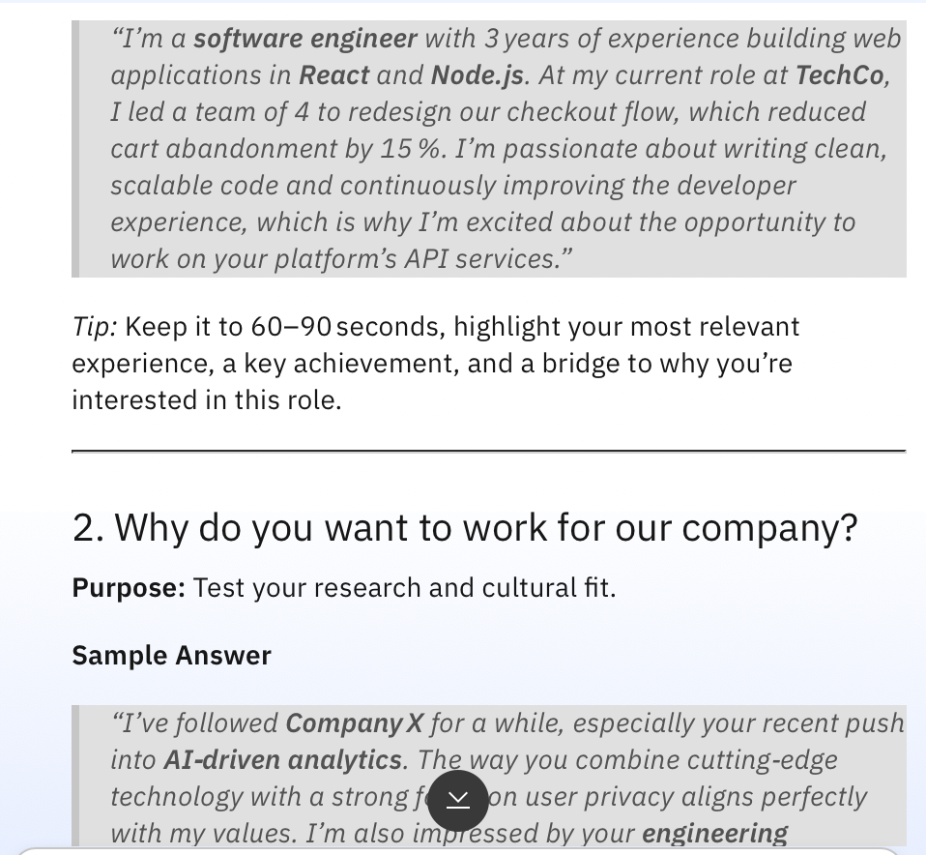
Generated Learning Path

Slide 11

Role of Agentic AI in the solution
Role of Agentic AI in Interview Trainer Agent
• Agentic AI enables the Interview Trainer Agent to act as an intelligent interview preparation assistant rather than a simple question-answer chatbot.
• Using IBM watsonx Orchestrate and IBM Granite Models, the system analyzes user queries and provides personalized interview guidance.
• The solution follows an agent-based approach, where the agent retrieves relevant information from the interview knowledge base and generates contextual responses.
• The Interview Trainer Agent helps users practice:
HR Interview Questions
Technical Questions
Role-Based Questions
Interview Preparation Tips
• Through RAG (Retrieval-Augmented Generation), the agent retrieves relevant interview content from the uploaded datasets before generating answers.
• Agentic AI provides personalized suggestions based on the user's selected role, skill level, and interview requirements.
• The system improves interview readiness by offering structured practice, sample answers, and preparation guidance.

Slide 12
Technology Used
IBM watsonx Orchestrate : Used to design and manage the Interview Trainer Agent workflow and coordinate interactions between components.
• IBM Granite Model (Granite 3.2-8B Instruct) : Used for natural language understanding, reasoning, and generating intelligent interview responses.
• Retrieval-Augmented Generation (RAG) : Retrieves relevant interview questions, answers, and tips from the uploaded knowledge base before generating responses.
• Knowledge Base : Stores HR questions, technical questions, role-based questions, and interview preparation tips.
• IBM watsonx.ai : Provides the AI foundation for building, testing, and managing the Interview Trainer Agent.
• GitHub : Used for version control, documentation, and project sharing.

Slide 13
Novelty and Uniqueness
The Interview Trainer Agent combines Agentic AI, RAG, IBM Granite Models, and conversational learning to create an intelligent interview preparation platform.
Key Unique Features
Personalized Interview Preparation : Provides interview guidance based on the user's role, skills, and career goals.
Role-Based Question Practice : Offers specialized interview questions for Software Developer and other technical roles.
RAG-Based Knowledge Retrieval : Retrieves relevant interview questions, answers, and tips from the knowledge base before generating responses.
AI-Powered Answer Generation : Uses IBM Granite Models to generate contextual and intelligent interview guidance.
Interactive Conversational Experience : Users can ask interview-related questions naturally and receive instant assistance.
Comprehensive Interview Coverage : Supports HR Questions, Technical Questions, Role-Based Questions, and Interview Tips in a single platform.
Agentic AI Workflow : The agent independently retrieves knowledge, understands user intent, and generates personalized responses.
Improved Interview Readiness : Helps candidates build confidence, improve communication skills, and prepare effectively for interviews.

Slide 14
Git Hub Link
https://github.com/nithya-0719/Interview-Trainer-Agent.git
·
·
·

Slide 15
Future Scope
• Support More Job Roles
Expand the knowledge base to support additional roles such as Data Analyst, Data Scientist, Cloud Engineer, Cybersecurity Analyst, DevOps Engineer, and UI/UX Designer.
• AI-Based Mock Interviews
Conduct interactive mock interviews where the agent asks questions and evaluates user responses in real time.
• Resume Analysis and Feedback
Analyze resumes and provide suggestions to improve content, formatting, and role-specific relevance.
• Personalized Improvement Recommendations
Identify weak areas based on interview performance and recommend focused preparation plans.
• Interview Performance Scoring
Generate confidence scores, communication scores, and technical readiness assessments after practice sessions.
• Voice-Based Interview Practice
Enable voice interaction for a realistic interview experience and communication skill improvement.
• Company-Specific Interview Preparation
Provide interview questions and preparation guidance tailored to specific companies and job profiles.
• Mobile and Web Application Integration
Deploy the Interview Trainer Agent as a mobile and web application for easy access anytime and anywhere.
• Advanced Analytics Dashboard
Track user progress, completed practice sessions, strengths, weaknesses, and improvement trends.
This Future Scope is directly related to your Interview Trainer Agent project rather than the learning-path project template.
·
·
·

Slide 16


