Slide 1
INTERNET OF THINGS IBM – NAAN MUdHALVAN COURSE
PHASE 1: PROBLEM SOLVING & DESIGN THINKING
Problem Statement
Solution
Project Objective
IoT Sensor Design
Real-Time Transit Information Platform
Integration Approach
TEAM RADIANCE
NARMADA.S
NITHYASREE.M
PRIYADHARSHINI.H

Slide 2
PROBLEM STATEMENT
The project involves integrating IoT sensors into public transportation vehicles to monitor ridership, track locations, and predict arrival times. The goal is to provide real-time transit information to the public through a public platform, enhancing the efficiency and quality of public transportation services. This project includes defining objectives, designing the IoT sensor system, developing the real-time transit information platform, and integrating them using IoT technology and Python.

Slide 3
SOLUTION :
DIGITAL BUS STATION SIGNAGE WITH RFID FOR ENHANCED PASSENGER EXPERIENCE
In the quest to modernize and streamline public transportation communication, our initiative adopts RFID technology, a game-changer in real-time data relay. By outfitting buses with RFID tags, we can swiftly capture and convey vital transit particulars. This information is then vividly and dynamically represented on digital displays at bus stations. As passengers receive timely updates, confusion and waiting times diminish. Consequently, this holistic approach not only magnifies the commuter experience but also fortifies the operational integrity and responsiveness of bus terminal systems.

Slide 4
Project objective
Instant Bus Identification
Platform Allocation
Operational Efficiency
Transit Visibility
As buses approach or enter a station, instantly identify them using RFID, ensuring quick and accurate information update.
Indicate which platform the bus is stationed at or directed to, ensuring efficient movement and organization within the bus station.
Allow passengers to see real-time information on buses currently at the station, reducing wait times and uncertainty.
Reduce the need for manual updates or announcements, thereby improving station management and passenger experience.

Slide 5
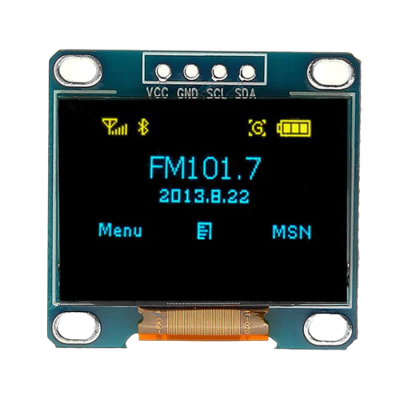
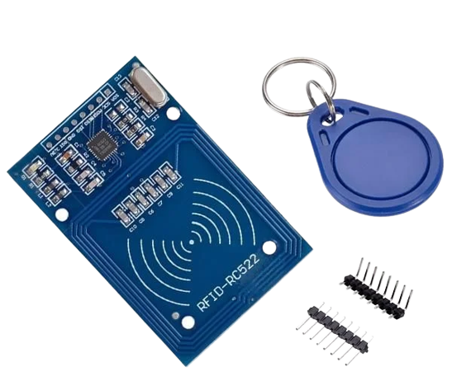
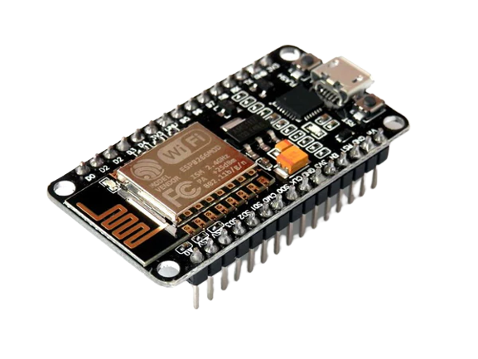
IoT COMPONENTS & sensor design
RFID READER & TAG
ESP8266 NodeMCU
OLED DISPLAY
These are strategically placed to detect the RFID tags on the buses as they approach, enter, or leave a station. Each bus will have a uniquely identifiable RFID tag attached. The RFID tags store the bus’s information.
In this project, the ESP8266 NodeMCU board serves as the central microcontroller, wirelessly connecting RFID readings to the display and potentially relaying data to the cloud for real-time transit updates.
Screens (like OLED) at each platform or centralized screens that will display real-time bus information based on RFID readings.

Slide 6
REAL-TIME TRANSIT INFORMATION PLATFORM
Centralized Display System
Platform-specific Displays
User Interface
Backend System
Large screens placed at vantage points within the bus station, showing information about all buses, their status (arrived, at which platform, departed), and other relevant details.
Smaller screens at each platform displaying information pertinent to buses at that specific platform
A computing system (like a Node MCU or a Firebase real-time database) processes RFID readings and updates the display in real time.
A clean, easy-to-read display layout that shows bus numbers, their current status, and platform number. The display should automatically update as buses come and go.

Slide 7
INTEGRATION APPROACH
RFID to Backend Integration
Backend to Display Integration
Backend Cloud Processing System
User-friendly Display Interface
As the RFID reader detects a bus, the unique identification data is sent to the backend system (Like cloud server). This can be done using WiFi modules like ESP8266.
The backend system processes the RFID data, determines the status and platform of the bus, and sends the appropriate information to be displayed on the OLED screens.
By integrating with Firebase, historical data, analytics, and remote monitoring can be added. This enables remote monitoring and control of bus flow and display information by the station management.
In advanced iterations, station management could have an interface to manually input or adjust data, allowing for changes in bus status, rerouting, or platform changes if necessary.

Slide 8
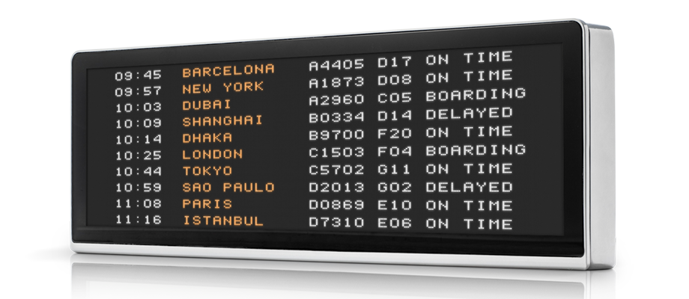
SUMMARY
Modernizing Transit Information
Enhancing User Experience
Streamlining Bus Station Operations
Sample Real-time Display at a Bus Station

Slide 9
THANK YOU

