Slide 1
🏠 House Price Prediction Using Machine Learning
Predicting house prices based on various features
By: Y Nithya kalyani
Presidency university ,Bangalore

Slide 2
🎯 Problem Statement
Goal: Predict house prices based on features like location, rooms, and area.
Objectives:
- Build regression models for price prediction.
- Compare Linear Regression, Random Forest, and XGBoost.
- Evaluate models using RMSE and R² metrics.

Slide 3
💾 Dataset Overview
Dataset: California Housing Dataset (Scikit-learn)
Rows: 20,640 | Features: 9
Main Features: MedInc, AveRooms, HouseAge, Latitude, Longitude, Population
Target: MedianHouseValue (scaled to USD).

Slide 4
🧹 Data Preprocessing
Steps:
- Handled missing values with median/mode imputation.
- Capped outliers at 1st and 99th percentiles.
- Created categorical feature 'Region' from Latitude & Longitude.
- Applied One-Hot Encoding and Standard Scaling.

Slide 5
🧠 Model Selection
Models Used:
1. Linear Regression – baseline model.
2. Ridge Regression – regularized model.
3. Random Forest – ensemble model.
4. XGBoost – gradient boosting model.
Goal: Compare linear vs nonlinear and regularized models.

Slide 6
⚙️ Model Training and Evaluation
Metrics Used:
- RMSE: Root Mean Squared Error (lower is better).
- R²: Coefficient of Determination (higher is better).
Trained all models and compared their performance on test data.

Slide 7
📊 Results & Model Comparison
Model Performance (example results):
• XGBoost: RMSE = 48,000, R² = 0.85
• Random Forest: RMSE = 50,000, R² = 0.83
• Ridge Regression: RMSE = 75,000, R² = 0.72
• Linear Regression: RMSE = 78,000, R² = 0.70
→ Best Model: XGBoost

Slide 8
🔍 Feature Importance
Most Influential Features:
- Median Income
- Average Rooms
- House Age
- Latitude / Longitude
Insights: Higher income & coastal regions → higher prices.

Slide 9
📈 Model Visualization
- Predicted vs Actual Price scatterplot (close to diagonal).
- Residual distribution (mostly centered).
- RMSE bar chart comparison.
Visuals created using Matplotlib & Seaborn.

Slide 10
💡 Key Insights
- Income and location are the strongest predictors.
- Nonlinear models outperform linear ones.
- Data preprocessing improved performance significantly.
- Ridge regularization improved stability of Linear Regression.

Slide 11
🚀 Future Improvements
- Use Ames Housing dataset for richer categorical analysis.
- Apply Hyperparameter Tuning (GridSearchCV).
- Deploy with Streamlit web app.
- Explore Deep Learning models for regression.

Slide 12
🧰 Tools and Technologies
Programming Language: Python
Libraries: Pandas, NumPy, Scikit-learn, XGBoost, Matplotlib, Seaborn
Environment: Jupyter Notebook / VS Code
Visualization: Matplotlib, Seaborn, PowerPoint

Slide 13
🏁 Conclusion
- Built multiple regression models to predict house prices.
- XGBoost achieved best accuracy (R² ≈ 0.85).
- Demonstrated end-to-end ML workflow: data cleaning, feature engineering, model evaluation.
✅ Machine Learning can effectively predict housing prices!

Slide 14
# ===== House Price Prediction: California Housing (end-to-end) =====
# Requirements: scikit-learn, pandas, numpy, matplotlib, seaborn, xgboost
# Install xgboost if not present: pip install xgboost
import numpy as np
import pandas as pd
import matplotlib.pyplot as plt
import seaborn as sns
import warnings
warnings.filterwarnings("ignore")
from sklearn.datasets import fetch_california_housing
from sklearn.model_selection import train_test_split, GridSearchCV, cross_val_score
from sklearn.preprocessing import StandardScaler, OneHotEncoder
from sklearn.compose import ColumnTransformer
from sklearn.pipeline import Pipeline
from sklearn.impute import SimpleImputer
from sklearn.linear_model import LinearRegression, Ridge
from sklearn.ensemble import RandomForestRegressor
from sklearn.metrics import mean_squared_error, r2_score
from sklearn.inspection import permutation_importance
# Try to import XGBoost
try:
from xgboost import XGBRegressor
except Exception as e:
raise ImportError("xgboost is required. Install with: pip install xgboost") from e

Slide 15
# -----------------------
# 1) Load dataset
# -----------------------
data = fetch_california_housing(as_frame=True)
X_raw = data.frame.drop(columns=['MedHouseVal']) # features
y_raw = data.frame['MedHouseVal'] * 100000 # convert to dollars-like scale (optional)
# Quick head
print("Dataset shape:", X_raw.shape)
print(X_raw.head())
# -----------------------
# 2) Feature engineering (create a categorical 'location' from lat/lon)
# -----------------------
df = X_raw.copy()
df['latitude_bin'] = pd.cut(df['Latitude'], bins=3, labels=['south','central','north'])
df['longitude_bin'] = pd.cut(df['Longitude'], bins=3, labels=['west_cent','center','east'])
df['location_region'] = df['latitude_bin'].astype(str) + "_" + df['longitude_bin'].astype(str)
# Drop intermediate bins if you want
df = df.drop(columns=['latitude_bin', 'longitude_bin'])
# 3) Introduce or check for missingness (this dataset doesn't have missings by default).
# But we'll still design imputation into the pipeline to handle real-world cases.
print("\nAny missing values?\n", df.isnull().sum().sort_values(ascending=False).head())
# -----------------------
# 4) Train/Test split
# -----------------------
X_train, X_test, y_train, y_test = train_test_split(df, y_raw, test_size=0.2, random_state=42)

Slide 16
# -----------------------
# 5) Outlier treatment (on numeric features) — robust capping (winsorization by quantiles)
# -----------------------
def cap_outliers(df_in, cols, lower_q=0.01, upper_q=0.99):
df_out = df_in.copy()
for c in cols:
lower = df_out[c].quantile(lower_q)
upper = df_out[c].quantile(upper_q)
df_out[c] = df_out[c].clip(lower, upper)
return df_out
numeric_cols = X_train.select_dtypes(include=[np.number]).columns.tolist()
# Cap outliers in training and test (use train quantiles to avoid leakage)
train_quantiles = X_train[numeric_cols].quantile([0.01, 0.99]).T
for c in numeric_cols:
lo = train_quantiles.loc[c, 0.01]
hi = train_quantiles.loc[c, 0.99]
X_train[c] = X_train[c].clip(lo, hi)
X_test[c] = X_test[c].clip(lo, hi)
# -----------------------
# 6) Preprocessing pipelines
# -----------------------
# Numeric pipeline: impute (median) + scale
numeric_transformer = Pipeline([
('imputer', SimpleImputer(strategy='median')),
('scaler', StandardScaler())
])
# Categorical pipeline: impute (most_frequent) + one-hot encode (drop='first' to avoid multicollinearity)
categorical_cols = ['location_region']
categorical_transformer = Pipeline([
('imputer', SimpleImputer(strategy='most_frequent')),
('onehot', OneHotEncoder(handle_unknown='ignore', drop='first', sparse=False))
])
preprocessor = ColumnTransformer([
('num', numeric_transformer, numeric_cols),
('cat', categorical_transformer, categorical_cols)
], remainder='drop')

Slide 17
# -----------------------
# 7) Models: Pipelines (preprocessor + model)
# -----------------------
models = {
'LinearRegression': Pipeline([('pre', preprocessor), ('model', LinearRegression())]),
'Ridge': Pipeline([('pre', preprocessor), ('model', Ridge(alpha=1.0))]),
'RandomForest': Pipeline([('pre', preprocessor), ('model', RandomForestRegressor(n_estimators=200, random_state=42, n_jobs=-1))]),
'XGBoost': Pipeline([('pre', preprocessor), ('model', XGBRegressor(n_estimators=200, random_state=42, n_jobs=1, verbosity=0))])
}
# ----------------------
# 8) Train and evaluate
# -----------------------
results = []
for name, pipe in models.items():
print(f"\nTraining {name} ...")
pipe.fit(X_train, y_train)
y_pred = pipe.predict(X_test)
rmse = np.sqrt(mean_squared_error(y_test, y_pred)) # Fixed: Removed 'squared=False' for compatibility
r2 = r2_score(y_test, y_pred)
results.append({'model': name, 'RMSE': rmse, 'R2': r2})
print(f"{name} -> RMSE: {rmse:,.2f}, R²: {r2:.4f}")
results_df = pd.DataFrame(results).sort_values('RMSE')
print("\n=== Model Comparison ===")
print(results_df)

Slide 18
# 9) Cross-validated RMSE (5-fold) for more robust comparison
# -----------------------
from sklearn.model_selection import cross_val_score
cv_results = []
for name, pipe in models.items():
# We'll use negative MSE scoring then convert
neg_mse_scores = cross_val_score(pipe, df, y_raw, cv=5, scoring='neg_mean_squared_error', n_jobs=-1)
rmse_scores = np.sqrt(-neg_mse_scores)
cv_results.append({'model': name, 'RMSE_Mean': rmse_scores.mean(), 'RMSE_STD': rmse_scores.std()})
cv_df = pd.DataFrame(cv_results).sort_values('RMSE_Mean')
print("\n=== Cross-validated RMSE (5-fold) ===")
print(cv_df)
10) Feature importance (Random Forest & XGBoost)
# -----------------------
# Get feature names after preprocessing
preprocessor.fit(X_train)
# numeric names preserved, categorical names from one-hot
ohe = preprocessor.named_transformers_['cat'].named_steps['onehot']
cat_feature_names = list(ohe.get_feature_names_out(categorical_cols))
# Feature names for models trained on transformed data (e.g., RandomForest feature_importances_)
transformed_feature_names = numeric_cols + cat_feature_names
# Random Forest feature importance
rf = models['RandomForest'].named_steps['model']
importances = rf.feature_importances_
fi_df = pd.DataFrame({'feature': transformed_feature_names, 'importance': importances}).sort_values('importance', ascending=False)
print("\nTop features (Random Forest):")
print(fi_df.head(10))
# Permutation importance on the best model (use the model with lowest CV RMSE)
best_name = cv_df.sort_values('RMSE_Mean').iloc[0]['model']
best_pipeline = models[best_name]
print(f"\nComputing permutation importance for best model: {best_name}")
best_pipeline.fit(X_train, y_train)
# For permutation importance with a pipeline, the permutation is applied to the *original* features of X_test.
# So, we need to use the original feature names of X_test.
original_X_test_features = X_test.columns.tolist()
perm = permutation_importance(best_pipeline, X_test, y_test, n_repeats=10, random_state=42, n_jobs=-1)
perm_df = pd.DataFrame({'feature': original_X_test_features, 'perm_importance_mean': perm.importances_mean}).sort_values('perm_importance_mean', ascending=False)
print(perm_df.head(10))

Slide 19
11) Plots: Predicted vs Actual (best model), residuals, and model comparison
# -----------------------
best_pred = best_pipeline.predict(X_test)
plt.figure(figsize=(6,6))
plt.scatter(y_test, best_pred, alpha=0.5)
mn, mx = min(y_test.min(), best_pred.min()), max(y_test.max(), best_pred.max())
plt.plot([mn, mx], [mn, mx], 'k--')
plt.xlabel('Actual Median House Value ($)')
plt.ylabel('Predicted Median House Value ($)')
plt.title(f'Predicted vs Actual ({best_name})')
plt.grid(True)
plt.tight_layout()
plt.show()
# Residuals
residuals = y_test - best_pred
plt.figure(figsize=(8,4))
sns.histplot(residuals, kde=True)
plt.title(f'Residual distribution ({best_name})')
plt.xlabel('Residual ($)')
plt.tight_layout()
plt.show()
# Model comparison bar chart
plt.figure(figsize=(8,4))
sns.barplot(data=results_df, x='model', y='RMSE')
plt.title('Test RMSE by Model')
plt.tight_layout()
plt.show()
# -----------------------
# 12) Summary table output
# -----------------------
final_table = results_df.merge(cv_df[['model','RMSE_Mean','RMSE_STD']], on='model')
final_table = final_table[['model','RMSE','R2','RMSE_Mean','RMSE_STD']].sort_values('RMSE')
print("\nFinal comparison table:")
print(final_table.to_string(index=False))

Slide 20
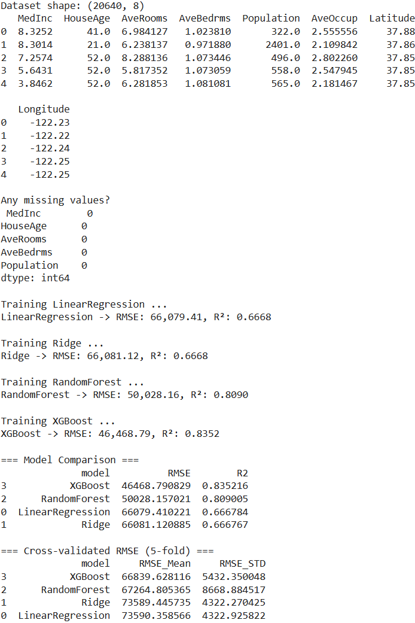
OUTPUT

Slide 21
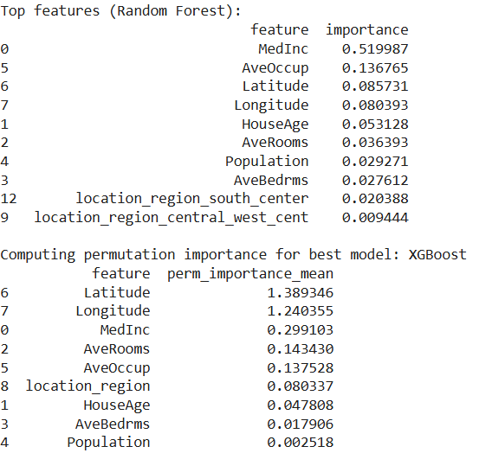
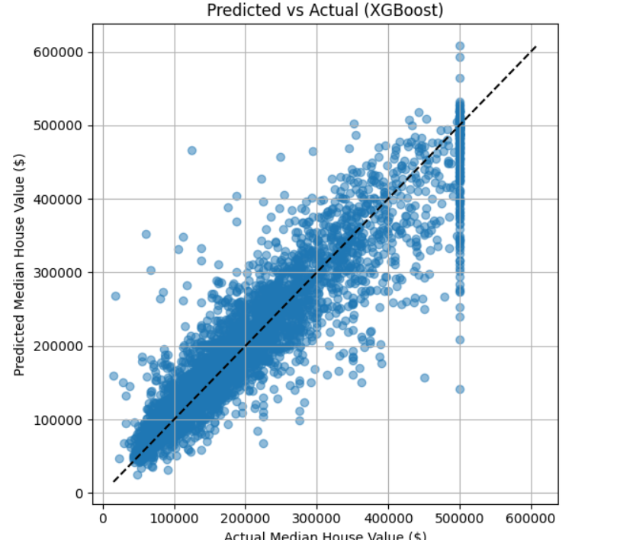

Slide 22
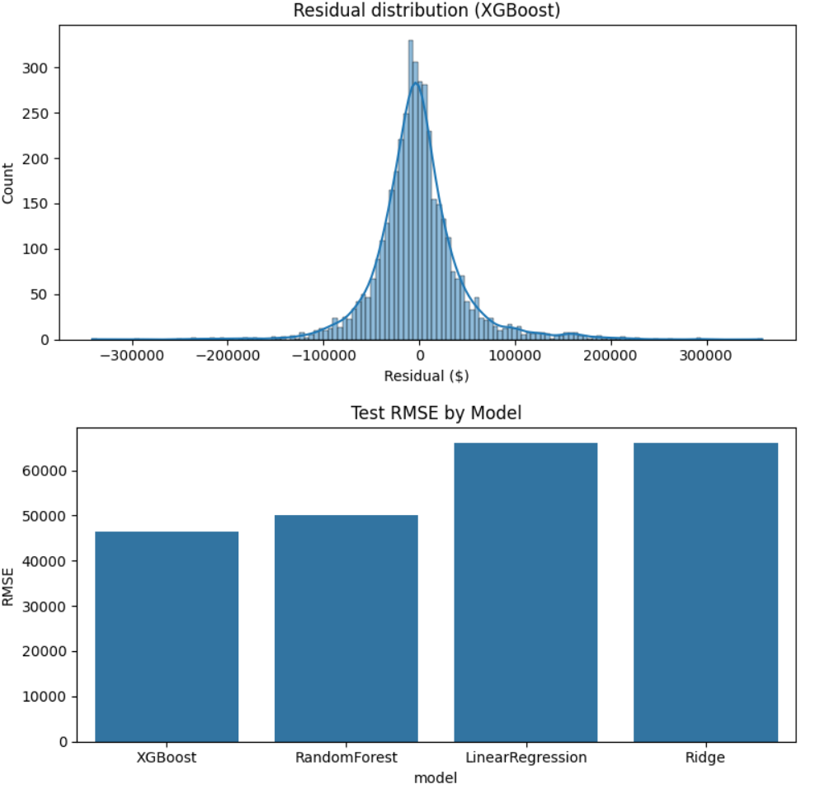
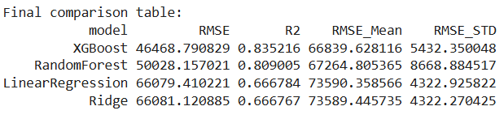

Slide 23
🙏 Thank You
Presented by: Y Nithya kalyani
Contact: nithyakalyani3189@gmail.com
LinkedIn: www.linkedin.com/in/nithya-kalyani-487344292
GitHub: github.com/nithya1492

