Slide 1

LOAN UTILIZATION TRACKING SYSTEM
A web application for loan applications, utilization proof, and officer-verified approvals
WEB APPLICATION
Nithya Sri S
Flask • MySQL • HTML/CSS/JavaScript

Slide 2

THE PROBLEM
Banks can't easily verify how loan money is actually spent
No utilization proof
Manual, paper-based checks
Mismatches go unnoticed
Once a loan is disbursed, banks have no simple way to confirm the funds were used for the stated purpose.
Verifying receipts and matching them to loan purpose is slow and inconsistent across officers.
A loan taken for 'Education' being spent on unrelated purchases can easily slip through without a systematic flag.
Loan Utilization Tracking System
2

Slide 3




OBJECTIVE
Digitize the full loan lifecycle — application to verified utilization
A single system where customers apply for loans and prove how funds were spent, while officers review, verify, and decide — with mismatches flagged automatically.
Customer portal
Apply for loans, upload receipts, track utilization %, export reports
Officer portal
Separate login; approve/reject loans and receipts with remarks
Auto utilization calc
Used / remaining amount and % computed from verified receipts only
Purpose validation
Automatic flag when receipt category doesn't match loan purpose
Loan Utilization Tracking System
3

Slide 4




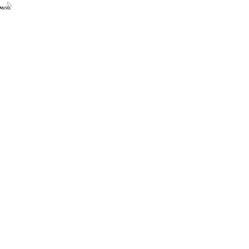

TECHNOLOGY
Tech Stack
HTML5
CSS3
JavaScript
Page structure
Styling & responsive layout
Chart.js visualizations
Flask
MySQL
Render + Aiven
Python web framework
Relational database
Hosting & managed DB
Loan Utilization Tracking System
4

Slide 5

ARCHITECTURE
Server-Rendered Web Application
Flask renders HTML templates directly — no separate frontend/backend split, no REST API layer needed for this scope.
Browser
Flask App
MySQL (Aiven)
HTML / CSS / JS
(Customer or Officer)
Routes, sessions,
business logic
users, loans,
receipts tables
Environment-variable driven DB config — same code runs against local MySQL or Aiven in production
Loan Utilization Tracking System
5

Slide 6
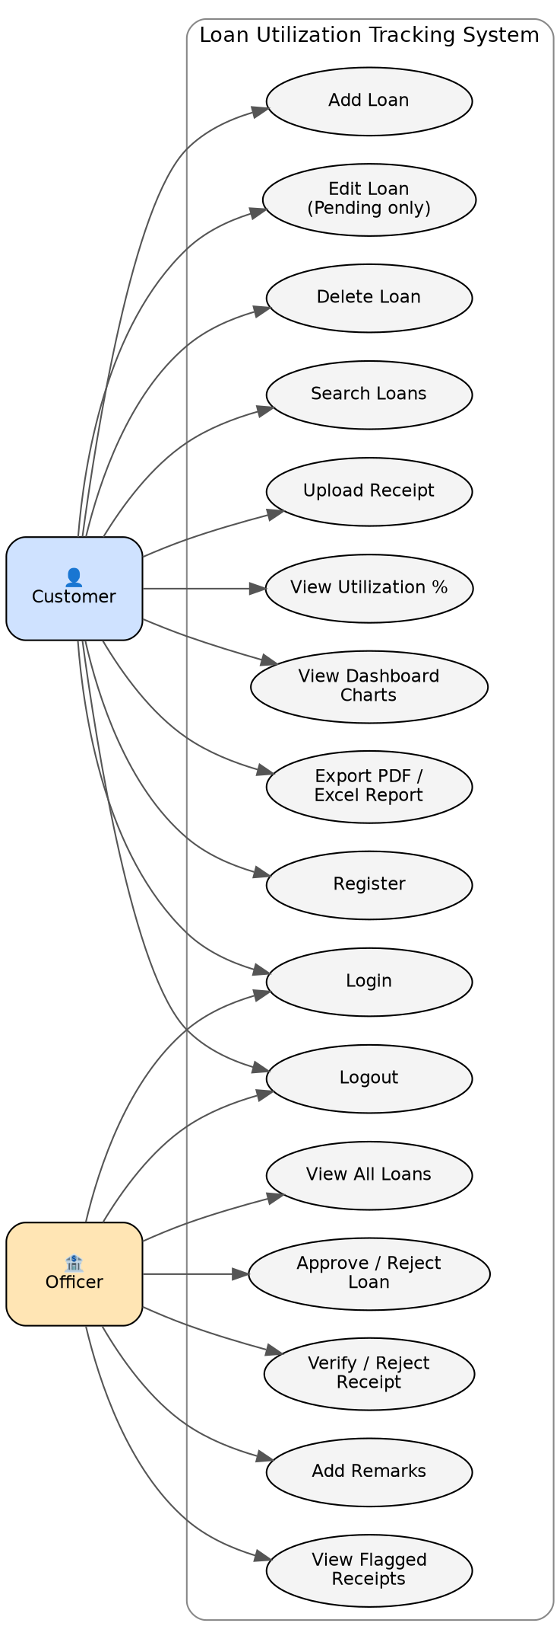
DESIGN
Use Case Diagram
Loan Utilization Tracking System
6

Slide 7
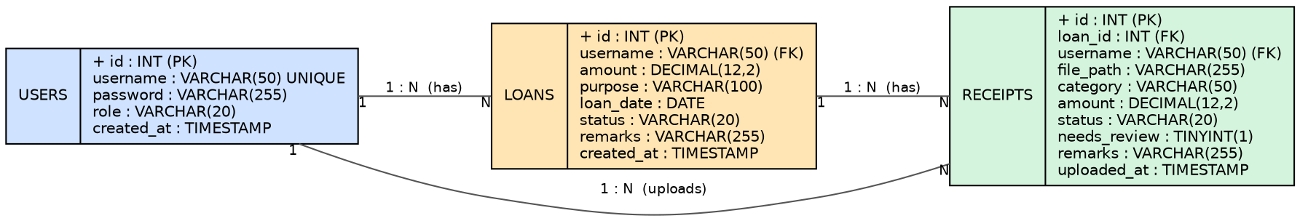
DESIGN
Entity-Relationship Diagram
users → loans → receipts, all linked with ON DELETE CASCADE foreign keys
Loan Utilization Tracking System
7

Slide 8




FEATURES
What the System Does
Loan CRUD
Receipt Upload
Utilization Tracking
Officer Portal
Add, edit, delete, search loans with status tracking (Pending / Approved / Rejected / Completed)
PNG/JPG/PDF upload, category-tagged, 5MB limit, sanitized filenames
Used amount, remaining amount, and % — calculated only from officer-verified receipts
Separate login and session role; approve/reject with remarks
Purpose Validation
Reminders
PDF & Excel Reports
Security
Auto-flags a receipt when its category doesn't match the loan's declared purpose
Pending loans aged 7 / 14 / 21+ days surface a reminder banner
Full loan history exportable with totals and generation date
Hashed passwords, CSRF tokens, parameterized queries, per-user data isolation
Loan Utilization Tracking System
8

Slide 9
HIGHLIGHT FEATURE
Automatic Purpose-Mismatch Flagging
Loan purpose and receipt category are drawn from one shared, fixed list — so a match is an exact comparison, not a guess.
Education
Medical
Wedding
Home Renovation
Travel
Vehicle
Agriculture
Business
Housing
Consumer Durables
Personal
Loan purpose:
Flagged for Officer Review
Wedding
needs_review = 1 in the database. Appears in the officer's “Needs Review” list before it can be verified.
Receipt category uploaded:
Education
Loan Utilization Tracking System
9

Slide 10
WORKFLOW
Loan Status Lifecycle
Pending
Approved
Completed
Created by customer, default state
Officer accepts — customer can upload receipts
Officer marks fulfilled after utilization review
Rejected
Only the officer can change a loan's status. A loan stays editable by its customer only while Pending.
Officer declines — loan closed, no further action
Loan Utilization Tracking System
10

Slide 11

SECURITY
Security Measures Implemented
Password Hashing
CSRF Protection
SQL Injection Safe
Salted PBKDF2 via Werkzeug — passwords never stored in plain text
Flask-WTF tokens required on every form submission
100% parameterized queries — no string-built SQL anywhere
User Isolation
Upload Validation
Env-Based Secrets
Every query scoped to session user — no cross-account data access
Extension whitelist + 5MB cap + sanitized filenames
DB password & secret key from environment variables, never hardcoded
Loan Utilization Tracking System
11

Slide 12

QUALITY ASSURANCE
Testing Summary
30
29
8
Test Cases
Passed
Categories Covered
Authentication (register, login, role separation, password hashing)
Loan CRUD (add, edit-while-pending, delete, ownership checks)
Receipt upload (valid/invalid types, size limits, mismatch flagging)
Utilization calculation (verified-only, remaining floor at 0)
Officer workflow (approve/reject, verify/reject, flagged review list)
Reports (PDF/Excel export), Security (CSRF, SQLi), Deployment checks
Loan Utilization Tracking System
12

Slide 13

DEPLOYMENT
Live on the Web
Render
Aiven
Env-Driven Config
Hosts the Flask app via Gunicorn, auto-deploys from GitHub on every push
Managed, SSL-required MySQL instance in the cloud
Same codebase runs locally (MySQL on localhost) or in production, no code changes
Live demo:
loan-utilization-tracking-via-mobile-g9zu.onrender.com
Note: free-tier hosting spins down after inactivity — first load after idle time may take ~50 seconds.
Loan Utilization Tracking System
13

Slide 14
ROADMAP
Future Enhancements
1
Migrate loan/receipt foreign keys from username to user_id for stricter relational design
2
Content-based file type verification (magic bytes), not just extension checking
3
Persistent cloud storage for uploaded receipts (currently ephemeral on free hosting)
4
Modular code structure — split app.py into routes / models / blueprints
5
Stronger password policy — enforce mixed case, numbers, symbols
6
Admin UI for officer account creation, replacing the manual seed script
Loan Utilization Tracking System
14

Slide 15
Thank You
Questions?
Loan Utilization Tracking System — Nithya Sri S

