Slide 1


Slide 2
abstract
Goal getters, the title itself describe the content as reaching of your goal based on some mcq’s related to math, chemistry and physics.
Here we will ask some questions giving related options and you have to chose them correctly.
We will conduct some certain levels and the toughness of questions will be increased as level increases..
We are going to give grades based on their performances.
Then based on their grades, we will recommend the books of respective subject.

Slide 3
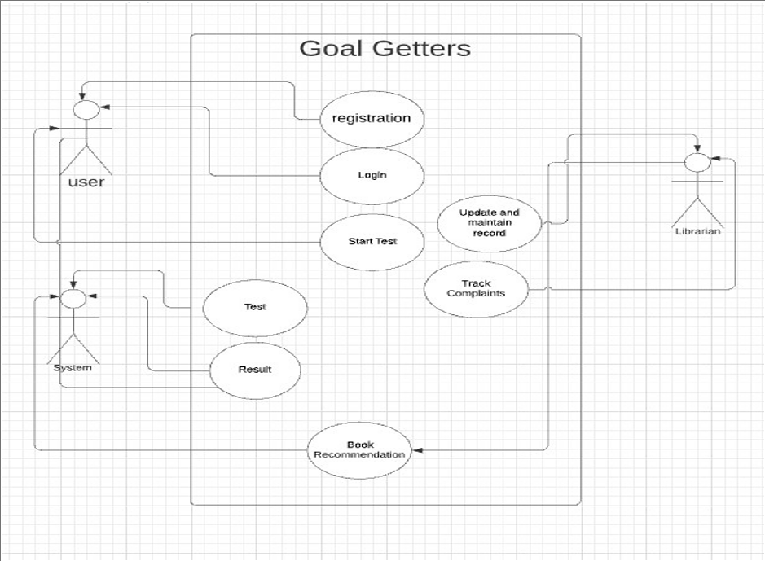
Use case diagram

Slide 4
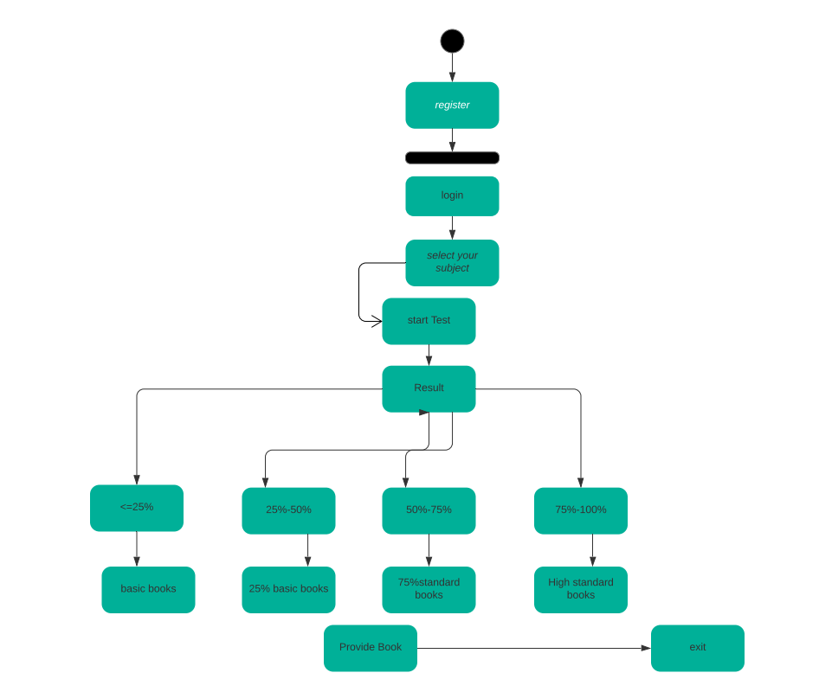
Activity diagram

Slide 5

Technology used
The tkinter package (“Tk interface”) is the standard Python interface to the Tcl/Tk GUI toolkit is used in this quiz game project . Both Tk and tkinter are available on most Unix platforms, including macOS, as well as on Windows systems.

Slide 6

Screenshots of execution

Slide 7
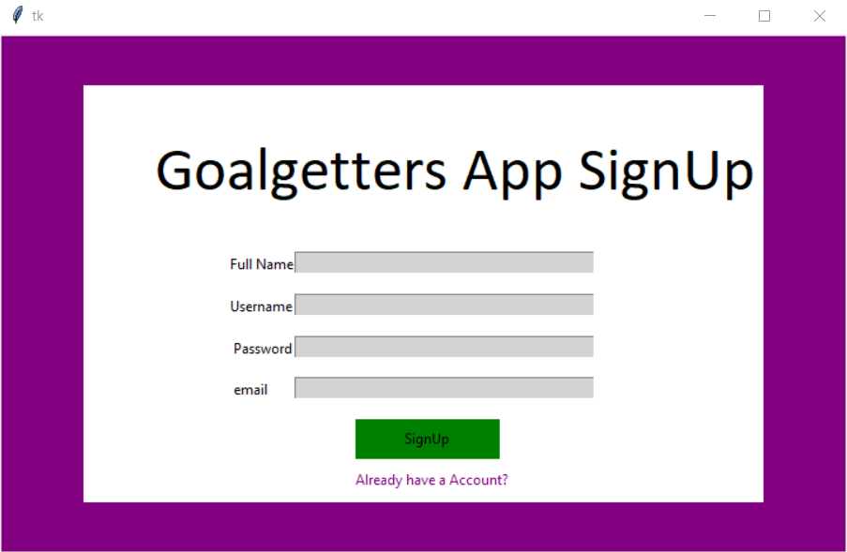

Slide 8
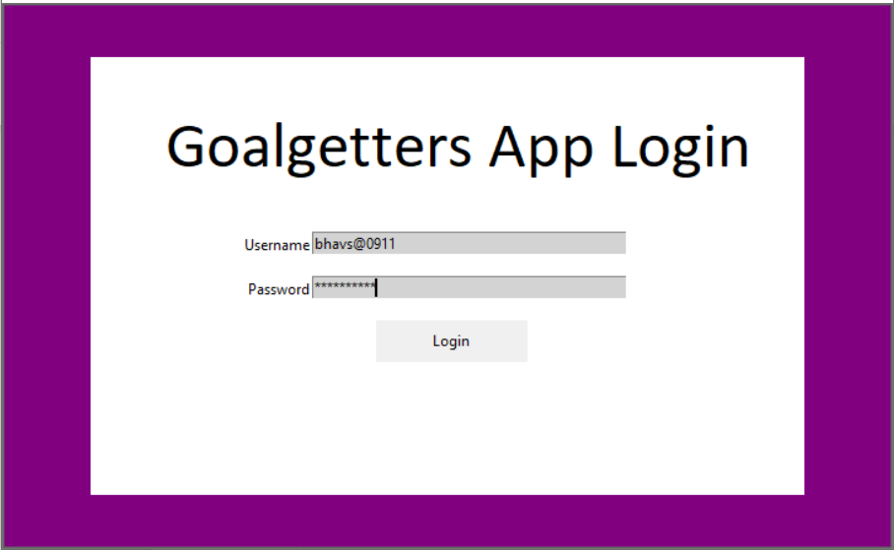

Slide 9
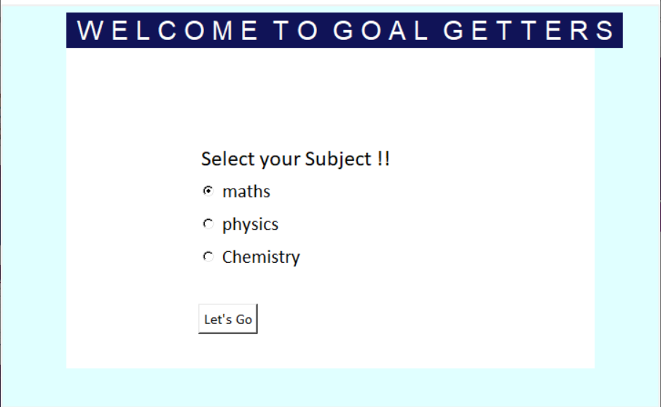

Slide 10
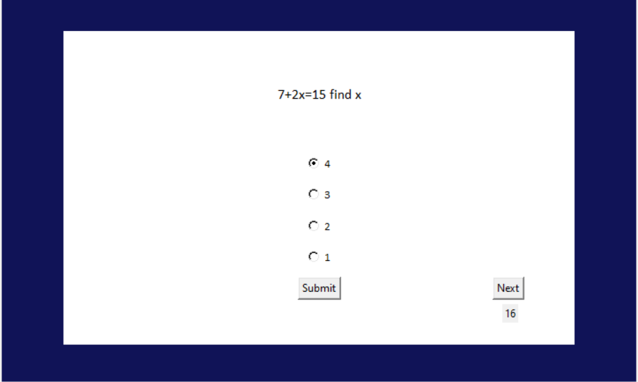

Slide 11
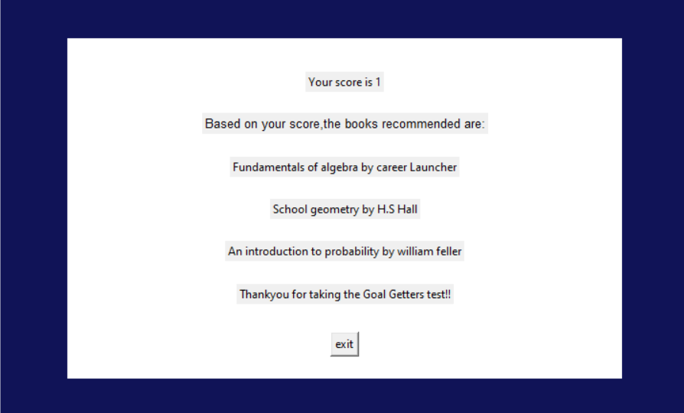

Slide 12
Conclusion and future scope
We know that most of the members are confused to choose what book they want In a library so here we will provide books based on their iq
In future we can this particular by mentioning each and every topic
. by this may know his/her iq levels

Slide 13


