Slide 1
The design and the implementation of the distributed data management layer for the metro mobile application
Project by:
Jukanna nityanand
Mani Kanth seelam

Slide 2
Introduction
1. Conceptual Schema
2. Workload
3. Logical Schema
4. Database generation
5. CQL implementation

Slide 3
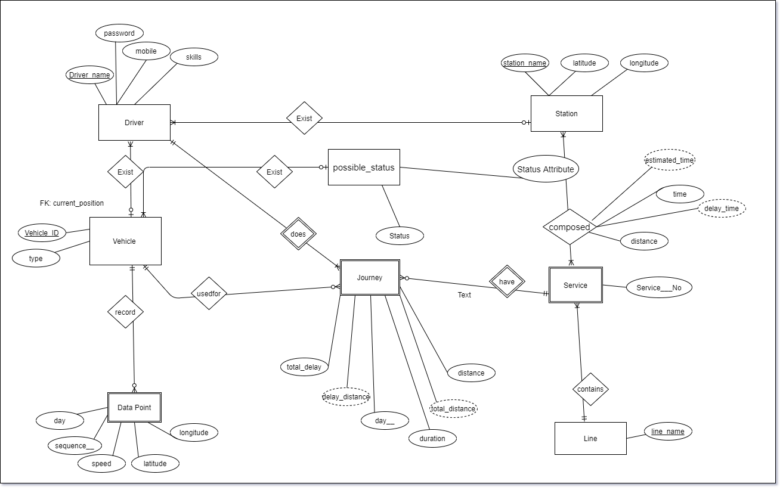
Conceptual schema
To identify the problem and its specifications we created ERD schema

Slide 4
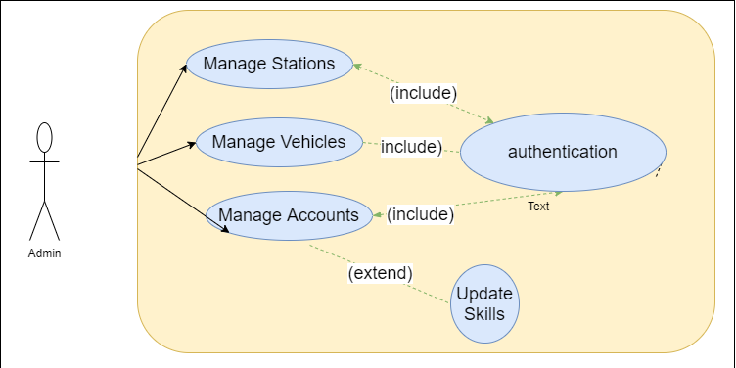
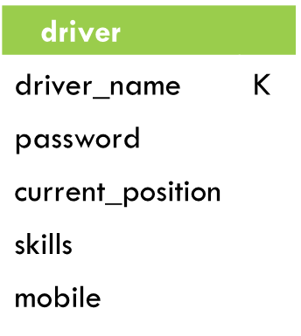
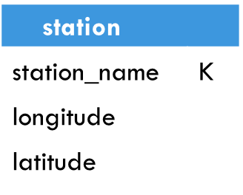
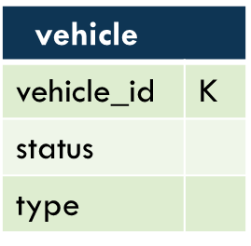
Workload Administrator
Class | Query
Queries A for Station | Insert/Delete/Update a Station
Queries B for Vehicle | Insert/Delete/Update a Vehicle
Queries C for Driver | Insert/Delete/Update a driver and his skils
use case of Admin
First version of logical schema

Slide 5
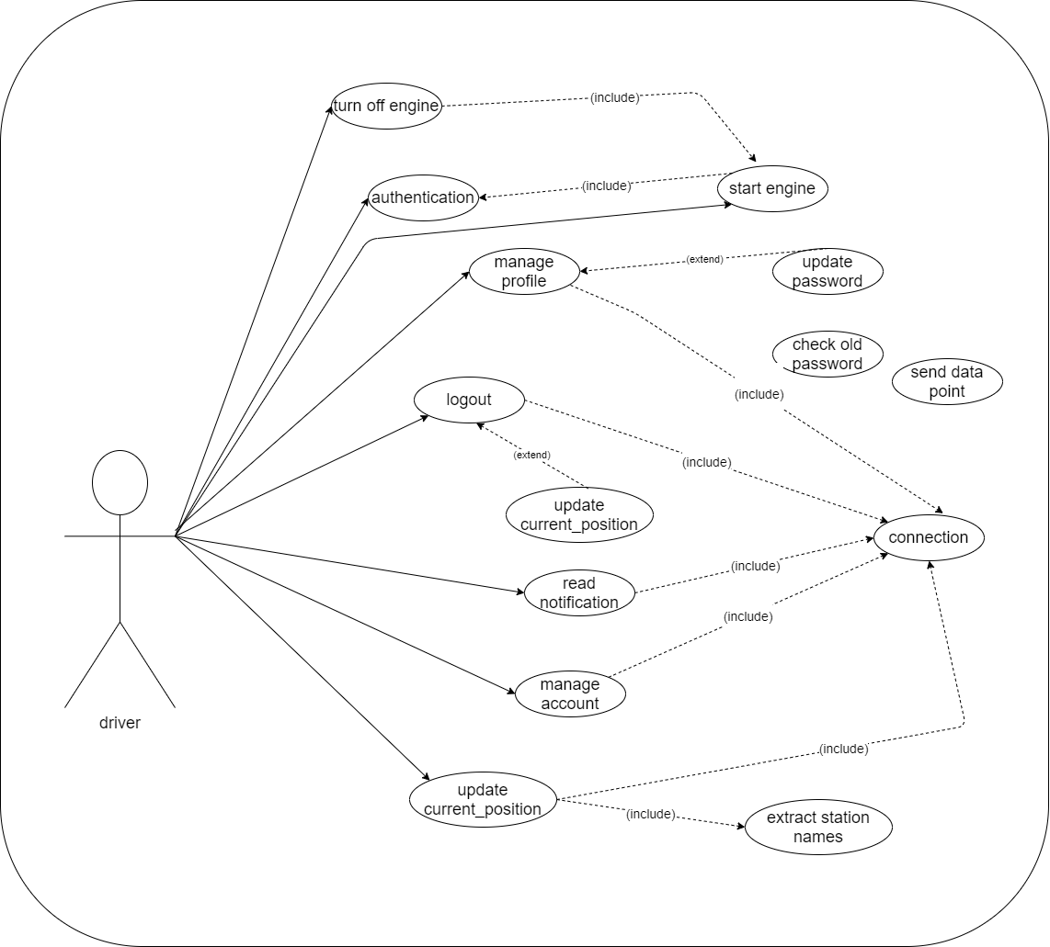
Workload Driver
use case of Admin and vehicle

Slide 6
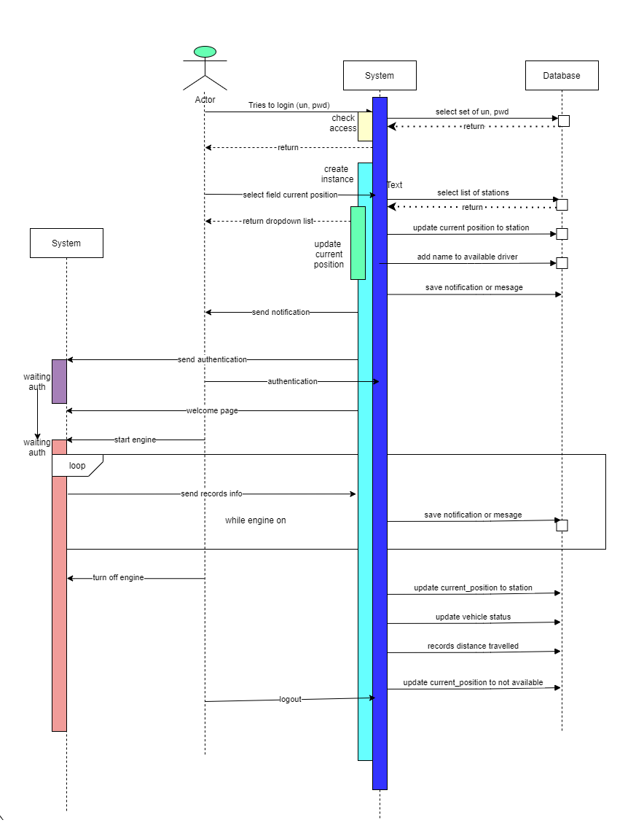
Here you have a list of items
And some text
But remember not to overload your slides with content
Your audience will listen to you or read the content, but won’t do both.
Sequence diagram

Slide 7
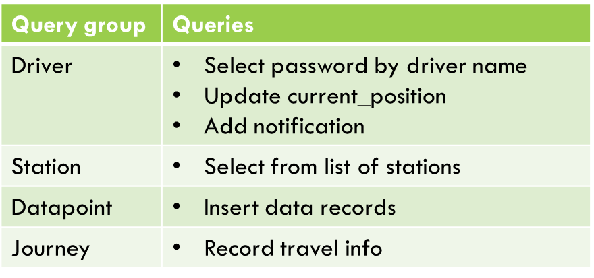
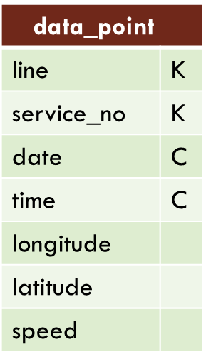
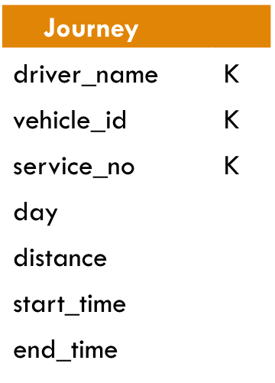
Workload driver
Second version of logical schema

Slide 8
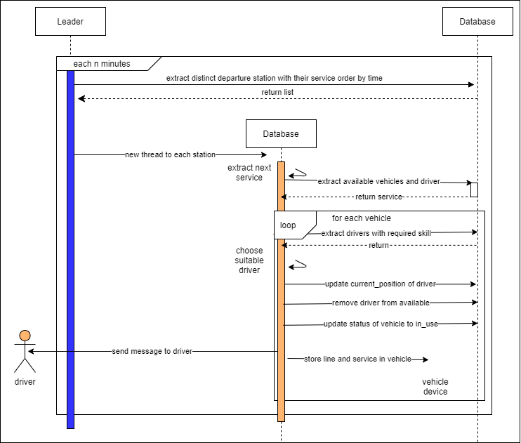
WorkLoad - Allocation of Vehicle and Driver

Slide 9
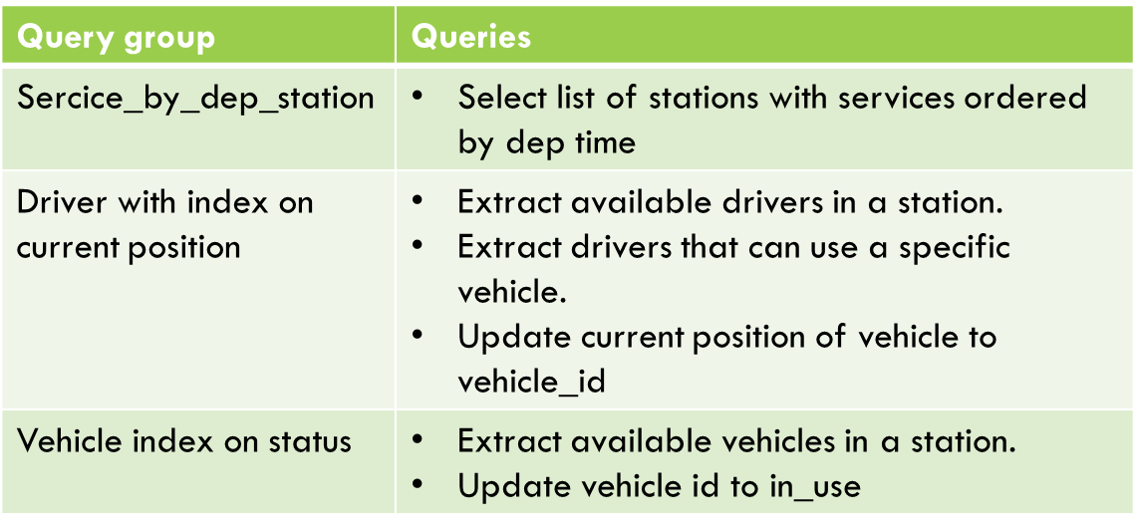

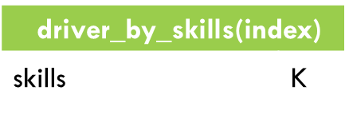
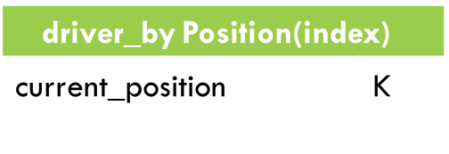
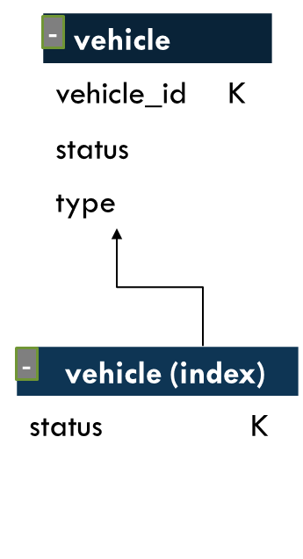
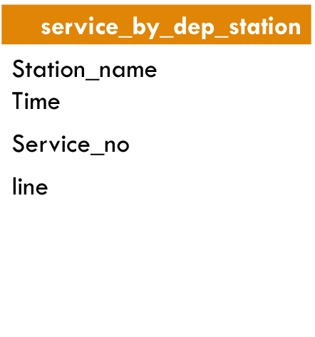
c
Workload - Allocation of Vehicle and Driver
K
Third version of logical schema
c

Slide 10
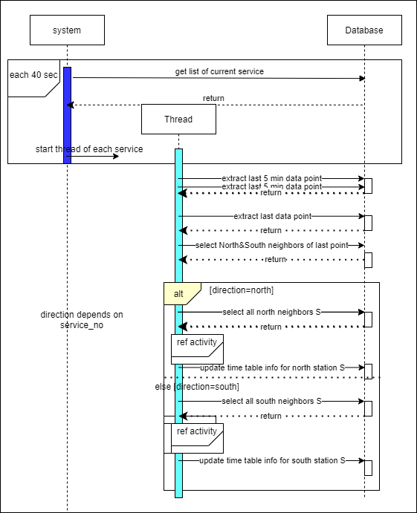

A picture is worth a thousand words
Workload Time table
A complex idea can be conveyed with just a single still image, namely making it possible to absorb large amounts of data quickly.

Slide 11
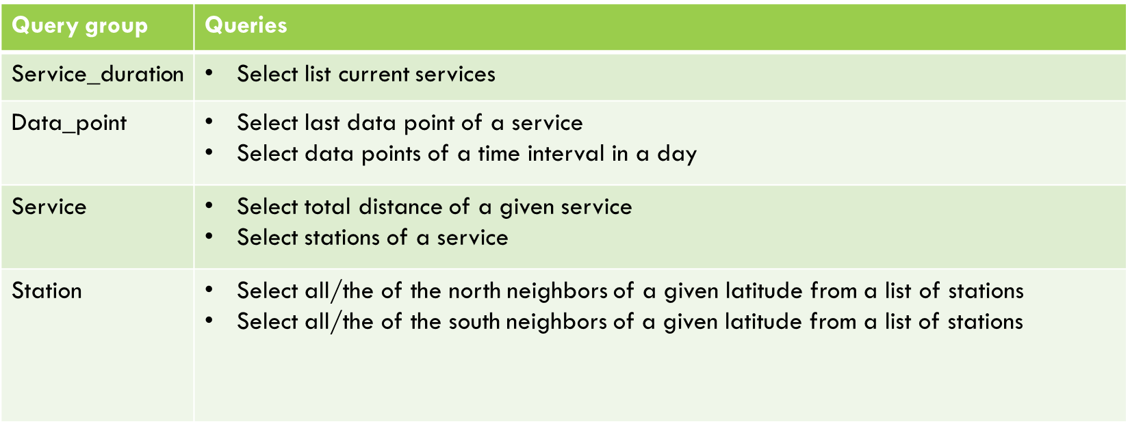
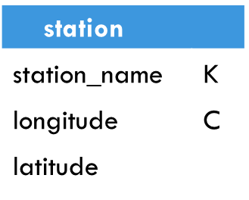
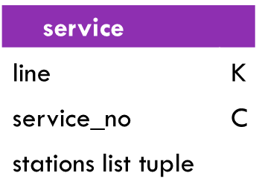
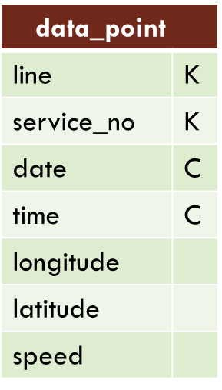
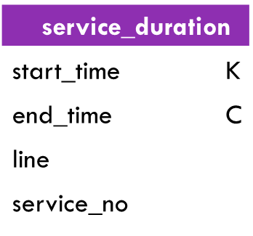
Workload Time table
last version of logical schema

Slide 12
Global Logical Schema
We created the final version of schema considering few other queries in order to analyze the database
Queries B:
Insert vehicle by admin
remove vehicle by admin
Update vehicle by admin
Update status
Select vehicle type
Select available vehicle in given station
Queries A:
Insert station by admin
Remove a station by admin
Select list of Station
Queries A(1,2,3)
Queries C (1,2,3,4,5)
Queries C:
Insert driver by admin
Remove driver by admin
Update driver skills by admin
Select password of driver by his name
Update current position to selected station
Select available driver in a given station(index)
Extract the drivers that can use a specific vehicle (index)
Queries B(1,2,3,4,5)
Queries C (7)
Queries C (6)
Queries B (6)

Slide 13
Global Logical Schema
Queries E (1,5)
Queries D (1,2,3)
Queries D:
Insert data records
Select data points for a given Line_service in time interval of day
Select last data points for a given Line_service and day
Queries E (1,4)
Queries E:
Insert new service
Select distance of a service
Select list of all stations of a service
Select current service with current time bigger than departure_time (distance=0) and small than arrivel/departure_time(distance !=0) => Service_duration(Index)
Select list of distinct station with their services ordered by time departure.
Queries E (1,2,3)

Slide 14
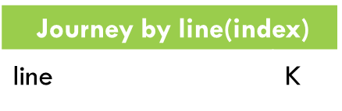
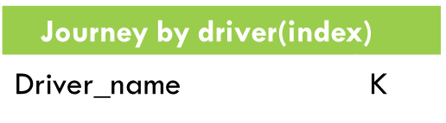
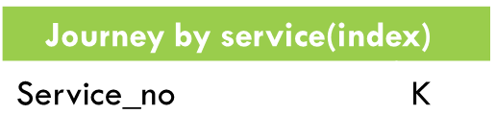
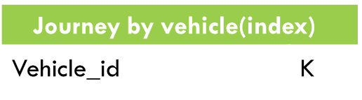
Global Logical Schema
Queries F:
1. Insert new records after selecting (QueryF.2,QueryD.5)
Select total number travels What does it mean total travels
Select average delay What is Average delay
Select total delay of a driver on a day interval index (travel_by_driver)
Select total work time of a driver on a day interval index (travel_by_driver)
Select total delay for a given vehicle on a day interval index (travel_by_vehicle)
Select total distance for a given vehicle on a day interval index (travel_by_vehicle)
Select average daily distance for a given vehicle index (travel_by_vehicle)
Select total travel of a service (travel_by_service) 10. Select total travel of a line (travel_by_line)
Select total travel of a line (travel_by_line)
Queries F (9)
Queries F (4,5)
Queries F (10)
Queries F (6,7,8)
Queries F (1,2,3)

Slide 15
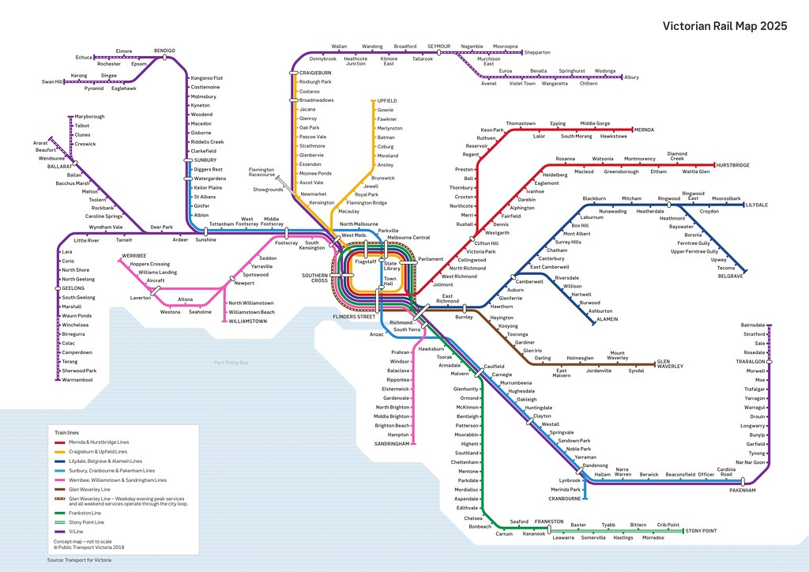
Data Generation
Based on Real world use case, we used Melbourne (Australia) city metro data. We collected station names and position, we divide them into line. Then we created all services , we implemented the simulation in order to compute all position
67 Drivers
219 stations
60 vehicles
750 services
15 lines
104133 data points

Slide 16
CQL implementation
Queries A on Station Table
CREATE TABLE ks_user39.station (station_name text PRIMARY KEY, latitude float, longitude float);
Queries B on Vehicle Table
CREATE TABLE ks_user39.vehicle (vehicle_id text PRIMARY KEY, status text, type text);
CREATE INDEX vehicle_status_idx ON ks_user39.vehicle (status);
Queries C on Driver Table
CREATE TABLE ks_user39.driver (driver_name text PRIMARY KEY, current_position text, password text, phone text, skills set<text>);
CREATE INDEX driver_current_position ON ks_user39.driver (current_position);
CREATE INDEX driver_by_skill ON ks_user39.driver (values(skills));
Queries D on Data_point Table
CREATE TABLE ks_user39.data_point (line text, service_no smallint, date int, time int, latitude float, longitude float, speed int, PRIMARY KEY ((line, service_no), date, time)) WITH CLUSTERING ORDER BY (date ASC, time ASC);

Slide 17
CQL implementation
Queries E on Services Table
CREATE TABLE ks_user39.Service_duration (start_time int,endtime int,line text,service_no smallint, PRIMARY KEY (start_time, endtime)) WITH CLUSTERING ORDER BY (endtime ASC);
CREATE TABLE ks_user39.Service (line text, service_no smallint, stations list<frozen<tuple<int, text, float>>>, PRIMARY KEY (line, service_no)) WITH CLUSTERING ORDER BY (service_no ASC);
CREATE TABLE ks_user39.Service_by_dep_station (station_name text PRIMARY KEY, services list<frozen<tuple<int, int, text>>>);
CREATE OR REPLACE FUNCTION lastOfList (input list<text>) CALLED ON NULL INPUT RETURNS float LANGUAGE java AS 'return Integer.valueOf(input.get(input.size()-1)); ‘;
CREATE OR REPLACE FUNCTION tuple_distance(input tuple<int,text,float>) CALLED ON NULL INPUT RETURNS float LANGUAGE java AS 'return Integer.valueOf(input.get(input.size()-1)); ';
Queries F on Travel Table
CREATE TABLE ks_user39.Journey (line text, service_no smallint, vehicle_id int, driver_name text, date int, delay int, distance float, PRIMARY KEY ((line, service_no, vehicle_id, driver_name), date)) WITH CLUSTERING ORDER BY (date ASC);

Slide 18
Thanks

