Slide 1
Talent Acquisition Management System
Database Design & Implementation
DADS6700 20504 Data Management for Analytics SEC 01 Fall 2025
Nithyaa Kesavamurthy (NUID: 002024548)

Slide 2
Problem Background
Database design for the talent acquisition management system which manages recruitment workflows capturing, managing and tracking:
candidates
job requisitions
Interviews
Evaluations
Offers
Onboarding.

Slide 3
Requirements Summary
The system must:
- Manage candidates and sourcing
- Track job requisitions
- Record interviews & evaluations
- Manage offers and onboarding
- Maintain lifecycle history

Slide 4
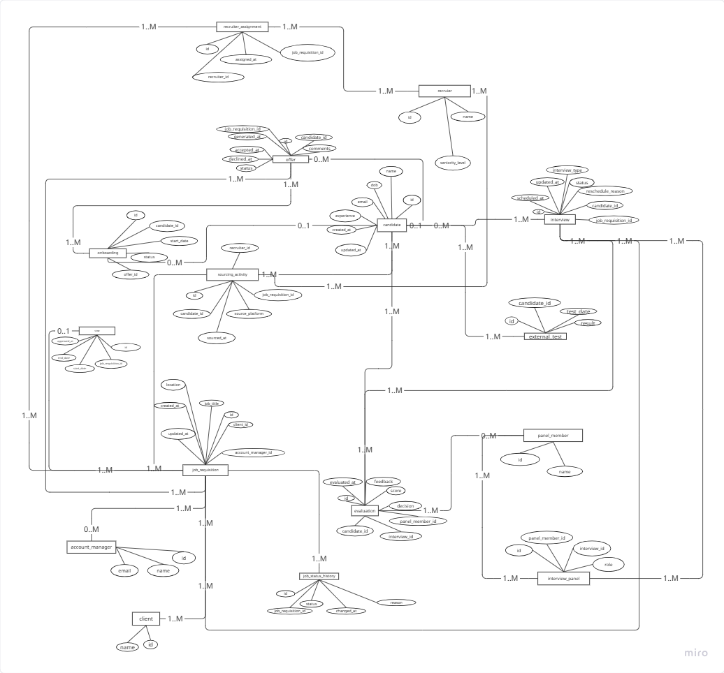
Conceptual model ERDiagram

Slide 5
ER Model – Entities and Relationships
Core Entities | Supporting tables
Candidates | External Test
Job Requisition | Sourcing Activity
Client | Recruiter Assignment
Recruiter | Interview Panel
Interview | Account Manager
Panel Member | SOW
Evaluation | Job Status History
Offer
Onboarding
Relationships
Candidate to Job Requisition by Recruiter (1–M via Sourcing Activity)
Client has 1-M Job Requisition
Candidate to Interview (1-M)
Recruiter to Candidate (1-M)
Interview has Evaluations by Panel Members (1–M)
Candidate receives Offers for Job Requisition (1–M)
Offer drives Onboarding activities (1–M)
Interview is conducted by Panel Members (M–N via Interview Panel)
Job Requisition is defined in SOW and managed by Account Manager (1–M)
Candidate completes External Tests (1–M)

Slide 6
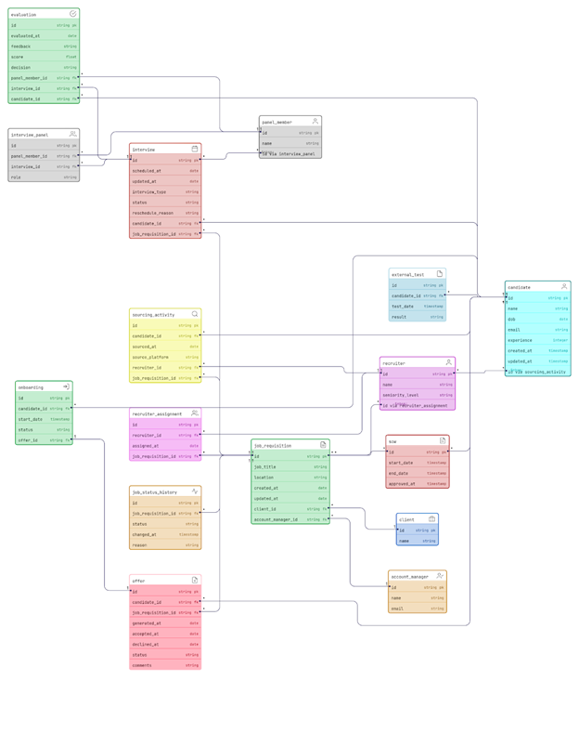
UML Class Diagram
Classes: Candidate, Recruiter, Job Requisition, Interview, Evaluation, Offer, Onboarding.
Associations: candidate-interview, job-interview, interview-evaluation.

Slide 7
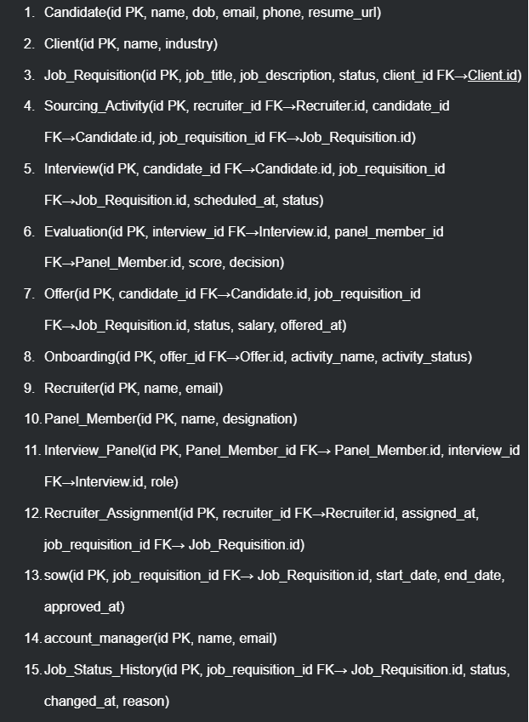
Relations, Primary Keys, and Foreign Keys

Slide 8
Normalization
Conforms to 1NF, 2NF, and 3NF.
All the tables are fully normalized, conforming to 1NF, 2NF, and 3NF.
All attributes are atomic
No partial or transitive dependencies.

Slide 9
MySQL Query Validation and Demo Overview
Implemented the Logical Relational Model in MySQL and validated it through progressively complex SQL queries.
Queries demonstrate relational integrity, advanced analytics, and business intelligence extraction.
Demo includes simple queries, joins, aggregates, nested, correlated, ALL/ANY, EXISTS, UNION, subqueries. The SQL Script can be found here.

Slide 10

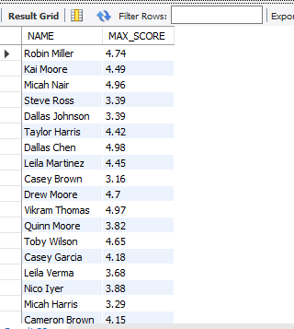
Sample SQL Queries
≥ ALL (Query 5)
Identifies the highest-scoring candidate(s) across the entire database.
Uses >= ALL (SELECT score FROM evaluation).
Insight: Definitively finds top performers without separately computing MAX().
Nested Subquery (Query 2)
Compares each candidate’s maximum score to the global average score.
Uses a nested SELECT AVG(score) and HAVING filter.
Insight: Quickly flags candidates performing above the overall benchmark.

Slide 11
NoSQL Overview
MongoDB Querying & NoSQL Flexibility
Uses a document-oriented model instead of SQL joins, leveraging find() and aggregate() for efficient querying.
Showcases five key query patterns demonstrating filtering, sorting, and aggregation capabilities.
Collections:
candidate, job_requisition, interview, offer, recruiter, client, account_manager, evaluation, external_test, interview_panel, onboarding, panel_member, recruiter_assignment, sourcing_activity.

Slide 12
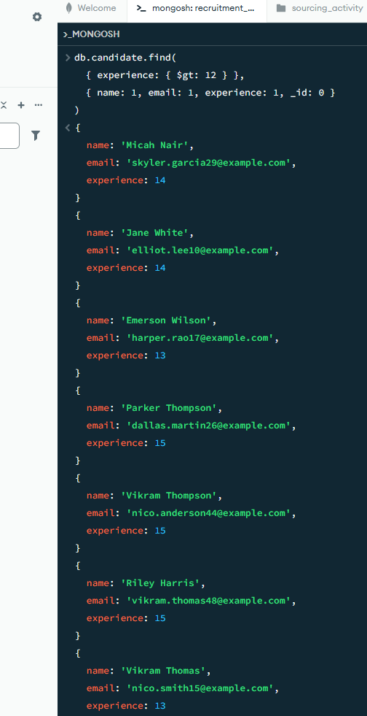
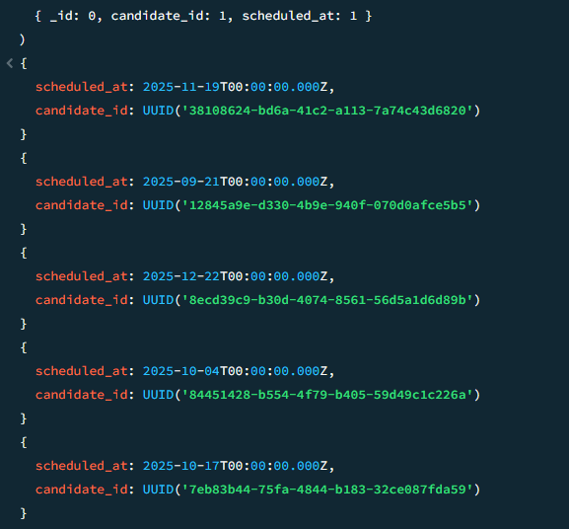
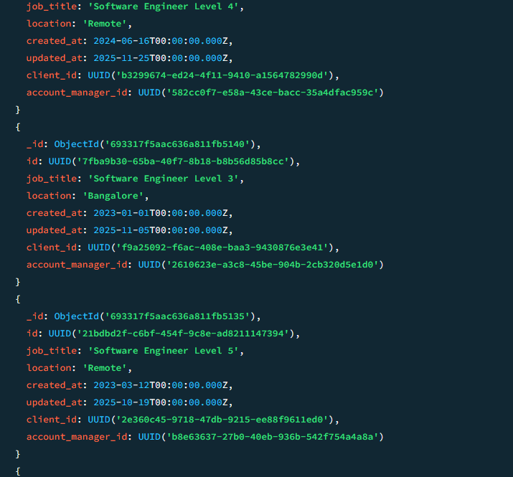
NoSQL Queries
Simple Filter + Projection
Action: Running Query 1
Explanation: Filters candidates with experience > 12 and projects only name, email, experience, excluding _id.
Sorting Query
Action: Running Query 2
Explanation: Retrieves all job requisitions and sorts them by updated_at (descending) to surface the most recently modified postings.
Condition-Based Retrieval (Date Filter)
Action: Running Query 3
Explanation: Filters the interview collection for interviews scheduled on or after Sept 1, 2025 using $gte—useful for forecasting workloads.

Slide 13
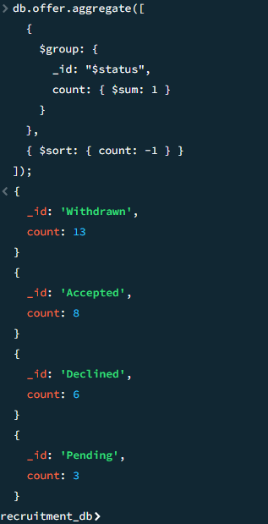
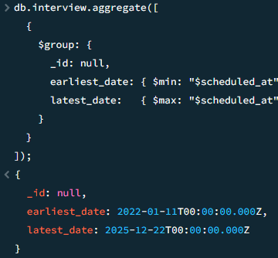
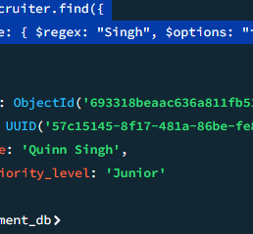
Key MongoDB Queries (5 Examples)
Aggregation: Group & Count
Action: Running Query 4
Explanation: Groups offer documents by status and counts occurrences, then sorts to identify the most common offer outcome.
Aggregation: Min & Max (Timeline Summary)
Action: Running Query 5
Explanation: Computes the earliest and latest interview dates using $min and $max across all interviews—helpful for timeline analysis.

Slide 14
Python App
Python Integration & Analytical Validation
Programmatic Access: Verified that the MySQL database can be seamlessly consumed using Python for analysis and visualization.
Data Retrieval Workflow: Connected via pymysql, executed SQL queries with pandas.read_sql(), and loaded results directly into DataFrames for instant analysis.

Slide 15
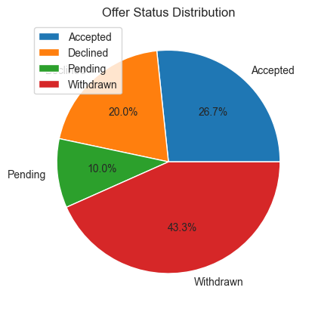
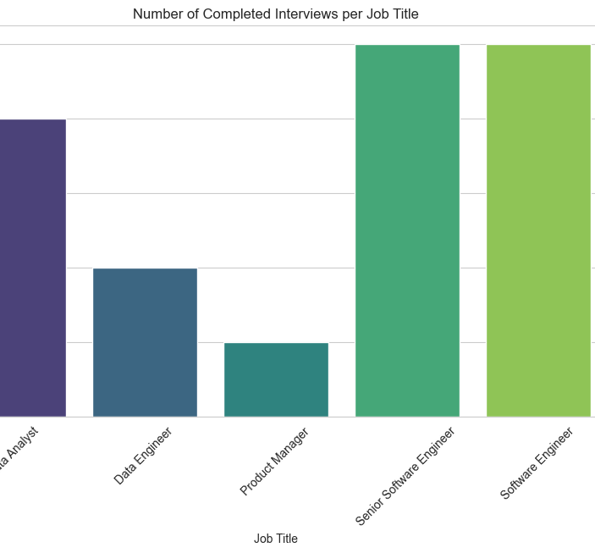
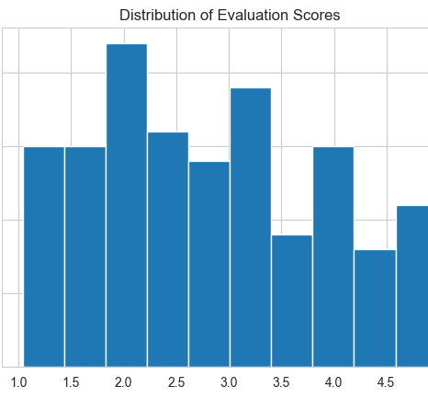
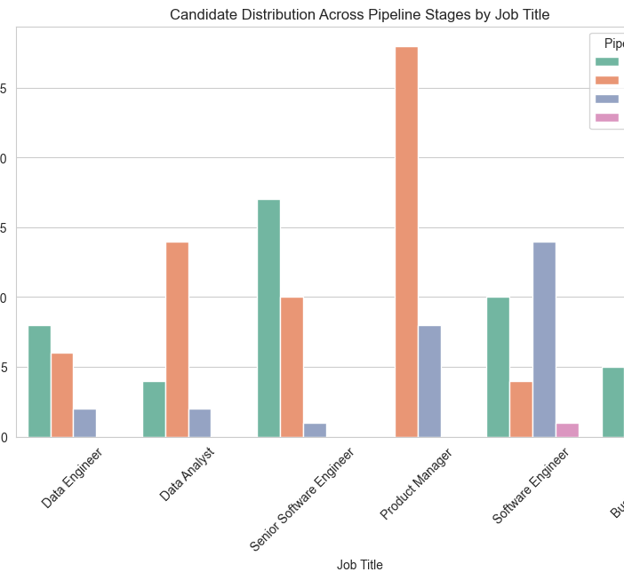
Python Visualizations
Key Visualizations Generated (6 Total)
Completed Interviews per Job Title
Source: MySQL Query 1 (Join + Aggregate)
Insight: Identifies funnel efficiency; “Software Engineer Level 1” shows the highest interview completions.
Candidate Distribution Across Pipeline Stages
Source: MySQL Query 4 (CASE WHEN + Join)
Insight: Highlights stage-wise candidate volumes to detect bottlenecks.
High-Scoring Candidates (Recent Comparison)
Source: MySQL Query 6 (> ANY)
Insight: Flags candidates scoring better than any evaluated in the past week.
Average Recruiter Score Analysis
Source: MySQL Query 9 (CTE)
Insight: Shows recruiter effectiveness; top performers include Harper Garcia & Parker Iyer.
Evaluation Score Distribution
Source: Simple SELECT
Insight: Histogram reveals scoring patterns around 2.0 and 3.0–3.5.
Offer Status Distribution
Source: Aggregate SELECT
Insight: Offers a critical metric—43% withdrawn, indicating a major drop-off point.

Slide 16
Summary
Robust Conceptual Design: Fully normalized 3NF data model with supporting EER & UML diagrams.
Dual Technology Implementation: Deployed in both MySQL (Relational) and MongoDB (NoSQL) for flexibility.
Advanced Analytics: Executed complex SQL & MongoDB queries (CTEs, aggregations) for business insights.
Python Analytical App: Visualized key metrics and insights to support decisions.
Business Impact: Provides a scalable, efficient, and insight-driven recruitment optimization system.

