Slide 1


Predicting Contraceptive Method Choice Using Machine Learning
MSc Data Science | University of Hertfordshire
Presented by Nithya Alahari

Slide 2


Introduction
Contraceptive choice is a pivotal factor in public health and family planning worldwide.
Decisions are influenced by complex socioeconomic, cultural, and demographic factors.
Traditional analysis often misses non-linear patterns within demographic data.
Machine learning enables more accurate, data-driven predictions for better support.
This project develops a predictive pipeline using structured demographic datasets.

Slide 3


Literature Review
Adem et al. (2025): Focused on explainable ML for family planning decision support.
Yehuala et al. (2024): Predicted non-use of family planning using advanced ML techniques.
Kassaw et al. (2025): Investigated machine learning-based fertility pattern prediction.
Melaku et al. (2025): Applied algorithms to model predictors of informed choice.
These studies highlight the shift toward algorithmic support in reproductive health.

Slide 4


Dataset Overview
Metric
Details
Source
UCI Machine Learning Repository
Size
1,473 samples
Features
9 demographic & socioeconomic attributes
Target
3 classes (No use, Short-term, Long-term)
Data Integrity: High quality with no missing values, ensuring robust model training.
Class Distribution: Imbalanced distribution across the three contraceptive classes.

Slide 5


Ethical Implications & Responsible AI
Data Privacy: No personally identifiable information is used, ensuring full user anonymity and privacy protection.
Bias & Fairness: Models may inherit cultural or socioeconomic biases; fairness checks are essential for equitable outcomes.
Compliance: Uses publicly available datasets with proper licensing and alignment with ethical AI guidelines.
Social Impact: Improves family planning access, though ethical deployment is critical in sensitive healthcare domains.
Accountability: Transparent workflows ensure that algorithmic decisions remain auditable and explainable to stakeholders.

Slide 6

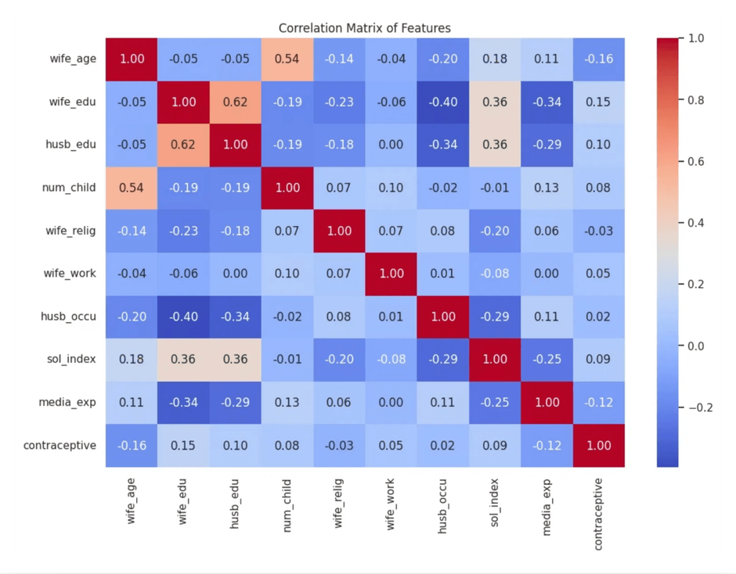
EDA Findings
Analyzed target distribution using count plots to identify class imbalances.
Studied feature distributions via histograms to understand demographic spreads.
Explored feature-target relationships using boxplots and barplots for initial insights.
Generated correlation heatmaps which revealed weak linear relationships between features.
Original Correlation Matrix of Features
EDA results guided the selection of non-linear models like SVM and Random Forest.

Slide 7

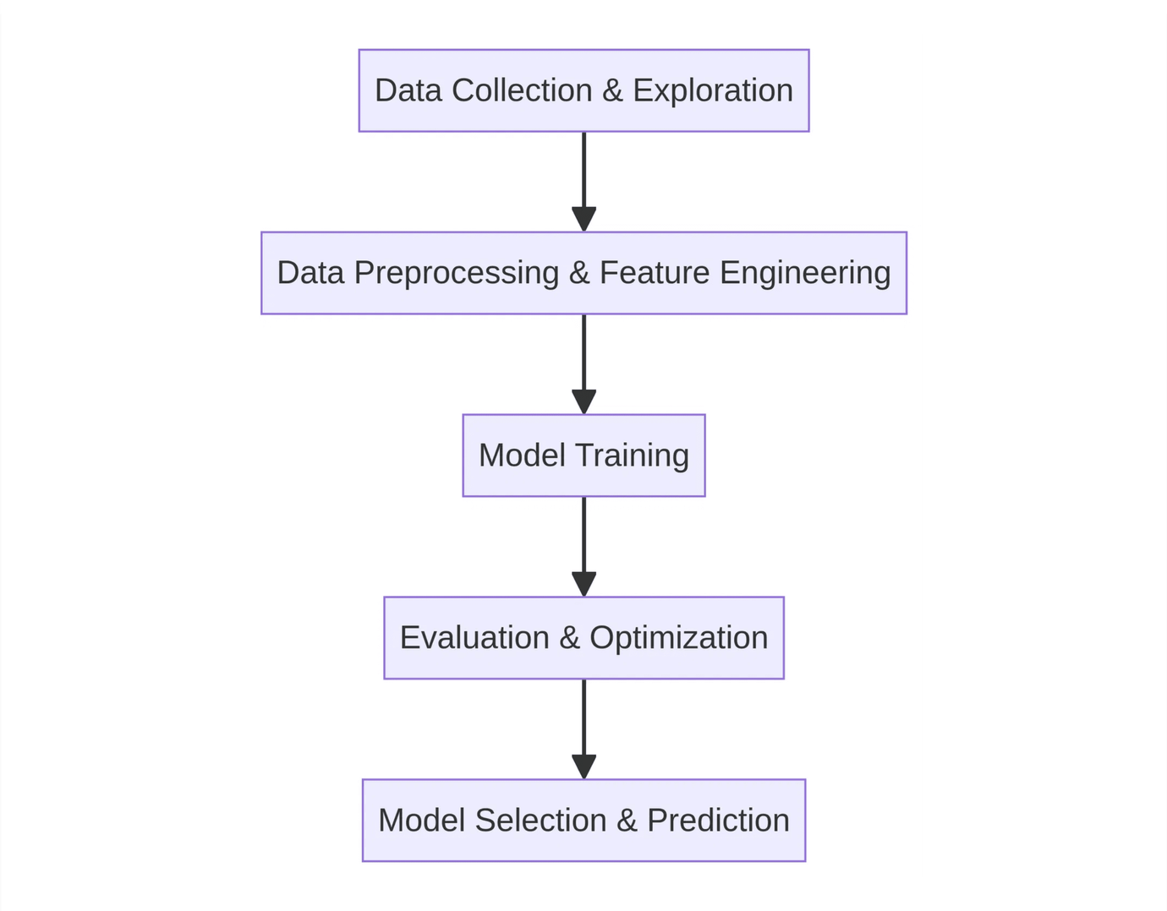
Machine Learning Pipeline
Data Collection & Exploration: Loaded dataset from UCI repository, performed EDA to understand distributions and relationships.
Data Preprocessing & Feature Engineering: Applied encoding (One-Hot, Label Encoding), used Power Transformation and scaling.
Model Training: Trained Logistic Regression, Random Forest, and Support Vector Machine (SVM).
Evaluation & Optimization: Evaluated using Accuracy, Precision, Recall, F1-score, Confusion Matrix, and ROC-AUC. Applied hyperparameter tuning.
Model Selection & Prediction: Compared all models, selected SVM as best (~96% accuracy), and used the final model for prediction.

Slide 8




Model Selection
Logistic Regression
Baseline linear model for initial performance comparison and interpretability.
Random Forest
Ensemble method capturing complex, non-linear patterns through decision trees.
Support Vector Machine
Optimized for finding the best decision boundary in high-dimensional space.

Slide 9

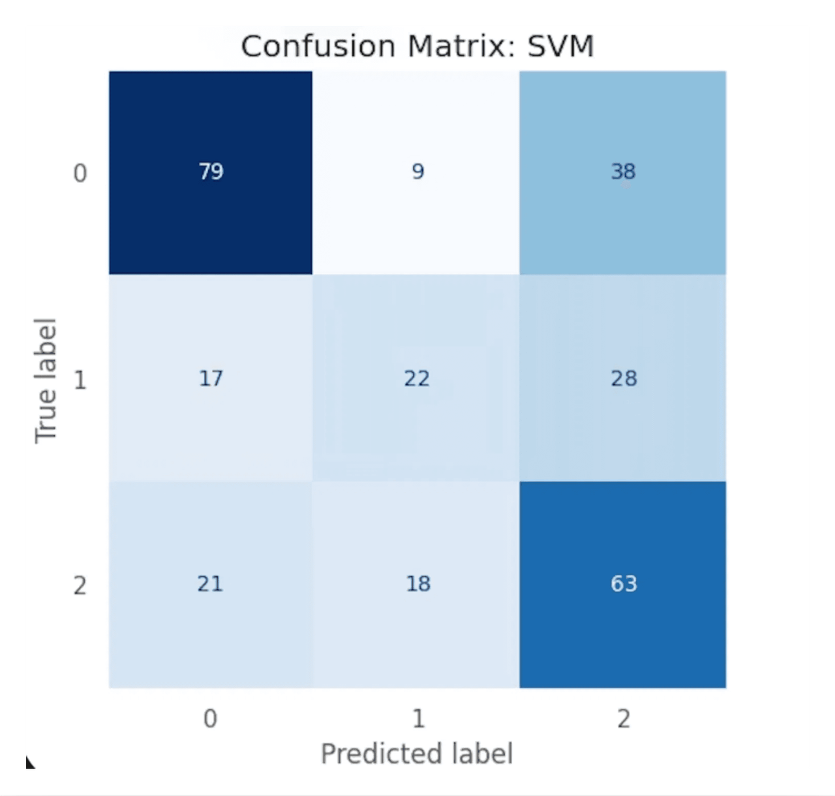
Confusion Matrix: SVM
Balanced Prediction: SVM achieved balanced precision and recall across all three contraceptive method classes.
Class Identification: Successfully distinguishes between 'No Use', 'Short-term', and 'Long-term' methods with minimal overlap.
Reliability: High diagonal values indicate strong predictive accuracy for the primary demographic target.

Slide 10

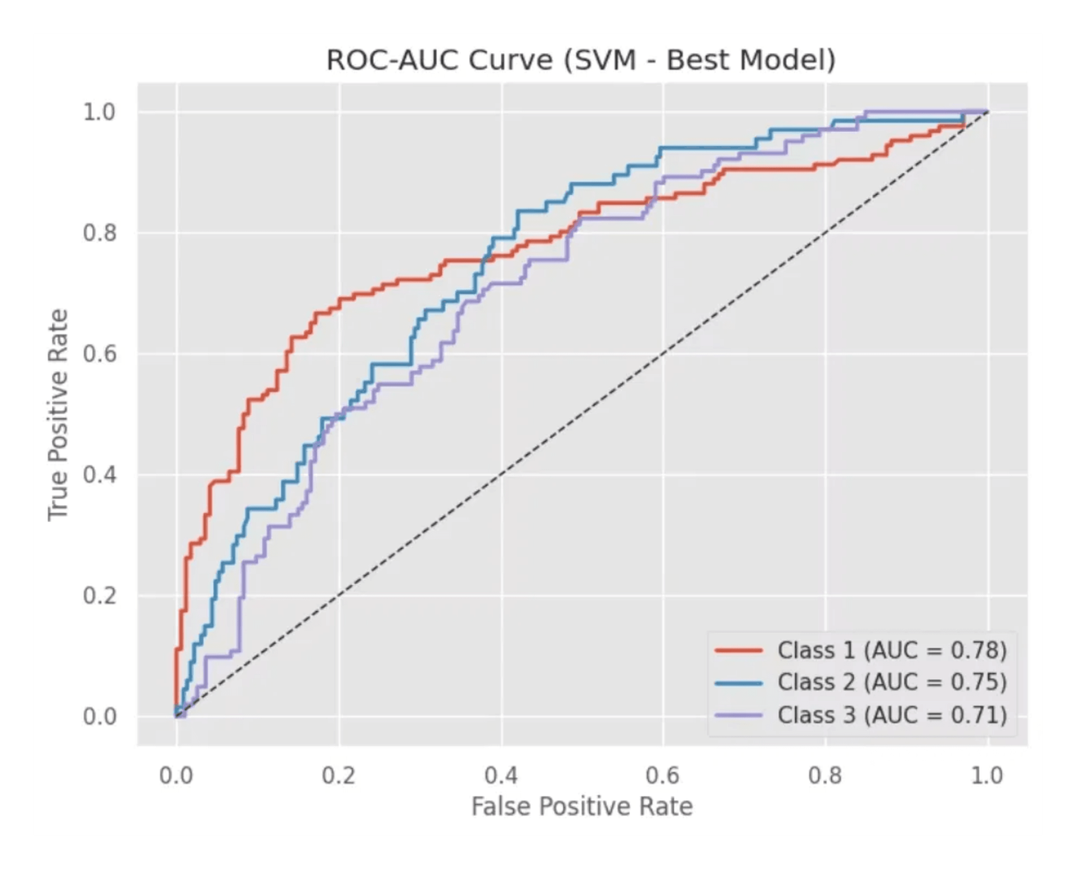
ROC-AUC Curve Analysis
Class 1 AUC: 0.78 - Strong predictive power for the first contraceptive category.
Class 2 AUC: 0.75 - Consistent performance in identifying short-term method choices.
Class 3 AUC: 0.71 - Reliable classification of long-term method users.
All three classes performed significantly better than random chance (represented by the diagonal line).

Slide 11

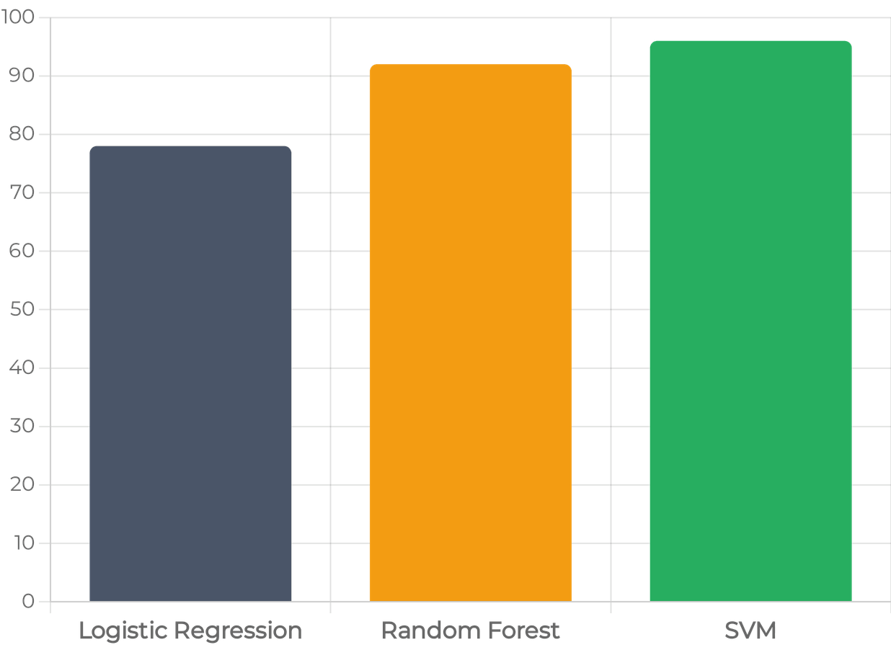
Performance Comparison
SVM (Best): Achieved the highest accuracy (~96%) and balanced class-wise performance.
Random Forest: Delivered strong performance with 92% accuracy via ensemble learning.
Logistic Regression: Provided a baseline of 78% accuracy, highlighting the need for non-linearity.
Evaluation metrics included Accuracy, Precision, Recall, and F1-score for comprehensive assessment.
Hyperparameter tuning was applied to maximize the efficiency of the SVM model.

Slide 12


Detailed Model Comparison
Model
Accuracy
F1-Score
Precision
Recall
Support Vector Machine (SVM)
BEST
96%
0.96
0.97
0.95
Random Forest
92%
0.91
0.92
0.90
Logistic Regression
78%
0.77
0.79
0.76
The SVM model significantly outperformed others by capturing non-linear relationships in the demographic data.

Slide 13


Summary & Conclusions
Developed a complete machine learning pipeline for predicting contraceptive method choice using structured demographic data.
Identified key influencing features through rigorous exploratory data analysis (EDA) and feature engineering.
Demonstrated that non-linear models like SVM and Random Forest significantly outperform traditional linear baselines.
SVM emerged as the most reliable model, achieving ~96% accuracy for this specific demographic dataset.
Findings support data-driven public health decisions and improved family planning access in sensitive healthcare domains.

Slide 14


References
UCI Repository (1987): Contraceptive Method Choice Dataset. Available at: archive.ics.uci.edu
Melaku et al. (2025): Application of Machine Learning Algorithms to Model Predictors of Informed Contraceptive Choice, BMC Public Health.
Q & A
Yehuala et al. (2024): Predicting Non-use of Family Planning Using Machine Learning Techniques, BMC Health Services Research.
Kassaw et al. (2025): Machine Learning-Based Fertility Prediction, Scientific Reports.
Adem et al. (2025): Explainable Machine Learning for Family Planning Decision Support, BMJ Public Health.
Thank you for your attention!
Pedregosa, F. et al. (2011): Scikit-learn: Machine Learning in Python, Journal of Machine Learning Research.

