Slide 1


Slide 2
x = [1, 2, 3]
Y = [1, 2, 3]
h(1) = 1.5 + 0(1) = 1.5
h(2) = 1.5 + 0(2) = 1.5
h(3) = 1.5 + 0(3) = 1.5

Slide 3
x = [1, 2, 3]
Y = [1, 2, 3]
h(1) = 0 + 1.5(1) = 1.5
h(2) = 0 + 1.5(2) = 3
h(3) = 0 + 1.5(3) = 4.5

Slide 4
X = [1, 2, 3]
Y = [1, 2, 3]
h(1) = 1 + 0.5(1) = 1.5
h(2) = 1 + 0.5(2) = 2
h(3) = 1 + 0.5(3) = 2.5

Slide 7
தீட்டா-0 =1.5, தீட்டா-1 =0
(1, 1) , (2, 2) , (3, 3)
Vs
(1, 1.5) , (2, 1.5) , (3, 1.5)
J = 1/2*3 [(1.5-1)**2 + (1.5-2)**2 + (1.5-3)**2]
= 1/6 [0.25 + 0.25 + 2.25]
= 2.75

Slide 8
தீட்டா-0 =0, தீட்டா-1 =1.5
(1, 1) , (2, 2) , (3, 3)
vs
(1, 1.5) , (2, 3) , (3, 4.5)
J = 1/2*3 [(1.5-1)**2 + (3-2)**2 + (4.5-3)**2]
= 1/6 [0.25 + 1 + 2.25]
= 3.50

Slide 9
தீட்டா-0 =1, தீட்டா-1 =0.5
(1, 1) , (2, 2) , (3, 3)
vs
(1, 1.5) , (2, 2) , (3, 2.5)
J = 1/2*3 [(1.5-1)**2 + (2-2)**2 + (2.5-3)**2]
= 1/6 [0.25 + 0 + 0.25]
= 0.50

Slide 14
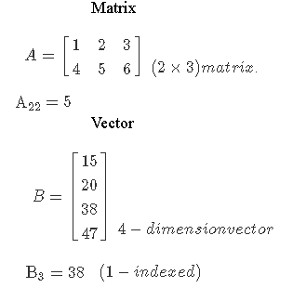

Slide 15
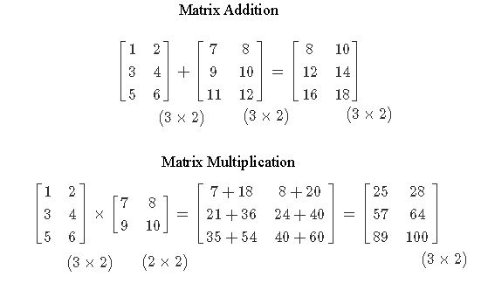

Slide 16
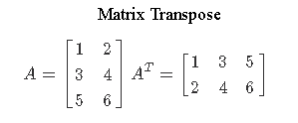

Slide 17
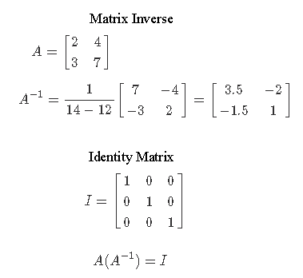

Slide 23
Feature Scaling
சதுர அடி = 800, 1200, 2400
அறைகள் = 2, 3, 5

Slide 24
particular value – mean of all values
--------------------------------------------------
maximum – minimum
சதுர அடி = (800 –1600)/(2400–800), (1200–1600)/(2400–800), (2400–1600)/(2400–800)
= -0.5 , 0.25, 0.5

Slide 25
particular value – mean of all values
--------------------------------------------------
maximum – minimum
அறைகள் = (2-3.5)/(5–2), (3-3.5)/(5–2), (5-3.5)/(5–2)
= -0.5 , -0.16, 0.5

Slide 30
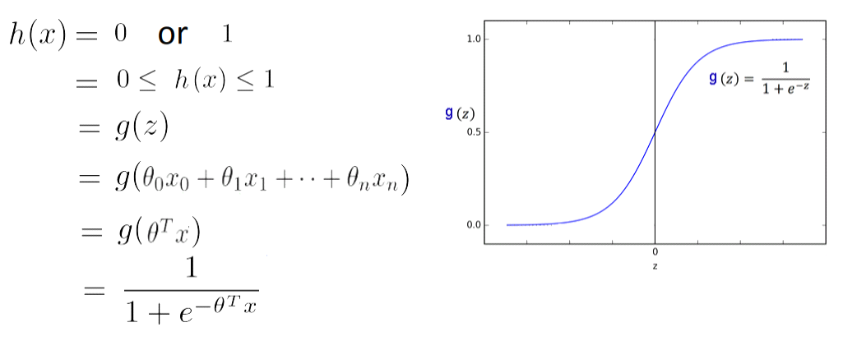

Slide 34
When y = 1,
= y . log(h(x)) + (1-y).log(1-h(x))
= 1.log(h(x)) + (1-1).log(1-h(x))
= log(h(x)) + 0
= log(h(x))
When y = 0,
= y . log(h(x)) + (1-y).log(1-h(x))
= 0.log(h(x)) + (1-0).log(1-h(x))
= 0 + 1.log(1-h(x))
= log(1-h(x))

Slide 36
P = True Positive / (True Positive+ False Positive)
R = True Positive / (True Positive+ False Negative)
F score = 2 (PR / P+R)

Slide 42
Forward Propagation

Slide 43
Back Propagation
delta = error of each node in the corresponding layer
Layer 3 : delta3 = h(x) – y
Layer 2 : delta2 = theeta T .delta3 .* a .* 1-a
Layer 1 : delta 1 = theeta T .delta2 .* a .* 1-a
where g'(z) = a .* 1-a = This is g-prime. = derivative of the activation function g
. * = element-wise multiplication

