Slide 1
Data Pre-processing
5th December, 2018
Venue-EB2 IVth Floor Conference room

Slide 2
Topics
Introduction
Importance of data pre-processing
Types of techniques available

Slide 3
Introduction
Data pre-processing is a technique comes under data mining . In machine learning it is used to convert raw and unstructured data obtain from source into structured and understandable data.
The data obtain from source is often incomplete, inconsistent and contains many errors
Data pre-processing is a proven technique for dealing this type of data
It prepare raw data for further processing i.e. for machine learning algorithms
Unstructured,
Inconsistent,
incomplete data
Structured,
Consistent,
understandable data
Data Pre-processing

Slide 4


Importance of Data Preprocessing
To obtain good results from the machine learning model, data used for building the ML model should be in proper format.
Few machine learning algorithm required data to be an specified manner.
For example null values in data set is not supported by random forest algorithm for calculation.
Data is arranged in such a manner that it can be used for multiple algorithm and best algorithm can be chosen.
Machine learning algorithm
Data Pre-processing

Slide 5
Techniques
Data formatting- Formatting the data , suitable for machine learning algorithm i.e. structured form.
Data cleaning- Cleaning of data based on some variables.
Data sampling- To reduce running time of algorithm.
Data transformation- Includes normalization, standardization etc.

Slide 6

Data Cleaning
It is based on the following variables
Insufficient data- depend upon the complexity of problem data size can vary from thousands to millions for a machine learning algorithm
Non- representative data – Selected data should represent the entire data set. If non-representative data train an algorithm it will not generalize well on new test data
Substandard data- Outliers, noise, error can be eliminated for good fitment to the model. Missing features can be eliminated or average value can be taken for the same
Insufficient ,
non representative,
substandard data

Slide 7
Data Sampling
It is based on the following variables
Sampling noise- Smaller sample space can cause sampling noise since they get trained in non representative data.
Sampling Bias – Larger sample size work well when right data is picked i.e. when there is no sampling bias

Slide 8
Data Transformation
It involves following methods
Feature Engineering – Selecting and extracting features from data set relevant to the problem and model algorithm. It includes selection, extraction, addition or/ and filtering of features.
Feature Scaling – In machine learning it is used for standardization of independent variables of data features. There are two 2 types of feature scaling : 1) Normalization 2) Standardization
Normalization- It refers to the re-scaling of data features between 0 and 1, which is a special case of Min-Max scaling.
Standardization- All features are standardized on the normal distribution. The mean of each feature is centered to zero and column of that future has standard deviation of 1
$X^{norm}=\frac{X^{i}−X_{min}}{X_{max}−X_{min}}$
$X_{istandard}=\frac{X_{i}−X_{mean}}{standarddaviation}$

Slide 9
Some more techniques
Interpolation- In this method values or set of values were estimated based on their context. Linear interpolation, a very simple form of interpolation, is basically the rendering of a straight line between two or more points. Likewise other polynomial interpolation functions are there. Interpolation is useful for filling in missing data, such as in upscaling images or creating statistical models.
Hample Filtering - The Hampel identifier is a variation of the three-sigma rule of statistics, which is robust against outliers. In this method for each sample of x, the function computes the median of a window composed of the sample and its six surrounding samples, three per side. It also estimates the standard deviation of each sample about its window median using the median absolute deviation(MAD). If a sample differs from the median by more than three standard deviations, it is replaced with the median. The 3σ rule is enforced via the estimator
σ≈1.4826 MAD
Cook Distance - Data points with large residuals (outliers) and/or high leverage may distort the outcome and accuracy of a regression. Cook's distance measures the effect of deleting a given observation. Points with a large Cook's distance are considered to merit closer examination in the analysis.

Slide 10
Continue
Cook's distance D_{i} of observation i (where i belongs to 1 to n) is defined as the sum of all the changes in the regression model when observation i is removed from it. Given by following expression.
$D_{i}=\frac{\sum{{\left(y_{j}−y_{j\left(i\right)}\right)}^{2}}}{{ps}^{2}}$
where y_{j(i)} is the fitted response value obtained when excluding i, and s² = (n-p)⁻¹ is the mean squared error of the regression model, p is the number of covariates or predictors for each observation.

Slide 11
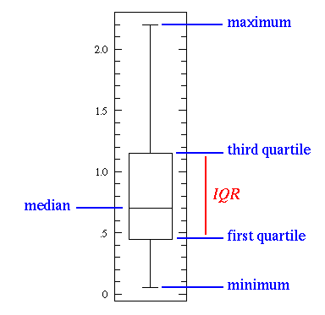
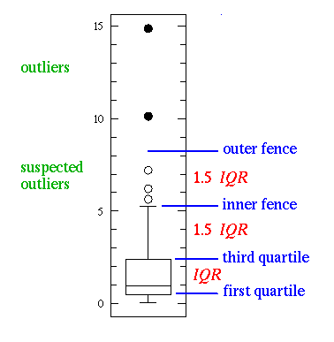
Method to identify Outliers
Box Plot - The box plot (a.k.a. box and whisker diagram) is a standardized way of displaying the distribution of data based on the five number summary:1) minimum 2) first quartile 3) median 4) third quartile 5) maximum. In the simplest box plot the central rectangle spans the first quartile to the third quartile (the interquartile range or IQR). A segment inside the rectangle shows the median and "whiskers" above and below the box show the locations of the minimum and maximum.
This simplest possible box plot displays the full range of variation (from min to max), the likely range of variation (the IQR), and a typical value (the median). Not uncommonly real datasets will display surprisingly high maximums or surprisingly low minimums called outliers. John Tukey has provided a precise definition for two types of outliers:
Outliers are either 3×IQR or more above the third quartile or 3×IQR or more below the first quartile.
Suspected outliers are are slightly more central versions of outliers: either 1.5×IQR or more above the third quartile or 1.5×IQR or more below the first quartile.

Slide 12
Winsorize method
Winsorization is a way to minimize the influence of outliers in the data by either:
    Assigning the outlier a lower weight
    Changing the value so that it is close to other values in the set.
Statistics such as the mean and variance are very susceptible to outliers; Winsorization can be an effective way to deal with this problem, improve statistical efficiency and increase the robustness of statistical inferences.
The downside is that bias is introduced into your results, although the bias is a lot less than if you had simply deleted the data point.
Method to Winsorize:-
1) Analyze your data to make sure the outlier isn’t a result of measurement error or some other fixable error.
2) Decide how much Winsorization you want. This is specified as a total percentage of untouched data. For example, if you want to Winsorize the top 5% and bottom 5% of data points, this is equal to 100% – 5% – 5% = 90% Winsorization. A 80% Winsorization means that 10% is modified from each tail area.
3) Replace the extreme values by the maximum and/or minimum values at the threshold. For example:
The following data set has several (bolded) extremes:
{0.1,1,12,14,16,18,19,21,24,26,29,32,33,35,39,40,41,44,99,125},Mean = 33.405.
After modifying the top and bottom 10% (I matched those values to the nearest extreme):
{12,12,12,14,16,18,19,21,24,26,29,32,33,35,39,40,41,44,44,44}, 80% Winsorized mean = 24.95.

