Slide 1
Disaster Preparedness and Response Education System for Schools and Colleges
CSE7302- University Project
Review-5
Batch Number: CIT_32
Under the Supervision of,
Ms. Pushpalatha M,
Assistant Professor,
School of Computer Science and Engineering,
Presidency University.
Roll Number | Student Name
20221CIT0130 | NITHYA H D
20221CIT0126 | SHREYA A J
20221CIT0123 | MANISHA S M
Name of the Program: : CIT- INTERNET OF THINGS
Name of the HoD : Dr. Anandaraj S.P
Name of the Program Project Coordinator: Dr. Sharmasth Vali Y
Name of the School Project Coordinators: Dr. Sampath A K , Dr. Geetha A

Slide 2
Content
Abstract
Literature Survey
Objectives
Existing Methods and Drawbacks
Proposed Method & Feasibility Study
Architecture Diagram
Modules
Hardware and Software Details
Github Link
Timeline (Gantt Chart)
References

Slide 3
Abstract
SafeLearn is an AI-powered disaster preparedness web platform developed to provide instant emergency guidance, disaster awareness resources, and secure user access through an interactive online system. The platform addresses the limitations of traditional static information sources by offering real-time assistance using a Generative AI chatbot. It was built using modern technologies such as Next.js, React.js, Tailwind CSS, Firebase Authentication, Firestore Database, and deployed on Vercel for scalable cloud access.
The system enables users to access preparedness information for disasters such as fire, flood, earthquakes, and first aid situations through a responsive and user-friendly interface. Performance optimization techniques including lazy loading, dynamic imports, image optimization, and efficient Firebase listeners improved the Lighthouse score from approximately 29 to 92+. The chatbot provides quick responses in less than 3 seconds with high relevance for common emergency queries.
SafeLearn demonstrates a cost-effective and scalable solution for improving public safety awareness, digital emergency support, and future readiness for IoT integration, multilingual assistance, offline access, and mobile application development.

Slide 4
Objectives
To develop an AI-powered web platform for disaster preparedness and emergency guidance.
To provide instant assistance through a Generative AI chatbot for disaster-related queries.
To create awareness about fire, flood, earthquake, first aid, and safety measures.
To implement secure user authentication and cloud-based data management.
To design a responsive and user-friendly interface accessible on multiple devices.
To optimize website performance for fast loading and smooth user experience.
To provide a scalable platform for future IoT sensor integration and mobile app development.

Slide 5
ALGORITHM DETAILS
Algorithm Used: Generative AI Chatbot with Rule-Based Query Processing
The SafeLearn platform uses a Generative AI (GenAI) chatbot to understand user queries and provide disaster preparedness guidance.
Natural Language Processing (NLP) is used to interpret user questions related to fire, flood, earthquake, first aid, and emergency situations.
The chatbot analyzes keywords and context from the user input.
Relevant disaster information and safety instructions are generated in real time.
Frequently asked queries are mapped with predefined safety responses for faster accuracy.
The system delivers responses in less than 3 seconds for common emergency questions.
Future enhancement includes integrating Machine Learning models (LSTM / Random Forest) for predictive disaster alerts.

Slide 6
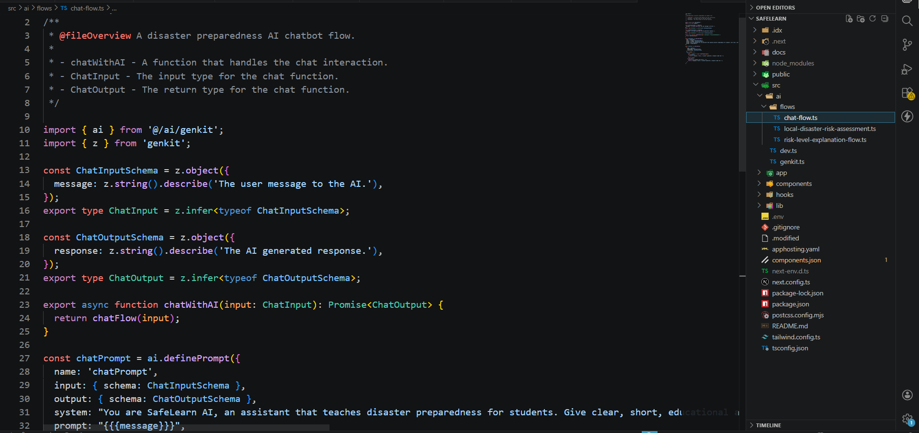
Pseudo-code
AI chatbot

Slide 7
ALGORITHM DETAILS
Algorithm Used: AI Response Generation and Query Matching
User enters a disaster-related query into the SafeLearn chatbot.
The system preprocesses the text by removing unnecessary words and identifying important keywords.
Natural Language Processing (NLP) is applied to understand the intent of the query.
The chatbot matches the query with relevant disaster categories such as fire, flood, earthquake, first aid, or emergency support.
Generative AI then produces a meaningful and user-friendly response based on the detected context.
The generated answer is displayed instantly through the web interface.
Continuous testing and prompt refinement improve chatbot accuracy and relevance.
Future versions can include machine learning algorithms for prediction and personalized recommendations.

Slide 8
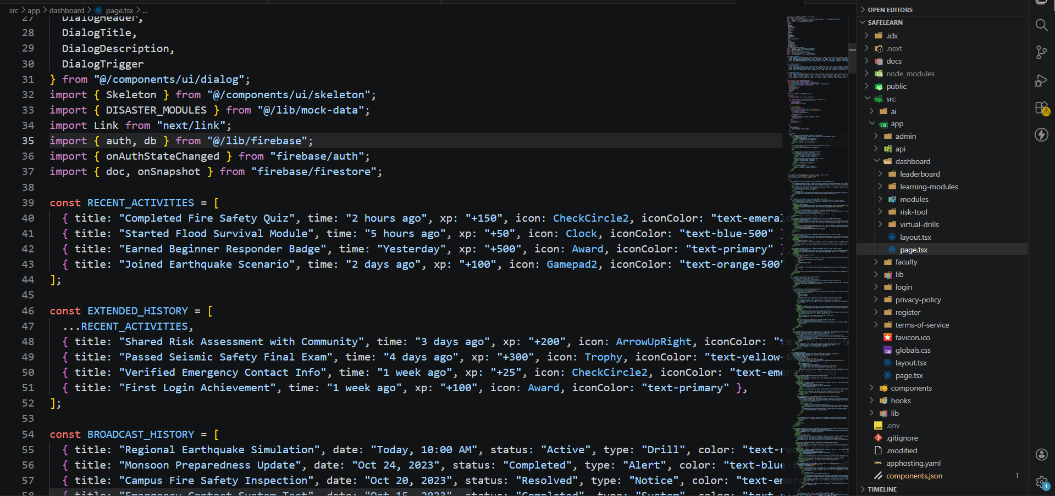
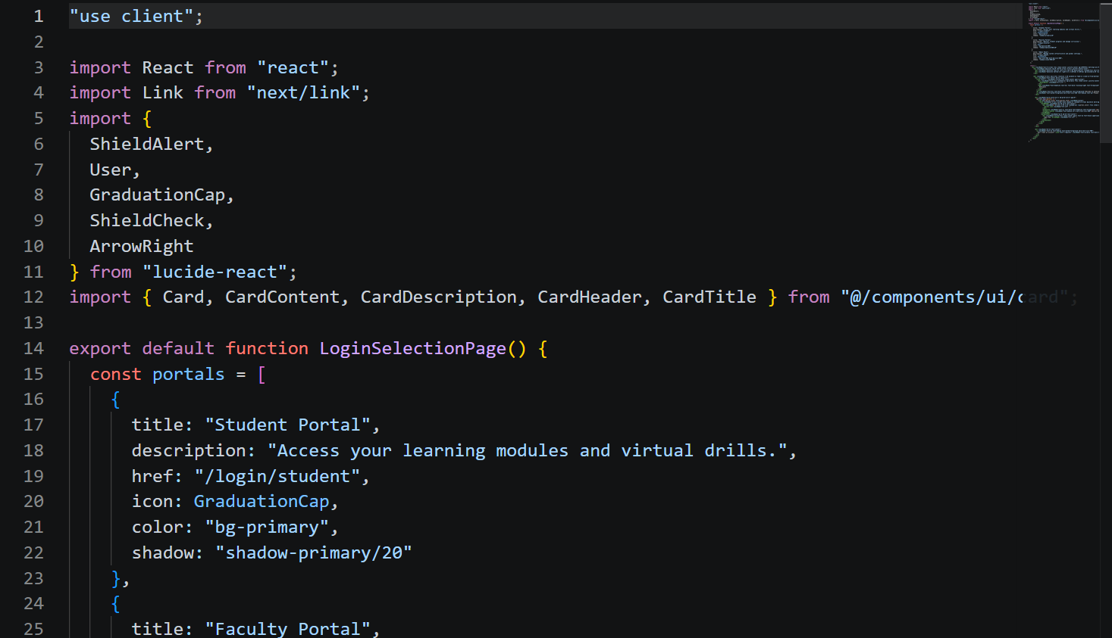
Pseudo-code
Main Dashboard
Student Login

Slide 9
ALGORITHM DETAILS
Algorithm Used: Decision Flow-Based Emergency Assistance Model
Step 1: User submits a question through the SafeLearn chatbot.
Step 2: The system detects disaster-related keywords from the query.
Step 3: Query is classified into categories such as Fire, Flood, Earthquake, First Aid, or General Safety.
Step 4: The chatbot retrieves relevant emergency guidelines and preparedness steps.
Step 5: Generative AI formats the response in clear and simple language.
Step 6: Response is displayed instantly to the user through the platform.
Step 7: If the query is unclear, the chatbot asks for more details.
Step 8: User receives quick and helpful guidance in less than 3 seconds.

Slide 10
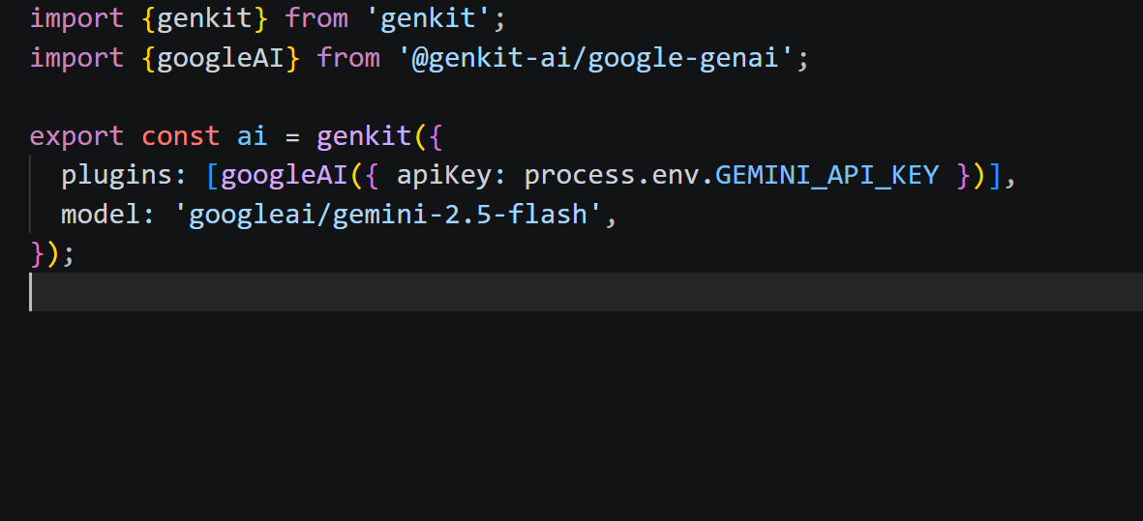
Pseudo-code

Slide 11
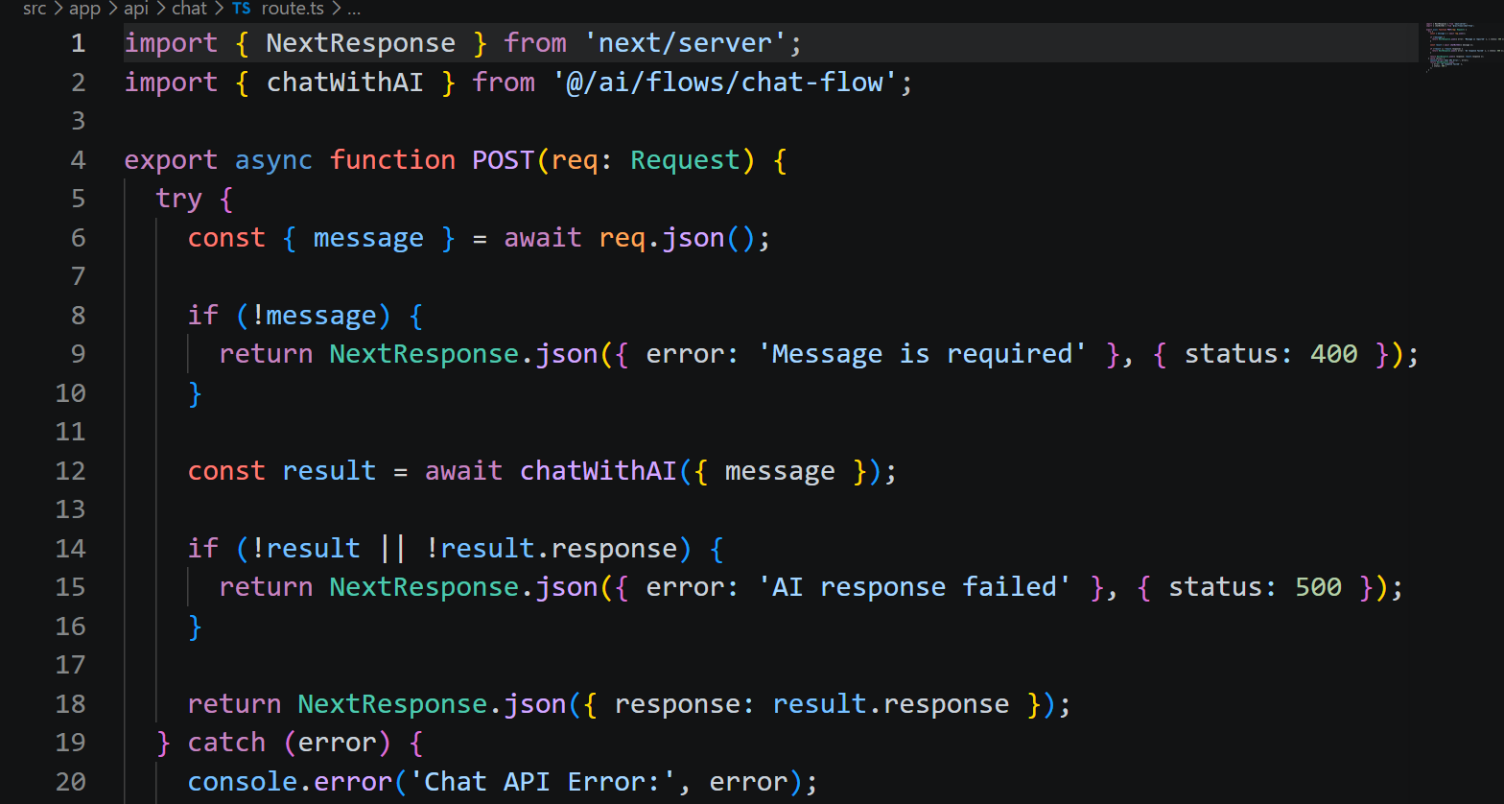
Pseudo-code

Slide 12
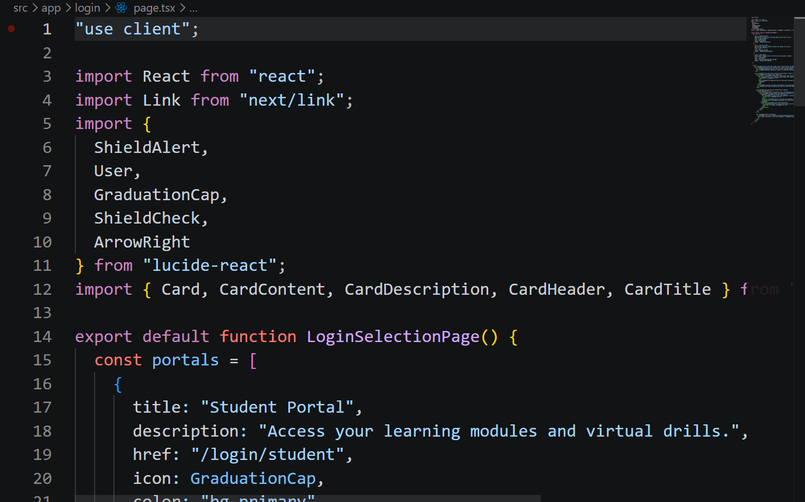
Source code details

Slide 13
Modules
Module | Functionality
User Module | User registration, secure login, profile access, and chatbot query input.
Frontend Module (Next.js + React) | Provides responsive UI, smooth navigation, disaster awareness pages, chatbot interface, and mobile-friendly design.
Backend Module (Firebase + API Integration) | Manages authentication, request handling, cloud connectivity and secure communication between frontend, chatbot, and database.
AI Chatbot Module (GenAI) | Processes user queries, understands disaster-based questions, and provides real-time emergency guidance for fire, flood, earthquake, first aid etc.
Database Module (Firestore) | Stores user details, chatbot history, disaster resources, and platform data with real-time cloud synchronization.

Slide 14
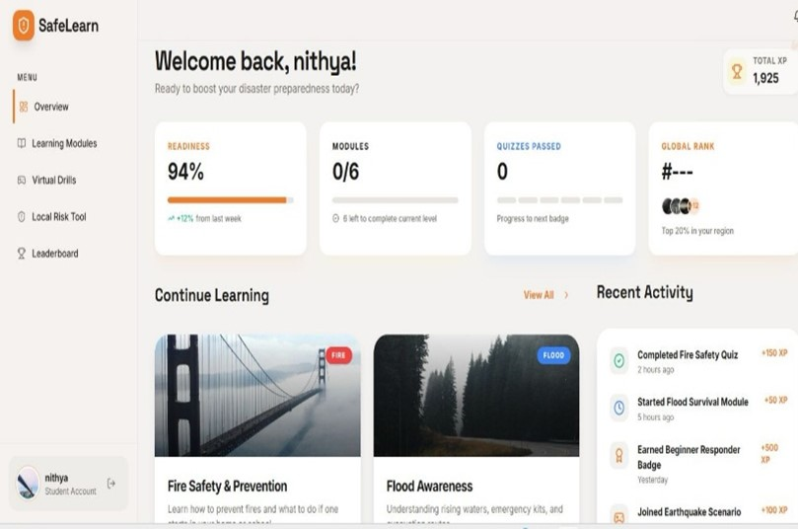
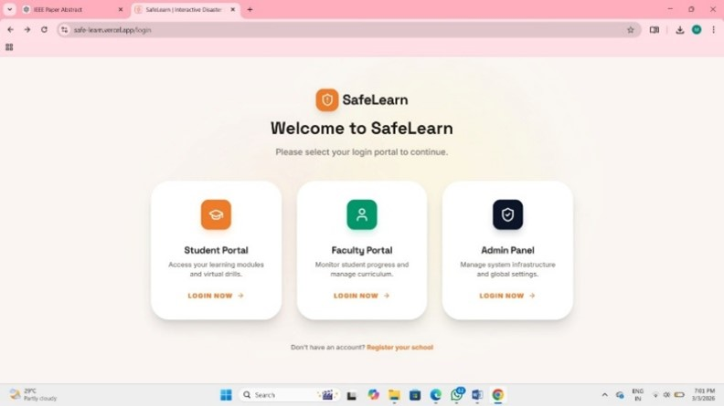
Code implementation

Slide 15
Existing Methods and Drawbacks
Existing Technology / Approach | Advantages (✔) | Limitations (✖)
General Information Websites (Wikipedia, Blogs, News Portals) | ✔ Easily accessible information ✔ Covers many disaster topics ✔ Free to use | ✘ Static information only ✘ No personalized emergency guidance ✘ Time-consuming during emergencies
Traditional Emergency Helpline Systems | ✔ Direct connection to authorities ✔ Useful in critical situations ✔ Trusted official support | ✘ Busy lines during disasters ✘ Delayed response possible ✘ No awareness/preparedness education
Mobile Weather / Alert Apps | ✔ Real-time weather alerts ✔ Location-based notifications ✔ Useful for storms/floods | ✘ Limited to specific disaster types ✘ No chatbot assistance ✘ Requires separate apps
General-Purpose Chatbots (Siri, Alexa, Google Assistant, Gemini Chat) | ✔ Understand natural language queries ✔ Fast responses ✔ Easy to use | ✘ Not specialized for disaster preparedness ✘ May provide generic answers ✘ Limited emergency-focused workflows
Manual Awareness Programs / Printed Guides | Manual Awareness Programs / Printed Guides | ✘ Not interactive ✘ Difficult to update quickly ✘ Limited accessibility during emergencies

Slide 16
Proposed Method & Feasibility Study
Proposed Method
The proposed system is a secure, scalable, and cloud-based AI-powered disaster preparedness web platform that enables users to access emergency guidance, disaster awareness resources, and interactive support through conversational natural language queries.
Utilizes a Generative AI chatbot to provide real-time responses for disaster scenarios such as fire, flood, earthquake, first aid, and emergency preparedness without requiring users to manually search through multiple information sources.
Uses Next.js frontend with responsive design, Firebase Authentication for secure user identity validation, Firestore Database for cloud data storage, and Vercel deployment for reliable global access with minimal latency.
Feasibility Study
Technical Feasibility: Fully implementable using modern and widely adopted technologies such as Next.js, React.js, Tailwind CSS, Firebase, Firestore, and Generative AI APIs; compatible with standard laptops, desktops, and mobile devices, making it suitable for broad public use.
Operational Feasibility: Reduces time required to obtain emergency guidance, improves disaster awareness, and enables users to receive instant assistance during urgent situations, making it practical for students, families, institutions, and communities.

Slide 17
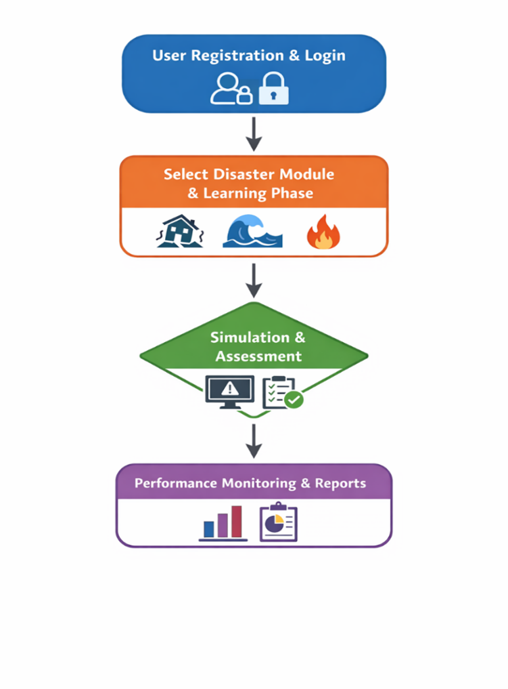
Architecture Diagram

Slide 18
Github Link
The Github link provided should have public access permission.
Github Link
https://github.com/nithyahd/safelearn

Slide 19
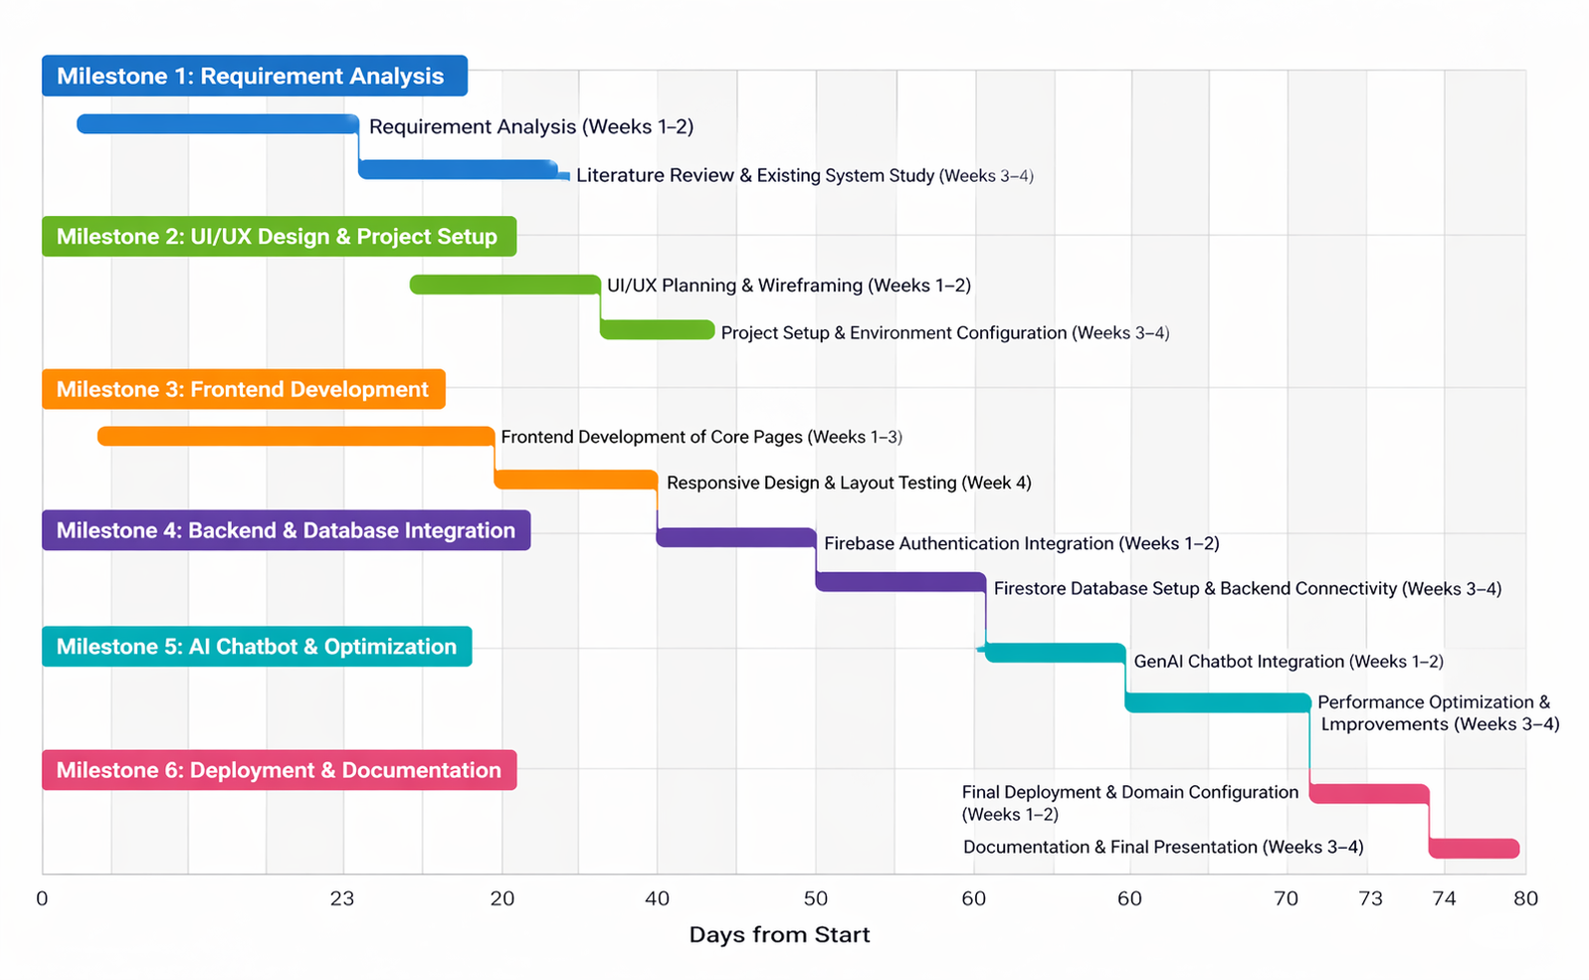
Timeline (Gantt Chart)

Slide 20
References
[1] World Health Organization (WHO), 2023. Emergency Preparedness, Response and Resilience Framework. World Health Organization.
[2] United Nations Office for Disaster Risk Reduction (UNDRR), 2022. Global Assessment Report on Disaster Risk Reduction. United Nations.
[3] International Federation of Red Cross and Red Crescent Societies (IFRC), 2021. Community-Based Disaster Risk Reduction Guidelines. IFRC Publications.
[4] National Disaster Management Authority (NDMA), Government of India, 2023. Guidelines on Disaster Management and Preparedness. New Delhi, India.
[5] Ministry of Home Affairs, Government of India, 2022. National Disaster Management Plan. Government of India.

Slide 21
References
[6] Sharma, R. and Verma, P., 2021. Artificial Intelligence in Disaster Prediction and Emergency Response Systems. International Journal of Computer Applications, 174(12), pp.15-22.
[7] Kumar, S. and Rao, M., 2020. Cloud-Based Emergency Management Systems Using Web Technologies. International Journal of Advanced Research in Computer Science, 11(4), pp.45-53.
[8] Patel, N. and Singh, A., 2022. Chatbot Applications for Public Safety and Crisis Communication. Journal of Emerging Technologies, 8(2), pp.67-75.
[9] Ghosh, T. and Mehta, R., 2021. Secure Authentication Mechanisms for Web-Based Public Service Platforms. Journal of Information Security, 13(1), pp.31-40.
[10] United Nations, 2020. Sustainable Development Goals. Department of Economic and Social Affairs UN, https://sdgs.un.org/goals.

Slide 22


