Slide 1
Disaster Preparedness and Response Education System for Schools and Colleges
CSE7302- University Project
Review-4
Batch Number: CIT_32
Under the Supervision of,
Ms. Pushpalatha M,
Assistant Professor,
School of Computer Science and Engineering,
Presidency University.
Roll Number | Student Name
20221CIT0130 | Nithya H D
20221CIT0126 | Shreya A J
20221CIT0123 | Manisha S M
Name of the Program:
Name of the HoD: Dr. Anandaraj SP
Name of the Program Project Coordinator: Dr. Sharmasth Vali
Name of the School Project Coordinators: Dr. Sampath A K , Dr. Geetha A

Slide 2
Problem Statement Number:SIH25008
Organization: Presidency University
Category (Hardware / Software / Both) :Software
Problem Description: In India, schools and colleges are often unprepared for natural disasters such as earthquakes, floods, and fires. While emergency guidelines exist on paper, there is a lack of structured disaster management education integrated into the curriculum. Institutions lack digital tools to simulate disaster scenarios or conduct virtual drills to train students and staff on safety protocols. Furthermore, there’s a gap in localized awareness—many students are unaware of how to react during disasters specific to their region. Manual drills, where they occur, are infrequent and often poorly coordinated, failing to instill practical preparedness.

Slide 3
Content
Problem Statement
Objectives
Background and Related work for title Selection
Analysis of Problem Statement
Innovation or Novel Contributions
Git-hub Link
Timeline of the Project
References

Slide 4
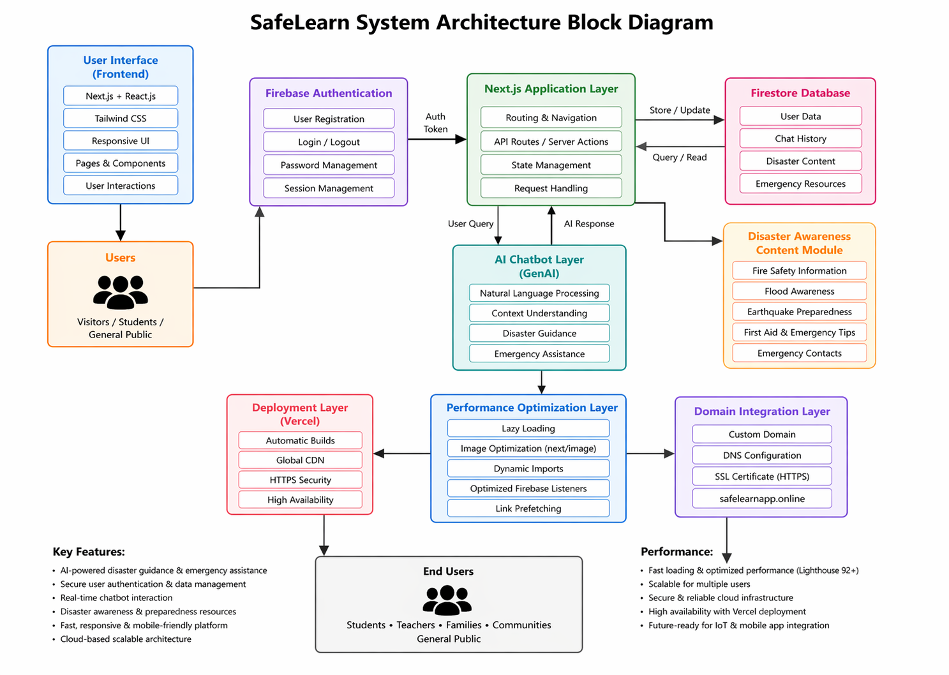
Final Architecture

Slide 5
Features Implemented
✔ Secure Login ✔ Chatbot Query Support ✔ Disaster Resources ✔ Fast Navigation ✔ Responsive Design

Slide 6
Performance Optimization
Implemented:
Lazy Loading
next/image
Dynamic Imports
Optimized Firebase Listeners

Slide 7
Challenges Solved
GitHub push error
Missing environment variables
Domain DNS issue

Slide 8
Background and Related work for title Selection
India frequently faces natural disasters such as floods, earthquakes, and fires, making disaster preparedness essential in educational institutions.
Schools and colleges currently rely on theoretical guidelines with minimal practical training.
Existing research mainly focuses on general disaster management systems rather than student-centered education.
Few studies address digital learning platforms or virtual simulations for disaster preparedness in schools and colleges.
Hence, this project is proposed to provide practical, digital, and structured disaster education for students.

Slide 9
Objectives
To design and develop a digital disaster preparedness and response education system that equips students and staff in schools and colleges with structured, practical knowledge to effectively respond to natural disasters.
To provide region-specific disaster awareness by educating users about disasters commonly occurring in their geographical area (such as floods, earthquakes, cyclones, or fires).
To simulate real-life disaster scenarios through virtual drills and interactive modules, enabling students to practice safety protocols in a risk-free environment.
To improve preparedness and response skills of students and staff by training them on evacuation procedures, first aid, emergency communication, and safety measures.
To overcome limitations of manual disaster drills by offering frequent, scalable, and well-coordinated digital training sessions.
To promote a culture of safety and resilience within educational institutions by encouraging continuous learning and awareness in disaster risk reduction.

Slide 10
Analysis of Problem Statement
Technology Stack Components:
Frontend: HTML, CSS, JavaScript – for building a responsive and user-friendly interface
Backend: Java / Python (Flask/Django) / Node.js – for handling application logic and user management
Database: MySQL / MongoDB – to store user data, training records, and assessment results
Simulation & Learning Modules: Interactive web-based simulations and quizzes for disaster scenarios
Deployment Platform: Cloud-based hosting (AWS / Azure / Local Server) for scalability and accessibility
Tools & APIs: Maps API, Notification services, and Analytics tools for location-based awareness and performance tracking

Slide 11
Features of the Website
Information about fire types and extinguishers
Step-by-step guide to use fire extinguishers
Disaster preparedness tips
Quiz section for user engagement
User input form for participation
Attractive UI with images and navigation

Slide 12
Disaster Management
Planning and preparation for emergencies
Steps include:
Prevention
Preparedness
Response
Recovery

Slide 13
Github Link
The Github link provided should have public access permission.
Github Link
https://github.com/nithyahd/safelearn

Slide 14
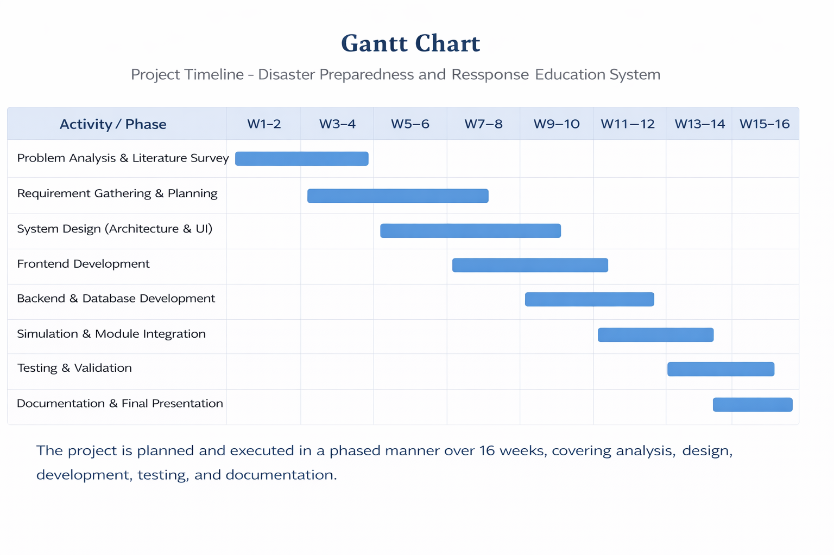
Timeline of the Project (Gantt Chart)

Slide 15
References (IEEE Paper format)
[1] S. Shaw, R. Takeuchi, and S. K. Jain, “Disaster education and preparedness: A systematic review of school-based disaster risk reduction programs,”
[2] A. R. Mishra and P. K. Singh, “A digital framework for disaster preparedness and emergency response training using simulation-based learning,”

Slide 16


