Slide 1
Disaster Preparedness and Response Education System for Schools and Colleges
CSE7302- University Project
Review-2
Batch Number: CIT_32
Under the Supervision of,
Ms. Pushpalatha M,
Assistant Professor,
School of Computer Science and Engineering,
Presidency University.
Roll Number | Student Name
20221CIT0130 | Nithya H D
20221CIT0126 | Shreya A J
20221CIT0123 | Manisha S M
Name of the Program:
Name of the HoD: Dr. Anandaraj SP
Name of the Program Project Coordinator: Dr. Sharmasth Vali
Name of the School Project Coordinators: Dr. Sampath A K , Dr. Geetha A

Slide 2
Abstract:
Natural and man-made disasters pose significant risks to educational institutions, often resulting in loss of life, infrastructure damage, and disruption of academic activities. A major challenge identified is the lack of structured disaster preparedness education and real-time response mechanisms in schools and colleges. This project aims to design a Disaster Preparedness and Response Education System that integrates awareness training, early warning dissemination, and coordinated response strategies for students and staff. The proposed system combines digital learning modules, alert systems, and institutional coordination tools to enhance preparedness, reduce panic, and improve disaster response efficiency. The approach focuses on education-driven resilience using affordable and scalable technologies suitable for academic environments.

Slide 3
Literature Survey
Shaw et al. (2011) emphasized the role of education in disaster risk reduction (DRR) and found schools to be effective centers for community preparedness.
Izadkhah & Hosseini (2005) highlighted that disaster education significantly improves student response behavior during emergencies.
Johnson et al. (2014) proposed digital learning platforms for disaster awareness but noted limited real-time response integration.
Petal (2008) discussed school safety frameworks and identified gaps in practical disaster drills.
Ronan & Johnston (2001) demonstrated that structured preparedness training reduces post-disaster psychological stress.

Slide 4
Literature Survey
Albrecht et al. (2018) studied mobile alert systems and found improved response time in educational campuses.
Paton & Johnston (2017) stressed the importance of multi-hazard education models in institutions.
Shiwaku et al. (2007) evaluated disaster simulations in schools and reported improved evacuation efficiency.
Cutter et al. (2015) analyzed institutional disaster resilience and recommended technology-supported preparedness.
UNDRR (2019) framework emphasized integrating disaster education into formal curricula.

Slide 5
Objectives
To design and develop a digital disaster preparedness and response education system that equips students and staff in schools and colleges with structured, practical knowledge to effectively respond to natural disasters.
To provide region-specific disaster awareness by educating users about disasters commonly occurring in their geographical area (such as floods, earthquakes, cyclones, or fires).
To simulate real-life disaster scenarios through virtual drills and interactive modules, enabling students to practice safety protocols in a risk-free environment.
To improve preparedness and response skills of students and staff by training them on evacuation procedures, first aid, emergency communication, and safety measures.
To overcome limitations of manual disaster drills by offering frequent, scalable, and well-coordinated digital training sessions.
To promote a culture of safety and resilience within educational institutions by encouraging continuous learning and awareness in disaster risk reduction.

Slide 6
Existing Methods And Drawbacks
Existing Methods
Drawbacks
Manual disaster drills and evacuation plans
Printed safety manuals and awareness sessions
Government alert systems (SMS, TV, radio)
Standalone mobile disaster alert apps
No centralized system for schools and colleges
Delayed communication during emergencies
Limited customization for campus-specific risks
Lack of continuous engagement and training
Minimal integration between education and real-time response

Slide 7
Proposed Method And Feasibility Study
Proposed Method
Feasibility Study
A web and mobile-based disaster education and response platform
Interactive learning modules for disaster preparedness
Real-time alert system integrated with government APIs
Emergency response dashboard for institutions
Automated evacuation and safety guidance
Technical Feasibility: Uses existing web, mobile, and cloud technologies
Economic Feasibility: Low-cost deployment using open-source tools
Operational Feasibility: Easy adoption by students and staff
Scalability: Can be extended to multiple institutions and regions

Slide 8
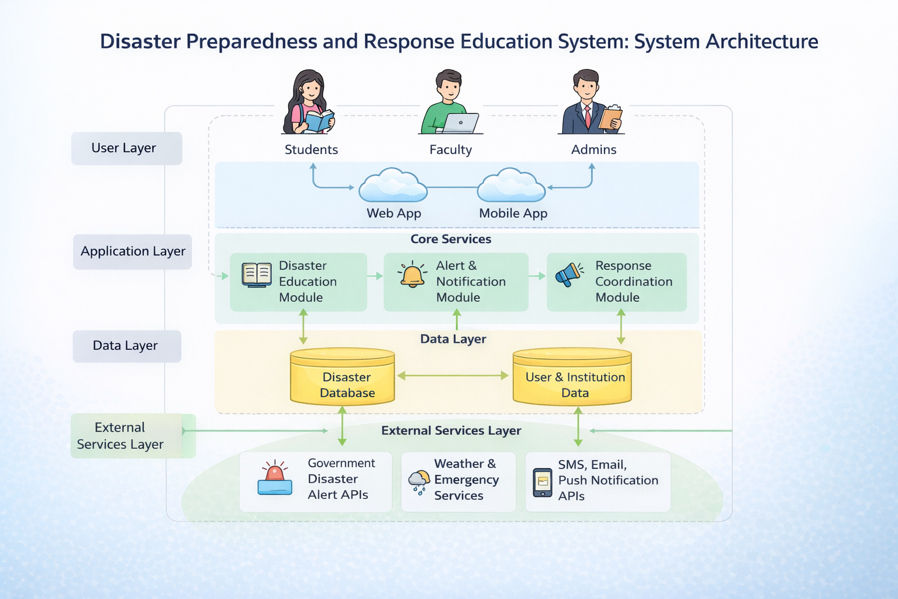
Architecture Diagram

Slide 9
Modules
User Management Module
Student, staff, and admin authentication
2. Disaster Education Module
E-learning content, quizzes, simulations
3. Alert & Notification Module
Real-time alerts via SMS, app, email
4. Response Coordination Module
Evacuation plans and emergency contacts
5. Reporting & Analytics Module
Preparedness reports and response analysis

Slide 10
Hardware And Software Requirements:
Software Requirements:
Operating System: Windows / Linux / macOS
Frontend Technologies: HTML, CSS, JavaScript
Backend Technologies: Java / Python / Node.js
Database: MySQL / MongoDB
Web Browser: Google Chrome / Mozilla Firefox
Development Tools: VS Code / IntelliJ / Eclipse
Hardware Requirements:
Processor: Intel i3 or higher
RAM: Minimum 4 GB (8 GB recommended)
Storage: Minimum 100 GB free space
Internet Connection: Required for online access and updates

Slide 11
Github Link
The Github link provided should have public access permission.
Github Link
https://github.com/MANISHA-S-M/final_year_project

Slide 12
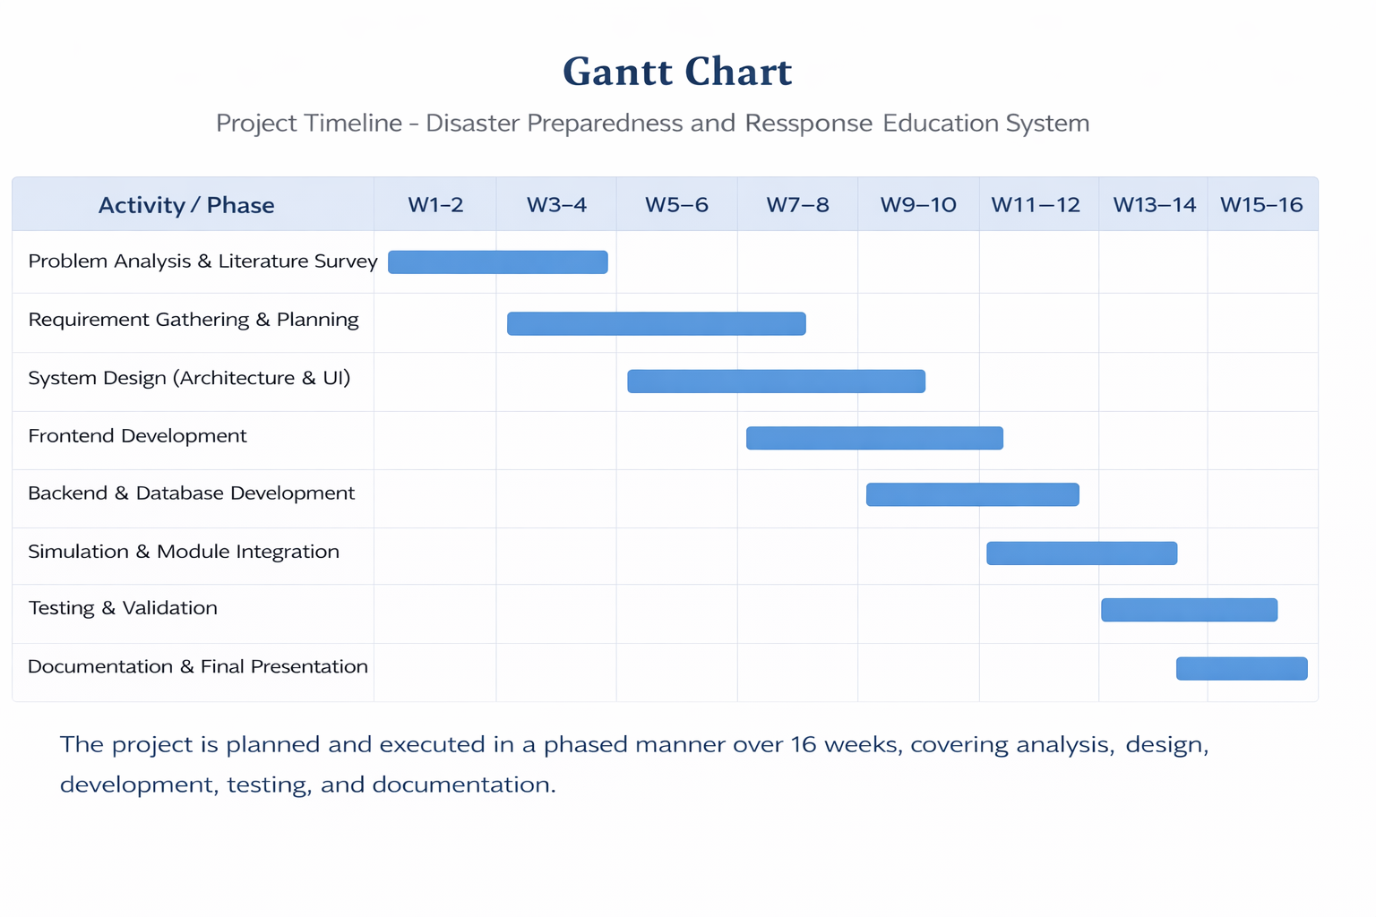
Timeline of the Project (Gantt Chart)

Slide 13
References (IEEE Paper format)
[1] S. Shaw, R. Takeuchi, and S. K. Jain, “Disaster education and preparedness: A systematic review of school-based disaster risk reduction programs,”
[2] A. R. Mishra and P. K. Singh, “A digital framework for disaster preparedness and emergency response training using simulation-based learning,”

Slide 14


