Slide 1
DATA SCIENCE
INTERSHIP
Group Members:
Nithyalakshmi J
Monisha P
Notes:
fvffb
Easwari Engineering College

Slide 2
Objective(s):
The target is to prepare an ML model which can predict the profit value of a company if the value of its R&D Spend, Administration Cost and Marketing Spend are given.
i) Construct Different Regression algorithms
ii) Divide the data into train set and test set
iii) Calculate different regression metrics
iv) Choose the best model
The model1 is successfully created with great R^2 value of 98.9%.
The model2 is successfully created with great R^2 value of 98.8%.
On comparing model 1 and model 2, model 1 is the best model

Slide 3
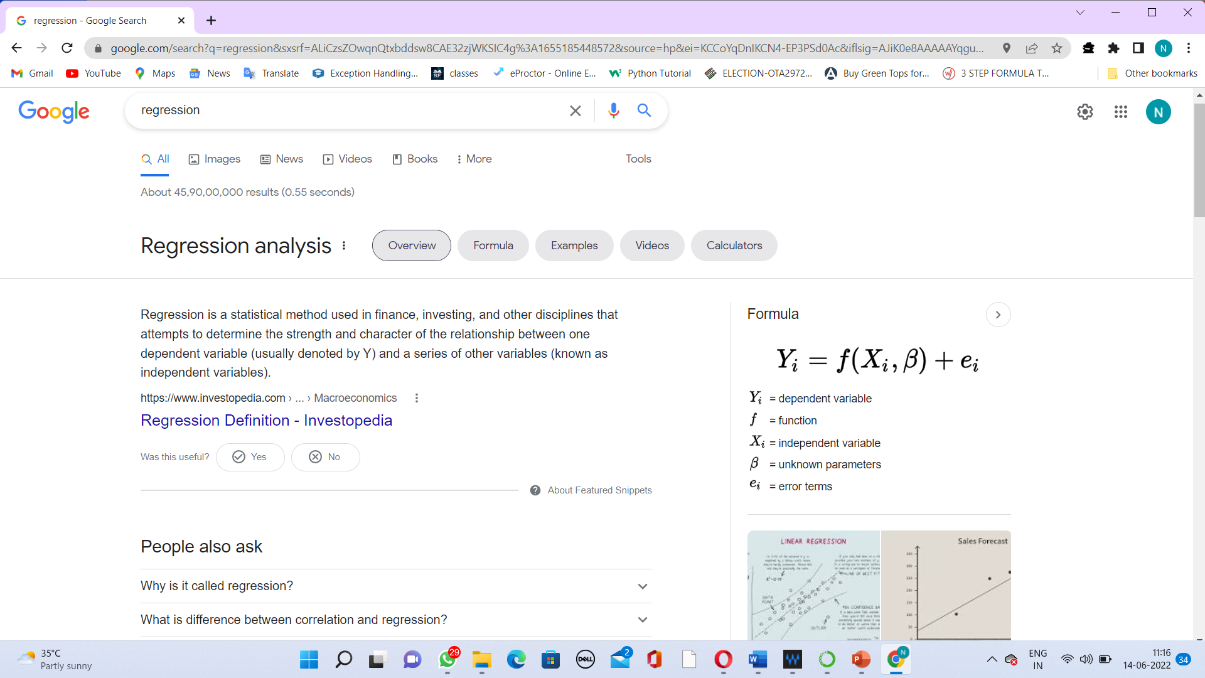
Regression
Regression is a statistical method used in finance, investing, and other disciplines that attempts to determine the strength and character of the relationship between one dependent variable (usually denoted by Y) and a series of other variables (known as independent variables).
Notes:
fvffb
Easwari Engineering College

Slide 4
Linear Regression
Linear regression is a linear approach for modelling the relationship between a scalar response and one or more explanatory variables (also known as dependent and independent variables).
The most common form of regression analysis is linear regression,
Linear regression models are often fitted using the least squares approach

Slide 5
Most applications fall into one of the following two broad categories:
If the goal is prediction, forecasting, or error reduction, linear regression can be used to fit a predictive model to an observed data set of values of the response and explanatory variables. After developing such a model, if additional values of the explanatory variables are collected without an accompanying response value, the fitted model can be used to make a prediction of the response.
If the goal is to explain variation in the response variable that can be attributed to variation in the explanatory variables, linear regression analysis can be applied to quantify the strength of the relationship between the response and the explanatory variables, and in particular to determine whether some explanatory variables may have no linear relationship with the response at all, or to identify which subsets of explanatory variables may contain redundant information about the response.

Slide 6
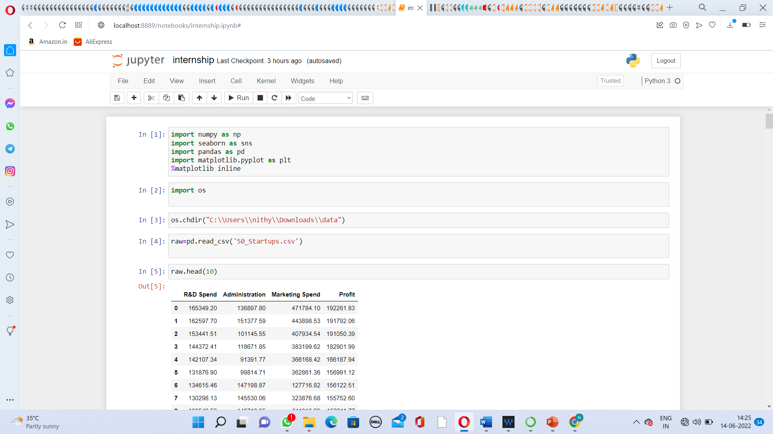
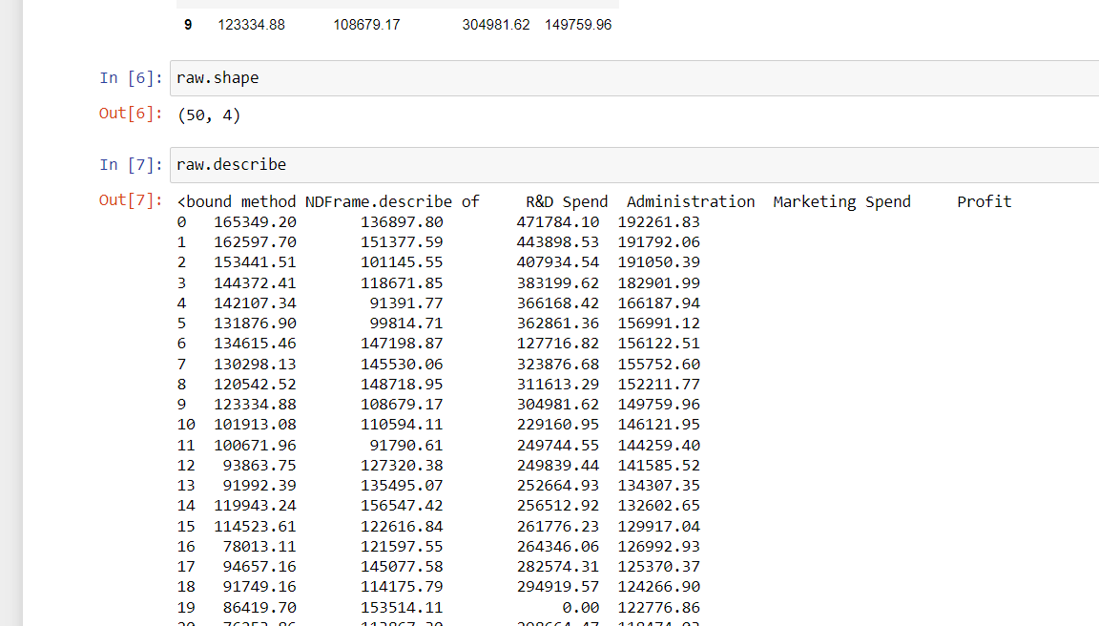
LOADING DATASET

Slide 7
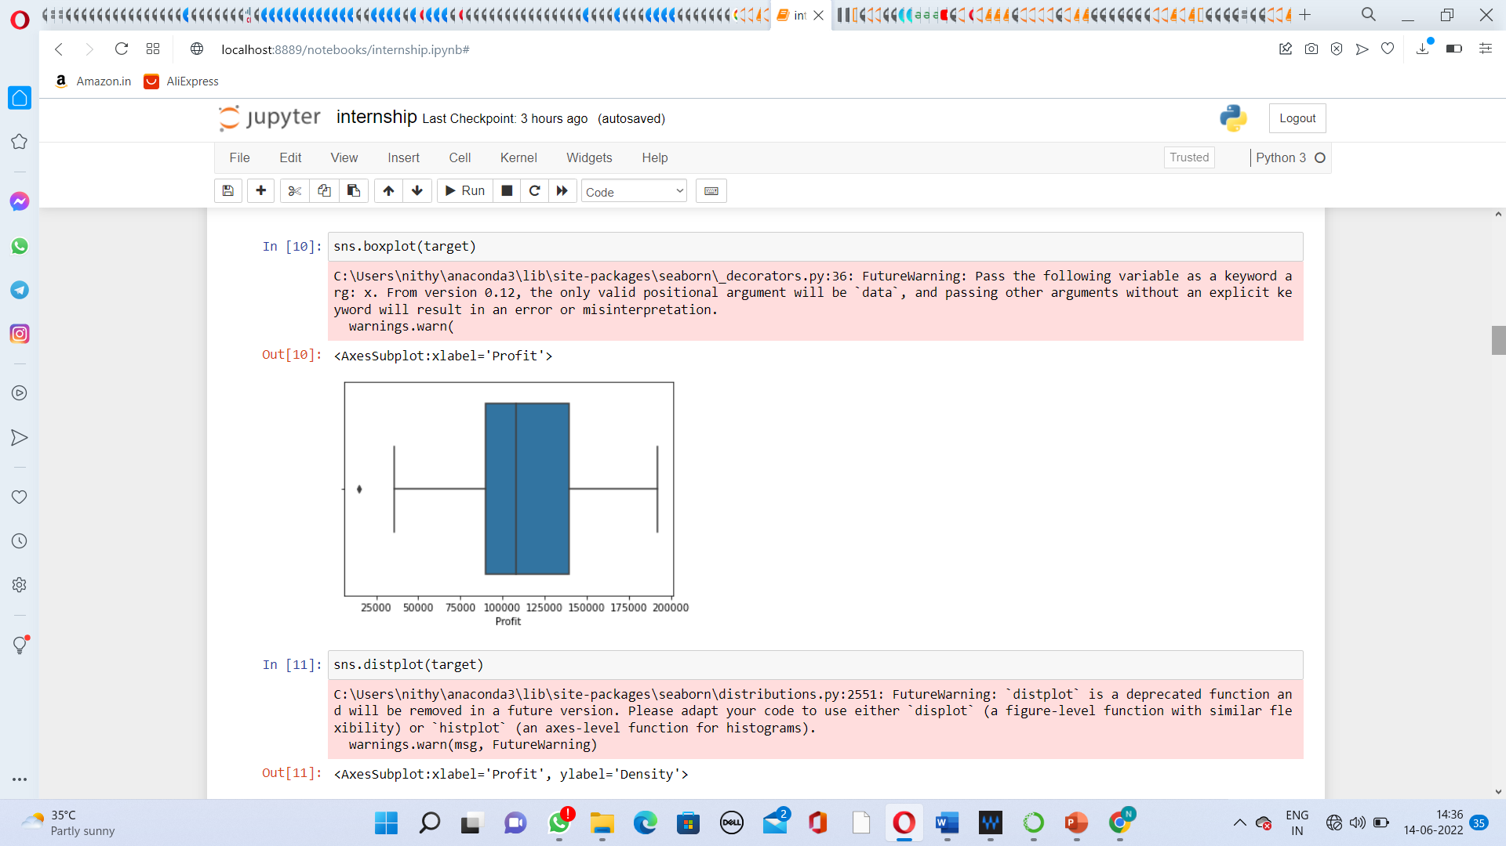
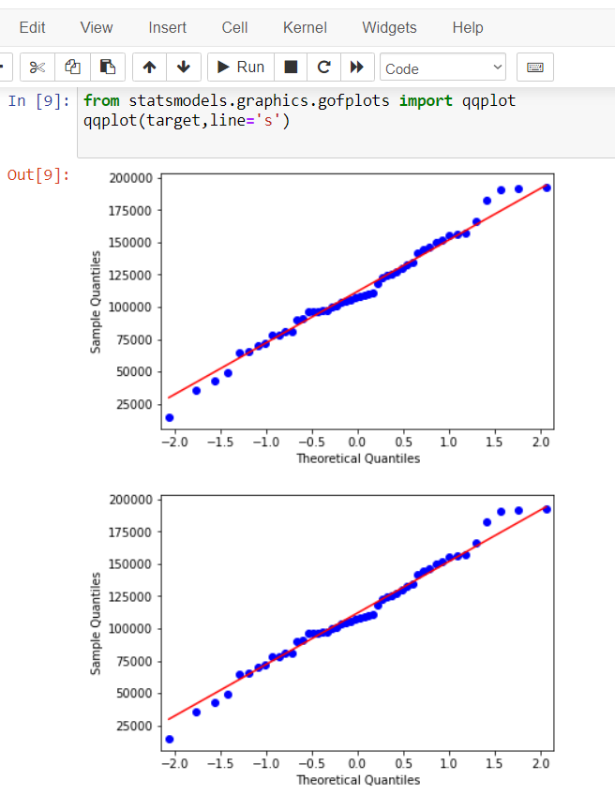
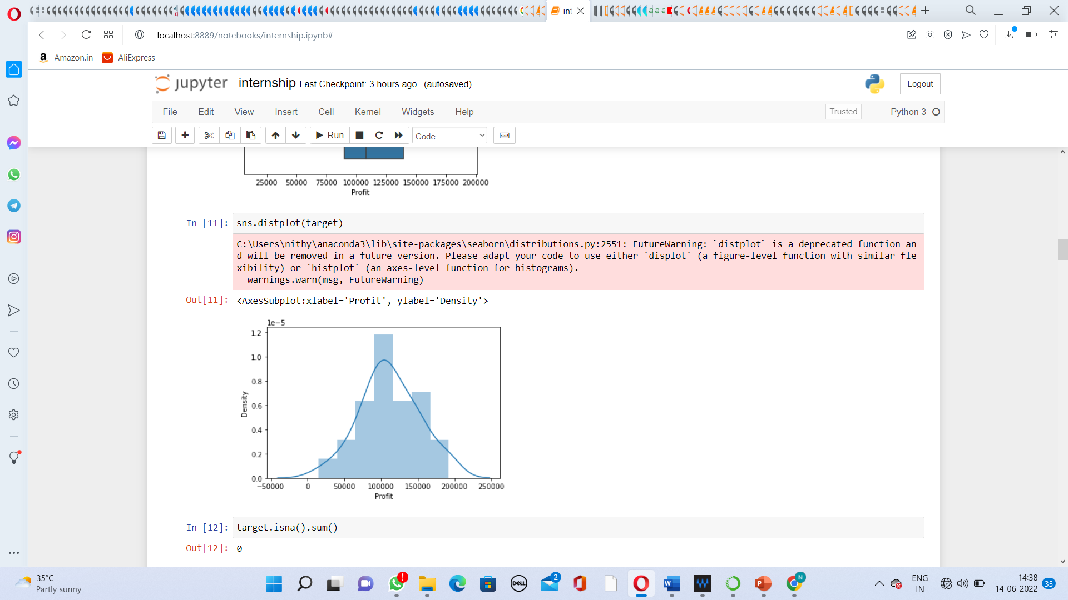
DATA VISUALISATION

Slide 8
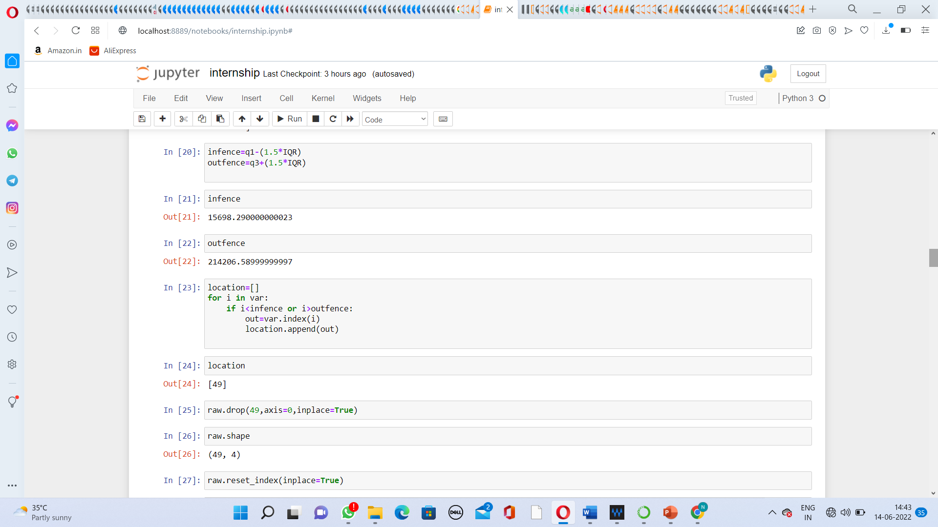
DATA PREPROCESSING

Slide 9
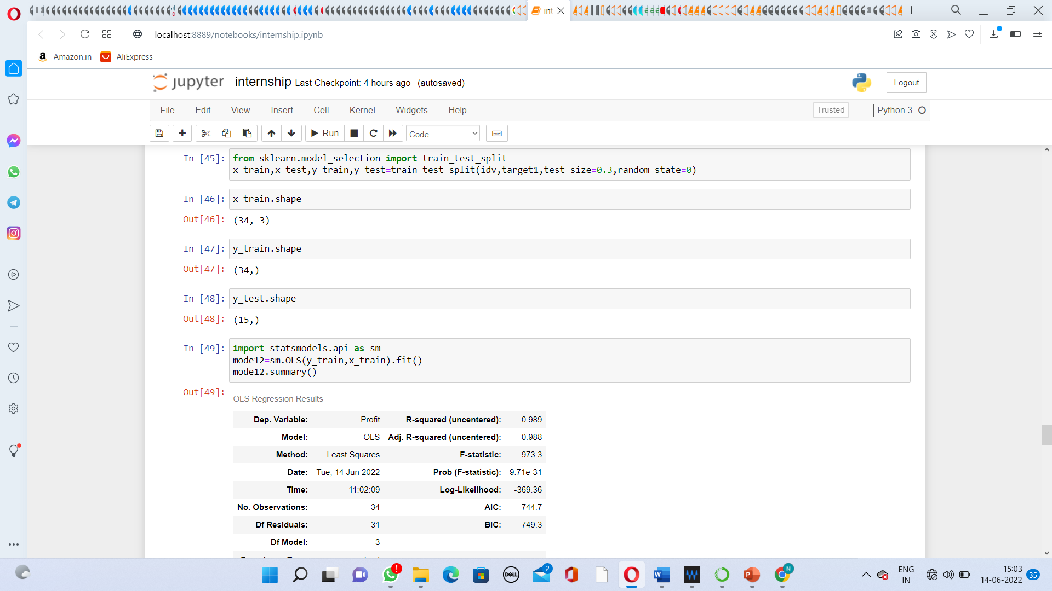
MODEL 1

Slide 10
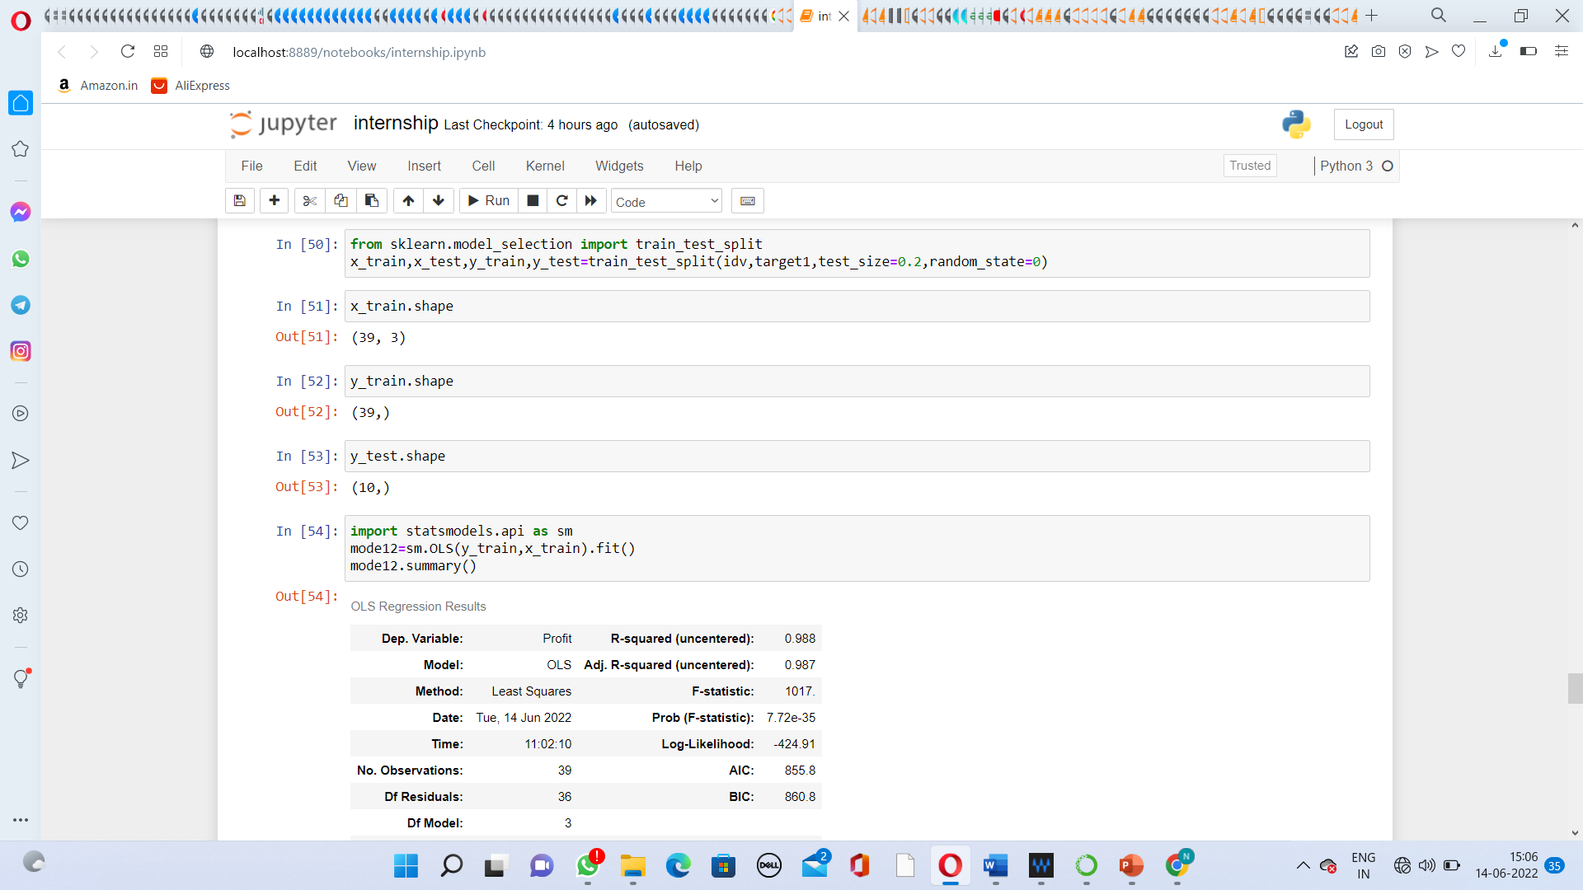
MODEL 2

Slide 11
Thank You

