Slide 1
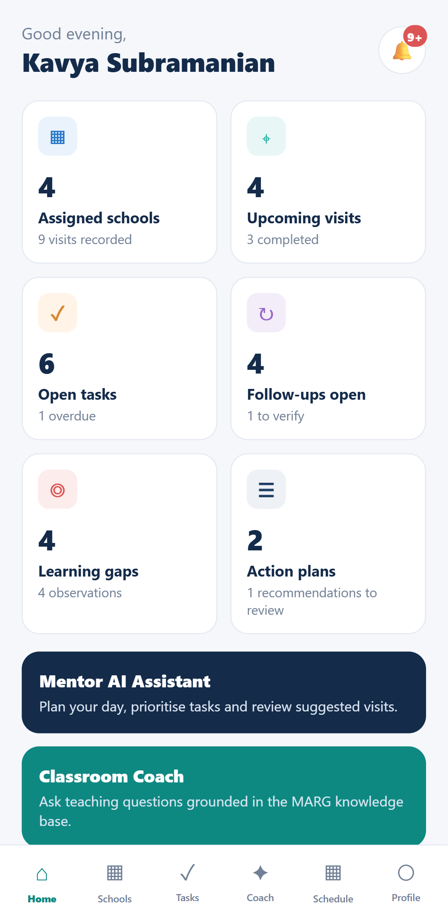
MARG
Mentoring · Action · Reflection · Growth
A mentor-focused platform that turns every classroom visit into a tracked improvement cycle — supported by two independent AI assistants.
Build Stage evaluation
Working prototype · tested locally · not yet deployed
Notes:
Status is stated up front: integrated and tested on the development machine; public deployment awaits approval.

Slide 2
PROBLEM STATEMENT
The challenge: classroom insights rarely become improvement
▪ Mentors support many teachers across many schools, often with long travel between them.
▪ Observations live on paper and in chat threads, so learning gaps are noticed but rarely tracked to closure.
▪ Follow-ups depend on memory: agreed actions, evidence and teacher responses are easily lost.
▪ Expert guidance is hard to reach in the moment: national frameworks (NCF, NEP, CCE) and mentoring manuals run to thousands of pages.
▪ Connectivity in schools is unreliable, so tools that need a constant connection fail exactly where work happens.
MARG's answer
One mentor app for the full cycle: visit → observation → learning gap → recommendation → action plan → follow-up with evidence — with AI help that never acts without the mentor.
Outcome we design for
Every identified gap has an owner, a plan, evidence and a closure — visible to the mentor at a glance, online or offline.
MARG · 2/15

Slide 3
INTENDED USERS
Built for mentors — not a student-facing app
Mentor (primary user)
Administrator (system only)
Teachers & students
▪ Signs in securely; sees only assigned schools
▪ Plans visits, observes, records findings
▪ Approves AI suggestions and plans
▪ Tracks follow-ups, tasks and reports
▪ Assigns mentors to schools
▪ Creates school records
▪ No mentoring workflows
▪ Uses the API; no extra screens added
▪ No accounts, no logins
▪ Teachers: subjects of mentoring; responses recorded by the mentor
▪ Students: appear only as aggregated learning gaps
▪ No student data or chatbot
All demonstration data is fictional (schools, teachers, observations).
MARG · 3/15

Slide 4
HOW IT FITS TOGETHER
System architecture: four projects, one controlled entry point
The app talks only to the backend. AI keys and service URLs never reach the device.
The two AI systems are independent and never share data stores.
Classroom Coach
educational intelligence
RAG Q&A · observation analysis
Qwen 2.5 3B
Ollama (local)
ChromaDB 33,624 chunks
service key
MARG Backend
FastAPI · PostgreSQL
auth · school-scoped data
sync · reports · evidence
MARG Frontend
Expo · React Native + web
offline outbox & cache
HTTPS + JWT
Mentor Intelligence
workflow intelligence
10 agents · proposals
Claude
claude-opus-5
Anthropic API
service key +
mentor identity
PostgreSQL
authoritative business data
Mentor Intelligence reads a per-mentor snapshot and executes approved actions only through backend APIs — never the database.
MARG · 4/15

Slide 5
CORE FEATURES
The mentor workflow, end to end
Plan visit
Observe
Analyse
Recommend
Action plan
Follow up
assigned schools,
timetables
notes, photos,
evidence
findings &
learning gaps
mentor approves
what is official
steps with owners
& dates
teacher response,
evidence, verify
Dashboard & reports
Tasks & schedule
Notifications
Evidence
Live counts, activity trends and learning-gap reports computed from records.
Priority-scored tasks, visit agenda, time proposals and daily workload.
Reminders for overdue tasks, upcoming visits, due steps and evidence to verify.
Photo/PDF evidence on observations and follow-ups, validated and access-controlled.
MARG · 5/15

Slide 6
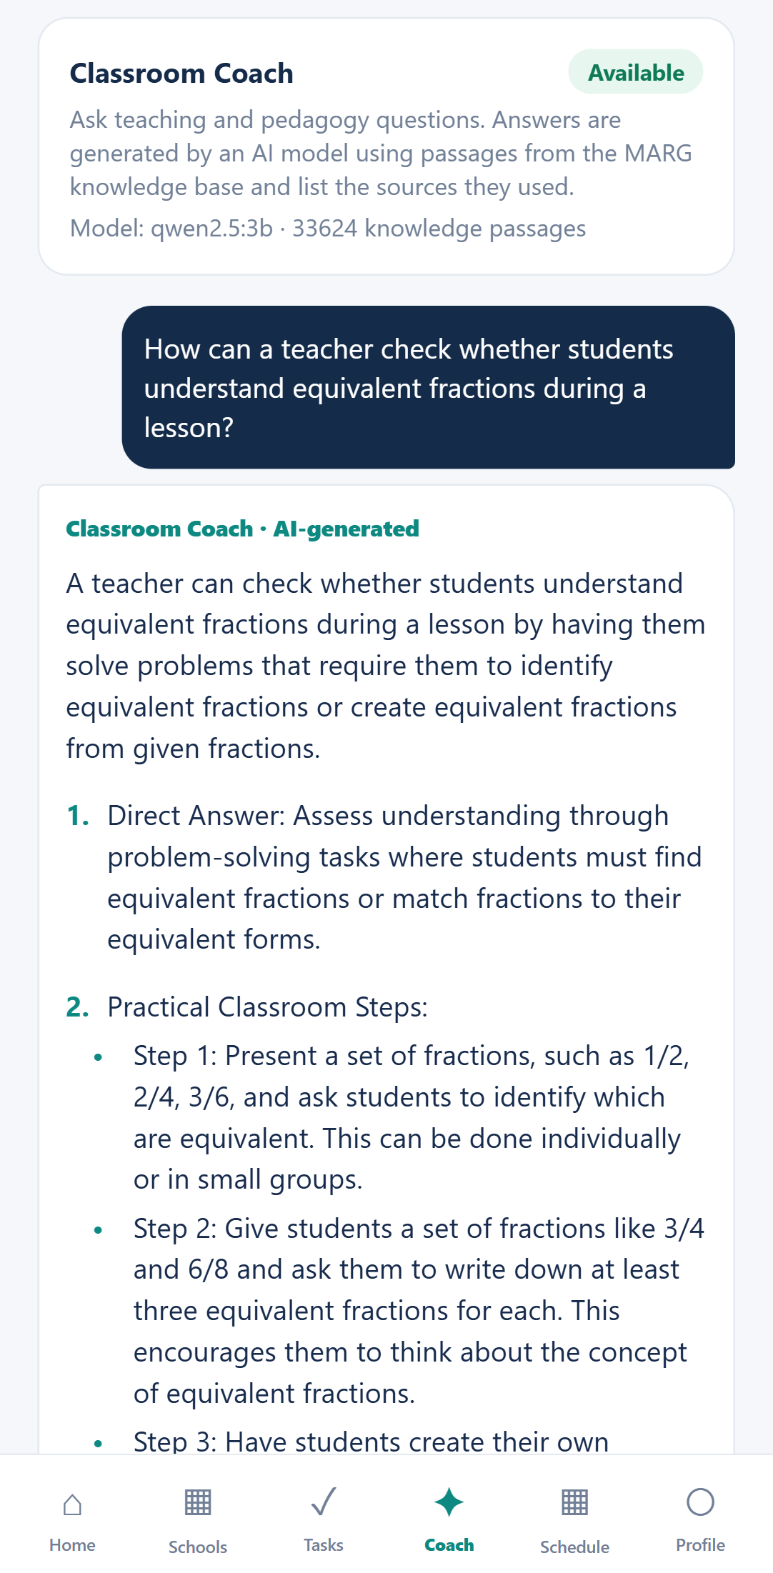
AI ASSISTANT 1 · LOCAL LLM + RAG
Classroom Coach: grounded educational intelligence
Question or
observation
Embed
MiniLM-L6-v2
Retrieve
ChromaDB
Filter
relevance · dedupe
Generate
Qwen 2.5 3B
Answer
+ sources [S1…]
▪ Knowledge base: 167 educational documents (NCF, NEP, CCE, mentoring and observation manuals) → 33,624 passages.
▪ Calibrated relevance: on-topic queries score 0.18–0.40; off-topic ≥ 0.75; cut-off 0.60. Nothing relevant → it says so and does not answer.
▪ Honest citations: real document titles and pages; citations to sources not retrieved are removed.
▪ Observation analysis: schema-constrained JSON — findings with quoted evidence, gaps, recommendations — saved only as “AI suggested”.
▪ Privacy: only subject, grade, topic and notes are sent — never teacher or student names. Runs locally (Ollama).
Live
answer
≈ 7 s
MARG · 6/15

Slide 7
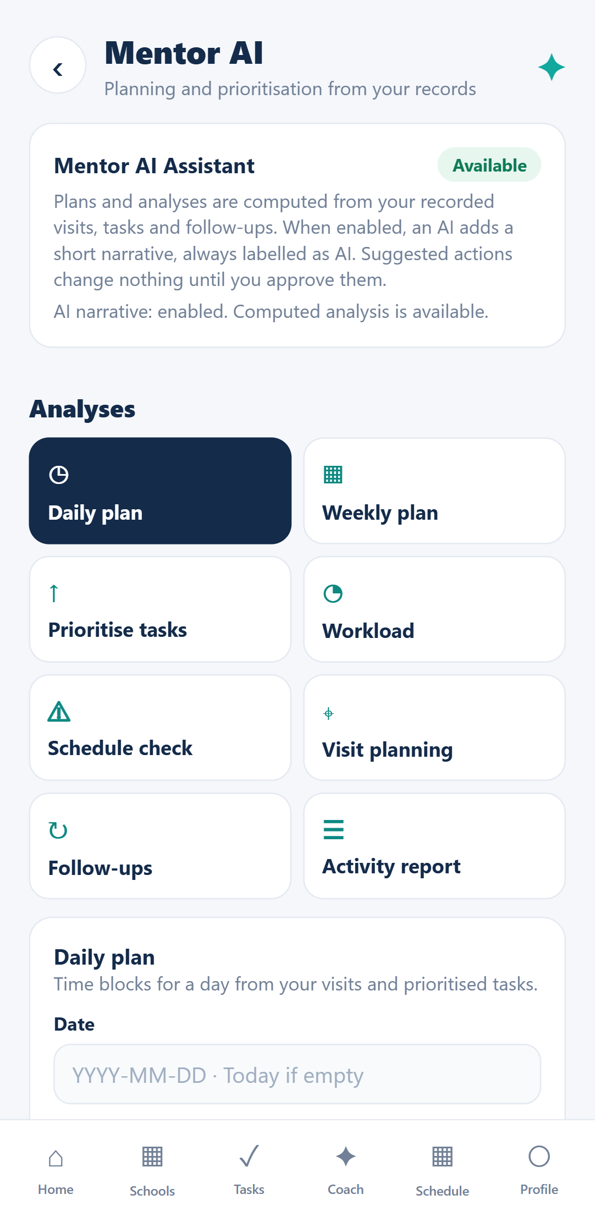
AI ASSISTANT 2 · CLAUDE-OPUS-5
Mentor Intelligence: Claude-powered workflow agents
Daily plan
Weekly plan
Task prioritisation
Workload
Schedule check
Visit planning
Follow-up analysis
Activity report
Teacher message draft
How every agent run works
1 Snapshot
mentor's records via
backend service API
2 Compute
deterministic scores,
plans, conflicts
3 Claude
validated JSON insights,
labelled as AI
4 Propose
actions wait for
mentor approval
▪ If Claude is unavailable, the computed analysis is still returned (ai_status).
▪ Teacher names become placeholders before any Claude call; token budgets and per-call usage are recorded.
▪ Refusal fallback enabled: server-side, to claude-opus-4-8 only if a request is declined.
MARG · 7/15

Slide 8
RESPONSIBLE AI & SECURITY
Safeguards: humans decide, data stays scoped, actions are audited
Human approval
Role & school-level access
Auditability & data care
▪ AI findings & recommendations start as “AI suggested”
▪ Action plans only from mentor-approved recommendations
▪ Mentor AI actions are proposals; only the owning mentor can approve
▪ Teacher messages are drafts the mentor sends personally
▪ Argon2 passwords; JWT + rotating refresh tokens; logout
▪ Login rate limiting; timing-safe sign-in
▪ Every query filtered to the mentor's assigned schools (deny by default)
▪ Admin-only school assignment; service keys between services
▪ Approval, execution and policy events in an audit log
▪ Every Claude call logged: model, tokens, latency, cost
▪ Versioned records; request IDs in all logs
▪ Uploads checked by file signature; no public file URLs
Verified live: proposals changed nothing until approved · another mentor's approval attempt → 403 · rejection changed nothing.
MARG · 8/15

Slide 9
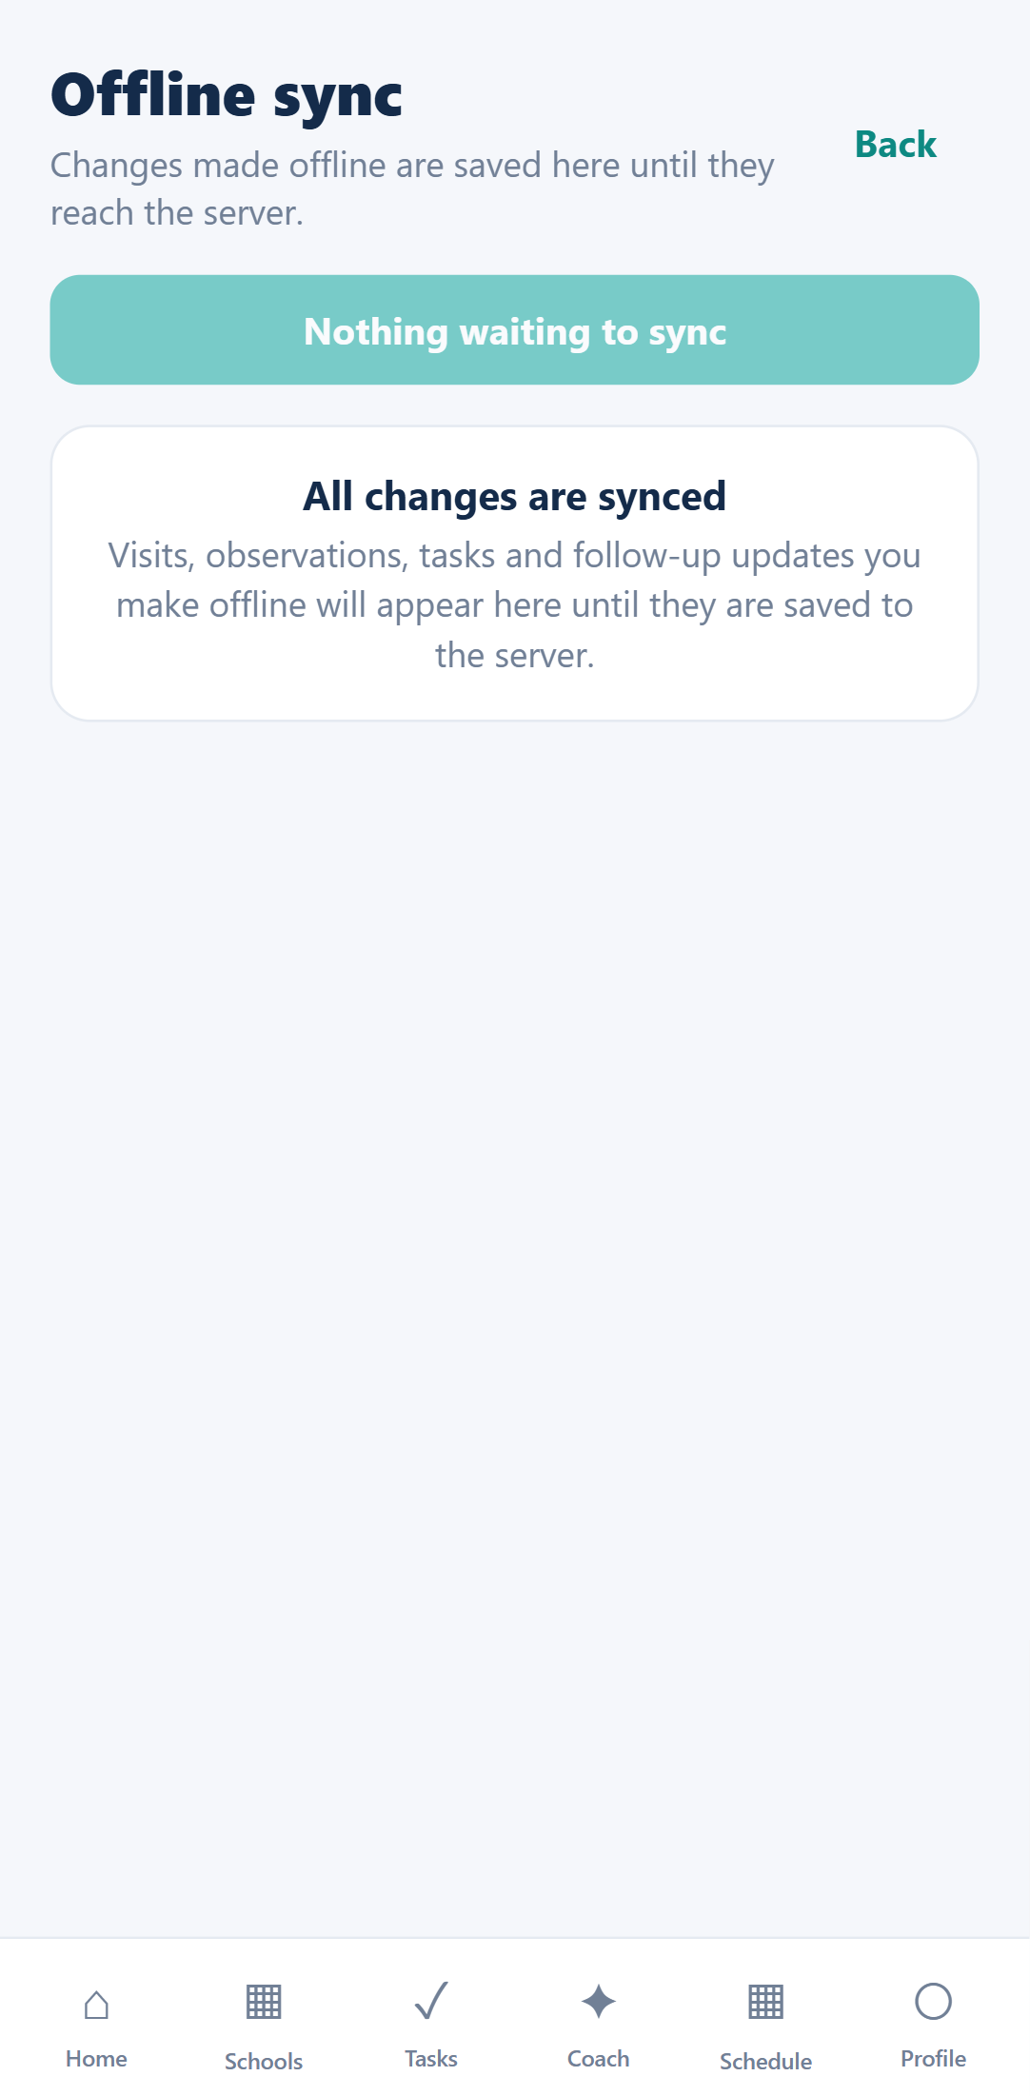
RELIABILITY
Offline-first: works in the classroom, syncs safely later
Mentor edits offline
visit status, observation,
task, teacher response
Saved on device
persisted outbox +
cached screens
Reconnect
automatic push to
/sync/push
Backend applies
same business rules &
school scope as online
Outcome per change
synced · conflict ·
failed (with reason)
▪ No silent overwrites: each change carries the version the device saw; if the server moved on, it becomes a conflict for the mentor to resolve.
▪ No duplicates: client-generated IDs and idempotency keys make re-sending safe.
▪ Partial failure is visible: one rejected change never blocks the rest; reasons are shown on the Sync screen.
▪ Pull sync: cursor-paginated changes with tombstones for deleted records.
MARG · 9/15

Slide 10
QUALITY
Testing evidence (all suites actually run)
Suite | Scope | Result
Backend | auth, school isolation, workflow, sync, AI integration, storage | 49 passed
Classroom Coach | API contract, grounding, errors (mocked LLM) | 8 passed
Mentor Intelligence | agents, approvals, adapter, gateway auth, fallback | 132 passed
Frontend (Jest) | API layer, offline outbox, login → dashboard screen | 9 passed
Browser E2E (Playwright) | 14 screens, task persistence, live Coach answer | 4 passed
Total automated |  | 202 passed
Live Claude workflow test
▪ 5 agents on demo data via backend → claude-opus-5
▪ All structured outputs valid; 5–26 s each
▪ 15,541 tokens · ≈ US$0.19 · no errors
Live Classroom Coach
▪ Grounded answer with sources ≈ 7 s
▪ Observation analysis ≈ 18 s on local GPU
▪ Off-topic question → “no relevant knowledge”
Plus 2 live Coach tests against the real model and knowledge base, and a live
refusal-fallback check (served by claude-opus-5). Run on 31 Oct 2026.
MARG · 10/15

Slide 11
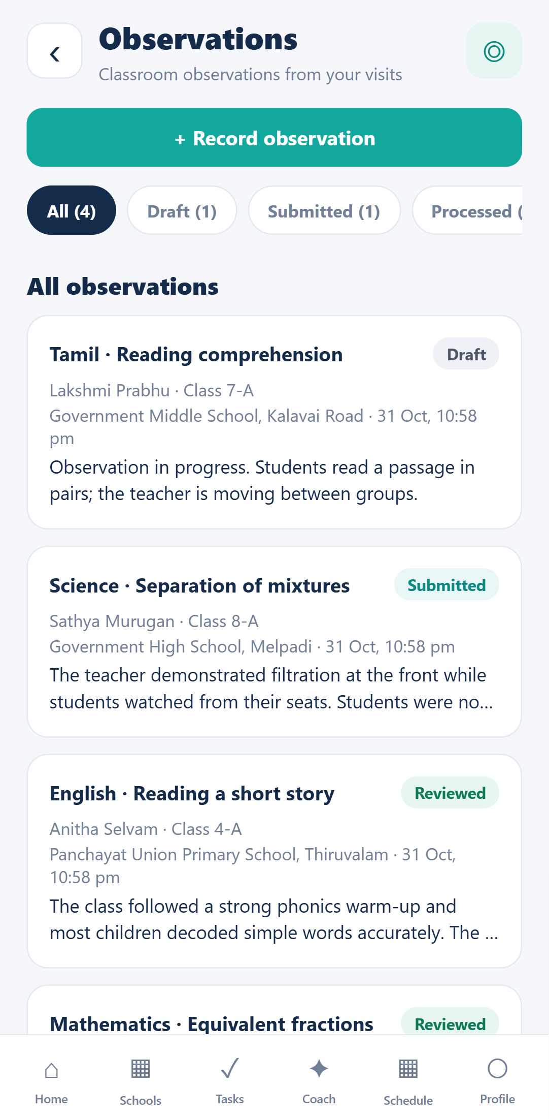
TRY IT
Demo scenarios for evaluators
1 The mentor's day
2 Observation to plan
Sign in → live dashboard → reminders → school, teachers and timetable. Only assigned schools are visible.
Analyse a Science observation with the Coach → keep suggestions → approve → create and approve an action plan.
3 Follow-up with evidence
4 Ask the Coach
Record the teacher's response, upload a photo, verify and close the follow-up.
A teaching question returns cited sources; an off-topic question is declined honestly.
5 Mentor AI + approval
Daily plan and visit planning → approve a proposed visit → it appears in Visits; a rejected one changes nothing.
Fictional demo workspace · step-by-step guide in docs/DEMO_GUIDE.md · credentials shared privately
MARG · 11/15

Slide 12
HONEST STATUS
Implemented vs. still pending
Implemented & tested
Pending / limitations
▪ Secure mentor login, school-scoped data, admin-only assignment
▪ Full workflow persisted in PostgreSQL; evidence storage (local / S3)
▪ Classroom Coach RAG + observation analysis with approval
▪ Mentor AI agents on real data; proposal approval loop
▪ Offline outbox with conflict detection; notifications; reports
▪ Deployment configuration written (Docker Compose, HTTPS, backups)
▪ Not deployed publicly; Docker images not yet built on a server
▪ No native Android/iOS device test yet (web + mobile viewport tested)
▪ WhatsApp sending via deep link only (no provider API)
▪ PDF evidence upload not in the app UI (photos only)
▪ Mentor AI: duplicate proposals across runs; AI text may show school IDs
▪ Coach on CPU: 20–60 s answers; knowledge base has duplicate PDFs, no OCR
MARG · 12/15

Slide 13
NEXT STEPS
Deployment feasibility and roadmap
Prepared: one VM (16 GB RAM) with Docker Compose + S3-compatible storage — awaiting approval, nothing purchased
Edge
Caddy · HTTPS ·
web app
Backend + worker
FastAPI
PostgreSQL
private; nightly
backups
Classroom Coach
Ollama + Chroma
volume
Mentor Intelligence
Claude API
Estimated VM cost about US$40–150/month (2026 prices vary — to be verified); object storage within free tier for the demo; Claude usage capped by token budgets.
Now → evaluation
Next
Later (planned)
▪ Server dry run & HTTPS
▪ Private repo + evaluator access
▪ Demo video
▪ Android build (EAS)
▪ PDF evidence picker
▪ De-duplicate proposals
▪ Offline browser E2E
▪ WhatsApp provider integration
▪ Push notifications
▪ Supervisor views (with approval)
▪ Knowledge base re-ingest with OCR
MARG · 13/15

Slide 14
BEYOND THE PROTOTYPE
Integration opportunities
State school information systems
Teacher communication
Import schools, teachers and timetables instead of manual setup (backend APIs are ready).
Connect an official WhatsApp Business provider to the existing queue and approval flow.
Knowledge partners
Programme dashboards
Add state curricula and local-language materials to the Coach knowledge base.
Aggregated, anonymised reports for district teams — only with consent and approval.
MARG · 14/15

Slide 15
Mentoring that leads to action.
Four integrated projects · two independent AI assistants · humans in control.
Tested end to end on a local stack; public deployment follows approval.
Docs: README · ARCHITECTURE · TESTING

