Slide 1
Student Companion
Sri Harsha Chennavajjala (7)
Teja Garidepally (12)
Raj Kiran Reddy Munnangi (32)
Suhas Sai Raparthi (51)
Team 7

Slide 2
Features
Allows the students to login and view their profile details and can update the password/personal information.
Students can view their class schedule and be informed about the tasks associated with their courses.
Application allows the users to view lab information with the details regarding the availability of the systems.
Students can also reserve a study room for a time slot using calendar view. The reservations can also be cancelled.
Student Assistants can view their shift schedule and also can take any available shifts.

Slide 3
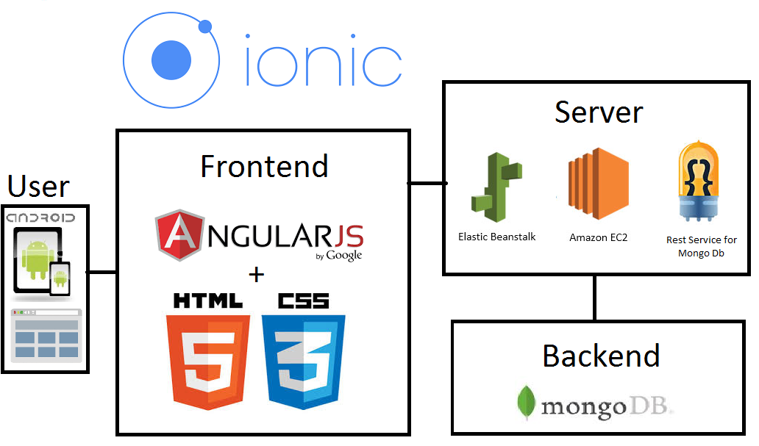
Application Building Blocks

Slide 4
Future Work
Dynamic integration of the application with the University’s Student Database.
Adding wait list feature for the already reserved/collided time-slots.

Slide 5
Thank You

