Slide 1
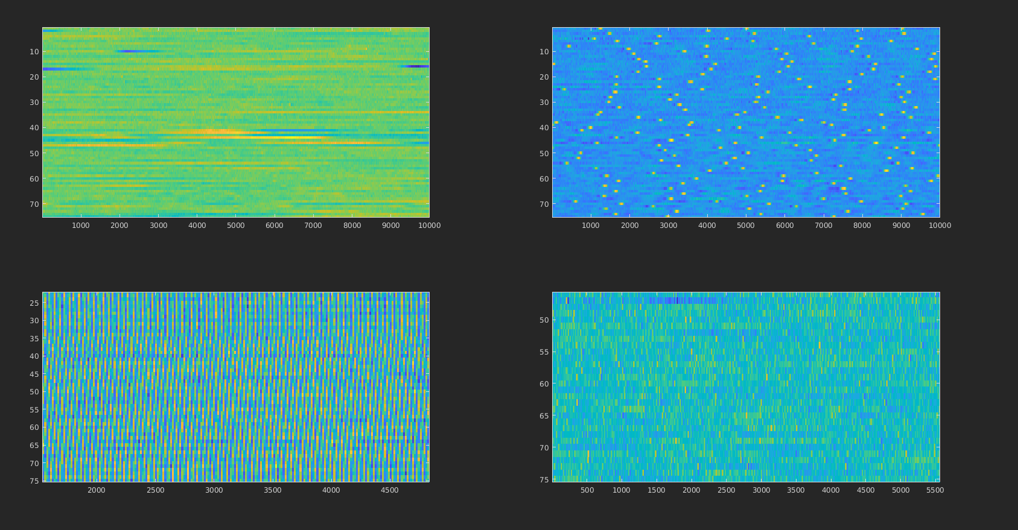
Blinks
EKG
Line Noise
Muscle

Slide 2
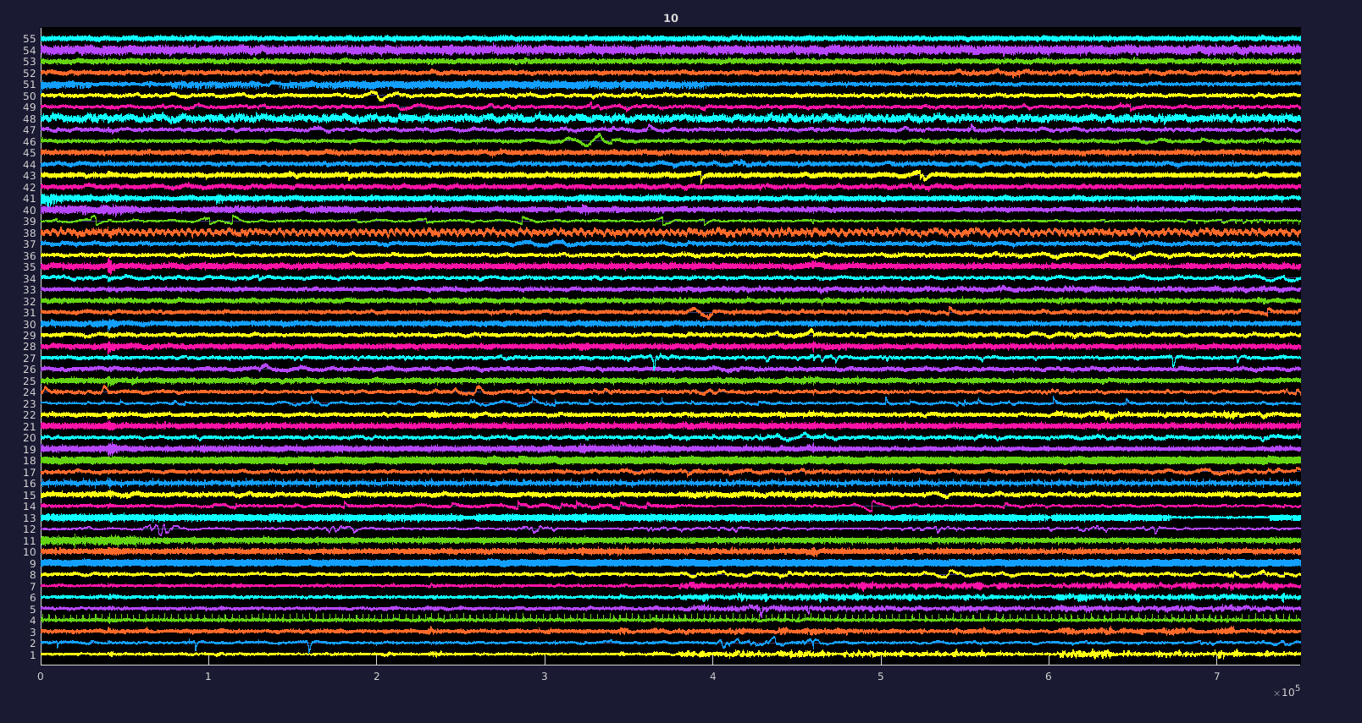
2,4,9,10,11,13,16,18,19,21,25,28,30,35,39,40,41,43,51
2 – Blinks, 4- EKG, 9 – 60 hz, 10-Muscle

Slide 3
Blink
Muscle
Saccade
Channel
EKG

