Slide 1
Relational Model
Databases Fundamentals & SQL Basics

Slide 2
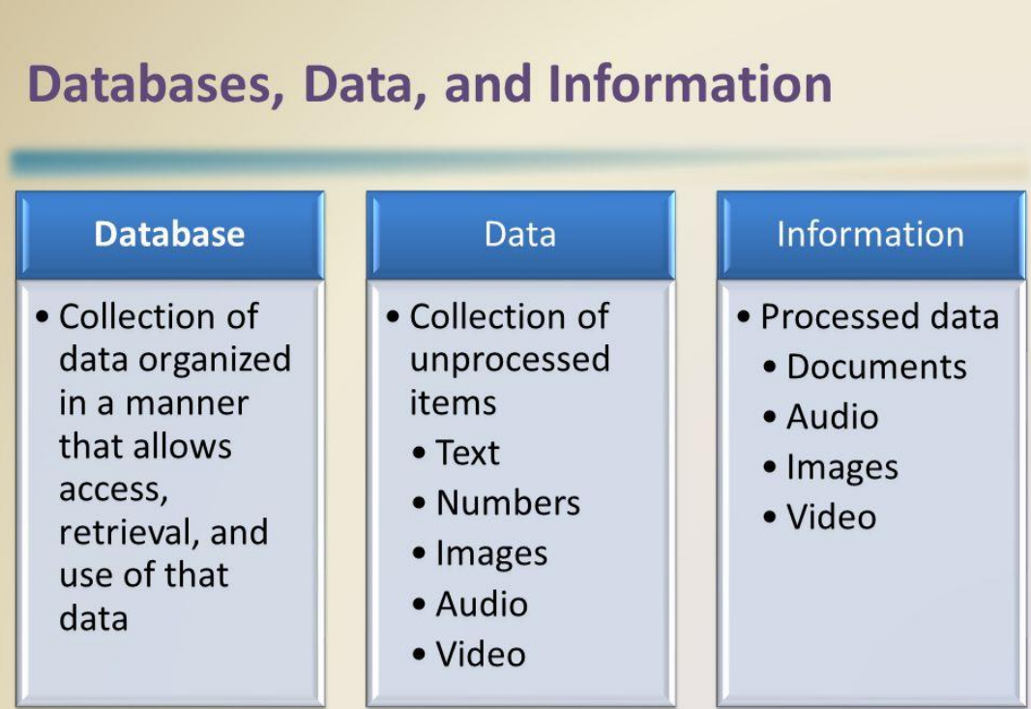

Slide 3

What is a Database?
Organized Data
2
Data Management
1
Databases provide tools and techniques for managing data, including creating, updating, deleting, and querying the stored information.
A database is a structured collection of data, organized in a way that allows for efficient storage, retrieval, and management of information.
3
Data Integrity
Databases ensure data integrity by enforcing rules and constraints, preventing data corruption and maintaining the accuracy of the information.

Slide 4
Types of Databases
Relational Databases
NoSQL Databases
Object-Oriented Databases
Organize data into tables with rows and columns, and establish relationships between them.
Eg:Oracle,MySQL,SQL Server
Provide flexible, schema-less data models, such as key-value, document-oriented, or graph-based, for handling unstructured data.
Eg:Cassandra,MongoDB
Store data as objects with their own properties and behaviors, ideal for applications that require complex data structures.
E.g.,Versant Object Database, ObjectDB, db4o, and Zope Object Database (ZODB)

Slide 5
Phases Involved in Database Design
Requirements Analysis
Data requirements
Functional Requirements
Conceptual Design
Conceptual Schema
(high-level data model)
Logical Design
Logical Schema
(low-level data model)
Physical Design
Implementation (Storage, Performance).

Slide 6
Introduction to RDBMS
A Relational Database Management System (RDBMS) is a software application that allows users to create, manage, and maintain relational databases. It provides a structured way to store, organize, and retrieve data, making it easier to manage complex information.

Slide 7

Relational Model
A database can be modeled as:
a collection of entities
relationship among entities
An entity is an object that exists and is distinguishable from other objects
Example: specific person, company, event, plant
Entities have attributes
Example: people have names and addresses
An entity set is a set of entities of the same type that share the same properties
Example: set of all persons, companies, trees, holidays

Slide 8
Database as a Collection of Entities & Relationships
Example: A university database stores entities like Students, Professors, and Courses.
Relationships:
Students enroll in Courses.
Professors teach Courses.
Courses belong to Departments.
Attributes of Entities🔹 Entities have attributes (properties describing them).Example:A Student entity may have:Student_ID (Primary Key)NameAgeEmail
Entity Example
🔹 An entity is a distinguishable object.
Example:
A specific student (John Doe, ID: 12345).
A company (Google, Amazon).
An event (Tech Conference 2025).
Entity Set Example🔹 An entity set is a group of similar entities sharing the same properties.Example:Set of all students in a university.Set of all employees in a company.Set of all books in a library.

Slide 9

Relational Data Models Basics
Data is viewed as existing in two dimensional tables known as relations
A relation (table) consists of unique attributes (columns) and tuples (rows)
Sometimes the value to be inserted into a particular cell may be unknown, or it may have no value. This is represented by a NULL
Relational Database: Any database whose logical organization is based on relational data model
RDBMS: A DBMS that manages the relational database

Slide 10

Features of RDBMS
Every piece of information is stored in the form of tables
Has primary keys for unique identification of rows
Has foreign keys to ensure data integrity
Provides SQL for data access
Uses indexes for faster data retrieval

Slide 11
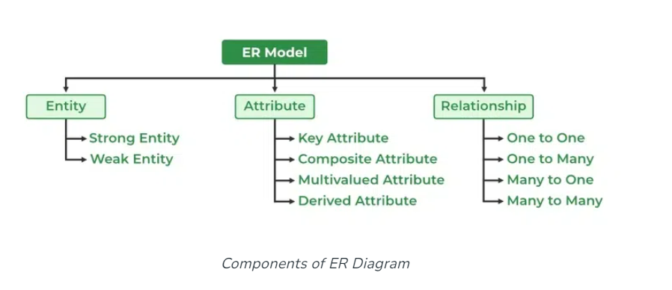
Components of ER diagram
ER Model consists of Entities, Attributes, and Relationships among Entities in a Database System.

Slide 12
Entity
An Entity may be an object with a physical existence – a particular person,
car, house, or employee – or it may be an object with a conceptual existence – a company, a job, or a
university course.
Types of Entity
1.Tangible Entity – Which can be touched like car , person etc.
2.Non – tangible Entity – Which can’t be touched like air , bank account etc.
Entity Set: An Entity is an object of Entity Type and a set of all entities is called an entity set.
Example, E1 is an entity having Entity Type Student and the set of all students is called Entity Set. In ER diagram, Entity Type is represented as:

Slide 13
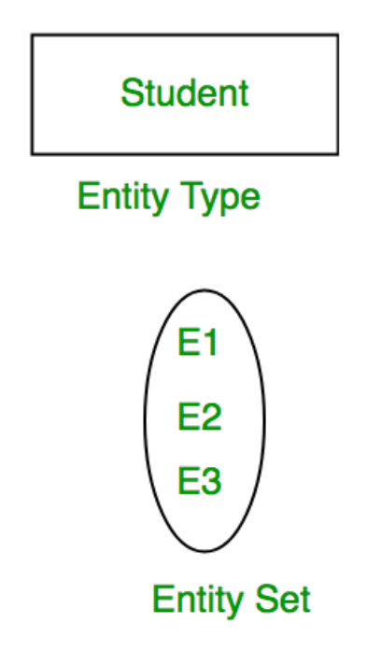

Slide 14
Strong Entity
A Strong Entity is a type of entity that has a key Attribute.
Strong Entity does not depend on other Entity in the Schema.
It has a primary key, that helps in identifying it uniquely, and it is represented by a rectangle. These are called Strong Entity Types.
2. Weak Entity
An Entity type has a key attribute that uniquely identifies each entity in the entity set.
Some entity type exists for which key attributes can’t be defined. These are called Weak Entity types.
A weak entity type is represented by a Double Rectangle.

Slide 15
Eg for Entity types:
A company may store the information of dependents (Parents, Children, Spouse) of an Employee. But the dependents can’t exist without the employee. So Dependent will be a Weak Entity Type and Employee will be Identifying Entity type for Dependent, which means it is Strong Entity Type.
Attributes
Attributes are the properties that define the entity type.
In ER diagram, the attribute is represented by an oval.
E.g., Roll_No, Name, DOB, Age, Address, and Mobile_No are the attributes that define entity type Student.

Slide 16

Types of Attributes:
Key Attribute
The attribute which uniquely identifies each entity in the entity set is called the key attribute.
Example, Roll_No will be unique for each student.
The key attribute is represented by an oval with underlying lines.

Slide 17
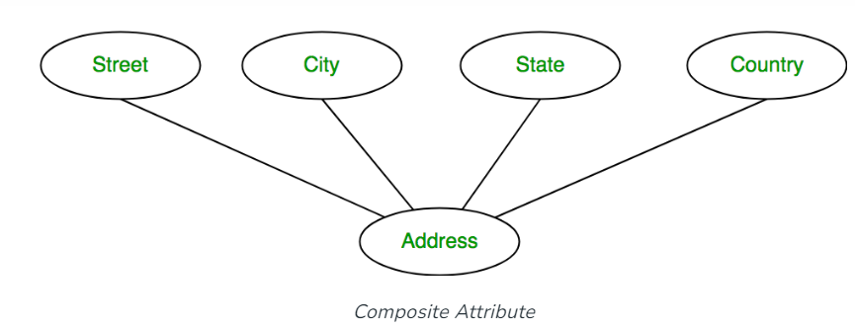
2. Composite Attribute
An attribute composed of many other attributes is called a composite attribute.
E.g.,the Address attribute of the student Entity type consists of Street, City, State, and Country. In ER diagram, the composite attribute is represented by an oval comprising of ovals.

Slide 18
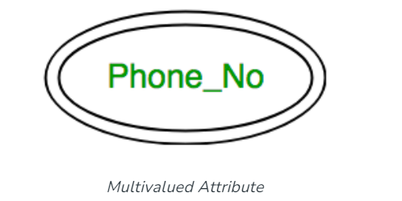
3. Multivalued Attribute
An attribute consisting of more than one value for a given entity.
For example, Phone_No (can be more than one for a given student).
In ER diagram, a multivalued attribute is represented by a double oval.

Slide 19
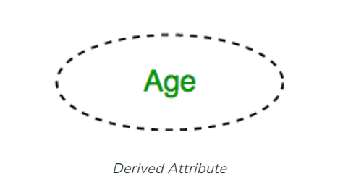
4. Derived Attribute
An attribute that can be derived from other attributes of the entity type is known as a derived attribute.
E.g.; Age (can be derived from DOB). In ER diagram, the derived attribute is represented by a dashed oval.

Slide 20
Keys in Relational Model
Candidate key
Primary Key
Foreign key
Key Attributes
Non-key Attributes
Composite primary key

Slide 21
Candidate Key
Candidate keys are identified during the design of the data base
Candidate Key/simple candidate key is an attribute, that is sufficient to distinguish every tuple in the relation from each one
Composite Candidate key is a Candidate key comprising of two or more attributes
Student Table
Student Id | Name | Email Id | Mobile No | Address
Candidate Keys

Slide 22

Key and Non-key Attributes
Key Attributes
The attributes that participate in the selection of candidate key are Key attributes
Non-Key Attributes
The attributes other than the Candidate Key attributes in a table/relation are called Non-Key attributes

Slide 23
Primary Key
One among the candidate keys is chosen by the database designer at the time of table creation. This key is called as PRIMARY KEY and is used to uniquely identify the tuples
The remaining candidate keys (other than the primary key) are called as Alternate keys
Cannot be NULL and have to be unique
Primary Key
Alternate Keys
Student Id | Name | Email Id | Mobile No | Address
Candidate Keys

Slide 24

Composite Primary Key
The Composite Primary Key - combination of more than one attribute of the relation which uniquely identifies the tuple
Student Marks Table
Student Id | Subject ID | Marks
Composite primary key

Slide 25
Foreign Key
A set of attribute (s) whose values are required to match values of a column in the same or another table
Foreign Key of a table (child table) is the primary key from another table (parent table)
Need not have to be unique and they can also be null
Establish relationships between the relational tables
Student Table(child Table)
Student Id | Name | Email Id | Mobile No | Branch Id
Branch Table(Parent Table)
Branch Id | Branch Name
Foreign Key

Slide 26
Relational Model Constraints
NOT NULL
Rules enforced on a relation is called as constraints
UNIQUE
PRIMARY KEY
Types of constraints
FOREIGN KEY
CHECK

Slide 27
How to Choose a Key?
Key
Column(s) that uniquely identify the record/tuple in a relation
Candidate Key
Has no unique subset

Slide 28
How to Choose a Key?
Candidate keys
PersonID | LastName | FirstName | DOB
PersonID (simple candidate key)
1 | Smith | Robert | 01/01/1970
LastName, FirstName (composite candidate key)
2 | Jones | Robert | 01/01/1970
4 | Smith | Henry | 01/01/1970
Primary key
5 | Jones | Henry | 01/01/1970
PersonID

Slide 29

How to Choose a Key?
Given relation:
Employee (Empno, FirstName, LastName, Email, PhoneNo)
Empno for each employee is different
Email for each employee is different
PhoneNo for each employee is different
Combination of FirstName and LastName for each employee is different
Assumptions:
Candidate key:
{Empno}, {Email}, {PhoneNo}, {FirstName, LastName}
Primary key:
{Empno}
Alternate Key:
{Email}, {PhoneNo}, {FirstName, LastName}

Slide 30
Keys: in a Nutshell
Attributes in a Relation
Non-key Attributes
Key Attributes
Candidate Key (OR composite CK)
Primary Key
Composite PK
Alternate Key

Slide 31

Integrity Rules
No Component of the Primary Key can be null
The Database must not contain any unmatched
Foreign Key values
Issues
Can the Foreign Key accept nulls?

Slide 32
Converting Relationships
The way relationships are represented depends on the cardinality and the degree of the relationship
The possible cardinalities are: 1:1, 1:M, M:M
The degrees are:
Unary
Binary
Ternary

Slide 33
UNARY 1:1 and 1:M Relationships
The entity in a 1:1 unary and 1:M unary relationship transformed into a relation with the primary key of entity will become the foreign key of the same table
1
EMPLOYEE
Spouse of
1
Employee
E# | Name | DoorNo. | Street | City | PinCode | DateOfJoining | SpouseID
N
EMPLOYEE
Manages
1
Employee
E# | Name | DoorNo. | Street | City | PinCode | DateOfJoining | ManagerID

Slide 34
UNARY M:N Relationships
The entity in a M:N unary relationship transformed into two relations one representing the entity and the other representing the M:N relationship with the primary key of the entity as the foreign key of the new relation
N
EMPLOYEE
Guarantor
M
Employee
E# | Name | DoorNo. | Street | City | PinCode | DateOfJoining
Employee Loan
E# | Name | Loan Amount. | Type of Loan | Guarantor

Slide 35
BINARY 1:1 Relationships
Every entity in a 1:1 binary relationship transformed into a relation with the primary key of partial participant will become the foreign key in the total participant
Vehicle
1
has
1
RC Book
Vehicle
Engine# | Make | Model | Year of manuf | color
RC BOOK
Regn# | Engine# | Name of the owner | Date of Regn

Slide 36
BINARY 1:M Relationships
Every entity in a 1:M binary relationship transformed into a relation with the primary key of partial participant will become the foreign key in the total participant
Customer
1
has
N
Order
Customer
Customer# | Name | EmailID
Order
OrderID | Customer# | Quantity | EDD

Slide 37
BINARY M:N Relationships
Every entity in a M:N binary relationship is transformed into a relation
Create a new relation representing the relationship containing the foreign keys from both the tables
Artist
M
sings
N
Song
Artist
Artist# | Name | EmailID | Date of Regn
Song
Song# | SongName# | Song Category
Album
Artist# | Song# | Album Name | Date of Release

Slide 38
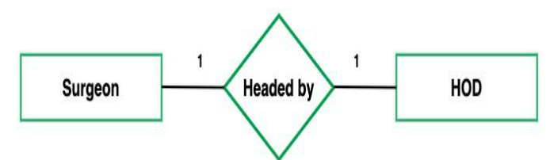
Cardinality
The number of times an entity of an entity set participates in a relationship set is known as cardinality.
Cardinality can be of different types:
1. One-to-One: When each entity in each entity set can take part only once in the relationship, the cardinality is one-to-one.
the total number of tables that can be used in this is 2.

Slide 39
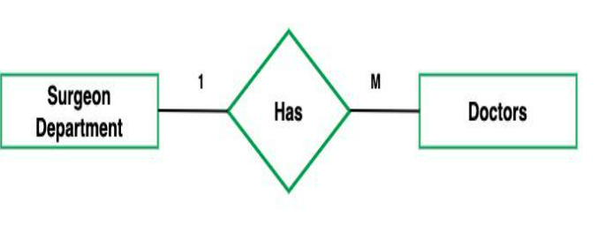
2. One-to-Many
In one-to-many mapping as well where each entity can be related to more than one entity
Total number of tables that can be used is 2.
E.g., one surgeon department can accommodate many doctors. So the Cardinality will be 1 to M. It means one department has many Doctors.

Slide 40
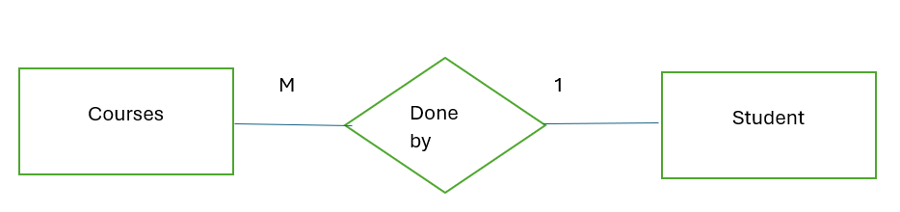
Many-to-One
When entities in one entity set can take part only once in the relationship set and entities in other entity sets can take part more than once in the relationship set, cardinality is many to one.
E.g., A student can take only one course but one course can be taken by many students. So the cardinality will be n to 1. It means that for one course there can be n students but for one student, there will be only one course.

Slide 41
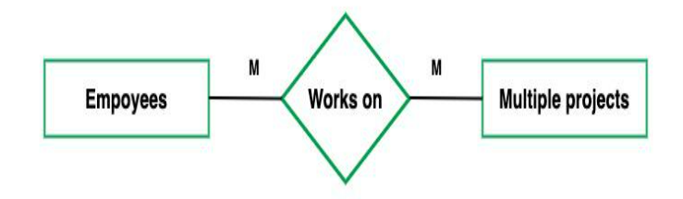
4.Many-to-Many
When entities in all entity sets can take part more than once in the relationship cardinality is many to many.
E.g.,A student can take more than one course and one course can be taken by many students. So the relationship will be many to many.

Slide 42
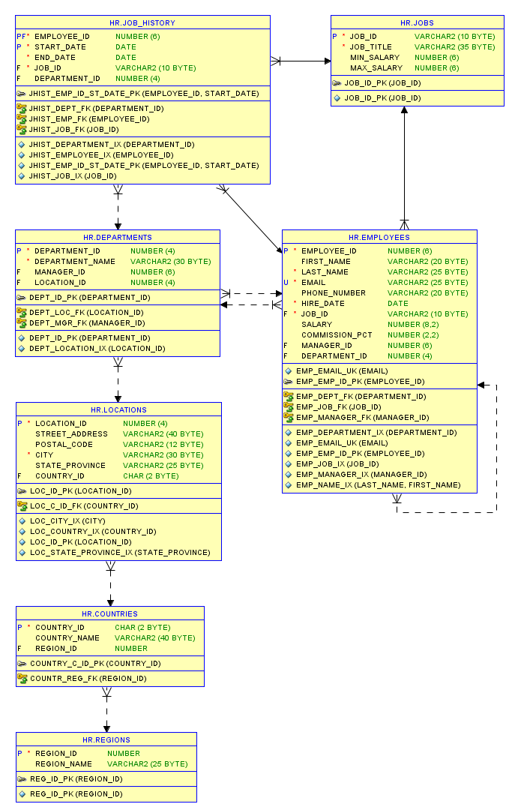

Slide 44
Quiz – How do you convert the below entity into a Relation
Customer_Name
CUSTOMER
entity with simple attributes
Customer_
ID
CUSTOMER
Customer_ Address
CUSTOMER Relation

Slide 45
CUSTOMER
Customer_ID
Customer_Name
Customer_Address

Slide 46
Quiz – How do you convert the below entity into a Relation
Street
Customer_Name
City
State
Customer_
ID
CUSTOMER
Customer_ Address
Zip

Slide 47
CUSTOMER
Customer_ID
Customer_Name
Street
City
State
Zip

Slide 48
Quiz – How do you convert the below entity into a Relation
Employee_Name
Employe_
ID
Employee_ Address
Employee
Skill

Slide 49
Multivalued attribute becomes a separate relation with foreign key
CUSTOMER
Employee_ID
Employee_Name
Employee_Address
EMPLOYEE_SKILL
Employee_ID
Skill

Slide 50
Retail Application – Case Study
A customer can register to purchase an item. The customer will provide bank account number and bank name ( the customer may have multiple account no)
After registration, each customer will have unique customer Id, user id and password
Customer can purchase one or more items in different quantities. The items can be of different classes based on their prices
Based on the quantity , price of item and discount(if any) on the purchased items, the bill will be generated. A bank account number is required to settle the bill
The application also mentions the information of suppliers who supply the items to the retail shop. The retail shop may give orders to supply the items based on some statistics they maintain about different items

Slide 51
Retail Application – Case Study
There are four strong entities in the ER Diagram of Online Retail Application
One binary 1:N relationship
Pays
Customer
One binary M:N relationship
Item
Ordered To
Bill
Supplier

Slide 52
Retail Application – Case Study
customer(customerId, customername, dateofregistration, userId, password)
bankInfo (customerId, accountNo)
Account No is multi valued Attribute
customerId is the Primary key of the customer relation
(customerId,accountNo) is the primary key of bankInfo relation
customerId of bankInfo relation is foreign key and refers to customerId attribute of customer relation

Slide 53
Retail Application – Case Study
supplier(supplierid, suppliername,suppliercontactno)
itemordered(itemid,supplierid,qtyordered,deliverystatus,orderdate,deliverydate)
supplierId is Primary key of supplier Relation
OrderedTo
relationship is M:N so new relation is required
(itemId,supplierid) is composite primary key of itemordered relation
itemid of itemordered relation is foreign key to Item relation
supplierid of itemordered relation is foreign key to supplier relation

Slide 54
ER Model
The Entity Relational Model is a model for identifying entities to be represented in the database and representation of how those entities are related.
The ER data model specifies enterprise schema that represents the overall logical structure of a database graphically.
The Entity Relationship Diagram explains the relationship among the entities present in the database.
ER Diagram is the structural format of the database.
They are used to model real-world objects like a person, a car, or a company and the relation between these real-world objects

Slide 55

Why Use ER Diagrams In DBMS?
ER diagrams are used to represent the E-R model in a database, which makes them easy to convert into relations (tables).
ER diagrams provide the purpose of real-world modeling of objects which makes them intently useful.
ER diagrams require no technical knowledge and no hardware support.
These diagrams are very easy to understand and easy to create even for a naive user.
It gives a standard solution for visualizing the data logically.

Slide 56
Thank You

