Slide 1
HASHSET

Slide 2
HashSet in java
Insert /Ass –O(1)
Search /contains -O(1)
Delete/Remove –O(1)
-> In hashset timecomplexity is less compare to array…
But in array
Insert-O(1)
Search-O(n)
Delete-O(n)

Slide 3
HashSet :order is not fixed (Unorder, and no duplicates allowed)
Imports:
import java.util.HashSet
Import java.util.Iterator
//creating
HashSet<Integer> set=new HashSet<>();
//Inserting
set.add(1);
Set.add(10);
Set.add(5);

Slide 4
//Delete
Set.remove(10);
//search ->we use keyword contains
Set.contains(5);
//Size
Set.size();
//print all elements
System.out.println(set);

Slide 5
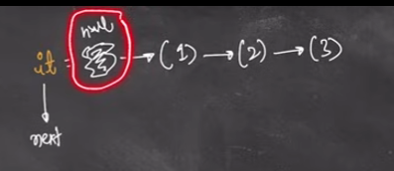
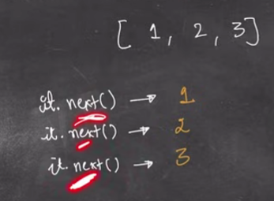
//Iterator
Iterator<Integer> it=set.iterator();
Iterator is a interface
->next();
Returns the elements
At first it has null so for print we use next();

Slide 6
->hashNext()
It.hashNext() ->will return true or false
That means if next value is ther return true…else return false
By using next() & hasNext() functions we can iterate the set..
Synatx:
Iterator<Integer> it=set.iterator();
while(it.hasNext()){
System.out.print(it.next()+" ");
}

Slide 7
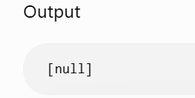
NOTE:
Allows one null only..
set.add(null);
set.add(null);
System.out.println(set);
//isEmpty()
Set.isEmpty() ->return true or flase
//clear() -→Removes everything
Set.clear();

Slide 8
HashSet<Integer> set = new HashSet<>();
boolean duplicate = false;
for(int num : arr){
if(set.contains(num)){
duplicate = true;
break;
}
set.add(num);
}
System.out.println(duplicate);

Slide 9
Q. Do these two arrays have at least one common element?
HashSet<Integer> set = new HashSet<>();
for(int num : a){
set.add(num);
}
boolean found = false;
for(int num : b){
if(set.contains(num)){
found = true;
break;
}
}
System.out.println(found);

Slide 10
HASHMAP

Slide 11
Hashmap :stores key and values
Unordered map..
Key must be unique
Values may or may not be unique
//imports
import java.util.HashMap
//create
//country (key) ,population (value)
HashMap<String ,Integer> map=new HashMap<>();

Slide 12
//Insertion
map.put(“India”,120);
map.put(“India”,120);
map.put(“china,150);
//print
System.out.println(map);
//re-insert the exsisting one
map.put(“china”,180);

Slide 13
//Insert in HashMap
map.put() :has 2 cases
1.Key exist
->update value
2.Key doesnot exist
->New pair inserted
//remove
map.remove("China");

Slide 14
//Search
if(map.containsKey(“china”)){
System.out.println(“Key is present in the map”);
}
else{
System.out.println(“Key is not present in the map”);
}
//.conatinsKey()
returns true or false

Slide 15
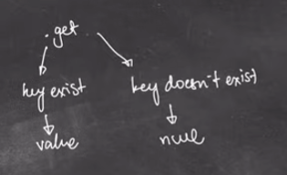
//getFunction(); -> returns the value of the key
System.out.println(map.get(“China”));
System.out.println(map.get(“Indonesia”));
//Iteration
for(Map.Entry<String,Integer> e : map.entrySet()){
System.out.println(e.getKey());
System.out.println(e.getValue());
}
Note:
In entry.Set() -> It have key and values

Slide 16
//Iteration (or) to print all keys and corresponding values::
Set<String> keys=map.keyset();
For(String key:keys){
System.out.println(key+” “+map.get(key));
}

