Slide 1
AURORA
Autonomous Understanding & Research Orchestrator for Advanced Science
Autonomous Agentic AI Research Assistant for Emerging Scientific Domains
Submitted By:
Nithyashree CP
Computer Science & Engineering (AI&ML)
Department of CSE(AI&ML), MCE, Hassan

Slide 2
Agenda
Background & Motivation
Problem Statement
Objectives
Core Design of the System
System Architecture
Agent Responsibilities
Memory System
Technology Stack
Implementation & Deployment
Conclusion and Future Scope
References

Slide 3

Background & Motivation
Manual literature review is time-consuming and repetitive
Existing AI tools lack persistence and verification mechanisms
Researchers often repeat similar analysis across sessions
These limitations motivate the need for an autonomous, memory-enabled research system.

Slide 4

Problem Statement
“Research in emerging scientific domains is increasingly complex due to rapidly growing and fragmented literature, requiring significant manual effort for analysis and validation. Existing AI tools are largely reactive and lack autonomous planning, verification, and long-term memory, limiting their effectiveness for sustained research”.

Slide 5

Objectives
Autonomously plans and executes research tasks
Retrieves verified academic knowledge from trusted sources
Performs structured analysis and validation
Retains high-quality research insights for future reuse

Slide 6

Core Design of the System
AURORA follows a multi-agent design, where:
Each agent has a clearly defined role
Agents operate sequentially with explicit state passing
Reasoning, verification, and memory are separated
Execution is deterministic and explainable
This design improves modularity, reliability, and extensibility.

Slide 7
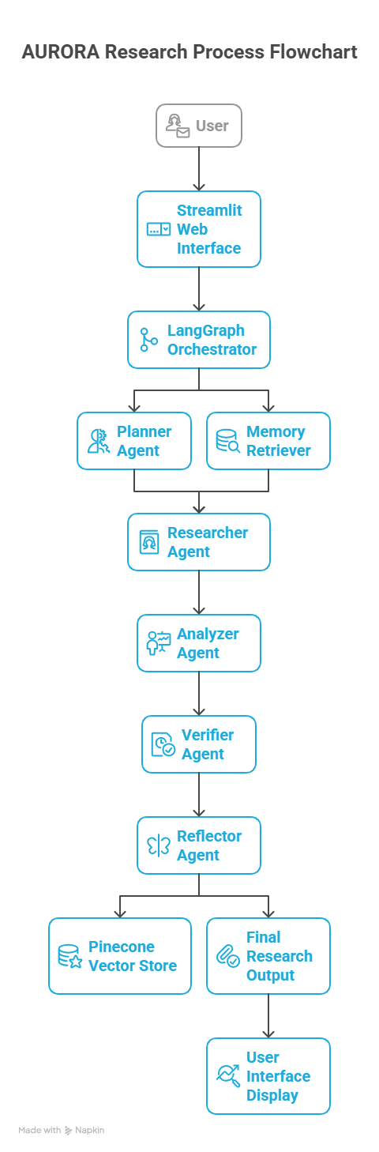
System Architecture
The system follows a linear agent pipeline:
Planner → Researcher → Analyzer → Verifier → Reflector
Orchestrated using LangGraph
External academic data retrieved from arXiv
Long-term memory implemented using a vector database
This architecture ensures controlled and transparent execution.

Slide 8
Agent Responsibilities
Planner Agent
Interprets the research topic
Determines analysis depth and research strategy
Researcher Agent
Retrieves relevant academic papers from arXiv
Extracts titles, abstracts, and direct paper links

Slide 9
Agent Responsibilities
Analyzer Agent
Synthesizes information from multiple research papers
Performs comparative and thematic analysis
Verifier Agent
Validates factual correctness of the analysis
Removes hallucinated or irrelevant content
Reflector Agent
Refines the verified analysis
Prepares structured final output

Slide 10
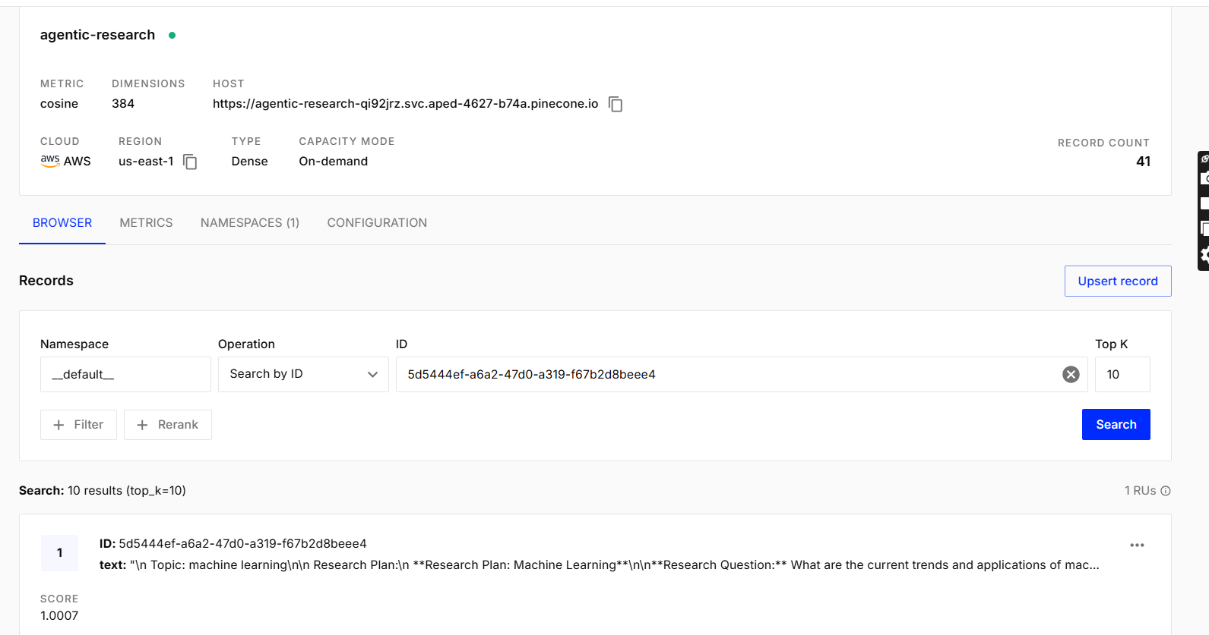
Memory System
Uses Pinecone vector database
SentenceTransformers generate semantic embeddings
Stores only verified research insights
This enables long-term learning and reuse of knowledge.
Department of CSE(AI&ML), MCE, Hassan

Slide 11
Technology Stack
Frontend: Streamlit
Agent Orchestration: LangGraph
Language Model: LLaMA-3.1-8B (via Groq API)
Knowledge Source: arXiv API
Vector Database: Pinecone
Embeddings: SentenceTransformers
Department of CSE(AI&ML), MCE, Hassan

Slide 12
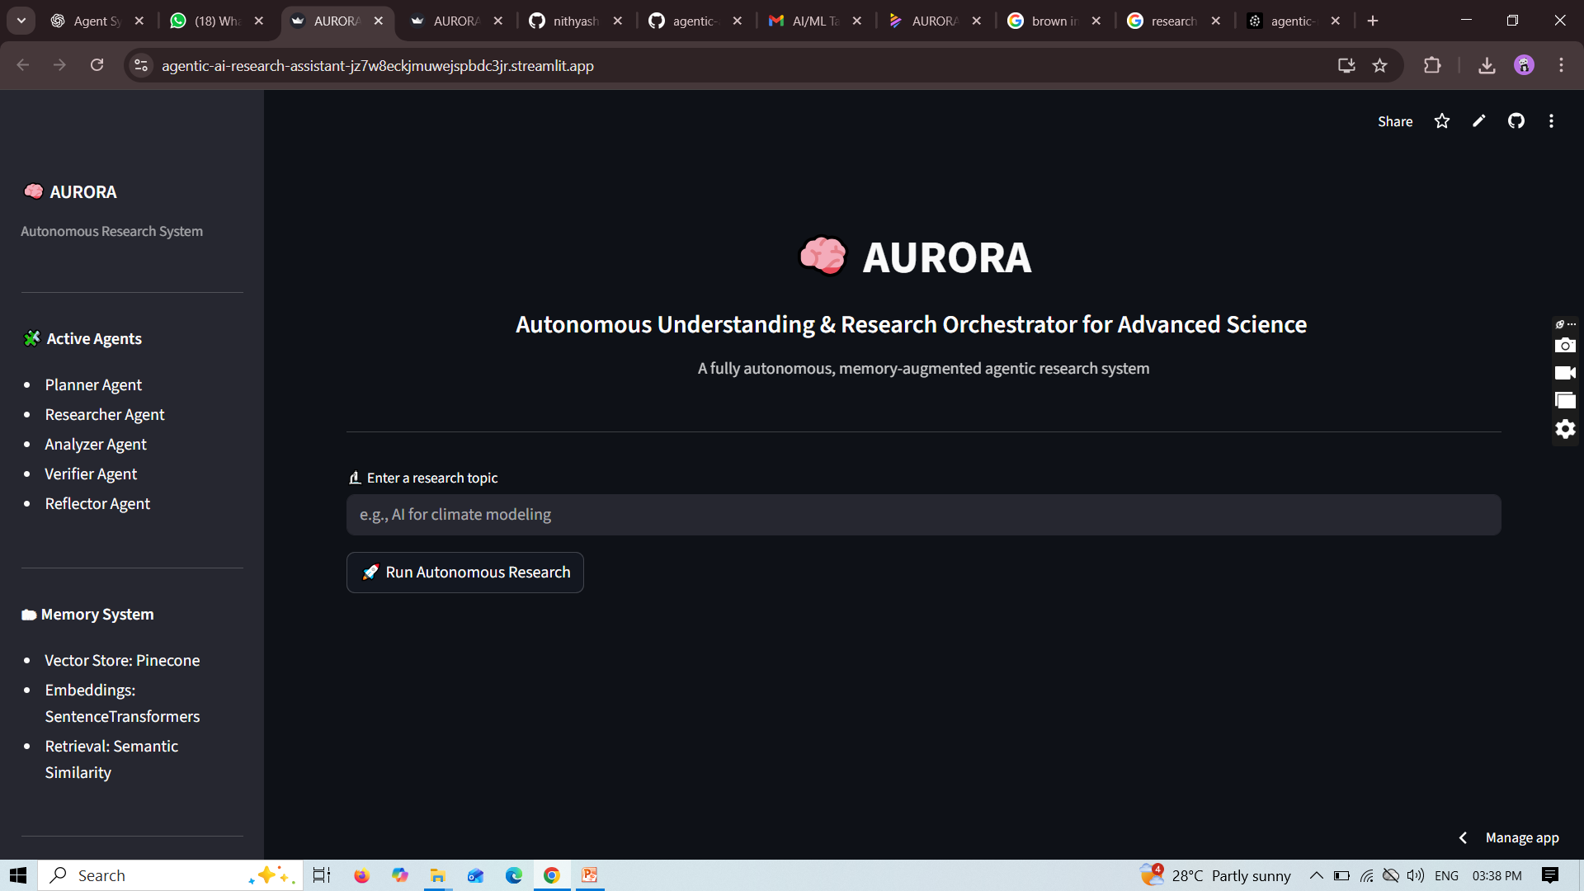
Implementation & Deployment
Implemented in Python with modular agent structure
Agent orchestration handled using LangGraph
Deployed using Git-based CI on Streamlit Cloud
Environment variables used for secure API management
The system provides a live, interactive research interface.
https://agentic-ai-research-assistant-jz7w8eckjmuwejspbdc3jr.streamlit.app/
Department of CSE(AI&ML), MCE, Hassan

Slide 13
Conclusion & Future Scope
Conclusion: The system enables autonomous, reliable research by combining multi-agent reasoning, verification, and long-term memory.
Future Scope: The system can be extended with domain-specific analysis, iterative verification, and detailed citation-based research reports
Department of CSE(AI&ML), MCE, Hassan

Slide 14
References
Castrillo, V. L. Fundamentals of Building Autonomous LLM Agents, arXiv Preprint (2025) https://doi.org/10.48550/arXiv.2510.09244
LangGraph Documentationhttps://langchain-ai.github.io/langgraph/arXiv
API Documentationhttps://arxiv.org/help/api
Touvron, H., Martin, L., Stone, K., et al. (2023).LLaMA: Open and Efficient Foundation Language Models. https://doi.org/10.48550/arXiv.2302.13971

