Slide 1
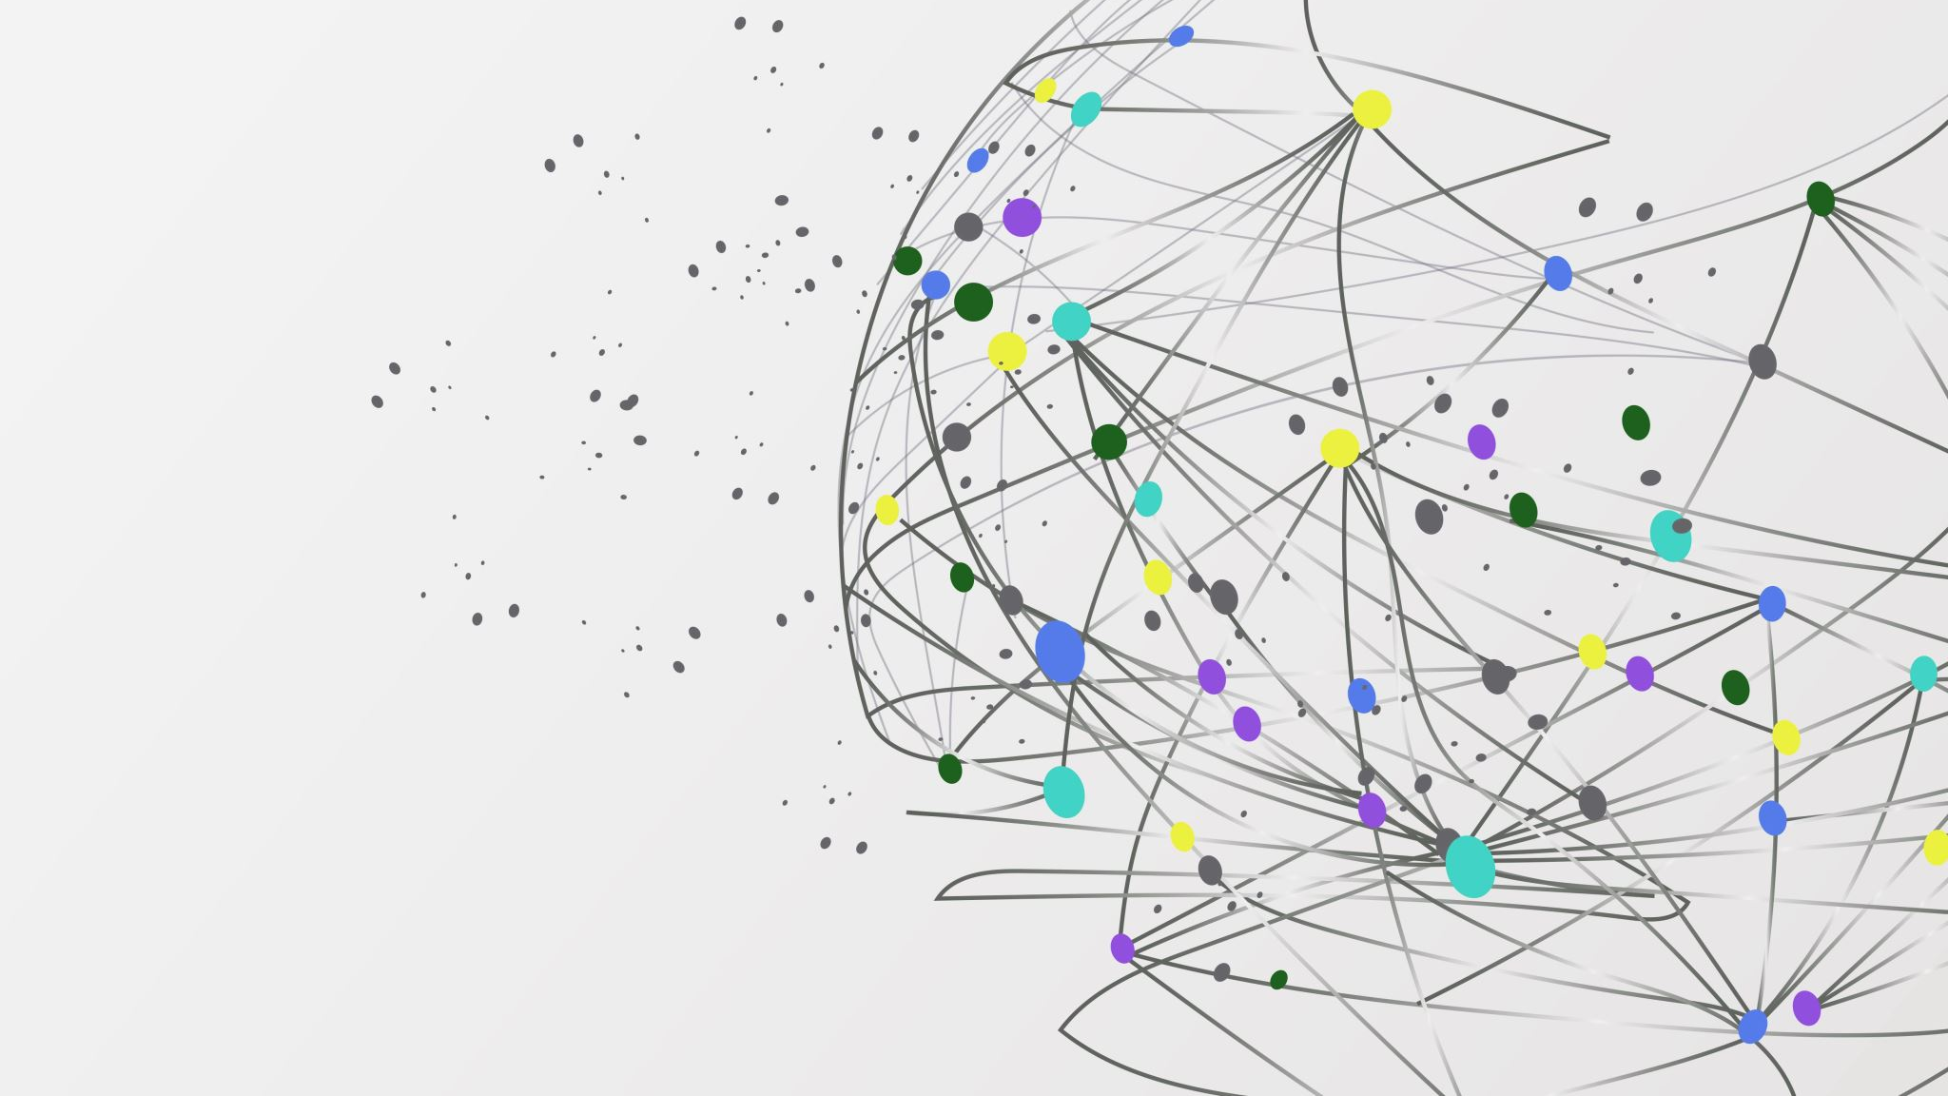
SERVICEBUS

Slide 2
WHAT IS AZURE SERVICE BUS?
Azure Service Bus is a fully managed enterprise message broker with message queues and publish-subscribe topics (in a namespace). Service Bus is used to decouple applications and services from each other, providing the following benefits:
Load-balancing work across competing workers
Safely routing and transferring data and control across service and application boundaries
Coordinating transactional work that requires a high-degree of reliability

Slide 3
WHY USE SERVICE BUS?
As Azure Service Bus is fully managed service, scaling and availability will be taken care by Azure team.
It is integrated with other Azure services like, Event Grid, Logic Apps, Stream Analytics etc
Shared Access Signatures (SAS), Role Based Access Control (RBAC) and Managed Service Identity (MSI) protocols are supported by it. Service Bus also supports client libraries for.Net,java,jms.

Slide 4
Service Bus Services
1)QUEUES
2)TOPICS
3)RELAYS

Slide 5
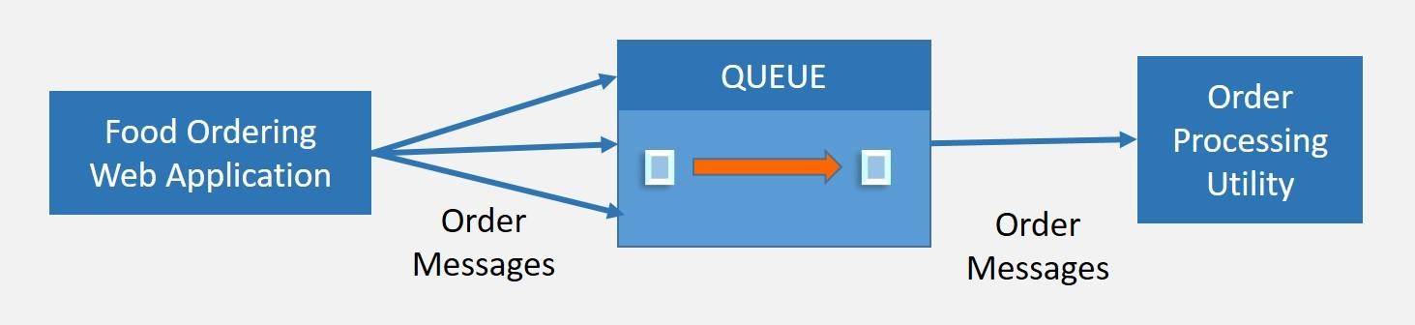
EXAMPLES FOR SERVICES
QUEUES:

Slide 6
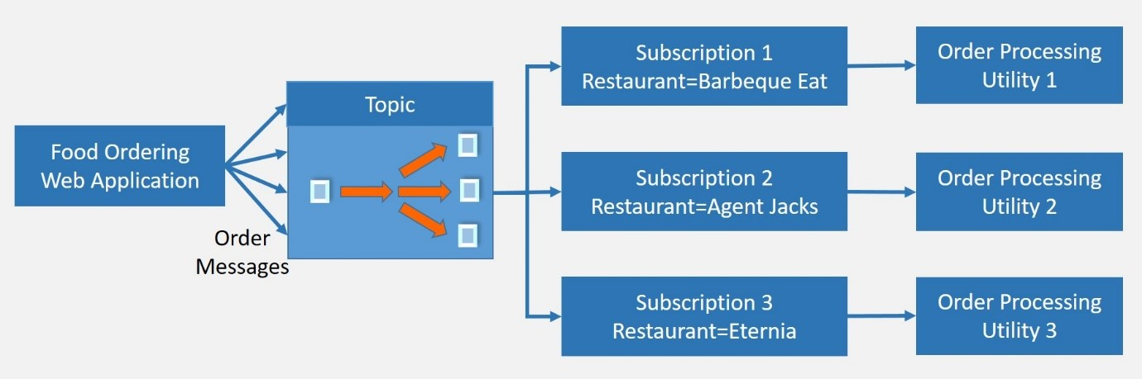
TOPICS:

Slide 7
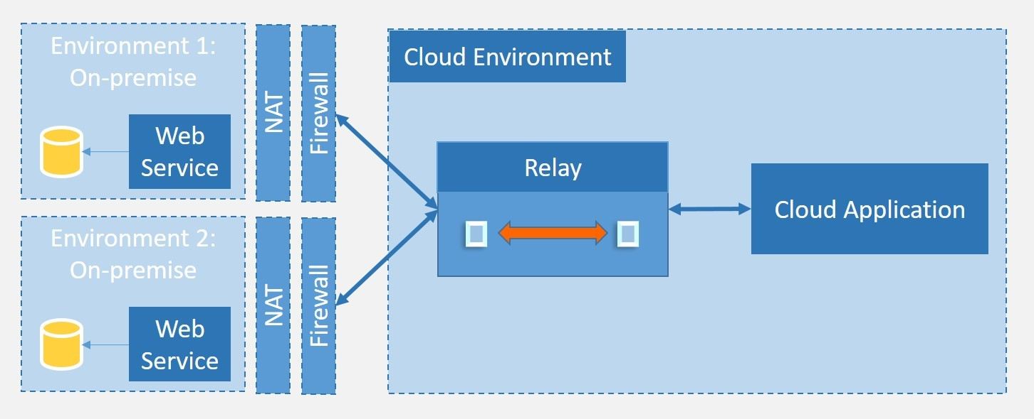
RELAYS:

Slide 8
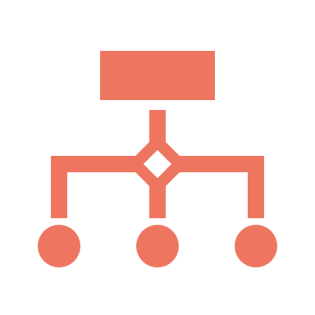
Service Bus Tiers with Features:
STANDARD TIER:
It can be used for initial development and QA environment deployments.
Latency and throughput in Standard tier are variable, hence performance is not predictable. In built scaling is also not available and maximum message size is upto 256 kb.
PREMIUM TIER:
It can be used for Production deployments. It provides high throughput and auto scaling for variable workloads.
Maximum message size can be up to 1mb. Premium name spaces provides CPU and memory level isolation for resources. Performance of Premium tier resources at peak load is much faster than Standard ones.

Slide 9
ADVANCED FEATURES:
MESSAGE SESSIONS:
DEAD-LETTERING:
SCHEDULED DELIVERY:
TRANSACTIONS
FILTERING AND ACTIONS:

Slide 10

CONCLUSION:
Message queues and publish-subscribe topics are features of the fully managed enterprise message broker Azure Service Bus (in a namespace).
The following advantages are available when using Service Bus to decouple applications and services from one another:
Distributing tasks among rival employees.
Exchanging data and control across service and application boundaries in a secure manner.
Coordinating transactional work that requires a high degree of reliability.

Slide 11
THANK YOU

