Slide 1
Predictive Modeling of Heart Disease Risk Assessment Group No.:09

Slide 2
Team Member
Jayan Francis
Elias Mani
Gayathri Manju Jayasena Kurup
Nitiben Patel
Mohana Krishna Sajja

Slide 3

Abstract
Heart disease poses a significant health burden globally, particularly in the United States, where it ranks as the leading cause of mortality. This project aims to leverage the Behavioral Risk Factor Surveillance System (BRFSS) 2015 dataset to explore the feasibility of using survey responses for predicting heart disease risk. With 253,680 cleaned survey responses, including 23,893 individuals with heart disease, the study seeks to assess the predictive power of BRFSS data and its potential utility for preventative health screening.

Slide 4

Introduction
Heart disease remains a pervasive health concern, emphasizing the importance of effective prevention and early detection strategies. Leveraging large-scale health surveys such as the BRFSS offers a valuable opportunity to analyze various risk factors associated with heart disease and develop predictive models for risk assessment.

Slide 5

Related Work
Prior research has highlighted the significance of risk factors such as high blood pressure, high cholesterol, and smoking in predicting heart disease. By examining existing literature and datasets, we aim to contextualize our study within the broader landscape of heart disease risk assessment and prevention.

Slide 6

Methods
We utilized the BRFSS 2015 dataset, comprising responses from over 250,000 individuals, to conduct predictive modeling for heart disease risk assessment. Exploratory data analysis, feature selection, and model development were performed to evaluate the predictive power of survey responses in identifying individuals at risk of heart disease.

Slide 7


Methodology

Slide 8
Dataset Description
The CDC gathers information about health-related telephone surveys called the Behavioral Risk Factor Surveillance System (BRFSS) once a year. Over 400,000 Americans participate in the annual survey, which gathers information on health-related risk behaviors, chronic illnesses, and the use of preventative services. This dataset, which is mainly intended for use in the binary categorization of heart disease, includes 253,680 survey responses from the cleaned BRFSS 2015. This dataset does not exhibit a significant class imbalance.

Slide 9

Exploratory data analysis(EDA)
it is a vital stage in deciphering the dataset's properties and spotting trends or connections between different variables. EDA was used in this work to investigate correlations between predictor variables and the target variable (heart disease status), as well as to look at the distribution of the variables, identify outliers, and evaluate missing values.

Slide 10
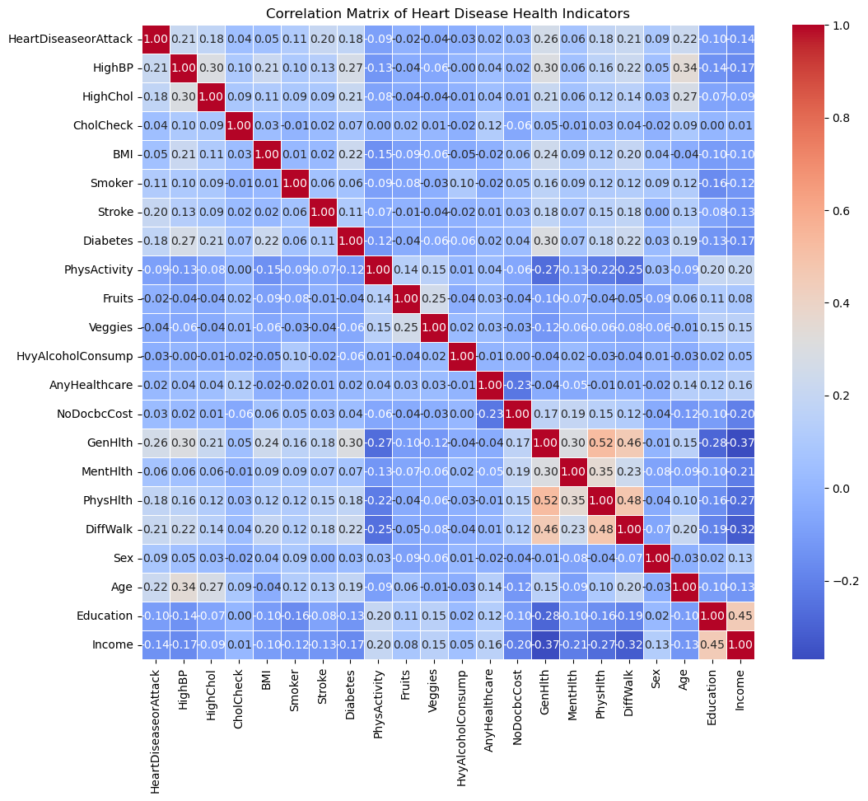
Correlations Matrix
This visualization provides insights into the relationships between different variables in the dataset, helping to identify patterns, correlations, and potential predictive features related to heart disease health indicators.

Slide 11
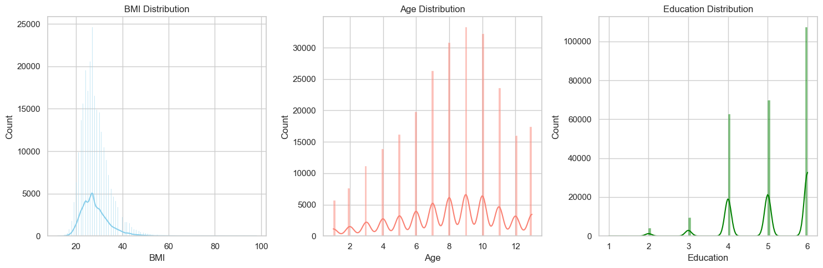
The distribution of the BMI, age, and education variables in the dataset may be quickly examined thanks to this visualization. While KDEs offer a smoothed estimate of the probability density function, histograms give a visual depiction of each variable's frequency distribution.
Distributions of BMI, Age, and Education

Slide 12
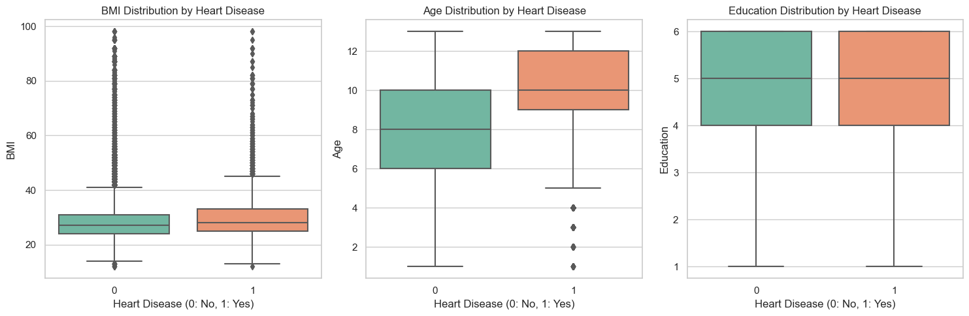
Box plots comparing variables by Heart Disease The distribution of BMI, age, and education between those with and without heart disease is shown visually in these box plots. They make it simple to spot variations or trends in these variables between the two groups, which helps to clarify any possible links between these variables and the risk of heart disease.

Slide 13
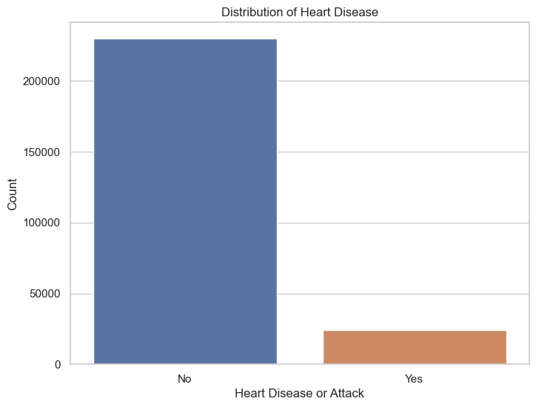
Distribution of Heart Disease
The frequency of people classified as having heart disease or not is displayed visually in this count plot, which represents the distribution of the target variable "HeartDiseaseorAttack." It offers insights on the prevalence of cardiac disease in the population being studied and aids in understanding the balance or imbalance of classes in the dataset.

Slide 14
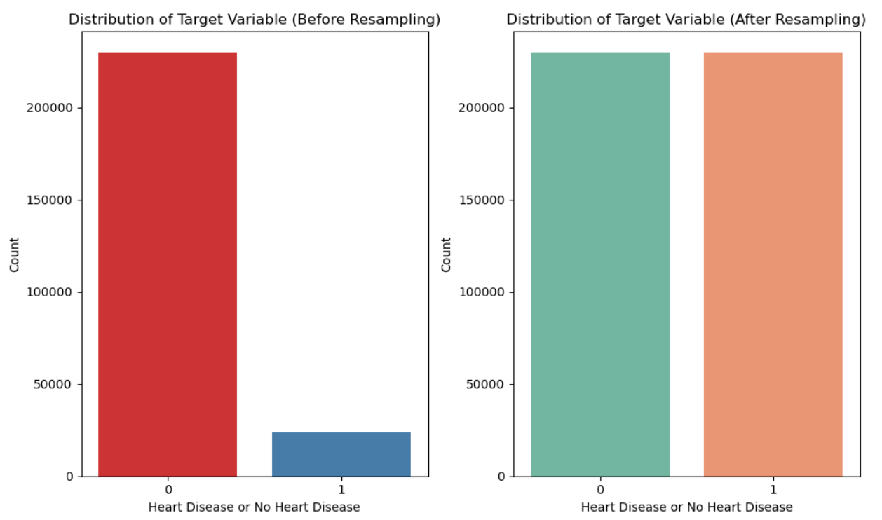
Controlling Class Imbalance with RandomUnderSampler and SMOTE: SMOTE (Synthetic Minority Over-sampling Technique) is used to address class imbalance, while RandomUnderSampler is used to address undersampling. Two count plots are created side by side to visualize the distribution of the target variable before and after resampling.

Slide 15
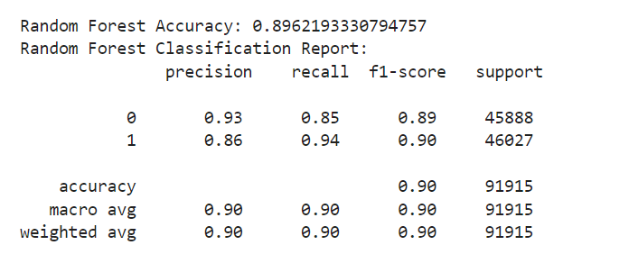
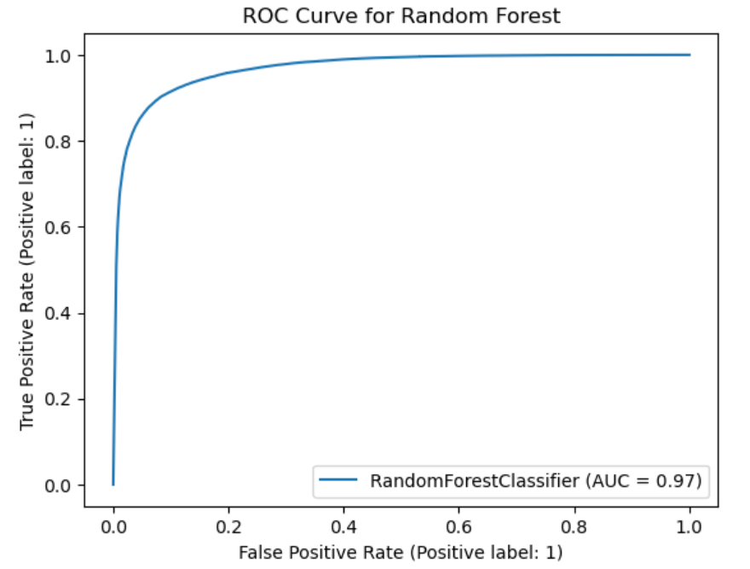
Model Development
Predictive models are created based on survey results to evaluate the risk of heart disease when pertinent features have been chosen. For binary classification applications such as heart disease prediction, the following methods are frequently utilized:
Preparing the data (normalization, encoding categorical variables, etc.), training the model, optimizing its hyperparameters, and evaluating the model using performance metrics (recall, accuracy, precision, and area under the receiver operating characteristic curve, or AUC-ROC) are normally steps in the model development process.

Slide 16
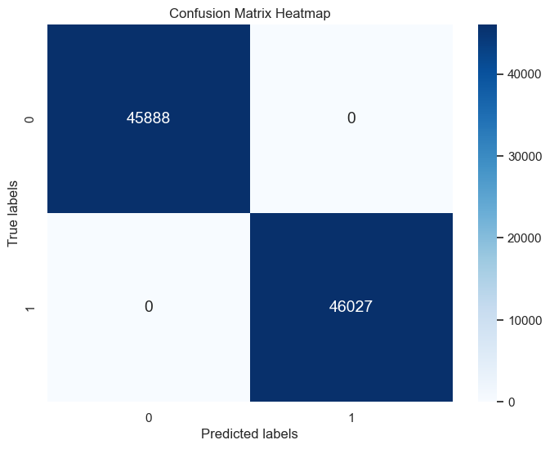
Confusion Matrix:
Making a Heatmap for the Confusion Matrix: Using sns.heatmap(), a heatmap of the confusion matrix is created to show the classifier's performance.

Slide 17
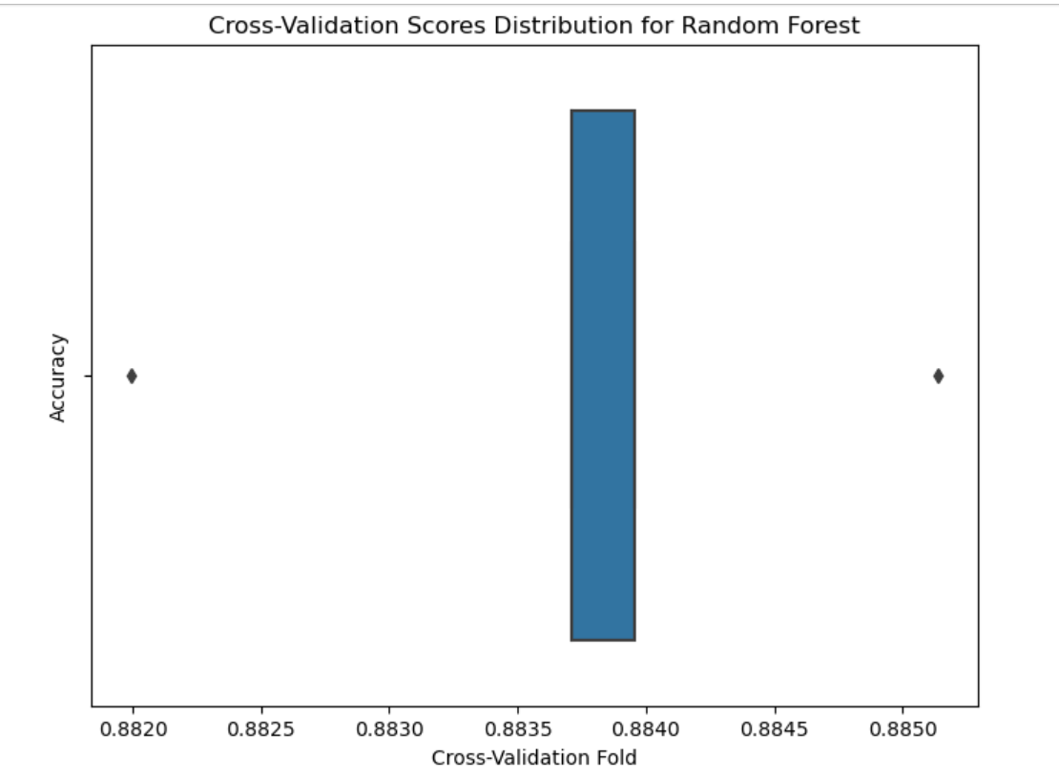
Robustness of the Model using Cross-Validation The Random Forest model's cross-validation scores are computed using cross_val_score() with five folds. To see the distribution of cross-validation scores, a boxplot is created. To evaluate the robustness of the model, cross-validation scores and the mean cross-validation score are printed.
Random Forest Cross-Validation Scores: [0.88371049 0.88199695 0.88395528 0.88513844 0.88370891]
Mean CV Score for Random Forest: 0.8837020173772286

Slide 18

Results
Preliminary analysis revealed a class imbalance in the dataset, with a majority of respondents not having/having had heart disease.
Through feature engineering and model training, we aim to address this imbalance and develop robust predictive models capable of accurately assessing heart disease risk based on BRFSS survey responses.

Slide 19
Discussion
The exploration of BRFSS data for heart disease risk prediction presents both opportunities and challenges. While the dataset offers a rich source of information, addressing class imbalance and selecting relevant features pose significant challenges.
Further refinement of predictive models and validation through rigorous testing are necessary to ensure the reliability and generalizability of findings.

Slide 20

Conclusion
The findings of this study will contribute to advancing our understanding of heart disease risk assessment using survey data. By developing predictive models based on BRFSS responses, we aim to provide valuable insights into the potential utility of health surveys for preventative health screening and early detection of heart disease.

Slide 21
References
CDC - 2015 BRFSS Survey Data and Documentation. (2019, February 9). Www.cdc.gov. https://www.cdc.gov/brfss/annual_data/annual_2015.html
Diabetes Health Indicators Dataset. www.kaggle.com.
https://www.kaggle.com/datasets/alexteboul/diabetes-health-indicators-dataset

Slide 22

THANK YOU

