Slide 1


Prototype Submission Phase

Slide 2
MEMBER DETAILS
TEAM NAME
TEAM MACHINE
VEMULA SHIVANI DASARI NITISH
THEME:
The Blue Sky Challenge
Sub-Theme:- Blue Sky Below

Slide 3
INDEX
TOPIC NAME | SLIDE
Introduction | 4
Problem Statement | 5
Purpose | 6
Methodology | 7
Dataset Attribute Information | 8
Visualisation of dataset | 9
Prototype and Attachments | 10 and 11

Slide 4
INTRODUCTION
Air quality has a significant impact on the overall well-being of humans and society across the globe. The rewards of good air quality are numerous, including substantial health, environmental, and economic benefits. As many number of factors in the air can have an impact on its quality. The role of temperature and carbon monoxide in air quality is vital.

Slide 5
PROBLEM STATEMENT
A number of factors in the air can have an impact on its quality. Multiple sensors monitoring various parameters are used in air quality monitoring sensing systems, which are available as a whole suite. The role of temperature and carbon monoxide in air quality is vital. The following issue that may be addressed via this hackathon in order to make such systems smarter:

Slide 6
PURPOSE
The main aim of the blue sky challenge is to raise public awareness at all the levels like individual, community etc…that clean air is important for our health, environment.
As many number of factors in the air can have their impact on its quality. In order to provide awareness we are here with the Machine Learning Model.
The tools/libraries used are NumPy, pandas, matplotlib, seaborn and scikit-learn.
We trained model using Linear Regression.
Easy Implementation and it can run on multiple platforms. Easy monitoring and controlling the dataset.

Slide 7
METHODOLOGY
INSTALLATION:-
This project requires Python 3.6 and the following libraries:
Seaborn
Scikit-learn
Matplotlib
NumPy
Pandas
You also need to install software to run and execute a Jupyter Notebook

Slide 8
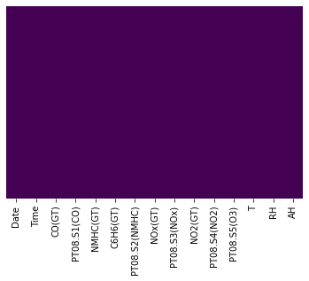
ATTRIBUTE INFORMATION

Slide 9
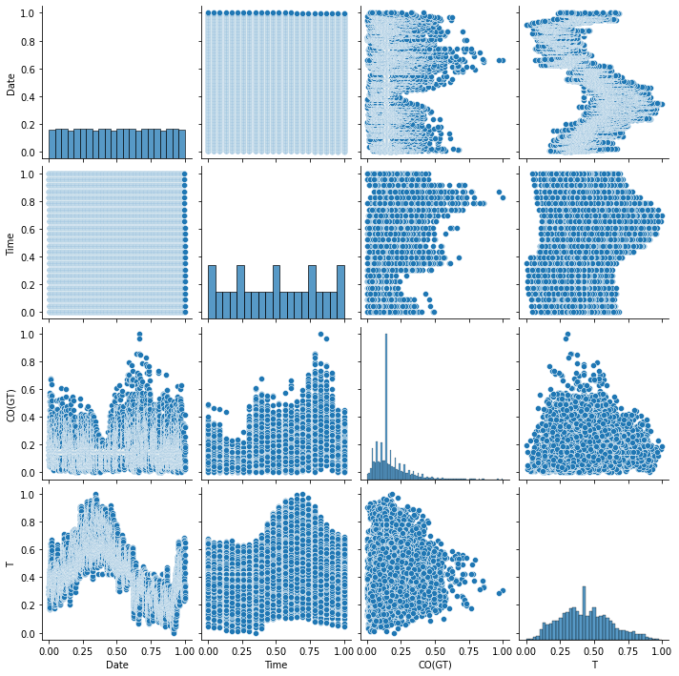
VISUALISING DATA INFORMATION

Slide 10
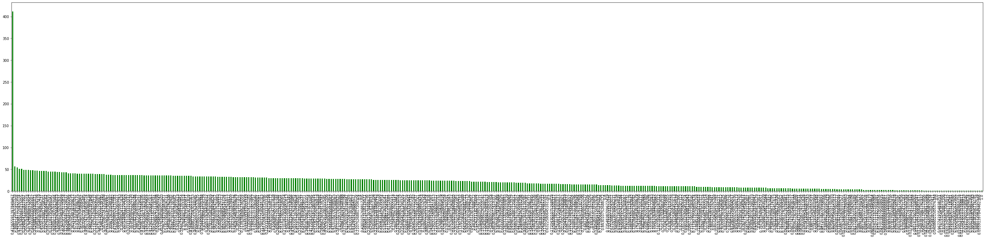
UNIQUE VALUES

Slide 11
Attachments
https://github.com/shivanidotcom/The_Blue_Sky

Slide 12
Thank You

