Slide 1
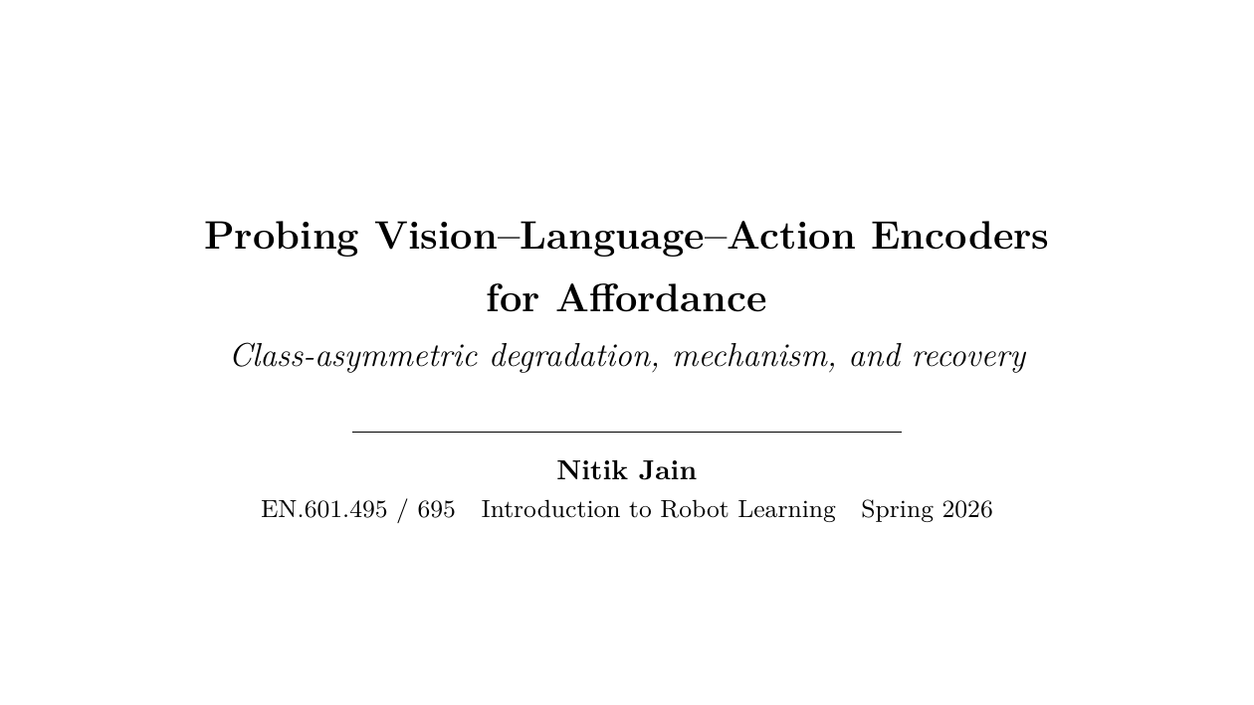
Notes:
Title slide. Hi, I'm Nitik. The question I'm presenting is upstream of robot manipulation: when a vision-language-action model fine-tunes its vision encoder end-to-end on robot trajectory data, does the per-class affordance signal that encoder started with survive? And if not, what happens to it, and can we get it back?

Slide 2
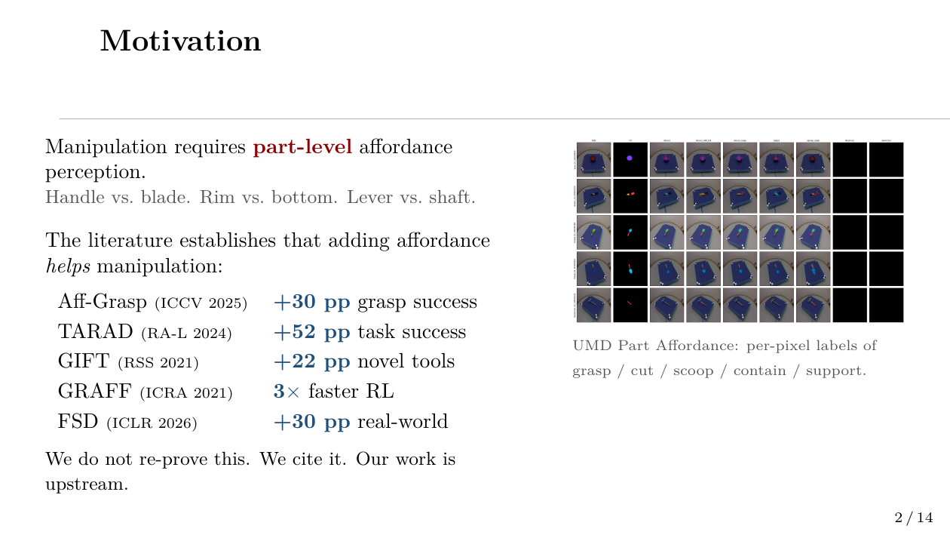
Notes:
Manipulation is fundamentally about which sub-region of an object affords which action. The affordance-helps-manipulation literature is settled: TARAD reports 52 points of task-success gain, Aff-Grasp 30 points of grasp-success gain on cluttered scenes, GRAFF triples RL convergence speed by injecting affordance as a prior. We treat this as established. Our question is upstream: do the encoders inside deployed VLAs even still carry the per-class signal?

Slide 3
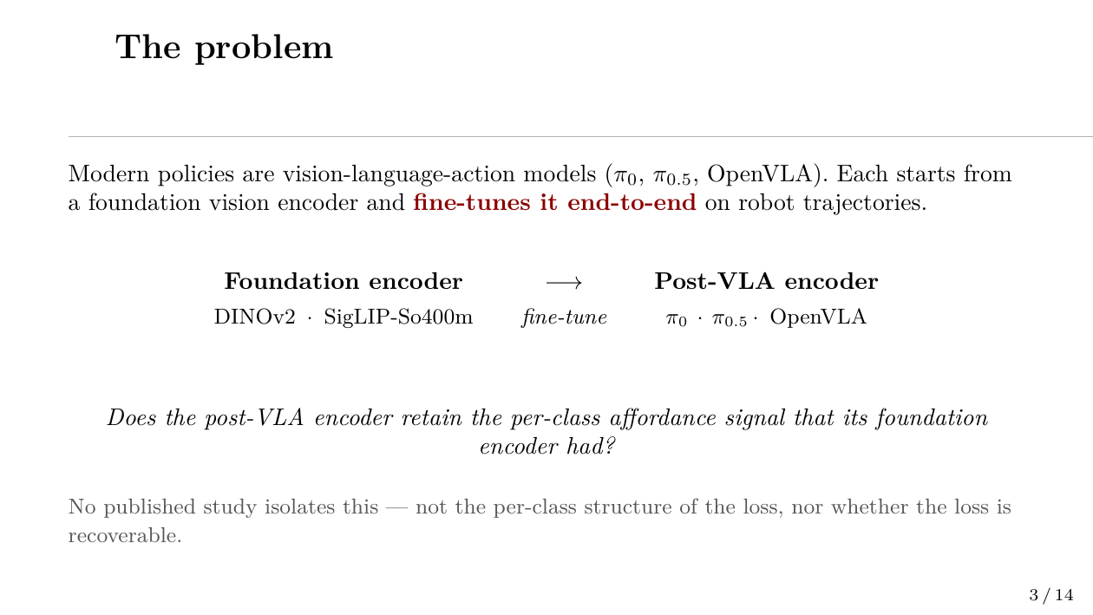
Notes:
Every modern open-weight VLA we look at — π0, π0.5, OpenVLA — starts from a known-strong foundation encoder, then fine-tunes that encoder end-to-end on robot trajectory data. Linear probing on the foundation encoder gives 0.61 mIoU on UMD. What does the same probe give on the post-VLA tower? That's the question.

Slide 4
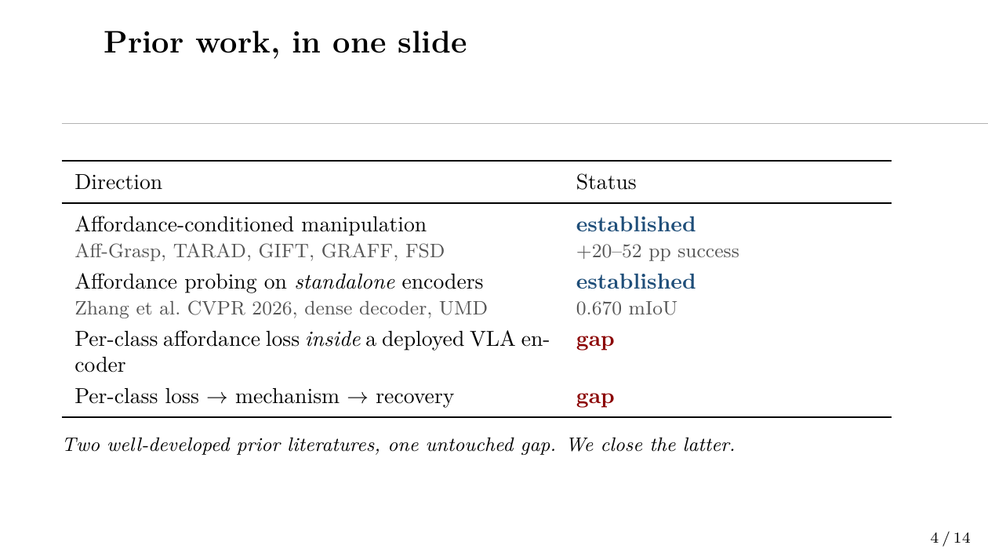
Notes:
Two well-developed prior literatures, one untouched gap. We don't redo the manipulation result. We don't redo standalone probing. We measure what's actually inside a deployed VLA's vision tower and characterize the rotation.

Slide 5
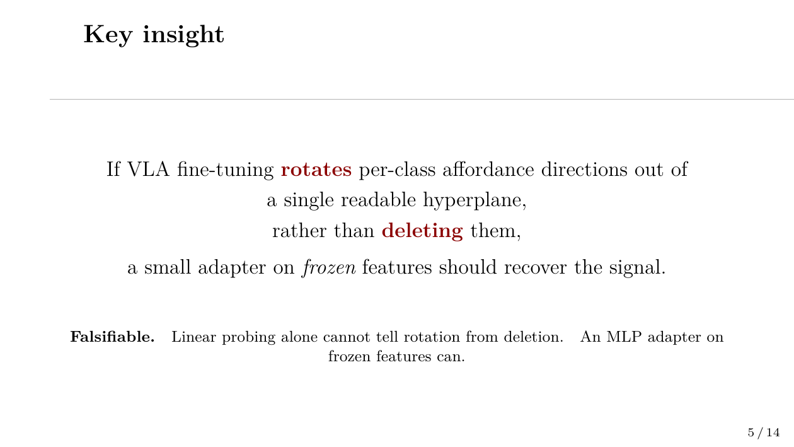
Notes:
Linear probes measure linearly readable signal. If fine-tuning destroys the signal, no head can recover it. If it merely rotates the readable directions out of a single hyperplane, a tiny non-linear adapter should recover most of it. This is the falsifiable test we run.

Slide 6
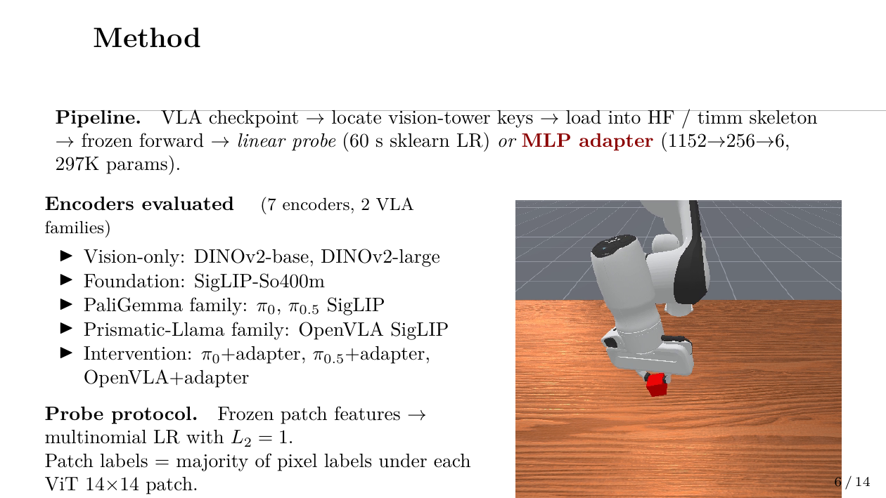
Notes:
The recipe is small. We extract just the vision-tower tensors from each VLA checkpoint — for π0 it's 437 of 448 tensors loaded into a fresh HuggingFace SigLIP skeleton. For OpenVLA, we load 342 of 342 timm-style keys into a timm vit-so400m. Then we freeze the encoder and either fit a 60-second linear probe or train a 297K-parameter MLP adapter. Image on the right is from a rendered ManiSkill3 PickCube rollout we used for downstream confirmation — π0's vision tower predicts cube xyz at 1.61 cm L2 error vs DINOv2's 3.68 cm.

Slide 7
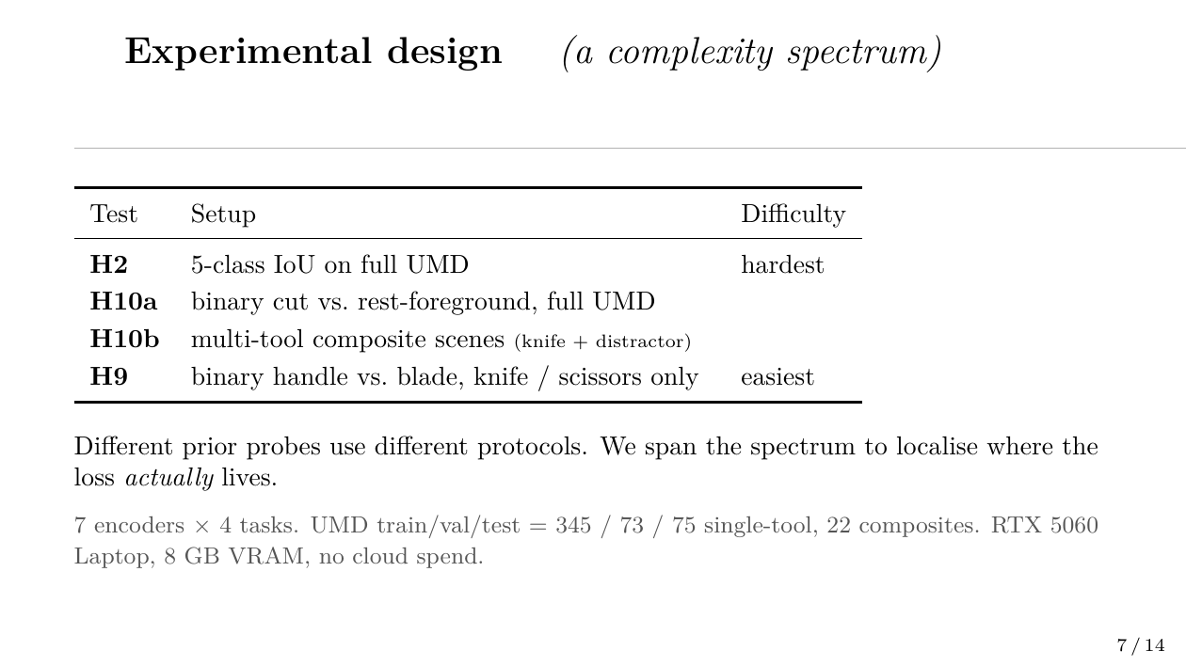
Notes:
Critical design choice. Instead of one probing metric, four — arranged from hardest, five-class IoU on full UMD, to easiest, binary handle-vs-blade on a single knife. Each level maps to a different real downstream regime. Aff-Grasp uses a setup close to H9. Standard probing uses H2. The spectrum lets us localize where the VLA loss actually appears versus where it's a multi-class artifact.

Slide 8
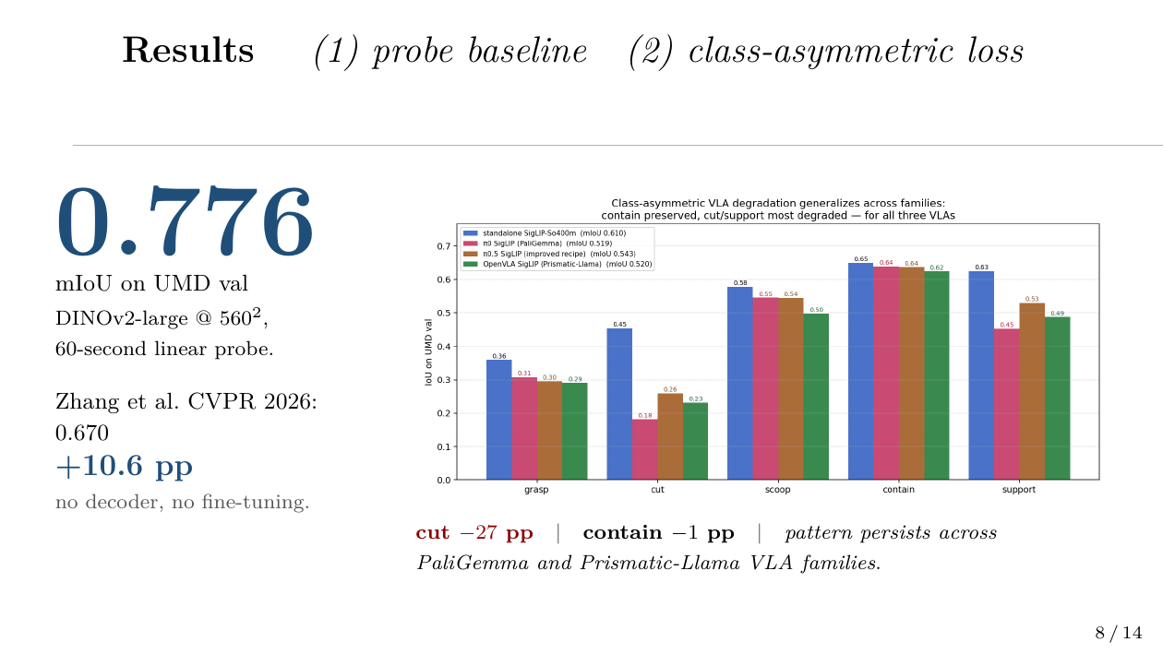
Notes:
Two findings. First: a 60-second linear probe on DINOv2-large at 560 pixels beats the published Zhang et al CVPR 2026 dense decoder by 10.6 points. Affordance is sitting in foundation features ready to be read. Second: looking at the SigLIP family — what every VLA uses — π0 loses 27 points of cut IoU but only 1 point of contain IoU. π0.5 partially recovers cut to 0.26. OpenVLA, totally different family with Llama-2 backbone and Open-X corpus, shows the same asymmetric pattern. The loss is class-asymmetric and family-general.

Slide 9
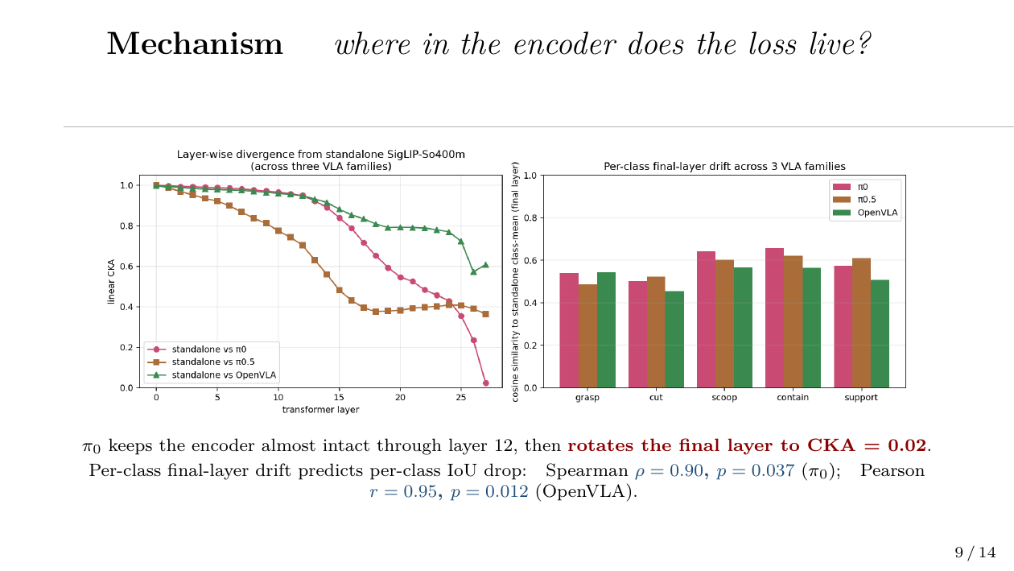
Notes:
Two mechanism panels. Left: layer-wise CKA — π0 keeps the encoder nearly identical through layer 12 then sharply rotates the final layer to a CKA of 0.02, almost orthogonal to standalone. π0.5 spreads the divergence; OpenVLA barely rotates. Right: per-class final-layer drift correlates with per-class IoU drop. Spearman 0.9 for π0 with p of 0.037; Pearson 0.95 for OpenVLA with p of 0.012. Mechanism predicts behavior, even with only 5 classes.

Slide 10
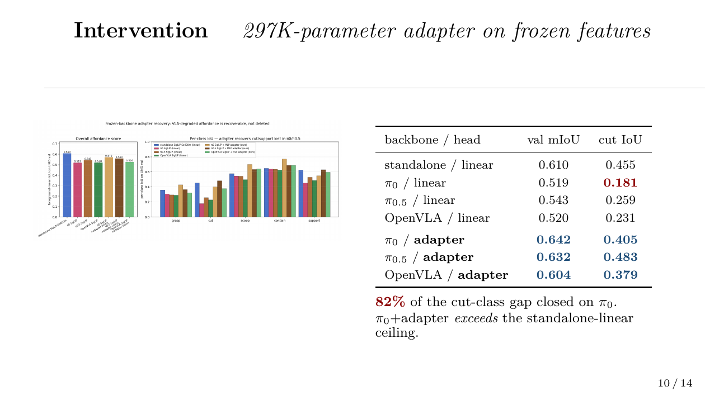
Notes:
A 297K-parameter MLP adapter on top of frozen π0 features recovers most of the lost cut signal. Cut goes from 0.18 to 0.40 — that's 82 percent of the gap closed to standalone. And π0+adapter actually exceeds the standalone linear-probe ceiling on overall mIoU. Same recipe transfers to π0.5 and OpenVLA. The signal was rotated, not deleted.

Slide 11
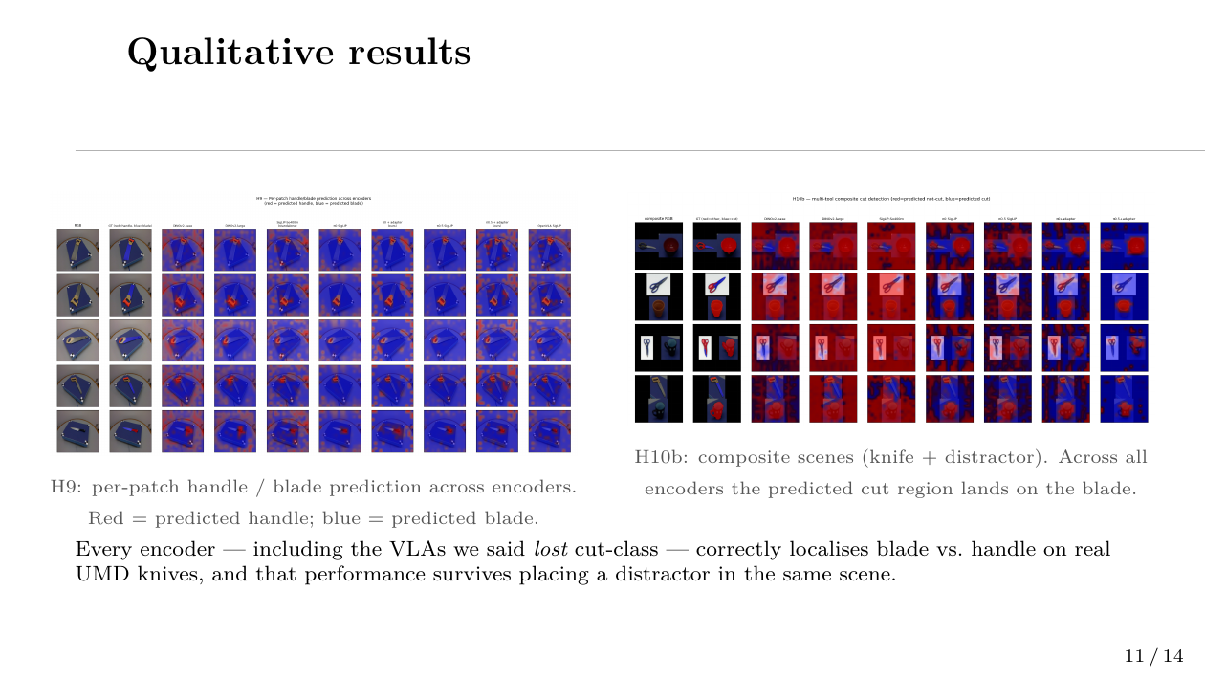
Notes:
Two qualitative panels. Left, H9: per-patch handle and blade prediction on UMD knives and scissors across all seven encoders. Red is predicted handle; blue predicted blade. Across all encoders — including the VLAs whose multi-class probe said they lost cut-affordance — the predicted blade region lands on the correct part of the object. Right, H10b: same task on composite scenes with a distractor mug or hammer in the frame. Performance survives. This is the visual evidence behind the complexity-spectrum finding next slide.

Slide 12
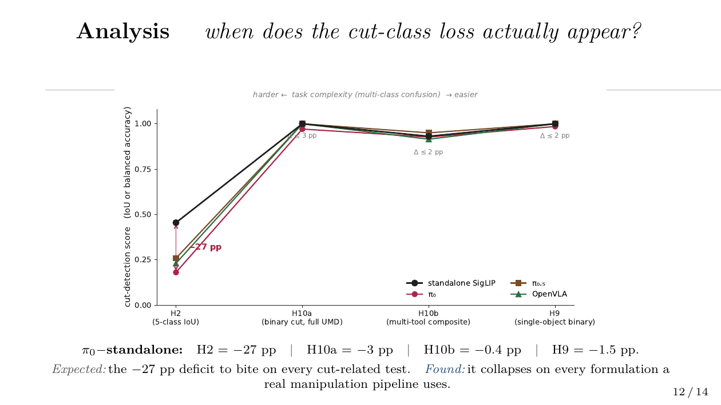
Notes:
The slide I want you to remember. We expected the 27-point cut deficit on the multi-class probe to predict deficits on every cut-related test. It doesn't. As we move from H2 — five-class IoU — to H10a — binary cut versus rest, full UMD — to H10b — multi-tool composite — to H9 — single-object handle versus blade — the gap collapses from 27 points to under 3 points. Aff-Grasp, GIFT, and Kokic's task-specific grasp planner all use binary part-discrimination — and on those, VLAs are essentially indistinguishable from the foundation encoders. The H2 metric, the field's standard, overstates the loss.

Slide 13
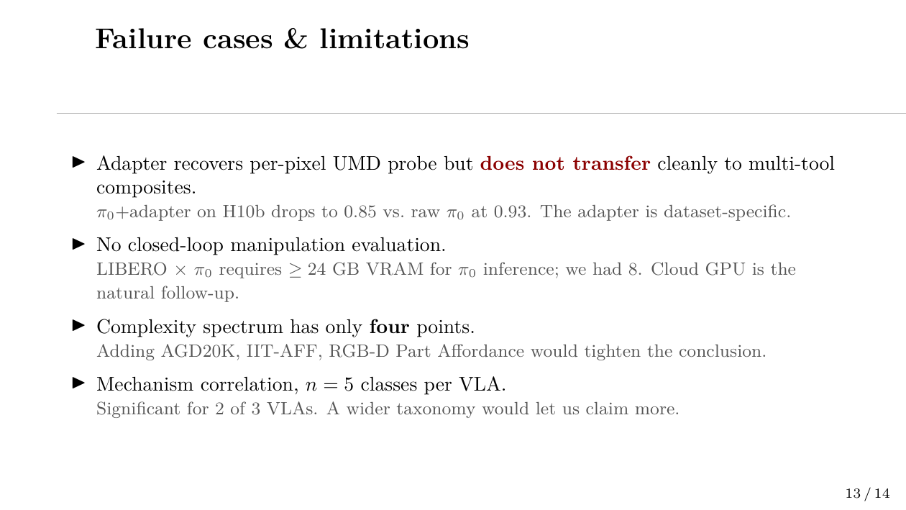
Notes:
Four honest limits. The adapter result is real on UMD but doesn't carry over cleanly to multi-tool composite scenes. We never closed the loop with an actual policy success rate — that's a 24-gigabyte cloud-GPU experiment we couldn't run locally. Four points on the complexity axis is a narrow basis for the headline. Mechanism correlation across only five affordance classes per VLA.

Slide 14
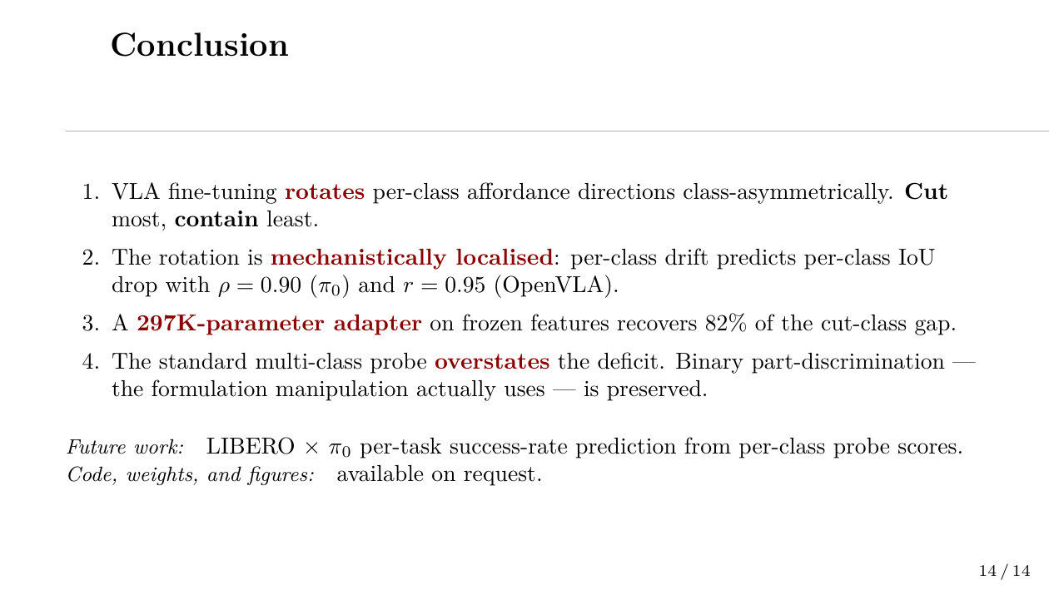
Notes:
Four take-aways. The cut-class loss is real and class-asymmetric. The mechanism is a final-layer rotation. A tiny adapter recovers most of the signal. But the standard probing protocol overstates the loss; the formulations downstream pipelines actually use show essentially no deficit. Natural follow-up is cloud-GPU LIBERO times π0 per-task success-rate prediction. Thank you. Happy to take questions.

