Slide 1

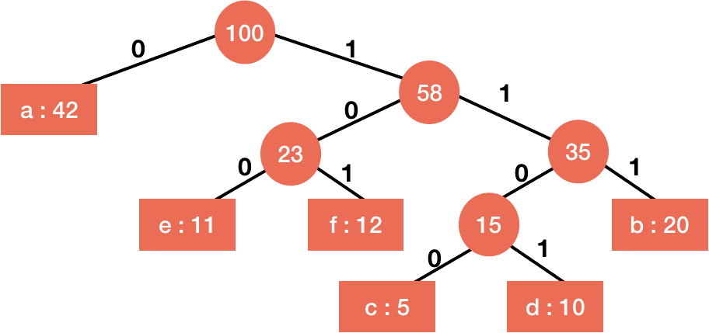
HUFFMAN CODING
(CAR PARKING DATA COMPRESSION )
Presented by- Nitika Pandey RA2211028010073

Slide 2

•Problem Statement
•Objective
• Algorithm/Analysis
• DryRun
• Conclusion

Slide 3
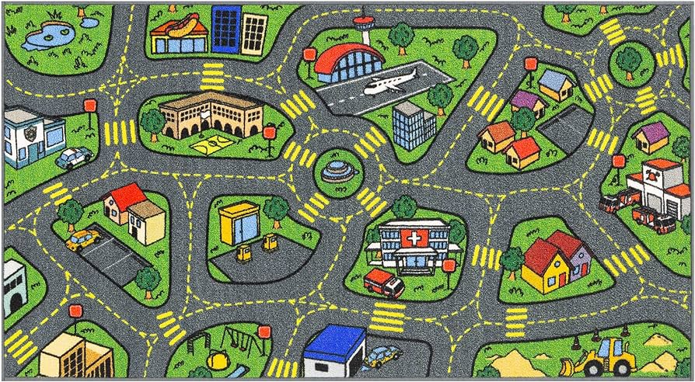
Problem Statement
In today's auto-tech era, storing vast location data is vital for computerized cars. Efficient compression systems are crucial, minimizing storage costs while maximizing data capacity, ensuring optimal functionality and resource utilization.

Slide 4

Objective
The objective is to develop a efficient compression system using huffman coding principles.
The objective is to provide an efficient framework to the car software to efficiently store large amounts of data in its system in a compact way.

Slide 5
Why Huffman Coding?
Optimal Compression
Simple Implementation
Lossless Compression
Fast Decoding
Easy To Implement
* The decoding table has to be sent with the data along to later decode it.

Slide 6
Algorithm
create a priority queue Q consisting of each unique character.
sort then in ascending order of their frequencies.
for all the unique characters:
create a newNode
extract minimum value from Q and assign it to leftChild of newNode
extract minimum value from Q and assign it to rightChild of newNode
calculate the sum of these two minimum values and assign it to the value of newNode
insert this newNode into the tree
return rootNode

Slide 7
DryRun:
Message > BCCABBDDAECCBBAEDDCC
Total- 20
Character | Count | Code | Message size(60bits)
A | 3 | 000 | 3*3
B | 5 | 001 | 5*3
C | 6 | 011 | 6*3
D | 4 | 110 | 4*3
E | 2 | 111 | 2*3

Slide 8
DryRun:
Message > BCCABBDDAECCBBAEDDCC Step_1- Arranging The Alphabets In Increasing Frequency Order
E(2) A(3) D(4) B(5) C(6)

Slide 9
DryRun:
Message > BCCABBDDAECCBBAEDDCC
E(2) A(3) D(4) B(5) C(6)
Step_2- Merge 2 smallest and make it a new node.
E(2) and A(3)

Slide 10
DryRun:
Message > BCCABBDDAECCBBAEDDCC
[5] D(4) B(5) C(6)
[5]
E(2) A(3) D(4) B(5) C(6)

Slide 11
DryRun:
Message > BCCABBDDAECCBBAEDDCC
[5] D(4) B(5) C(6)
[9] B(5) C(6)
[9]
[5]
E(2) A(3) D(4) B(5) C(6)
E(2) A(3) D(4) B(5) C(6)

Slide 12
DryRun:
Message > BCCABBDDAECCBBAEDDCC
B(5) and C(6)
[9]
[5]
[11]
E(2) A(3) D(4) B(5) C(6)
E(2) A(3) D(4) B(5) C(6)

Slide 13
DryRun:
Message > BCCABBDDAECCBBAEDDCC
11 and 9
[20]
[9]
[5]
[11]
E(2) A(3) D(4) B(5) C(6)
E(2) A(3) D(4) B(5) C(6)

Slide 14
DryRun:
Message > BCCABBDDAECCBBAEDDCC
Marking the Edges
0
[20]
1
[9]
0
1
[5]
[11]
0
1
0
1
E(2) A(3) D(4) B(5) C(6)
E(2) A(3) D(4) B(5) C(6)

Slide 15
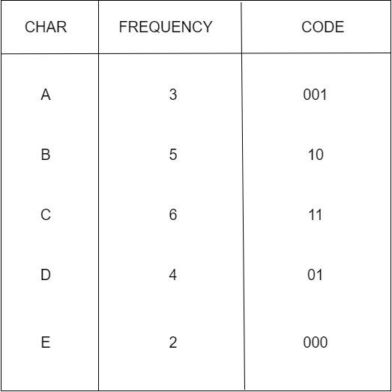
ENCODED TABLE:
Message > BCCABBDDAECCBBAEDDCC
Table:
Total=45 bits
40 bits (8x5)(CHAR)
12 bit (CODE)
---------------------------------------------
97 bits
3x3=9
5x2=10
6x2=12
4x2=8
2x3=6

Slide 16

Example Code:
Coordinate 1 (AABBCC)
Coordinate nth

Slide 17
How To Use
Real-Life Application: Parking Lot Management
1. Data Representation:
- Each parking spot is represented as a node in the Huffman tree.
- The frequency of a spot is determined by factors like historical occupancy patterns, time of day, or day of the week.
2. Data Collection:
- Occupancy data is collected in real-time using sensors, cameras, or other monitoring systems.
- Historical data may be used to assign frequencies, considering patterns of high and low usage.
3. Huffman Tree Construction:
- The system periodically analyzes the collected data to determine the frequency of each parking spot.
- A Huffman tree is constructed based on these frequencies.

Slide 18
4. Huffman Coding:
- Each parking spot is assigned a unique binary code based on its position in the Huffman tree.
- Frequently used spots get shorter codes, leading to more efficient representation.
5. System Operations:
- The Huffman codes are used to represent parking spots in the system's data storage or communication protocols.
- When transmitting or storing parking information, the Huffman codes reduce the amount of data needed, optimizing efficiency.
6. Dynamic Updates:
- The Huffman tree can be dynamically updated as occupancy patterns change.
- Real-time adjustments in the Huffman coding allow the system to adapt to evolving parking conditions.

Slide 19
Example Scenario:
Consider a smart parking system in a city:
- Data Collection:
- Sensors collect real-time data on parking spot occupancy.
- Historical data reveals that certain spots are frequently used during weekdays.
- Huffman Tree Construction:
- The system constructs a Huffman tree, giving higher frequencies to spots with historical and real-time high occupancy.
- Huffman Coding:
- Each spot receives a unique binary code. Popular spots near offices might have shorter codes.
- Real-Time Application:
- When transmitting data about parking spot occupancy, the system uses Huffman codes to reduce the amount of information sent.
- The dynamic nature of Huffman coding allows the system to adapt to changing patterns, ensuring efficient representation.

Slide 20
TIME AND SPACE Analysis:
Huffman Coding Complexity
The time complexity for encoding each unique character based on its frequency is O(nlog n).
Extracting minimum frequency from the priority queue takes place 2*(n-1) times and its complexity is O(log n). Thus the overall complexity is O(nlog n).

Slide 21
Conclusion
Efficiency: The algorithm efficiently constructs the Huffman tree in O(n log n) time complexity, where n is the number of unique characters in the input. This efficiency is crucial for real-time or large-scale data compression applications.
Optimality: Huffman coding guarantees an optimal prefix-free code, ensuring that no other prefix-free code can achieve a better compression ratio for the same input frequencies.
Versatility: Huffman coding finds applications in various fields, including data compression in file formats (like ZIP), image and video compression, telecommunications, and cryptography, car parking systems.

