Slide 1
Web Accessibility Basics

Slide 2
GOALS
Accessibility is about building Applications that can be navigated and read by everyone, regardless of disability, location, experience or technology.
Web Accessibility is designed to work for all people with mental and physical disability. When the application meets this goal, it is accessible to people with a diverse range of hearing, movement, sight, and cognitive ability.
Current Web standards for accessibility is WCAG2.0 (Web Content Accessibility Guidelines)

Slide 3
OVEVIEW
WCAG Addresses following:
User Scenario
Visual
Motor/Mobility
Auditory
Seizures
Cognitive/Intellectual
Blind user
Partial Blind
Color Blind
Deaf/Hard of Hearing
Mobility issues
Old age
Difficulty in understanding

Slide 4
SPECIFICATIONS
3 Level of compliance documented by WCAG
A
AA
AAA
Web Accessibility Goal
Basic Level of Accessibility
Highest Level of Accessibility

Slide 5
PRINCIPLES
PERCIEVEABLE
OPERABLE
UNDERSTANDABLE
ROBUST
Perceivable: Available through Sight, Touch and Hearing
Operable: Compatible with Mouse, Keyboard and device
Understandable: Easy to comprehend and Navigate
Robust: Works across browser, Assistive Technology, Mobile devices

Slide 6
Design Accessibility

Slide 7
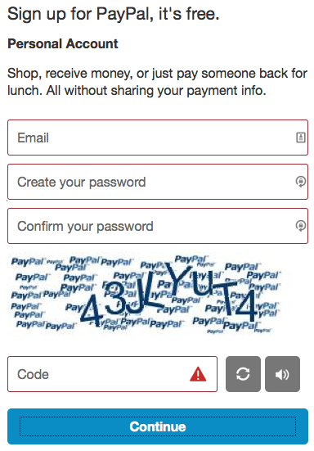
Don’t use color as the only visual means of conveying information.
Use of only color to represent important information is not good practice
Provide information to the user by using both color and text
Target audience:
People with cognitive issue
People with color blindness

Slide 8
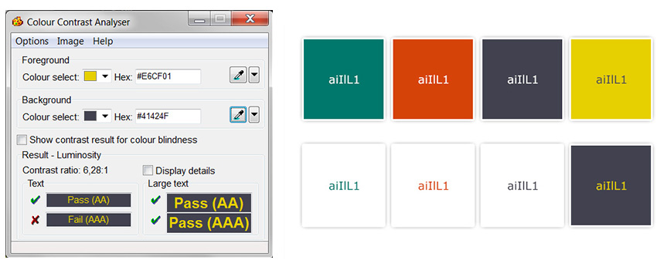
Ensure sufficient contrast between text and its background.
WCAG 2.0 level AA requires a contrast ratio of 4.5:1 for normal text and 3:1 for large text.
Level AAA requires a contrast ratio of 7:1 for normal text and 4.5:1 for large text.
Large text is defined as 14 point (typically 18.66px) and bold or larger, or 18 point
(typically 24px) or larger.

Slide 9
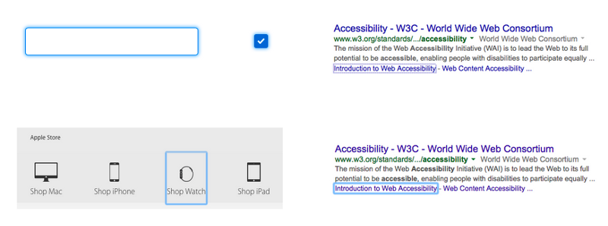
Provide visual focus indication for keyboard focus.
Provide visual indicator to the users, helps user navigate the web application knowing
what part of the information the user is on.
Designers can choose to use the default browser focus or choose a different color or
Background to represent this information

Slide 10
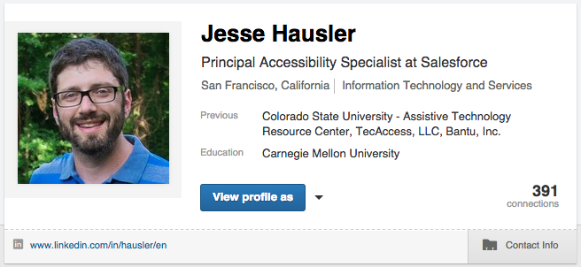
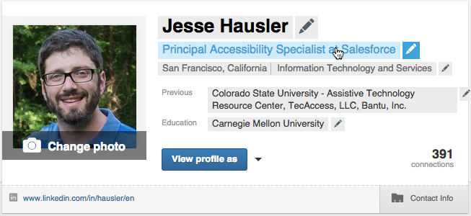
Don’t make people hover to find things.
Initial Screen of LinkedIn
After hover on card

Slide 11

Accessible Card View
In this design the important actions are available to the user without hovering on the
Card. All the important information is shown to the user.

Slide 12
Level A Accessibility

Slide 13
Guideline | Summary
Non-text Content | Provide text alternatives for non-text content
Audio-only and Video-only (Pre-recorded) | Provide an alternative to video-only and audio-only content and Video with audio has a second alternative
Info and Relationships | Logical structure
Meaningful Sequence | Present content in a meaningful order
Sensory Characteristics | Use more than one sense for instructions
Use of Color | Don’t use presentation that relies solely on color
Keyboard | Accessible by keyboard only
No Keyboard Trap | Don’t trap keyboard users
Timing Adjustable | Time limits have user controls
Bypass Blocks | Provide a ‘Skip to Content’ link
Focus Order | Logical order
Name, Role, Value | Build all elements for accessibility
Error Identification | Clearly identify input errors
Language of Page | Page has a language assigned
On Focus | Elements do not change when they receive focus

Slide 14
Level AA Accessibility

Slide 15
Guideline | Summary
Contrast (Minimum) | Contrast ratio between text and background is at least 4.5:1
Resize Text | Text can be resized to 200% without loss of content or function
Images of Text | Don’t use images of text
Multiple Ways | Offer several ways to find pages
Headings and Labels | Use clear headings and labels
Focus Visible | Ensure keyboard focus is visible and clear
Language of Parts | Tell users when the language on a page changes
Consistent Navigation | Use menus consistently
Consistent Identification | Use icons and buttons consistently
Error Suggestion | Suggest fixes when users make errors
Captions (Live) | Live videos have captions
Audio Description (Pre-recorded) | Users have access to audio description for video content

Slide 16
Level AAA Accessibility

Slide 17
Guideline | Summary
Contrast (Enhanced) | Contrast ratio between text and background is at least 7:1
Visual Presentation | Offer users a range of presentation options
No Timing | No time limits
Interruptions | Don’t interrupt users
Three Flashes | No content flashes more than three times per second
Location | Let users know where they are
Link Purpose (Link Only) | Every link’s purpose is clear from its text
Unusual words | Explain any strange words
Abbreviations | Explain any abbreviations
Help | Provide detailed help and instructions
Reading Level | Users with nine years of school can read your content
Media Alternative | Provide a text alternative to videos

Slide 18
Assistive Technology

Slide 19
Assistive technology helps people who have difficulty speaking, typing, writing, remembering, pointing, seeing, hearing, learning, walking, and many other things. Different disabilities require different assistive technologies
For MAC Voiceover is used as screen reader to interact with the web application and for Window JAWS, NVDA, plugins like Chromevox are used to interact with the web application.
Screen reader
JAWS/NVDA for Windows
Keys: Tab, Arrow Keys, CTRL+Alt+Arrow keys
Voiceover for Mac/Ipad/iphone
Keys: Tab, Arrow Keys, Command+Option+ Arrow keys

Slide 20
Screen reader Commands - NVDA

Slide 21
Reading Text
Command | Description
← or Numpad 1 | Say Prior Character
→ or Numpad 3 | Say Next Character
Numpad 2 | Say Current Character
Numpad 5 | Say Word
Numpad 5 twice quickly | Spell Word
Ctrl + ← or Numpad 4 | Say Prior Word
Ctrl + → or Numpad 6 | Say Next Word
↑ or Numpad 7 | Say Prior Line
↓ or Numpad 9 | Say Next Line
NVDA + ↑ or Numpad 8 | Say Current Line
NVDA + ↑ twice quickly | Spell Current Line
NVDA + ↓ or Numpad + | Read all starting at current position
Shift + Numpad 7 | Top line
Shift + Numpad 9 | Bottom Line
Shift + Numpad 1 | Start of Line
Shift + Numpad 3 | End of Line

Slide 22
Headings, Lists and Tables
Command | Description
H | Headings Quick Key
1-6 | Headings level 1-6
L | List Quick Key
I | List Item Quick Key
Command | Description
T | Table Quick Key
Ctrl + Alt + → | Cell to Right
Ctrl + Alt + ← | Cell to Left
Ctrl + Alt + ↓ | Cell Below
Ctrl + Alt + ↑ | Cell Above

Slide 23
Forms
Command | Description
F | Form Quick Key
B | Button Quick Key
Enter or NVDA + Space (in a form element) | Enter Forms Mode
NVDA + Space | Exit Forms Mode
Tab | Navigate to Next form Control
Shift + Tab | Navigate to Previous Form Control
Spacebar | Select and Deselect Checkboxes
Alt + ↓ | Open Combo Box/Jump Menu/Auto-complete Menu
↑/↓ | Select Radio Button
↑/↓ or the First letter | Select Element in Combo Box
X | Checkbox
C | Combo Box
R | Radio Button
Enter (in forms mode) | Submit Form
Command | Description
F | Form Quick Key
B | Button Quick Key
Enter or NVDA + Space (in a form element) | Enter Forms Mode
NVDA + Space | Exit Forms Mode
Tab | Navigate to Next form Control
Shift + Tab | Navigate to Previous Form Control
Spacebar | Select and Deselect Checkboxes
Alt + ↓ | Open Combo Box/Jump Menu/Auto-complete Menu
↑/↓ | Select Radio Button
↑/↓ or the First letter | Select Element in Combo Box
X | Checkbox
C | Combo Box
R | Radio Button
Enter (in forms mode) | Submit Form

Slide 24
Links
Command | Description
Tab | Jump to next link/form element
K | Next link
Shift + Tab | Jump to previous link/form element
NVDA + F7 | Elements List - lists page links, headings, and landmarks
U | Unvisited Link Quick Key
V | Visited Link Quick Key

Slide 25
Other Commands
Command | Description
Ctrl + F | Search for a word or a phrase
NVDA+ 1 | Keyboard help
G | Next Image
Ctrl + ↑/↓ | Previous/Next Paragraph
Q | Blockquote
NVDA + F2 | Next key you hit ignores NVDA and is a normal Windows key
NVDA + 2 | Speaks characters typed
NVDA + 3 | Speaks words typed
NVDA + B | Reads the entire foreground window (useful for reading a dialog box)
NVDA + T | Announces the title of the current foreground window
NVDA + Q | Quit NVDA

Slide 26
Screen reader Commands - JAWS
JAWS Commands: https://dequeuniversity.com/assets/pdf/screenreaders/jaws.pdf

Slide 27
Reference:
https://www.w3.org/standards/webdesign/accessibility
https://www.w3.org/WAI/standards-guidelines/wcag/
https://www.marcozehe.de/web-accessibility-resources/

Slide 28
Q&A

