Slide 1
Introduction to Machine Learning
Nitika Sharma
nitika.11.11@gmail.com

Slide 2

1. Are you confused?
Machine Learning
Data Warehouse
Data Mining
Data Analytics
Data Science
Databases
Big Data

Slide 3
2. Let’s sort out!
Data Storage & Management
Data Processing
Databases
Data Science
Data Warehouse
Data Mining
Big Data
Data Analytics
Machine Learning

Slide 4
2. Let’s sort out!
Handles large and complex data
Big data is usually unstructured, or semi-structured data
3 Characteristics of Big Data
Volume
Velocity
Variety
Big data challenges include capturing data, data storage, data analysis,search, sharing, transfer, visualization, querying, updating and information privacy
Data Storage & Management
Special type of database
Used for Online Analytical Processing (OLAP). This reads the historical data for the Users for business decisions
The Tables and joins are simple since they are de-normalized
Optimized for read operations
High performance for analytical queries
Used for Online Transactional Processing (OLTP)
Data is Normalized
Optimized for write operation
Performance is low for analysis queries
Example: Banking, e-commerce
Database
Data Warehouse
Big Data

Slide 5
2. Let’s sort out!
Data Processing
Machine Learning focuses on designing algorithms that can learn from and make predictions on the data
Data Analytics is focussed on unlocking the right information required for business growth. It can also deploy data mining tools and techniques to find hidden patterns in the data-set.
No clear distinction between terms!
Data science is an interdisciplinary field about scientific methods, processes, and systems to extract knowledge or insights from data in various forms, either structured or unstructured
Data Mining is the science that uses machine learning algorithms in order to extract hidden, useful and important patterns from data
Data Science
Data Mining
Data Analytics
Machine Learning

Slide 6
3. Common Machine Learning Tasks
Regression
Linear Regression
Logistic Regression
Clustering
K-means algorithm
Agglomerative/ Hierarchical clustering
Classification
k-Nearest Neighbours(k-NN)
Decision Tree

Slide 7
3.1. Linear Regression
Linear Regression establishes a relationship between dependent variable (Y) and one or more independent variables (X) using a best fit straight line (also known as regression line).
Regression Line is represented by an equation
Y = a + b*X , where a is y-intercept,
b is slope of the line
This equation can be used to predict the value of target variable based on given predictor variable(s).
Example: Linear analysis on the sales data with monthly sales can help the company to forecast sales in future months.

Slide 8
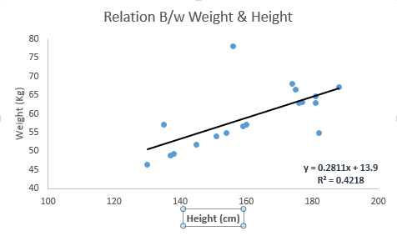
Example

Slide 9
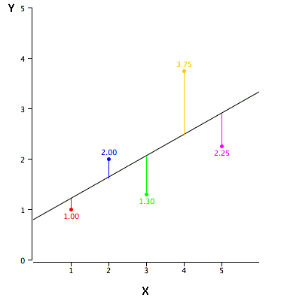
How to obtain best fit line?
Least Square Method
Minimizes the sum of the squares of the vertical deviations from each data point to the line.

Slide 10
Simple Linear Regression on Iris Dataset in R
Iris Dataset in R is a data frame with 150 cases (rows) and 5 variables (columns)
Sepal.Length
Sepal.Width
Petal.Length
Petal.Width, and
Species
Dataset has 50 flowers from each of 3 species:
Iris setosa
versicolor, and
virginica.

Slide 11
Simple Linear Regression on Iris Dataset in R
Steps to be performed
Loading and understanding Iris dataset
Pre-processing the data
Select required data subset, we will find relationship between 2 sets of variables:
Sepal Length(Independent) and Sepal Width(Dependent)
Petal Length (Independent) and Petal Width(Dependent)
Apply Linear Model function “lm” to get Regression Line
Plot data points and Regression line
Perform Prediction to find value of Dependent variable for any given value of Independent Variable

Slide 12
3.2. Clustering
Clustering is the task of grouping a set of objects in such a way that objects in the same group (called a cluster) are more similar to each other than to those in other groups (clusters)
It’s an Unsupervised Learning technique
Example:
Identification of areas of similar land use in an earth observation database
Outlier detection applications such as detection of credit card fraud

Slide 13
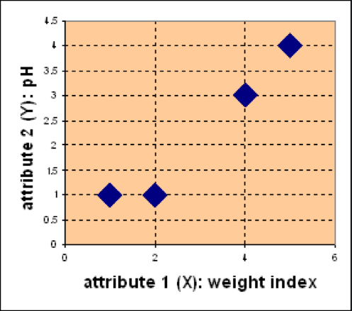
K-means clustering
Problem: Suppose we have 4 types of medicines and each has two attributes (pH and weight index).
Goal: Group these objects into k=2 group of medicine.
D
Medicine | Weight | pH-Index
A | 1 | 1
B | 2 | 1
C | 4 | 3
D | 5 | 4
C
A
B
Source: University of Manchester, COMP24111 Machine Learning

Slide 14
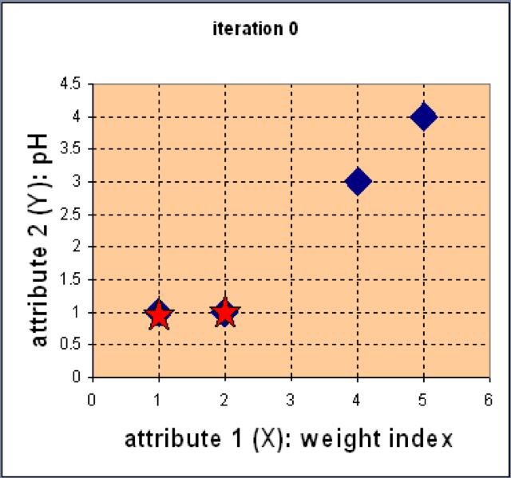
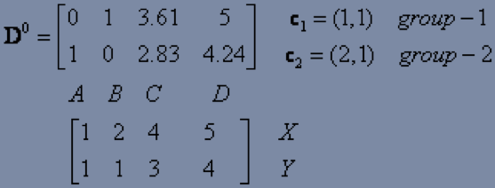
Step 1: Use initial random centroids (seed points) for partitioning
D
C
Euclidean distance
A
B
Assign each object to the cluster
with the nearest seed point

Slide 15
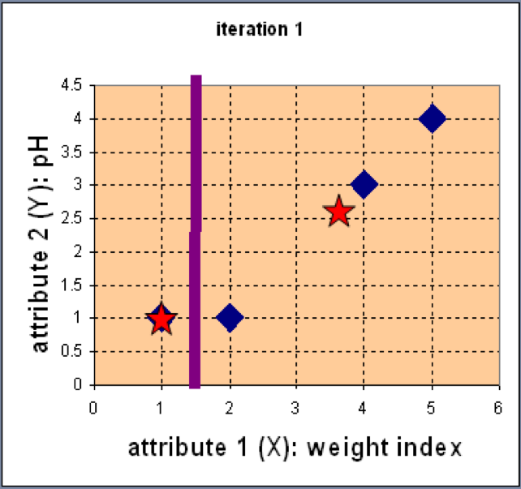
Step 2: Compute new centroids of the current partition
Knowing the members of each
cluster, now we compute the new centroid of each group based on these new memberships.

Slide 16
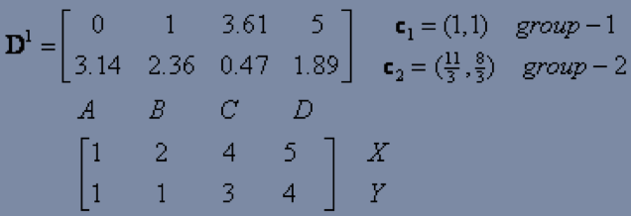
Step 3: Renew membership based on new centroids
Compute the distance of all objects to the new centroids
Assign the membership to objects

Slide 17
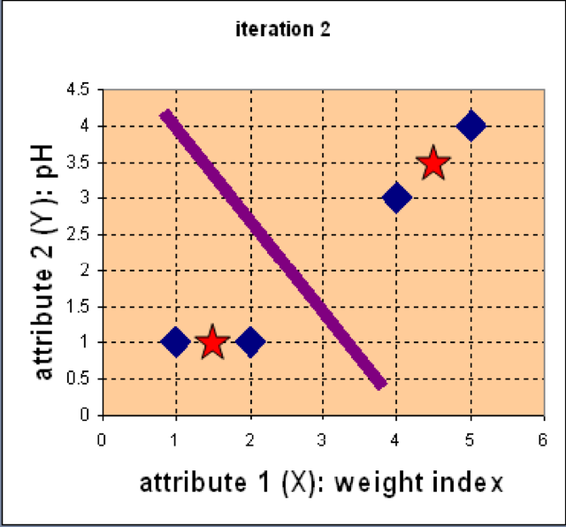
Step 4: Repeat the first two steps until its convergence
Knowing the members of each
cluster, now we compute the new
centroid of each group based on
these new memberships.

Slide 18
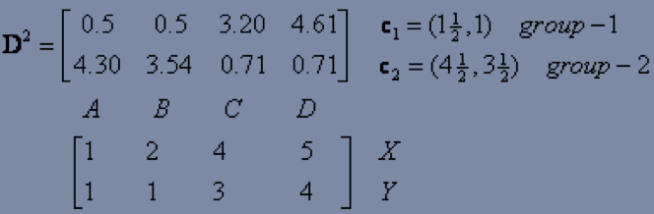
Step 4(conti..): Repeat the first two steps until its convergence
Compute the distance of all objects to the new centroids
Stop due to no new assignment
Membership in each cluster no longer change

Slide 19
K-means Clustering on Iris Dataset in R
Steps to be performed
Loading and understanding Iris dataset
Pre-processing the data
Separate class attribute "Species" and store it in another variable
Normalize the value of attributes between 0 and 1
Apply k-means clustering algorithm
Verify clusters formed by comparing them to “Species” class attribute

Slide 20
3.3. Classification
Classification is the problem of identifying to which of a set of categories a new observation belongs, on the basis of a training set of data containing observations (or instances) whose category membership is known.
It’s a Supervised Learning technique
Example:
assigning a given email into "spam" or "non-spam" classes
assigning a diagnosis to a given patient as described by observed characteristics of the patient (gender, blood pressure, presence or absence of certain symptoms, etc.).

Slide 21
K-NN Algorithm for classification
Problem: Which of the three categories does the Smiley Face fall in?
Classify Smiley Face using knn with k=1, 5, 11

Slide 22
K-NN Example
1-Nearest Neighbour (1NN)
The closest neighbour is PLUS, therefore, SMILEY will be classified as PLUS.

Slide 23
K-NN Example
5-Nearest Neighbour
Amongst the 5 closest neighbours, MULTIPY wins by majority voting, therefore, SMILEY will be classified as MULTIPLY.

Slide 24
K-NN Example
11-Nearest Neighbour
Amongst the 11 closest neighbours, PLUS wins by majority voting, therefore, SMILEY will be classified as PLUS!!!
The chosen value of “k” shouldn’t be too large to include noise but also not too small so that it avoids bias.
Generally, the value of “k” is chosen as square root of total number of instances in dataset.

Slide 25
K-NN classification on Iris Dataset in R
Steps to be performed
Loading and understanding Iris dataset
Pre-processing the data
Randomize the dataset since dataset is ordered by "Species" by default
Normalize the value of attributes between 0 and 1
Divide the dataset into two subsets for Training and Testing
Apply k-NN classification algorithm
Verify classification results

Slide 26
Useful Links
Beginners guide for R and R Studio: https://github.com/nitika1111/R-RStudio-BeginnersCompleteGuide/blob/master/README.md
Practical Machine learning examples in R: http://rpubs.com/Nitika
Online Courses:
Coursera: https://www.coursera.org/specializations/jhu-data-science
Datacamp: https://www.datacamp.com/tracks/data-scientist-with-r
Online Competitions:
Kaggle: https://www.kaggle.com/

Slide 27
Thank You

Slide 31
Example
Problem: Suppose we have 4 types of medicines and each has two attributes (pH and weight index). Our goal is to group these objects into K=2 group of medicine.
D
Medicine | Weight | pH-Index
A | 1 | 1
B | 2 | 1
C | 4 | 3
D | 5 | 4
C
A
B
Source: University of Manchester, COMP24111 Machine Learning

Slide 32
K-means Algorithm
Given the cluster number K, the K-means algorithm is carried out in three steps after initialisation:
Initialisation: set seed points (randomly)
Assign each object to the cluster of the nearest seed point measured with a specific distance metric
Compute new seed points as the centroids of the clusters of the current partition (the centroid is the centre, i.e., mean point, of the cluster)
Renew membership of each point based on new centroids
Go back to Step 1), stop when no more new assignment (i.e., membership in each cluster no longer changes)

Slide 33
Example
Step 1: Use initial seed points for partitioning
D
C
Euclidean distance
A
B
Assign each object to the cluster
with the nearest seed point

Slide 34
Example
Step 2: Compute new centroids of the current partition
Knowing the members of each
cluster, now we compute the new
centroid of each group based on
these new memberships.

Slide 35
Example
Step 3: Renew membership based on new centroids
Compute the distance of all objects to the new centroids
Assign the membership to objects

Slide 36
Example
Step 4: Repeat the first two steps until its convergence
Knowing the members of each
cluster, now we compute the new
centroid of each group based on
these new memberships.

Slide 37
Example
Step 4: Repeat the first two steps until its convergence
Compute the distance of all objects to the new centroids
Stop due to no new assignment
Membership in each cluster no longer change

Slide 38
K-nearest neighbours algorithm
Given a training set, we can use kNN to predict the class of a previously unseen instance by comparing it to other points in the space.
The classification of the unknown instance is done by finding the distance or similarity between itself and already known points in the training set. We then classify the instance based on the k closest training examples.
The idea behind the algorithm is that two points which are close together or similar are more likely to belong to the same class than those which are further apart.

Slide 40
2. Let’s sort out!
Data Storage
Data Processing
Databases
Data Mining
Data Warehouse
Data Analytics
Machine Learning
Big Data
Data Science

