Slide 1
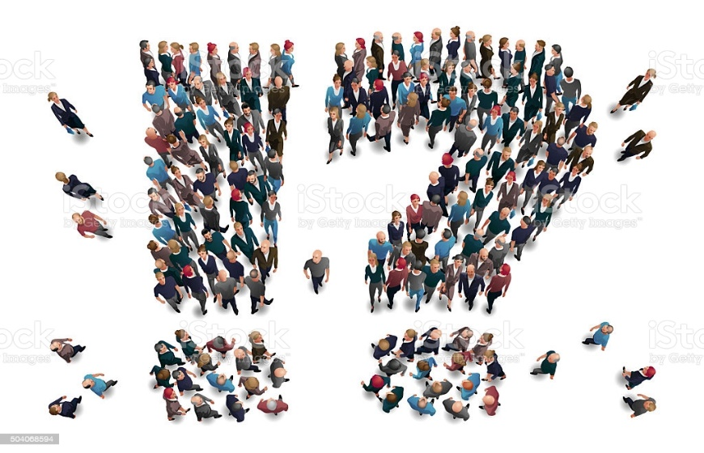
Covid-19 vaccination- public discussions around the world
ITEC5205W - 2021
Nitika Sharma
Pre-final Presentation (Design and Development of Data-Intensive Application)
(nitikasharma3@cmail.Carleton.ca)
April 7th , 2021

Slide 2

ITEC5205W - 2021
Introduction to the area
Evaluation
Literature review
Comparative analysis
Problem Statement
Proposed Solution
Novelty
More to add
Research operation analysis
Related work comparison
April 7th , 2021

Slide 3

Introduction to the area
ITEC5205W - 2021
Covid-19 (Coronavirus) is discovered as one of the most infectious diseases around the globe.
Vaccination of Covid-19 is much awaited thing in this pandemic.
As per the information of the US, 68% of the American adults claims getting the news about Covid-19 from social media.
Twitter has been observed as one of the crucial platforms for public discussion regarding the pandemic.
April 7th ,2021

Slide 4
Literature Review
ITEC5205W - 2021
Stream | Key Findings of stream | Citations to the key sources
Benefits to the public, government officials and health-care professionals. | Correct and accurate information plays a crucial role in handling infodemics and misinformation. Quick assessment of change in public opinion. Positive correlation between social media and the spreading of pandemic panic has been observed. The usage of Twitter by different communities for pandemic related information is analysed. Tracking of real-time public attitude will help the health officials to identify the intensity of the outrage of the virus. | Tsao et al., 2021 Depoux et a., 2020 Ahmad & Murad, 2020 Abd-Alrazaq et al., 2020 Dyer & Kohlic, 2020
April 7th , 2021

Slide 5
Comparative Analysis
ITEC5205W - 2021
Topic | Problem Addressed | Theoretical Solution | Methods | Key findings | Information and year of publication
Twitter discussions and emotions about the COVID-19 pandemic: a machine learning approach | Examining the concerns, discussions, and sentiments of users via their tweets about Covid-19. | Analyzing the intensity of the fear amongst the public during the new cases and death counts due to Covid-19, expressed through social media, is an important aspect to study so that proper health-related planning and responses can be conveyed. | Purposive sampling approach for Twitter data collection. ( Sampling then data collection followed by pre-processing of raw data) Used the machine learning approach to analyze the Twitter data and 4 million Twitter messages using 25 hashtags in 2020 from March 1 to April 21. Identified using unigrams, bigrams, and the topics related to sentiments during the pandemic. | The public uses different types of words while referring to Covid-19 such as coronavirus, virus. As per the new emerging topic, the increase in the discussion regarding the connection between Covid-19 and politics is increasing as the situation evolves. Fear and anticipation of the pandemic is a frequent topic. | Journal of Medical Internet Research 2020
April 7th ,, 2021

Slide 6
ITEC5205W - 2021
Topic | Problem Addressed | Theoretical Solution | Methods | Key findings | Information and year of publication
Tracking Social Media Discourse about the COVID-19 Pandemic: Development of a Public Coronavirus Twitter Data Set | Description of Covid-19 Twitter datasets including multiple languages using Covid-19- Tweet IDs GitHub repository. | Analysis of the online conversations of the Twitter dataset about Covid-19 will provide the researcher the ability to study the impact of social media during the global health crisis. | Using specific keywords and accounts, tweets are collected using Twitter API. Continuously monitoring the trending topics on Twitter. | Identified the number of verified accounts and their information tweets related to the pandemic. These are also referred to as authentic accounts. Tweets in different languages such as Spanish, Italian, and Japanese over time, are also collected. | JMIR Public Health and Surveillance 2020
Framing COVID-19: How we conceptualize and discuss the pandemic on Twitter | Analysis of large tweets on Covid-19 during March to April 2020. | Issues about the pandemic are discussed on Twitter and also about the treatment and containment of the virus which will help in framing the treatment methods of the disease. | Identification of the topics that were discussed about Covid-19 on Twitter. (Using Twitter API and Tweepy Python library) | As per Twitter, The most common topics that were discussed in Covid-19 were politics, reacting to the epidemic, community, and social compassion. | PLoS ONE 2020
April 7th , 2021

Slide 7
Problem Statement
ITEC5205W - 2021
What do we already know?
Existing literature review tells the importance of public opinion which turns out to be essential for fighting the pandemic.
What do we need to know?
As the vaccination process is initiated in the entire world, several concerns of the population are to be analyzed for the efficient campaign. Comparison of datasets over the time.
Why do we need to know it?
The retrieved data will not only help the public to get an answer for all their concerns, but will also help the health officials for the proper alignment of the entire vaccination process.
April 7th , 2021

Slide 8

Proposed Solution
ITEC5205W - 2021
Comparison of two different datasets:
Extracted dataset from Twitter using Tweepy
Vs
Online dataset available through Kaggle
Data Extraction duration from Twitter – April, 2021
Data Extraction duration from Kaggle – December, 2020
April 7th , 2021

Slide 9
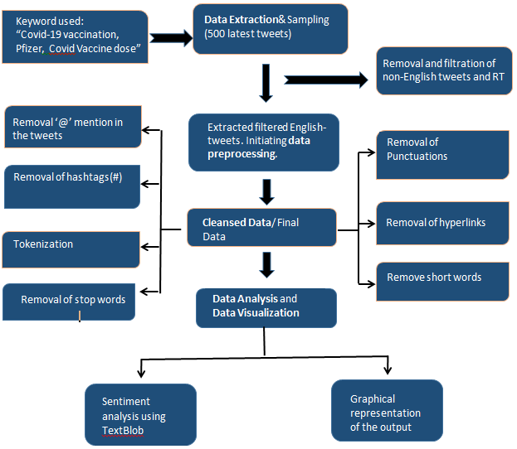
ITEC5205W - 2021
Architecture of the analysis process for Twitter extracted data
April 7th , 2021

Slide 10
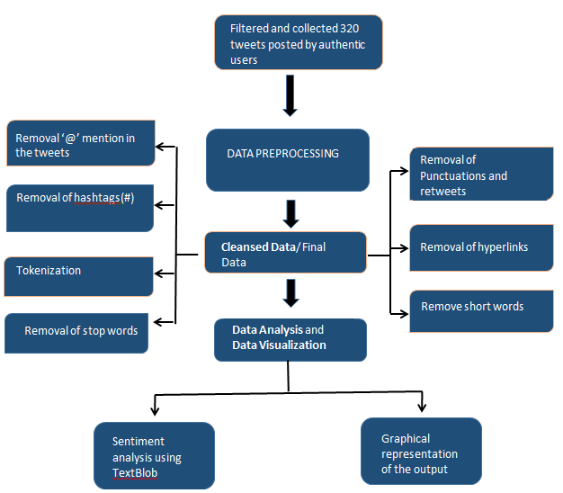
ITEC5205W - 2021
Architecture of the analysis process for online available dataset
April 7th , 2021

Slide 11
Pseudo code of the solution
ITEC5205W - 2021
Data extraction (SOFTWARE: GOOGLE COLAB)
FOR TWITTER EXTRACTION
#Get the necessary keys and token from the twitter developer account
consumer_key = ‘put the key here’
consumer_secret = ‘put the key here’
access_key = ‘put the key here’
access_token_secret = ‘put the key here’
#Initiating with the importing of the libraries and package
Import the pandas
Import the tweepy package from tweepy library
Import TextBlob package from textblob library
Import WordCloud
Import numpy
Import re
Import the matplotlib package
from nltk.corpus import stopwords
ALREADY AVAILABLE DATASET
#For loading the dataset
Use the google colab upload function for loading the csv file of the dataset
April 7th , 2021

Slide 12
ITEC5205W - 2021
#extract the data using search key word and creation of a dataframe
Specify the keyword as a search_term = ‘keywords’
Use “ –filter:retweets” for filtering all the RT to avoid repetition in data in the
search_term variable and store the new data in the new variable
Number of tweets to be extracted, tweet_amount = ‘number’
#Use cursor for searching the tweets in twitter and put in the variable
Variable = .Cursor(api.search, q=new_var, language = “?",
tweet_mode = “?“).items(tweet_amount)
#Extracting and printing the raw tweets into a dataframe
Pandas. DataFrame [final_text for tweet in varible] , column name = [‘Name’]
Call pandas.set_option to display all the columns and rows to none
Print the DataFrame
#Passing the keys for authorizing with the tweepy
OAuthhandler
#Authentication with the consumer_key and consumer_secret
tweepy .OAuthHandler(consumer_key, consumer_secret
#Authentication for setting the access token
authen.set_access_token(access_key, access_secret)
#Pass the above authorizations to tweepy
tweepy.API(authen, wait_on_rate_limit=True)
April 7th , 2021

Slide 13
Results after data extraction
ITEC5205W - 2021
DATA EXTRACTION USING TWEEPY | DATA EXTRACTION USING EXISTING DATASET
Number of Tweets using tweepy: Total Tweets extracted- 500 Tweets after filtration of Retweets: Tweets left – 55 Total number of Retweets Retweets - 445 | Number of tweets displayed using dataframe: Total number of tweets- 320 *(After prior filtration of tweets as per the research)*
April 7th , 2021

Slide 14

ITEC5205W - 2021
II. Data Preprocessing
#Data filtration and cleansing process
#Create a function called cleanTxt()
Remove ‘@’ mentions using re.sub(). Declare the pattern to be found as a raw string.
re.sub(r’pattern to be removed or replaced’, ‘ ‘ )
Remove ‘unwanted characters such as A-Z, a-z, 0-9 using re.sub()
Remove the hashtags ‘#’ using re.sub()
Remove the hyperlinks ‘https?:’ using re.sub()
Apply the cleanTxt function to the extracted tweets
Print
#more filteration
Removing short words after declaring a function
Tokenization using split function
Removing stop words
Joining the final tokenized tweets without stop words
Print the dataframe
April 7th , 2021

Slide 15
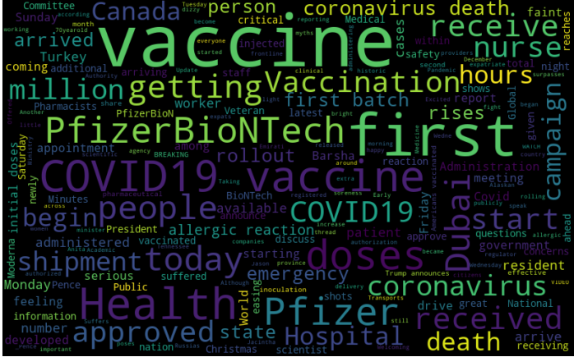
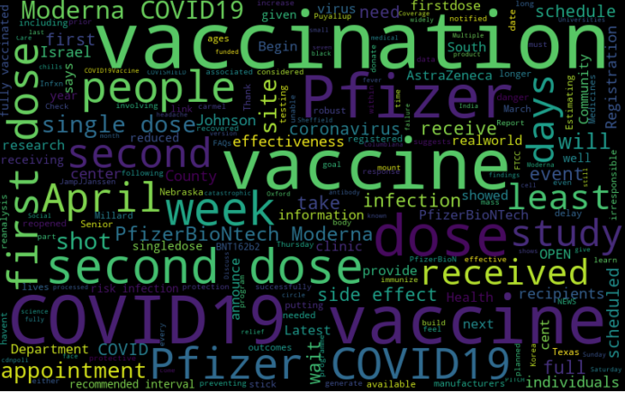
ITEC5205W - 2021
Word Cloud of April 2021 tweets
Word Cloud of December 2020 dataset
April 7th , 2021

Slide 16
Data Analysis and Data Visualization
ITEC5205W - 2021
(Defining subjectivity and polarity)
Defining the function ‘getSubjectivity’ and ‘getPolarity’
Apply both on the message dataframe
Display the resulting dataframe
#with two more columns displaying the subjectivity and the polarity of the tweets
#function building for the computation of the positive, negative and neutral analysis
Define a function named ‘getAnalysis’ where
If score(polarity) is less than 0 then
Print ‘Negative’
Else if score(polarity) is equal to 0 then
Print ‘Neutral’
Else
Print ‘Positive’
Display the Analysis after applying the result of the function ‘getAnalysis’ to the polarity dataframe
April 7th , 2021

Slide 17
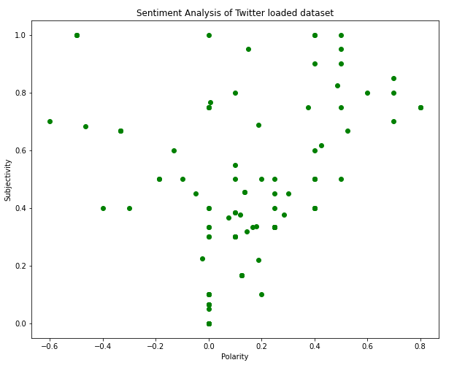
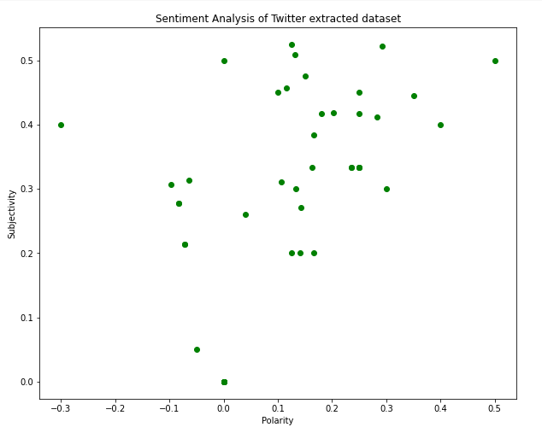
ITEC5205W - 2021
Percentage of Positive Tweets – 30.6
Percentage of Negative Tweets- 5.0
Percentage of Positive Tweets – 52.7
Percentage of Negative Tweets- 14.5
April 7th , 2021

Slide 18

ITEC5205W - 2021
The comparison of discussions in 10 selected states of Canada.
A summary table with all the details of keywords, hash tags used and most frequently used words.
The complete count of the tweets and re-tweets .
April 7th , 2021

Slide 19
Novelty
ITEC5205W - 2021
The analysis public discussions about the Covid-19 discussions is not yet done.
The comparison of data of two different time-period has been done for proper visualization and better understanding.
THIS RESEARCH IS USEFUL BECAUSE:
The results of this research could be used for future research work and analysis.
The summary of data will provide better understanding to the readers.
April 7th , 2021

Slide 20

Evaluation
ITEC5205W - 2021
Polarity and the subjectivity of the tweets are identified.
Polarity helped in the quantification of the sentiments with a positive, negative and neutral value.
Subjectivity for analyzing the public opinion.
The entire process is carried out for the utmost accuracy and the authenticity of the result.
April 7th , 2021

Slide 21
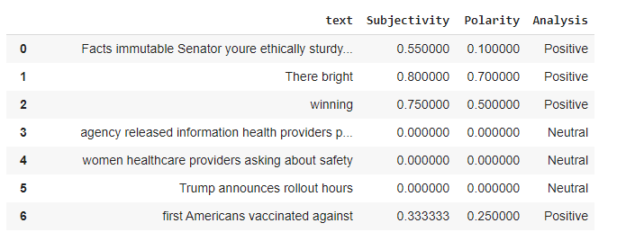
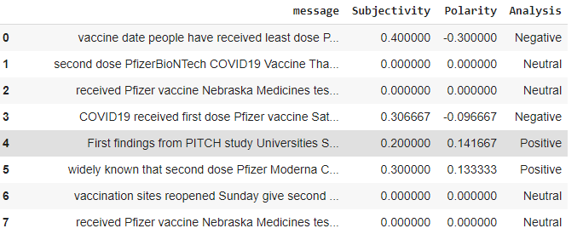
Research operational analysis
ITEC5205W - 2021
The python coding done for the research eventually resulted in:
Calculation of the re-tweets and the actual tweets.
Visualizing the total number of positive and negative tweets.
Word Cloud of dataset of two different durations.
Open dataset
Tweepy extracted dataset
April 7th , 2021

Slide 22
Related work comparison
ITEC5205W - 2021
Authors | Topic | Information about Research
Ahmad & Murad, 2020 | The Impact of Social Media on Panic During the COVID-19 Pandemic in Iraqi Kurdistan: Online Questionnaire Study | Study about the impact of Covid-19 in Kurdistan.
Xue et al., 2020 | Twitter discussions and emotions about the COVID-19 pandemic: a machine learning approach | Public discussions about coronavirus on Twitter
Fang & Costas, 2020 | Tracking the Twitter attention around the research efforts on the COVID-19 pandemic | A long-term impact of Covid-19 on the Twitter discussion is observed.
April 7th , 2021

Slide 23
References
ITEC5205W - 2021
Abd-Alrazaq, A., Alhuwail, D., Househ, M., Hamdi, M. and Shah, Z., 2020. Top Concerns of Tweeters During the COVID-19 Pandemic: Infoveillance Study. Journal of Medical Internet Research, 22(4), p.e19016.
Ahmad, A. and Murad, H., 2020. The Impact of Social Media on Panic During the COVID-19 Pandemic in Iraqi Kurdistan: Online Questionnaire Study. Journal of Medical Internet Research, 22(5), p.e19556.
Banda, J., Tekumalla, R., Wang, G., Yu, J., Lui, T., Ding, Y., Artemova, K., Tutubalina, E., Chowell, G., 2020. A large-scale COVID-19 Twitter chatter dataset for open scientific research - an international collaboration. arXiv:2004.03688
Bracci, A., Nadini, M., Aliapoulios, M., McCoy, D., Gray, I., Teytelboym, A., Gallo, A. and Baronchelli, A., 2021. Dark Web Marketplaces and COVID-19: before the vaccine. EPJ Data Science, 10(1).
Chen, E., Lerman, K. and Ferrara, E., 2020. Tracking Social Media Discourse about the COVID-19 Pandemic: Development of a Public Coronavirus Twitter Data Set. JMIR Public Health and Surveillance, 6(2), p.e19273. Doi: 10.2196/19273.
Depoux, A., Martin, S., Karafillakis, E., Preet, R., Wilder-Smith, A. and Larson, H., 2020. The pandemic of social media panic travels faster than the COVID-19 outbreak. Journal of Travel Medicine, 27(3).
April 7th , 2021

Slide 24
ITEC5205W - 2021
Dyer, J. and Kolic, B., 2020. Public risk perception and emotion on Twitter during the Covid-19 pandemic. Applied Network Science, 5(1).
Edo-Osagie, O., De La Iglesia, B., Lake, I. and Edeghere, O., 2020. A scoping review of the use of Twitter for public health research. Computers in Biology and Medicine, 122, p.103770.
Fang, Z., Costas, R., 2020. Tracking the Twitter attention around the research efforts on the COVID-19 pandemic. arXiv:2006.05783.
Hamoui, B., Alashaikh, A. and Alanazi, E., 2020. What are Covid-19 Arabic tweeters talking about? DOI:10.20944/preprints202007.0172.v1.
Hernández-García, I. and Giménez-Júlvez, T., 2020. Assessment of Health Information About COVID-19 Prevention on the Internet: Infodemiological Study. JMIR Public Health and Surveillance, 6(2), p.e18717.
Huang, X., Jamison, A., Broniatowski, D., Quinn, S., and Dredze, M., 2020. Coronavirus Twitter Data: A collection of COVID-19 tweets with automated annotations. Doi:https://doi.org/10.5281/zenodo.3735015.
Lamsal, R., 2020. Design and analysis of a large-scale COVID-19 tweets dataset. Applied Intelligence.
Li, X., Zhou, M., Wu, J., Yuan, A., Wu, F., Li, J., 2020. Analyzing COVID-19 on online social media: trends, sentiments and emotions. arXiv preprint arXiv:2005.14464.
Mourad, A., Srour, A., Harmanai, H., Jenainati, C. and Arafeh, M., 2020. Critical Impact of Social Networks Infodemic on Defeating Coronavirus COVID-19 Pandemic: Twitter-Based Study and Research Directions. IEEE Transactions on Network and Service Management, 17(4), pp.2145-2155.
Rabindra Lamsal, 2020. Coronavirus (COVID-19) Tweets Dataset. Doi: https://dx.doi.org/10.21227/781w-ef42.
April 7th , 2021

Slide 25
ITEC5205W - 2021
Tsao, S., Chen, H., Tisseverasinghe, T., Yang, Y., Li, L. and Butt, Z., 2021. What social media told us in the time of COVID-19: a scoping review. The Lancet Digital Health.
Valdez, D., ten Thij, M., Bathina, K., Rutter, L. and Bollen, J., 2020. Social Media Insights Into US Mental Health During the COVID-19 Pandemic: Longitudinal Analysis of Twitter Data. Journal of Medical Internet Research, 22(12), p.e21418.
Wicke, P., Bolognesi, M.M., (2020). Framing COVID-19: How we conceptualize and discuss the pandemic on Twitter . PLoS ONE 15(9): e0240010. Doi: https://doi.org/10.1371/journal.pone.0240010
Xue, J., Chen, J., Hu, R., Chen, C., Zheng, C., Su, Y. and Zhu, T., 2020. Twitter Discussions and Emotions About the COVID-19 Pandemic: Machine Learning Approach. Journal of Medical Internet Research, 22(11), p.e20550.
Authentication Tutorial — tweepy 3.10.0 documentation. [online] Available at: https://docs.tweepy.org/en/latest/auth_tutorial.html [Accessed 19 Mar. 2021].
Covid19.who.int. 2021. WHO Coronavirus Disease (COVID-19) Dashboard. [online] Available at: <https://covid19.who.int/> [Accessed 22 March 2021].
Earth Data Science - Earth Lab. (2018). Automate Getting Twitter Data in Python Using Tweepy and API Access. [online] Available at: https://www.earthdatascience.org/courses/use-data-open-source-python/intro-to-apis/twitter-data-in-python/.
Bagheri, H. & Islam, J. M., (2020). Sentiment analysis of twitter data. DOI: https://arxiv.org/abs/1711.10377
April 7th , 2021

Slide 26

ITEC5205W - 2021
April 7th , 2021

