Slide 1

ALY 6020 – Predictive Analytics
Winter 2020 Quarter
Toxic Comment Classification
Group Members:
Nitika Bhatia
Rajeev Kumar Maram
Shweta Gupta

Slide 2

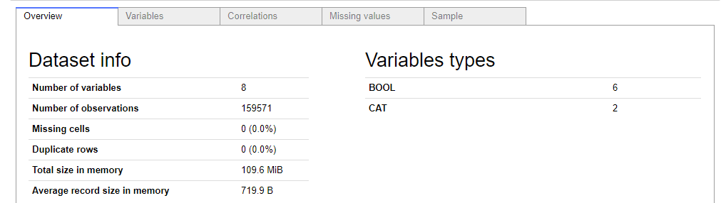
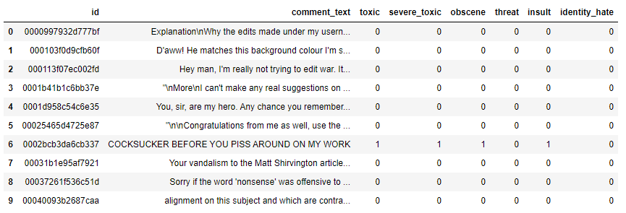
Data Summary
Source: Kaggle
About Data: Large number of Wikipedia comments which have been labeled by human raters for toxic behavior
Classification Variables:
Toxic - 1
Severe_toxic - 2
Obscene - 3
Threat - 4
Insult - 5
Identity_hate - 6

Slide 3


Goal
Build a model that’s capable of predicting the classification of comments into different types of toxicity like threats, obscenity, insults, and identity-based hate
Focus
Our area of focus is to study the negative online behaviors, like toxic comments (i.e. comments that are rude, disrespectful or otherwise likely to make someone leave a discussion)
Techniques
Natural Language Processing
Text Mining
Feature Extraction
Classification

Slide 4
Roadmap Of The Project
EDA
Feature Extraction
Model Comparison
1
2
3
4
5
Text Mining
Model Building

Slide 5
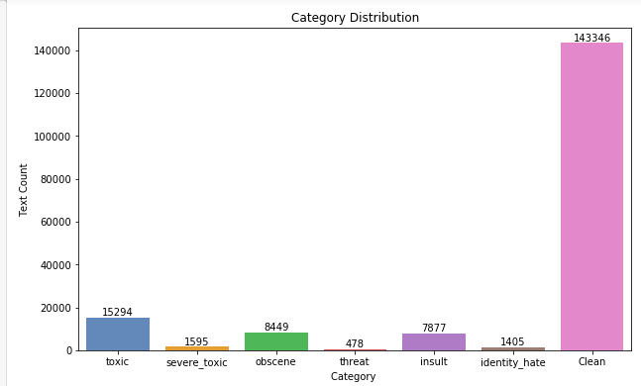
1. Exploratory Data Analysis
Distribution of Categories
90% of the comments in our dataset are clean and do not fall into any of the toxic categories
A comment that is classified as severe toxic (2) also falls into the toxic (1) category
Only 0.003% comments are classified into the Threat (4) category

Slide 6
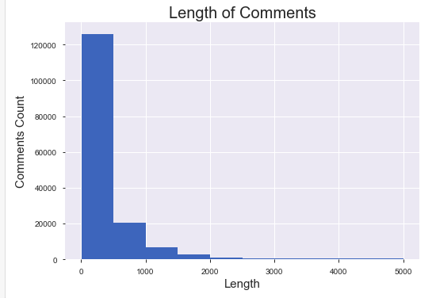
1. Exploratory Data Analysis
Most of comments have length around 200.
Maximum length – 5000
Minimum length - 6

Slide 7

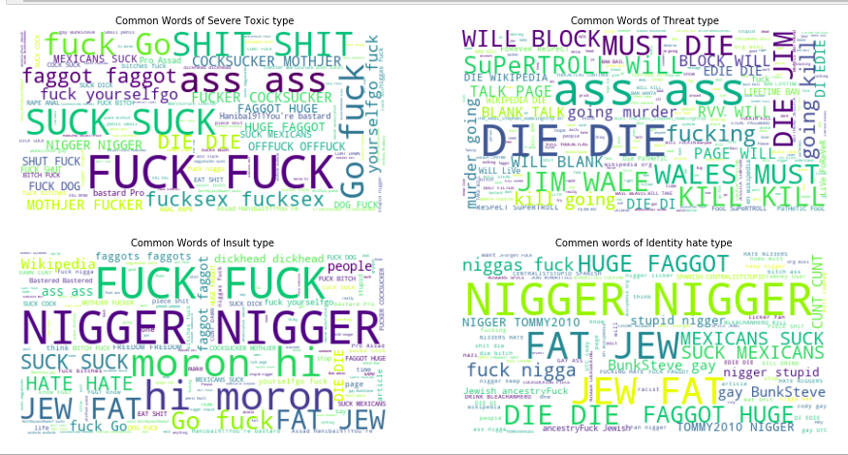


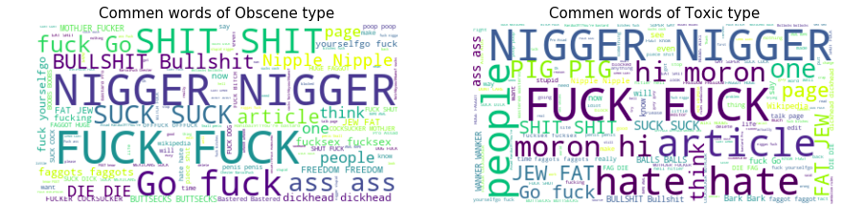

Word Cloud

Slide 8
2. Text Mining
Converting the text to lower case
Removing Punctuation
Removing Stop words
Lemmatization

Slide 9
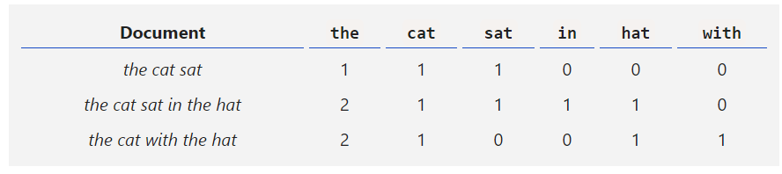
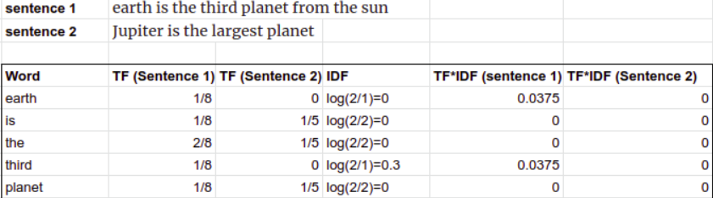
3. Feature Extraction
Count Vectorization: It count how many times each word appears in a sentence.
TF-IDF: TF-IDF representation, the term frequency for each word is normalized by the inverse document frequency, or IDF. The inverse document frequency normalization reduces the weight of terms which occur more frequently in the collection.

Slide 10


Model Building
Training Set
Models
80%
Dataset
20%
Testing Set

Slide 11
Models
Naïve Bayes
Logistic Regression
Random Forest
XGBOOST

Slide 12

Naïve Bayes
Naive Bayes methods are a set of supervised learning algorithms based on applying Bayes’ theorem with the “naive” assumption of conditional independence between every pair of features given the value of the class variable. Bayes’ theorem states the following relationship, given class variable y and dependent feature vector x1 through xn:

Slide 13
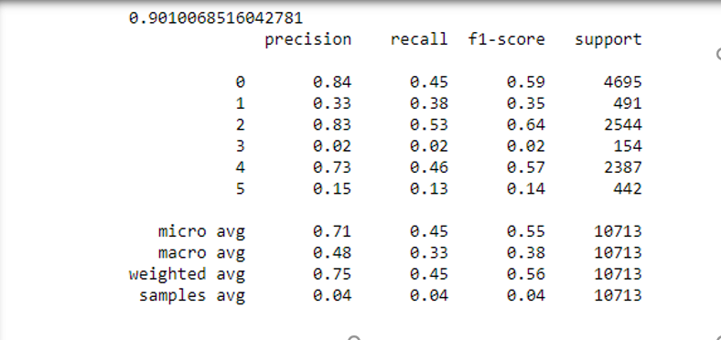
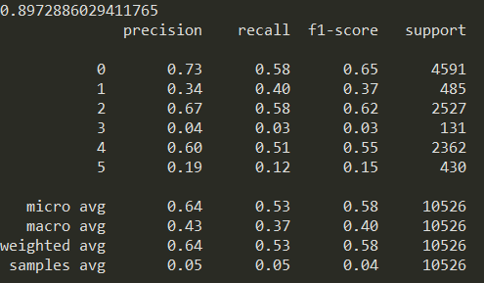
Naive Bayes
TF-IDF
Count Vectorization

Slide 14

Logistic Regression
Logistic Regression is method of binary classification of a categorical variable depending on other independent variables. It determines the probability of an event occurring (1) or not occurring (0).

Slide 15
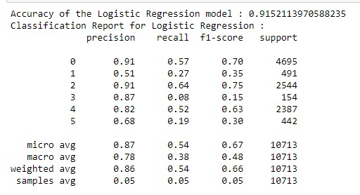
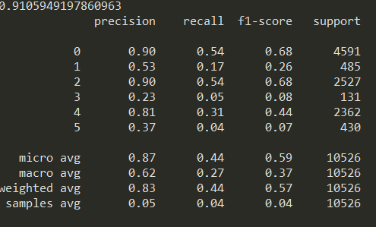
Logistic Regression
TF-IDF
Count Vectorization

Slide 16
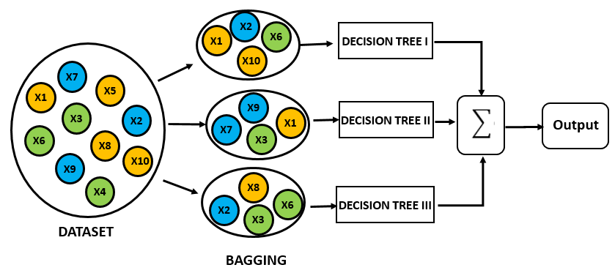
Random Forest - Bagging
Random Forest is a meta estimator that fits a number of decision tree classifiers on various sub-samples of the dataset and uses averaging to improve the predictive accuracy and control over-fitting.

Slide 17
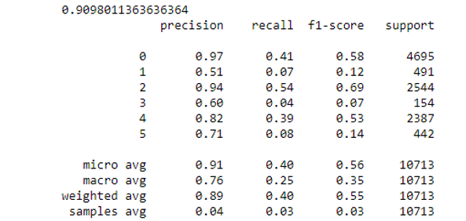
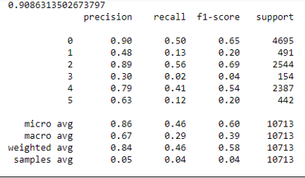
Random Forest
TF-IDF
Count Vectorization

Slide 18
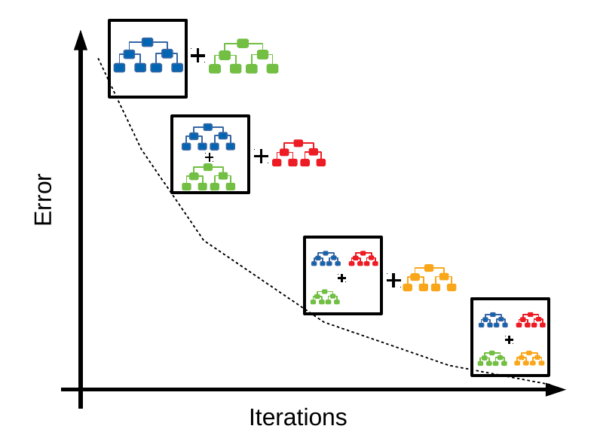
Gradient Boosting
Gradient Boosting builds an additive model in a forward stage-wise fashion; it allows for the optimization of arbitrary differentiable loss functions.

Slide 19
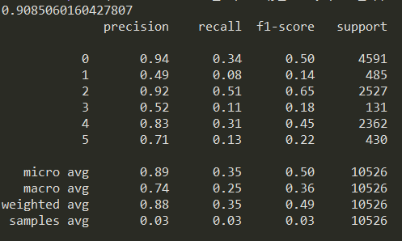
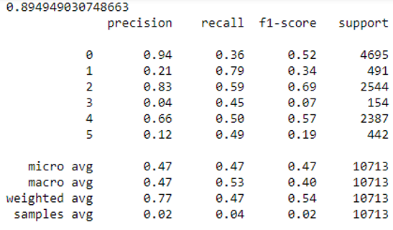
Gradient Boosting
TF-IDF
Count Vectorization

Slide 20
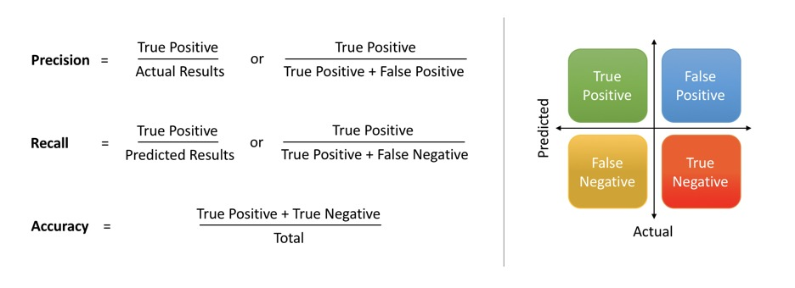
Model Performance Parameters

Slide 21
Model Performance summary
Parameters | CV | CV | CV | CV
 | Naïve Bayes | Logit Model | RF Model | XG Boost
Precision | 0.43 | 0.62 | 0.86 | 0.89
Recall | 0.37 | 0.27 | 0.46 | 0.35
F1 Score | 0.39 | 0.36 | 0.6 | 0.5
Accuracy | 0.89 | 0.91 | 0.91 | 0.9
Parameters | TF-IDF | TF-IDF | TF-IDF | TF-IDF
 | Naïve Bayes | Logit Model | RF Model | XG Boost
Precision | 0.71 | 0.87 | 0.91 | 0.9
Recall | 0.45 | 0.54 | 0.40 | 0.3
F1 Score | 0.55 | 0.67 | 0.56 | 0.52
Accuracy | 0.90 | 0.92 | 0.91 | 0.9

Slide 22
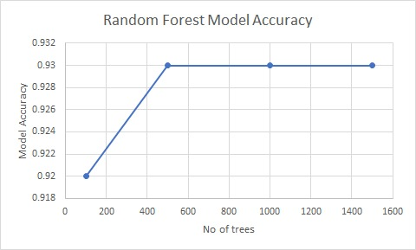
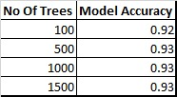
Random Forest Cross Validation
Final Model: Random Forest with 100 trees

Slide 23
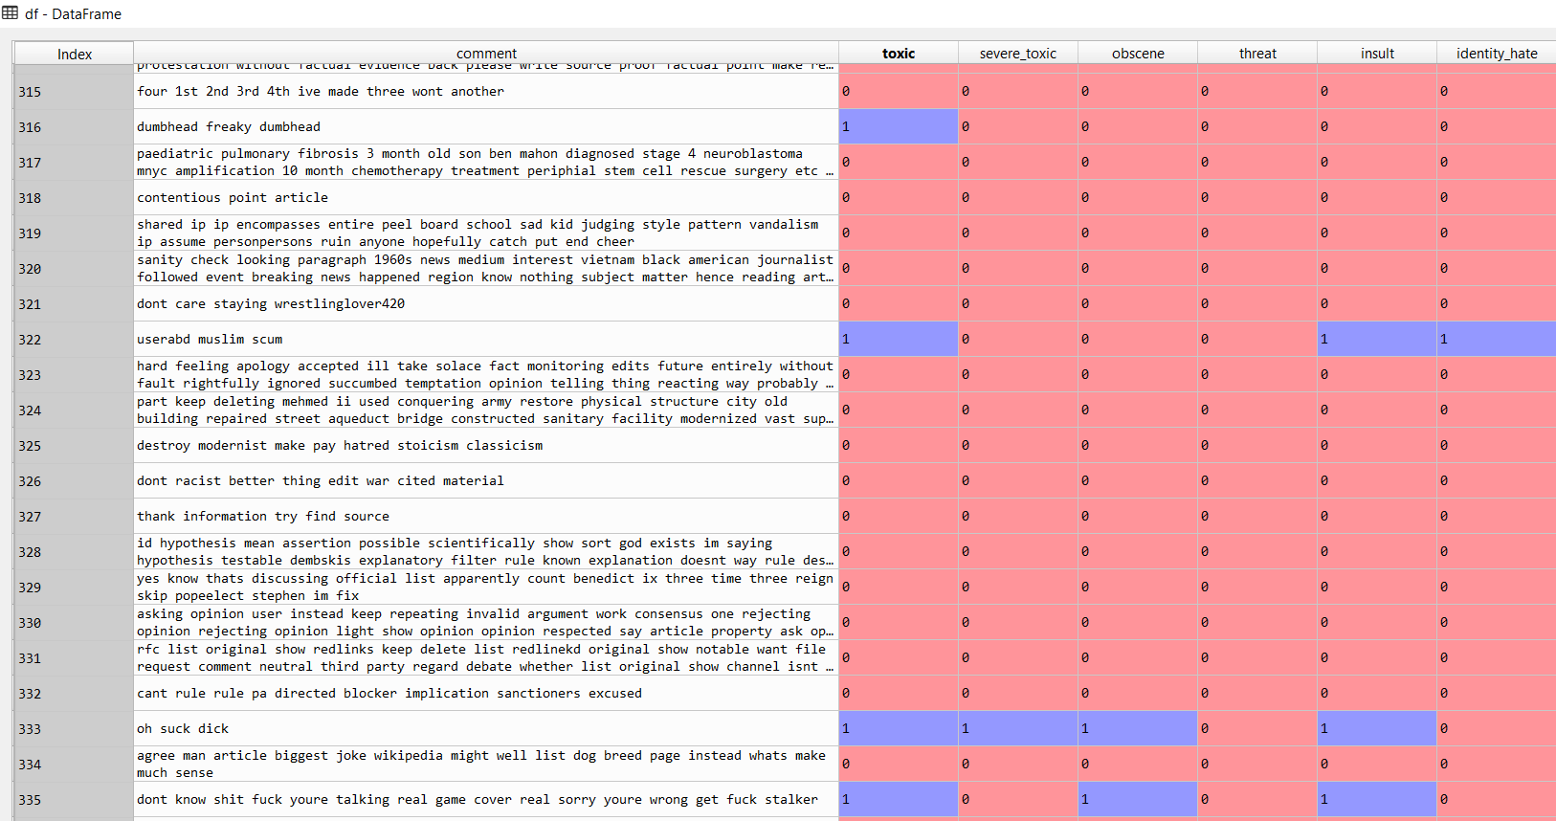
Our Predictions

Slide 24

Our Model in Real World
In 2018, Mark Zuckerberg said - "By the end of this year we're gonna have more than 20,000 people working on security and content review,"
Our toxicity classification model can come to their rescue!

Slide 25

Any questions ?

Slide 26

Thank You for your time

