Slide 1
Investigating a Potential Milky Way Radio Halo
Nitika Yadlapalli, Vikram Ravi
Department of Astronomy, California Institute of Technology

Slide 2
Components of the Radio Sky
Notes:
ARCADE 2 = Absolute Radiometer for Cosmology, Astrophysics, and Diffuse Emission. Main goal = look for deviations from CMB’s blackbody spectrum. Experiment from 2006
5 frequency bands – 3,8,10,30,90 GHz. At 3 and 8 GHz, they noticed significant excess emission. Using this as well as analyses from other lower frequency maps, they fit the excess brightness temperature as a function of frequency and discovered this.
0.5 K excess at 1 GHz, spectral index of -2.6
Facts of instruments you should prob memorize:
-12º beam width

Slide 3
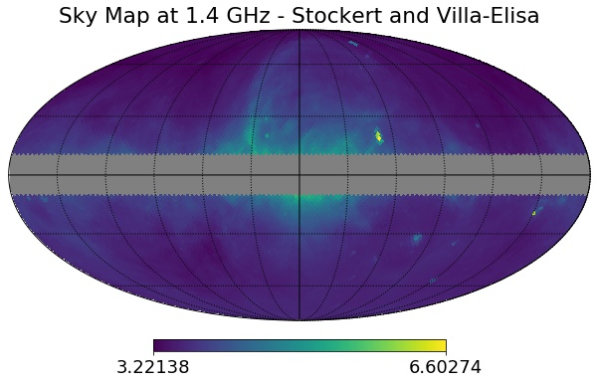
Components of the Radio Sky
(Reich & Reich 1986)
Notes:
ARCADE 2 = Absolute Radiometer for Cosmology, Astrophysics, and Diffuse Emission. Main goal = look for deviations from CMB’s blackbody spectrum. Experiment from 2006
5 frequency bands – 3,8,10,30,90 GHz. At 3 and 8 GHz, they noticed significant excess emission. Using this as well as analyses from other lower frequency maps, they fit the excess brightness temperature as a function of frequency and discovered this.
0.5 K excess at 1 GHz, spectral index of -2.6
Facts of instruments you should prob memorize:
-12º beam width

Slide 4
Components of the Radio Sky
Notes:
ARCADE 2 = Absolute Radiometer for Cosmology, Astrophysics, and Diffuse Emission. Main goal = look for deviations from CMB’s blackbody spectrum. Experiment from 2006
5 frequency bands – 3,8,10,30,90 GHz. At 3 and 8 GHz, they noticed significant excess emission. Using this as well as analyses from other lower frequency maps, they fit the excess brightness temperature as a function of frequency and discovered this.
0.5 K excess at 1 GHz, spectral index of -2.6
Facts of instruments you should prob memorize:
-12º beam width

Slide 5
Components of the Radio Sky
~ 0.1 K
Notes:
ARCADE 2 = Absolute Radiometer for Cosmology, Astrophysics, and Diffuse Emission. Main goal = look for deviations from CMB’s blackbody spectrum. Experiment from 2006
5 frequency bands – 3,8,10,30,90 GHz. At 3 and 8 GHz, they noticed significant excess emission. Using this as well as analyses from other lower frequency maps, they fit the excess brightness temperature as a function of frequency and discovered this.
0.5 K excess at 1 GHz, spectral index of -2.6
Facts of instruments you should prob memorize:
-12º beam width

Slide 6
Components of the Radio Sky
~ 0.1 K
2.7 K
Notes:
ARCADE 2 = Absolute Radiometer for Cosmology, Astrophysics, and Diffuse Emission. Main goal = look for deviations from CMB’s blackbody spectrum. Experiment from 2006
5 frequency bands – 3,8,10,30,90 GHz. At 3 and 8 GHz, they noticed significant excess emission. Using this as well as analyses from other lower frequency maps, they fit the excess brightness temperature as a function of frequency and discovered this.
0.5 K excess at 1 GHz, spectral index of -2.6
Facts of instruments you should prob memorize:
-12º beam width

Slide 7
Components of the Radio Sky
~ 0.1 K
2.7 K
Notes:
ARCADE 2 = Absolute Radiometer for Cosmology, Astrophysics, and Diffuse Emission. Main goal = look for deviations from CMB’s blackbody spectrum. Experiment from 2006
5 frequency bands – 3,8,10,30,90 GHz. At 3 and 8 GHz, they noticed significant excess emission. Using this as well as analyses from other lower frequency maps, they fit the excess brightness temperature as a function of frequency and discovered this.
0.5 K excess at 1 GHz, spectral index of -2.6
Facts of instruments you should prob memorize:
-12º beam width

Slide 8
Components of the Radio Sky
~ 0.1 K
2.7 K
ARCADE 2: ~0.5 K at 1 GHz
(Seiffert et al. 2011)
Notes:
ARCADE 2 = Absolute Radiometer for Cosmology, Astrophysics, and Diffuse Emission. Main goal = look for deviations from CMB’s blackbody spectrum. Experiment from 2006
5 frequency bands – 3,8,10,30,90 GHz. At 3 and 8 GHz, they noticed significant excess emission. Using this as well as analyses from other lower frequency maps, they fit the excess brightness temperature as a function of frequency and discovered this.
0.5 K excess at 1 GHz, spectral index of -2.6
Facts of instruments you should prob memorize:
-12º beam width

Slide 9
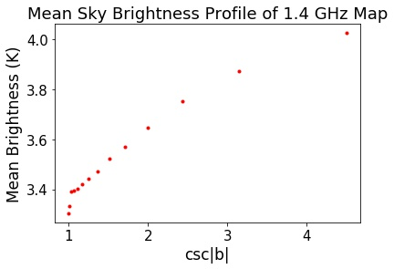
Galactic Foreground Modeling
The Plane Parallel Slab Model
Notes:
So, the galaxy model chosen by ARCADE 2 was the plane parallel slab model. This model is a linear function of latitude, as shown above, rather than both latitude and longitude
Basically, they took their data, subtracted off their expected extragalactic components at each frequency as well as the CMB, and then used the leftover emission to fit for the slope and intercept of the linear fit. Talk about how I equation, c(v) is nonzero, which is the indication of extra emission. But these is a change that rather than more uniform background emission, the extra emission can be explained by another component to the galactic foreground, such as a halo

Slide 10
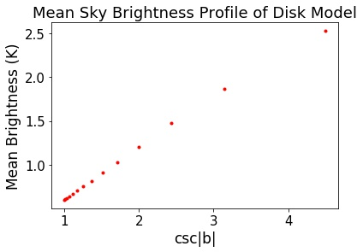
Galactic Foreground Modeling
The Plane Parallel Slab Model
(Kogut et al. 2011)
Notes:
So, the galaxy model chosen by ARCADE 2 was the plane parallel slab model. This model is a linear function of latitude, as shown above, rather than both latitude and longitude
Basically, they took their data, subtracted off their expected extragalactic components at each frequency as well as the CMB, and then used the leftover emission to fit for the slope and intercept of the linear fit. Talk about how I equation, c(v) is nonzero, which is the indication of extra emission. But these is a change that rather than more uniform background emission, the extra emission can be explained by another component to the galactic foreground, such as a halo

Slide 11
Galactic Foreground Modeling
Disk + Halo Model
Notes:
Talk about how these are examples of all-sky models of disk + halo and how models like these will be used later on determine best fits of disks+halos to actual data

Slide 12
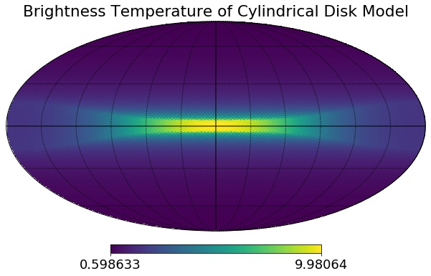
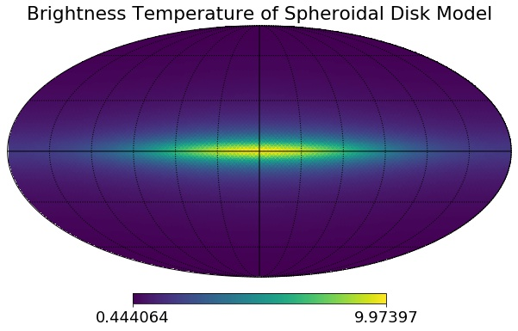
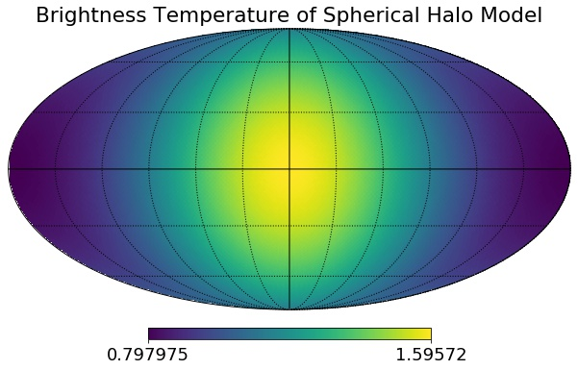
Galactic Foreground Modeling
Disk + Halo Model
Notes:
Talk about how these are examples of all-sky models of disk + halo and how models like these will be used later on determine best fits of disks+halos to actual data

Slide 13
Analyzing All-Sky Map
Notes:
Just to see though, 50th percentile values for each parameter, model and residuals

Slide 14
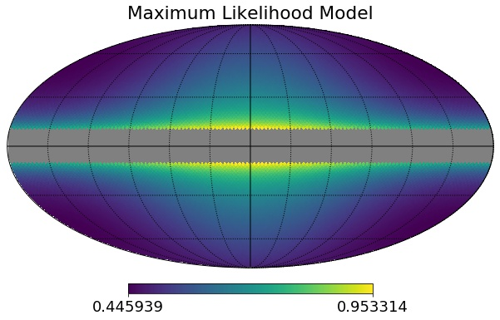
Analyzing All-Sky Map
Notes:
Just to see though, 50th percentile values for each parameter, model and residuals

Slide 15
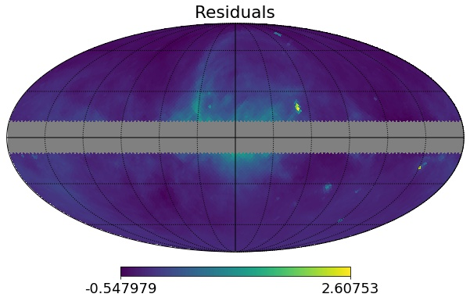
Analyzing All-Sky Map
Notes:
Just to see though, 50th percentile values for each parameter, model and residuals

Slide 16
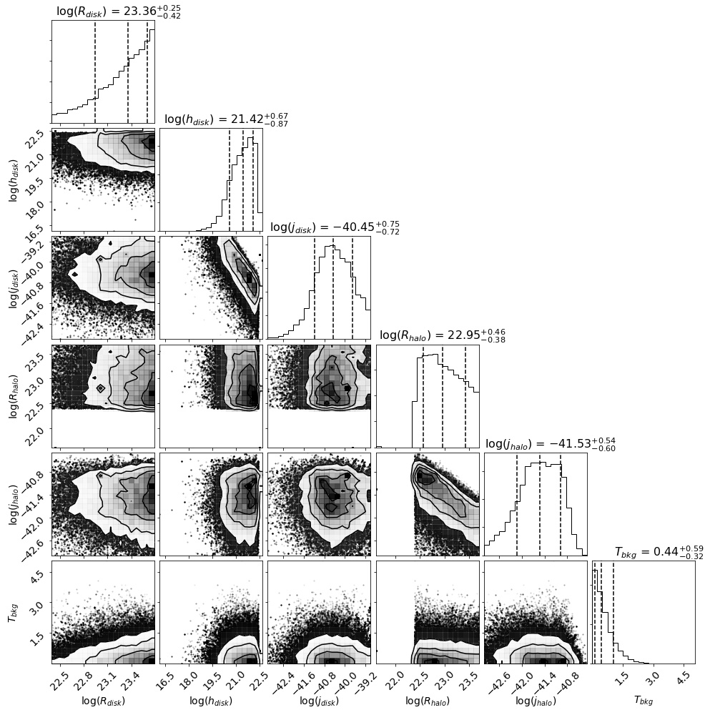
Analyzing All-Sky Map
Notes:
Example of such an MCMC analysis. Some things to note right away: badly constrained for radius of disk bc we blanked center of disk in analysis
R_halo pushing towards smaller values – potentially this because residuals are best when emission from North Galactic Spur, this huge feature in the middle, is better subtracted
Slightly thick disk predicted, 0.85 kpc
Ultimately, not very well converged and errors and are pretty large

Slide 17
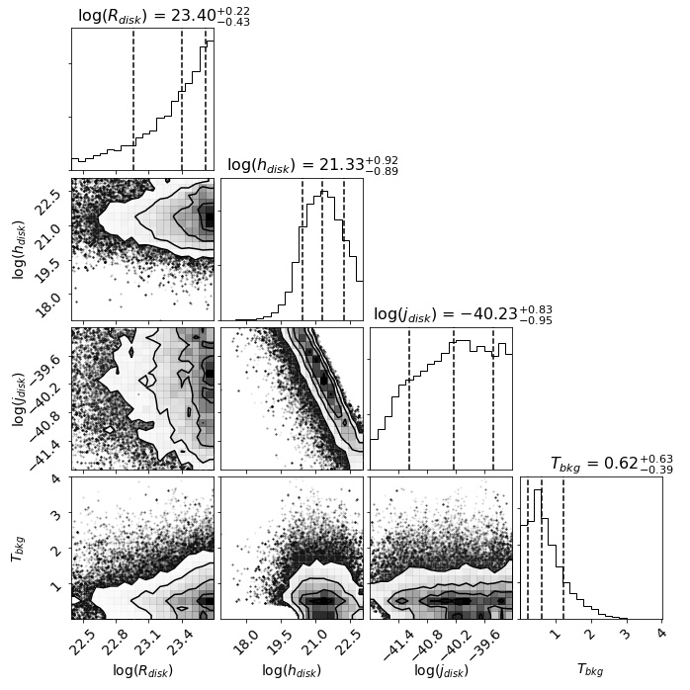
Analyzing All-Sky Map
Notes:
Disk + bkg model rather than disk + halo + bkg
Parameter values still not fantastically converted, however, maximum likelihood looks to be non-zero in disk only model whereas that’s not true in disk+halo model.

Slide 18
Analyzing TRIS Data
Notes:
TRIS = another absolutely calibrated radiometer. Observes at 0.6 and 0.82 GHz, single declination strip. Avoids big nearby features

Slide 19
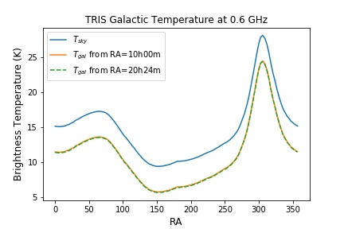
Analyzing TRIS Data
Notes:
Exact methods outlined in TRIS paper, but basic premise is use galaxy temperature at a given reference location to calculate the galactic temperature at every location. By galactic here, we mean subtract off uniform background without actually calculating the background separately. Example shown in graph. Now, we have the chance to try and fit our disk+halo model to this graph.

Slide 20
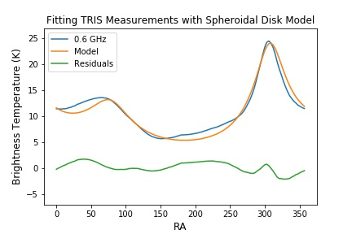
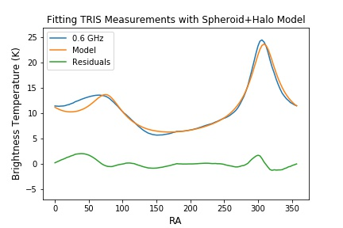
Analyzing TRIS Data
Notes:
Again, we ran both disk only and disk+halo model
By eye, we can see that adding the halo fits the middle slope really well.
Note here, too few values existed in TRIS data for reliable results from KS test, so we did a simple integral in abs value of residuals

Slide 21
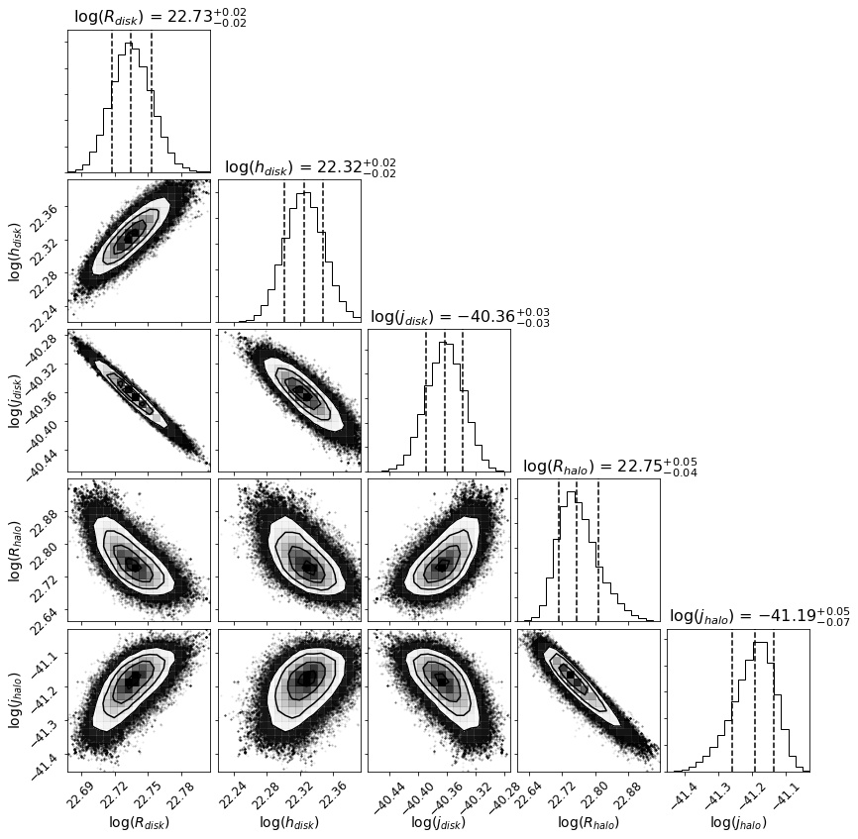
Analyzing TRIS Data
Notes:
Chains are much better converged! And errors are small. Results are strange though. Disk and Radius halo both very similar, 2.2d and 2.3d. Is that reasonable? Not sure
Thickness though, has maximum likelihood here of like 0.86d. That’s huge and doesn’t seem right, but unclear what the result means. Results are very different from all sky map fits. Only emissivities are similar in the sense that disk is an order of magnitude more emissive than halo

Slide 22
Final Thoughts
Notes:
So, to bring it back to this, did we discover that we live in a synchrotron halo? Not conclusively no. But we have suspicions that the disk only model of the galaxy is insufficient. From here, we may wish to apply model selection criterion to our fits to see if adding a halo was valuable to our data or not. It would also be interesting to run a similar test for the ARCADE data and match the results, as these are both absolutely calibrated radiometers. A multi-frequency fit could be run too.

Slide 23
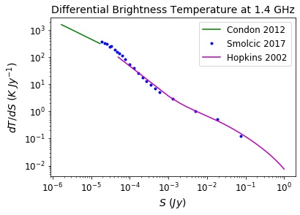
Extragalactic Brightness Temperature
Notes:
Now, we need to address how extragalactic brightness is calculated to be subtracted from model

Slide 24




Brightness Temperature
Notes:
Now, we need to address how extragalactic brightness is calculated to be subtracted from model

Slide 25



Electron Cooling Time
Notes:
Now, we need to address how extragalactic brightness is calculated to be subtracted from model

Slide 26
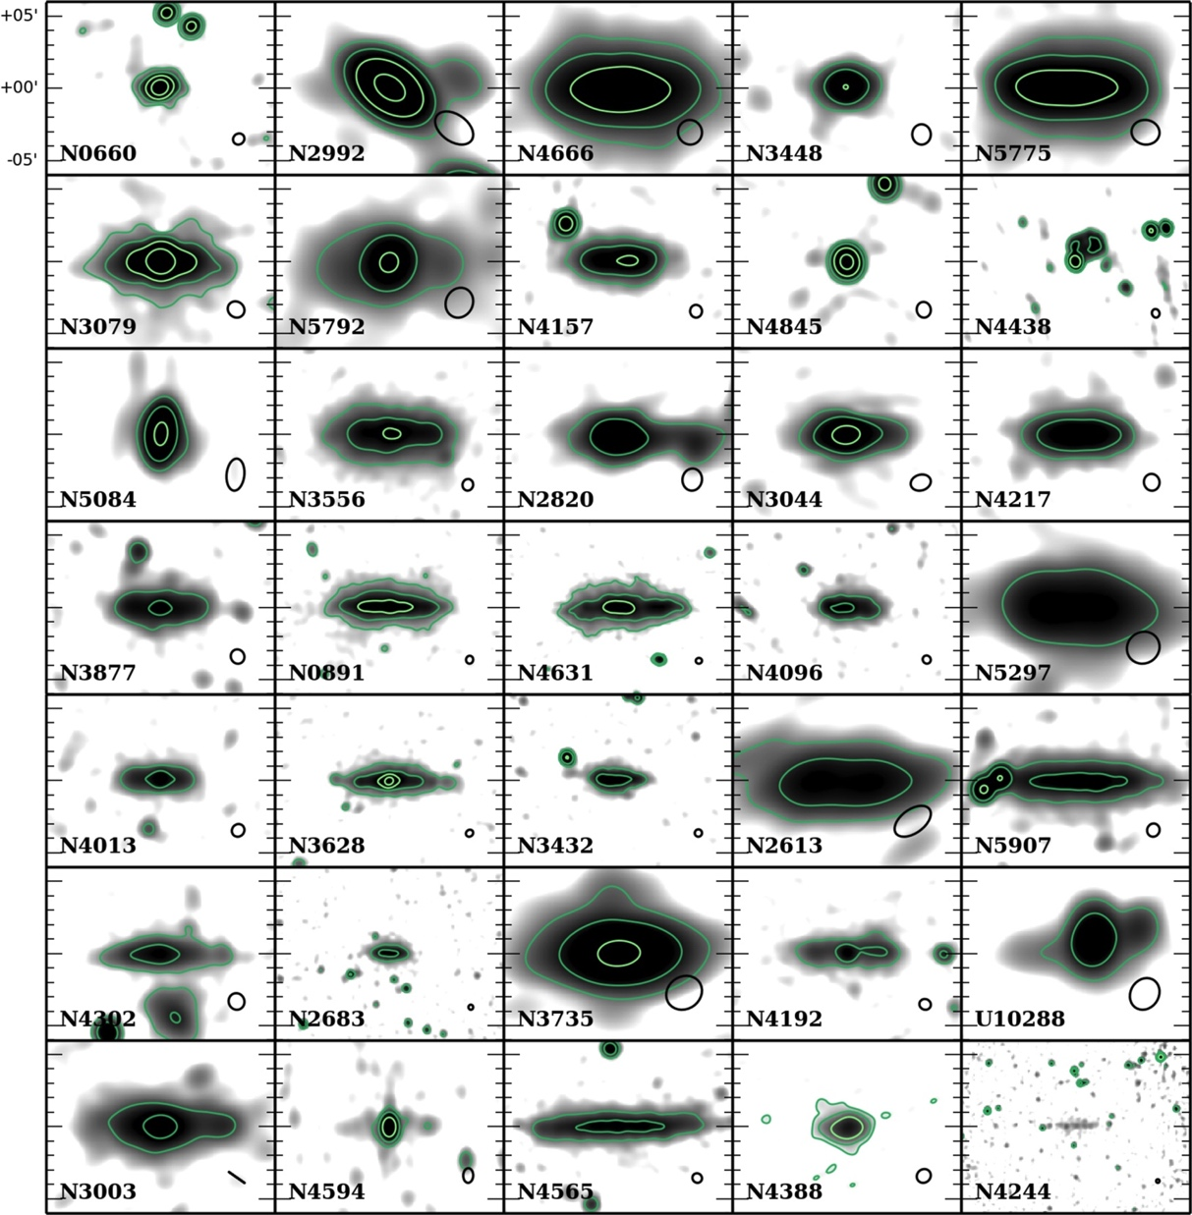
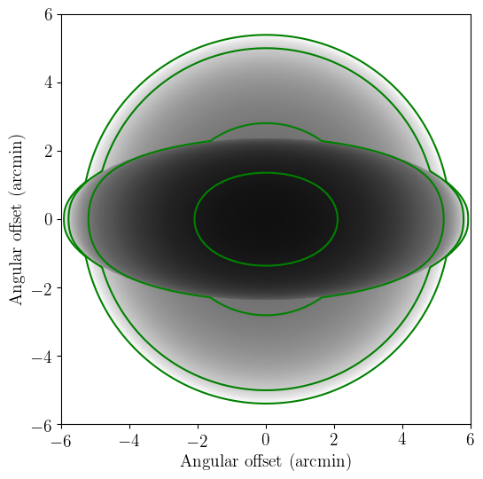
Extragalactic Halos
Wiegert et al 2015
Notes:
Chains are much better converged! And errors are small. Results are strange though. Disk and Radius halo both very similar, 2.2d and 2.3d. Is that reasonable? Not sure
Thickness though, has maximum likelihood here of like 0.86d. That’s huge and doesn’t seem right, but unclear what the result means. Results are very different from all sky map fits. Only emissivities are similar in the sense that disk is an order of magnitude more emissive than halo

