Slide 1
Normalization

Slide 2
Normalization of data can be considered a process of analyzing the given relation schemas based on their FD’s and primary keys to achieve the desirable properties of:
Minimizing Redundancy
Minimizing the insertion,deletion and updation anomalies.
Minimizing Nulls.

Slide 3
Function Dependency
A Functional dependency denoted by X->Y states that Y is functionally dependent of X . This means the value of Y attribute is determined by X. The X attribute uniquely determine the value of the Y attribute.
For Example: Consider a Relation:
Parts(Part_name,Cost)
Cost is functionally dependent on the Part_Name.
The cost will be same if part_name repeat in the table.

Slide 4
For example: Suppose we have a student table with attributes: Stu_Id, Stu_Name, Stu_Age. Here Stu_Id attribute uniquely identifies the Stu_Name attribute of student table because if we know the student id we can tell the student name associated with it. This is known as functional dependency and can be written as Stu_Id->Stu_Name or in words we can say Stu_Name is functionally dependent on Stu_Id.

Slide 5
Suppose a manufacturing company stores the employee details in a table named employee that has four attributes:
emp_id for storing employee’s id, emp_name for storing employee’s name, emp_address for storing employee’s address and
emp_dept for storing the department details in which the employee works.
At some point of time the table looks like this:

Slide 6
emp_id | emp_name | emp_address | emp_dept
101 | Rick | Delhi | D001
101 | Rick | Delhi | D002
123 | Maggie | Agra | D890
166 | Glenn | Chennai | D900
166 | Glenn | Chennai | D004

Slide 7
Anomalies in Relational Schemas
Update anomaly: In the above table we have two rows for employee Rick as he belongs to two departments of the company. If we want to update the address of Rick then we have to update the same in two rows or the data will become inconsistent.
If somehow, the correct address gets updated in one department but not in other then as per the database, Rick would be having two different addresses, which is not correct and would lead to inconsistent data.

Slide 8
Insert anomaly: Suppose a new employee joins the company, who is under training and currently not assigned to any department then we would not be able to insert the data into the table if emp_dept field doesn’t allow nulls.
Delete anomaly: Suppose, if at a point of time the company closes the department D890 then deleting the rows that are having emp_dept as D890 would also delete the information of employee Maggie since she is assigned only to this department.

Slide 9
Anomalies in Relational Schemas
Consider a Relation:
Emp-Proj (Empno,Proj_no,Ename,Pname,No_Hours)
Update Anomaly: If there is redundancy in the database and we want to make modification in the database that will cause the user to do lot of modifications where the data is present in the database. For example: If in the above relation the project name of Proj_number 10 is to be changed to some other this will cause to change the number of rows because there will be no of employees working on that particular project.

Slide 10
Insert Anomaly: This Anomaly is generated when we want to insert the information which is partially available. For example: In the above relation we can insert the employee information until or unless is not assigned any project.
Delete Anomaly: This anomaly is generated when we want to delete the information which is not relevant and relevant information get deleted. For example: In above relation we want to delete the project the employees information also get deleted with the project information which is relevant.

Slide 11
Normal Forms
There are Four Normal Forms for normalization the relation:
1st Normal Form
2nd Normal Form
3rd Normal Form
Boyce codd Normal Form

Slide 12
1st Normal Form or 1NF: It states that the domain of an attribute must have an atomic value and that value of any attribute in a tuple must be single value from the domain of that attribute.
For example: Consider a Relation:
Department( Dname , Dnumber,Dmgrno,Dlocation)
Functional dependency:
Dnumber -> Dname , Dmgrno

Slide 13
In the above relation Dlocation is not dependent upon dnumber .It is possible that Dlocation does not have atomic value corresponding to the dnumber i.e. a department can exist in number of location keeping that in mind our relation is not in First normal Form if such kind of condition is Given in the question.
Or the Values given in the relation does not satisfy the condition of first normal form then also the relation is not in First normal Form.

Slide 14
DNAME | Dnumber | Dmgrno | Dlocation
Research | 3 | 101 | (delhi,mumbai,pune)
Administration | 2 | 102 | Mumbai
Headquaters | 1 | 103 | Punjab
In the above table the dlocation does not have atomic values so the relation is not in first normal form. To convert the relation in first normal form we have three methods:
First method is to expand the dlocation column i.e. there will be three rows having having different dlocation . This will increase redundancy in the database so this method is not suitable.
Second Method is to create three columns for dlocation i.e dlocation1,dlocation2 and dlocation3 .This method is also not suitable because number of NULL values will be increased in the database.
The Third method is the best method among the three is to decompose the table into two i.e.( dname,dnumber and dmgrno) and (dnumber ,dlocation) in which dnumber act as a foreign key in referring to the first table dnumber column.

Slide 16
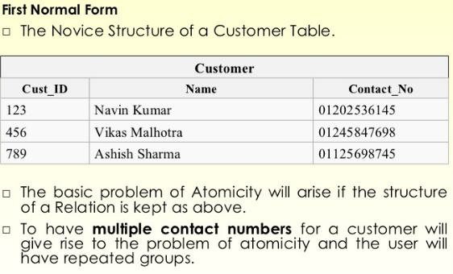
1st NORMALFORM EXAMPLE

Slide 17
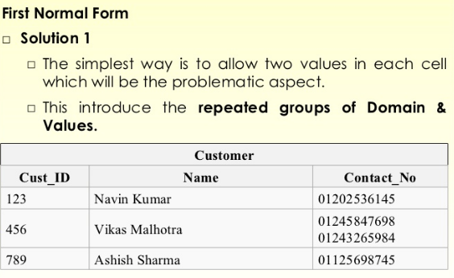

Slide 18
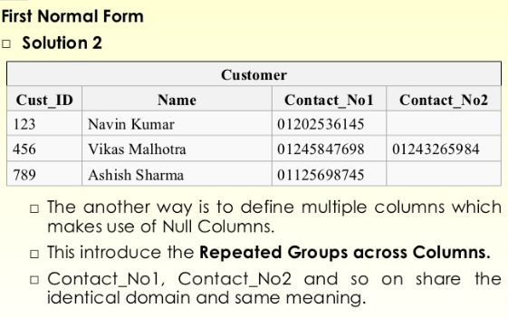

Slide 19
Solution 3
The Third method is the best method among the three is to decompose the table into two tables with cust_id and contact nos.

Slide 20
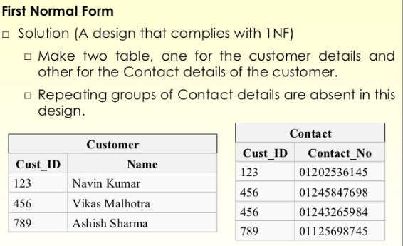
Solution 3

Slide 21
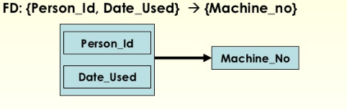
FUNCTIONAL DEPENDANCY

Slide 22
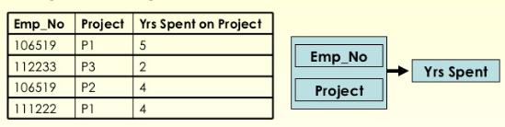

Slide 23
Second Normal Form
The relation is second normal form when it satisfy the two following condition:
The Relation Should be in First Normal Form.
The Relation Should have Full Functional Dependency no Partial Dependencies should exist in Relation.
If the relation satisfy the above two condition then it is said to be in second normal form.

Slide 24
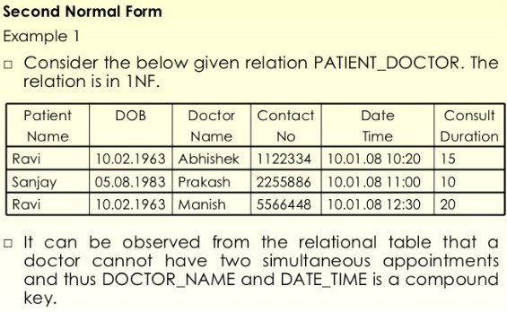
SECOND NORMAL FORM

Slide 25
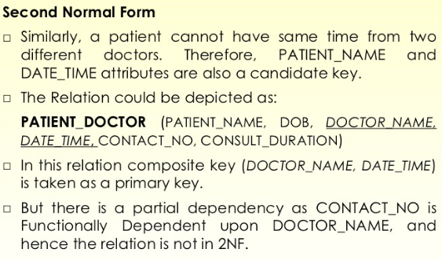

Slide 26
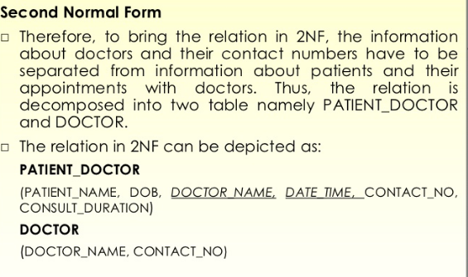

Slide 27
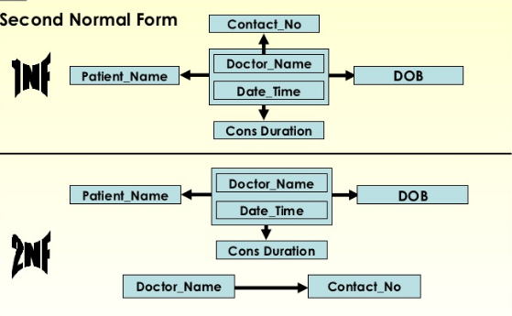

Slide 28
Third Normal Form
A Relation is said to be in Third Normal Form when it satisfy the following two conditions:
A Relation should be in Second Normal Form .
A Relation should not contain Any Transitive Dependency.
If the relation satisfy the above two condition then the relation is said to be in third normal form.

Slide 29
Transitive Dependency:
A Transitive Dependency is dependency in which the number of attribute is dependent of a attribute or a pair of attributes and among those attributes which are dependent if one or more attribute is dependent on the some other attributes that is known as transitive dependency.
To remove this dependency we have to decompose this relation.
Consider the relation:
Emp-dept(emp_no,ename,dept_no,dname,dlocation)
1)emp_no->ename,dept_no
2)dept-no->dname,dlocation

Slide 30
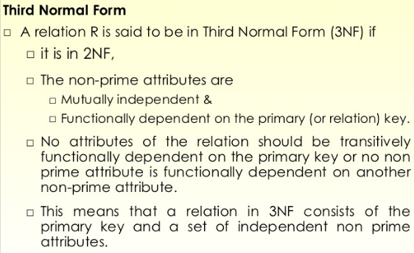
THIRD NORMAL FORM

Slide 31
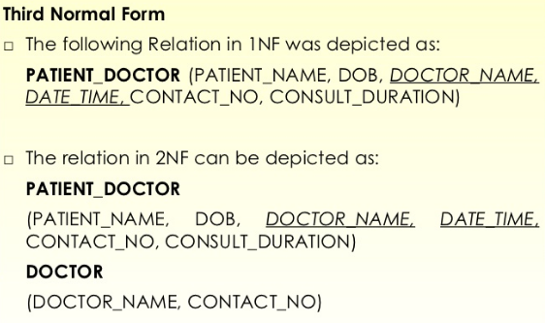
Third normal form

Slide 32
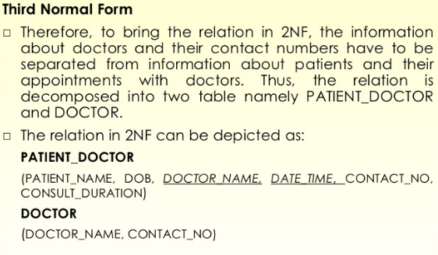
Third normal form

Slide 33
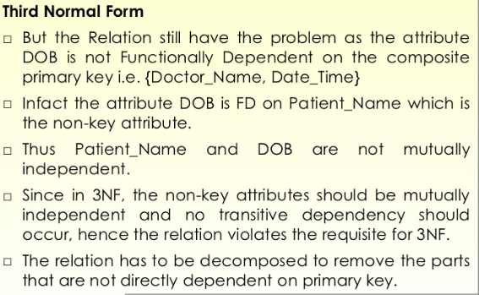
Third normal form

Slide 34
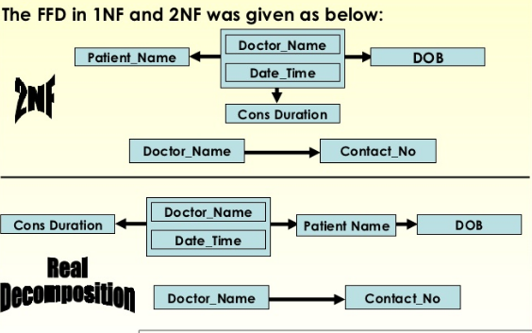
Third normal form

Slide 35
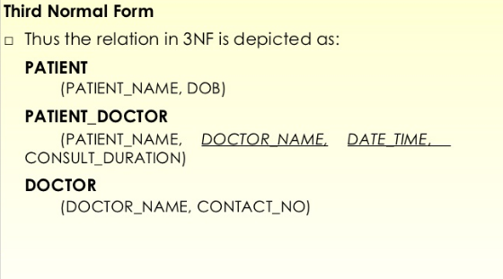
Third normal form

Slide 36
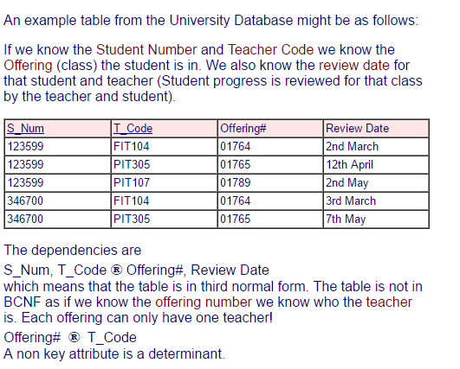
BCNF

Slide 37
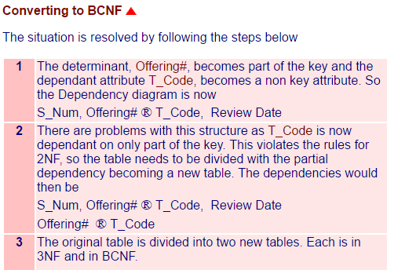
BCNF

Slide 38

BCNF

Slide 39
Full Functional Dependency: If there is pair of attributes in a relation on which number of attributes depend then There can not be dependency in a relation in which the attributes are dependent on single attribute from a pair of attributes That is known to be as Partial Dependency.
To remove partial Dependency we have to decompose the Relation.
Consider the relation:
Emp_project(emp_no,proj_no,hours,ename,proname,plocation)
1) emp_no,proj_no->hours
2)emp_no->ename
3)proj_no->proname,plocation

Slide 40
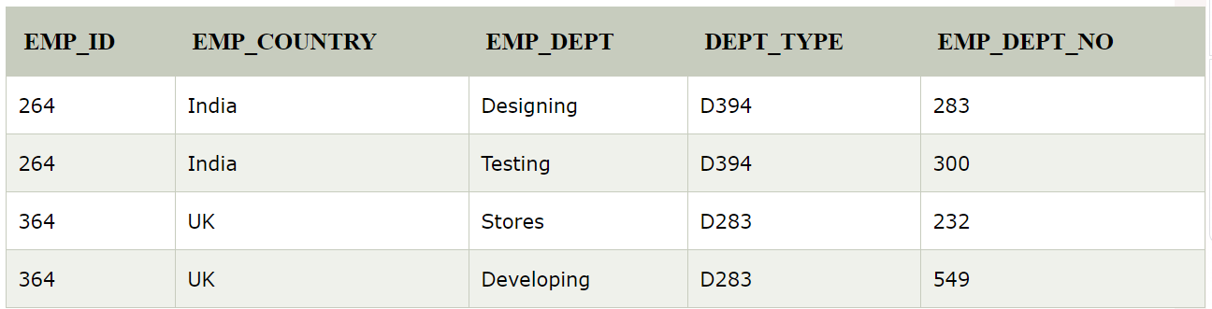
example
EMP_ID → EMP_COUNTRY
EMP_DEPT → {DEPT_TYPE, EMP_DEPT_NO}
Candidate key: {EMP-ID, EMP-DEPT}
The table is not in BCNF because neither EMP_DEPT nor EMP_ID alone are keys.

Slide 41
Q: Consider a following relation:
invoice(invoice_no, invoice_date,cust_no cust_name, cust_addr, pet_no, pet_name, procedure , amount )
Having functional Dependency:
1)invoice_no->invoice_date,cust_no
2)cust_no->cust_name,cust-adr
3)invoice_no,pet_no->procedure,amount
4)pet_no->pet_name
Convert the above relation into 1nf ,2nf andd 3 nf.

Slide 42
In the above relation each customer can have number of pets so pets information and customer information should be decompose to form two tables so that the redundancy can be reduces in this case.
invoice(invoice_no,invoice_date,cust_no,cust_name,cust_adr)
Invoice_pet(invoice_no,pet_no,pet_name,procedure,amount)
The above tables are in 1NF.

Slide 43
invoice(invoice_no,invoice_date,cust_no,cust_name,cust_adr)
Invoice_pet(invoice_no,pet_no,pet_name,procedure,amount)
1)invoice_no->invoice_date,cust_no
2)cust_no->cust_name,cust-adr
3)invoice_no,pet_no->procedure,amount
4)pet_no->pet_name
To convert the above relation in 2NF we have to check that whether the tables are in 1NF
The above tables are in in 1NF so first condition is satisfied

Slide 44
invoice(invoice_no,invoice_date,cust_no,cust_name,cust_adr)
For table 1 functional dependency are:
1)invoice_no->invoice_date,cust_no
2)cust_no->cust_name,cust-adr
There is no partial dependency only full functional dependency exists in table so table one is 2NF
Invoice_pet(invoice_no,pet_no,pet_name,procedure,amount)
1)invoice_no,pet_no->procedure,amount
2)pet_no->pet_name
The second dependency is partial dependency so we have to decompose the table so convert the table into 2NF

Slide 45
Invoice_pet(invoice_no,Pet_no,procedure,Amount)
Pet(pet_no,pet_name)
Now three tables are in 2NF.
To check the tables are in 3NF or not
Three tables are in 2NF so first condition is satisfied.
No transitive dependency should be there.
invoice(invoice_no,invoice_date,cust_no,cust_name,cust_adr)
1)invoice_no->invoice_date,cust_no
2)cust_no->cust_name,cust-adr
This table contain the transitive dependency so it should be decomposed.

Slide 46
invoice [ invoice_no, invoice_date, cust_no ]
customer [ cust_no, cust_name, cust_adr ]
and
Invoice_pet(invoice_no,Pet_no,procedure,Amount)
Pet(pet_no,pet_name)
Now these are the final tables after decomposition they are in 3NF.

