Slide 1
Exploratory Data Analysis Of FIFA Dataset
Content
Data Preprocessing / Data Cleaning
Reading Data
Dropping Unnecessary Columns
Data Types Conversion
Missing value Imputation
Exploratory Data Analysis

Slide 2
Data Preprocessing / Data Cleaning
Reading Dataset
So we have the FIFA dataset is given in csv format.
The dataset is all about the FIFA Football players and their reputation and market values.
I load the dataset and do some preprocessing stuff on the dataset for better analysis.
There are total 18207 rows and 60 columns.
By looking into the dataset some variables have not in proper data types.
And there are some columns which are not useful for the EDA part.
Dropping Unnecessary Columns
From data preprocessing there are some columns as Photo and Club Logo which are not useful.
So I delete those columns.
Data Type Conversion
So there are some variables which are have not proper datatypes
So I changed the datatypes of some columns.
Missing Values Imputation
Height, Weight, International Reputation and Release Clause those are the important variables in given dataset for EDA.
I checked for null values.
There are very less percentage of null values in those variables i.e. less than 15%.
So no need to replace the null values with the mean value.
So I directly delete those rows.
Now our dataset is ready for the Exploratory Data Analysis.

Slide 3
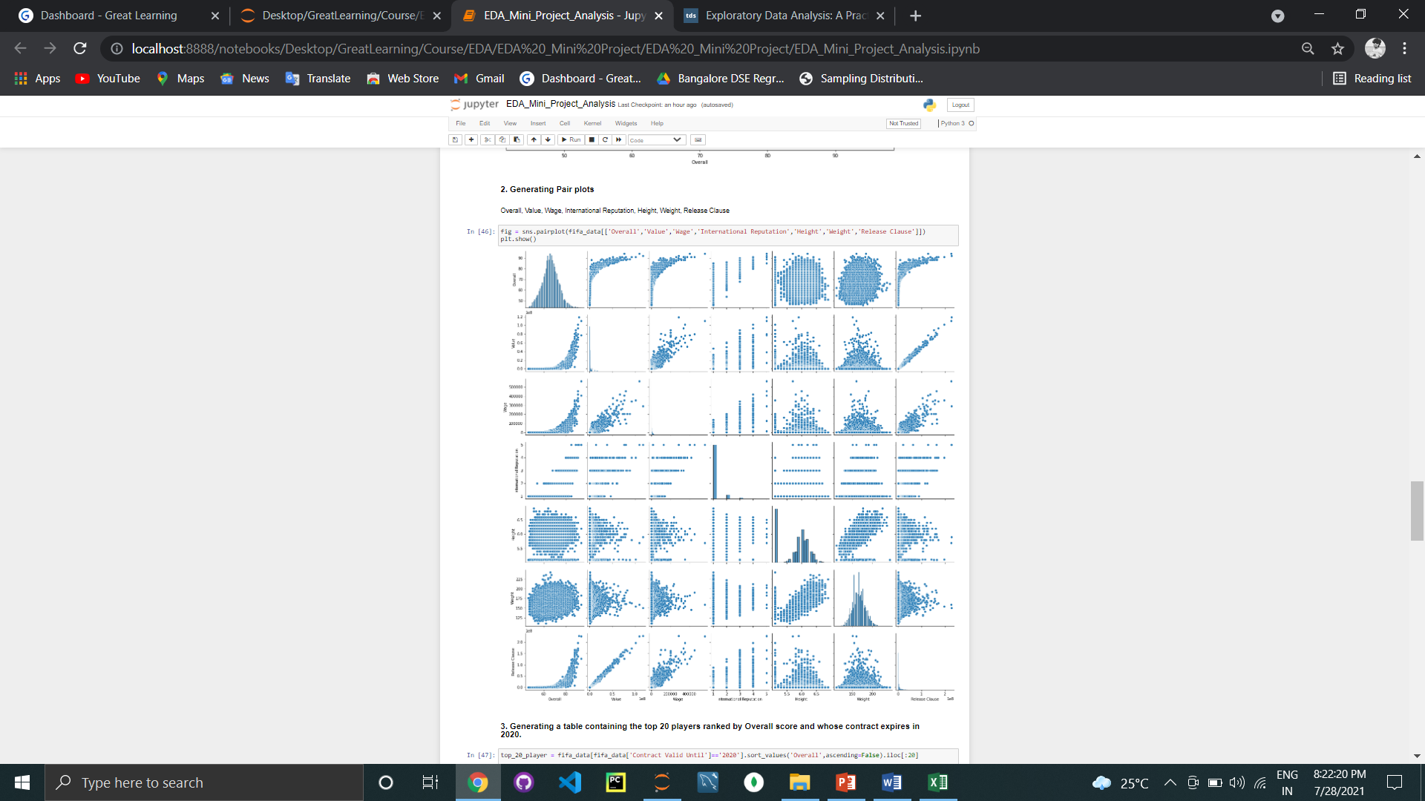
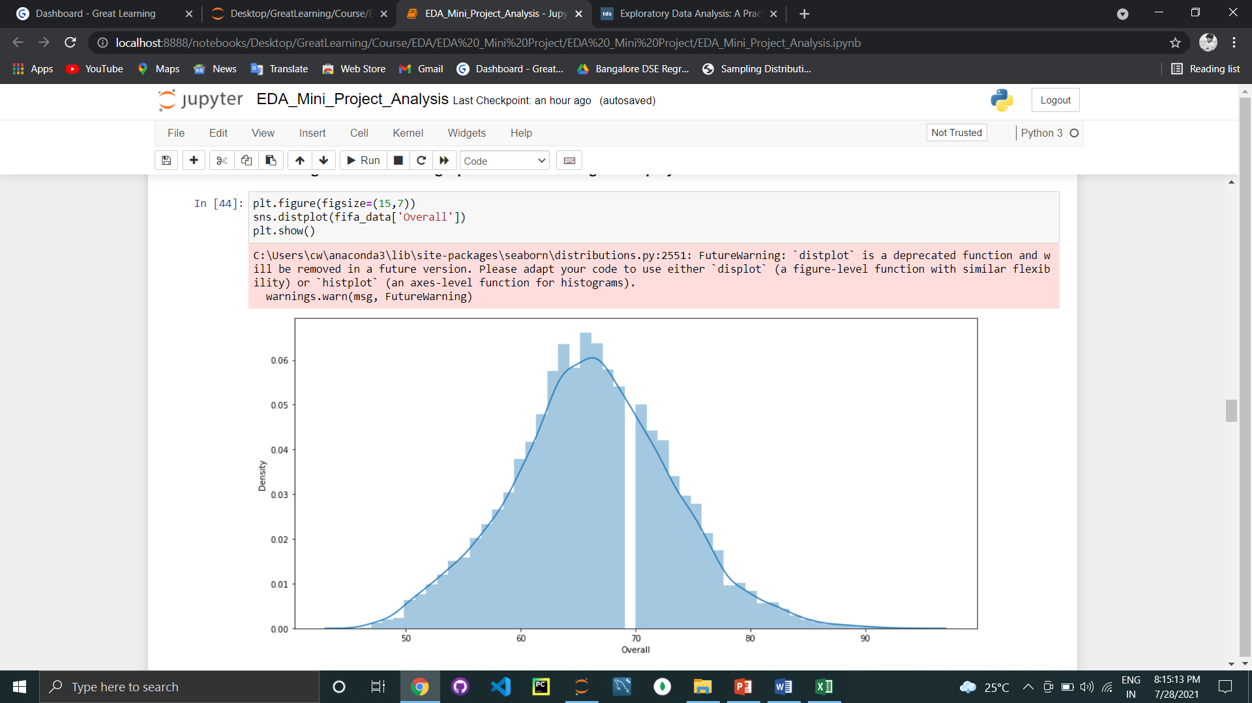
Exploratory Data Analysis
Normal Distribution of data
By plotting the graph of overall ranking of FIFA players it seems like the data is normally distributed.
For taking more details from dataset we plot a pair plot and it seems like that there are some relation between player ratings on their current market values, reputation and wage of players and their release clause.

Slide 4
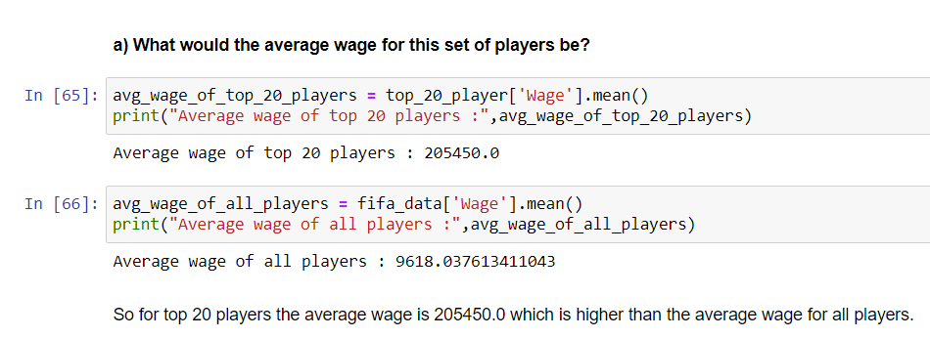
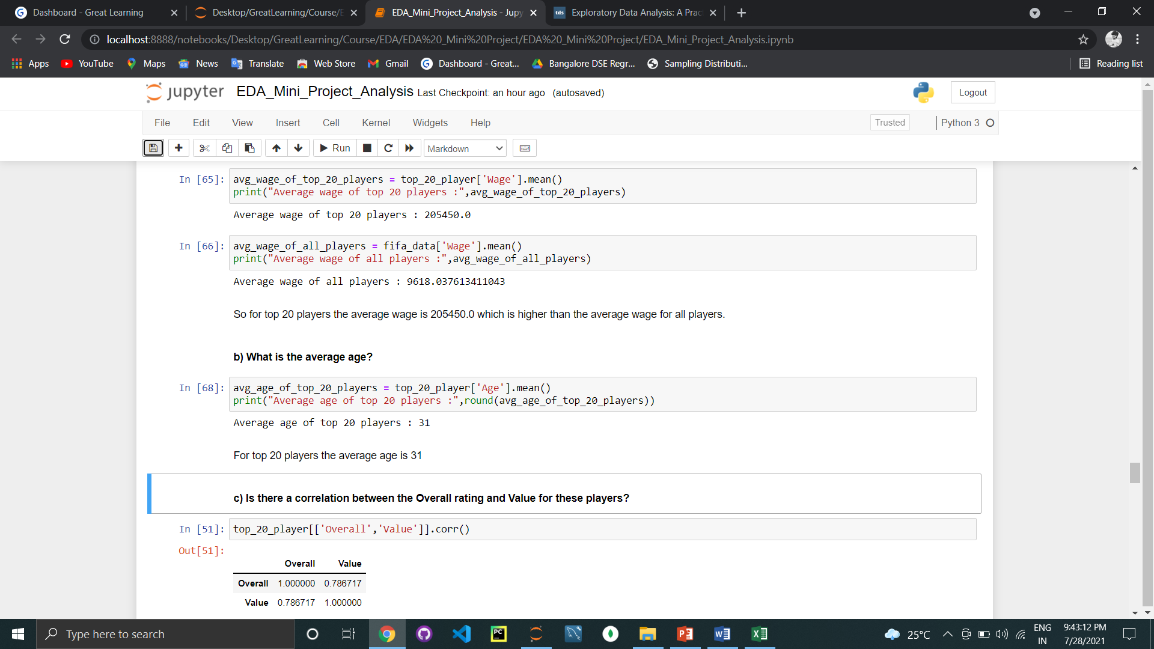
Top 20 players
For better understanding we find out the top 20 players. And compare the wage values and more for top 20 players and for overall players.
The average wage of top 20 player is 205450.0, So if there is a player coming in top 20 then the wage for him is near about the average wage of top 20 player.
So the average wage of all the players is less then the average wage for top 20 players.
The average age of top 20 players is 31.

Slide 5
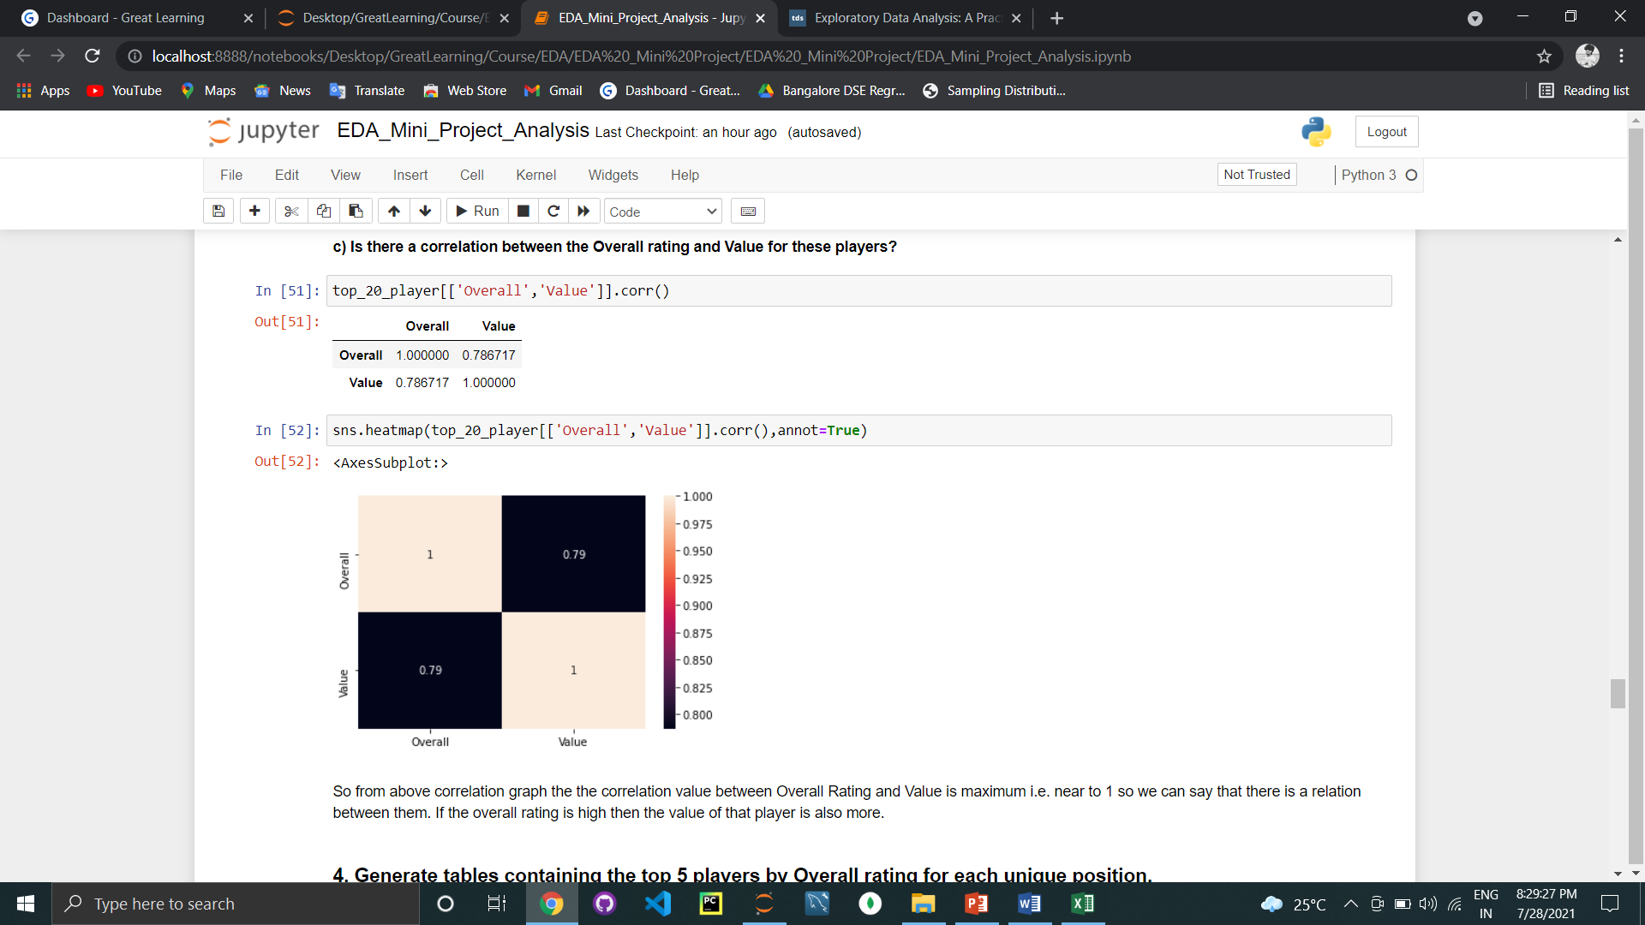
Relationship between Overall Ranking and Current Market Value
We find the relationship between the ranking of player and their market value.
By using correlation method, here the value of correlation is 0.79 between the overall ranking and the current market value of the players.
Overall ranking and current market value are positively correlated with each other.
So from the above plot we can say that the relation between overall ranking and the current market value of the players are strongly related to each other.
When the overall ranking of any player is high then the market value is also high.

Slide 6
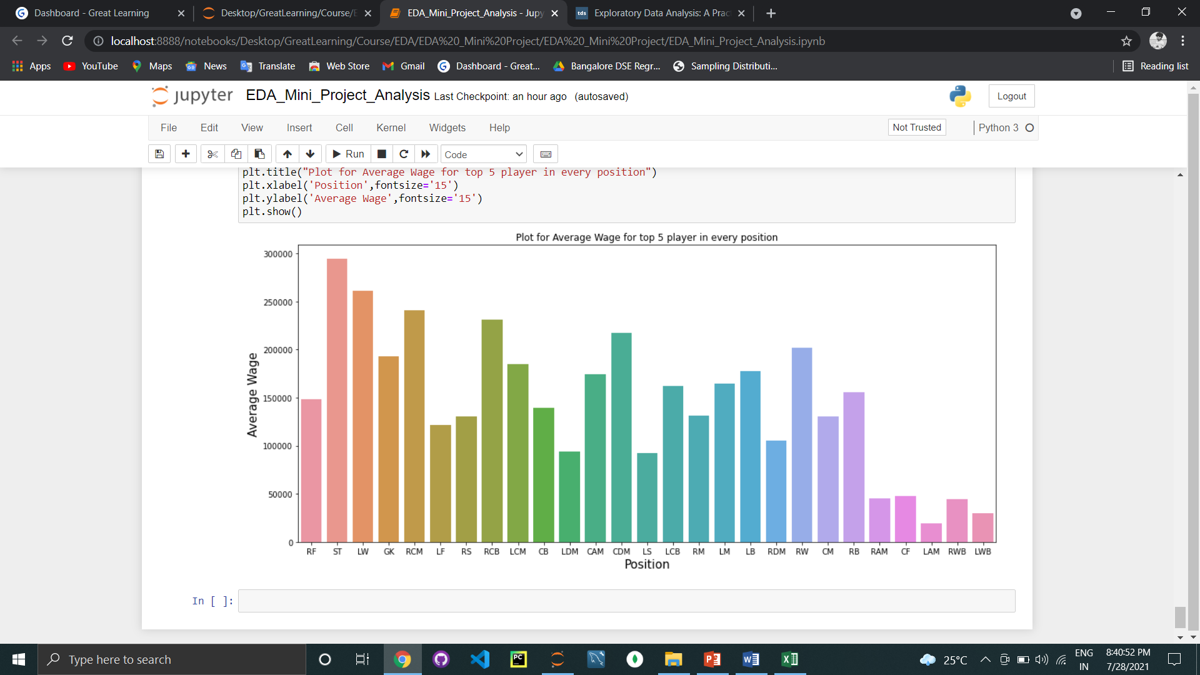
Average wage of top 5 players for each distinct position
Looking forward we find out the positions of players.
There are total 27 positions of FIFA players.
We find that the average wage expect to pay in top 5 players for each distinct positions.
By plotting a graph for average wage of top 5 players for each distinct positions it seems that for ST position the average wage is high and for LAM position the average wage is minimum.

