Slide 1

Goodreads: Books analysis and similar books recommendation
Sinhgad College Of Engineering,Pune
Department Of Computer Engg.
Year 2019-2020
Sr. No. | Name | Roll No.
1 | Nitin Ajay Dixit | 305073
2 | Vasant Raju Donurkar | 305074
3 | Sameer Shah | 305075
Guided By : Nalini Mhetere Mam

Slide 2
Contents:-
Python Programming
Machine Learning
K-means clustering
K Nearest neighbour method (KNN)
Dash by Plot.ly (GUI)

Slide 3
Problem Statement :-
To analyze Goodreads dataset to get a fair idea about the relationships between the multiple attributes a book might have, such as the aggregrate rating of each book, the most rated books and books with more pages, etc. And to recommend movies to users by using k-means clustring and KNN algorithm.

Slide 4
Requirements:
Software Requirements :-
Operation System : Windows / Linux
Dash by plotly (Front-end)
Python,Machine Learning (Back-end)
Python IDE (e.g:- Anaconda spyder / Pycharm etc.)
Hardware Requirements :-
Processor : Pentium IV or Higher.
Ram : 1 GB or more.
Hard Disk Space : 256 GB or more.
Monitor : Colour monitor

Slide 5
Introduction:-
Book Recommendation System through content based method. Recommended systems are powerful new technology and it helps users to find items which they want to buy. A recommendation system is broadly used to recommend products to the end users that are most appropriate.
This Website is used to display demographic analysis and visualization of Goodreads books data and recommend books that user may have an interest in.
This website will help people who are avid reader to read books by recommending the accurate predictions.

Slide 6
Methodology
K Nearest neighbour method (KNN)
Collaborative Filtering
Content-Based Recommending

Slide 7
K-means clustering:-
K-means clustering is one of the simplest and popular unsupervised machine learning algorithms,
which is used when you have unlabeled data (i.e., data without defined categories or groups).
The goal of this algorithm is to find groups in the data, with the number of groups represented by the variable K.
The algorithm works iteratively to assign each data point to one of K groups based on the features that are provided.
Data points are clustered based on feature similarity.
The results of the K-means clustering algorithm are:
1.The centroids of the K clusters, which can be used to label new data
2.Labels for the training data (each data point is assigned to a single cluster)
“the objective of K-means is simple: group similar data points together and discover underlying patterns. To achieve this objective, K-means looks for a fixed number (k) of clusters in a dataset.”
A cluster refers to a collection of data points aggregated together because of certain similarities.
The ‘means’ in the K-means refers to averaging of the data; that is, finding the centroid.

Slide 8
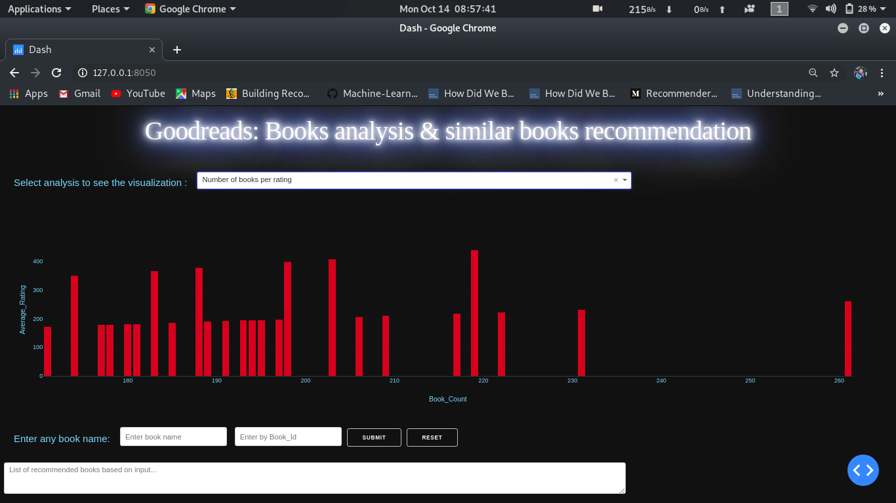
Result and discussion 1.0

Slide 9
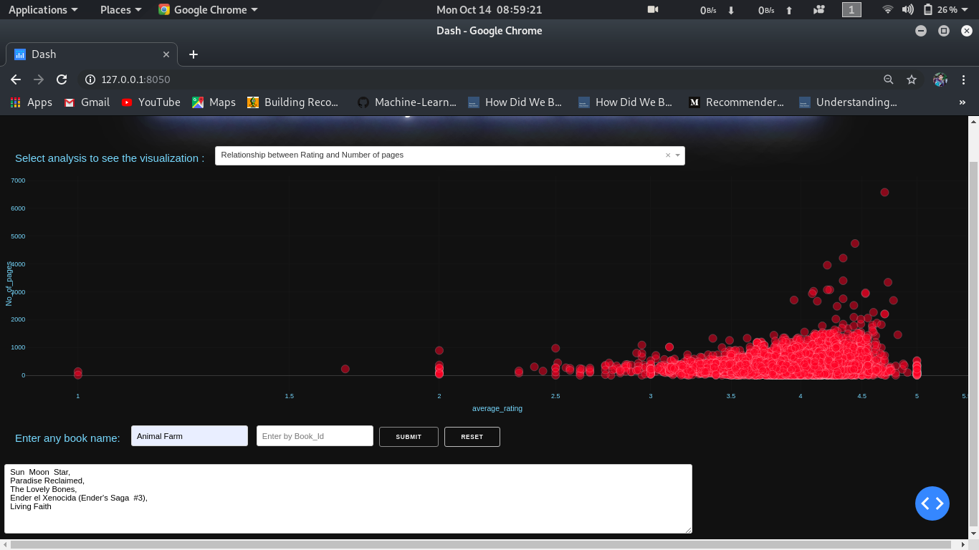
Result and discussion 1.1

Slide 10
Conclusion
The Book recommendation system project has been successfully completed. The goal of the system is achieved.
This project is develoed in this manner that this is user-friendly.

Slide 11
References:
https://www.kaggle.com/jealousleopard/goodreadsbooks

Slide 12

…

