Slide 1

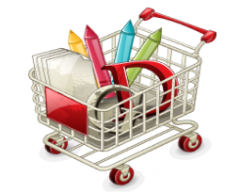
Retail Business Solution Whole Sale Distributors Retailers www.Meretoo.in Grocessary Stores Garments Cosmetics Fashion Fertilizers Furniture
Product Features
Smart Data View
Drill Down reporting Tool
Purchase Analysis
Sales Analysis
Stock analysis
Customer Sales Reports
Supplier Purchase Reports
Margin Analysis
Supplier Ledger
Customer Ledger
Contact for Demo – 9763292136
GST Billing & Accounting Software
Efficient Inventory Management
Easy Purchase Management
Credit and Retail Sales
Customer Management
Supplier Management
Payment voucher
Receipt voucher
Accounting Management
Easy Reporting Tool
Easy GST Return File Data

