Slide 1
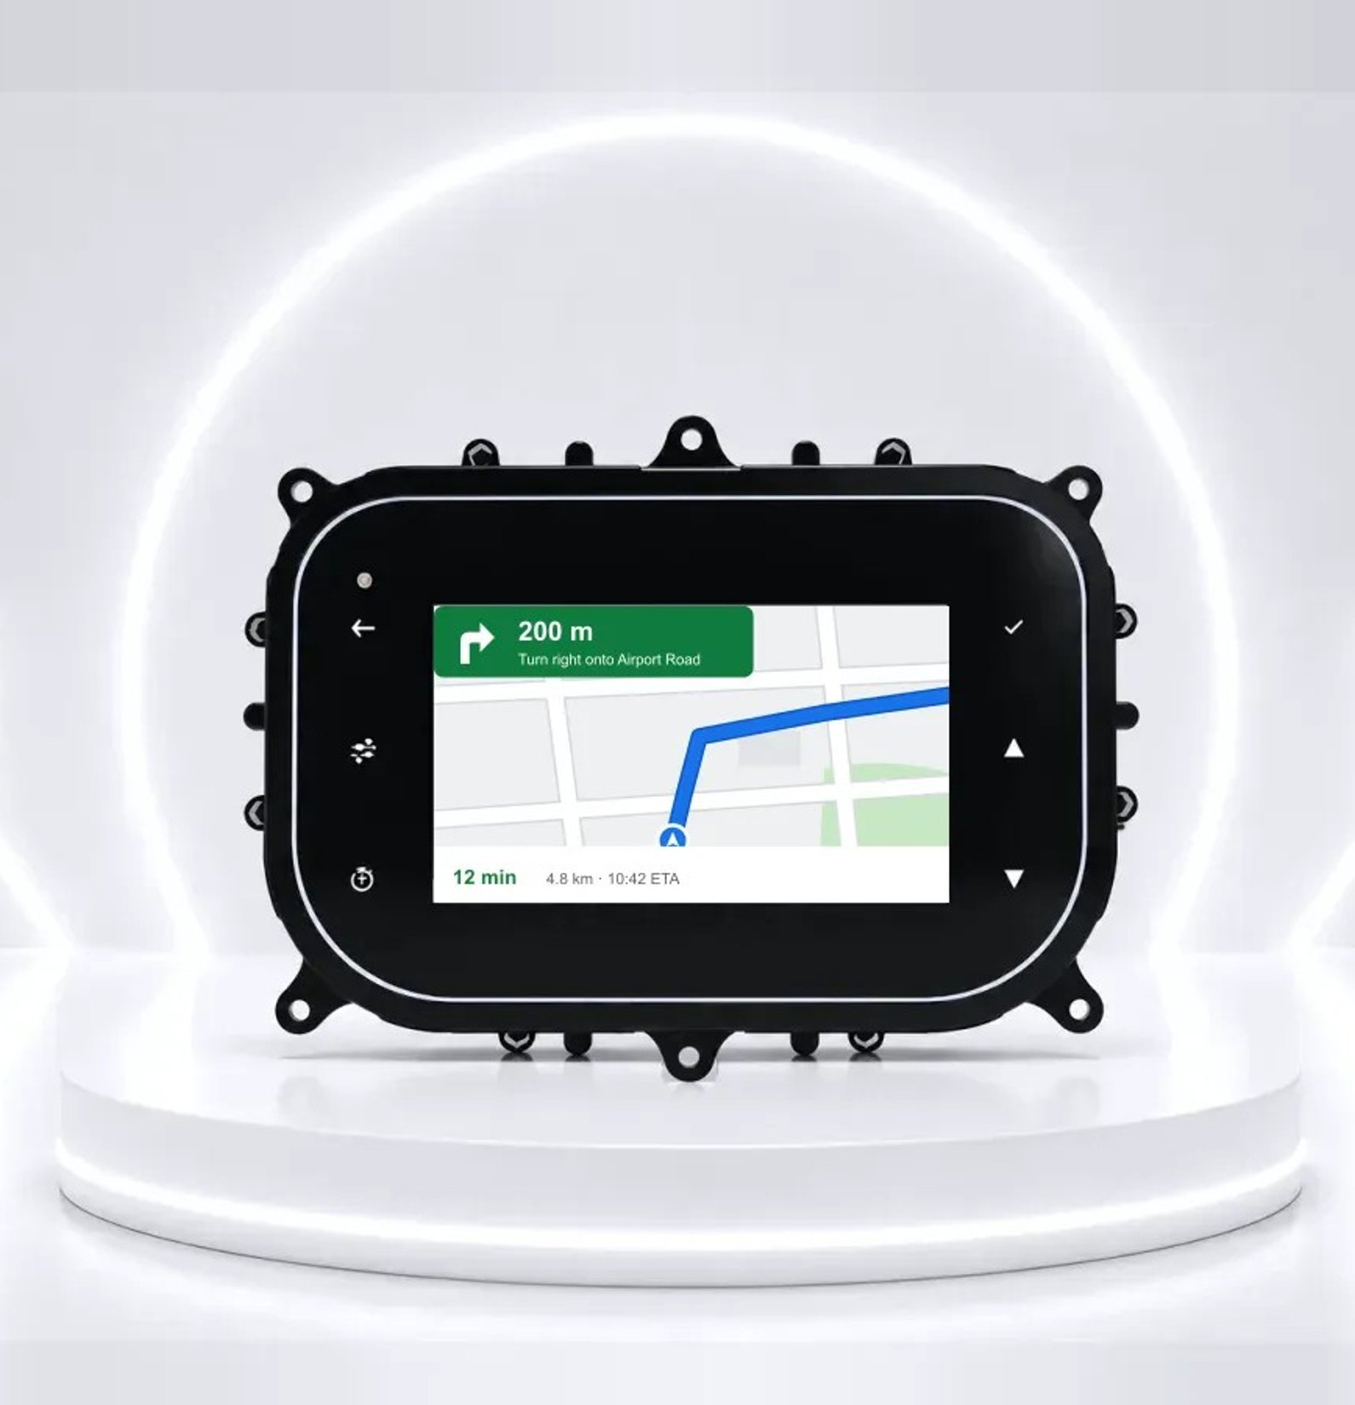

AUTOMOTIVE & IOT SOLUTIONS
Smart clusters,
connected devices
Smart instrument clusters with phone screen mirroring, GPS trackers and gateways, and IoT devices — designed and manufactured in India by Walnut Technologies.
Walnut Technologies™ · Mohali, India · walnutmedical.in

Slide 2
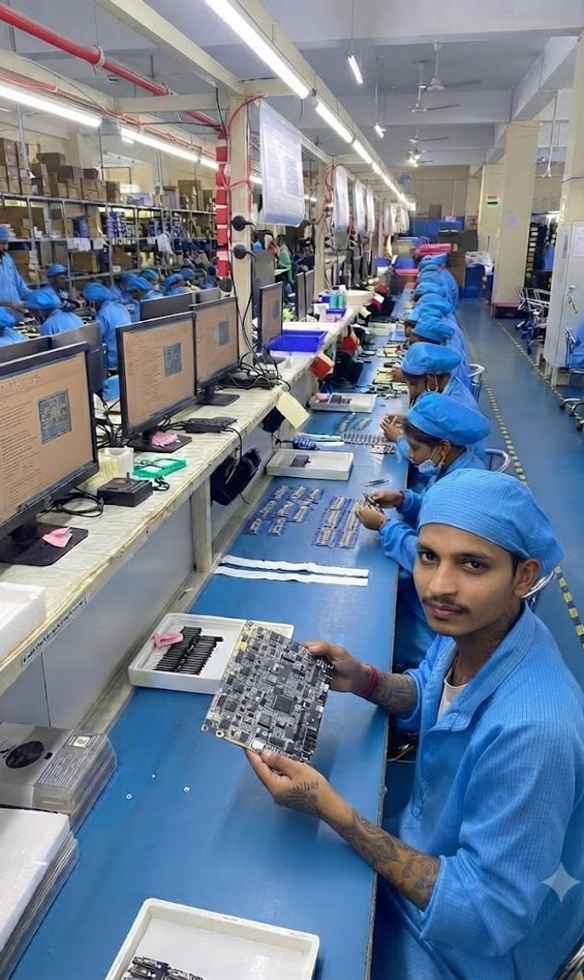
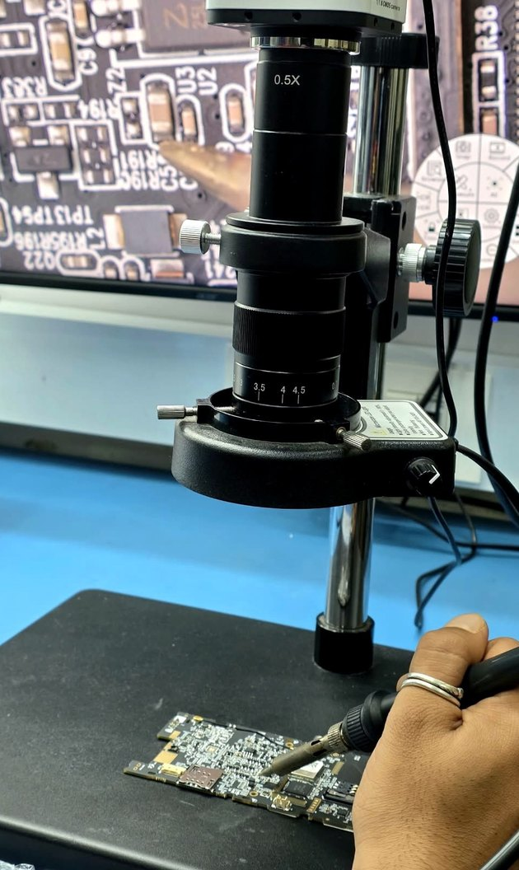


Who we are
01 · ABOUT WALNUT
Walnut Medical & Walnut Technologies is a multi-vertical original design and equipment manufacturer (ODM/OEM). Established in 2016, we have grown from a small electronics workshop into a vertically integrated design and manufacturing partner for technologically advanced products — today including smart instrument clusters, telematics and IoT devices.
From PCB design to final assembly, every stage is in-house: electronics and firmware design, mould design, SMT, testing, quality and dispatch.
Production units
Mohali (Punjab) · AMTZ, Visakhapatnam (Andhra Pradesh) · Dhanana (Upcoming in Haryana)
Certified quality
ISO 13485 · CE · FCC · BIS · Industry 4.0 · Full traceability

Slide 3
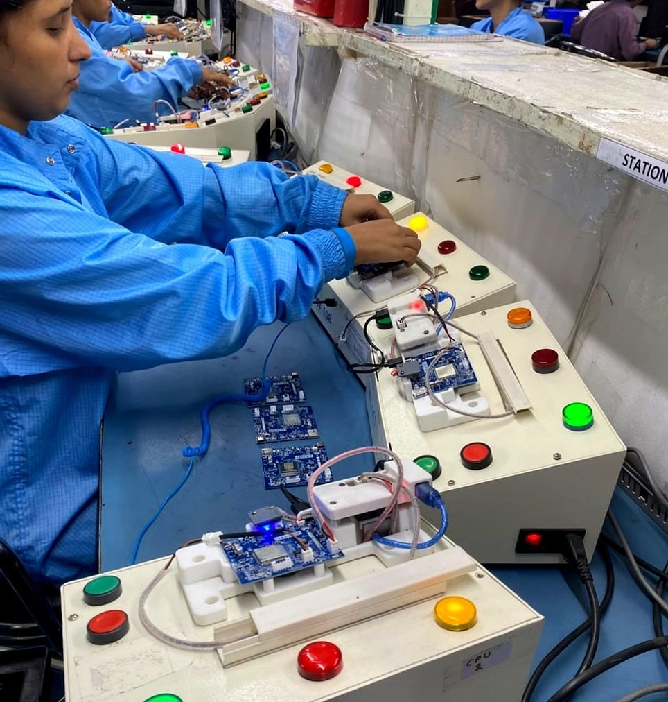
Walnut at a glance
SCALE & REACH
10+
600+
10+
Years of excellence
Engineers & technicians
Countries served
500K+
150,000
4
Units manufactured / month
Sq. ft facility
SMT production lines

Slide 4
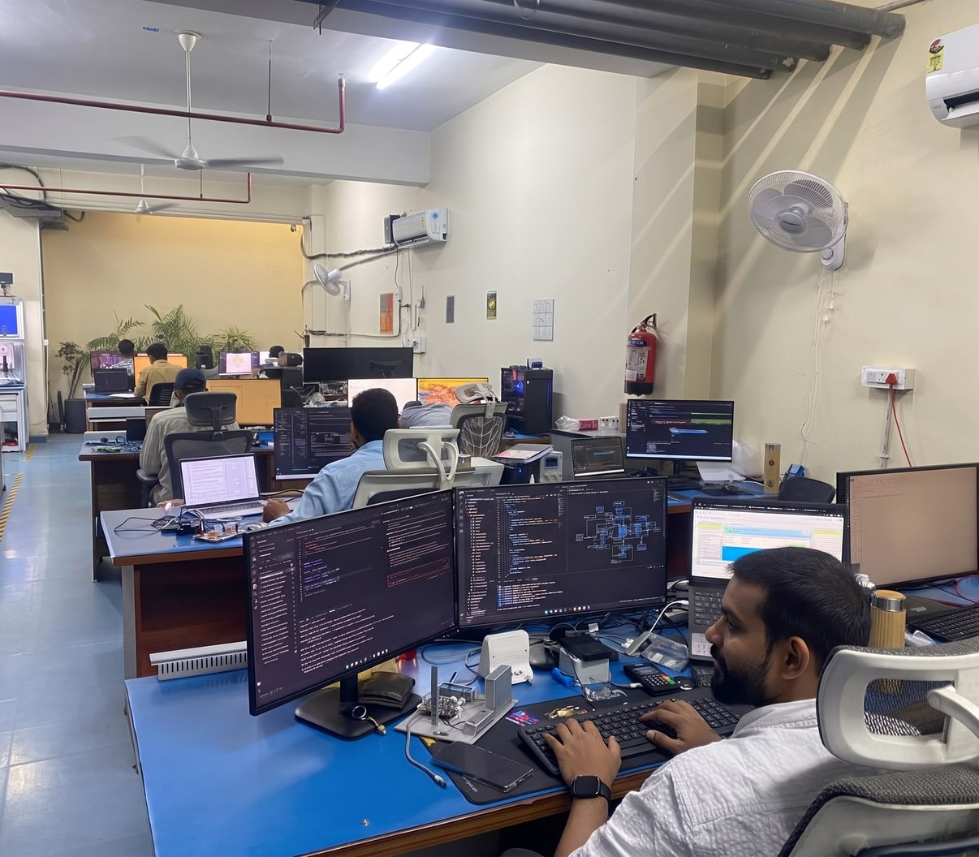
Leadership
01 · ABOUT WALNUT
SD
Siddharth Dhawan
Director & CEO
Spent 10 years at National Instruments Corp. in the USA and India, working in high-tech embedded and control systems and managing the business in India.
AB
Amol Bhardwaj
Director & CTO
Leads medical device development; launched devices across diagnostics, therapeutics and robotics — EEG, ECG, rTMS and gait training robots. Expert in QC tools, SPC, APQP, PPAP, Six Sigma, Cpk and 5S; Management Representative for ISO 13485 and CE audits (2009–2014).

Slide 5

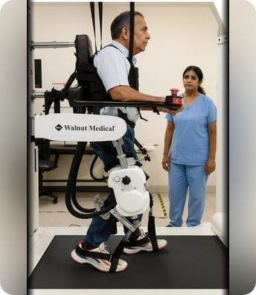


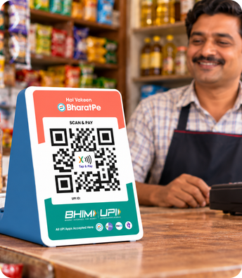
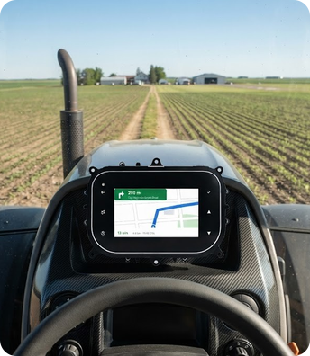
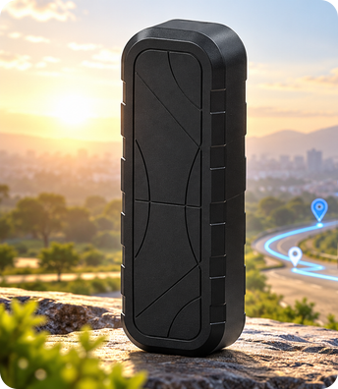
Our journey
02 · JOURNEY 2016 – 2026
2016
2017
2019
2021
2022
2025
2026
Walnut Medical founded
Robotics & neuro-rehab
Medical devices
Walnut Technologies
Fintech · soundbox
Smart clusters
GPS tracker & IoT
Started with a vision to make quality healthcare more accessible.
Walkex functional therapy and the WalkLab gait-training robot.
IR thermometer and digital BP monitor, then nebulizers and oxygen concentrators.
Engineering expands beyond healthcare into electronics for every industry.
Smart payment soundboxes and POS devices, in mass production from 2023.
5″ and 7″ smart clusters for 2-wheelers, tractors and vehicles.
GPS tracker & gateway and a growing range of connected IoT devices.

Slide 6
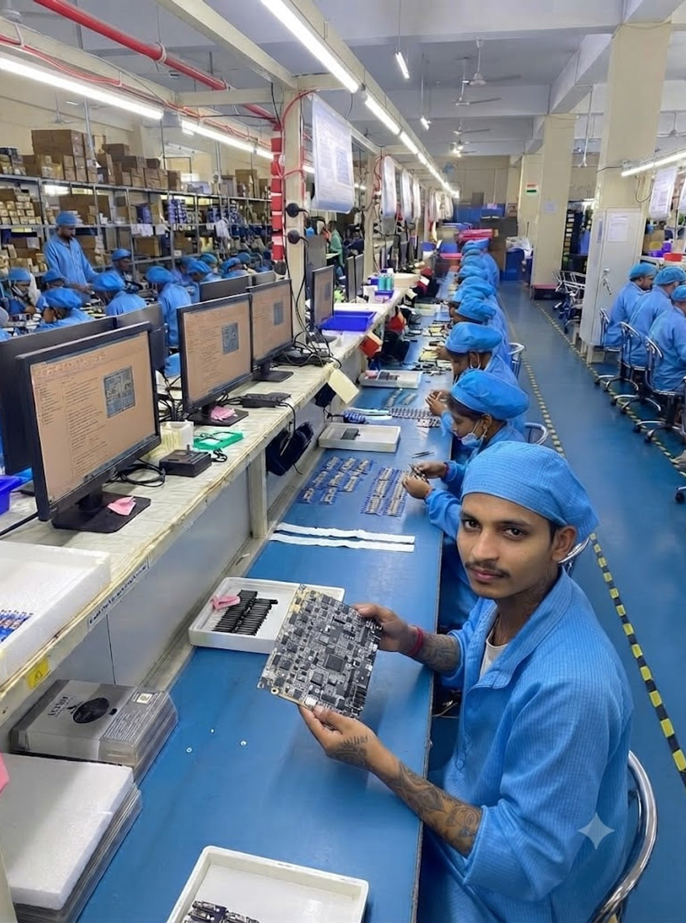
Infrastructure & manufacturing
03
In-house electronics design, SMT, testing and quality — from prototype to 500K+ units a month.

Slide 7
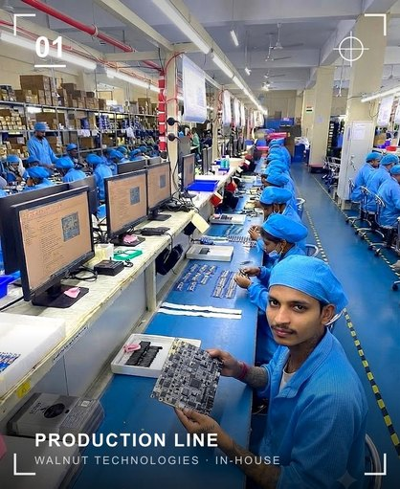
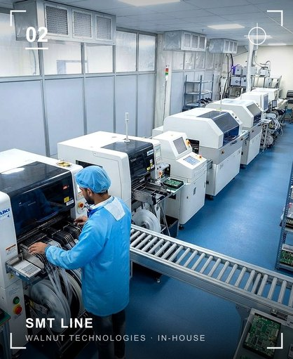
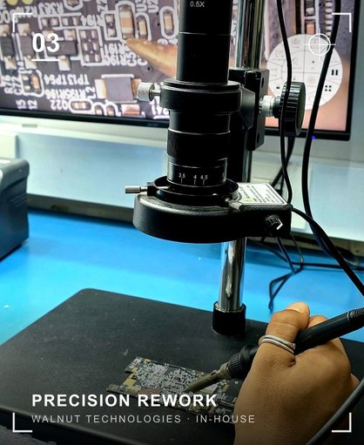



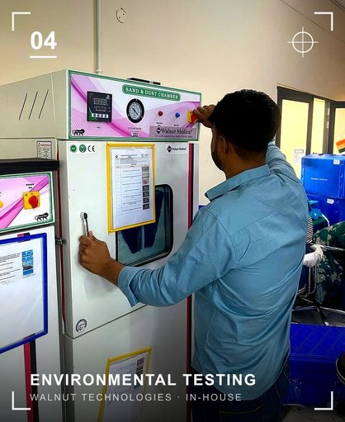
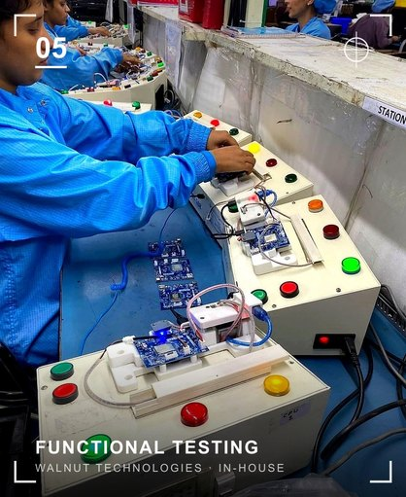
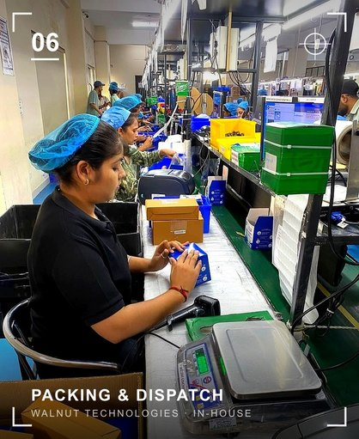



Manufacturing infrastructure
03 · INFRASTRUCTURE
150,000 sq. ft facility
Mohali · AMTZ · Dhanana (Upcoming in Haryana)
4 SMT production lines
Fully automatic SMT — JUKI RS-1, FUJI, 200,000 CPH
In-house test & calibration
Keysight · National Instruments · Rigol · Tektronix
PCB design to production
Design, validation, prototyping, pilot lots, full scale
IQC · LQC · OQC quality teams
Inspection at incoming, line and outgoing stages
Moulds & injection moulding
Mass-production mould design and plastics in-house

Slide 8

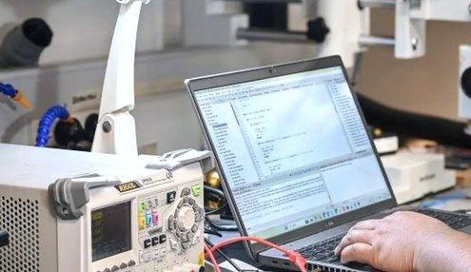
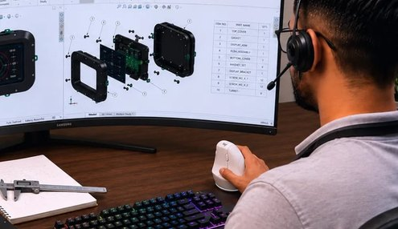

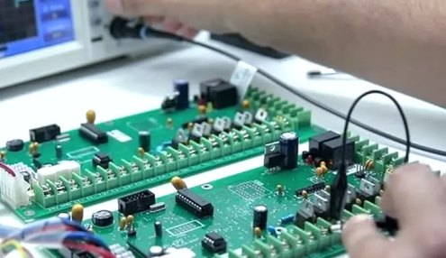
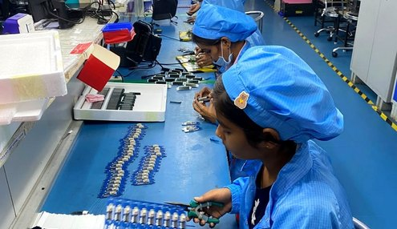

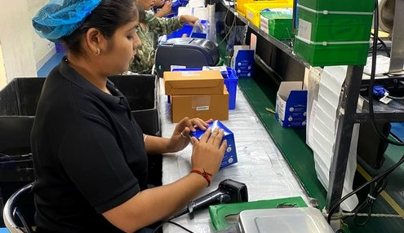


End-to-End Production Process
03 · HOW WE WORK
01
Idea & Requirement
02
Research & Market Analysis
03
Design & Engineering
04
Prototype Development
05
Validation & Testing
Clear direction
Right opportunity
Optimized design
Working prototype
Validated performance
06
Manufacturing Engineering
07
Quality Assurance
08
Packaging & Dispatch
09
After-Sales Support
10
Continuous Improvement
Production ready
Zero-defect mindset
Safe, on-time delivery
Reliable support
Better every day

Slide 9
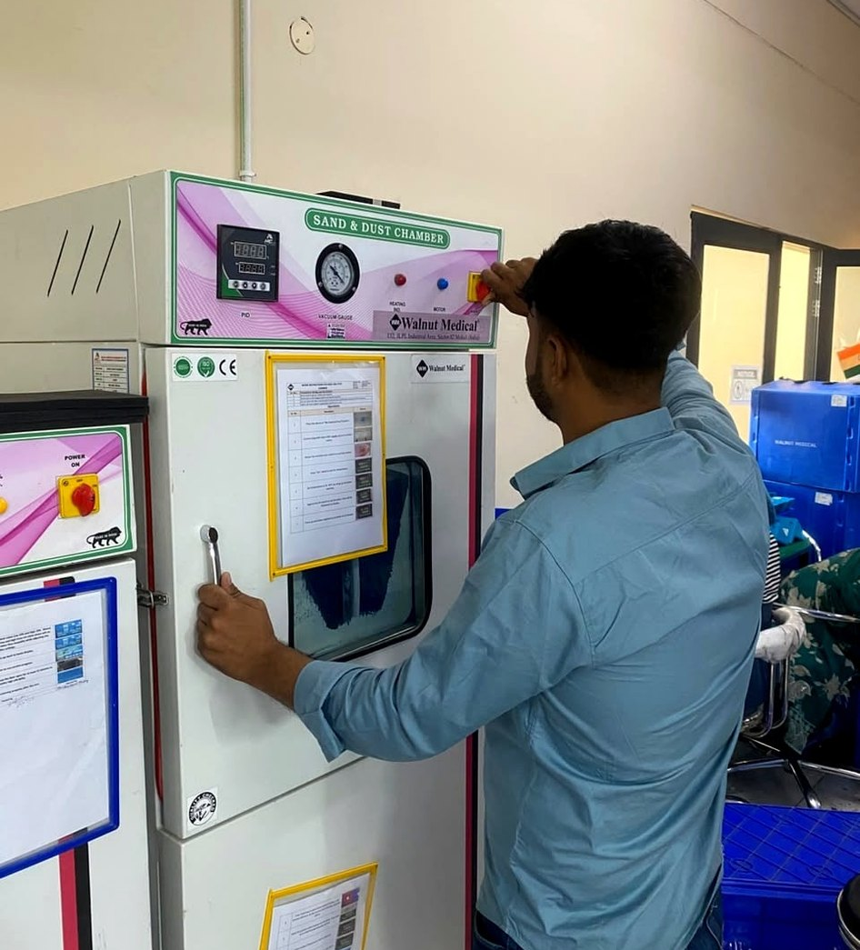
Quality & certifications
03 · QUALITY
ISO
ISO 13485
4.0
Industry 4.0
Quality management for medical devices
Connected, data-driven production with traceability
CE
CE · FCC · PCI-DSS
IEC
IEC 60601
European, US and payment-security standards
Medical electrical equipment safety
BIS
BIS certified
QA
IQC · LQC · OQC
Bureau of Indian Standards compliance
Inspection at incoming, line and outgoing stages
Compliances: ISO 13485, ISO 80601-2-69, IEC 60601-1, IEC 60601-1-2 (NABL-accredited labs), CE, FCC, RoHS

Slide 10
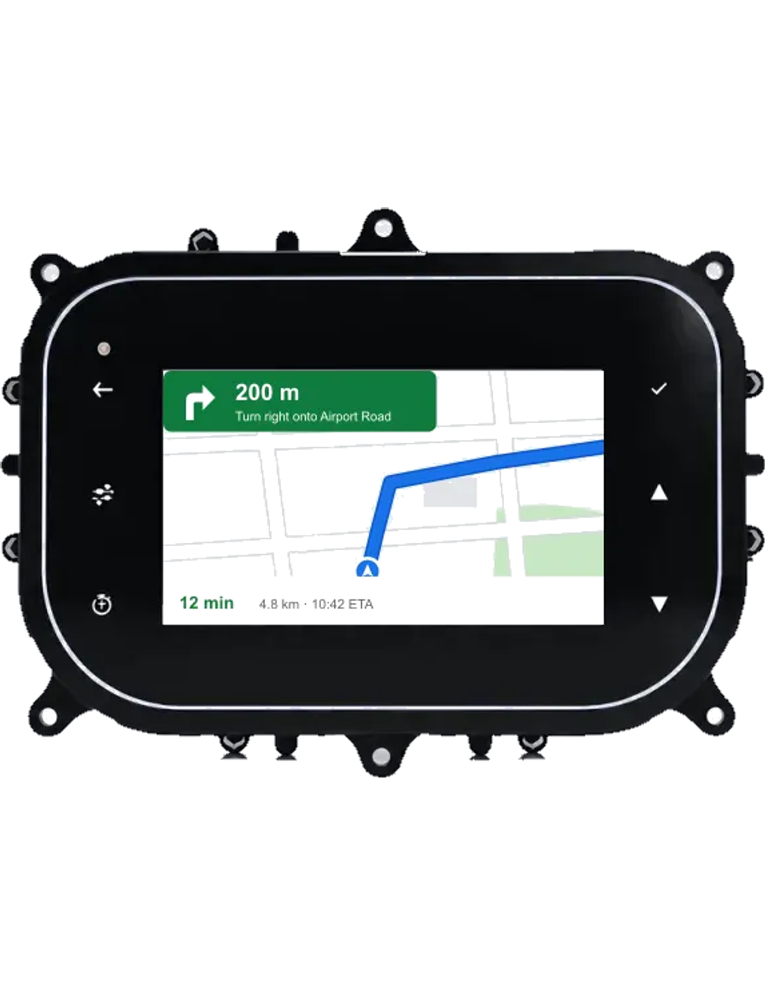
Automotive electronics
04
Smart instrument clusters in 5-inch and 7-inch, with Google Maps navigation through phone screen mirroring.

Slide 11
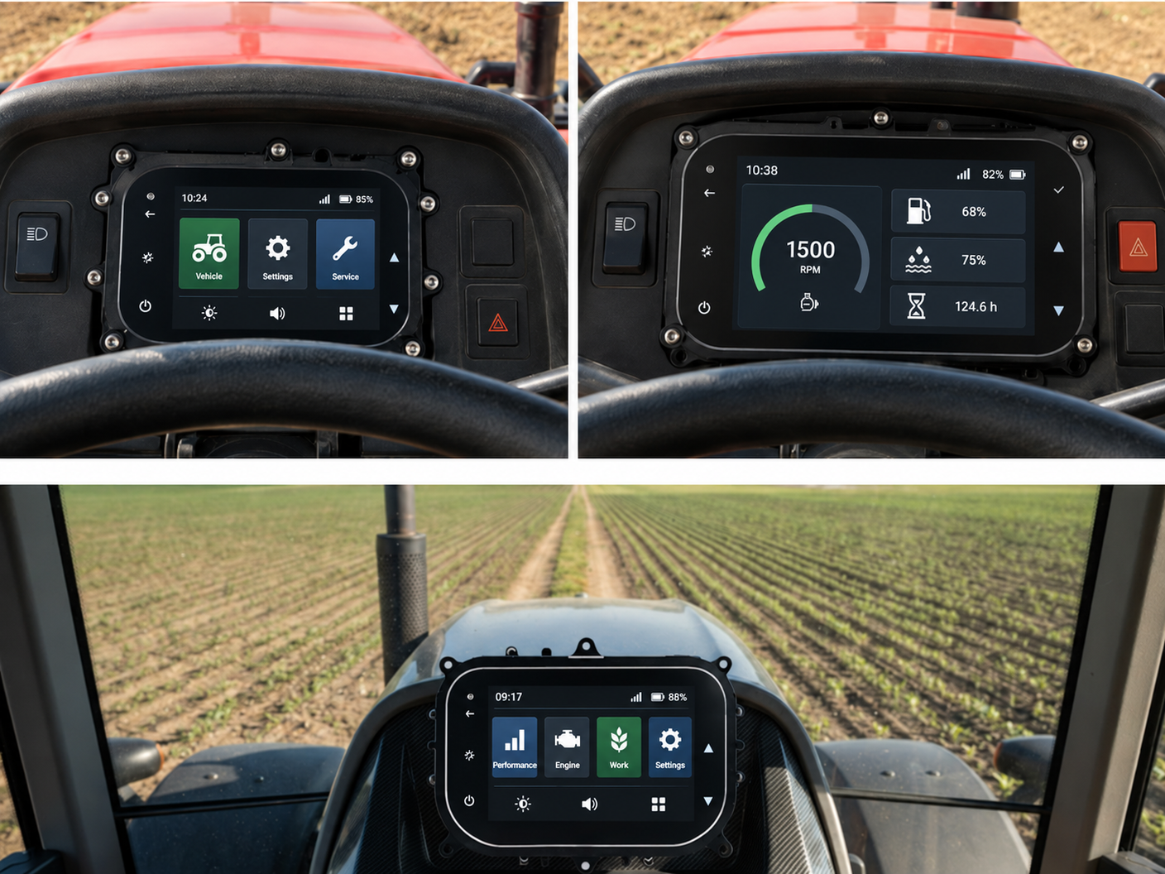


Smart instrument clusters
04 · AUTOMOTIVE ELECTRONICS
Next-generation digital clusters with high-resolution displays, real-time vehicle data and customisable driver interfaces — built for durability and clarity.
5-inch and 7-inch displays
Two sizes to suit compact and full-size dashboards
Android and RTOS based
Smart and cost-optimised platform options
4G · Bluetooth · Wi-Fi
Connected cluster with phone screen mirroring
BUILT FOR
2-wheelers
Tractors & farm equipment
LMV & HMV

Slide 12
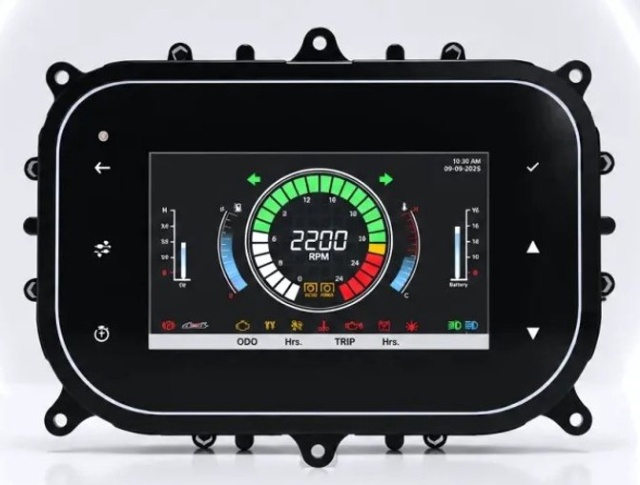
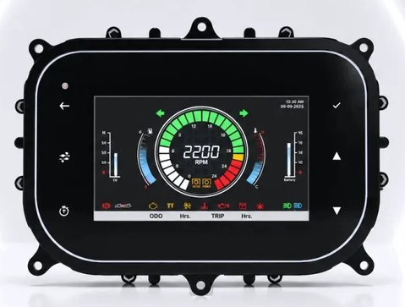
Choose your size: 5-inch or 7-inch
04 · CLUSTER OPTIONS
Configuration options
Display size | 5-inch · 7-inch
Platform | RTOS · Android
Connectivity | 4G · Bluetooth · Wi-Fi
Navigation | Phone screen mirroring — Google Maps on the cluster
Interface | Custom layouts, themes and brand integration
Vehicle data | Real-time speed, RPM, fuel, temperature, diagnostics
5″
5-inch display
7″
7-inch display
Smart instrument cluster
Smart instrument cluster
Clusters shown at relative scale. Final specifications and combinations are confirmed per project; datasheets on request.

Slide 13
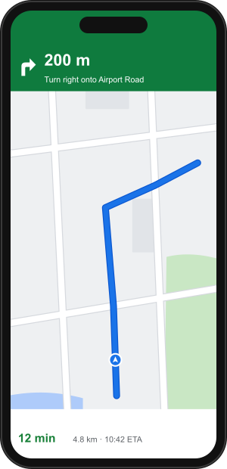
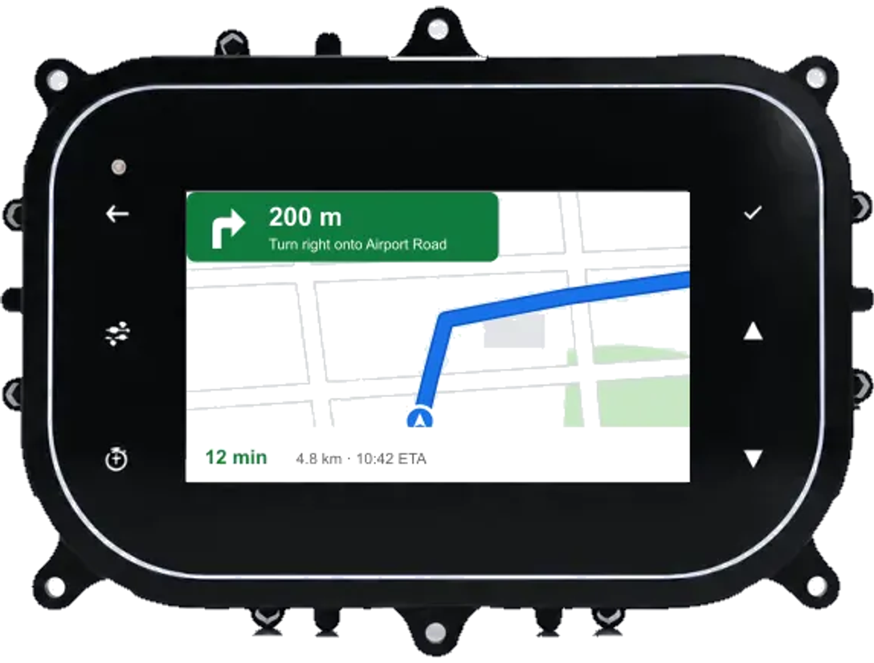




Google maps capture on non-andriod cluster
04 · PHONE SCREEN MIRRORING
Turn-by-turn on the dash
Eyes stay on the road
Works with your phone
Google Maps navigation from the rider's phone appears on the cluster screen.
Directions sit in the driver’s line of sight — no phone on the handlebar or dashboard.
Pair over the cluster’s wireless connectivity and start navigating.

Slide 14






Engineered for the road and the field
04 · CLUSTER FEATURES
High-resolution display
Advanced processing
Low power consumption
Crystal-clear visuals for real-time vehicle data; anti-glare, wide viewing angles, sunlight readable.
Multiple data streams processed simultaneously for instant driver feedback.
Energy-efficient design for extended vehicle battery life.
Rugged build
Customisable interface
Temperature resistant
Industrial-grade components for harsh environments.
Configurable layouts and themes for different vehicles and brands.
Operating range from −40 °C to +85 °C for all climates.

Slide 15
Automotive engineering capabilities
04 · CAPABILITIES
01
Display technology
02
Real-time data processing
High-brightness LCD/TFT displays with anti-glare coating and wide viewing angles.
Speed, RPM, fuel, temperature and diagnostics handled simultaneously.
LCD/TFT · Anti-glare · Sunlight readable
CAN bus support · Diagnostics · Instant updates
03
Custom design & engineering
04
Quality & certification
Clusters designed to your vehicle specifications, brand identity and functions.
Tested for temperature, vibration, humidity and electromagnetic compatibility.
Custom layouts · Brand integration · DFM
IATF 16949 ready · AEC-Q100 · EMC & vibration tested

Slide 16
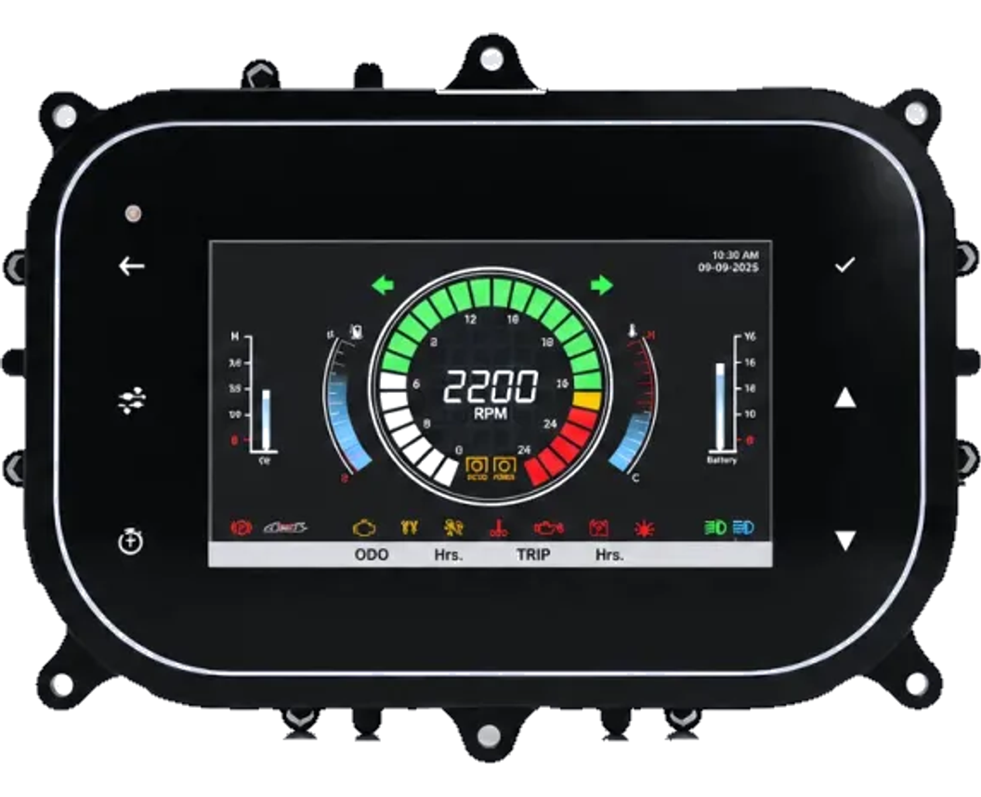



Automatic tractor electronics suite
04 · AGRI & OFF-HIGHWAY
A complete suite of smart, IoT-enabled electronics for agricultural equipment, earth-moving equipment and tractors.
Smart instrument clusters
5″ and 7″ clusters with 4G, Bluetooth and Wi-Fi
Tractor automation electronics
Electronics for automation of agricultural tractors
Telematics & tracking
GPS tracker and gateway for fleet visibility in the field
Connected platform
Cloud dashboards, mobile apps and OTA updates

Slide 17
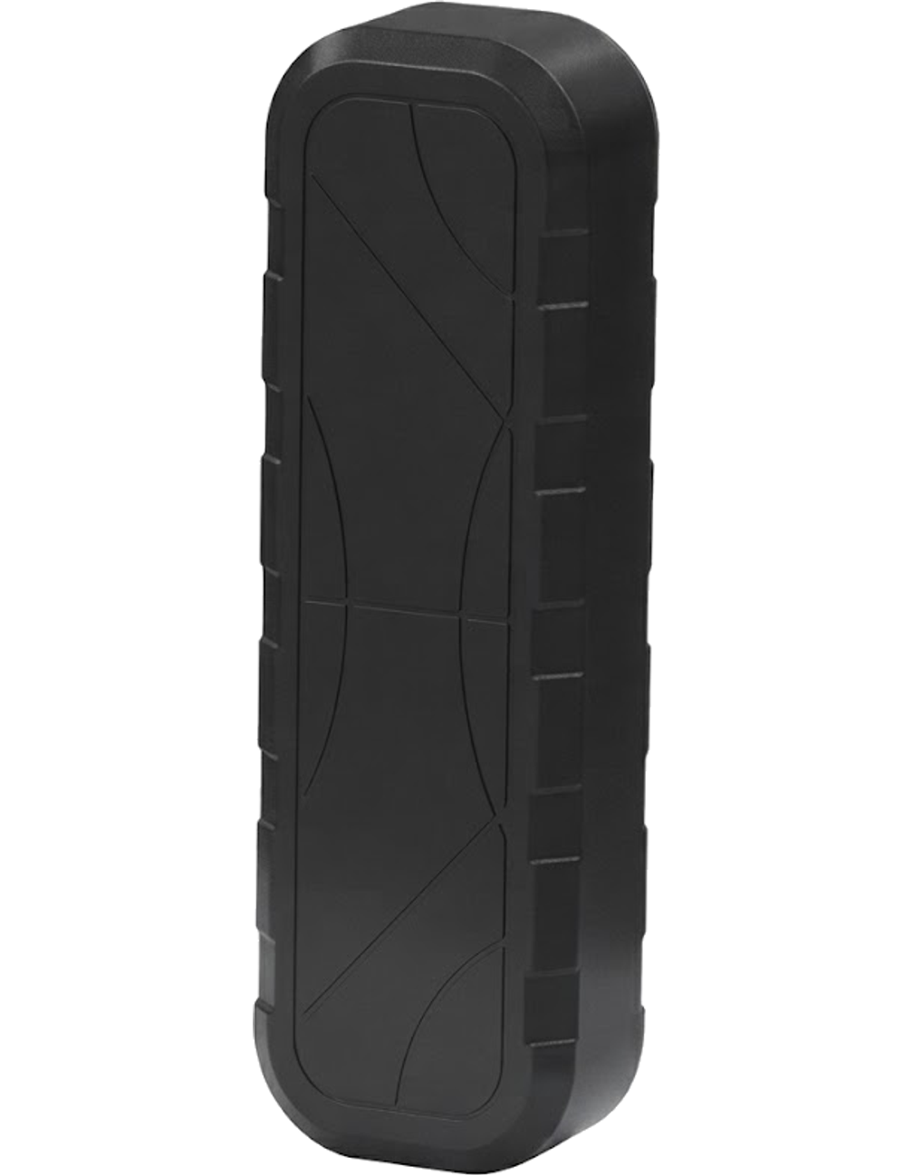
IoT solutions
05
GPS tracker & gateway, 4G smart lock, connected payment devices and the cloud platform behind them.

Slide 18






GPS Tracker WM-MFT-4G
05 · SMART TRACKING | SAFER VEHICLES | SMARTER FLEETS
Smart tracking. Total control. A rugged 4G GPS tracker for real-time fleet visibility, smart geo-fencing, and route intelligence — built for tractors, auto-rickshaws, construction equipment, trucks and two-wheelers.
Precision GPS tracking
<2.5 m positioning accuracy with continuous round-the-clock vehicle tracking.
4G LTE CAT-1 connectivity
Reliable and seamless real-time data transmission anywhere on the network.
Smart geo-fencing
Customisable virtual boundaries with instant entry and exit alerts.
10,000 location history logs
Route tracking, trip analysis and complete movement records on demand.
Ignition intelligence
Real-time ACC / engine ignition status monitoring and anti-theft security.
FOTA & SOS support
Remote over-the-air firmware upgrades plus SOS emergency button.
Tractors
Auto-rickshaws
Construction
Trucks
Two-wheelers

Slide 19


Technical specifications — WM-MFT-4G
05 · GPS TRACKER
GNSS | GPS + GLONASS · L1 · 33 tracking channels
Accuracy | <2.5 m CEP · tracking −167 dBm · acquisition −149 dBm
TTFF (open sky) | Hot start <5 s · cold start <40 s
Cellular | LTE CAT-1 4G module · Nano-SIM
Power | 9–90 V DC input · 60 mAh / 3.7 V battery · battery backup
Interface | 1 ignition input · 1 output (CAN optional) · LED: GNSS blue, cellular green
Physical | 82.5 × 38.5 × 15.0 mm · 50 g · built-in GSM & GNSS antennas
Environment | −20 °C to +70 °C · 5–95% RH, non-condensing
Data storage | Up to 10,000 history logs (as per customer requirement)
ADDITIONAL FEATURES
LBS positioning
Cell-tower (station mode) positioning
Geo-fence
Optional customisable boundaries
FOTA updates
Firmware-over-the-air upgrades
CAN optional
For diagnostics or data exchange
Protocol
TCP (server based) and MQTT, customisable
SOS button
Enhanced safety in critical situations

Slide 20
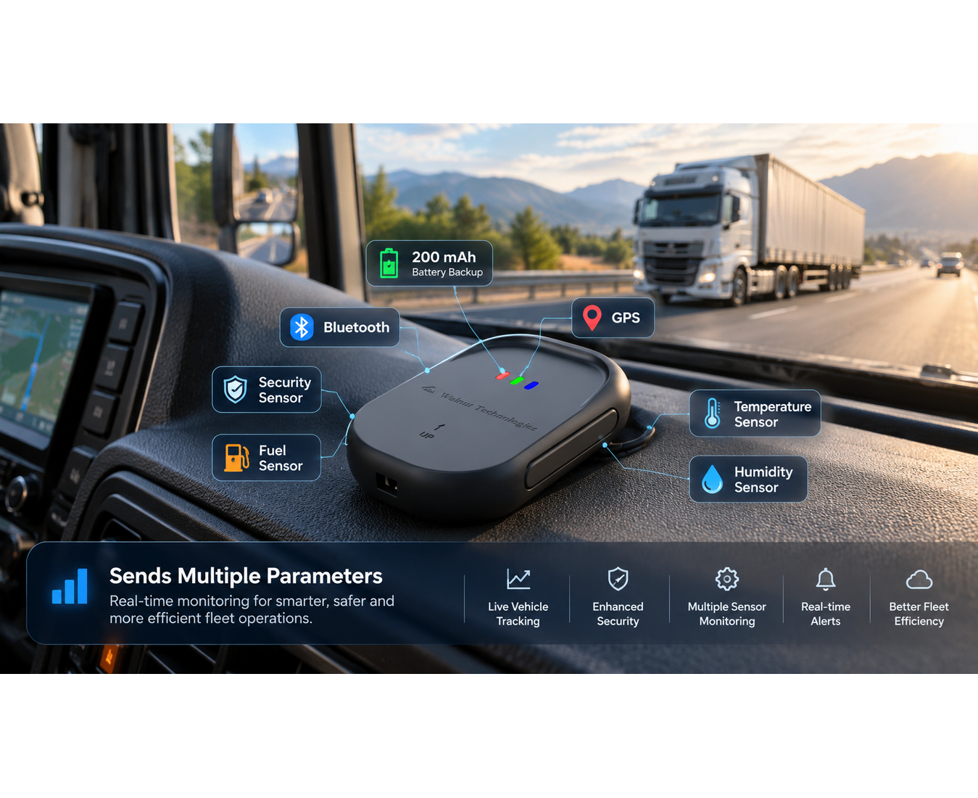


GPS gateway
05 · MULTI-SENSOR ASSET TRACKING & TELEMETRY
Reliable GPS gateway for industrial and logistics applications — multi-sensor monitoring, real-time tracking, telemetry reporting, and fleet management with secure cloud connectivity.
200 mAh battery backup
Internal backup battery ensures continuous telemetry transmission even if main power is disconnected.
Bluetooth & GPS connectivity
Dual wireless interfaces: precise GNSS location combined with BLE for wireless sensor integration.
Multi-sensor capability
Supports Security sensor, Fuel sensor, Temperature sensor, and Humidity sensor simultaneously.
Sends multiple parameters
Transmits all telemetry parameters in real time for smarter, safer, and more efficient fleet operations.
Secure cloud gateway
Encrypted cloud communication to fleet dashboards and mobile monitoring applications.

Slide 21
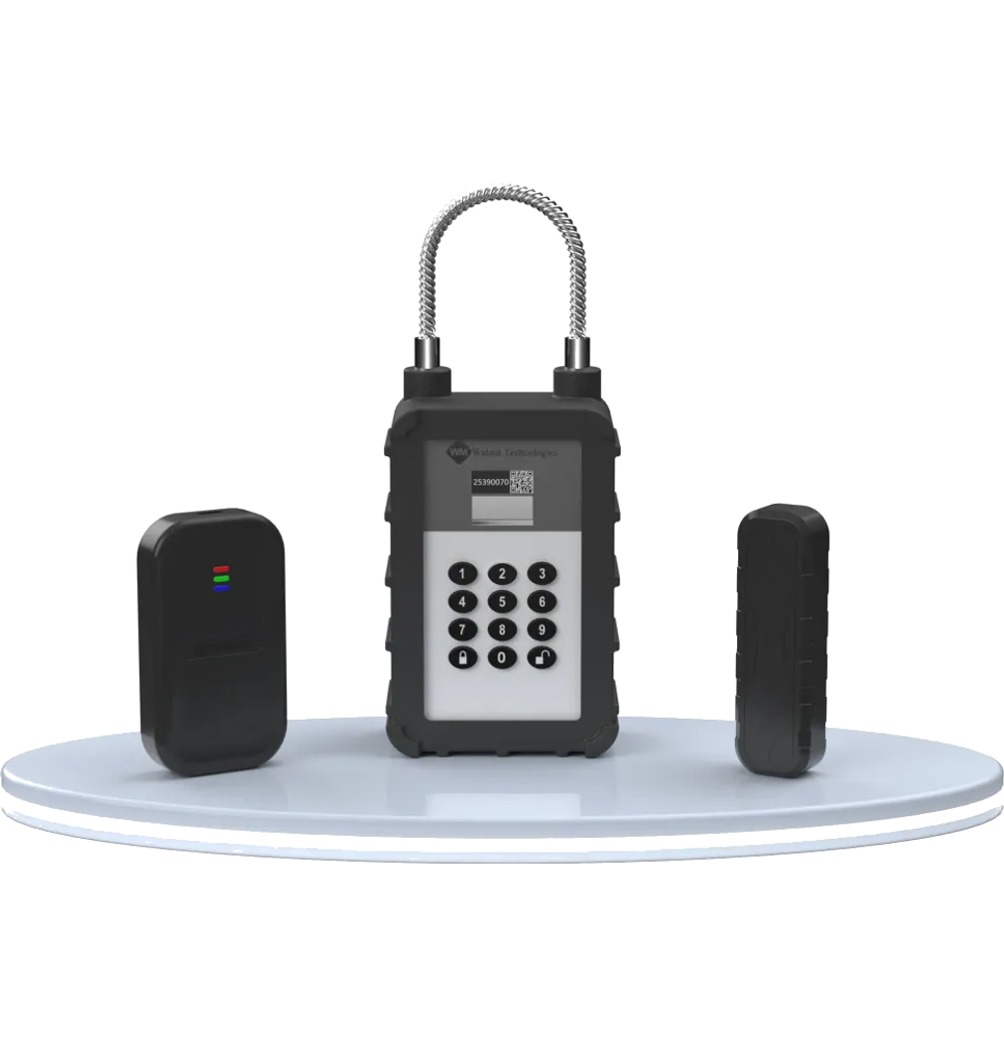


4G smart lock
05 · IOT SECURITY
Connected smart lock for logistics, assets and infrastructure — remote access control, real-time monitoring and cloud management from anywhere.
Real-time status monitoring
Industrial-grade IP67 design
6 months standby capability
4G · BLE · Wi-Fi connectivity
Remote access control
Cloud integration

Slide 22


Connected payment devices
05 · IOT AT SCALE
Smart payment soundboxes
NFC tap & pay with EMV chip
IoT management platform
BIS-approved soundboxes with 4G/2G, NB-IoT, Bluetooth and Wi-Fi, multi-language audio confirmation and secure integrations.
Contactless and chip-insert payments — launching in 2026.
SaaS platform for monitoring and managing deployed payment and IoT devices.

Slide 23
IoT engineering, end to end
05 · CAPABILITIES
01
Product design & development
02
Security & authentication
From concept to connected product: hardware, firmware and connectivity.
End-to-end encryption, secure boot and tamper detection for mission-critical devices.
Hardware · RTOS firmware · Wireless
Encryption · Secure element · Tamper detection
03
Manufacturing & assembly
04
Cloud & mobile platforms
4 SMT lines and 500K+ units per month with full traceability.
Companion apps and cloud dashboards with real-time analytics.
SMT & PCB · RF testing · Firmware flashing
Dashboards · Mobile apps · OTA updates
PROTOCOLS
AWS
MQTT
HTTPS
FOTA
JSON
RTOS
BLE
4G LTE
NB-IoT

Slide 24








Trusted by leading brands
06 · CLIENTS & INDUSTRIES
Healthcare
Defence & aerospace
Banking & payments
Hospitals, clinics and medical device companies
Mission-critical electronics for defence
POS terminals, soundboxes and payment devices
Pharmaceutical
Energy & utilities
Industrial & automotive
Manufacturing equipment and monitoring systems
Smart metering, grid monitoring, industrial controls
Industrial electronics, sensors and automotive

Slide 25





Let's build what's next
Engineering precision with user-centric design — we welcome the opportunity to collaborate with your team.
Address
Plot 132, JLPL Industrial Park, Sector 82, Mohali 160055
Dhanana (Upcoming in Haryana)
Phone
+91 77194 63719
Email
contact@walnutmedical.in
Website
walnutmedical.in

