Slide 1
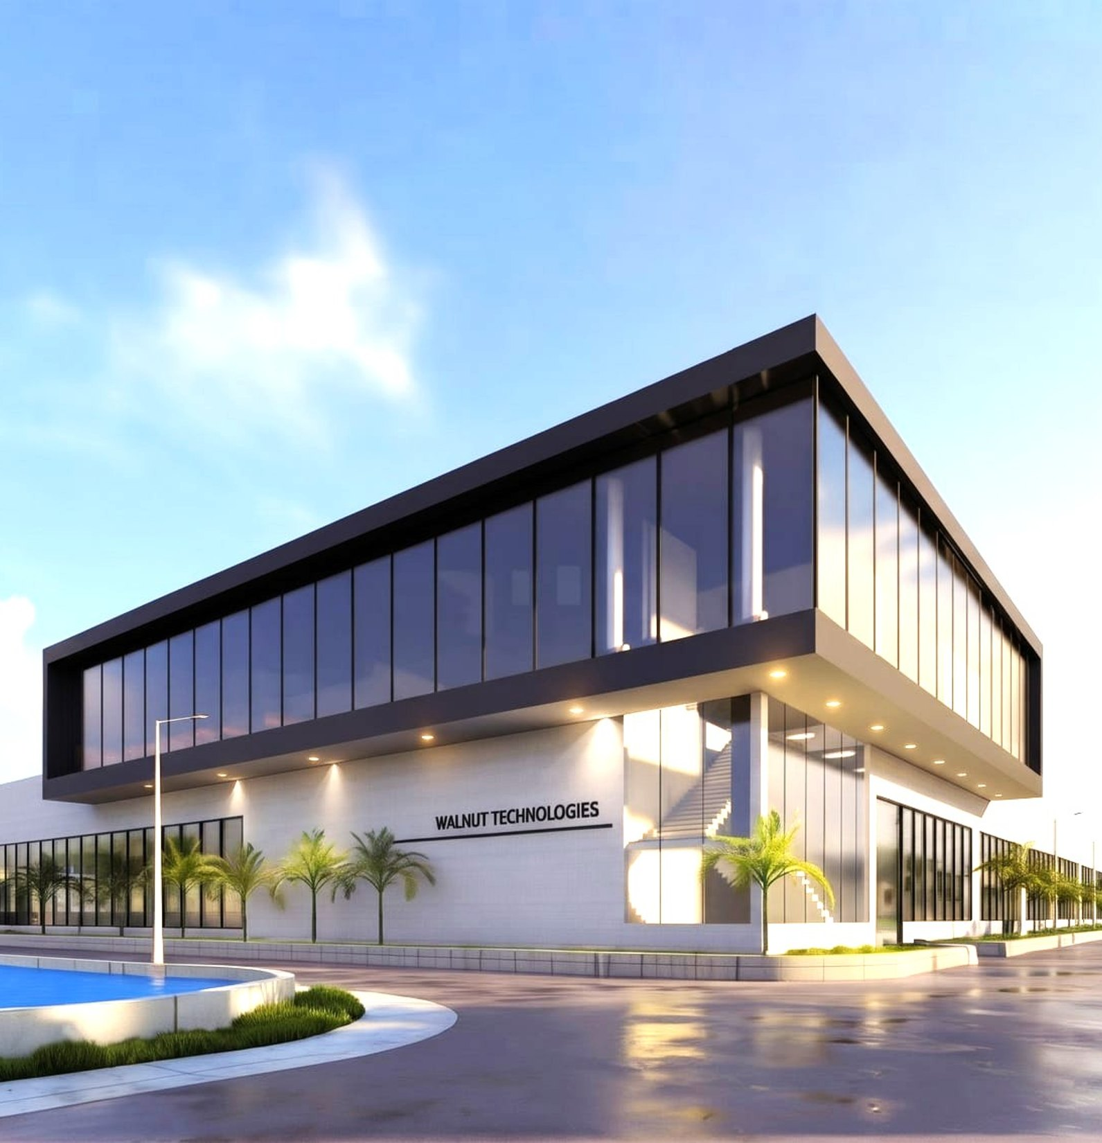

COMPANY PRESENTATION 2026
Intelligent Embedded Systems, Engineered for a Connected World
End-to-end design, development and manufacturing partner (ODM/OEM) for medical devices, neuro-rehabilitation robotics, Payment system and its software eco-system, IoT and automotive electronics.
Walnut Technologies™ · Mohali, India · walnutmedical.in

Slide 2
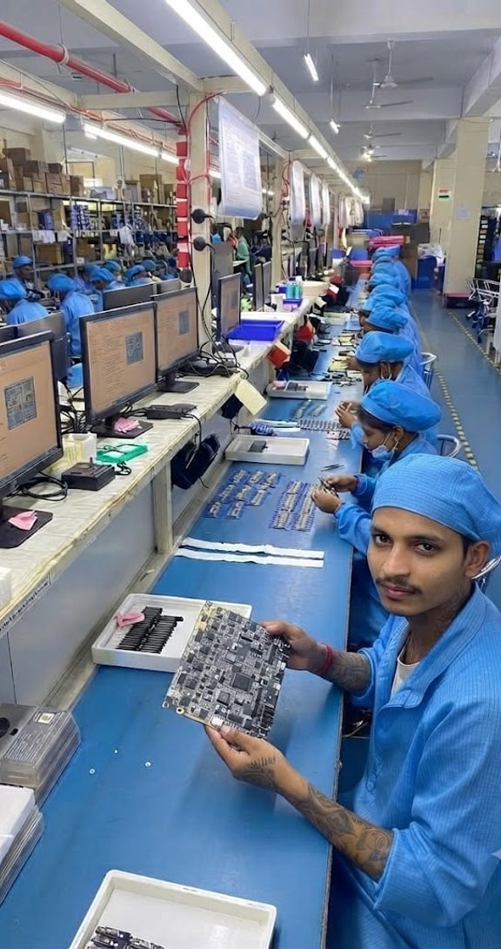
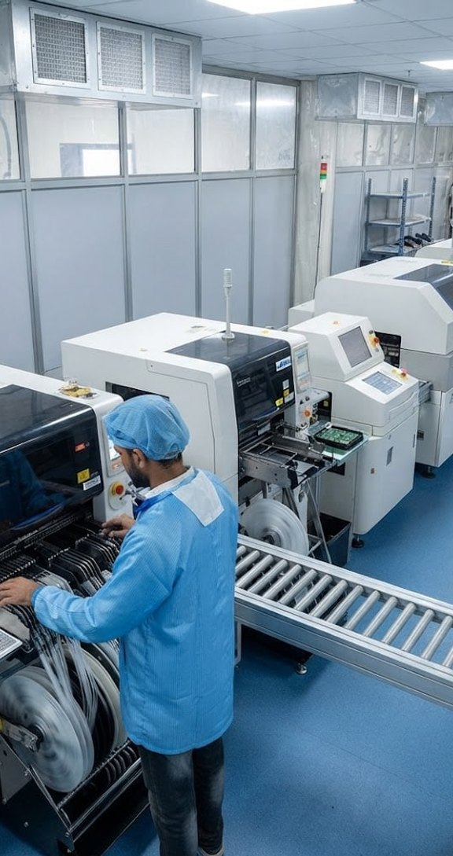


Who we are
01 · ABOUT WALNUT
Walnut Medical & Walnut Technologies, established in 2016, has grown into a vertically integrated design and manufacturing company — from PCB design to final assembly, every stage is in-house.
10+
600+
10+
Years of excellence
Engineers & technicians
Countries served
500K+
150,000
4
Units manufactured / month
Sq. ft facility
SMT production lines
Mohali · AMTZ Visakhapatnam · Dhanana (Upcoming in Haryana)
Production line
SMT line · JUKI & FUJI
ISO 13485 · CE · FCC · BIS · Industry 4.0 · Full traceability

Slide 3







Vision, mission & strengths
01 · ABOUT WALNUT
OUR VISION
OUR MISSION
To become India's leading technology and manufacturing powerhouse, delivering innovative, high-quality payment and electronic solutions to global markets.
Customer First
Quality Excellence
Exceed expectations with innovative, reliable solutions.
Superior products through continuous improvement.
Integrity & Trust
Sustainable Growth
The highest standards of ethics and transparency.
Lasting value for customers, partners and stakeholders.
R&D
D&D
Cloud & Firmware
Lean Mfg.
Fast Growth
Research & Development
Design & Development
In-House Architecture
Six Sigma & 5S
100%+ CAGR
Dedicated research and innovation driving next-gen hardware, firmware, and embedded system technologies.
In-house design capability — from industrial aesthetics and mechanical CAD to schematics, PCB layout, and validation.
AWS server-side, RTOS platforms, MQTT, HTTPS, FOTA and JSON for connected IoT devices.
5S, Kaizen and Six Sigma practices — less waste, shorter lead times, and consistent high quality.
CAGR above 100% over the last four years with expanding international footprint.

Slide 4

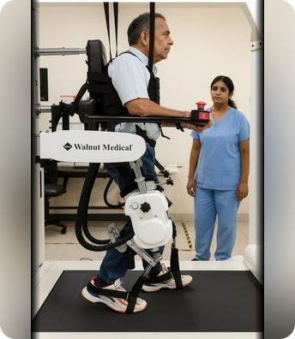
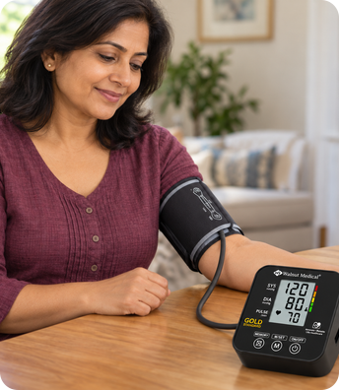

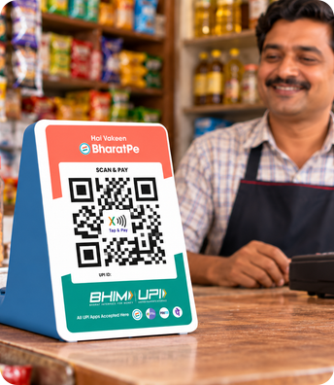
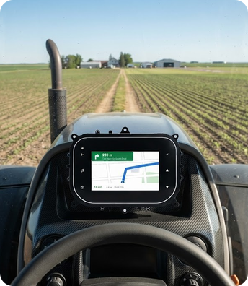
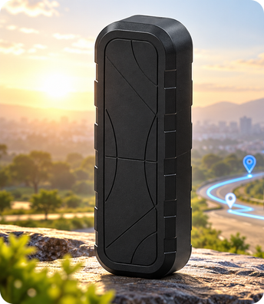
Our journey
02 · JOURNEY 2016 – 2026
2016
2017
2019
2021
2022
2025
2026
Walnut Medical founded
Robotics & neuro-rehab
Medical devices
Walnut Technologies
Fintech · soundbox
Smart clusters
GPS tracker & IoT
Started with a vision to make quality healthcare more accessible.
Walkex functional therapy and the WalkLab gait-training robot.
IR thermometer and digital BP monitor, then nebulizers and oxygen concentrators.
Engineering expands beyond healthcare into electronics for every industry.
Smart payment soundboxes and POS devices, in mass production from 2023.
5″ and 7″ smart clusters for 2-wheelers, tractors and vehicles.
GPS tracker & gateway and a growing range of connected IoT devices.

Slide 5
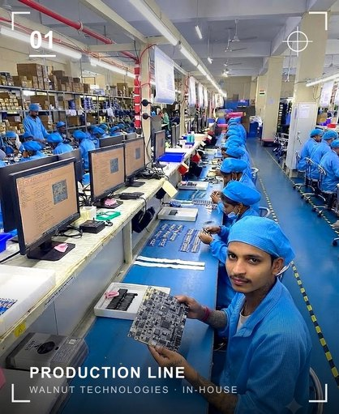
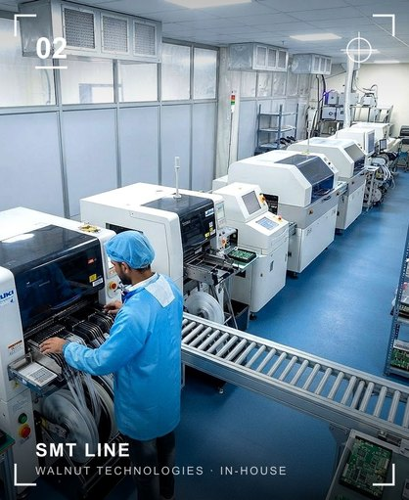
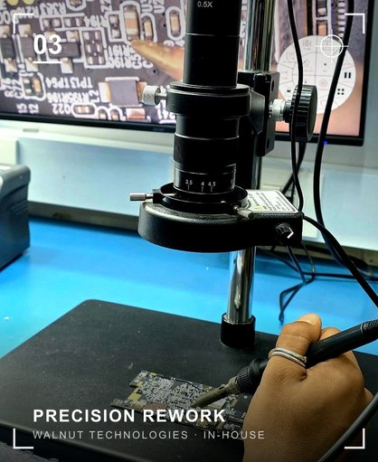


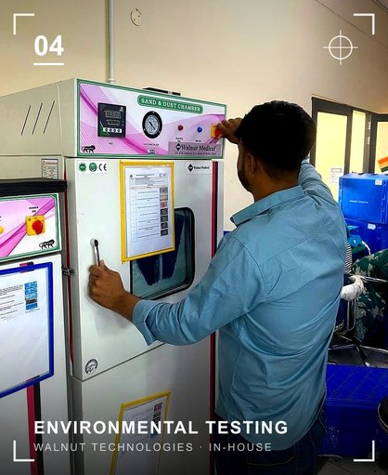
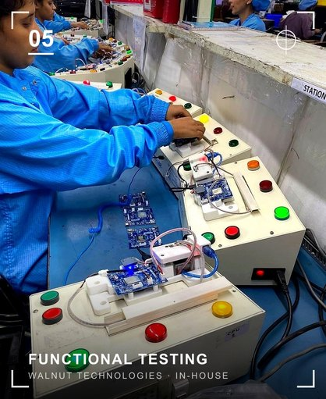
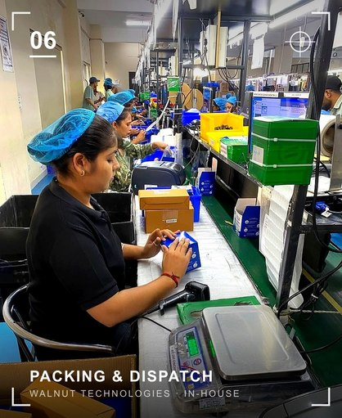


Manufacturing infrastructure
03 · INFRASTRUCTURE
150,000 sq. ft facility
Mohali · AMTZ · Dhanana (Upcoming in Haryana)
4 SMT production lines
Fully automatic SMT — JUKI RS-1, FUJI, 200,000 CPH
In-house test & calibration
Keysight · National Instruments · Rigol · Tektronix
PCB design to production
Design, validation, prototyping, pilot lots, full scale
IQC · LQC · OQC quality teams
Inspection at incoming, line and outgoing stages
Moulds & injection moulding
Mass-production mould design and plastics in-house

Slide 6

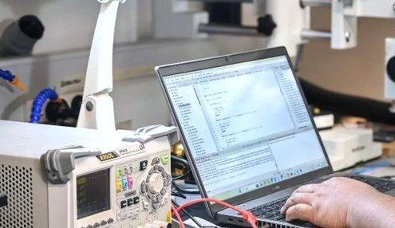
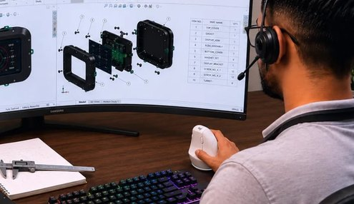
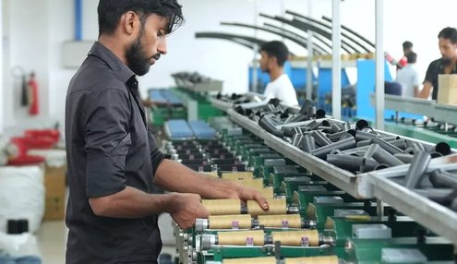
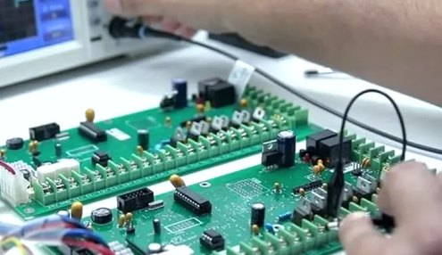
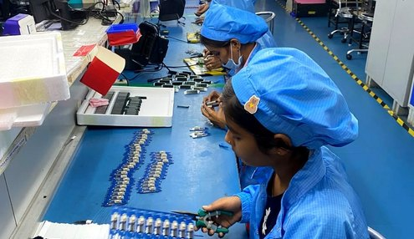

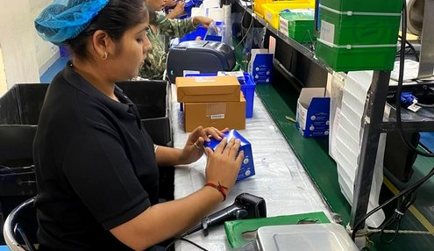


End-to-End Production Process
03 · HOW WE WORK
01
Idea & Requirement
02
Research & Market Analysis
03
Design & Engineering
04
Prototype Development
05
Validation & Testing
Clear direction
Right opportunity
Optimized design
Working prototype
Validated performance
06
Manufacturing Engineering
07
Quality Assurance
08
Packaging & Dispatch
09
After-Sales Support
10
Continuous Improvement
Production ready
Zero-defect mindset
Safe, on-time delivery
Reliable support
Better every day

Slide 7
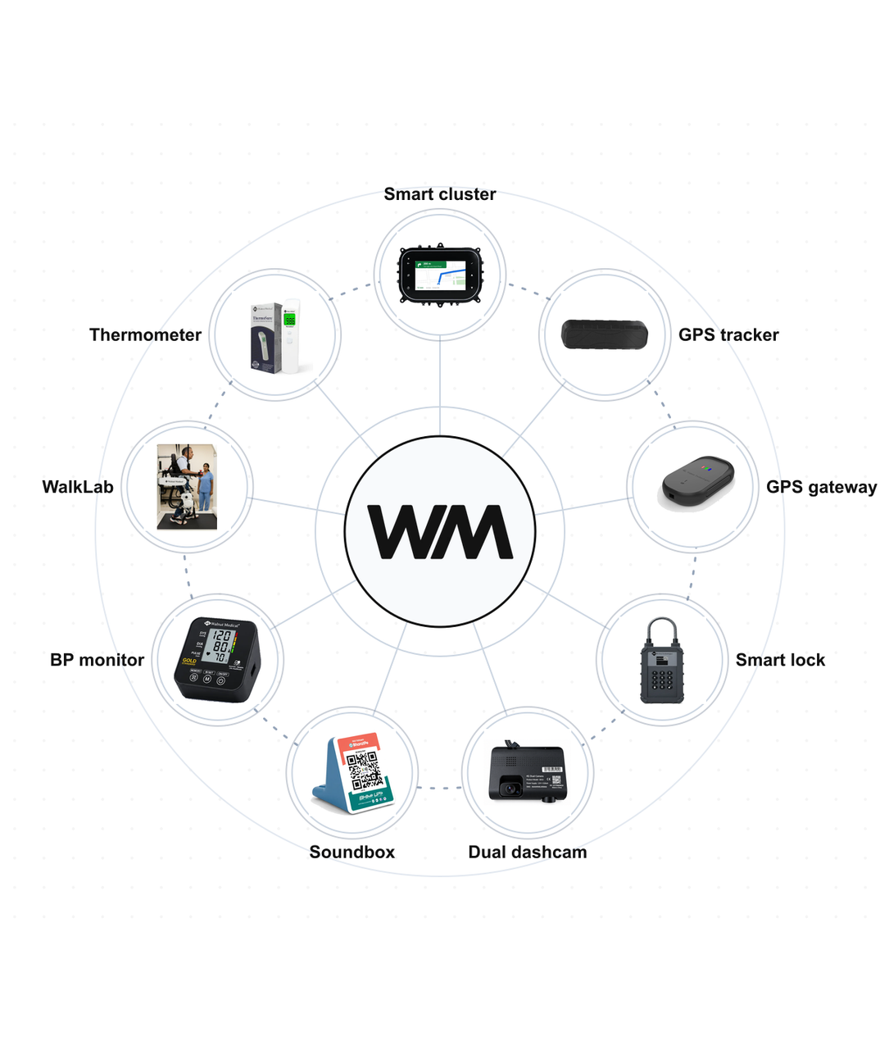




SECTION 04
Products
Five product families, designed and built in-house.
Medical
Diagnostics & monitoring
Neuro-rehabilitation
Robotics & FES therapy
Fintech
Soundboxes & payment POS
Automotive
Smart instrument clusters
IoT
Trackers, gateways & locks

Slide 8
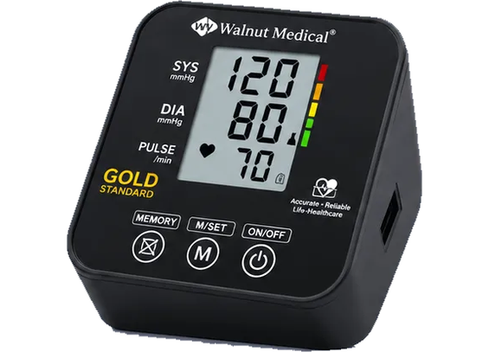
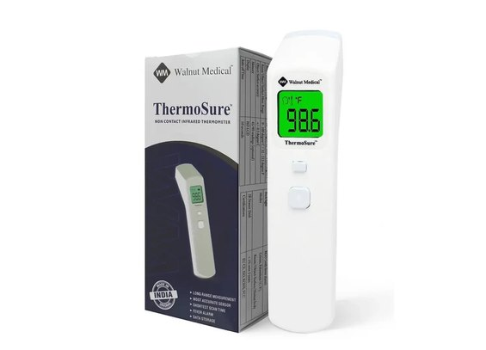
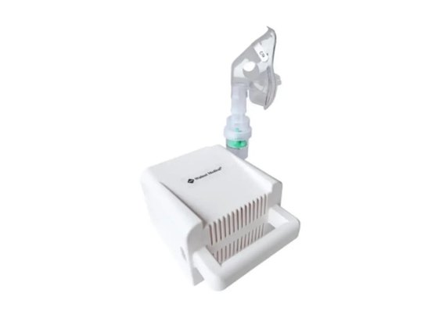
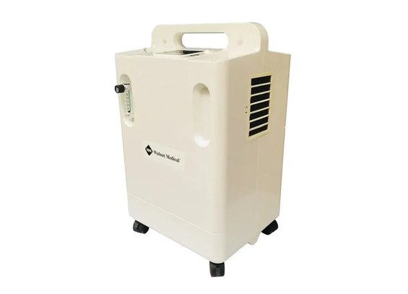
Medical devices
04 · MEDICAL
CDSCO-approved Class B and Class C medical devices, designed and manufactured under ISO 13485.
Digital BP monitor
IR thermometer
Compressor nebulizer
Oxygen concentrator
Clinical-grade automatic blood pressure monitor with digital display and memory.
ThermoSure non-contact infrared thermometer — fast, hygienic readings.
Compact, low-noise respiratory therapy for clinic and home.
5 L and 10 L, single and dual flow, for clinical and homecare use.
In development: a gold-standard electronic BP monitoring device, with ICMR funding and clinical trials at AIIMS Nagpur, AIIMS Delhi and Chettinad Super Speciality Hospital.

Slide 9
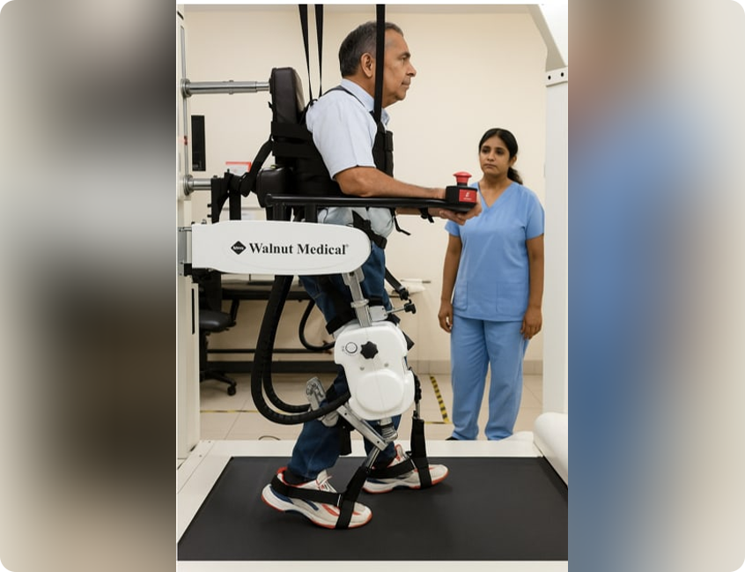
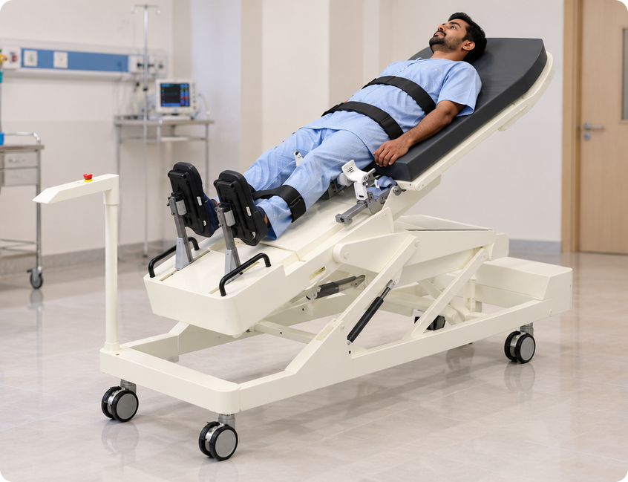
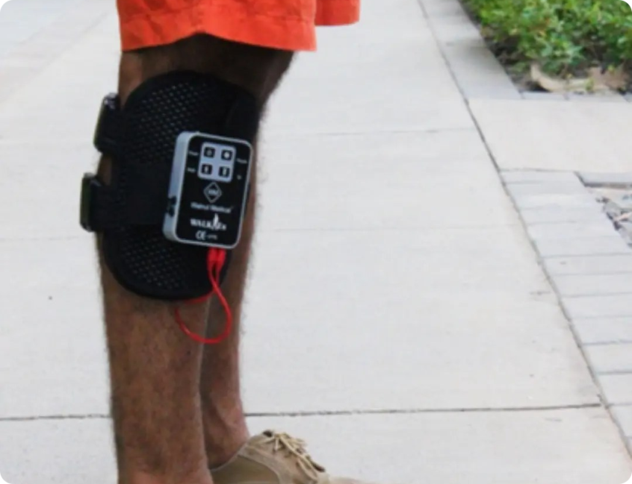
Neuro-rehabilitation & robotics
04 · NEURO REHAB
AI-assisted therapy
Real-time monitoring
Tele-rehab ready
FES
rTMS
RMNS
WalkLab
Weebo
Walkex
Lower limb walk trainer.
Early rehabilitation robot and functional electrical stimulation.
Functional electrical stimulation for foot drop — stroke and paralysis recovery.

Slide 10

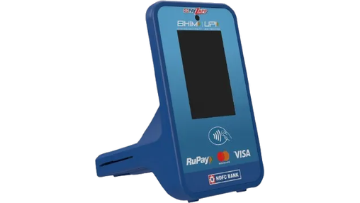
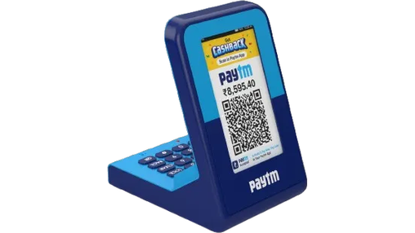
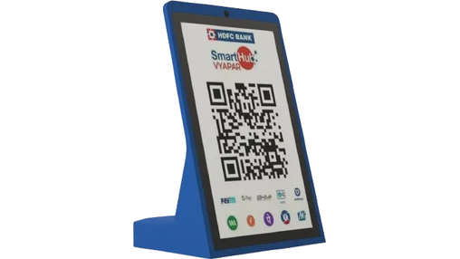
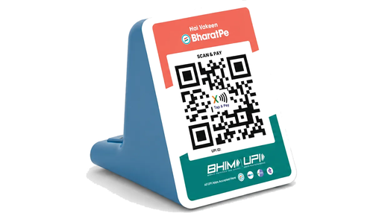
Fintech & payment devices
04 · FINTECH
BIS approved
PCI-DSS
NPCI compliant
EMV L1/L2
Multi-language audio
NFC tap & pay — 2026
All in one
DQR — Digital QR
LDQR — Large display
Payment soundbox
On-device QR generation with EMV tap and chip insert, and a certified PIN pad.
High-contrast LCD for dynamic QR and clear transaction visibility.
10″ touchscreen, 2.4″ merchant display, keyboard and NFC tap-and-pay.
4G/2G, NB-IoT, Bluetooth and Wi-Fi smart payment speakers.

Slide 11
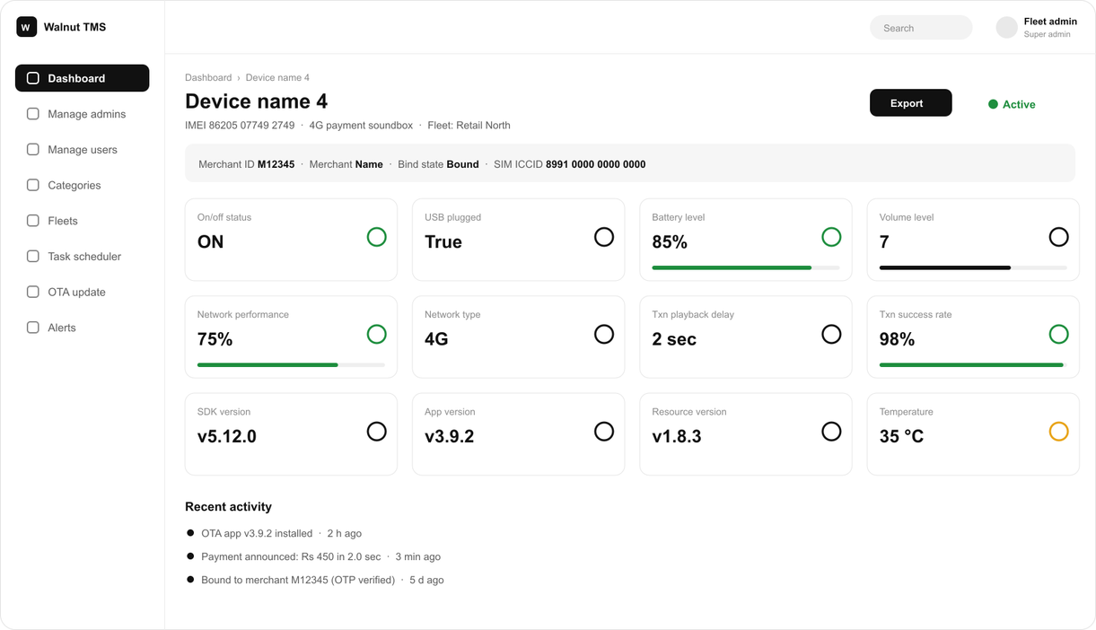



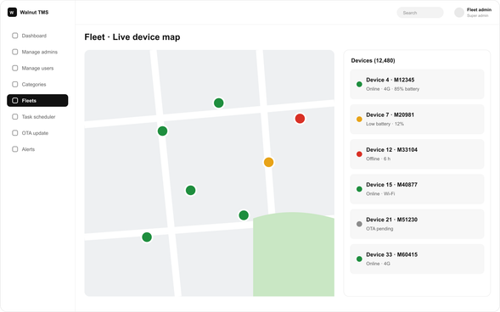
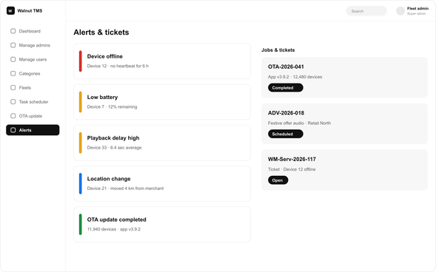


Terminal Management System
04 · END-TO-END SOUNDBOX ECOSYSTEM
Manage your fleet anywhere, anytime. A control centre for your entire terminal estate — TMS streamlines the full device lifecycle, from deployment to OTA updates and troubleshooting, with real-time visibility into every unit.
Device & network
Storage, CPU, memory, battery, IP, IMEI, operator and live location.
App details
App, SDK, sound-file and language versions; install history.
Scheduler
Schedule OTA jobs, advertisements and remote commands.
Onboarding
Link to merchant accounts, release OTP, un-bind, watch the transaction matrix.
Defender
Security metrics, anomaly detection, audits, alerts and mitigation.

Slide 12
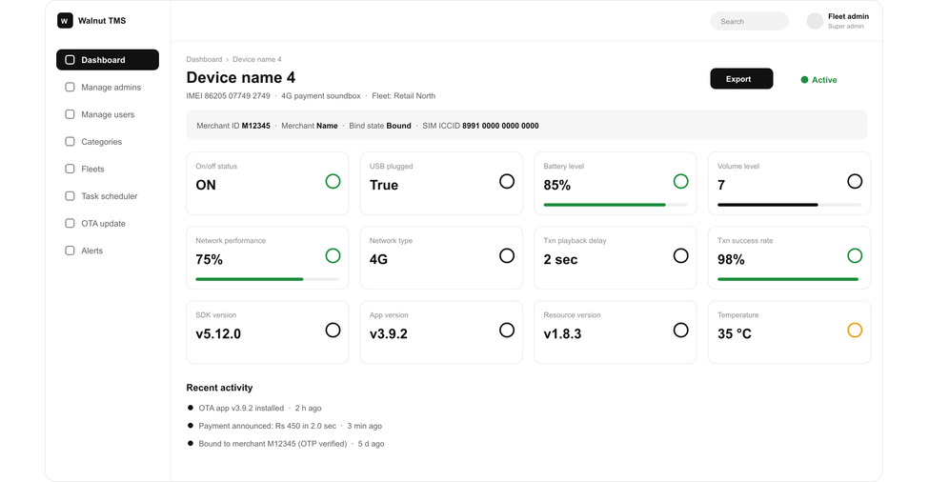




MQTT broker — instant, secure announcements
04 · END-TO-END SOUNDBOX ECOSYSTEM
Carrier-grade, isolated messaging infrastructure delivering payment voice confirmations in under 200 ms with end-to-end cryptographic integrity.
Dedicated connection
TLS 1.2 encryption
MQTT traffic isolated on its own fast-path to prevent network congestion and guarantee ultra-low latency.
Hardware-accelerated end-to-end encryption, MITM protection, and verified data integrity in transit.
Centralised broker
Lightweight by design
< 200 ms
TLS 1.2
99.99%
Streamlined broker architecture for simplified access control, ACLs, and enterprise policy enforcement at scale.
Minimal packet overhead, QoS 1 delivery, and optimized keep-alive intervals tailored for battery-operated soundboxes.
Voice announcement latency
Bank-grade payload encryption
Delivery success rate

Slide 13
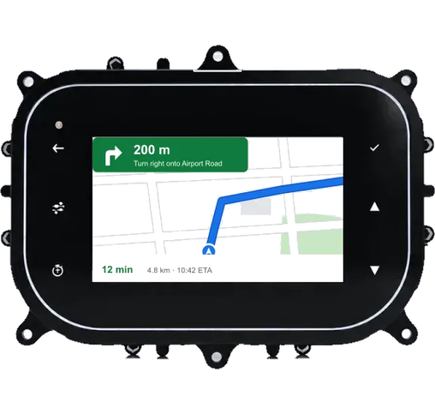
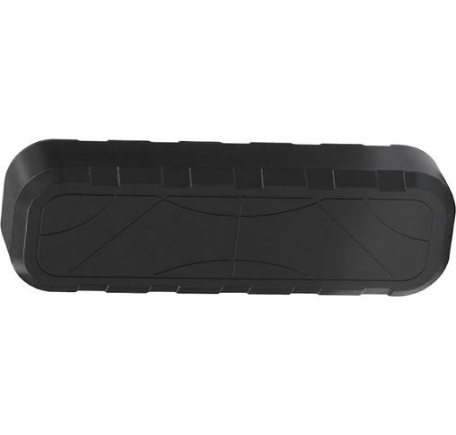
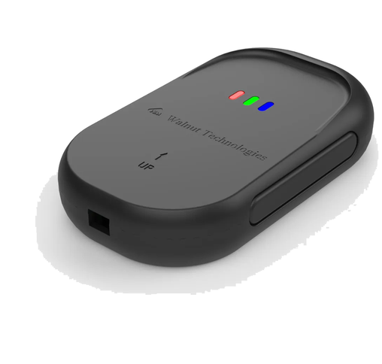
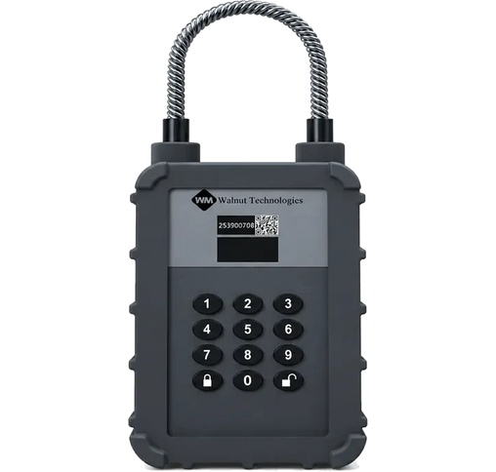
Automotive & IoT
04 · AUTOMOTIVE & IOT
Smart clusters
GPS tracker
GPS gateway
4G smart lock
5″ and 7″ · Android & RTOS · 4G, BT, Wi-Fi · Google Maps mirroring · custom cluster development
WM-MFT-4G · <2.5 m accuracy · 4G CAT-1 · geo-fencing · ignition monitoring · SOS
Asset tracking and telemetry · fleet management · secure cloud connectivity
Remote access control · real-time status · IP67 · with battery backup

Slide 14
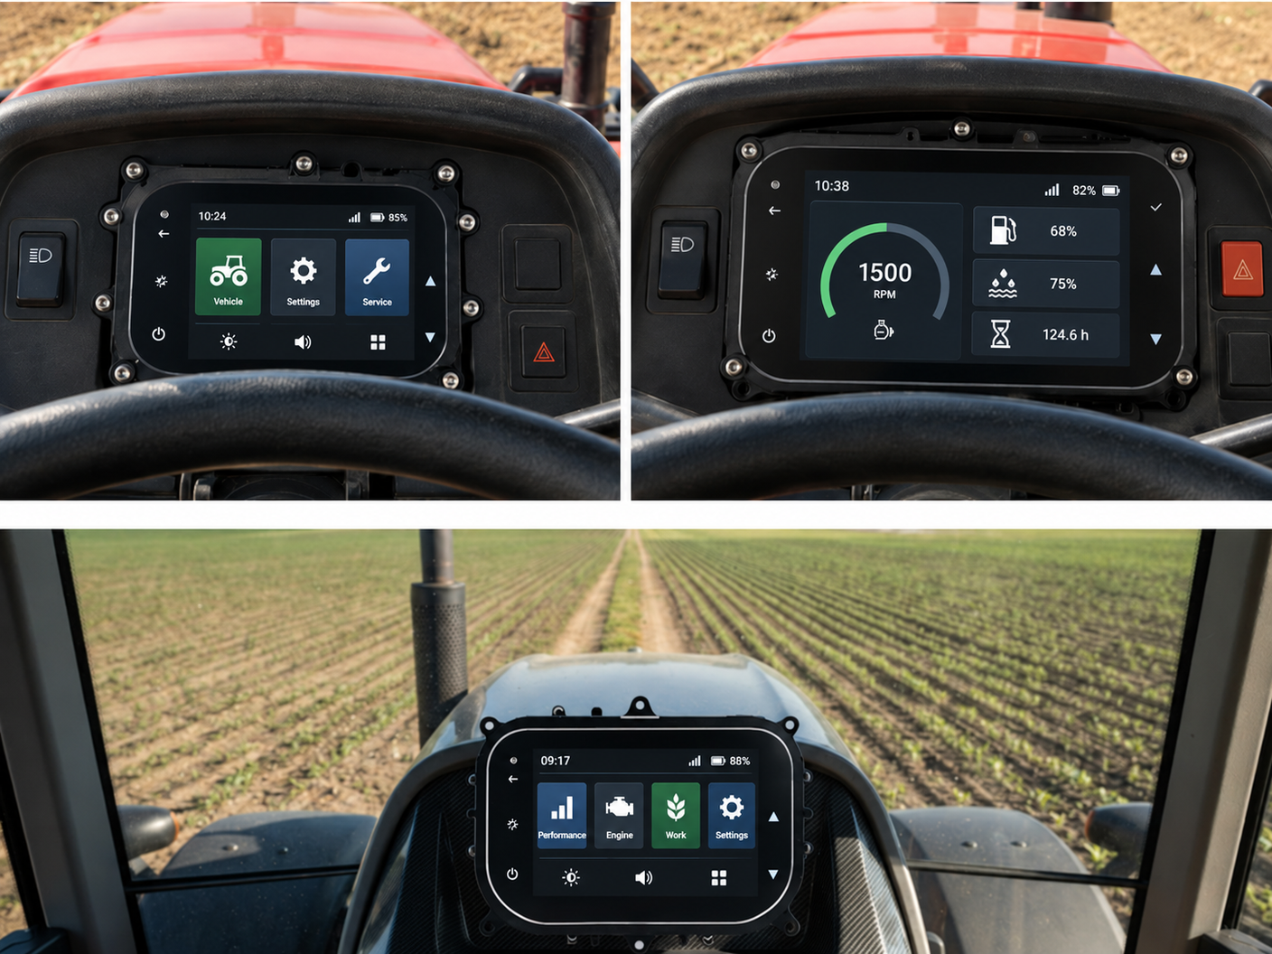

Smart instrument clusters
04 · AUTOMOTIVE ELECTRONICS
Next-generation digital clusters with high-resolution displays, real-time vehicle data and customisable driver interfaces — built for durability and clarity.
5-inch and 7-inch displays
Two sizes to suit compact and full-size dashboards
Android and RTOS based
Smart and cost-optimised platform options
4G · Bluetooth · Wi-Fi
Connected cluster with phone screen mirroring
BUILT FOR
2-wheelers
Tractors & farm equipment
LMV & HMV

Slide 15
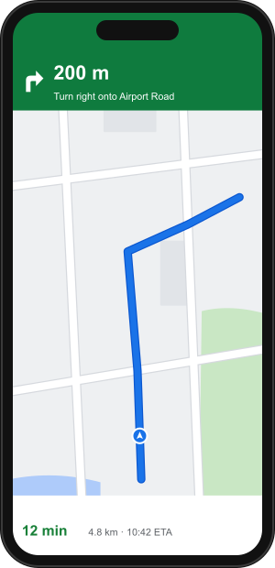
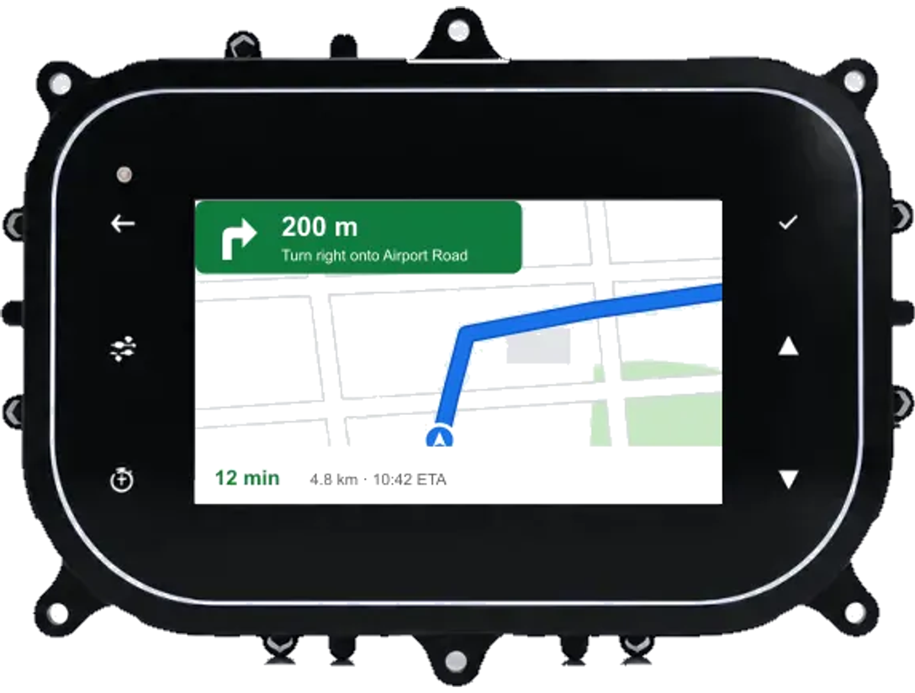


Google maps capture on non-andriod cluster
04 · PHONE SCREEN MIRRORING
Turn-by-turn on the dash
Eyes stay on the road
Works with your phone
Google Maps navigation from the rider's phone appears on the cluster screen.
Directions sit in the driver’s line of sight — no phone on the handlebar or dashboard.
Pair over the cluster’s wireless connectivity and start navigating.

Slide 16
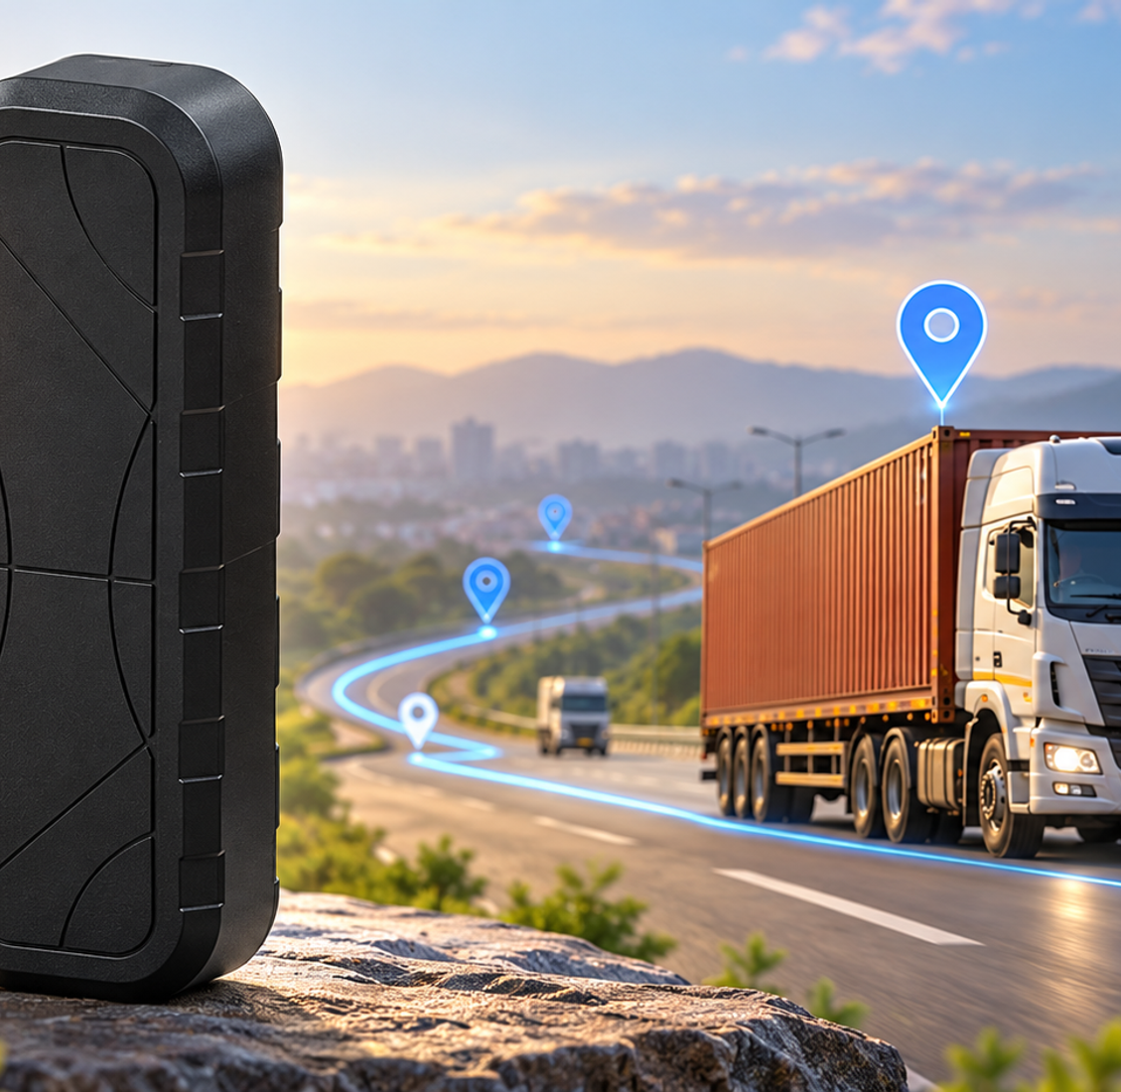



GPS Tracker WM-MFT-4G
04 · SMART TRACKING | SAFER VEHICLES | SMARTER FLEETS
Smart tracking. Total control. A rugged 4G GPS tracker for real-time fleet visibility, smart geo-fencing, and route intelligence — built for tractors, auto-rickshaws, construction equipment, trucks and two-wheelers.
Precision GPS tracking
<2.5 m positioning accuracy with continuous round-the-clock vehicle tracking.
4G LTE CAT-1 connectivity
Reliable and seamless real-time data transmission anywhere on the network.
Smart geo-fencing
Customisable virtual boundaries with instant entry and exit alerts.
10,000 location history logs
Route tracking, trip analysis and complete movement records on demand.
Ignition intelligence
Real-time ACC / engine ignition status monitoring and anti-theft security.
FOTA & SOS support
Remote over-the-air firmware upgrades plus SOS emergency button.
Tractors
Auto-rickshaws
Construction
Trucks
Two-wheelers

Slide 17

Technical specifications — WM-MFT-4G
04 · GPS TRACKER
GNSS | GPS + GLONASS · L1 · 33 tracking channels
Accuracy | <2.5 m CEP · tracking −167 dBm · acquisition −149 dBm
TTFF (open sky) | Hot start <5 s · cold start <40 s
Cellular | LTE CAT-1 4G module · Nano-SIM
Power | 9–90 V DC input · 60 mAh / 3.7 V battery · battery backup
Interface | 1 ignition input · 1 output (CAN optional) · LED: GNSS blue, cellular green
Physical | 82.5 × 38.5 × 15.0 mm · 50 g · built-in GSM & GNSS antennas
Environment | −20 °C to +70 °C · 5–95% RH, non-condensing
Data storage | Up to 10,000 history logs (as per customer requirement)
ADDITIONAL FEATURES
LBS positioning
Cell-tower (station mode) positioning
Geo-fence
Optional customisable boundaries
FOTA updates
Firmware-over-the-air upgrades
CAN optional
For diagnostics or data exchange
Protocol
TCP (server based) and MQTT, customisable
SOS button
Enhanced safety in critical situations

Slide 18
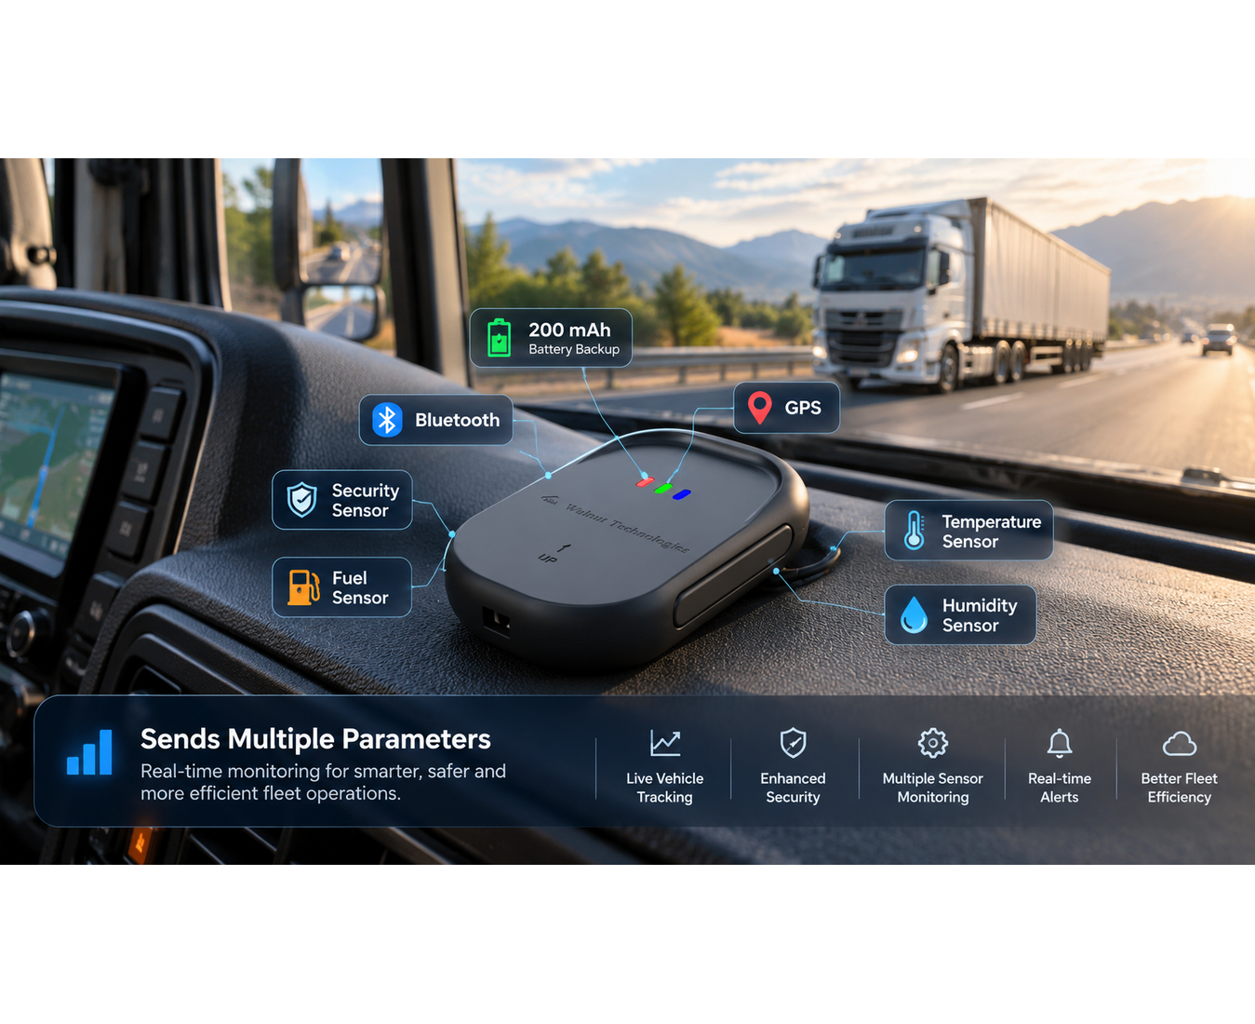

GPS gateway
04 · MULTI-SENSOR ASSET TRACKING & TELEMETRY
Reliable GPS gateway for industrial and logistics applications — multi-sensor monitoring, real-time tracking, telemetry reporting, and fleet management with secure cloud connectivity.
200 mAh battery backup
Internal backup battery ensures continuous telemetry transmission even if main power is disconnected.
Bluetooth & GPS connectivity
Dual wireless interfaces: precise GNSS location combined with BLE for wireless sensor integration.
Multi-sensor capability
Supports Security sensor, Fuel sensor, Temperature sensor, and Humidity sensor simultaneously.
Sends multiple parameters
Transmits all telemetry parameters in real time for smarter, safer, and more efficient fleet operations.
Secure cloud gateway
Encrypted cloud communication to fleet dashboards and mobile monitoring applications.

Slide 19
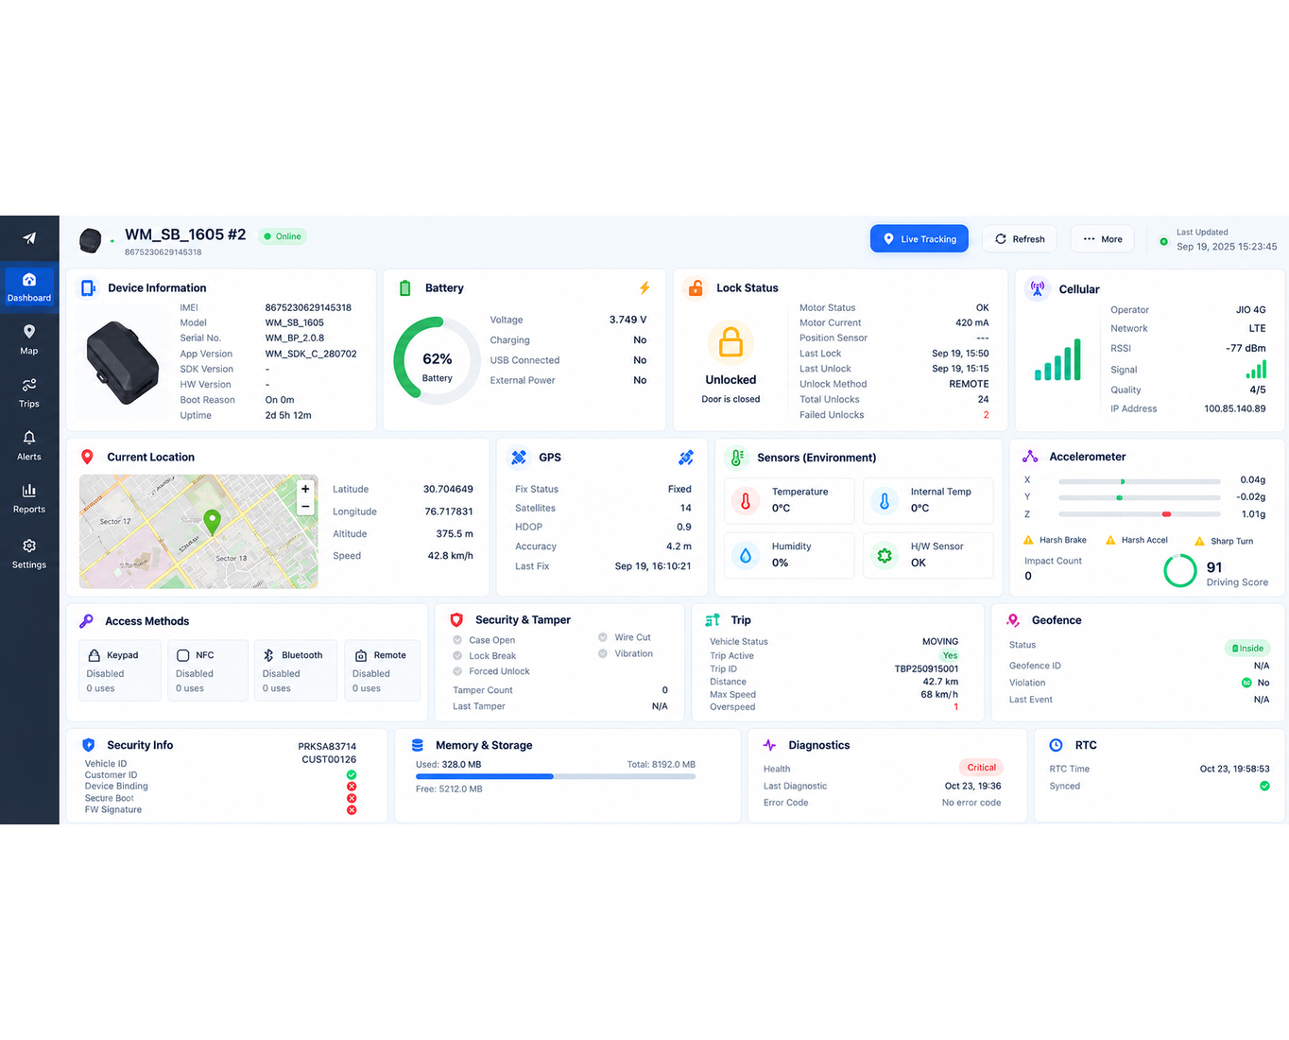



Smart GPS & IoT Monitoring Dashboard
04 · IOT SECURITY & FLEET CONTROL
KEY FEATURES
1. Device Monitoring
6. Security Monitoring
Device info, firmware & health status.
Tamper detection, alerts & device security.
2. GPS Tracking
7. Driving Analytics
Real-time location, speed & trip monitoring.
Harsh braking, acceleration & driving score.
3. Connectivity
8. Geofencing
4G/LTE, Bluetooth and NFC interfaces.
Location boundaries & violation alerts.
4. Battery Management
9. Sensor Monitoring
Battery level, charging and power status.
Temperature, humidity & motion detection.
5. Smart Lock Control
10. Remote Diagnostics
Lock/unlock status and access management.
Device health, memory & error monitoring.

Slide 20
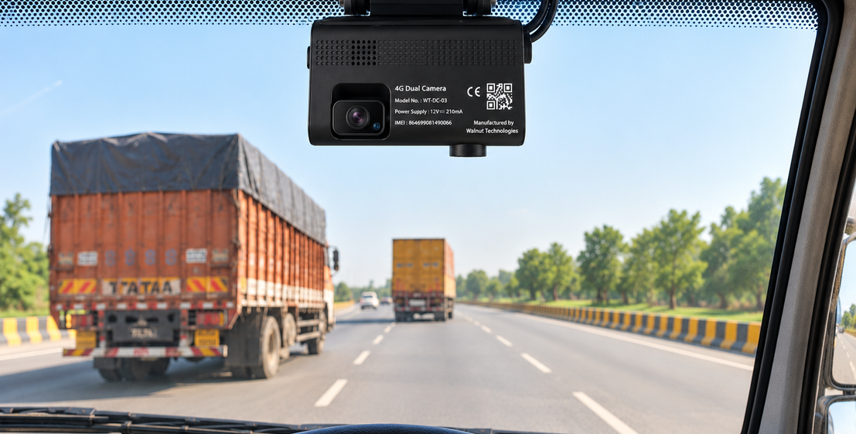
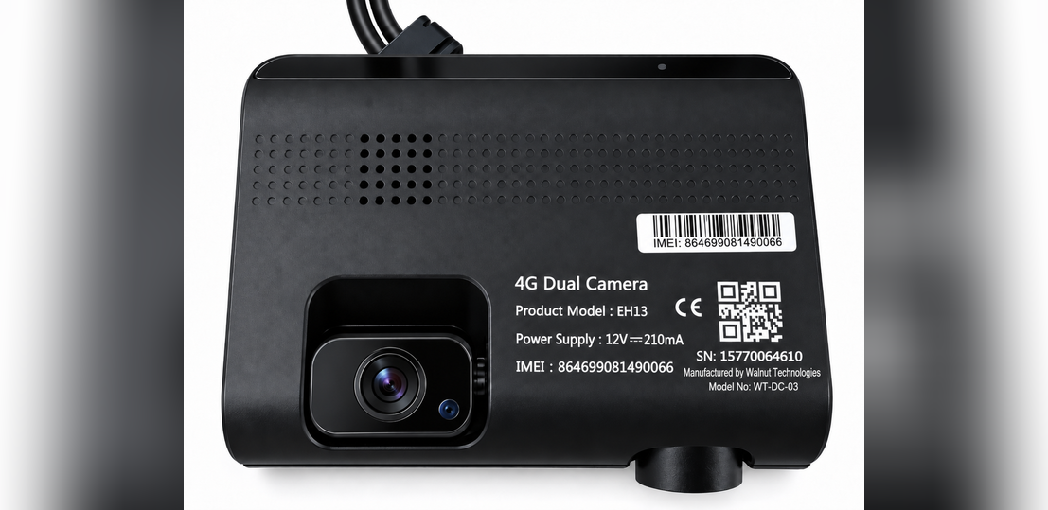
HW-EH13 — 4G Dual Camera Dashcam
04 · CONNECTED VIDEO TELEMATICS
Intelligent vehicle security dashcam with dual Full HD cameras, 4G LTE Cat 1 connectivity, live video streaming, and collision telematics.
Single Dashcam
Dual Dashcam
Full HD 1080p
4G LTE Cat 1
Dual Camera | Front & Rear/Cabin Recording
Video Quality | Full HD 1080p, 25 FPS
Connectivity | 4G LTE Cat 1 module
GPS Tracking | Real-time vehicle location
Safety Features | Collision & vibration alerts
Storage | Up to 128 GB MicroSD
Audio | Built-in microphone & speaker
Power Supply | 9–36 V DC wide input
Video Compression | H.265 / H.264 high efficiency
Compact Design | 105 × 86 × 32 mm enclosure
Remote Monitoring | Video & data transmission
Applications | Fleet tracking, vehicle security & driver monitoring

Slide 21






Trusted by leading brands
05 · CLIENTS & INDUSTRIES
Healthcare
Defence & aerospace
Banking & payments
Hospitals, clinics and medical device companies
Mission-critical electronics for defence
POS terminals, soundboxes and payment devices
Pharmaceutical
Energy & utilities
Industrial & automotive
Manufacturing equipment and monitoring systems
Smart metering, grid monitoring, industrial controls
Industrial electronics, sensors and automotive

Slide 22






Let's build what's next
Engineering precision with user-centric design — we welcome the opportunity to collaborate with your team.
Address
Plot 132, JLPL Industrial Park, Sector 82, Mohali 160055
Dhanana (Upcoming in Haryana)
Phone
+91 77194 63719
Email
contact@walnutmedical.in
Website
walnutmedical.in

