Slide 1

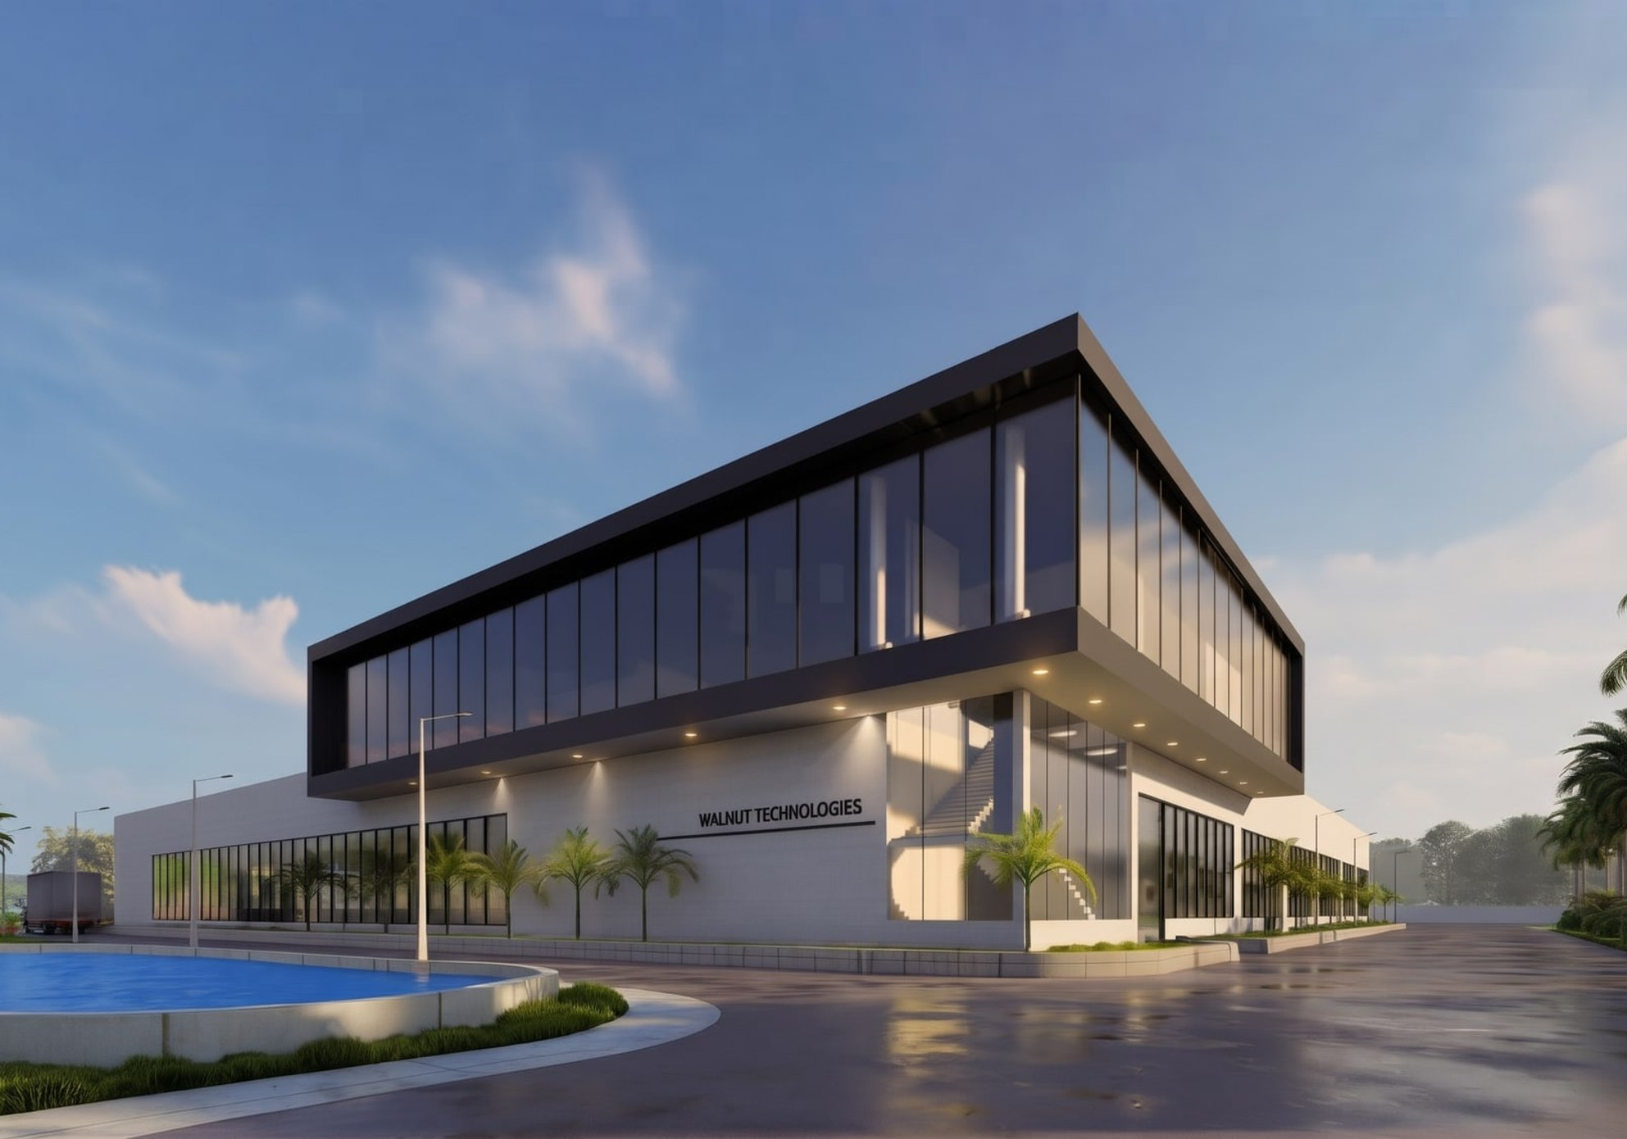
PRODUCT CATALOG 2026
Intelligent Embedded Systems, Engineered for a Connected World
Medical · Neuro-rehabilitation · Fintech · Automotive · IoT
Walnut Technologies Pvt. Ltd. · Mohali, India · walnutmedical.in

Slide 2
Inside this catalog
CONTENTS
Walnut Medical & Walnut Technologies design and manufacture electronics end to end — from idea and PCB design to SMT, assembly, testing and dispatch. This catalog introduces the company and every product line we build.
01
About Walnut
03
Who we are, at a glance, leadership
02
Our journey
06
2016 – 2026 milestones
03
Infrastructure & quality
07
Facilities, production process, certifications
04
Medical devices
10
BP monitor, thermometer, nebulizer, oxygen concentrator
05
Neuro-rehabilitation
14
WalkLab, Weebo, CES Repose
06
Fintech & payment devices
17
Soundbox platform and models
07
Automotive electronics
20
5″ & 7″ clusters, Google Maps mirroring, tractor suite
08
IoT solutions
25
GPS tracker & gateway, 4G smart lock
09
Expertise & clients
28
Capabilities, brands and industries
10
Contact
30
Addresses and contacts

Slide 3
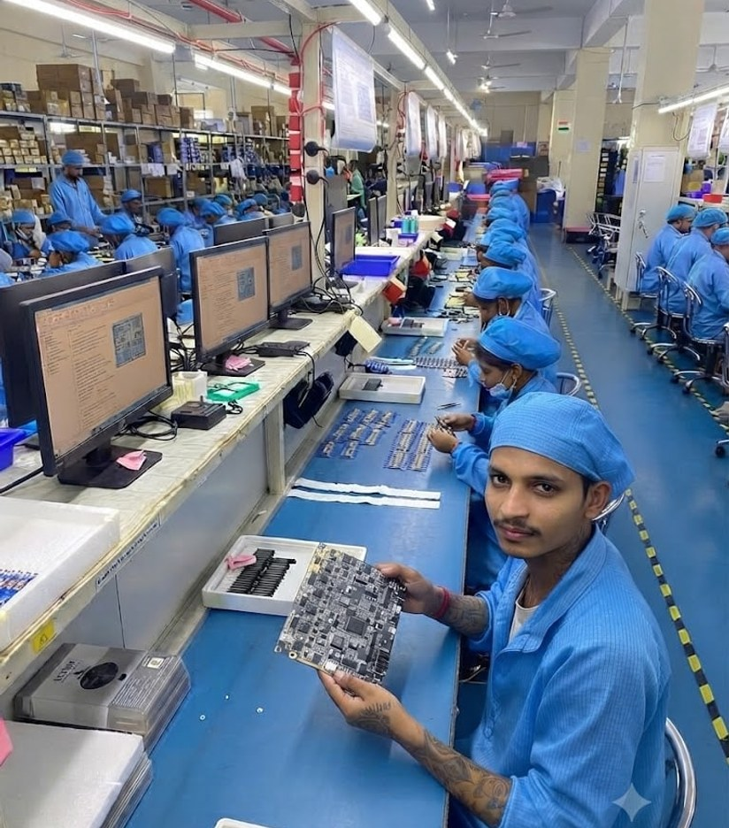
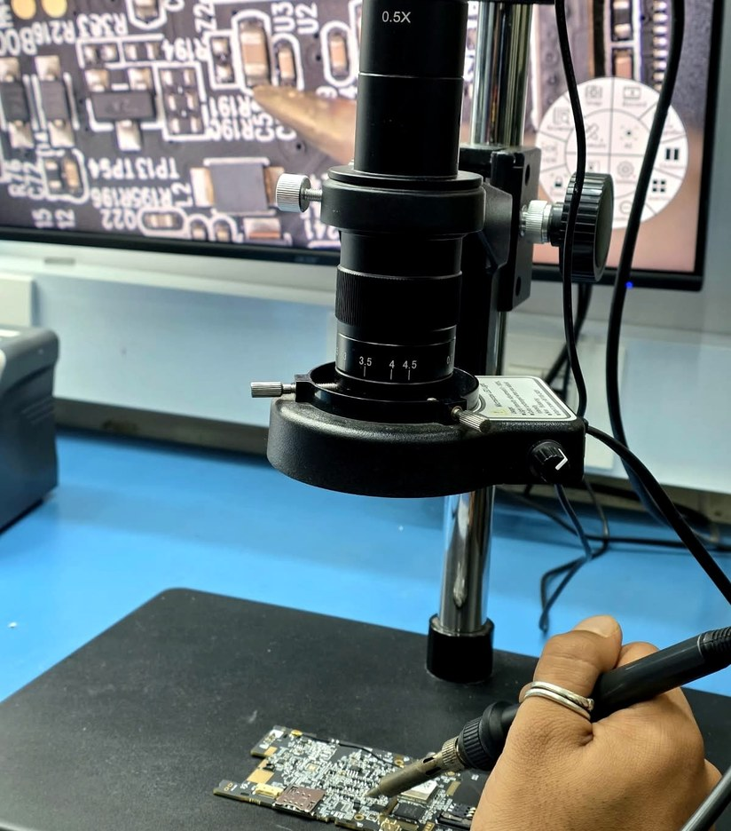



Who we are
01 · ABOUT WALNUT
Walnut Medical & Walnut Technologies is a multi-vertical original design and equipment manufacturer (ODM/OEM). Established in 2016, we have grown from a small electronics workshop into a vertically integrated design and manufacturing partner for medical devices, neuro-rehabilitation robotics, payment devices, IoT and automotive electronics.
Production units
Mohali (Punjab) · AMTZ, Visakhapatnam (Andhra Pradesh) · Dhanana (Upcoming in Haryana)
Fully in-house
Electronics & firmware design, mould design, SMT, testing, quality and dispatch
Certified quality
ISO 13485 · Class 10K cleanroom · CE · FCC · BIS

Slide 4




Walnut at a glance
01 · ABOUT WALNUT
10+
600+
10+
Years of excellence
Engineers & technicians
Countries served
500K+
150,000
4
Units / month
Sq. ft facility
SMT lines
Mission
Vision
Deliver world-class original design manufacturing for electronics across healthcare, finance and technology — globally.
The most trusted ODM partner for mission-critical electronics, ISO 13485 certified, serving 50+ countries by 2030.
OUR VALUES
Quality first
Innovation
ISO 13485 and ISO 9001 certified processes with a Class 10K cleanroom.
600+ engineers pushing boundaries in medical, payment and custom electronics.
Global reach
Vertical integration
Serving 10+ countries with end-to-end manufacturing and logistics.
From PCB design to final assembly — complete in-house capabilities.

Slide 5
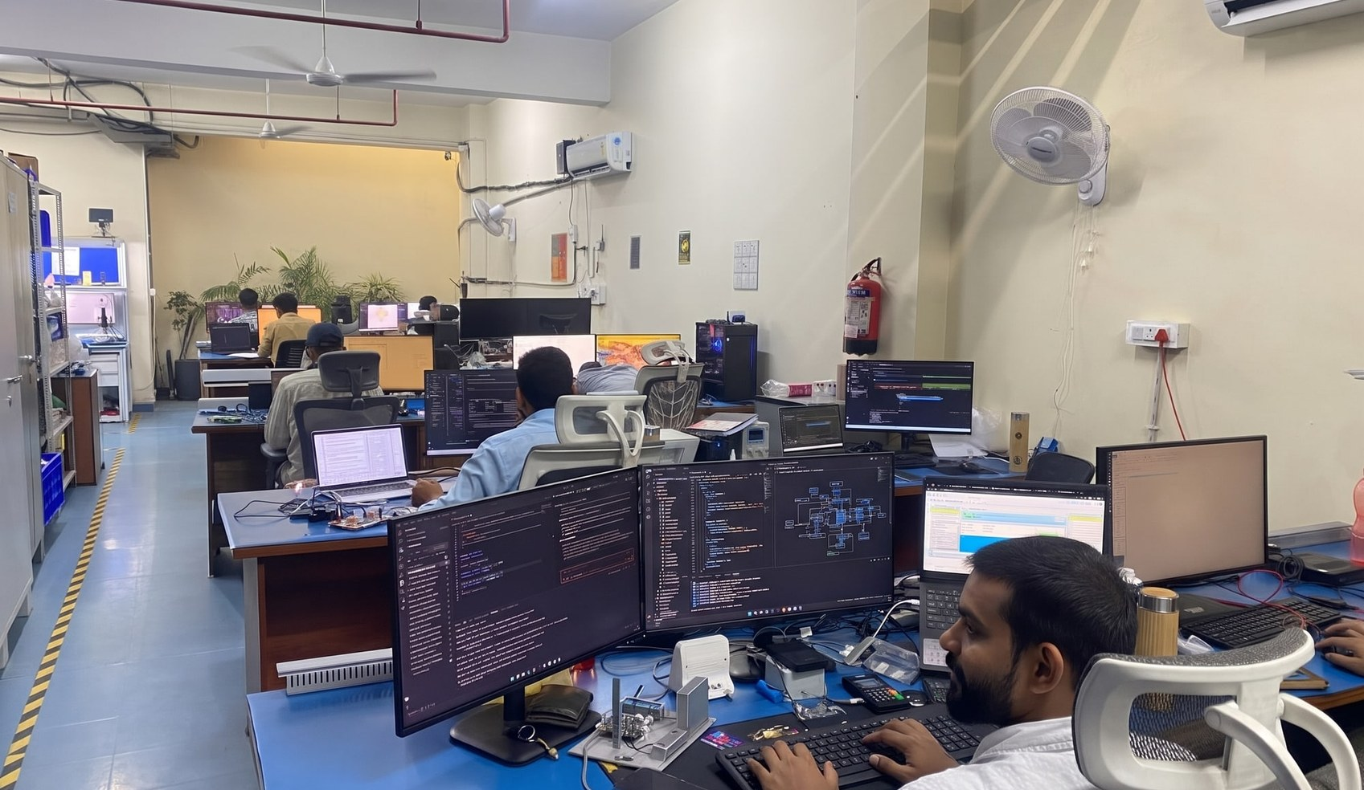
Leadership
01 · ABOUT WALNUT
SD
Siddharth Dhawan
Director & CEO
Spent 10 years at National Instruments Corp. in the USA and India, working in high-tech embedded and control systems and managing the business in India.
AB
Amol Bhardwaj
Director & CTO
Leads medical device development; launched devices across diagnostics, therapeutics and robotics — EEG, ECG, rTMS and gait training robots. Expert in QC tools, SPC, APQP, PPAP, Six Sigma, Cpk and 5S; Management Representative for ISO 13485 and CE audits (2009–2014).

Slide 6

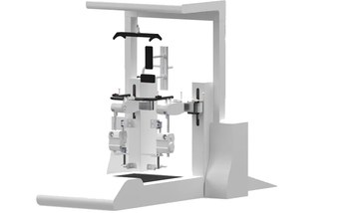
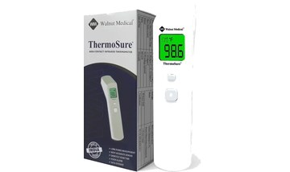

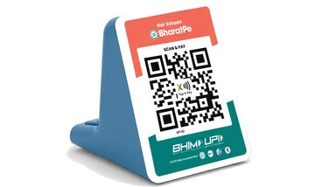
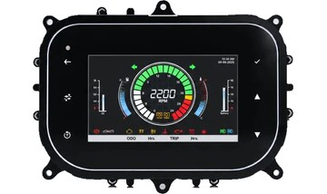
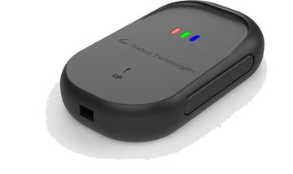
Our journey
02 · JOURNEY 2016 – 2026
2016
Walnut Medical founded
Started with a vision to make quality healthcare more accessible.
2017
Robotics & neuro-rehab
Walkex functional therapy and the WalkLab gait-training robot.
2019
Medical devices
IR thermometer and digital BP monitor, then nebulizers and oxygen concentrators.
2021
Walnut Technologies
Engineering expands beyond healthcare into electronics for every industry.
2022
Fintech · soundbox
Smart payment soundboxes and POS devices, in mass production from 2023.
2025
Smart clusters
5″ and 7″ smart instrument clusters for 2-wheelers, tractors and vehicles.
2026
GPS tracker & IoT
GPS tracker & gateway and a growing range of connected IoT devices.

Slide 7
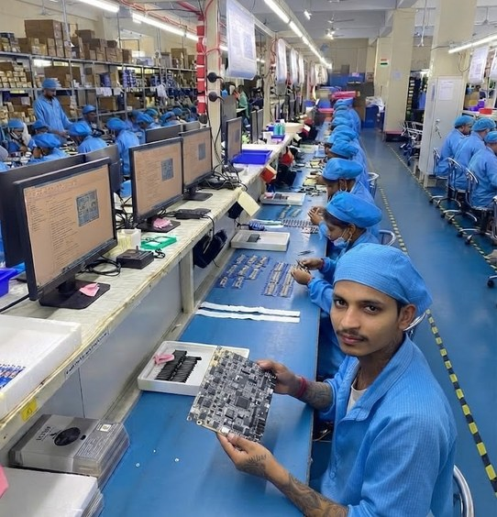
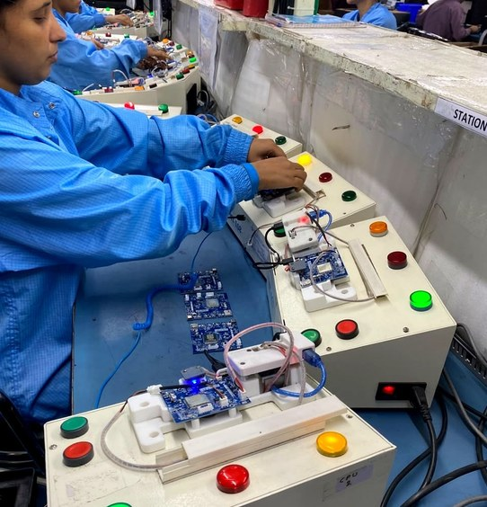
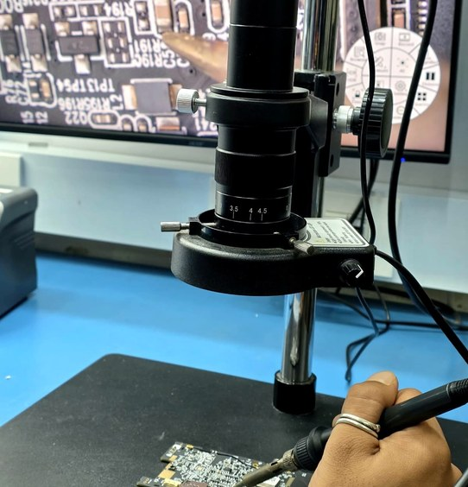
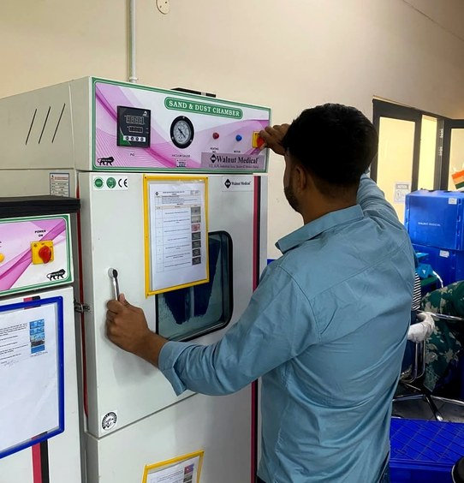
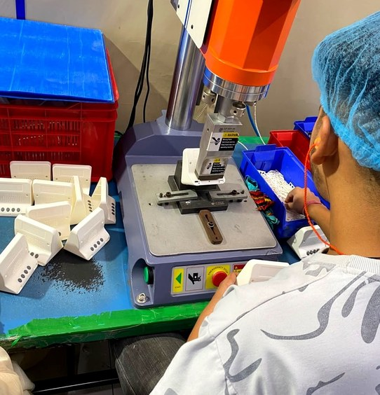
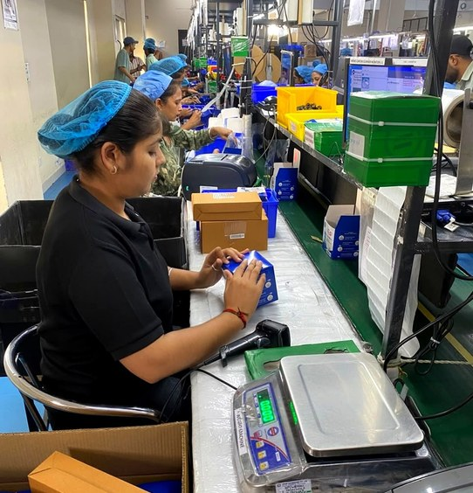





Manufacturing infrastructure
03 · INFRASTRUCTURE
150,000 sq. ft facility
4 SMT production lines
Mohali · AMTZ Visakhapatnam · Dhanana (Upcoming in Haryana)
Fully automatic SMT — JUKI RS-1, 100,000 CPH
In-house test & calibration
PCB design to production
Keysight · National Instruments · Rigol · Tektronix
Design, validation, prototyping, pilot lots, full scale
IQC · LQC · OQC quality teams
Moulds & injection moulding
Class 10K cleanroom for controlled builds
Mass-production mould design and plastics in-house

Slide 8

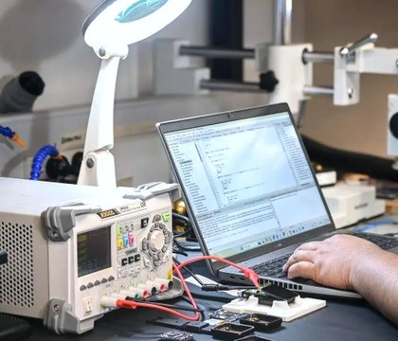
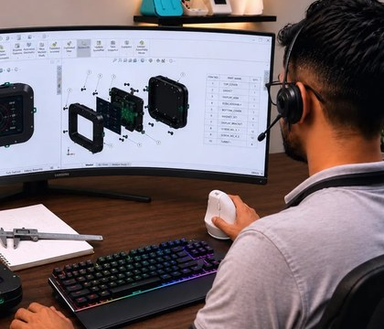
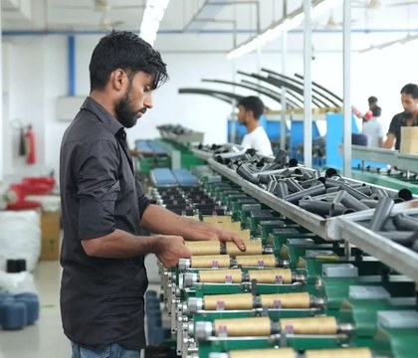
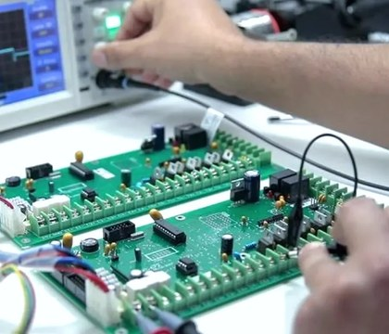
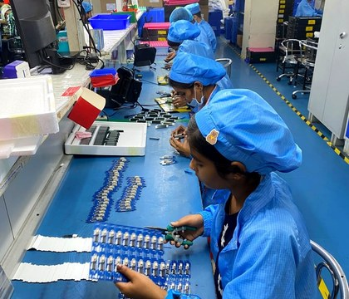

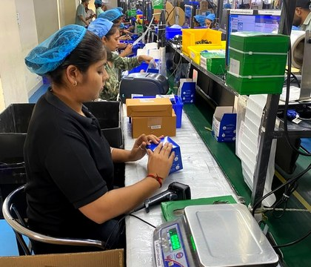


End-to-end production process
03 · HOW WE WORK
01
02
Idea & Requirement
Research & Market Analysis
Clear direction
Right opportunity
03
04
Design & Engineering
Prototype Development
Optimized design
Working prototype
05
06
Validation & Testing
Manufacturing Engineering
Validated performance
Production ready
07
08
Quality Assurance
Packaging & Dispatch
Zero-defect mindset
Safe, on-time delivery
09
10
After-Sales Support
Continuous Improvement
Reliable support
Better every day

Slide 9
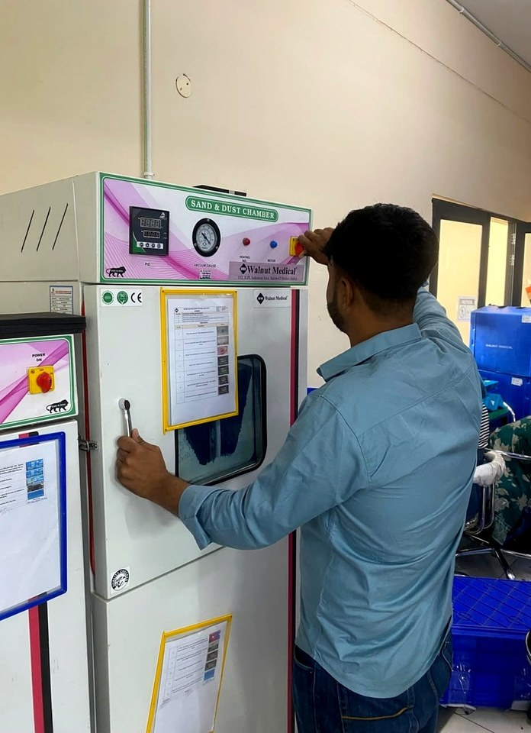

Quality & certifications
03 · QUALITY
Quality is built into every stage — incoming, in-line and outgoing inspection, environmental and functional testing, and full traceability from component to customer.
Incoming inspection (IQC)
In-process inspection (LQC)
Final quality check (OQC)
Reliability & environmental testing
Traceability
ISO
ISO 13485
10K
Class 10K cleanroom
Quality management for medical devices
Controlled manufacturing environment
CE
CE · FCC · PCI-DSS
IEC
IEC 60601
European, US & payment-security standards
Medical electrical equipment safety
BIS
BIS certified
ISO
ISO 9001
Bureau of Indian Standards
Quality management systems
Compliances: ISO 13485, ISO 80601-2-69, IEC 60601-1, IEC 60601-1-2 (NABL-accredited labs), CE, FCC, RoHS

Slide 10
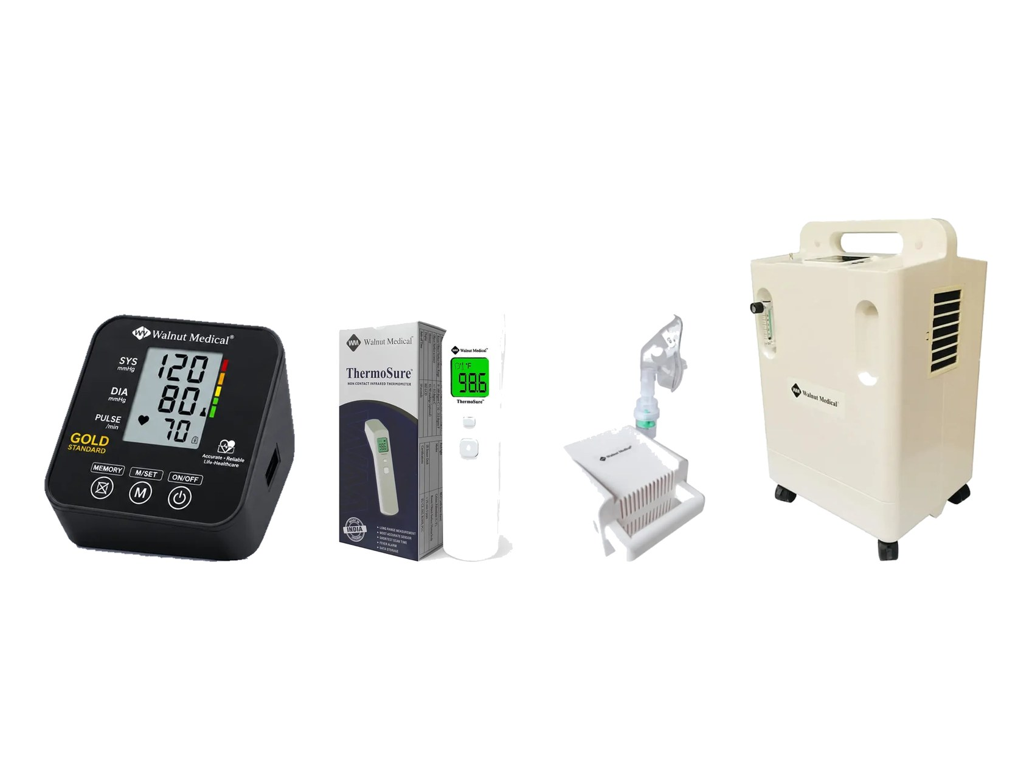
04
Medical devices
CDSCO-approved Class B and Class C medical devices, designed and manufactured under ISO 13485 in a Class 10K cleanroom.
CDSCO approved
ISO 13485
IEC 60601
Class 10K cleanroom

Slide 11
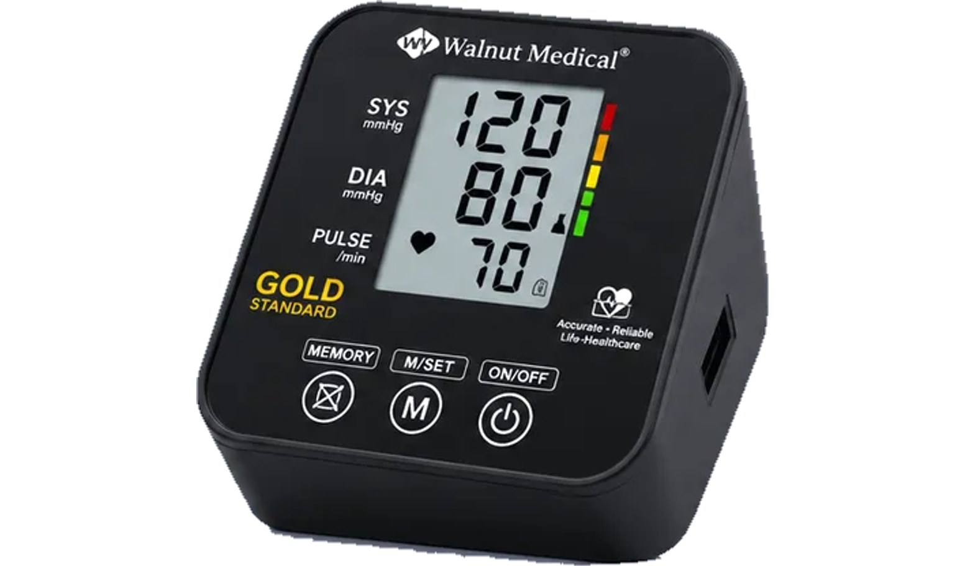
Digital Blood Pressure Monitor
04 · MEDICAL DEVICES
Clinical-grade precision
Precision blood pressure monitoring device with advanced cuff technology and a digital display for accurate clinical readings. Memory storage for multiple readings and an easy-to-use interface. A gold-standard electronic BP monitor is in development with ICMR funding and clinical trials at AIIMS Nagpur, AIIMS Delhi and Chettinad Super Speciality Hospital.
KEY FEATURES
Clinical grade accuracy
Large digital display
Memory storage
NABL certified
Systolic, diastolic & pulse
Simple one-touch operation
CDSCO approved
ISO 13485

Slide 12
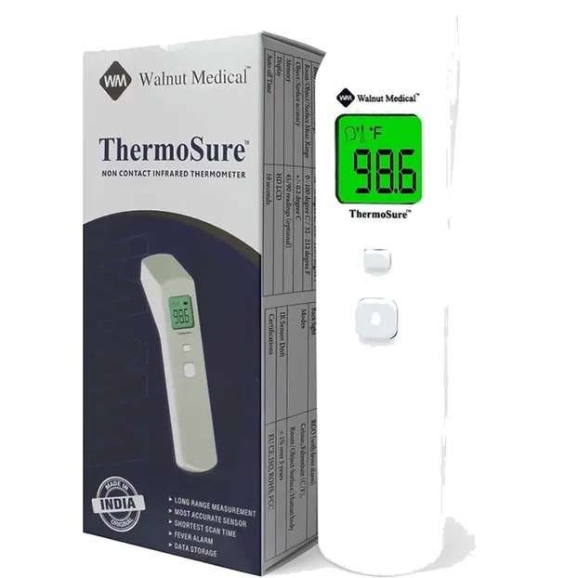
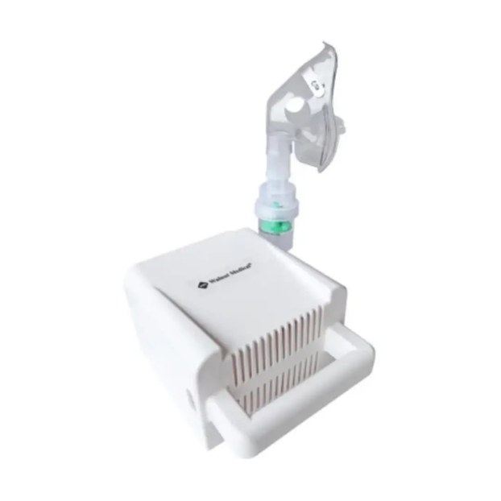
Respiratory & diagnostics
04 · MEDICAL DEVICES
IR Thermometer
ThermoSure · non-contact temperature measurement
Fast, hygienic temperature measurement with infrared technology. Ideal for clinical screening and home use — instant readings without physical contact.
Non-contact
Instant reading
Hygienic
Battery operated
Compressor Nebulizer
Respiratory therapy
Efficient compressor nebulizer for respiratory therapy. Compact design with reliable performance for clinical and home settings, delivering medication directly to the lungs.
Efficient nebulization
Low noise
Compact design
Medical grade

Slide 13
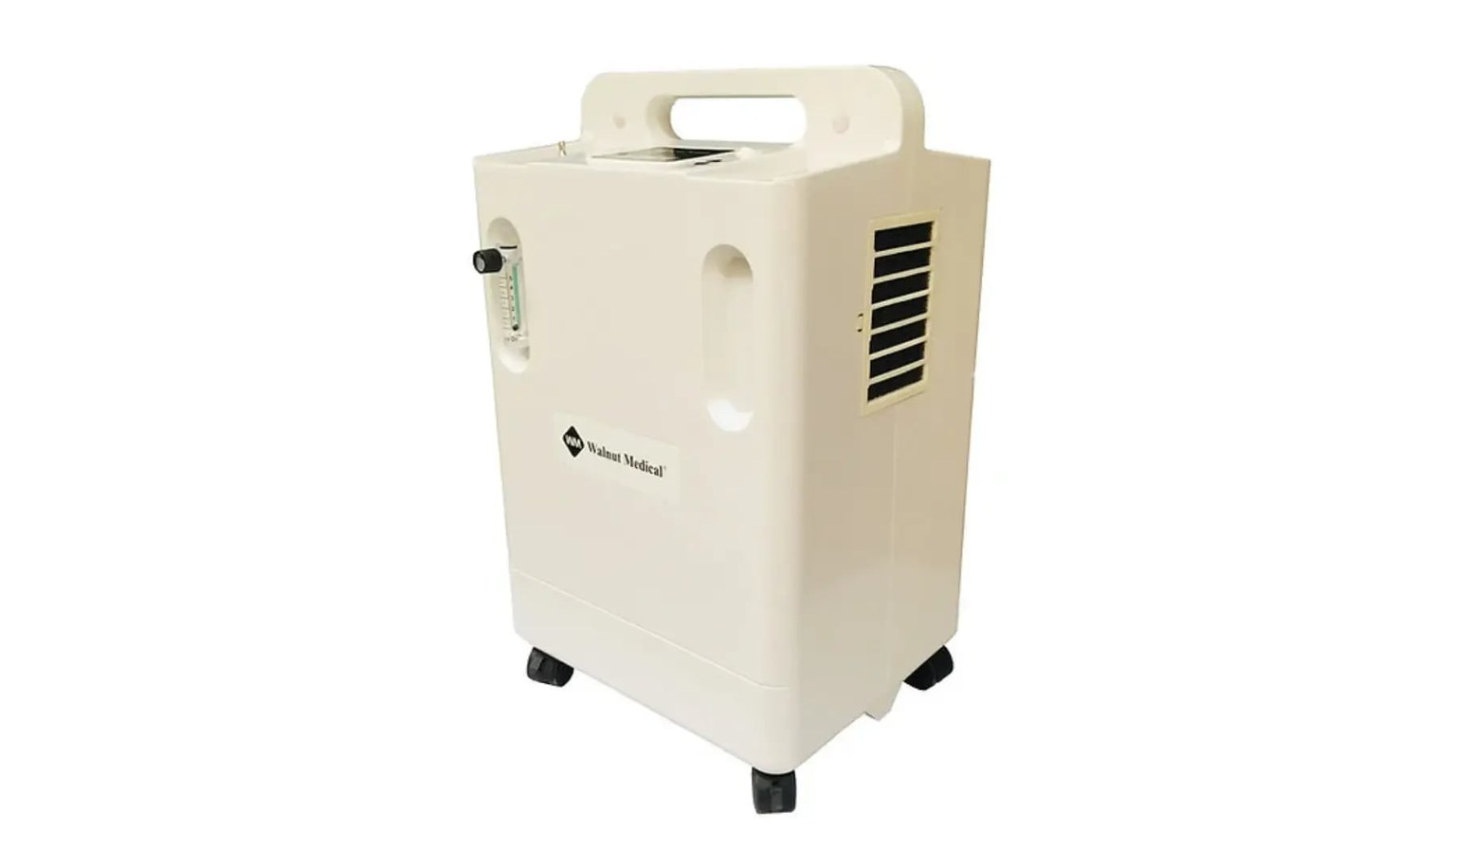
Oxygen Concentrator
04 · MEDICAL DEVICES
Reliable oxygen therapy
Reliable oxygen concentrators available in 5 L and 10 L configurations with single and dual flow options, designed for clinical and homecare settings with low-noise operation.
5 L / 10 L
Single / dual
ISO 13485
Flow configurations
Flow outputs
Manufactured under
KEY FEATURES
5 L & 10 L flow
Single or dual flow
Low-noise operation
Clinical & homecare use
ISO 80601-2-69 compliance
Made in a Class 10K cleanroom

Slide 14
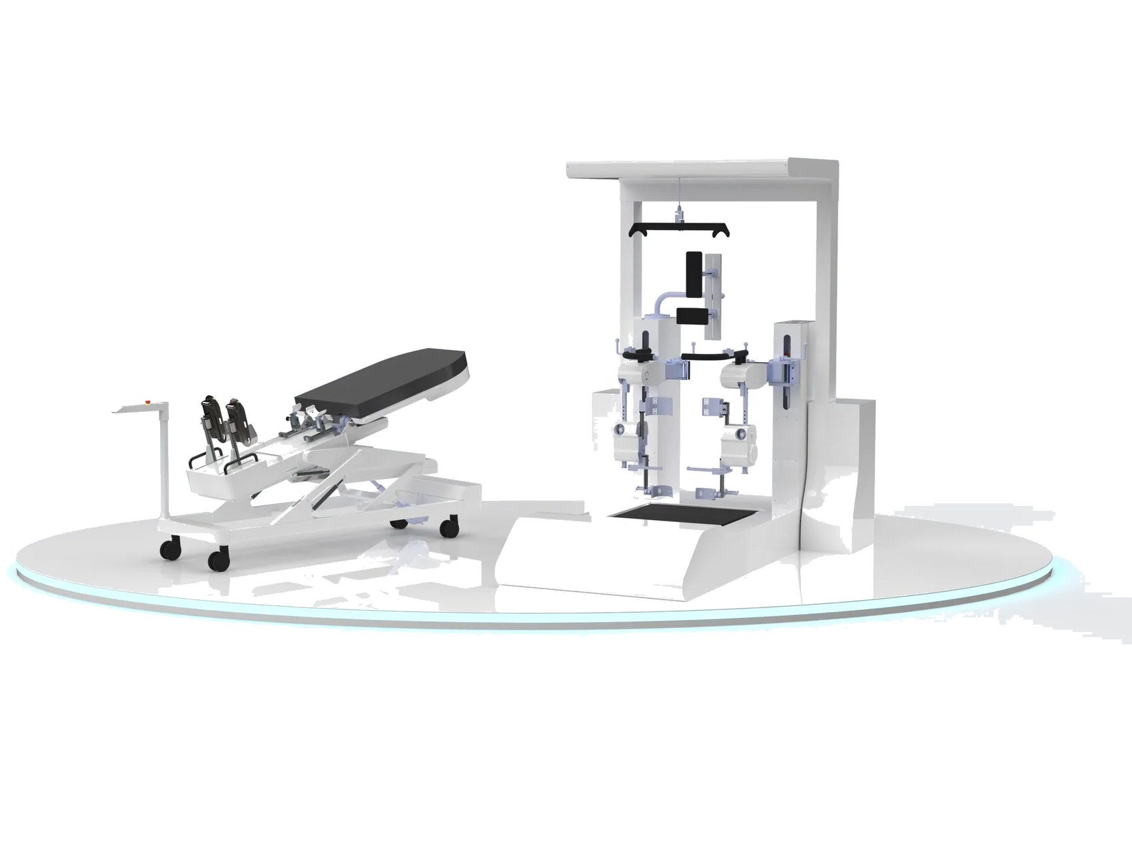
05
Neuro-rehabilitation
Rehabilitation robotics and neuro-stimulation for stroke, traumatic brain injury, spinal cord injury and neurological conditions — with AI-assisted therapy and real-time monitoring.
AI-assisted therapy
Tele-rehab ready
Real-time monitoring

Slide 15
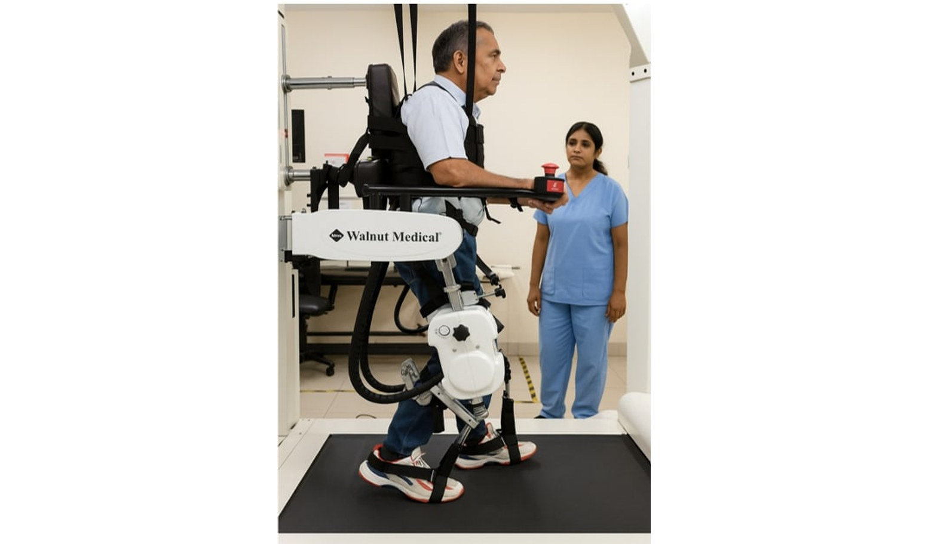
WalkLab Gait Training System
05 · NEURO-REHABILITATION
Flagship · lower-limb gait training system
A high-level gait training platform that improves gait outcomes, accelerates recovery and reduces cost of care through intensive, repetitive retraining of normal movement. Sensors track lower-limb kinematics and muscle activation to guide each step with the correct timing and force, with instant audio and visual feedback — for stroke, TBI, spinal cord injury, cerebral palsy, MS, Parkinson's and orthopedic conditions.
150 kg
1.8–4 km/h
<10 min
Max patient weight
Treadmill speed
Therapist setup time
KEY FEATURES
Neural gait retraining
VR multitask training
Real-time audio & visual feedback
Objective progress per session

Slide 16
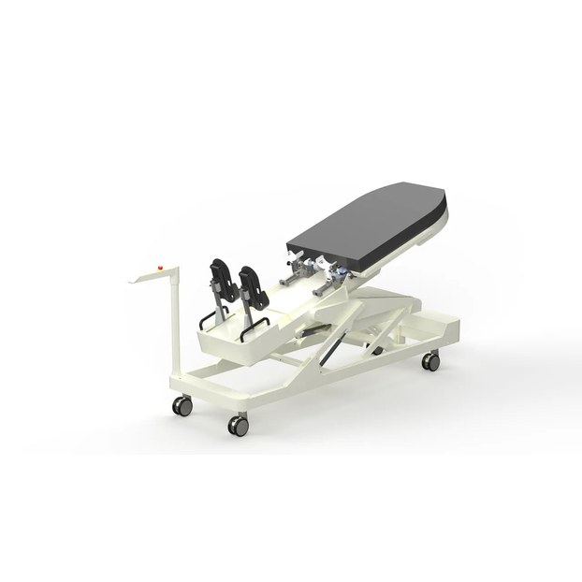
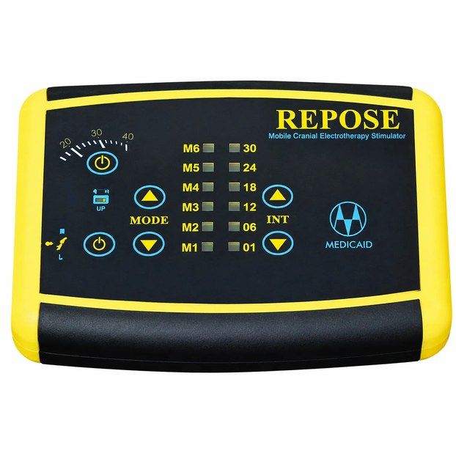
Early rehabilitation & neuromodulation
05 · NEURO-REHABILITATION
Weebo
Early rehabilitation robot with FES
A motorised tilt table with an integrated leg-stepping mechanism. The table rises gradually toward vertical while the legs move in an alternating stepping pattern, maintaining venous return so verticalization can start earlier and be tolerated longer.
0–90°
45°
20–39
Tilt range
Leg stroke
Steps / min
Progressive verticalization
Alternating stepping motion
Maintains venous return
Prevents bed-rest complications
CES — Repose
Mobile cranial electrotherapy stimulator
Portable cranial electrotherapy stimulation device from the Walnut Medical neuro-modulation range. Also available in the range: Functional Electrical Stimulation (FES), rTMS and RMNS (right median nerve stimulation).
Portable, mobile unit
Multiple programmes & intensity levels
Clear control panel
Part of the neuromodulation range

Slide 17
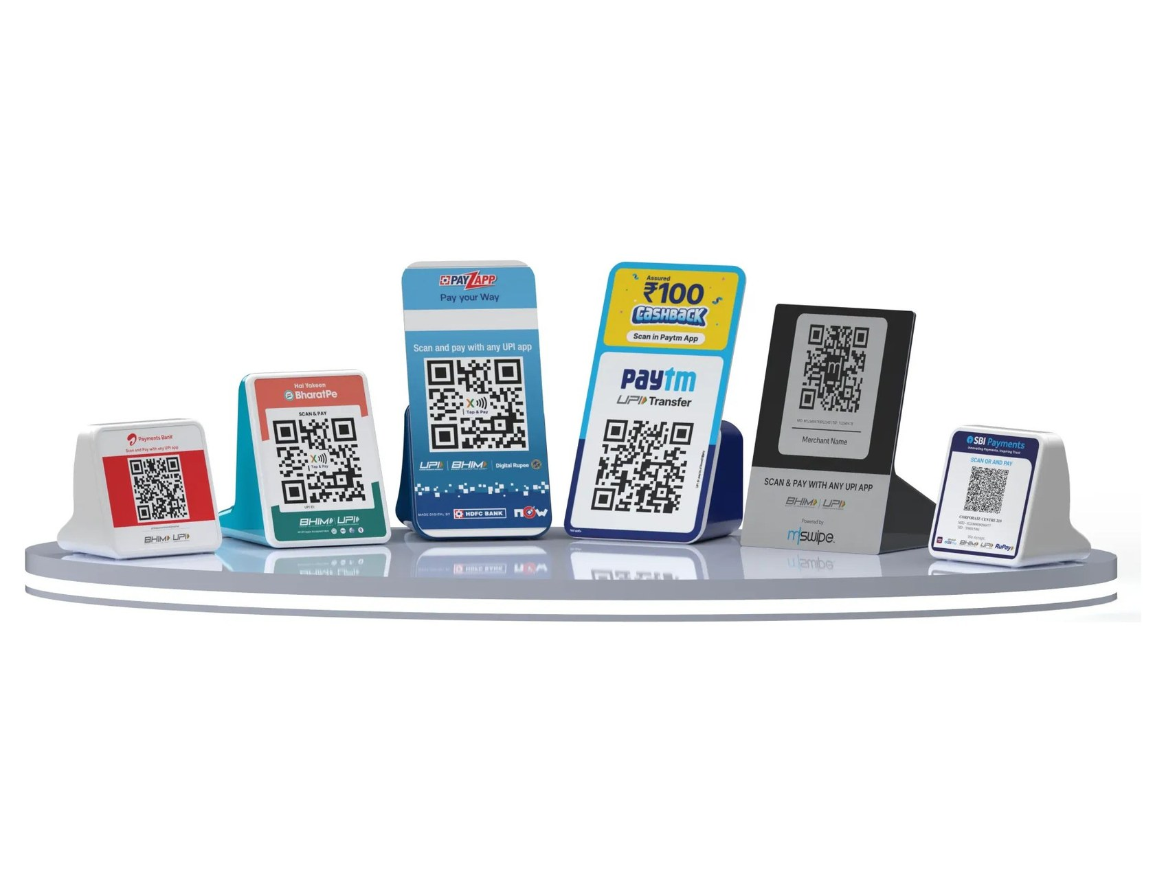
06
Fintech & payment devices
BIS-approved smart payment soundboxes with multi-language audio confirmation, secure integrations and a complete software ecosystem — in mass production since 2023.
BIS approved
PCI-DSS
NPCI compliant
EMV L1/L2

Slide 18
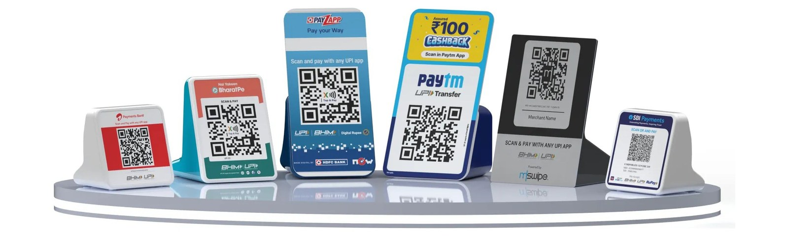






Soundbox hardware platform
06 · FINTECH
PLATFORM SPECIFICATIONS
Types | Tabletop, pocket, DQR
Connectivity | LTE CAT 1 — 4G, 3G, 2G, Bluetooth, Wi-Fi
Battery | Rechargeable, up to 6000 mAh — lasts about 1 month per charge
Internal memory | 4 MB to 256 MB
Audio output | 2–5 W
SIM card | Nano / Micro
POS integration | API for POS integration
Add-on features | LCD with backlight, BT, Wi-Fi, FM, solar
Protection | Level 4 ESD protection, pin-hole reset
Power efficiency | PCB consumes 4 mA (vs 20–35 mA typical)
SOFTWARE & SERVICES
Finished hardware in your branding
MQTT broker — low-latency announcements
Terminal management system & OTA
SIM connectivity partners
Field deployment app (Android & iOS)
500K+ units / month capacity

Slide 19
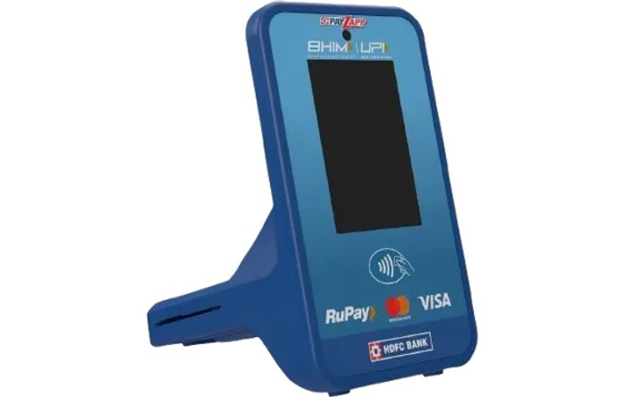
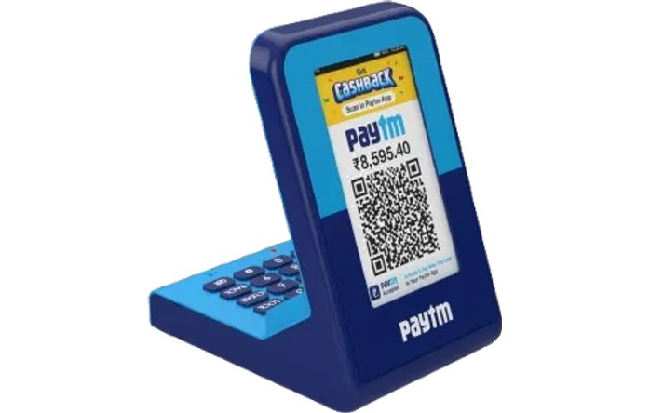
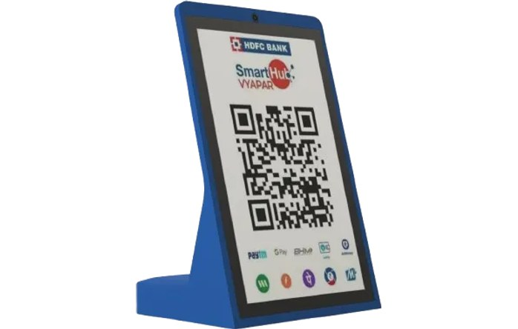
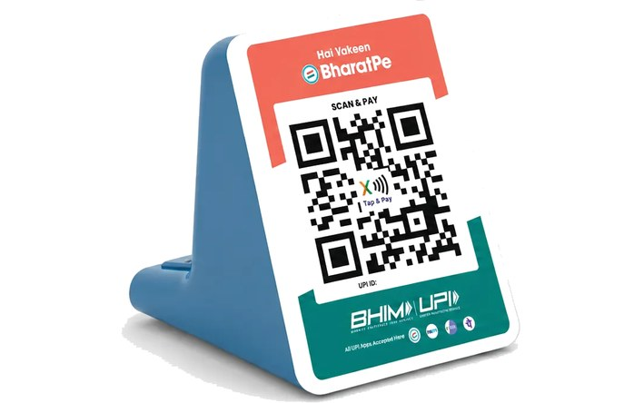
Soundbox models
06 · FINTECH
RTOS — All-in-one
DQR — Digital QR
Multiple display options to suit every merchant.
Compact digital-QR soundbox with a high-contrast LCD.
3.47″ or 2.8″ LCD, or segment display
Digital QR display
2.4″ merchant display
Bright LCD for amount & confirmation
On-device QR generation
Loud, clear audio
Built-in keyboard
Plug-and-play deployment
LDQR — Large display QR
Payment soundbox
Premium soundbox with a large touchscreen customer display.
Smart payment speaker for every counter.
10″ touchscreen
4G / 2G, NB-IoT
2.4″ merchant display
Bluetooth & Wi-Fi
Keyboard & custom QR
Multi-language audio
NFC tap-and-pay
Long battery life

Slide 20
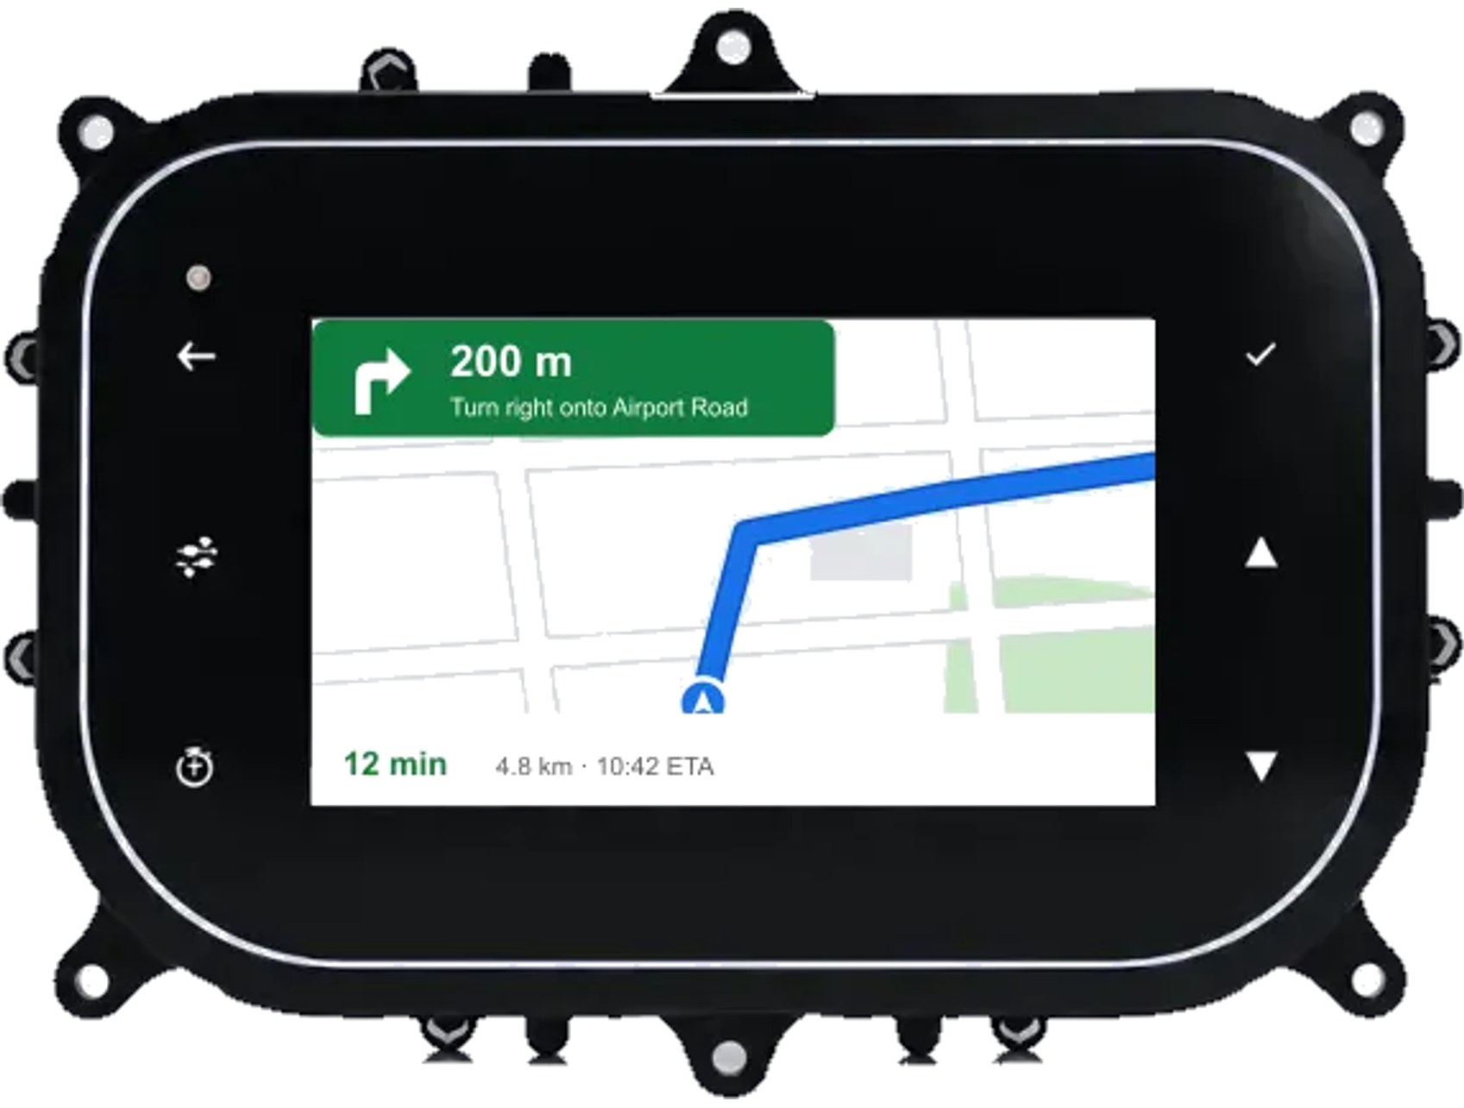
07
Automotive electronics
Smart instrument clusters in 5-inch and 7-inch, Android and RTOS based, with 4G, Bluetooth and Wi-Fi — and Google Maps navigation through phone screen mirroring.
5″ & 7″
Android · RTOS
4G · BT · Wi-Fi
Phone mirroring

Slide 21
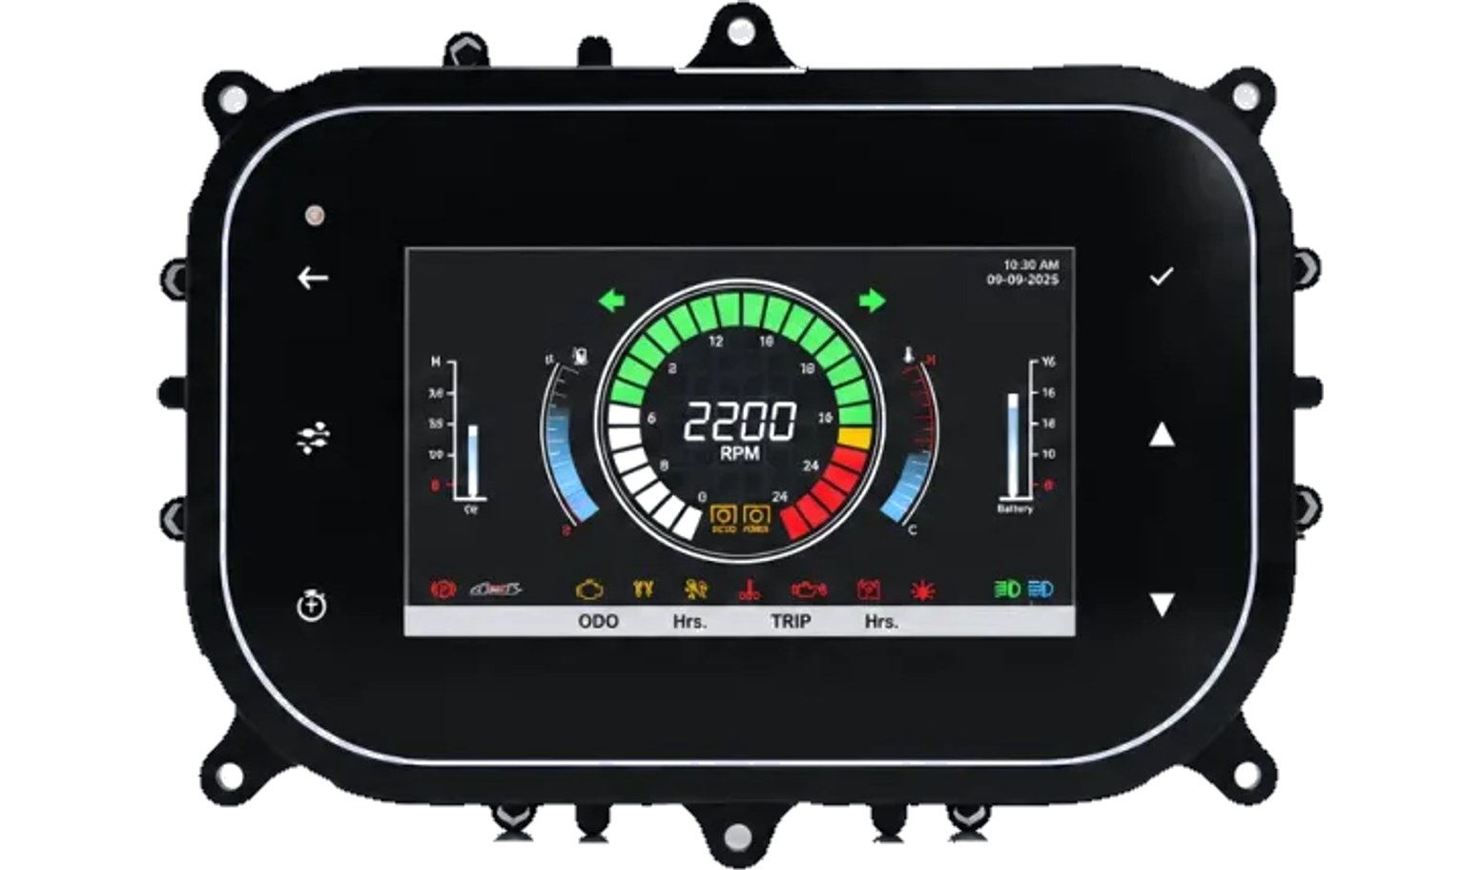
Smart Instrument Cluster
07 · AUTOMOTIVE ELECTRONICS
Digital clusters for 2-wheelers, tractors & farm equipment, LMV & HMV
Next-generation digital clusters with high-resolution displays, real-time vehicle data and customisable driver interfaces — built for durability and clarity. Real-time processing of speed, RPM, fuel, temperature and diagnostics, with CAN bus support.
KEY FEATURES
High-resolution LCD/TFT, sunlight readable
Advanced real-time processing
Low power consumption
Rugged, industrial-grade build
Customisable layouts & themes
Operates from −40 °C to +85 °C
IATF 16949 ready
AEC-Q100
EMC tested
Vibration tested

Slide 22
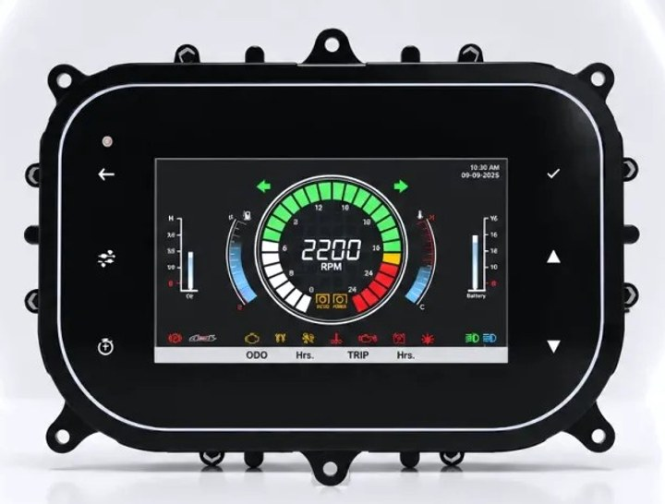
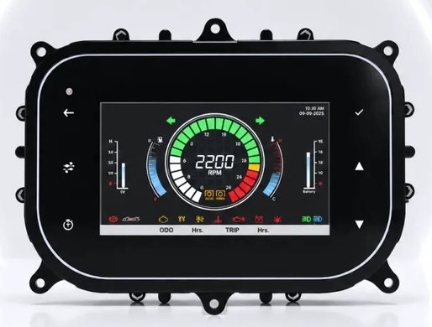
Choose your size: 5-inch or 7-inch
07 · AUTOMOTIVE ELECTRONICS
5″
5-inch display
7″
7-inch display
Smart instrument cluster
Smart instrument cluster
Clusters shown at relative scale.
CONFIGURATION OPTIONS
Display size | 5-inch · 7-inch
Platform | RTOS · Android
Connectivity | 4G · Bluetooth · Wi-Fi
Navigation | Phone screen mirroring — Google Maps on the cluster
Interface | Custom layouts, themes and brand integration
Vehicle data | Real-time speed, RPM, fuel, temperature, diagnostics
Vehicle bus | CAN bus support
Final specifications and combinations are confirmed per project; datasheets on request.

Slide 23
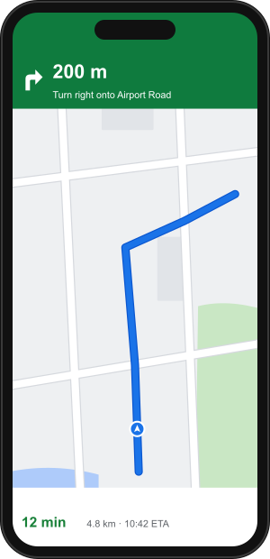
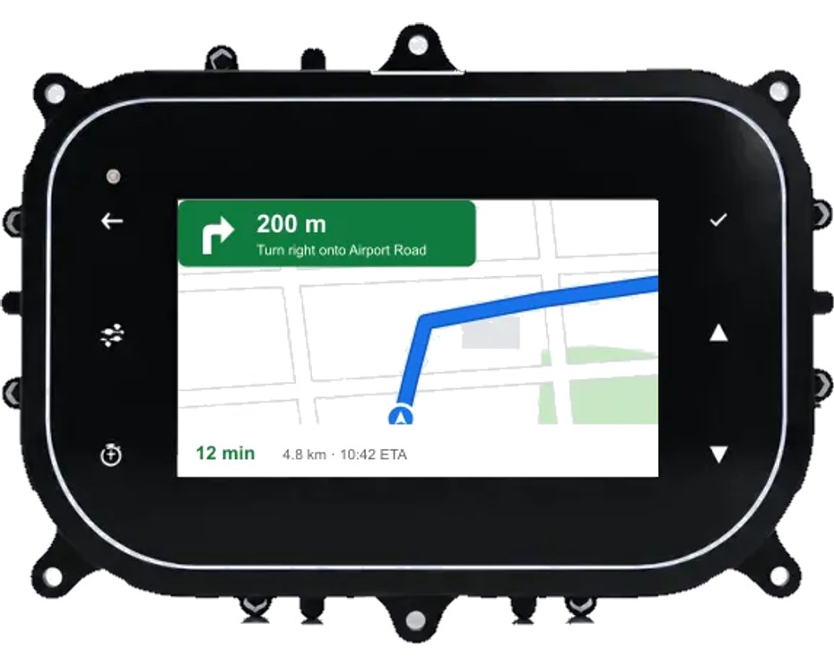



Google Maps on the cluster
07 · AUTOMOTIVE ELECTRONICS
Phone screen mirroring brings turn-by-turn Google Maps navigation from the rider's phone onto the cluster display — directions stay in the line of sight, alongside speed and vehicle data.
Turn-by-turn on the dash
Google Maps navigation from the rider's phone appears on the cluster screen.
Eyes stay on the road
Directions sit in the driver's line of sight — no phone on the handlebar or dashboard.
Works with your phone
Pair over the cluster's wireless connectivity and start navigating.
One screen for everything
Navigation, speed and vehicle data together on the cluster display.

Slide 24
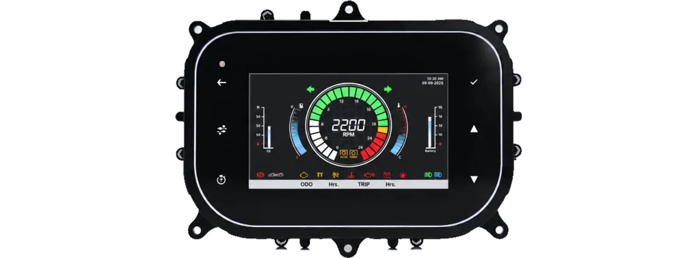
Agri & off-highway electronics
07 · AUTOMOTIVE ELECTRONICS
Automatic tractor electronics suite: a complete suite of smart, IoT-enabled electronics for agricultural equipment, earth-moving equipment and tractors.
Smart instrument clusters (5″ & 7″)
Tractor automation electronics
GPS tracker & gateway telematics
Cloud dashboards, mobile apps, OTA
AUTOMOTIVE ENGINEERING CAPABILITIES
01
Display technology
02
Real-time data
LCD/TFT · anti-glare · sunlight readable
CAN bus · diagnostics · instant updates
03
Custom design
04
Quality
Custom layouts · brand integration · DFM
IATF 16949 ready · AEC-Q100 · EMC & vibration tested

Slide 25
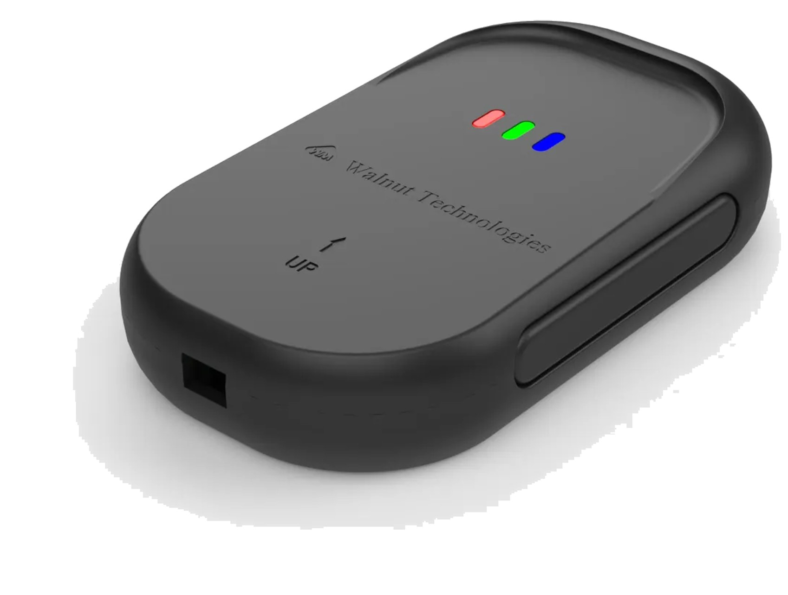
08
IoT solutions
GPS tracker & gateway, 4G smart lock and the cloud and mobile platform behind them — designed, built and supported in-house.
GPS tracking
Telemetry
Fleet management
Cloud & apps

Slide 26
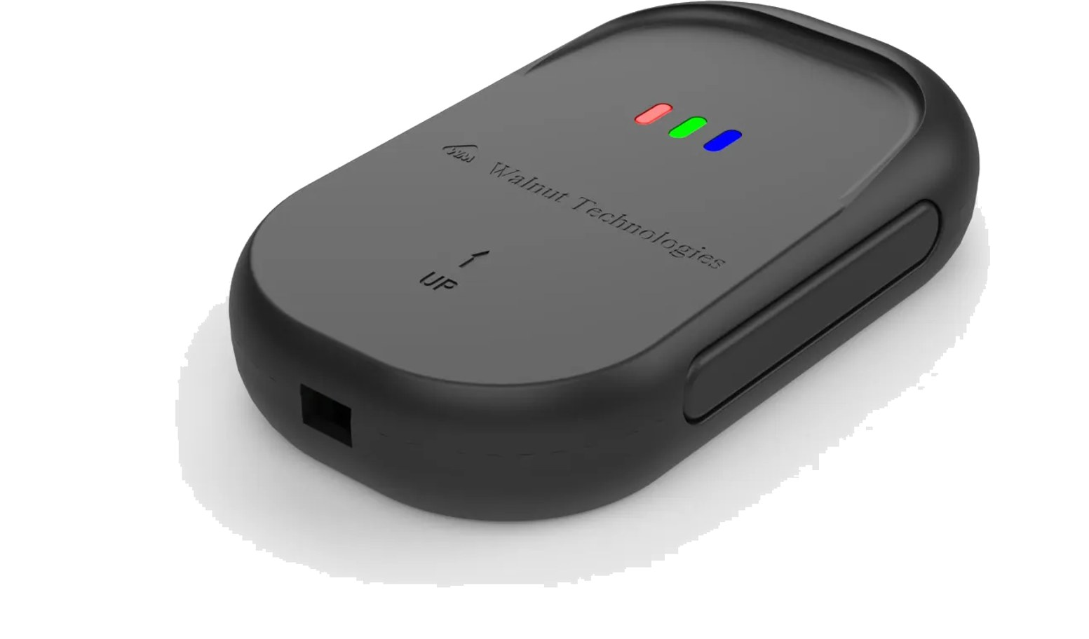
GPS Tracker & Gateway
08 · IOT SOLUTIONS
Asset tracking & telemetry
Reliable GPS tracking device and gateway for industrial and logistics applications — real-time tracking, telemetry reporting and fleet management with secure cloud connectivity.
KEY FEATURES
Real-time GPS tracking
Telemetry reporting
Fleet management
Secure cloud gateway
Mobile app ready (iOS & Android)
Encrypted data transmission
Fleet & logistics
Asset tracking
Industrial
Agriculture

Slide 27
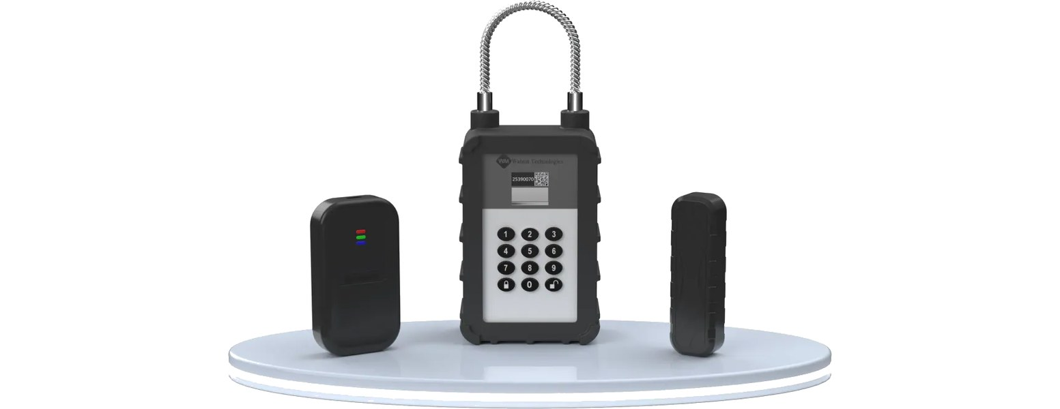
4G smart lock & IoT platform
08 · IOT SOLUTIONS
4G Smart Lock
Connected smart lock for logistics, assets and infrastructure — remote access control, real-time monitoring and cloud management from anywhere.
Real-time status monitoring
Industrial-grade IP67 design
6 months standby capability
4G · BLE · Wi-Fi connectivity
Remote access control
Cloud integration
IOT ENGINEERING, END TO END
Product design
Security
Hardware · RTOS firmware · BLE / Wi-Fi / LTE
Encryption · secure element · tamper detection
Manufacturing
Cloud & mobile
SMT & PCB · RF testing · firmware flashing
Dashboards · mobile apps · OTA updates
AWS
MQTT
HTTPS
FOTA
JSON
RTOS
BLE
4G LTE
NB-IoT

Slide 28






Engineering expertise
09 · WHY WALNUT
Medical electronics
Embedded systems & IoT
Life-critical device design with full regulatory compliance.
Firmware, RTOS and cloud-connected embedded solutions.
PCB design & fabrication
Manufacturing & assembly
Multi-layer, HDI and flex PCBs for high-volume production.
4 SMT lines, 500K+ units per month, 99.8% yield.
Quality & compliance
Payment hardware security
ISO 13485 quality management, Class 10K cleanroom.
PCI PTS, EMVCo and NPCI certified terminal design.
Software & firmware
Supply chain & logistics
Full-stack firmware, drivers and companion apps.
Global component sourcing and door-to-door delivery.
WHY MANUFACTURERS CHOOSE WALNUT
Mass manufacturing
DICE & chip bonding
500K+ units every month
Maximum cost savings
Lean manufacturing
Cloud & firmware in-house
Across the whole organisation
AWS, RTOS, MQTT, FOTA
Debt-free & bootstrapped
Fast growth
A stable long-term partner
CAGR above 100% (last 4 years)

Slide 29








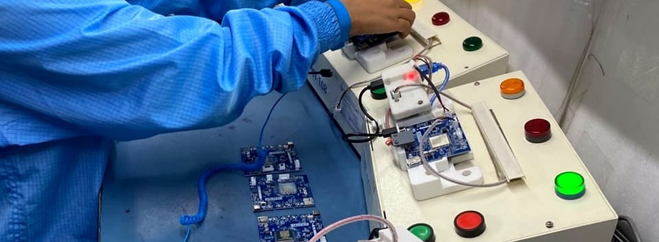
Trusted by leading brands
09 · CLIENTS
INDUSTRIES WE SERVE
Healthcare
Defence & aerospace
Hospitals, clinics and medical device companies
Mission-critical electronics for defence
Banking & payments
Pharmaceutical
POS terminals, soundboxes and payment devices
Manufacturing equipment and monitoring systems
Energy & utilities
Industrial & automotive
Smart metering, grid monitoring, industrial controls
Industrial electronics, sensors and automotive

Slide 30



Let's build what's next
10 · CONTACT
Engineering precision with user-centric design. We welcome the opportunity to collaborate with your team — from a first prototype to mass production.
Address
Plot No. 132, JLPL Industrial Park, Sector 82, Mohali, Punjab 160055, India
Upcoming facility
Dhanana (Upcoming in Haryana)
Phone
+91 77194 63719
Email
contact@walnutmedical.in
Website
walnutmedical.in

Slide 31
Notes
NOTES

Slide 32

Intelligent Embedded Systems, Engineered for a Connected World
Medical · Neuro-rehabilitation · Fintech · Automotive · IoT
Walnut Technologies Pvt. Ltd.
Plot No. 132, JLPL Industrial Park, Sector 82, Mohali, Punjab 160055, India
Dhanana (Upcoming in Haryana)
+91 77194 63719 · contact@walnutmedical.in · walnutmedical.in

