Slide 1
PIZZA SALES
🍕
SQL PROJECT ANALYSIS
Database: Pizzamania (MySQL)
Tool:
MySQL Workbench
Queries:
13 SQL Analyses (Basic → Advanced)
Presented by Nitin Tiwari

Slide 2
📊 Project Overview
🗄️
Database
📋
Tables
pizzamania
orders, order_details,
pizzas, pizza_types
🔢
Total Orders
💰
Total Revenue
21,350
$817,860.05
📌 Levels: Basic (Q1–Q5) · Intermediate (Q6–Q9) · Advanced (Q10–Q13)
Pizza Sales Analysis | Database: Pizzamania | Tool: MySQL Workbench | By Nitin Tiwari

Slide 3
🗂️ Database Schema
orders
order_details
order_id (PK)
order_details_id (PK)
date
order_id (FK)
time
pizza_id (FK)
quantity
pizzas
pizza_types
pizza_id (PK)
pizza_type_id (PK)
pizza_type_id (FK)
name
size
category
price
ingredients
Pizza Sales Analysis | Database: Pizzamania | Tool: MySQL Workbench | By Nitin Tiwari

Slide 4
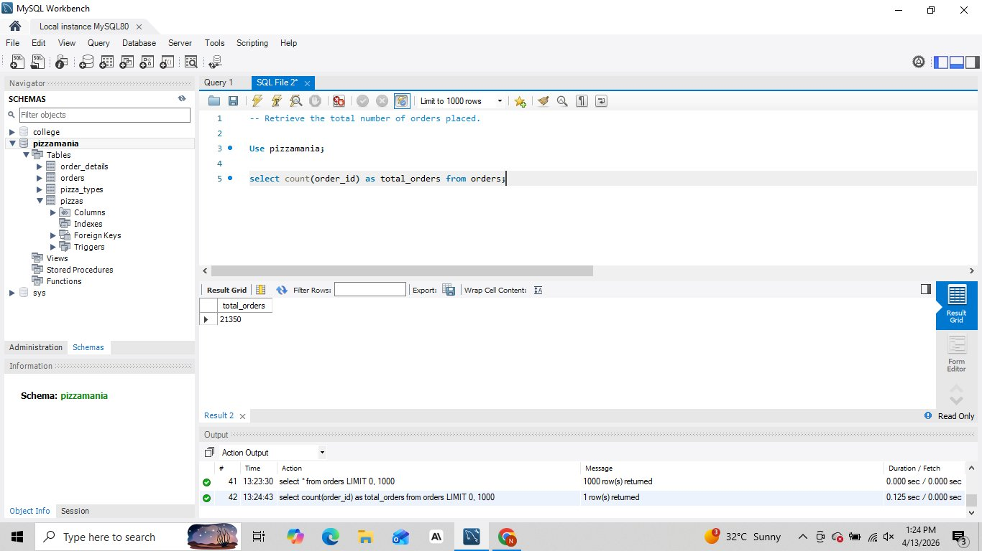
Total Number of Orders
Q1
RESULT
21,350 total orders placed
💡 INSIGHT
The pizzeria processed over 21 thousand orders, reflecting strong customer demand throughout the year.
Pizza Sales Analysis | Database: Pizzamania | Tool: MySQL Workbench | By Nitin Tiwari

Slide 5
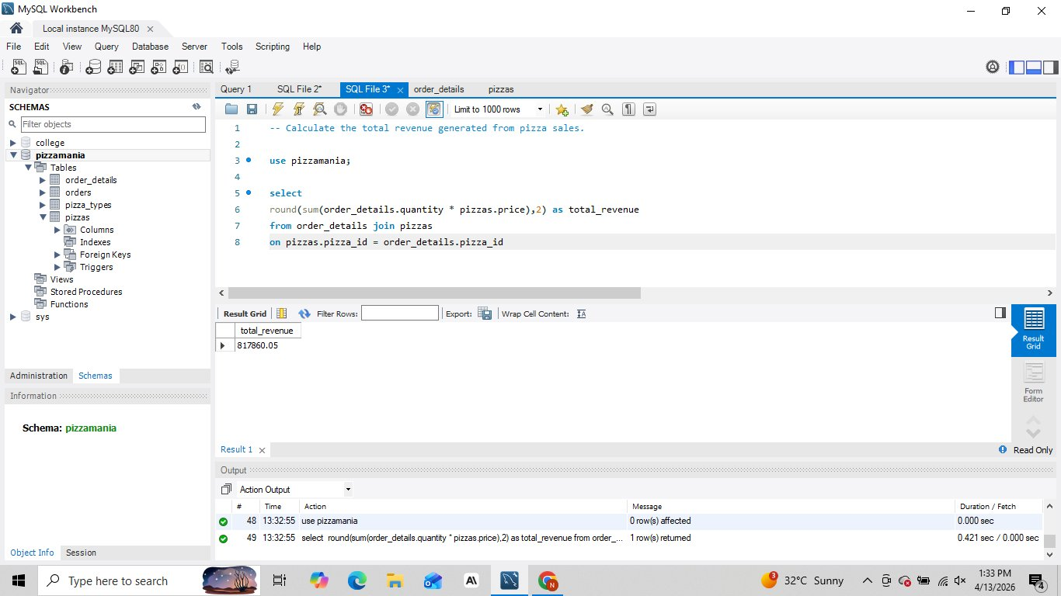
Total Revenue from Pizza Sales
Q2
RESULT
$817,860.05 total revenue
💡 INSIGHT
The business generated over $817K in revenue — a healthy yearly performance for a single pizza outlet.
Pizza Sales Analysis | Database: Pizzamania | Tool: MySQL Workbench | By Nitin Tiwari

Slide 6
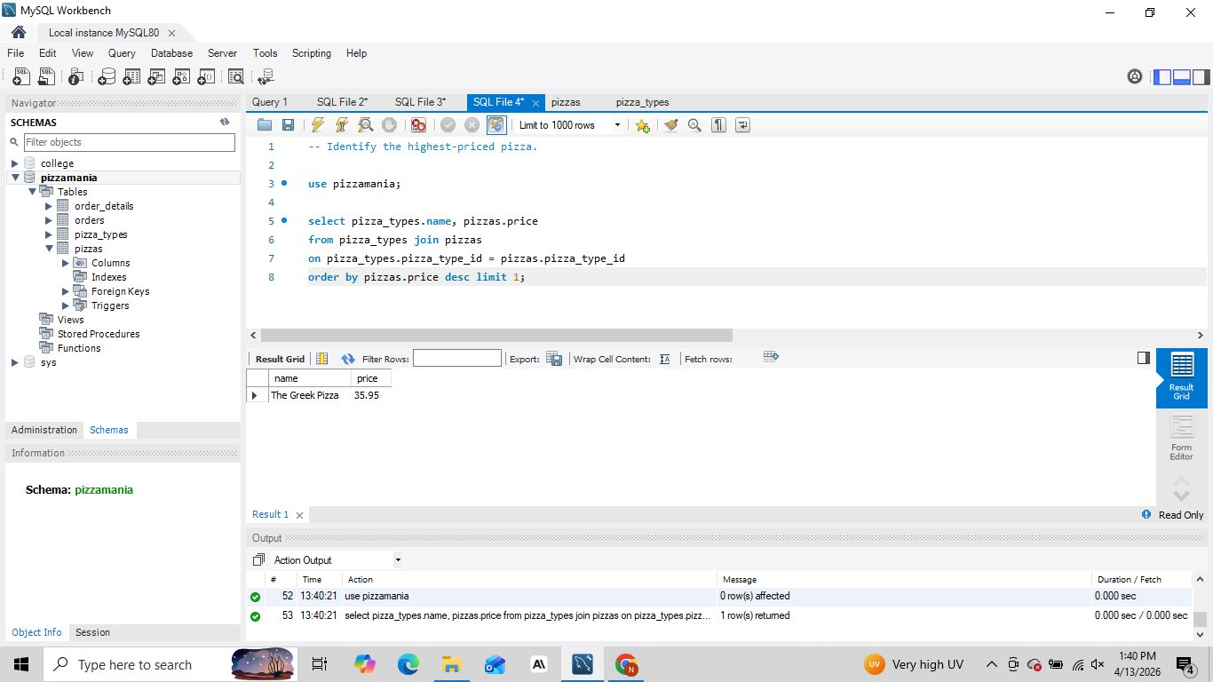
Highest-Priced Pizza
Q3
RESULT
The Greek Pizza — $35.95
💡 INSIGHT
The Greek Pizza tops the price list at $35.95, likely a premium / large-size specialty offering.
Pizza Sales Analysis | Database: Pizzamania | Tool: MySQL Workbench | By Nitin Tiwari

Slide 7
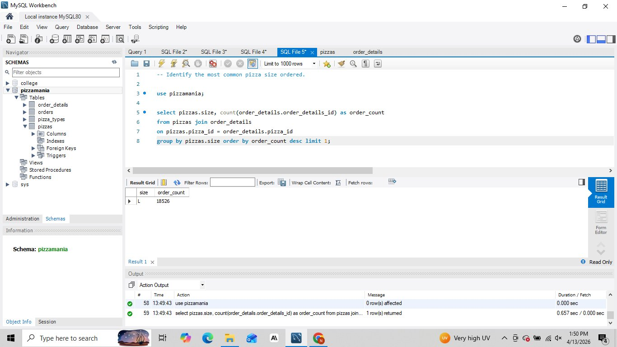
Most Common Pizza Size Ordered
Q4
RESULT
Size L — 18,526 orders
💡 INSIGHT
Large pizzas dominate orders (18,526), suggesting customers prefer value-for-money larger portions.
Pizza Sales Analysis | Database: Pizzamania | Tool: MySQL Workbench | By Nitin Tiwari

Slide 8
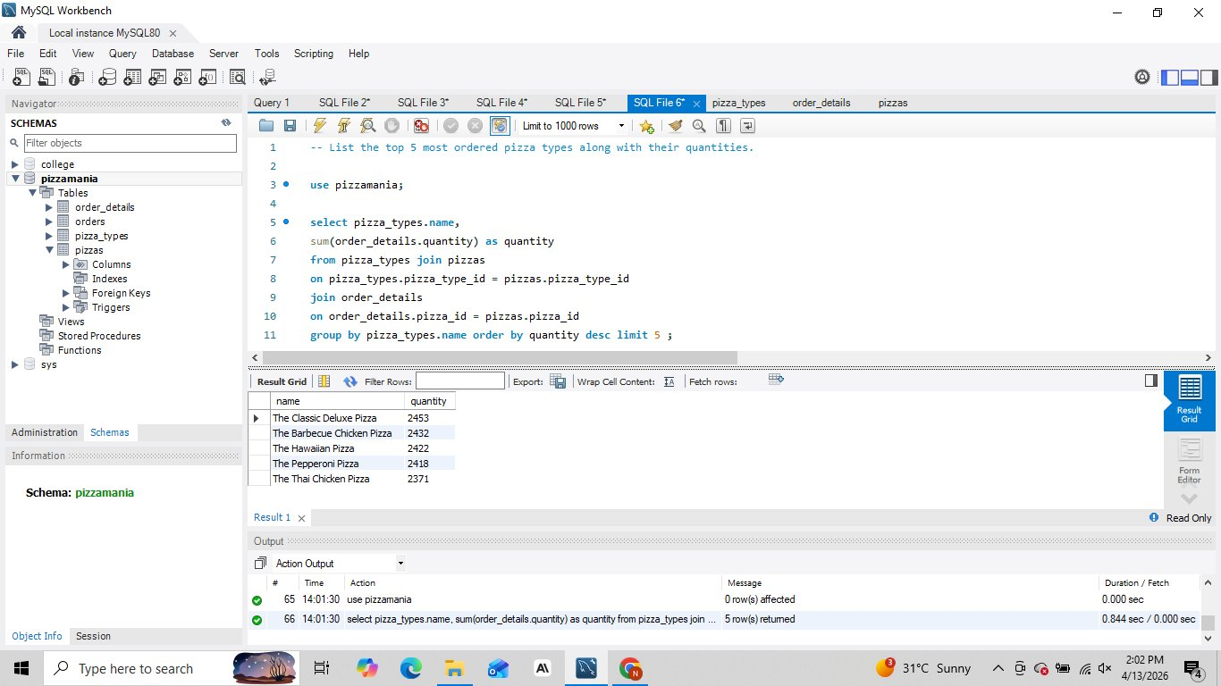
Top 5 Most Ordered Pizza Types
Q5
RESULT
Classic Deluxe (2453) · BBQ Chicken (2432) · Hawaiian (2422) · Pepperoni (2418) · Thai Chicken (2371)
💡 INSIGHT
Classic Deluxe leads, but top-5 quantities are closely clustered, indicating broad popularity across types.
Pizza Sales Analysis | Database: Pizzamania | Tool: MySQL Workbench | By Nitin Tiwari

Slide 9
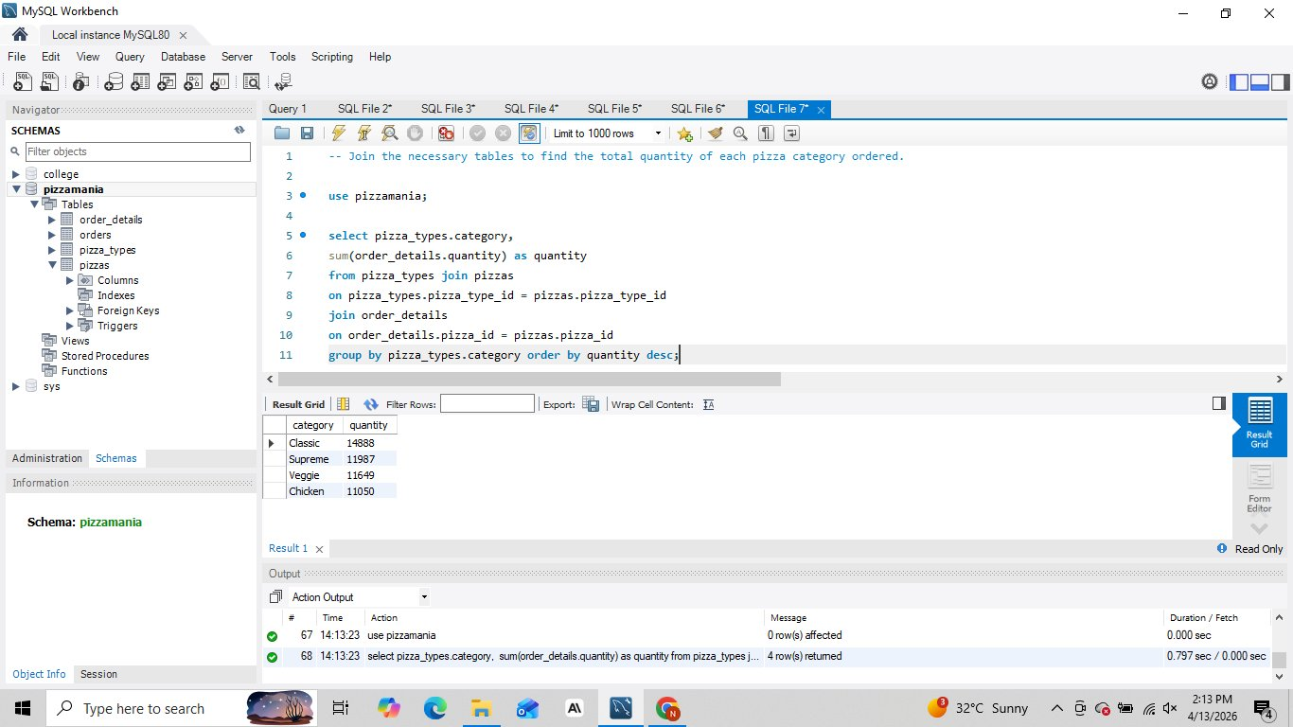
Total Quantity by Pizza Category
Q6
RESULT
Classic (14,888) · Supreme (11,987) · Veggie (11,649) · Chicken (11,050)
💡 INSIGHT
Classic category leads in volume; all four categories have strong representation with no extreme outlier.
Pizza Sales Analysis | Database: Pizzamania | Tool: MySQL Workbench | By Nitin Tiwari

Slide 10
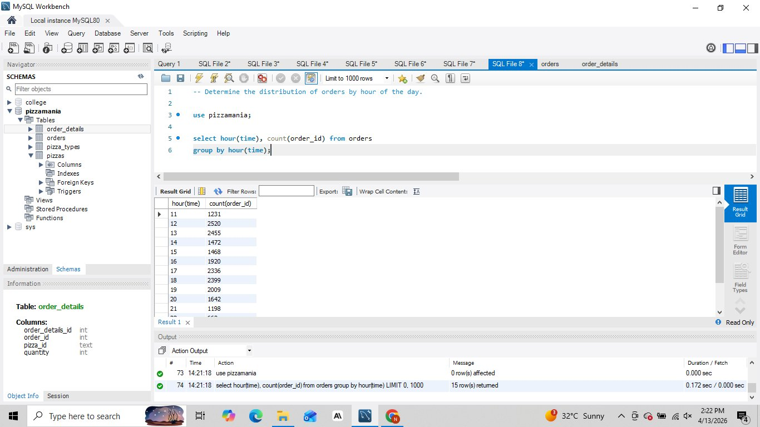
Order Distribution by Hour of Day
Q7
RESULT
Peak at 12:00 (2520) and 17:00–18:00 (1920–2336)
💡 INSIGHT
Lunch hour (12 PM) is the busiest period. A secondary evening peak occurs around 5–6 PM.
Pizza Sales Analysis | Database: Pizzamania | Tool: MySQL Workbench | By Nitin Tiwari

Slide 11
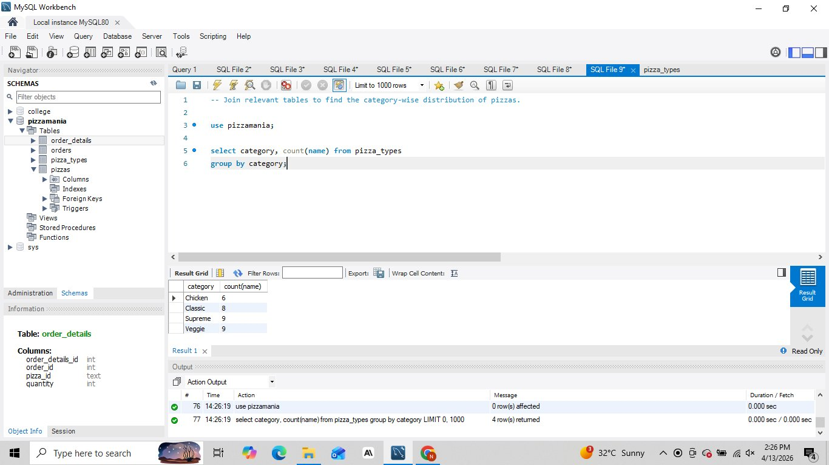
Category-wise Pizza Distribution
Q8
RESULT
Chicken (6) · Classic (8) · Supreme (9) · Veggie (9)
💡 INSIGHT
Supreme and Veggie categories offer the widest variety (9 pizzas each), giving customers more choice.
Pizza Sales Analysis | Database: Pizzamania | Tool: MySQL Workbench | By Nitin Tiwari

Slide 12
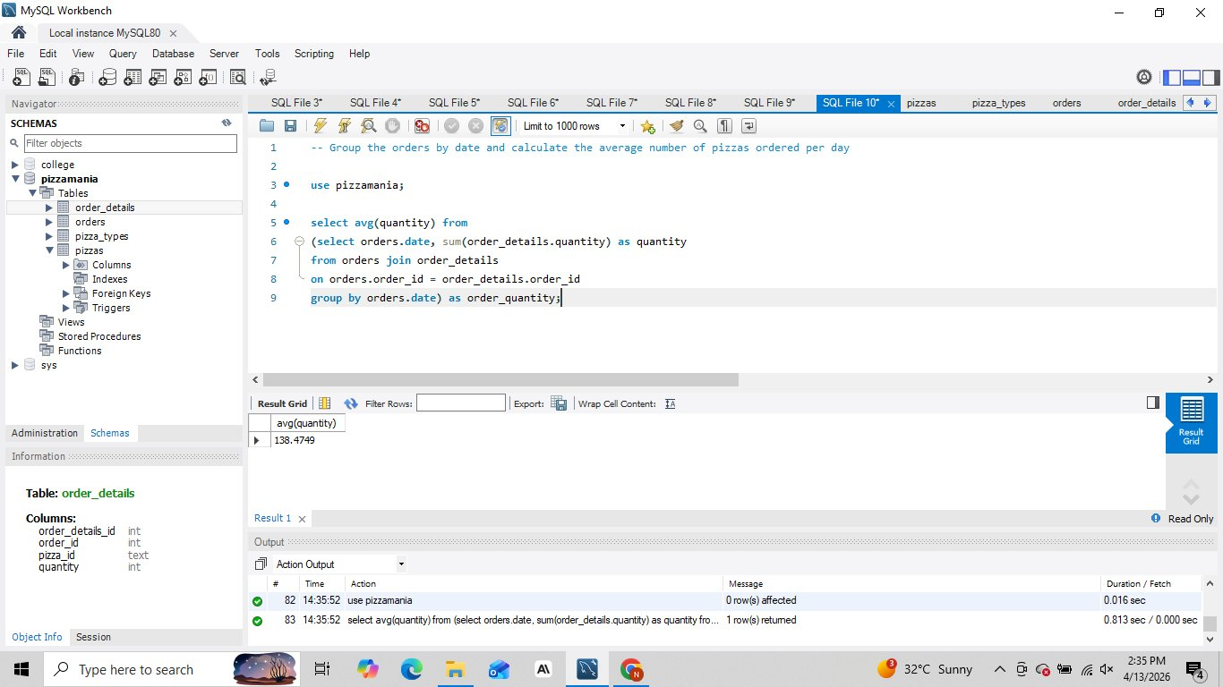
Average Pizzas Ordered Per Day
Q9
RESULT
138.47 pizzas per day (on average)
💡 INSIGHT
On average, ~138 pizzas are ordered daily, providing a useful baseline for inventory and staffing.
Pizza Sales Analysis | Database: Pizzamania | Tool: MySQL Workbench | By Nitin Tiwari

Slide 13
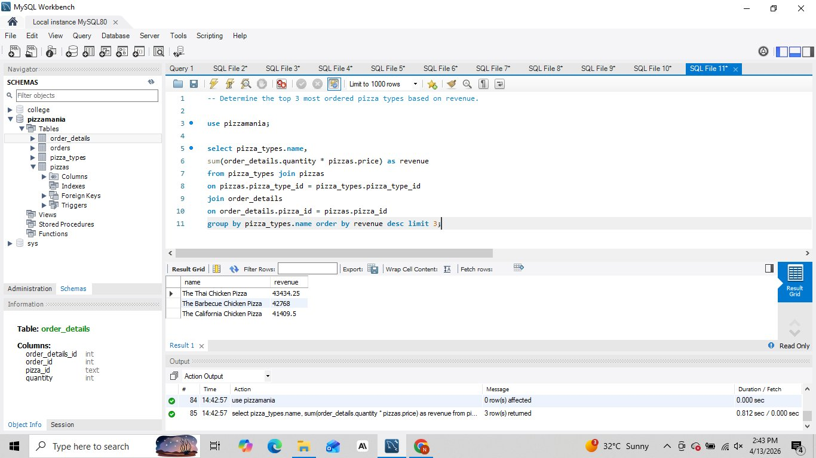
Top 3 Pizza Types by Revenue
Q10
RESULT
Thai Chicken ($43,434) · BBQ Chicken ($42,768) · California Chicken ($41,409)
💡 INSIGHT
Chicken-based pizzas dominate revenue despite not being the most ordered by quantity — higher price points drive value.
Pizza Sales Analysis | Database: Pizzamania | Tool: MySQL Workbench | By Nitin Tiwari

Slide 14
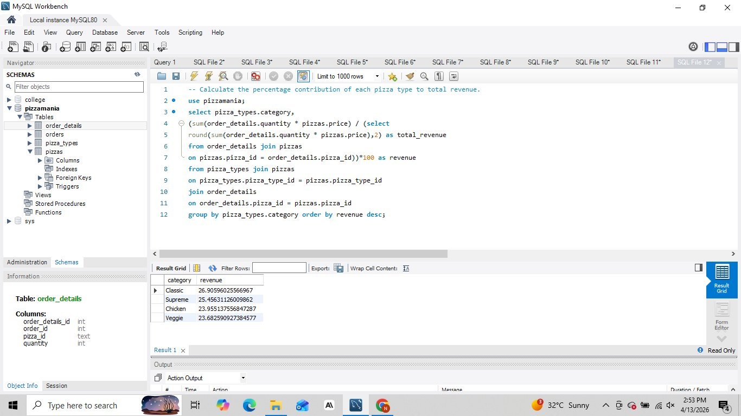
Revenue % Contribution by Category
Q11
RESULT
Classic 26.9% · Supreme 25.5% · Chicken 24.0% · Veggie 23.7%
💡 INSIGHT
Revenue is remarkably balanced across all four categories, indicating a well-rounded and diversified menu.
Pizza Sales Analysis | Database: Pizzamania | Tool: MySQL Workbench | By Nitin Tiwari

Slide 15
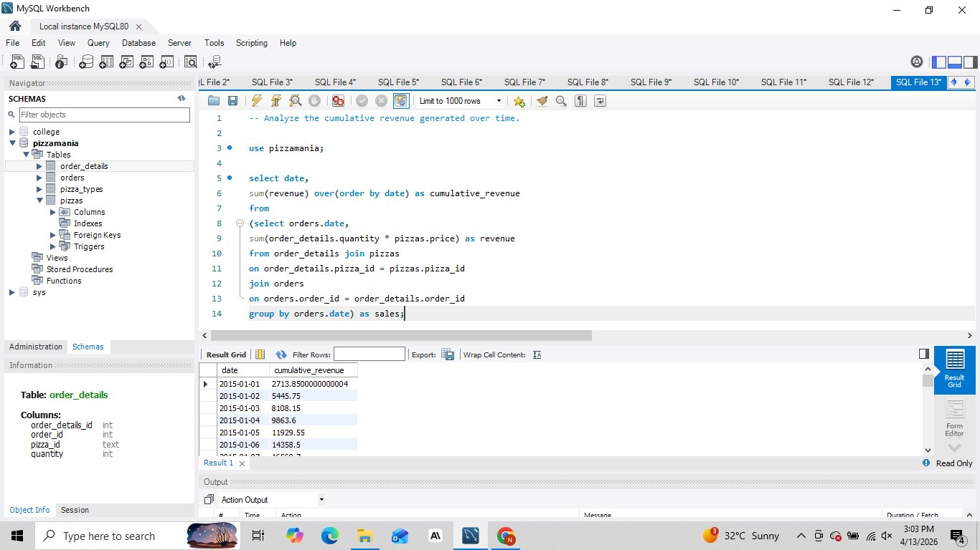
Cumulative Revenue Over Time
Q12
RESULT
Steady growth from Jan 2015 — consistent daily revenue accumulation
💡 INSIGHT
Cumulative revenue curve is smooth and consistent — no major seasonal slumps, indicating steady year-round demand.
Pizza Sales Analysis | Database: Pizzamania | Tool: MySQL Workbench | By Nitin Tiwari

Slide 16
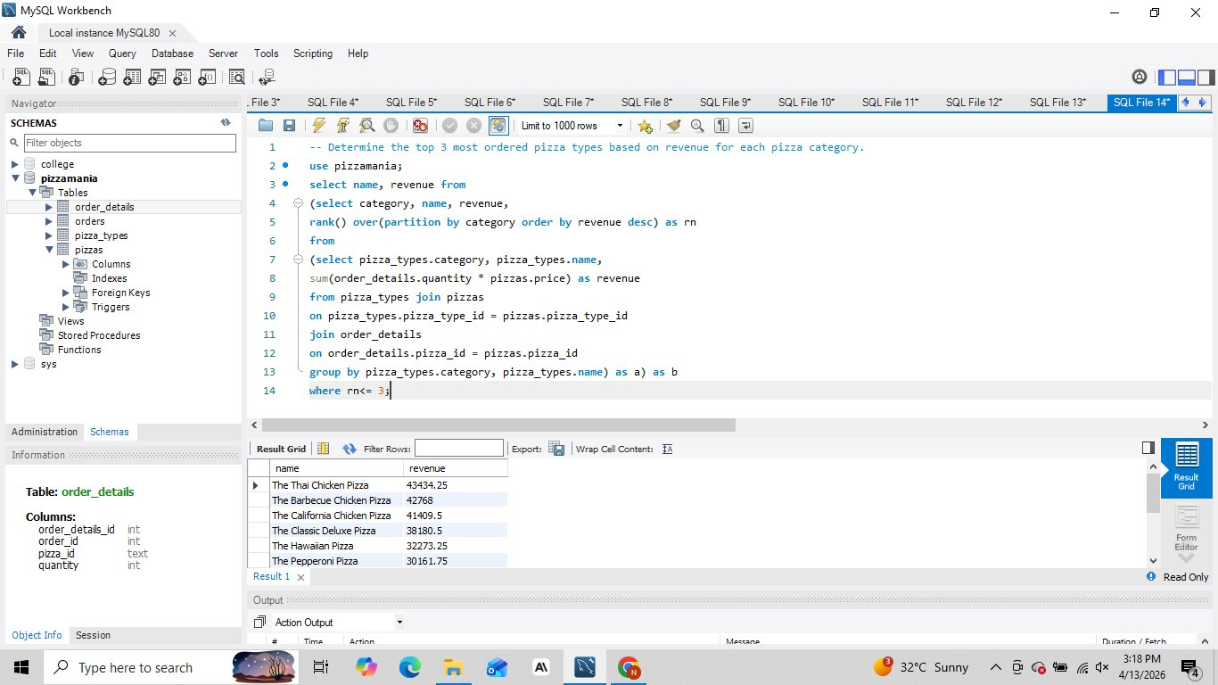
Top 3 Pizza Types per Category (Revenue)
Q13
RESULT
Chicken: Thai, BBQ, California · Classic: Deluxe, Hawaiian, Pepperoni · Supreme & Veggie: top-3 each
💡 INSIGHT
Using RANK() window function to partition revenue per category — Thai Chicken leads all categories at $43,434.
Pizza Sales Analysis | Database: Pizzamania | Tool: MySQL Workbench | By Nitin Tiwari

Slide 17
🏆 Key Insights Summary
💰
📦
📏
$817,860
21,350
Size L
Total Revenue
Total Orders
Most Popular Size
🍕
⭐
📅
Classic
$35.95
138/day
Top Category
Highest-Priced Pizza
Avg. Daily Orders
Pizza Sales Analysis | Database: Pizzamania | Tool: MySQL Workbench | By Nitin Tiwari

Slide 18
🛠️ SQL Techniques Used
Basic
Joins
SELECT, COUNT, SUM, ROUND
ORDER BY, LIMIT, GROUP BY
WHERE clause filtering
INNER JOIN across 3 tables
Multi-table joins (pizza_types → pizzas → order_details)
JOIN with aggregation
Advanced
Functions
Subqueries (correlated)
Window Functions — SUM() OVER, RANK() OVER
PARTITION BY category
Cumulative revenue analysis
HOUR(time) — time extraction
AVG() on subquery result
ROUND() for formatting
COUNT(name), COUNT(order_id)
Pizza Sales Analysis | Database: Pizzamania | Tool: MySQL Workbench | By Nitin Tiwari

Slide 19
🍕
Thank You!
Nitin Tiwari · Pizza Sales SQL Project · Database: Pizzamania

