Slide 1

AIRPAY LEARNING & DEVELOPMENT · LEADERSHIP SHOWCASE
Airpay Academy 2.0
powered by Sentientia LMS - our own enterprise learning platform
UAT showcase - what is running on the test environment today, what it means for people, technology and risk, and what we need decided
For the MD & Founder, CTO and CHRO · Prepared by Nitin Rajput, Head of Learning & Development · September 2026
Notes:
One-line story: the learning platform we bought has been rebuilt into a platform we own - Airpay Academy 2.0 on Sentientia LMS - and it is running on a UAT environment today with every persona validated. Be precise: it is NOT live; no real user is on it yet. Today we show it, and ask for five decisions.

Slide 2
EXECUTIVE SUMMARY
Built, validated on UAT, ready for the tester cohort
Where we are. Sentientia LMS - a white-label enterprise learning platform we own end to end, with Airpay Academy as its first customer - has been running on a dedicated UAT environment (academy2.airpay.ninja) since 3 September on the modern stack IT approved (Moodle 5.2, PHP 8.3, MySQL 8.4). Every persona's demo surface loads clean, tenant isolation and Hindi have been verified on screen, and the security audit findings that block production are down to three external items. It is not live: every user on it is a test persona. Real users load only after a passed migration rehearsal.
67 / 67
16 / 16
3
3
demo surfaces load clean across 11 persona walks
on-screen checks passed after the September fixes (10 + 6)
tenants isolated on one platform (Airpay · Public · ZEEA Tanzania)
security items still open before production - all external
WHAT WE ASK TODAY
1. Green-light the tester cohort: 13 personas, a two-week window, findings triaged daily
2. Close the three external blockers: payment-hash merge (product owner), reCAPTCHA keys + Entra SSO app + office-IP allowlist (IT)
3. Approve direction on the security & certification programme and the AI operating budget - spend plans already drafted
4. Confirm the go-live gate: a passed live-backup rehearsal, not a calendar date
Airpay Academy 2.0 · Sentientia LMS · UAT showcase · Confidential
2
Notes:
Figures: 67/67 from the functional walk (UAT-DEMO-READINESS), 16/16 = 10 checks on 16 Sep + 6 on 17 Sep, 3 tenants, 3 open security items (C1 payment hash merge, H2 reCAPTCHA keys, M5 which rides on C1). Say clearly: not live, no real users yet.

Slide 3
HOW WE GOT HERE
Six weeks from approval to a validated UAT
4 AUG
Roadmap signed
Reconciled product roadmap (ADR-028) and decision memo signed: parallel trust + product tracks, "5.2 now" as the single cutover path
19 AUG
UAT infrastructure
CTO-approved cloud environment provisioned: Ubuntu 24.04 / PHP 8.3.6 / MySQL 8.4.9 behind a load balancer (ticket HS-20260819-79876)
3 SEP
Stage A install
Fresh command-line install of the Sentientia 5.2 package: PASS-WITH-NOTES, 480 plugins, environment check 64 OK / 0 errors; 10 test personas + 14 courses seeded
4 - 17 SEP
Hardening on real screens
Security findings fixed, tenant scoping tightened, Hindi parity completed, author role wired, footer and licence wording set - 16 on-screen checks passed
NOW
Tester cohort
13 personas, guided scripts, shared tracker - the UAT Phase 1 that turns our checks into your people's verdict
GATED
Stage B rehearsal → cutover
Live-backup migration rehearsal on UAT (100 % parity gate), then a same-domain cutover with history intact - only on the product owner's go
The live airpay.academy has stayed untouched throughout - by design. Nothing changes for today's learners until the rehearsal passes.
Airpay Academy 2.0 · Sentientia LMS · UAT showcase · Confidential
3
Notes:
If asked "when does it go live": after the Stage B rehearsal passes and IT has production on MySQL 8.4 / PHP 8.3. Deliberately not date-promised.

Slide 4
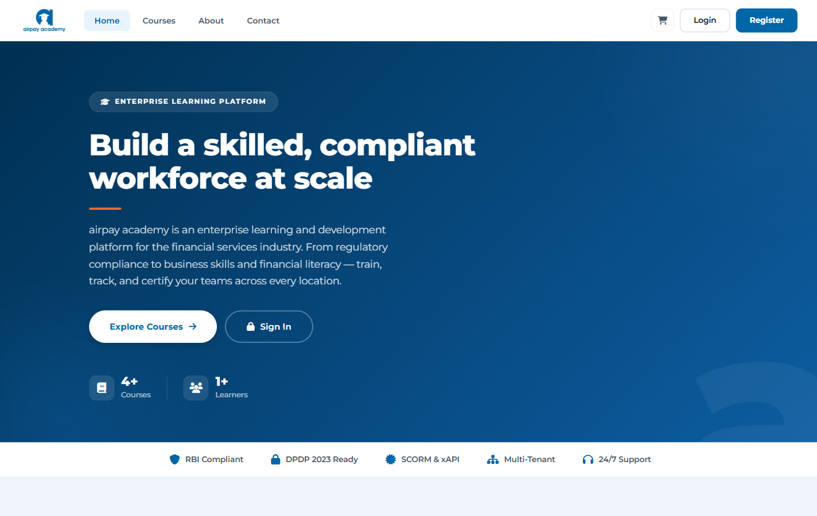
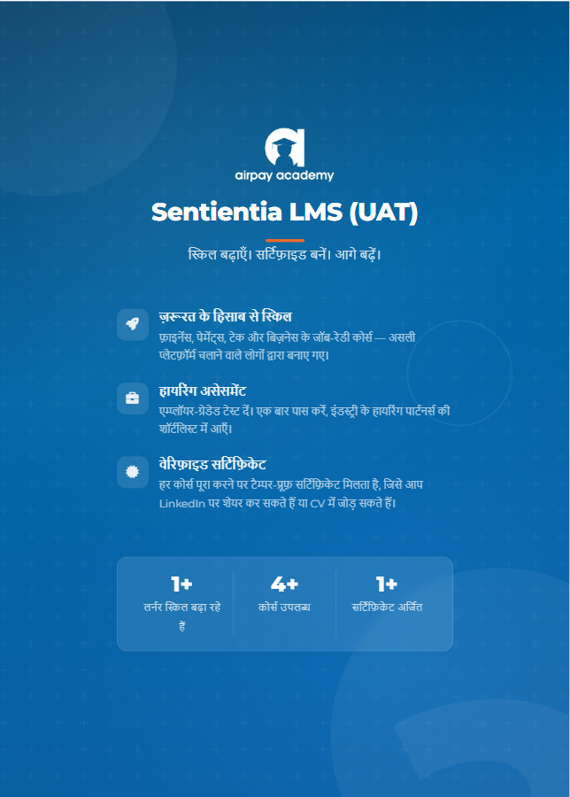
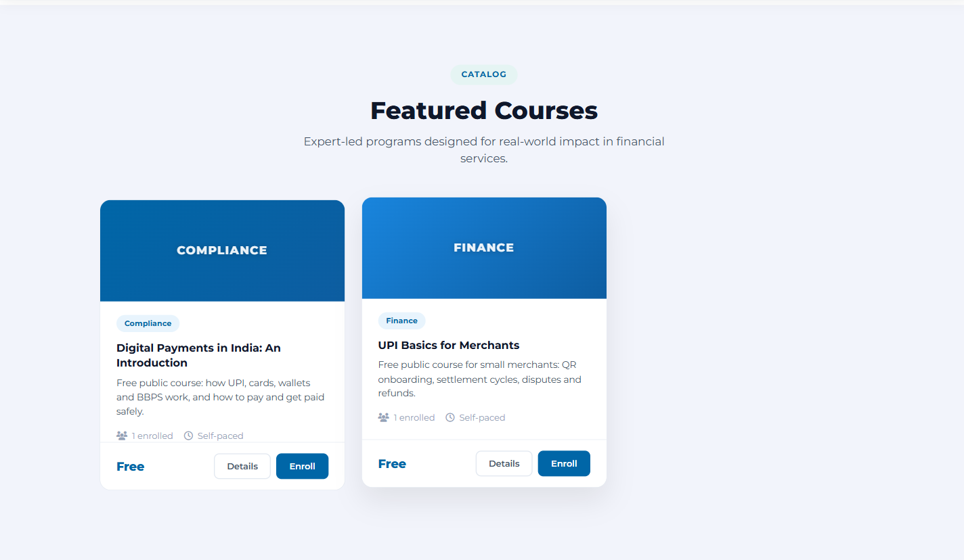
ON THE UAT ENVIRONMENT TODAY
Airpay-branded and bilingual, built for financial services
Public catalogue with free and paid courses
3 tenants · 13 personas · 14 courses
seeded on UAT - learning paths, classrooms, an exam, a live poll and four compliance-tracked courses
Public landing page - the storefront for the Public tenant
Login in Hindi - one switch, every screen
Live in the room: the 20-minute demo path walks a learner, a manager, a trainer's live poll, the L&D admin and the second tenant - all on this environment, all on test data. Screens shown here are captured from UAT on 17 September.
Airpay Academy 2.0 · Sentientia LMS · UAT showcase · Confidential
4
Notes:
Captured from https://academy2.airpay.ninja on 17 Sep 2026 (public pages). Logged-in screens are shown live during the demo.

Slide 5






WHAT THE PEOPLE FUNCTION GETS
Employees get consumer-grade learning; managers get control
Learners
Inclusion built in
Managers
Role-aware dashboard with continue-learning, deadlines, achievements and a 7-day streak; My Courses, catalogue, certificates wall, skills self-assessment with gap radar; SCORM, quizzes and assignments in one branded player.
Full Hindi experience - 332 theme strings and every plugin surface on the demo path verified on screen; Marathi, Kannada and Swahili packs started. Accessibility: WCAG-AA contrast, reduced-motion, screen-reader structure.
Team dashboard with enrolments, completions and completion rate; compliance table with overdue drill-down; approvals for course requests; CSV export - managers see their team without asking L&D.
Compliance
Engagement
Onboarding & lifecycle
Mandatory training with deadlines and auto-reminders (7/3/1 days), manager escalation (1/7/14 days overdue), tenant-scoped compliance matrix with Excel export, recompletion cycles for annual certifications, DPDP data-rights tooling.
Sentientia Live: in-class polls, quizzes, word clouds and Q&A with real-time results (Mentimeter-class, built in-house); gamification points, levels and leaderboards; a running town-hall poll is seeded on UAT.
First-login onboarding wizard (shown in Hindi for a new joiner persona); HRMS-driven joiner / mover / leaver automation proven on the full 2,871-employee record; KeKa webhook receiver hardened.
Why it matters: adoption. A platform people like using turns compliance training into a learning culture - and it is the same storefront we would show a paying customer.
Airpay Academy 2.0 · Sentientia LMS · UAT showcase · Confidential
5
Notes:
CHRO framing: adoption, inclusion (Hindi), manager self-service, compliance evidence. Live sessions and gamification are demoable on UAT; outbound email/WhatsApp are deliberately switched off on UAT.

Slide 6



WHAT TECHNOLOGY LEADERSHIP GETS
A modern, owned platform with engineering discipline behind it
Platform
Integration & identity
Delivery discipline
Moodle 5.2 core (Build 20260519) on PHP 8.3.6 / MySQL 8.4.9 RDS, Apache + PHP-FPM behind an ALB - the stack IT approved for UAT
Sentientia layer: 46 plugins, 6 blocks, a standalone 708-file design system - every template owned
Multi-tenant by design: tenant isolation on the org path, verified on real data (Airpay admin 743 users, ZEEA admin 6, site admin 1,426)
Feature flags at 5 levels, default OFF - platform behaviour never changes by accident
SCIM 2.0 users + groups and signed outbound webhooks built and unit-tested (flag-OFF until a consumer exists)
KeKa HRMS joiner / mover / leaver webhook hardened; 24-column HRMS CSV import proven on 2,871 records
Entra SSO + MFA: configuration packs ready, 0 lines of code - waits on the IT app registration
Public REST API v1 with rate limiting and OpenAPI; LTI 1.3 scaffolding; xAPI activity capture
Checksummed release packages (v4.2.0: 65,588 files, SHA-256 published) and a surgical deployer with pre-deploy backups
17 pre-commit checks + CI: language parity, security scans, template leaks, contract checks; PHPUnit on every touched plugin
30 architecture decision records + per-component state cards - any engineer or auditor can reconstruct why
Same-domain cutover plan with a 100 % data-parity gate (2,057-step upgrade already rehearsed error-free on production-shaped data)
Licence posture: the core stays GPL v3 (Moodle); we sell hosting, implementation and service, not seats. End-user screens carry Airpay's private-and-confidential notice.
Airpay Academy 2.0 · Sentientia LMS · UAT showcase · Confidential
6
Notes:
CTO questions to expect: stack currency (5.2/8.3/8.4 - yes on UAT; production RDS is still 8.0.44 and needs IT's change request), isolation proof (screen-checked 16-17 Sep), how changes ship (checksummed, backed-up, upgrade + purge), licence (GPL core, SaaS model).

Slide 7
SECURITY POSTURE
Audit findings closed fast; three external items remain
FIXED AND VERIFIED ON UAT
STILL OPEN - ALL EXTERNAL TO ENGINEERING
C2 - cross-tenant self-enrolment closed (a Public learner now gets 404 on Airpay / ZEEA courses)
H1 - signup account enumeration closed
H3 - xAPI endpoint rate-limited; H4 - real-time stream connection caps (137 tests)
M1 / M3 / M4 - HSTS, X-Frame-Options, nosniff, Referrer and Permissions policies; server banner hidden; config file 640; debug off
Payment-verification bypass in the inherited gateway fixed fail-closed (13-test suite) - merge pending
Database access moved to an app-scoped user; the superuser password delivered in plain text was rotated
C1
Payment hash fix branch to be merged; needs one Airpay gateway sandbox round-trip Product owner
H2
Production reCAPTCHA keys for public signup IT
M5
Rides on C1 - closes with the merge Product owner
Gate
Office-IP allowlist on the UAT load balancer before any real-data rehearsal IT / Cloud.in
Audit verdict (3 Sep): CONDITIONAL PASS for UAT, BLOCK for production until these close.
Beyond fixes: the funded trust track (CERT-In pen-test, ISO 27001, SOC 2, 25k-user load test) is what turns "secure by our word" into buyer-grade evidence - direction approval requested today.
Airpay Academy 2.0 · Sentientia LMS · UAT showcase · Confidential
7
Notes:
Source: docs/security/UAT-SECURITY-POSTURE-2026-09-03.md and the validation plan. Present the open items as decisions, not gaps: C1 is a merge + sandbox test, H2 is a key from IT.

Slide 8



SCALE AND DATA - WHAT IS REAL, WHAT IS TEST
Hardened at production scale, running on test data only
2,871
100 %
13
employee records in the production data copy the platform was hardened against (411 courses, 3 tenants)
data parity in the local migration rehearsal - 32,248 completions, 11,415 certificates, 8,687 quiz attempts matched row for row
test personas on UAT across 3 tenants, 14 seeded courses, learning paths, classrooms, an exam and a live poll
0
2,057
3,500+
errors under a 20-user load baseline on UAT; p95 under 1 second; backup + restore drill in 44 seconds
upgrade steps in the 5.1 → 5.2 data migration, rehearsed error-free - the one real transform on cutover day
learners on the live airpay.academy today - untouched, still on the previous platform until the rehearsal passes
Two environments, one rule: the development copy holds a test import of production data; UAT holds fake personas. No real learner has used Sentientia yet.
Airpay Academy 2.0 · Sentientia LMS · UAT showcase · Confidential
8
Notes:
Sources: migration plan §3.1 (parity baseline), validation plan 2.2/2.3 (drill, load), Phase 0 provisioning. The 3,500+ figure is the live airpay.academy population, not Sentientia users.

Slide 9

ONE PLATFORM, MANY ORGANISATIONS
Three tenants isolated; a second customer is a config task
Airpay internal (/1)
Public (/77)
ZEEA Mafunzo, Tanzania (/177)
HRMS-synced employees, supervisor hierarchy, mandatory compliance. L&D admin sees 9 users, 6 courses on UAT - and only those.
Self-signup storefront with cart and the Airpay payment gateway (checkout stops at "Payment coming soon" on UAT).
Partner tenant in Swahili; its admin sees 2 users, 4 courses and its own compliance course - nothing of Airpay's.
White-label by architecture
Customer registry demonstrated in August: a fictional second customer ("Meridian Financial Services") resolves end to end with its own feature flags and isolation
Branding, legal footer and every customer-name string resolve from configuration - the Airpay private-and-confidential notice is one such string
Honest caveat: the multi-customer layer is early-stage - production keeps customer #1 hard-wired until a second customer is signed; the isolation that matters today is tenant-level, and that is verified
This is the growth option: the same build that serves Airpay can be offered to other enterprises as a hosted, managed platform.
Airpay Academy 2.0 · Sentientia LMS · UAT showcase · Confidential
9
Notes:
Tenant figures are from the 16-17 Sep screen checks on UAT. Customer-N demo is on the development environment (2026-08-20). Do not oversell multi-customer - say "architecture demonstrated, productisation deferred until customer #2".

Slide 10
ROADMAP (ADR-028, SIGNED 4 AUG)
Two tracks in parallel; cutover is its own gated path
TRUST TRACK
PRODUCT TRACK
CUTOVER PATH
Identity pack: Entra SSO + MFA configuration ready - execute when IT registers the app
CERT-In empanelled penetration test, then ISO 27001 gap closure and Stage 1
SOC 2 Type II observation window for global buyers
25k-user load test tiers - published scale proof
Status: funded in principle (envelope ₹80-120 lakh; spend annex ₹52-109 lakh) - approval pending
Done: customer registry (2.1), skills-first home (2.2), SCIM 2.0 + webhooks (2.4), KeKa hardening
Blocked: live AI (2.3) - six features run in mock mode until the monthly cap and API key exist
Next: engagement loop (2.5), marketplace connectors Go1 + Coursera (2.6), Indic text-to-speech evaluation (2.7)
Funded: native mobile app (Capacitor) on the REST v1 surface; PWA hardened meanwhile
UAT Phase 1: tester cohort, findings triaged daily (now)
Phase 3: integrations as IT delivers keys (SSO, reCAPTCHA, SMTP via OAuth2)
Stage B: live-backup rehearsal on UAT with the 100 % parity gate - needs UAT resize + office-IP allowlist
Production prerequisites: RDS to MySQL 8.4 and PHP 8.3 (IT change requests - committed dates requested)
Cutover: same domain, history intact, multi-hour maintenance window sized from the rehearsal
Working targets, not commitments to risk: the production cutover follows a passed rehearsal and IT's platform upgrades, whatever the calendar says.
Airpay Academy 2.0 · Sentientia LMS · UAT showcase · Confidential
10
Notes:
ADR-028 decisions: freeze rejected → parallel tracks; Q3 full trust roadmap; Q5 native app funded; Addendum A AI budget (cap TBD, key not provisioned); Addendum B "5.2 now". Phase 2.1/2.2/2.4 done; 2.3 blocked on cap + key.

Slide 11
EYES OPEN
What is not yet true, and how each is handled
Not live yet
Payments stay dark at go-live
Sentientia has never served a real user; all figures are from test data. UAT tester cohort → Stage B rehearsal → gated cutover. The live platform keeps running untouched meanwhile.
The gateway fix is unmerged and the Verify-API step unproven against the sandbox. Commerce is disabled and verified disabled at cutover; enablement is a separate, later decision after C1 closes.
AI is mock-mode
No certifications, no pen-test yet
No live model call has ever been made; six features wait on a budget cap and an API key. Off by default at two independent levels. The central spend ledger and monthly cap live in the gateway, and code now refuses a live call unless gateway metering is routing - so spend cannot escape the meter by configuration mistake.
Buyers and auditors will ask early. Trust track funded in principle; VAPT first, then ISO 27001 and SOC 2 - the spend annex is ready for sign-off.
UAT sizing is smoke-only
Small team, big surface
t3a.small / db.t3.small (2 GB each) cannot host a live-backup rehearsal. Resize to medium class before Stage B; a same-day cloud operation already flagged with DevOps.
The platform was built by a very small team with AI-assisted engineering. 30 decision records, runbooks and state cards make it reconstructible; a support-engineer hire and the vendor AMC option spread the load.
Presenting these ourselves is the point: every item has an owner and a mitigation, and none of them is a surprise.
Airpay Academy 2.0 · Sentientia LMS · UAT showcase · Confidential
11
Notes:
The key-person risk is the one leadership will feel most; the support-engineer ask (August deck) is its mitigation.

Slide 12
TO CLOSE TODAY
Decisions requested from this room
CHRO
Green-light the tester cohort and two-week UAT window; nominate the 13 persona testers and a daily triage owner
CTO / IT
Commit dates for: production reCAPTCHA keys, Entra SSO app registration, office-IP allowlist on the UAT load balancer, UAT resize, production RDS → MySQL 8.4 and PHP 8.3
MD & Founder
Approve direction on the security & certification programme (₹80-120 lakh envelope; annex ₹52-109 lakh) and the AI operating budget (monthly cap + API key)
Product owner
Merge the payment-hash fix after one gateway sandbox round-trip (closes C1 and M5)
All
Note the go-live gate: a passed live-backup rehearsal with 100 % data parity - not a calendar date
Airpay Academy 2.0 · Sentientia LMS · UAT showcase · Confidential
12
Notes:
Items 3 asks for direction, not final numbers - the security spend annex (Aug 2026) and an AI cap estimate follow as annexes. Item 5 is a note, not an approval: it protects everyone from date pressure.

Slide 13
THE LIVE DEMO
Twenty minutes, seven stops, one environment
1
Guest
Landing page → public catalogue: the storefront story
3 min
2
Learner (Priya)
Dashboard with progress and badge, open a course, SCORM walkthrough, certificates
4 min
3
Manager (Vikram)
Team dashboard, a report's progress, compliance RAG with an overdue flag, approve a request
3 min
4
Trainer (Arjun)
Run the live poll - the audience answers from their phones
3 min
5
L&D admin (Meera)
Manage Users / Courses, compliance report + Excel export, analytics, the feature Switchboard
3 min
6
Tenant isolation
Log in as the ZEEA admin: only ZEEA data, in its own compliance view
2 min
7
Close
Hindi toggle on a dashboard; the migration story - same domain, full history carried over
2 min
Explained, not clicked: outbound email and WhatsApp (switched off on UAT), real payments (gateway not connected), SSO/MFA (keys pending), live AI generation (mock mode).
Airpay Academy 2.0 · Sentientia LMS · UAT showcase · Confidential
13
Notes:
Persona credentials are in the confidential UAT handout, never on a slide. Every stop was walked and screen-verified between 7 and 17 September.

Slide 14
APPENDIX
What changed on UAT between 4 and 17 September
Area
Finding
Outcome
Security
C2 cross-tenant self-enrol · H1 enumeration · H3/H4 rate limits · M1/M3/M4 headers
Fixed and verified on UAT (3-4 Sep)
Realtime
Live-session stream buffered by the web server (F-11)
Fixed at the proxy; first byte in 0.05 s
Roles
Course author landed on a learner shell (T-01)
Author role seeded on install + upgrade; authoring nav live (8 Sep)
Tenancy
Admin dashboard and compliance report leaked other tenants' figures and filters
Every widget, filter and export tenant-scoped; screen-verified (16-17 Sep)
Language
English fragments and escaped characters on dashboards, login, filters, reports
Theme 332/332 + plugin packs at parity; 16 on-screen checks passed
Content
SCORM untested on the new stack
Real SCORM 1.2 package plays; files serve correctly
Branding
Footer carried an open-source licence badge
Replaced with Airpay's private-and-confidential notice (en + hi)
Ops
Backup/restore and load never measured on UAT
Restore drill 44 s; 20-user baseline 0 errors, p95 ≤ 1 s; daily log-scan
Every row has a commit, a checksummed deploy record and, where it is visual, a screenshot folder under docs/visual-evidence. Versions on UAT (17 Sep): theme 2026090805, courses 1.11.5, compliance report 1.0.2, gamification 1.0.3, content market 1.0.2.
Airpay Academy 2.0 · Sentientia LMS · UAT showcase · Confidential
14
Notes:
Backup slide for the CTO. One further theme fix (Hindi login placeholders) is committed and awaits the next deployment window.

