Slide 1
SENTIENTIA LMS
The content engine: SOP to multilingual, scenario-based course, built in India
Study findings, staged plan, costs and the decisions we need
Prepared for Nitin Rajput, Head of L&D, Airpay | 15 October 2026 | For the founder and C-suite | Confidential
Notes:
Source: STUDY.md in docs/research/2026-10-15-scorm-lxp and the C-suite brief. Nothing in this deck claims a feature is live; all AI and voice calls so far were mocked.

Slide 2
The category moved. Our content engine has not.
Authoring moved inside the LMS. Vendors now turn a document into a course with AI, voice it, translate it and package it to SCORM or cmi5 automatically.
Our moat is governance, not generation. Regulated buyers ask who approved this Hindi sentence, where this voice was made, and whether it runs in their LMS.
Thirteen languages is a cost problem first. Machine translation is cheap; reviewers are not.
Voice scales badly when rented. Per-character fees across thirteen languages never end.
THE DECISION
Build the content engine as a Sentientia product, on the platform we already own, instead of renting one.
Sentientia Content Engine | 15 October 2026 | Confidential
2
Notes:
STUDY.md section 2 and the C-suite brief section 1.

Slide 3
What we did: tested a report, a market and our own code
20
51
13
55
6
INR 0
platforms compared
criteria, weighted for an India BFSI buyer
languages planned, incl. Urdu and Arabic
tests on the pilot harness
clickable prototypes
spent: no paid API call
The report's 30 checkable vendor claims were verified one by one against vendor pages and reviews.
Sentientia was scored from its code, not its brochure; where the two disagree the code wins (six places).
A mock pilot compiles one course into SCORM 1.2, SCORM 2004 and cmi5 and was played in a real browser.
Sentientia Content Engine | 15 October 2026 | Confidential
3
Notes:
STUDY.md sections 1, 3, 4, 5, 13. Vendor scores come from public pages and are scored low where only marketing exists.

Slide 4
The report: right architecture, uneven facts
Right: a canonical course document, a proxy for live AI, tag-safe translation with human stages, a packager hardened for Moodle. We adopt all four.
Thin: no buyer, no price, no compliance, voice assumed to be rented.
Wrong: the "forget 50% in an hour" figures are folklore, not Ebbinghaus's data.
Vendor marketing: "150+ languages", "four months to four weeks" and template counts are vendor claims.
Sentientia Content Engine | 15 October 2026 | Confidential
4
Notes:
STUDY.md sections 2 and 3.1; sources/R1 (claim table) and sources/R6 (learning science).

Slide 5
No vendor in the set is ahead; the lanes we want are open
Weighted score on 51 criteria, % of maximum (scored low where only marketing exists)
Moodle Workplace 39%, Articulate 30%. Sentientia is at 31% today.
Targets, not facts: 58% after Stage 1, 84% after Stage 3.
15 of 51 criteria have no vendor at "shipped and documented".
Confidence: 10 vendors low, 10 medium, none high.
Sentientia Content Engine | 15 October 2026 | Confidential
5
Notes:
matrix/capability-matrix.csv and matrix/scoring-method.md. Sentientia is scored from code with full visibility; vendors from public pages. The structure of the finding survives a one-point change in any cell; the exact percentages do not.

Slide 6
Where the market is open
Localisation governance
In-region speech
Decision analytics
Translation memory with XLIFF and a two-stage human review: documented by almost no one
Machine translation plus glossary is everywhere; reviewer workflow is not
Where speech is processed, how a brand name is pronounced, how captions are aligned: documented by none of 20
Self-hosting in India is a differentiator, if it passes a quality gate
Scenario choices as data, not just a score
Spaced practice after completion; roleplay with human-calibrated scoring
No vendor shows an India hosting region or a DPDP statement. Self-hosted Moodle and Tenneo's client-server option are the only on-premise paths found. That is what an Indian bank's security questionnaire probes.
Sentientia Content Engine | 15 October 2026 | Confidential
6
Notes:
STUDY.md sections 3, 4.2 and 9. Tenneo and Invince name large bank customers; every reference is vendor-sourced and unverified.

Slide 7
Where Sentientia stands, from code and not the brochure
Exists today
Proved in this study
Designed, not built
Deferred, costed only
AI gateway with spend caps
Authoring drafts with review gate
Real Moodle course builder
Translation of pasted text, 4 languages
xAPI endpoint, cmi5 session tracker
No live AI call has ever run
Canonical course schema
Compiler to 3 standards
Hardened runtimes and validation
55 tests, browser run
Six prototypes
Self-hosted speech service and gate
XLIFF, memory, two-stage review
Scenario editor
Daily Review practice
Live roleplay (formative first)
AI avatar video
Native mobile app (funded separately)
SCORM import / decompile
Sentientia Content Engine | 15 October 2026 | Confidential
7
Notes:
STUDY.md section 5 (and 5.5, where the written record overstates the code). Flags default OFF; nothing here is live for learners.

Slide 8
One course document, three standards
SCORM 1.2
Canonical course document
Airpay default today
SOP, PDF, DOCX, PPTX or prompt
slides | branching scenario | quiz
every language | protected terms
approvals | provenance | audit
SCORM 2004 4th Ed.
buyers who require it
cmi5 / xAPI
LRS-first, decision analytics
Generate and translate on Claude through our own gateway: keys, spend ledger, caps, mock-first.
Speech in India on a service we control, with a quality gate per language and a fallback.
One static player written once and hardened against Moodle's runtime traps (the 4,096-character progress limit, exit state, interaction logging).
Nothing machine-made reaches learners without a named human approval, recorded in a hash-chained audit log.
Sentientia Content Engine | 15 October 2026 | Confidential
8
Notes:
ADR-034 decisions D1 to D3; STUDY.md section 6. Package mode default is multilingual (one activity, one completion); per-language packages are an option.

Slide 9
Thirteen languages, two human stages
Segment
Memory
Machine draft
Auto checks
Translator
Subject expert
Admin sign-off
Voice
Blue = human stages. Only approved languages reach learners; machine drafts are preview-only.
Languages: Hindi, Marathi, Kannada, Tamil, Telugu, Bengali, Gujarati, Malayalam, Punjabi, Odia, Assamese, Urdu, Arabic, English (Swahili kept).
Right-to-left done properly: mirrored layout, isolated terms and amounts, script fonts.
XLIFF out and in for agencies; checks catch placeholders, numbers and brand terms.
THE NUMBER THAT SETS THE LANGUAGE COUNT
5 to 6 hours
of human review per language per course. Fifty courses a year in thirteen languages is about two full-time reviewers. Translation memory makes repeat content 30 to 50% cheaper, so languages are enabled by demand.
Sentientia Content Engine | 15 October 2026 | Confidential
9
Notes:
STUDY.md section 7 (7.4 reviewer capacity). Capacity planning values are assumptions to be replaced by quotes.

Slide 10
Our own voice: cheap to run, only worth it if it passes a gate
Check (per language) | How | Pass
Naturalness | Blind listening panel, 20 native raters | MOS 4.0 or more
Intelligibility | ASR round trip vs a human recording | within 1.2x
Brand terms, numbers | 60-term and 50-item sets | 95% or more
Speed and cost | Real-time factor on a T4-class GPU | 0.5 or less
Licence | Commercial use confirmed in writing | no CC-BY-NC
Compute is a few rupees: INR 5 to 11 per course-language on on-demand India GPUs.
Why self-host: residency, unlimited regeneration while reviewing, one consistent voice.
Fallback stays wired: an India-region voice (INR 12 to 24).
A language that fails the gate stays on the fallback until it passes. Urdu and Arabic will probably stay there longest. Several strong open models are non-commercial licences and are excluded.
Sentientia Content Engine | 15 October 2026 | Confidential
10
Notes:
STUDY.md section 8; sources/R3 (candidate engines, licences, India GPU cost). No model was downloaded and no voice was synthesised in this study.

Slide 11
Compliance built in, for DPDP and a bank's vendor questionnaire
Control | What it does | Answers
Personal-data gate | Scans every source and generated string for Aadhaar, PAN, mobile, email, IFSC, card; blocks the run | DPDP safeguards; no PII to any model
Residency record | Every artefact records where it was processed; speech runs in India | Data-location statement per component
Hash-chained audit | Who generated, translated, approved; model; hashes; cannot be overwritten | Audit and access rights
Vendor posture pack | Sub-processor list, DPA template, exit plan (JSON, XLIFF, TMX, standard packages) | RBI IT-outsourcing style questionnaire
Incident path | 6-hour CERT-In reporting folded into the existing runbook | CERT-In 2022 directions
Open for counsel: is Claude inference available in India? Is an employee-training system a material IT outsourcing for Airpay? These are the first questions, not afterthoughts.
Sentientia Content Engine | 15 October 2026 | Confidential
11
Notes:
STUDY.md section 9 and sources/R4. Not legal advice; clause references are marked verified or unverified in R4.

Slide 12
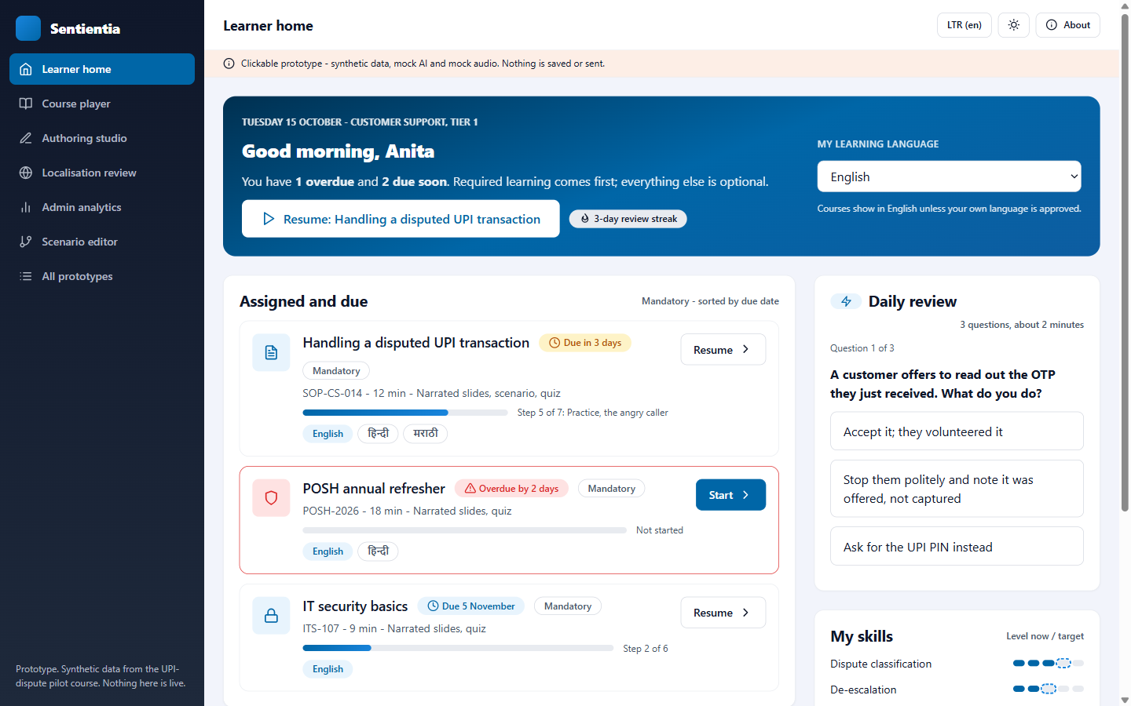
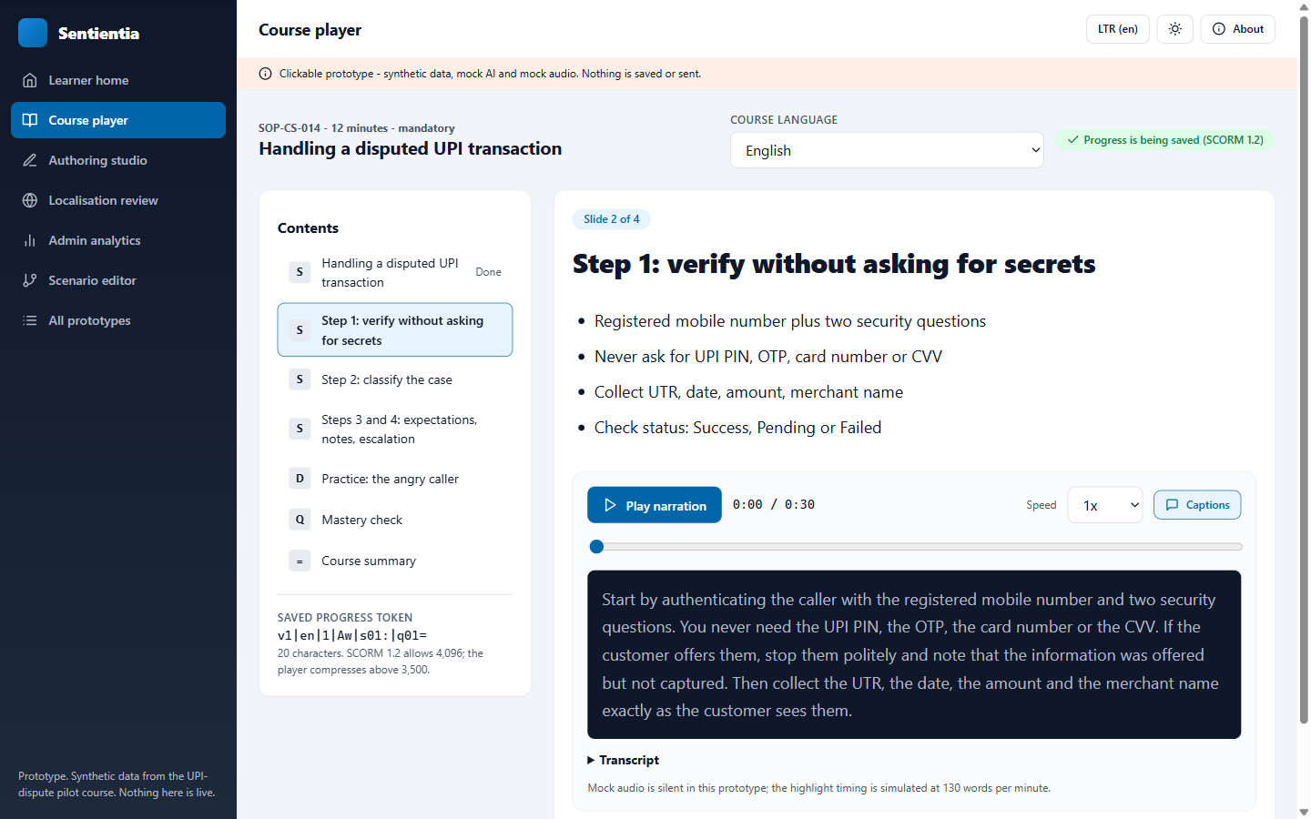
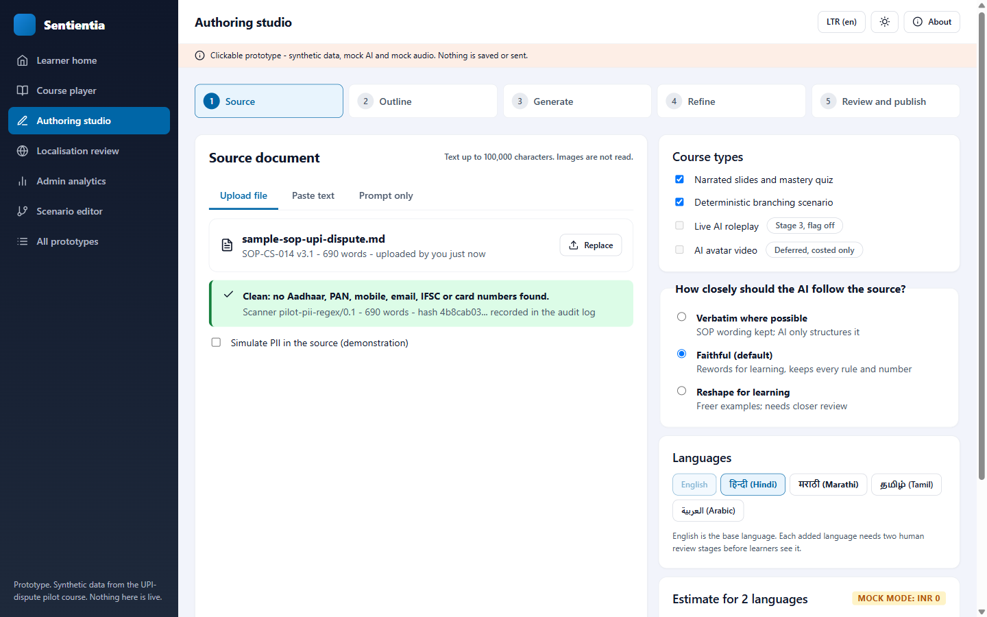
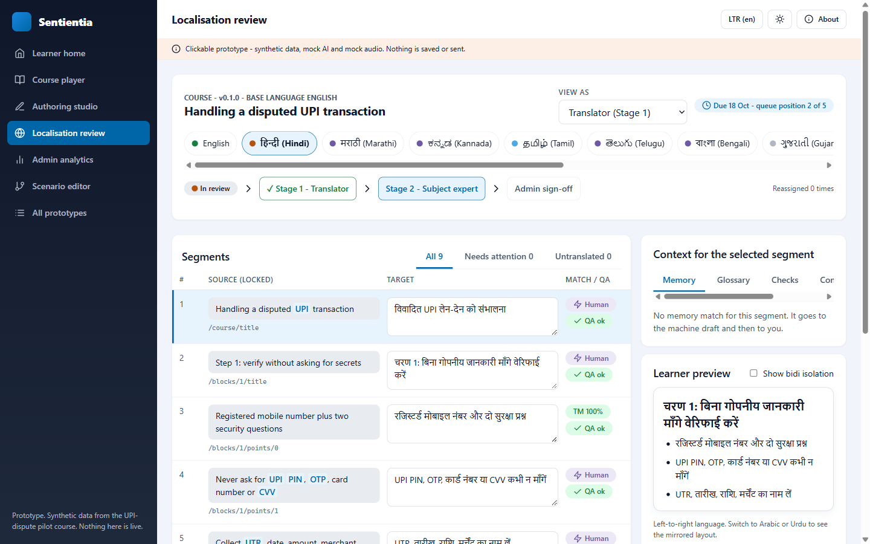
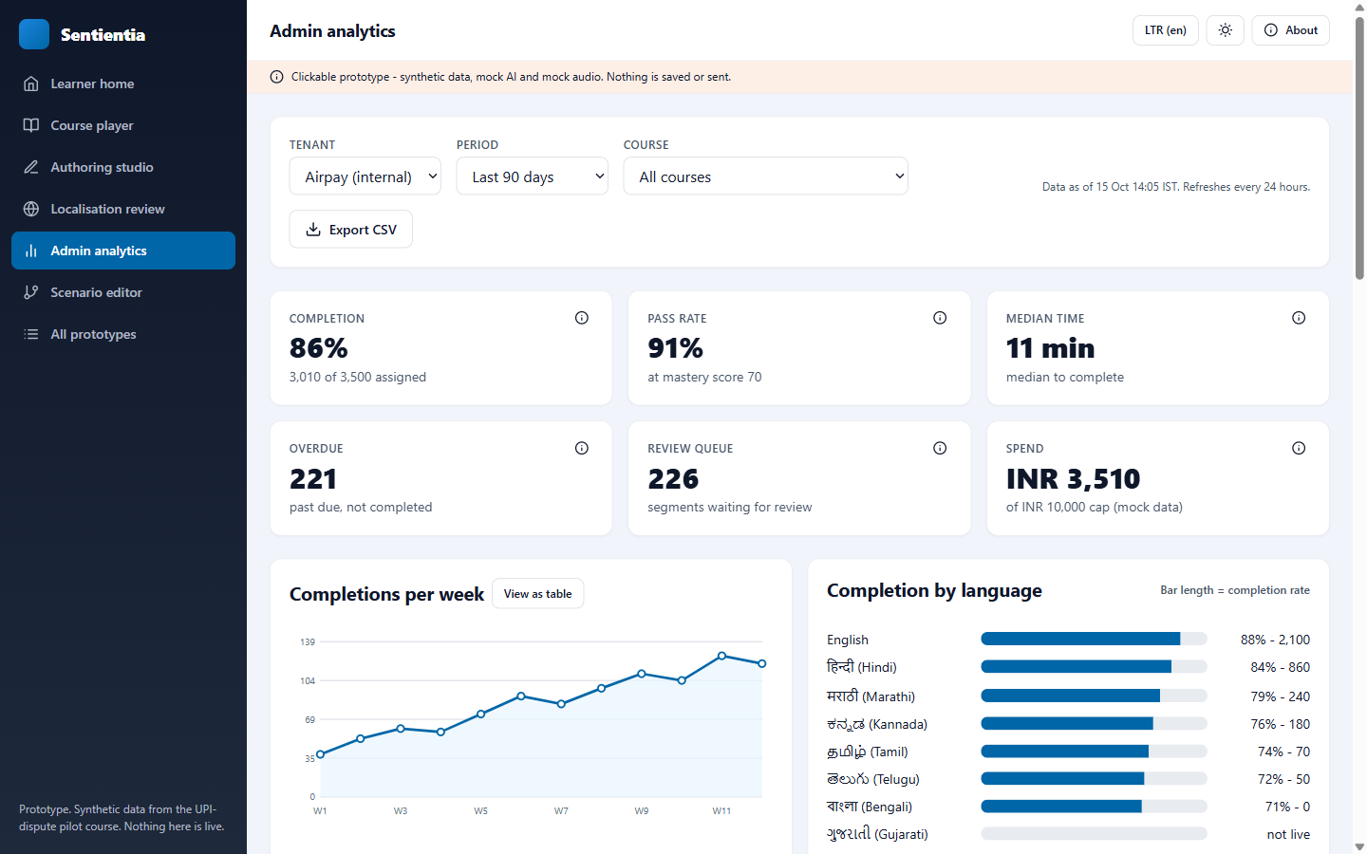
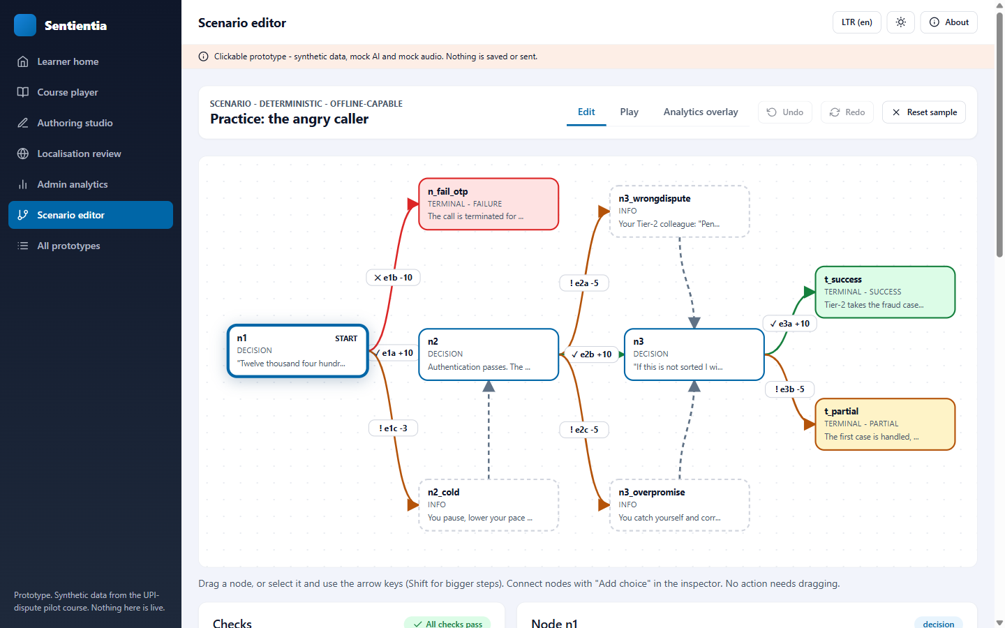
Six clickable prototypes on our design tokens
Learner home
Course player
Authoring studio
Localisation review
Admin analytics
Scenario editor
Sentientia Content Engine | 15 October 2026 | Confidential
12
Notes:
prototypes/index.html (open from the file system). Light and dark, LTR and RTL, 1440 and 375 px. Synthetic data; no screen-reader or performance testing yet. Self-assessment in prototypes/README.md.

Slide 13
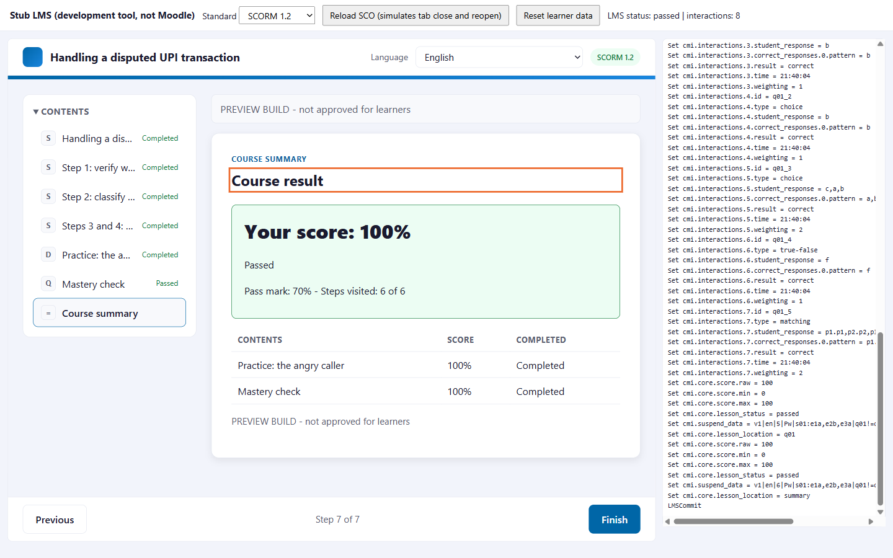
The pilot: one document, three standards, zero rupees
Compiles a UPI-dispute course (four slides, nine-step scenario, five questions, 13 languages) to SCORM 1.2, SCORM 2004 and cmi5.
Validates every package (21 checks), simulates a learner, and the build is byte-for-byte repeatable.
Played in a real browser against a stand-in LMS: pass, fail and resume after reload.
55 tests; a browser bug that all unit tests missed was found and fixed.
Live path refuses to start without the spend cap, the API key and a typed confirmation per call.
Stand-in LMS log beside the player: score 100, passed, 8 interaction records, 102-character saved state.
Sentientia Content Engine | 15 October 2026 | Confidential
13
Notes:
pilot/evidence/ (reports, audit logs, screenshots) and STUDY.md section 13. Mock mode proves the compiler and runtimes; it does not prove translation quality, voice quality or Moodle 5.3 behaviour.

Slide 14
The plan: 90, 180 and 365 days, each with a stop rule
Stage | Delivers | Evidence gate | Stop rule
1 Foundation days 0 to 90 | Course document, compiler for 3 standards, translation core with two-stage review, speech service v0, Hindi end to end, live pilot | Runs in Moodle 5.3 with resume and pass/fail; Hindi approved by named reviewers; speech scorecard | Compiler fails Moodle tests after 3 rounds: SCORM 1.2 only. Hindi voice fails twice: rented voice stays primary
2 Scenarios and scale days 90 to 180 | Scenario editor, Daily Review practice, 13 languages, right-to-left, decision analytics | Scenario authored in under 2 hours; practice engagement; reviewer throughput | Authoring over 4 hours: simplify; reviewers under half of plan: cut languages
3 Roleplay and product days 180 to 365 | Formative AI roleplay, learner speech, sellable tier, conformance, hardening | Rubric agreement with raters 0.6 or more; second customer in a day | No customer asks by day 240: defer; scores never count until calibrated
About 72 Claude sessions in all. One developer takes over the speech service and pulls analytics forward; two bring the 13-language rollout in by day 150; a localisation lead owns reviewers and glossaries.
Sentientia Content Engine | 15 October 2026 | Confidential
14
Notes:
STUDY.md section 11 (11.1 table, 11.2 developer unlocks). Every feature flag defaults OFF; nothing flips for learners without Nitin's call.

Slide 15
What it costs per course per language
Tier | What it is | Per language | 13 languages
T0 Mock | Everything simulated | INR 0 | INR 0
T1 Lean | AI draft, self-hosted voice, one review | INR 1,450 to 3,050 | INR 19k to 40k
T2 Standard (compliance) | AI draft, voice and quality check, two-stage review, audit export | INR 2,800 to 5,850 | INR 36k to 76k
T3 Premium / fallback | Premium AI, rented voice or professional translation, two-stage review | INR 5,100 to 12,200 | INR 66k to 160k
People are over 90%. AI is INR 25 to 45; voice INR 5 to 11 self-hosted.
Fixed: India GPU about INR 7.5k to 17k a year at 100 courses; listening panel INR 5k to 15k per language.
Pilot month cap: INR 10,000.
Planning values at list prices. Human rates are assumptions to be replaced by quotes. The first live run measures the real cost per course per language.
Sentientia Content Engine | 15 October 2026 | Confidential
15
Notes:
STUDY.md section 12. Model lines at INR 87 per USD; speech lines at about INR 95 per USD (a 9% spread that changes no conclusion).

Slide 16
Risks and how each is gated
Risk | Gate or mitigation | Fallback
Voice quality not good enough | Per-language listening-panel gate; pronunciation lexicon | Rented India-region voice; self-hosted stays evaluation-only
Model licence not commercial | Written confirmation before any engine ships | Switch engine
Reviewer capacity not staffed | Languages by demand; memory reuse; localisation lead | Fewer languages; machine drafts preview-only
Moodle runtime surprises | SCORM 1.2 default; cmi5 external first; test inside Moodle | SCORM 1.2 only
Model data leaves India | Only de-identified content; PII gate; sub-processor pack | Customer-specific on-premise model, costed later
Engineering bandwidth | Stop rules per stage; whole builds only | Stage 3 defers first
Sentientia Content Engine | 15 October 2026 | Confidential
16
Notes:
STUDY.md section 14 (twelve risks with likelihood and impact). What we will not claim until evidence exists: live, serving learners, conformant, 150+ languages, minutes-not-months.

Slide 17
The six asks
1
Accept ADR-034 and the Stage 1 scope.
2
Set the AI spend cap (Addendum A, still blank): INR 10,000 for the pilot month, and provide the API key.
3
Approve the speech line: India GPU batch jobs (about INR 10k to 20k a year), listening-panel honoraria, a six-week evaluation time-box.
4
Name Hindi reviewers: a translator and a subject expert, so the two-stage loop runs on real content.
5
Decide the product stance: part of the Enterprise plus AI tier, or a priced add-on.
6
Reconfirm data residency with compliance: de-identified content to Claude outside India with the study's controls, or cost an on-premise option.
Sentientia Content Engine | 15 October 2026 | Confidential
17
Notes:
C-suite brief section 9. Until the cap and key exist, no AI or voice call can run live; the pilot harness refuses to start without them.

Slide 18
What happens next
Horizon | Focus
Now to +90 days | Stage 1 foundation; live pilot once the cap and key exist; Hindi reviewed end to end; first speech gate
+3 to +6 months | Scenarios, Daily Review, thirteen languages, right-to-left, decision analytics
+6 to +12 months | Live roleplay (formative), engine packaged for a second customer, conformance testing
Study, matrix, architecture decision, pilot and prototypes are on the branch claude/research-scorm-lxp, not merged.
Nothing is live; every flag defaults OFF; the next step on your side is the cap, the key and the reviewers.
Sentientia Content Engine | 15 October 2026 | Confidential
18
Notes:
docs/research/2026-10-15-scorm-lxp/README.md lists every deliverable. Pilot prerequisites: pilot/LIVE-RUN-CHECKLIST.md.

