Slide 1
Lightning Network
Instant Payments
Scalability
off-blockchain (NOT off-line)
Bi-directional Payment
All images are based on diagrams from BitcoinMagazine

Slide 2
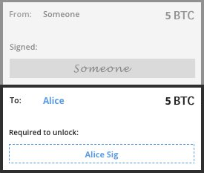
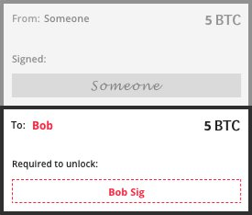
Alice
Bob

Slide 3
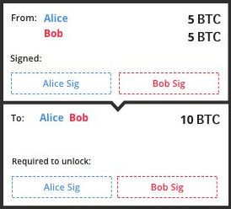

Slide 4
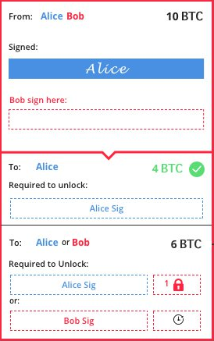
Alice

Slide 5
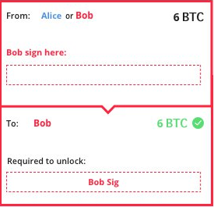

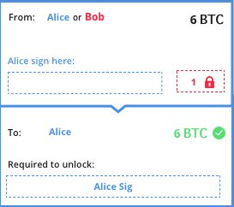
Alice
Bob

Slide 6
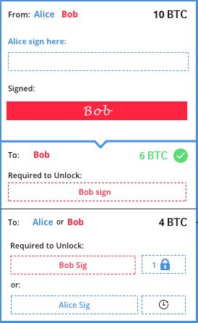
Bob

Slide 7
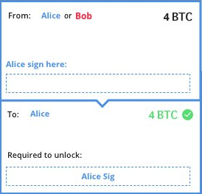

Alice
Bob

Slide 9



Bob
Alice

Slide 10
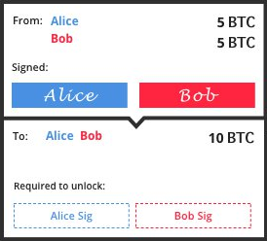

Slide 11


Slide 14
Bob
Alice

Slide 15
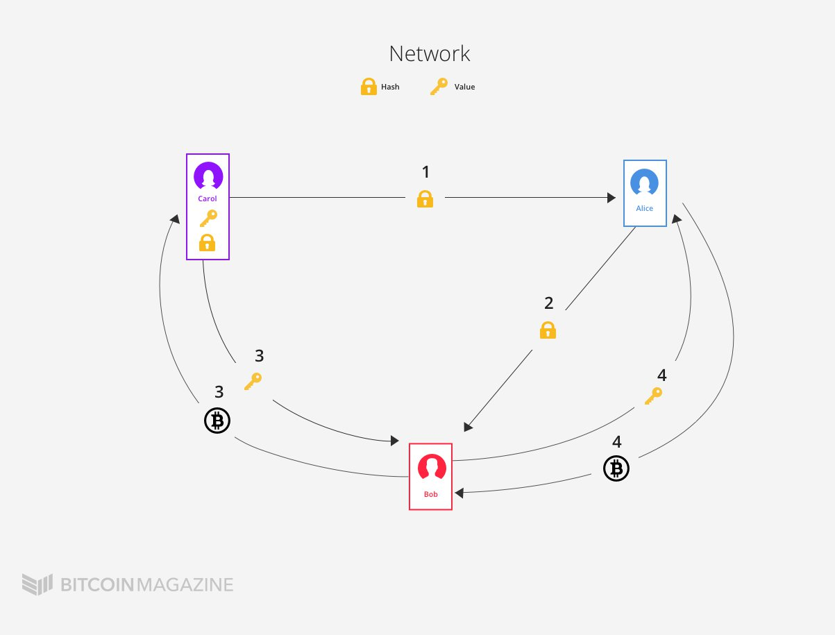

Slide 16
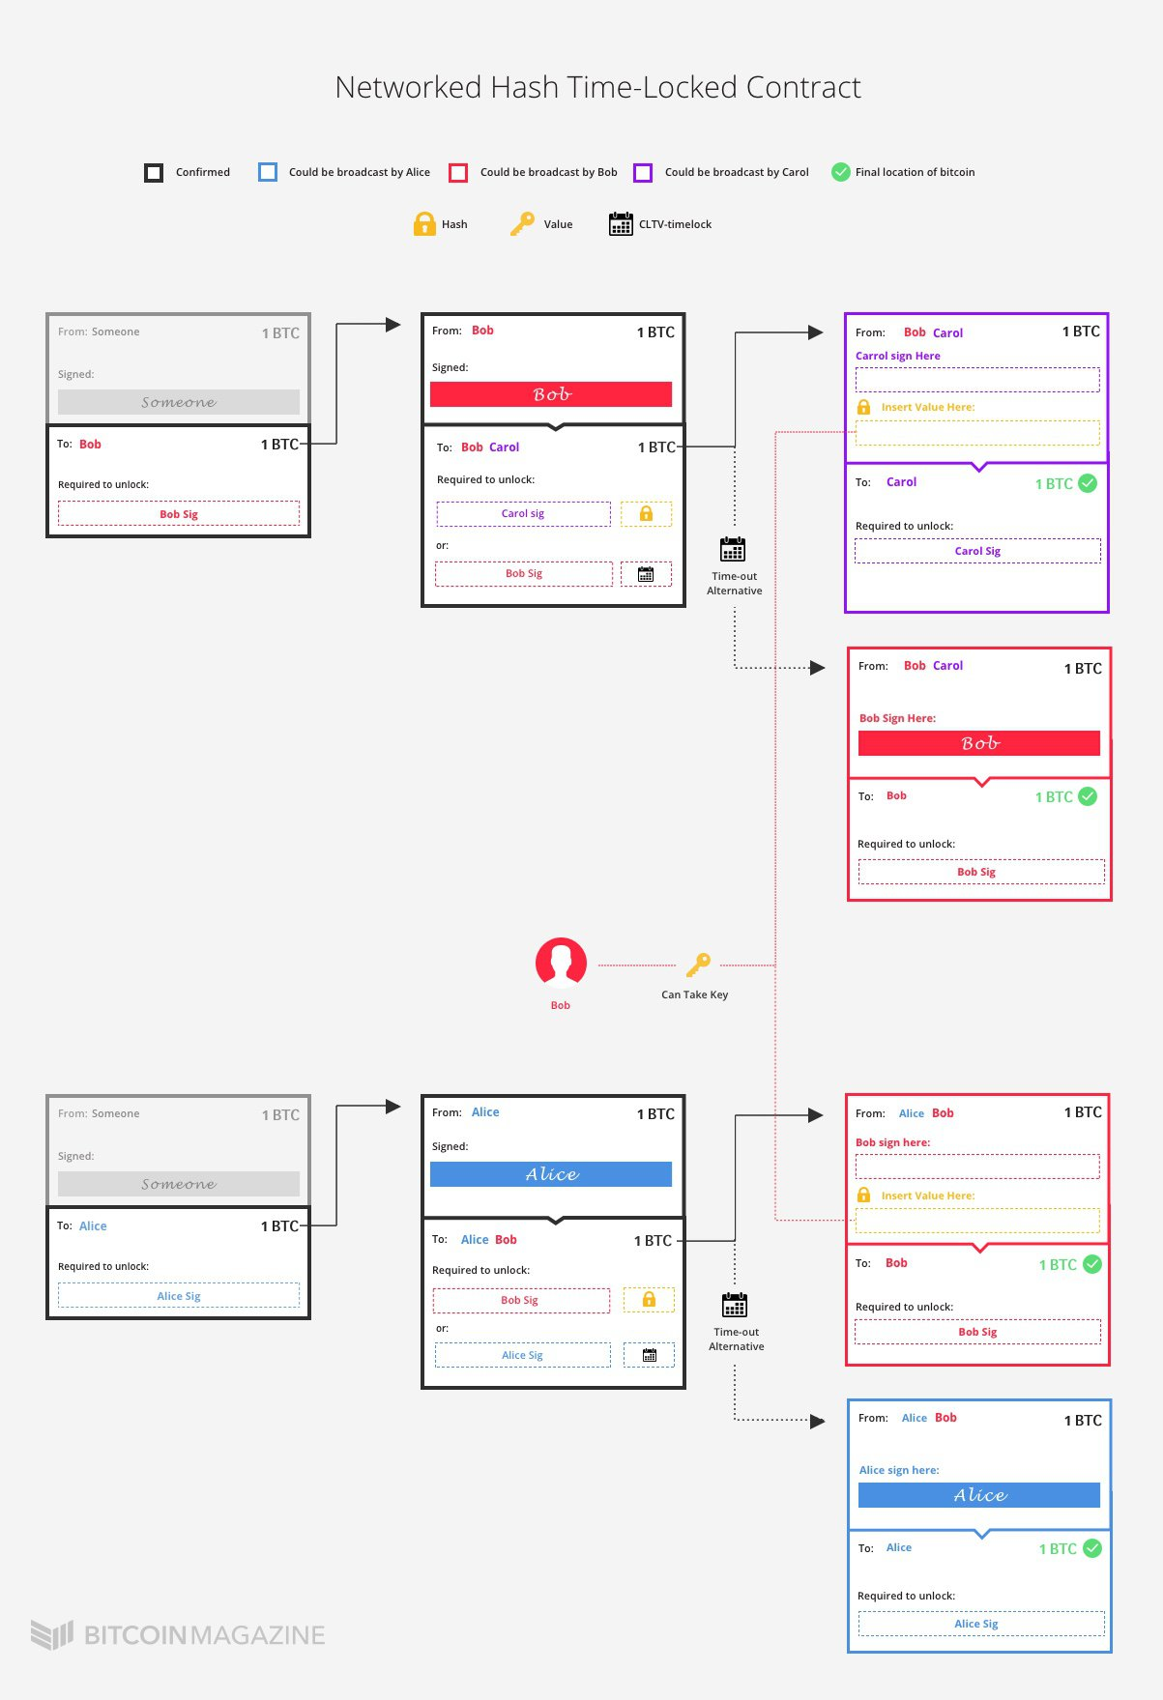

Slide 17



Slide 18
Bob
Alice

Slide 19
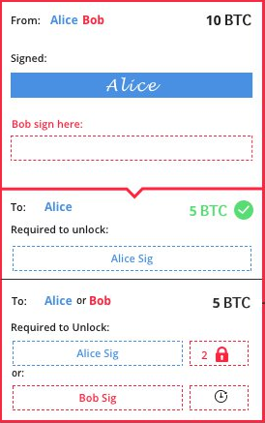
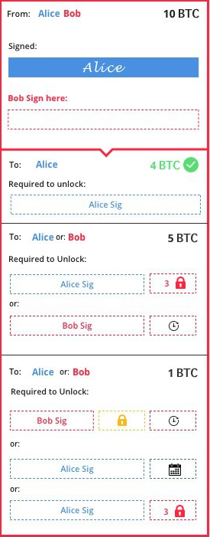

Slide 22
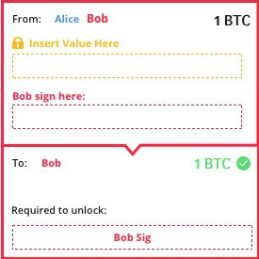
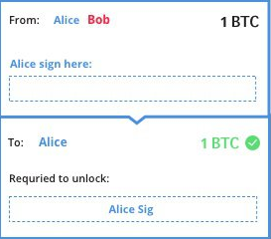


Slide 24

Bob
Alice

Slide 25
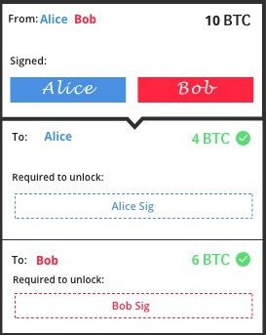
Bob
Alice

Slide 26
References
POON, J., AND DRYJA, T. TheBitcoin Lightning Network: ScalableOff-Chain Instan tPayments.
  https://lightning.network/lightning-network-paper.pdf
Russell R., Reaching The Ground With Lightining
  https://github.com/ElementsProject/lightning/blob/master/doc/deployable-lightning.pdf
Aaron van Wirdum,
  https://bitcoinmagazine.com/articles/understanding-the-lightning-network-part-building-a-bidirectional-payment-channel-1464710791/
  https://bitcoinmagazine.com/articles/understanding-the-lightning-network-part-creating-the-network-1465326903/
  https://bitcoinmagazine.com/articles/understanding-the-lightning-network-part-completing-the-puzzle-and-closing-the-channel-1466178980/
All Image are based on diagrams from https://bitcoinmagazine.com

