Slide 1

World Energy Consumption
Group 5
Nitin Singh Rana (0770080)
Devansh Panchal (0790189)

Slide 2
Calculated fields
Fossil fuel = [Coal Production]+[Gas Production]+[Oil Production]
Non-renewable Energy Cons Change Pct = [Fossil Cons Change Pct]+[Nuclear Cons Change Pct]
Non-renewable energy consumption = [Fossil Fuel Consumption]+[Nuclear Consumption]
Renewable Energy Cons Change Pct = [Wind Cons Change Pct]+[Solar Cons Change Pct]+[Renewables Cons Change Pct]+[Other Renewables Cons Change Pct]+[Hydro Cons Change Pct]+[Biofuel Cons Change Pct]
Renewable energy consumption = [Solar Consumption]+[Wind Consumption]+[Other Renewable Consumption]+[Hydro Consumption]+[Biofuel Consumption]

Slide 3
Analysis Focus:
Developed, Developing & Under-developed countries
100 Years of data
Renewable & Non-renewable energies

Slide 4
World Energy Consumption
Types of Energy
Nuclear
Renewable (Geothermal, Wind, Solar)
Fossil
Wind
Coal
Gas
Biofuels

Slide 5
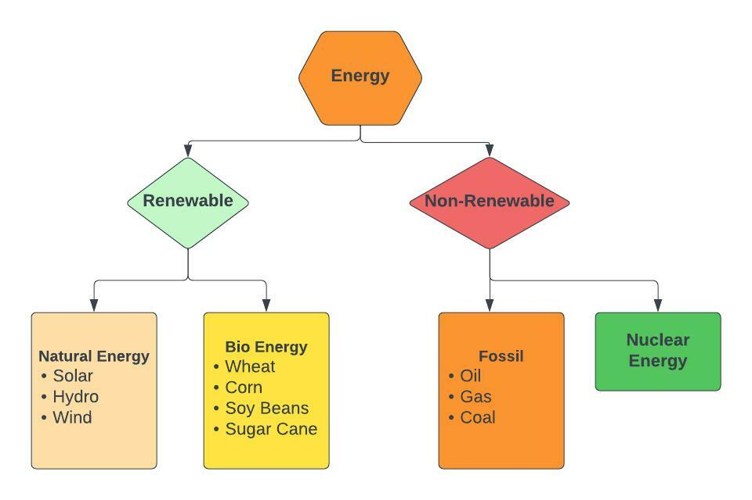

Slide 6
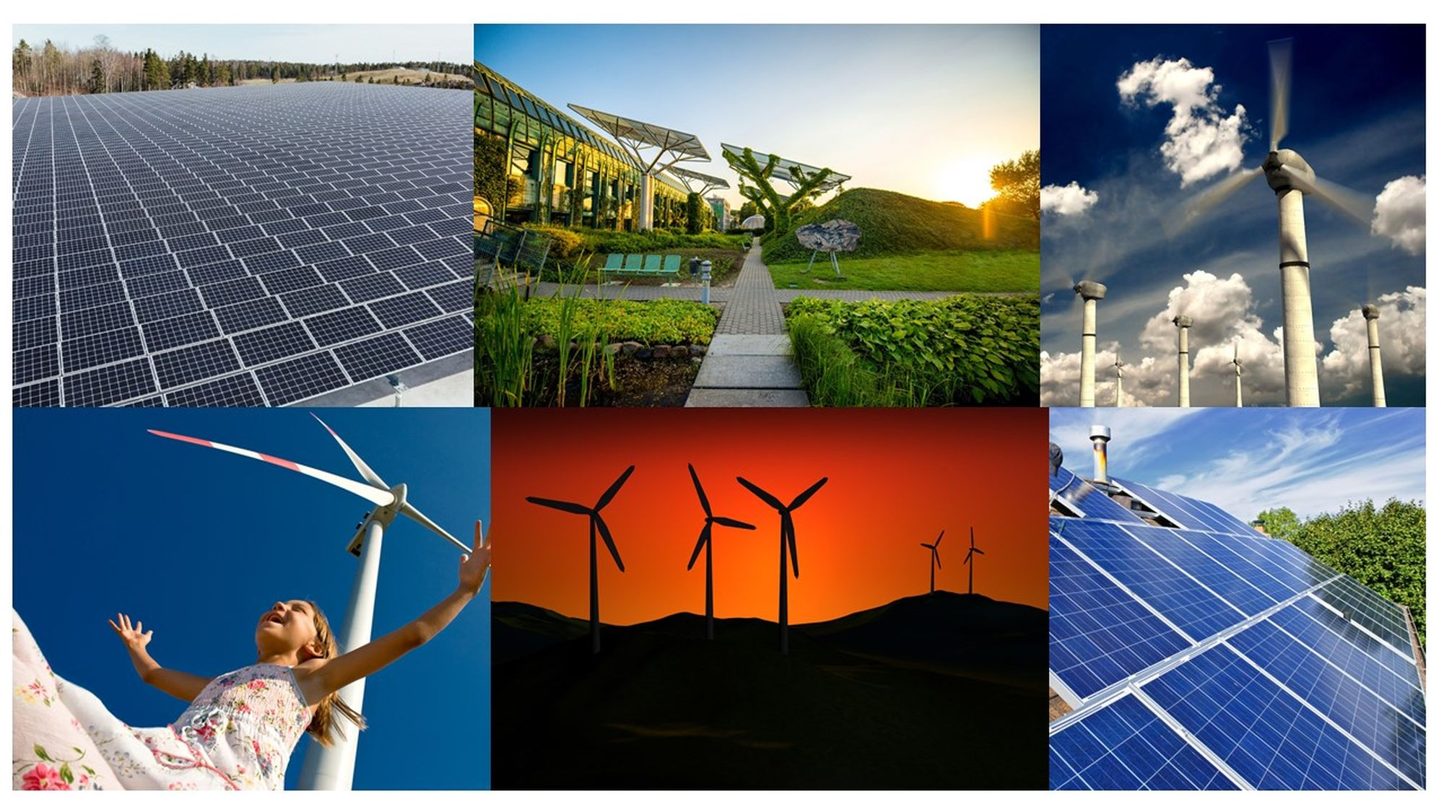

Slide 7
Analysis Questions
Q1) What are the highly used energy resources across the World ?
Q2) Top10 Countries high in Solar Electricity usage ?
Q3) What are the steps and measure being implemented by Top 10 highly populated Countries to cut down carbon their footprint?
Q4) Highest Amount of Electricity Generation Across the World and why ?
Q5) Which is the most used fuel type and what are its consequences on global warming ?
Q6) Which countries are shifting their focus from Fossil Fuel energy to Nuclear Energy and why?
Q7) How is the energy consumption trend across the developed & under-developed countries?
Q8) When Major producers become Major Consumers ?
Q9) Wealthy Countries are the major non-renewable energy consumers ?
Q10) Is renewable energy started taking place over non-renewable energy ?
What are the indicators ?
Q11) What are the indicators ?
Q12) Non-Renewable are at extinction ?

Slide 8
Q1) What are the highly used energy resources across the World ?
Coal electricity is both the largest source of electricity generation and the largest single source of CO2 emissions. Which is the major cause for "ACID RAIN“.
Hydroelectricity is a fast-growing energy source with a global share of more than 6%, while its 10-year average growth rate is 3.3%. Hydroelectricity consumption has been steadily on the rise with Asia Pacific accounting for a major share.
Nuclear electricity consumption has grown over the past couple of years and has recently crossed its 10-year average annual decline of 0.8%.
Renewable electricity often provides energy for electricity generation to a grid, air and water heating / cooling, and stand-alone power systems. About 20% of humans' global energy consumption is renewables, including almost 30% of electricity.

Slide 9
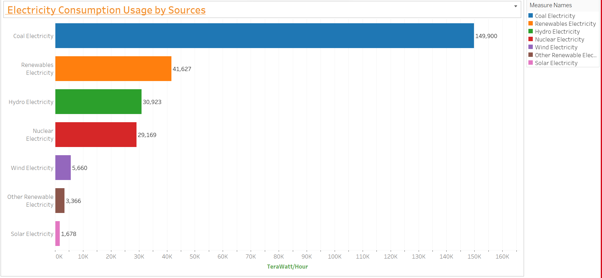

Slide 10
Q2) Top10 Countries high in Solar Electricity usage ?
The burning of fossil fuels has created greenhouse gasses that have contributed to pollution and climate change.
Countries that use solar energy the most are working towards a sustainable future by investing in renewable energy sources.
From smartphones and TVs to streetlights and electric trains, there is no denying that energy runs our lives.
In short, we’re living in an energy-hungry world.
Nowadays, everything in our day-to-day lives revolves around electricity and solar radiation is an abundant and inexhaustible energy source that can be used anywhere in the world

Slide 11
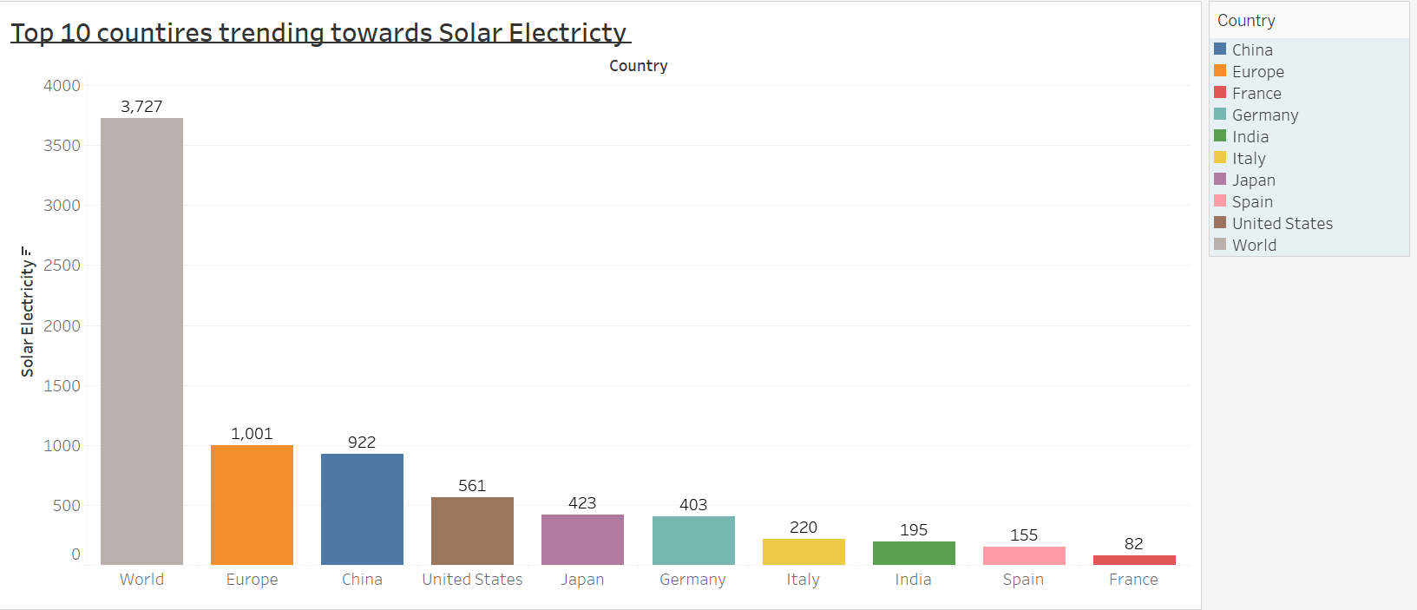

Slide 12


Slide 13
Q3) What are the steps and measure being implemented by Top 10 highly populated Countries to cut down carbon their footprint?
Countries have reduced their carbon footprint in many ways. Methods often employed include generating electricity from renewable energy sources (solar, wind, hydroelectric) instead of fossil fuels.

Slide 14
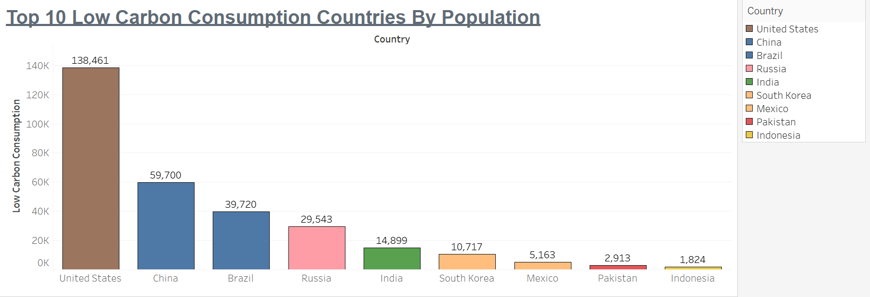

Slide 15
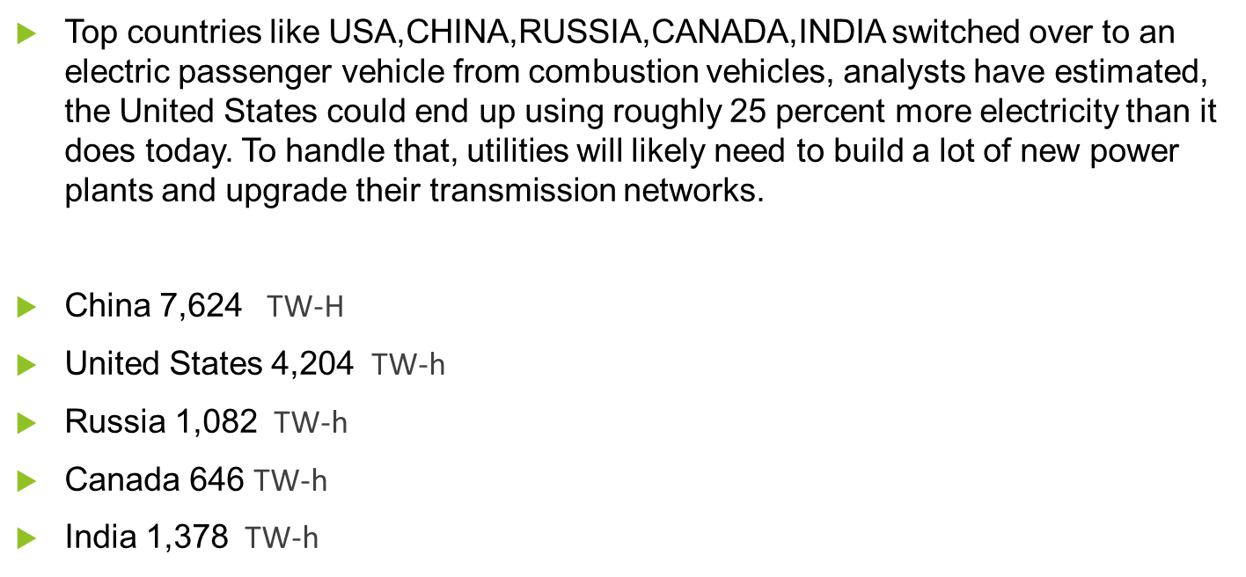
Q4) Highest Amount of Electricity Generation Across the World and why ?

Slide 16
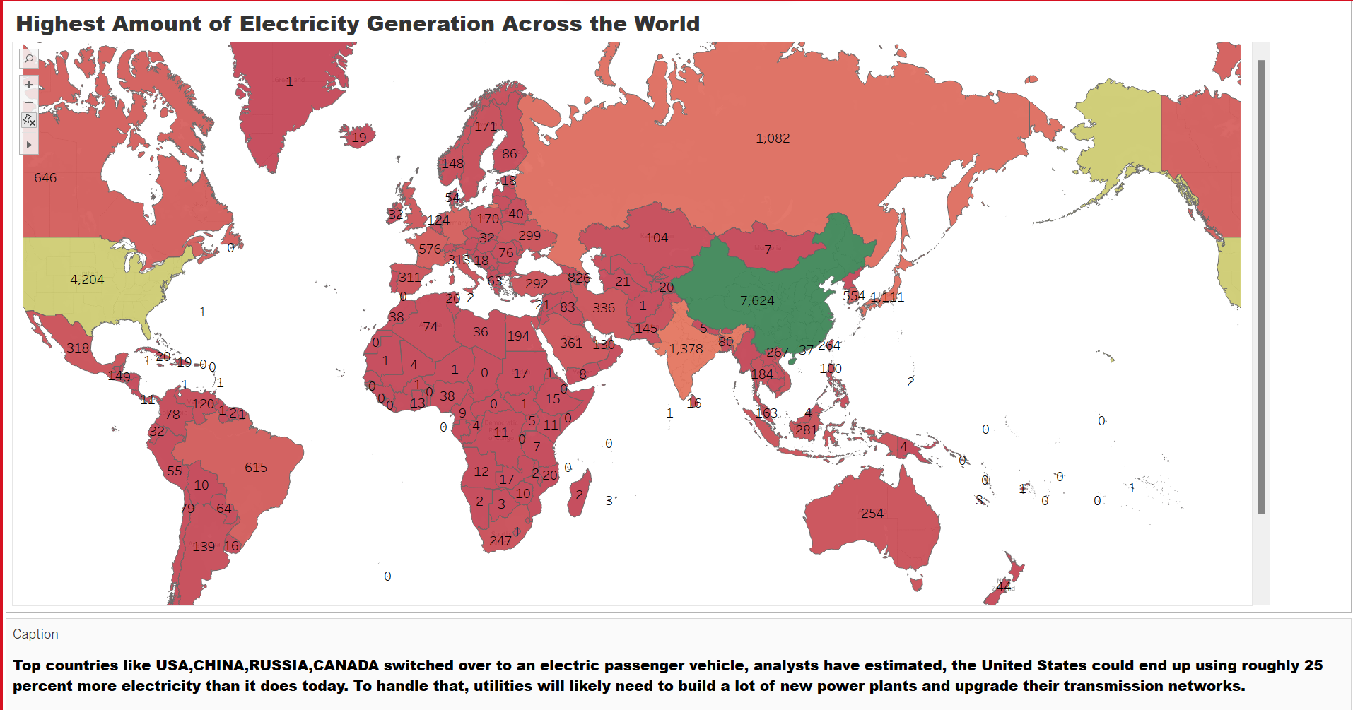

Slide 17
Q5) Which countries are shifting their focus from Fossil Fuel energy to Nuclear Energy and why?
Advantages of nuclear energy over fossil fuels include efficiency, reliability and cost. About 90% of greenhouse gas emissions from electricity generation come from coal-powered plants while nuclear power plants do not emit greenhouse gases. More nuclear plants are scheduled for future construction.
United States – 2,255 (TW-H)
France – 1,215 TW-H
Japan – 905 TW-H
China – 863 TW-H
Russia – 517 TW-H
Canada – 297 TW-H
India – 112 TW-H

Slide 18
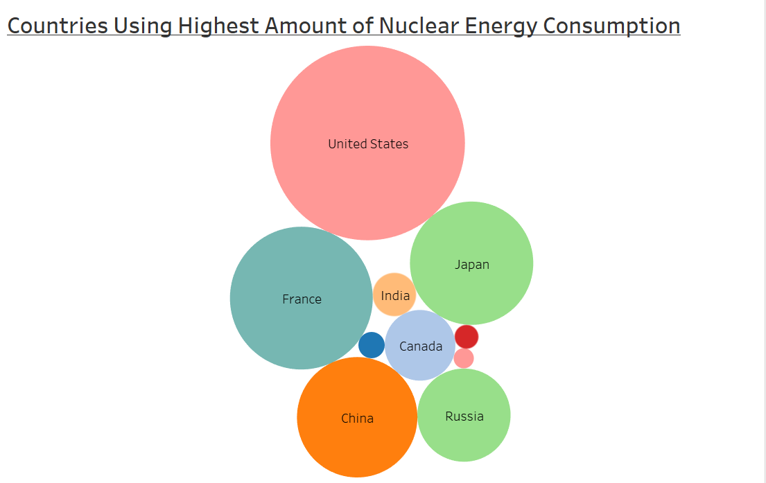

Slide 19
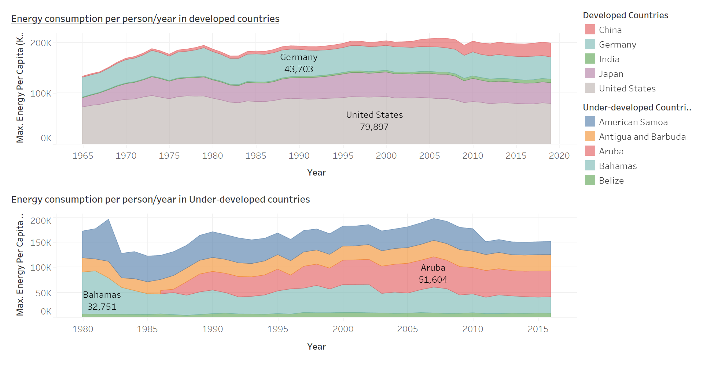
How is the energy consumption trend across the developed & under-developed countries?
Developed countries seem increased use of energy per-person
Under-developed countries maintained usage per-person

Slide 20
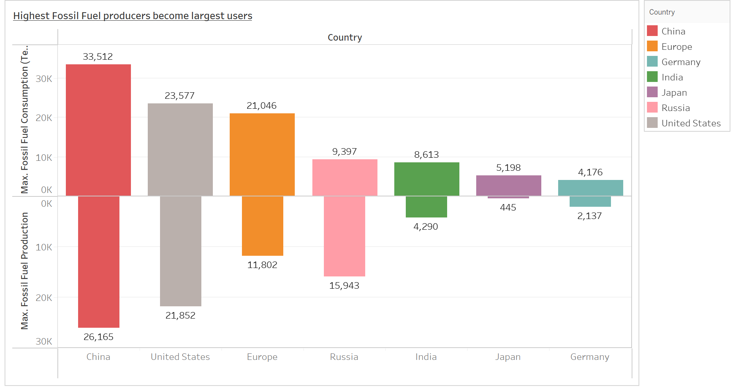
When Major producers become Major Consumers.
China, US, EU, Russia, IND, Japan & Germany are the major producers & the users of fossil fuels.
Highest population belongs to these countries
Higher population leads to more vehicles
& More homes with more appliances
Higher amount of different industries.

Slide 21
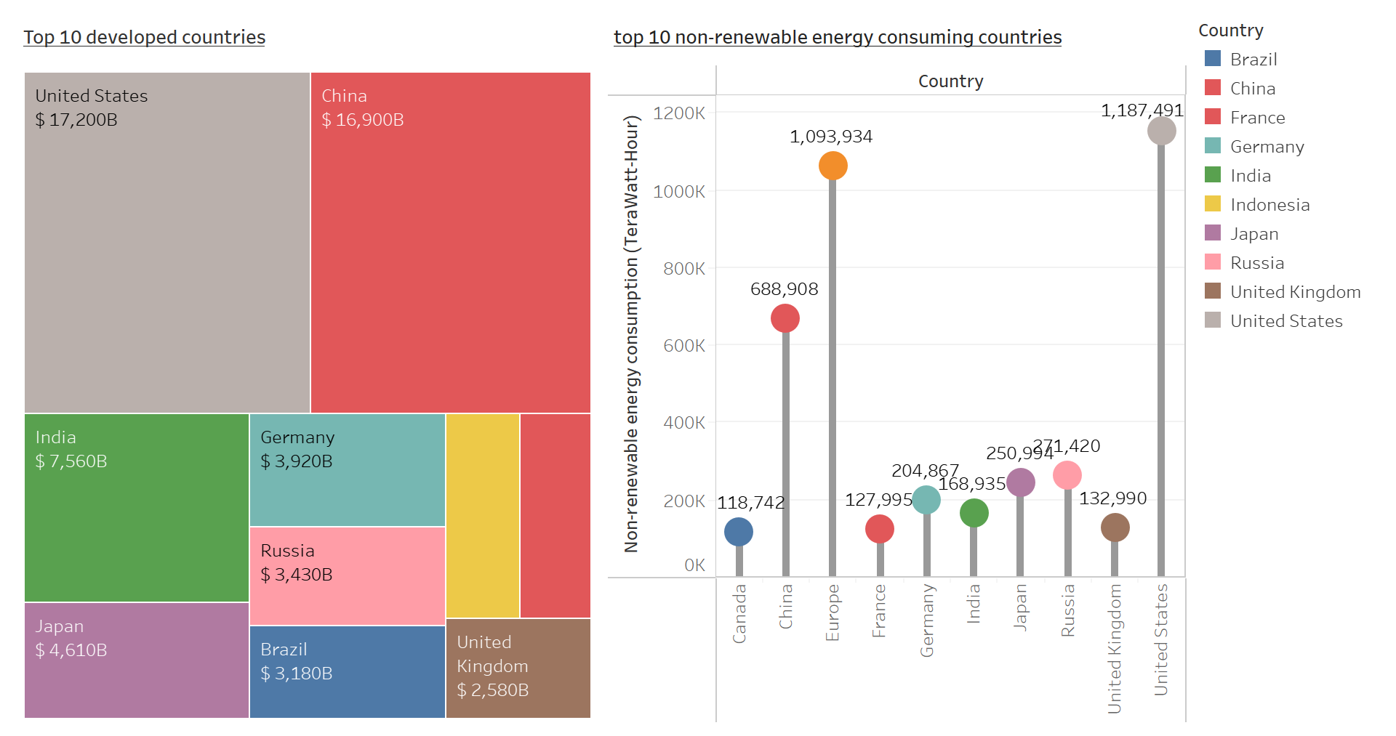
Wealthy Countries are the major non-renewable energy consumers.
China, US, EU, Russia, IND, Japan & Germany are the major producers & the users of fossil fuels.
Highest population belongs to these countries
Higher population leads to more vehicles
& More homes with more appliances
Higher amount of different industries.

Slide 22
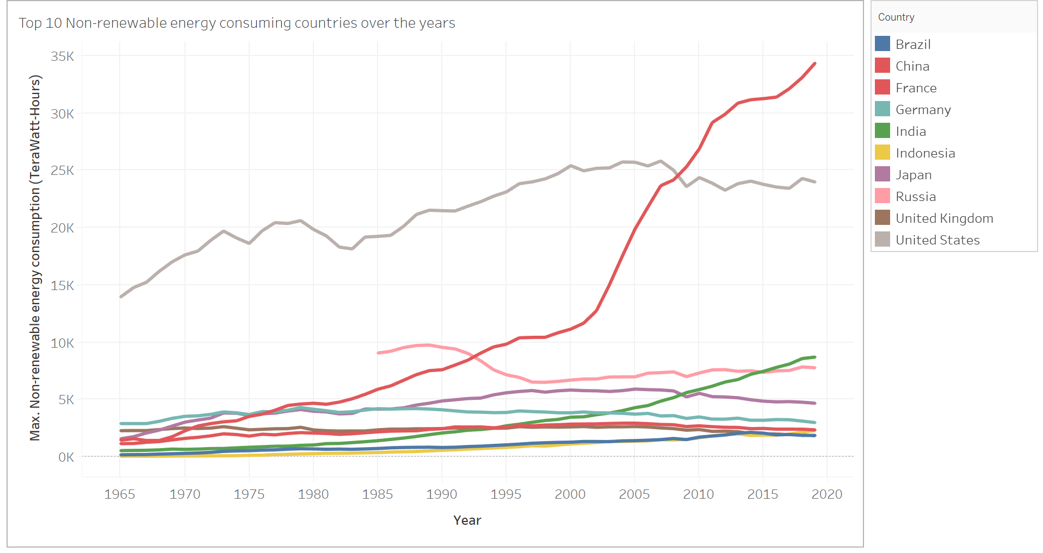
Is really renewable energy started taking place over non-renewable energy ?
What are the indicators?
YES
Developed countries already started decreasing their usage
INDIA & CHINA still uses at higher amount as being developing economies
highest in population
Industries are still in developing stage
Higher amount of vehicles, etc.

Slide 23
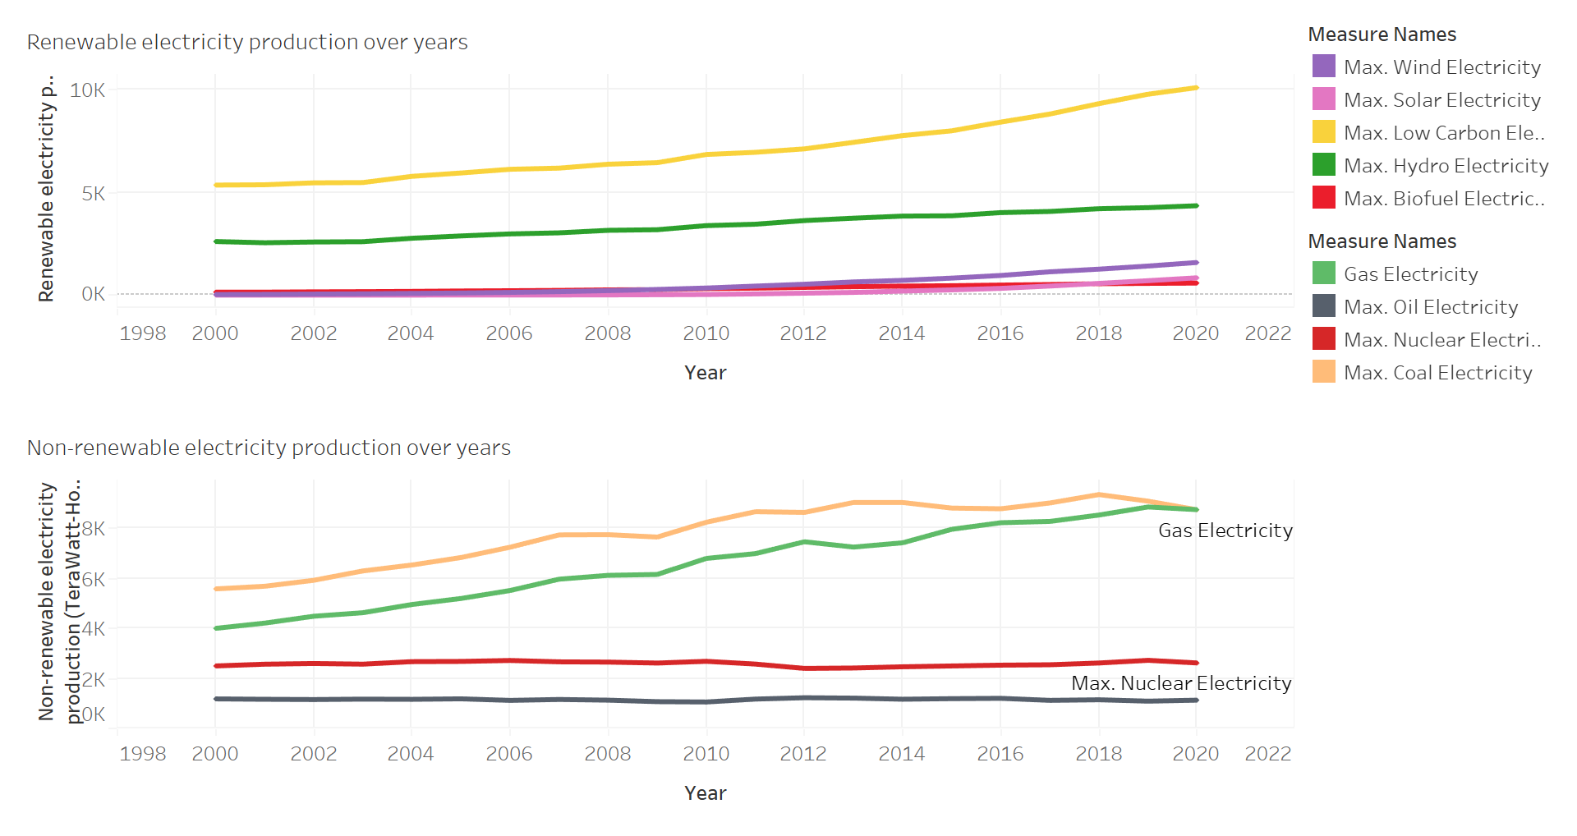
What are the indicators?
Firstly, Majority countries started adopting low-carbonate energy sources for electricity production.
Secondly, natural energy sources showing increasing trend.
Although, Gas & Coal tend to be increased few years back due to higher coal & gas production and high supply at cheaper rate
But after covid pandemic it stated decreasing.

Slide 24
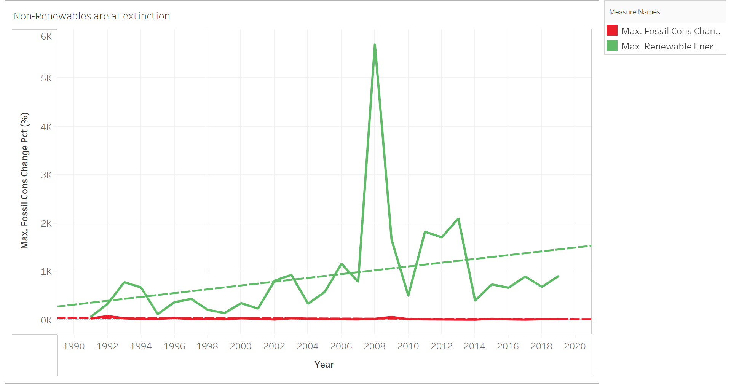
Non-Renewable are at extinction ?
This graph clearly proves that non-renewable energy are on the verge of extinct.
Moreover, this proves that developed countries started moving towards green energy and started reducing usage of fossil fuels.
Major reduction in usage of fossil due to lower raw-materials left in the earth’s core as well.

Slide 25
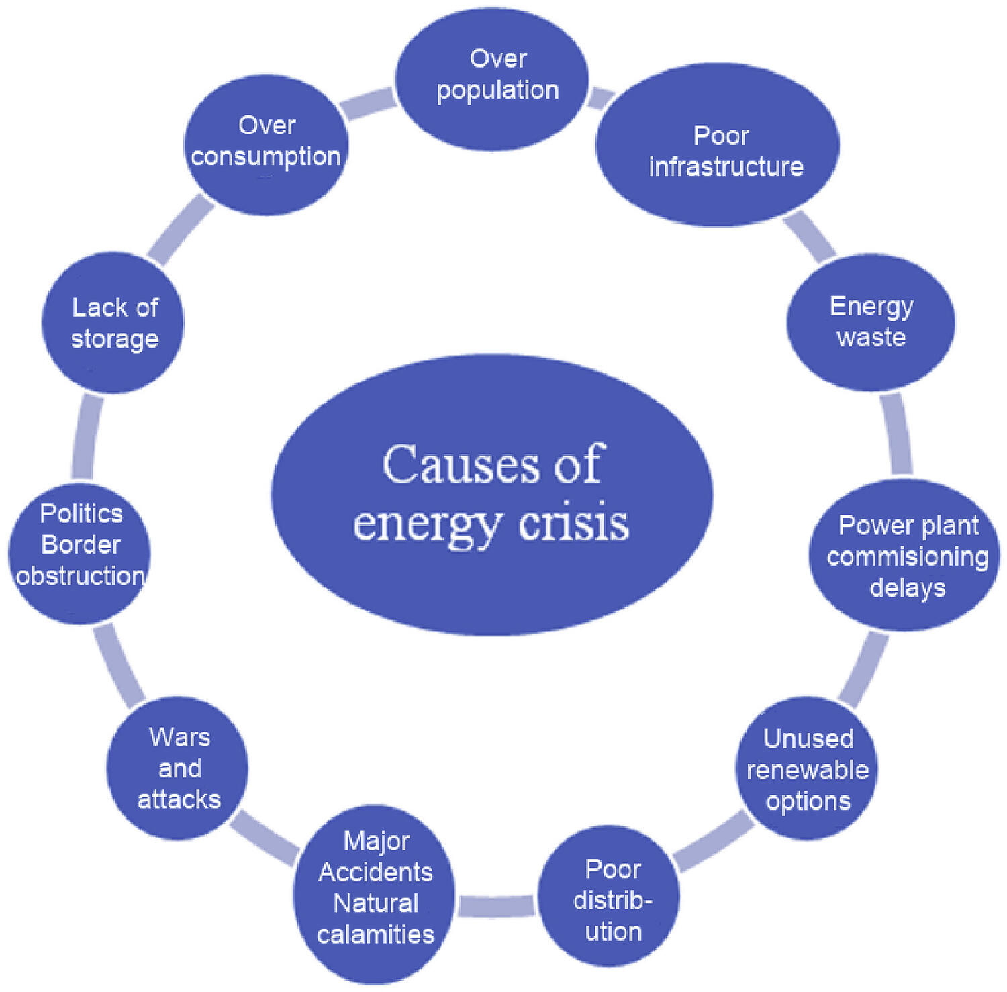
Causes of Energy Crisis
Overconsumption. The energy crisis is a result of many different strains on our natural resources, not just one.
Overpopulation. Another cause of the crisis has been a steady increase in the world’s population and its demands for...
Poor Infrastructure. Aging infrastructure of power generating equipment is yet another reason for energy shortage.
Unexplored Renewable Energy

Slide 26
Key Insights
The gradual decrease of fossil fuel availability from the earth core has spiked up the cost of Oil & Gas across the globe.
When the demand and supply of Fossil Fuel increases year by year it has alerted the countries across the world to shift their gear from Fossil Fuel Supply to Green Energy by adopting various strategies and innovations in utilizing the naturally available energy resources such as Wind, Solar, Hydro.
Shifting from Energies which are creating a spike in the Global Environmental crisis to Eco-Friendly Energy can bring down the Judgement Day which is the melting of glaciers.

