Slide 1
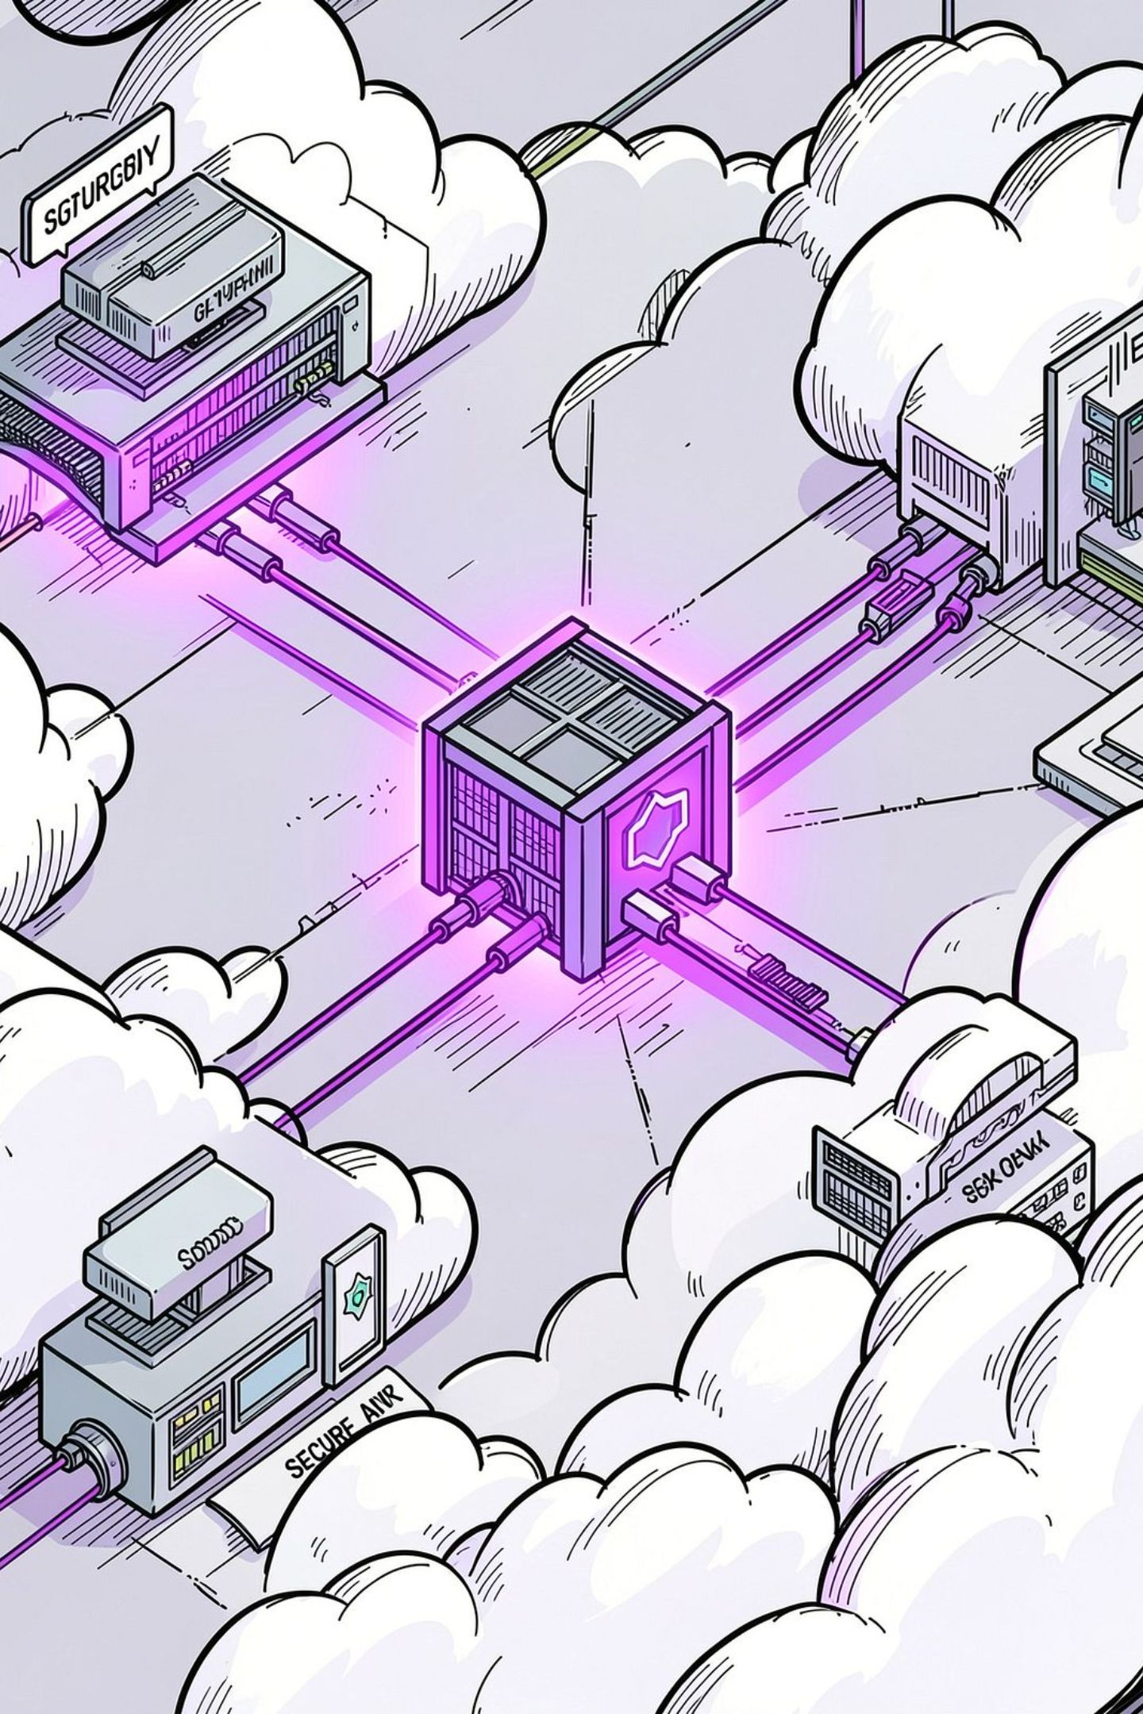
Azure Bastion Deployment — Remove Public RDP Access
Project ID: 24CC3046-P014 · Domain: Cloud Security
Team:
2400032774 - ALLA VENKATA SAI NIKHIL ·
2400032788 - GANTA RISHITHA CHOWDARY ·
2400032799 - YAKKALI SREEVALLI ·
2400032801 - NITIN KUMAR

Slide 2
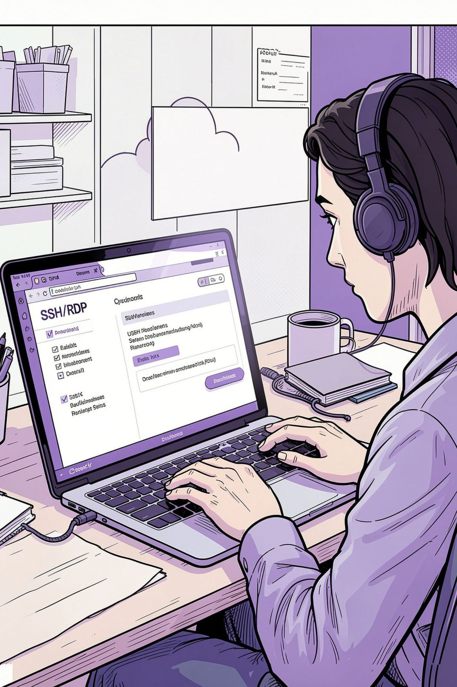
Introduction — Why Azure Bastion?
Managed service for secure remote administration of Azure VMs without exposing public management IPs.
Provides browser-based RDP and SSH over HTTPS via the Azure Portal (HTML5), removing the need for public RDP/SSH ports.
Allows VMs to keep private IPs inside the VNet, reducing attack surface and network exposure.
Streamlines operations while enforcing centralized access controls and logging.

Slide 3




Problem Statement — Risks of Public RDP/SSH
Active Internet Scanning
Public IPs and open ports are constantly discovered by automated scanners and opportunistic attackers.
Expanded Attack Surface
Exposed RDP/SSH ports (3389/22) increase the probability of brute-force and credential-stuffing attacks.
Vulnerable Entry Points
Unpatched services, weak credentials, or zero-day exploits enable unauthorized access and lateral movement.

Slide 4
Project Objectives
01
02
03
Restrict RDP/SSH
Harden SSH Exposure
Secure Access Mechanism
Remove direct public RDP/SSH access; enforce private-only management paths.
Limit SSH to approved jump hosts or Bastion; remove broad public rules.
Use Azure Bastion for browser-based sessions and centralized control.
04
05
Private Network Posture
Improve Security Posture
Keep VMs in private subnets; require bastion or VPN for admin access.
Reduce attack surface, increase monitoring, and enforce least-privilege access.

Slide 5
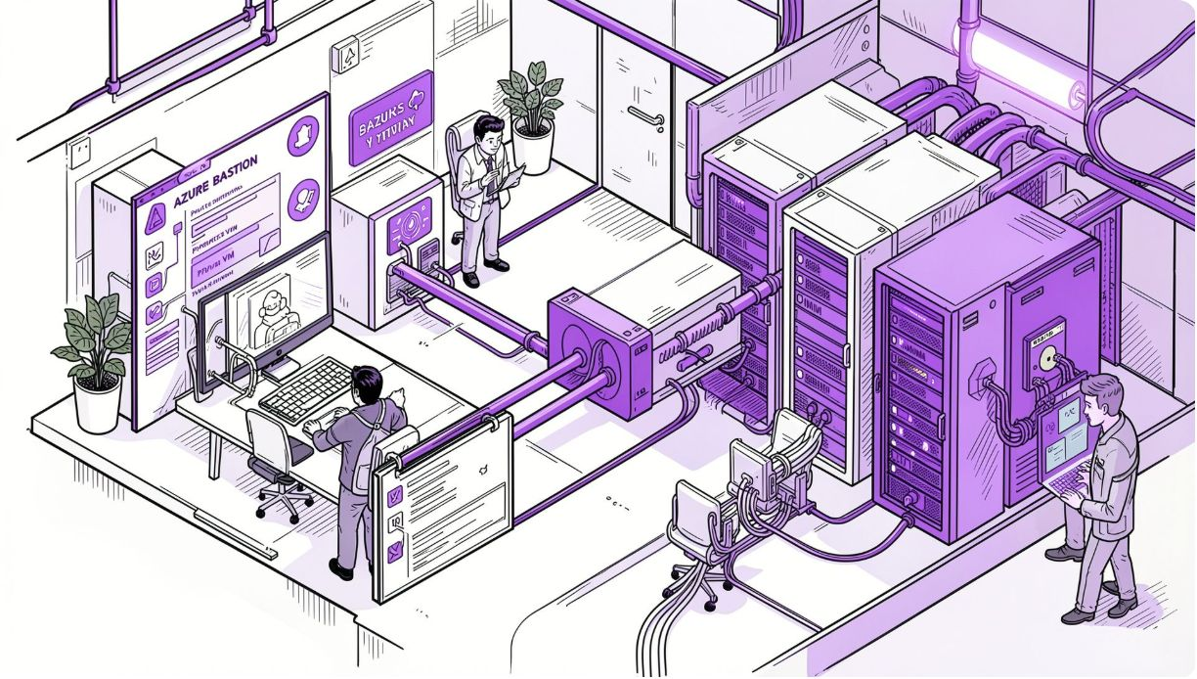



Proposed Solution — Azure Bastion as Secure Entry
Azure Bastion is deployed into a dedicated AzureBastionSubnet inside the VNet and acts as a hardened gateway. Administrators initiate RDP/SSH sessions from the Azure Portal over HTTPS — no public VM IP required.
Administrator
Azure Bastion
Private VM
Starts a secure session from any network using Portal authentication and MFA.
Brokered RDP/SSH sessions over TLS with host isolation and integrated NSG controls.
Retains private IP; management traffic flows only through the Bastion subnet.

Slide 6
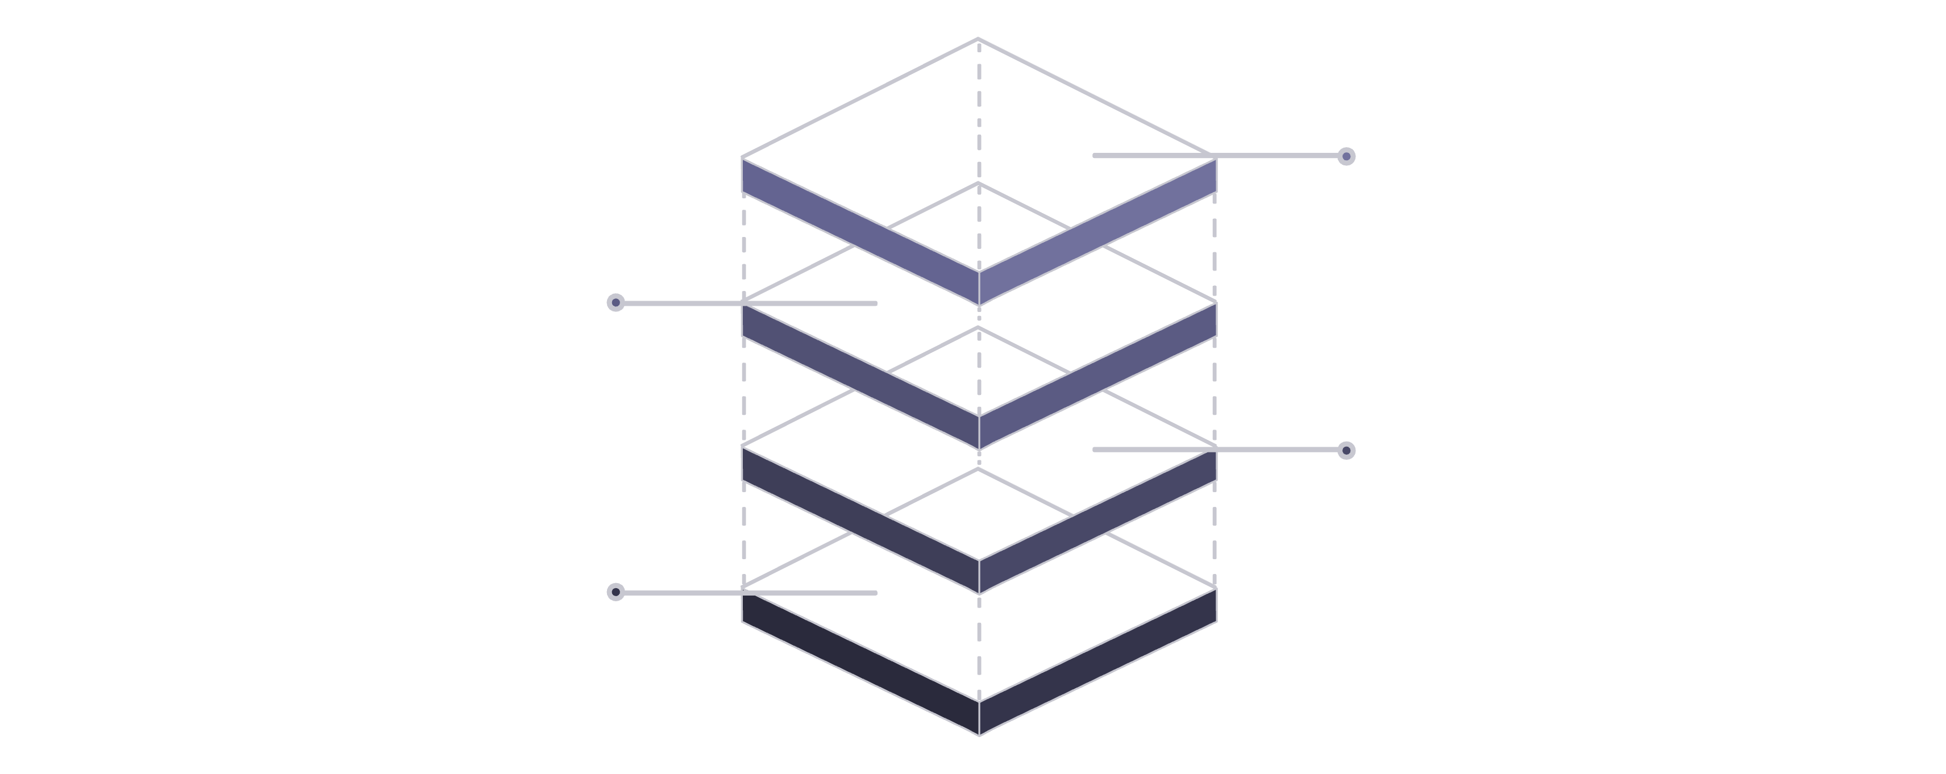
System Architecture — High Level
Private VM
No public RDP/SSH on NICs
Network Security Group
Controls inbound management to Bastion
Azure Bastion
Hosted in AzureBastionSubnet
Administrator Portal
Initiates HTTPS tunnel to Bastion
Caption: Bastion sits in a dedicated subnet (AzureBastionSubnet). NSGs restrict inbound management only to Bastion. No public RDP/SSH rules on VM NICs.

Slide 7
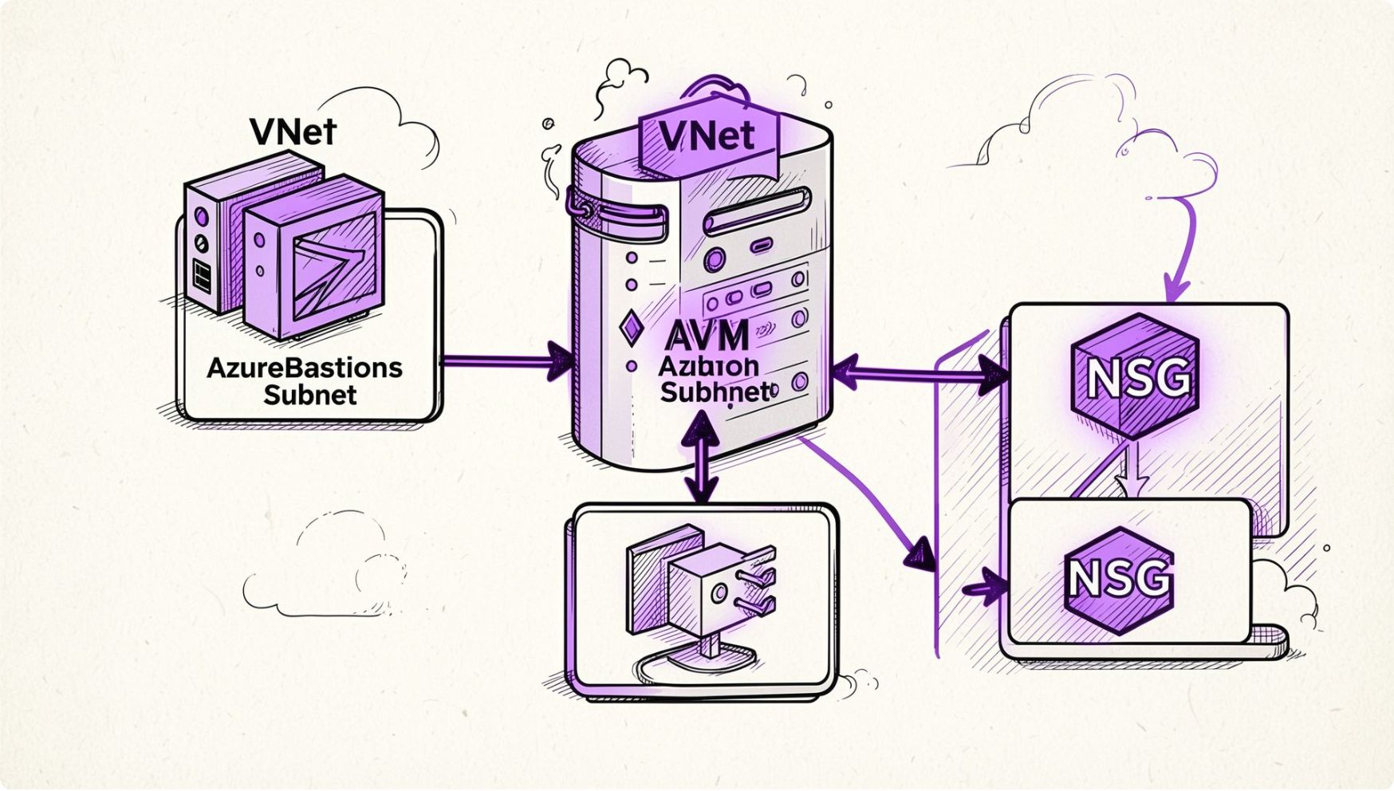
Network Configuration — Key Details
VNet address space: Example 10.0.0.0/16 — plan subnets to avoid overlap.
AzureBastionSubnet: Required dedicated subnet named exactly "AzureBastionSubnet" (example 10.0.2.0/24).
VM Subnet: Example 10.0.1.0/24 — VMs use private IPs only.
NSG rules: Block inbound RDP/SSH from Internet; allow Bastion-managed traffic and admin jump sources as needed.
No overlapping ranges: Avoid address conflicts across VNets and on-prem networks used by VPN/ExpressRoute.

Slide 8



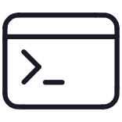

Technologies & Azure Services
Microsoft Azure
Azure Virtual Network
Network Security Group (NSG)
Cloud platform hosting VNet, VMs, and Bastion.
Private network containing subnets for VMs and Bastion.
Enforces inbound/outbound rules—block Internet RDP/SSH.
RDP / SSH
Azure Portal
Protocol sessions brokered by Bastion over TLS—no public exposure.
Browser-based entry point; integrate with Azure AD and MFA for strong auth.

Slide 9
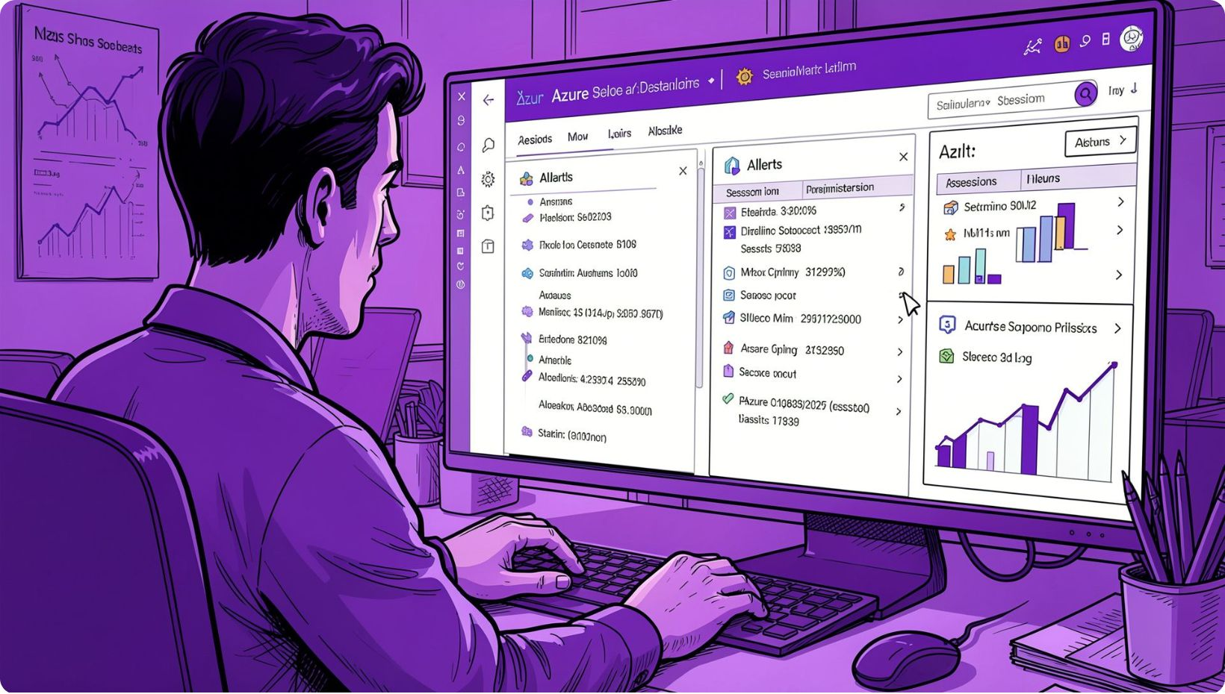
VM Configuration & Operational Controls
Place VMs in private subnet; remove public IP assignment from NIC.
Ensure NSG denies Internet inbound on ports 22 and 3389; allow Bastion subnet as needed.
Enforce Azure AD sign-in + MFA for Portal access; use role-based access control for Bastion usage.
Enable Azure Monitor / NSG flow logs and Log Analytics for session audit and alerting.

Slide 10

Deployment Workflow — Hackathon Ready Steps
Create Resource Group and VNet with planned address space.
Create VM Subnet and deploy target VM(s) with private IPs only.
Create AzureBastionSubnet (exact name) with recommended /26 or larger range.
Deploy Azure Bastion resource into the AzureBastionSubnet.
Apply NSG rules: block public RDP/SSH; allow Portal/Bastion-managed traffic.
Test: Azure Portal → VM → Connect → Bastion → Authenticate → Confirm desktop/session.
Operationalize: Enable logging, restrict RBAC for Bastion, enforce MFA, document rollback and emergency access procedures.

