Slide 1
Mask Wear Detector with Computer Vision

Slide 2
Objective:
This project underscores the potential of computer vision to directly impact and safeguard the well-being of communities, marking a significant stride towards a safer and healthier society.
Benefits:
Promoting Public Health and Safety : Reducing Virus Transmission, Protecting Vulnerable Populations .
Compliance Enforcement : Facilitating Law Enforcement.
Workplace Safety :Employee Protection .
Efficiency and Automation, Analytics and Reporting, Legal and Liability Protection , Maintaining Customer Confidence .

Slide 3
Data Sharing Agreement :
Images
Videos

Slide 4
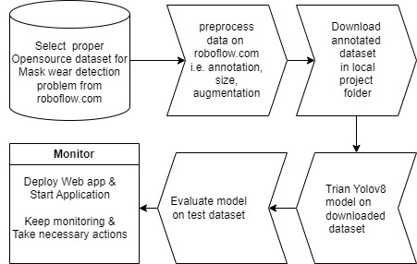
Architecture

Slide 5
Data Collection and Data Preprocessing:
Collection of opensource dataset form roboflow.com.
We will use opensource mask wear dataset for project.
We will make sure images are properly annotated and split into train , test , valid sets.
We will make sure we have enough images , else we will apply data augmentation techniques.
We will resize images to size 640x640.

Slide 6
Model Training:
Opensource Data Import From Roboflow.com :
The accumulated data form roboflow.com
Data Preprocessing
We perform image preprocessing, such as size , annotation , augmentation.
We will train yolov8 model from ultralytics.
We will evaluate trained model on test dataset.
After that we will deploy model for live prediction.

Slide 7
Prediction:
We have create web application to take input from user, for prediction.
We use current model in production for prediction purpose.
Once valid input is given, prediction will be displayed on the web page.

Slide 8
Q & A:
Q1) What’s the source of data?
The data for training is opensource data.
Q 2) What was the type of data?
The data consist of all images.
Q 3) What’s the complete flow you followed in this Project?
Refer slide 4th for better Understanding

Slide 9
Q 5) How logs are managed?
We are using different logs as per the steps that we follow in validation and
modeling like data ingestion, data validation ,data transformation , model trainer ,
model evaluation , model pusher , pipeline, etc.
Q 6) What techniques were you using for data pre-processing?
Removing unwanted attributes
Checking data drift
Checking and changing Distribution of continuous values
Cleaning data and imputing if null values are present.
Scaling the data

Slide 10
Q 7) How training was done or what models were used?
Data is divided into training and testing set , using stratify method.
The scaling was performed over training and validation data.
Algorithms like LogisticRegression, Decision Tree , RandomForestClassifier , SVC were used based on the F1 score final model was used for prediction and we saved that model .
Q 8) How Prediction was done?
Web application created for user , to input data. Data collected will go through , preprocessed object.
After data is preprocessed, trained model will generate prediction for that particular record.
Prediction will be shown on the same web app.

