Slide 1
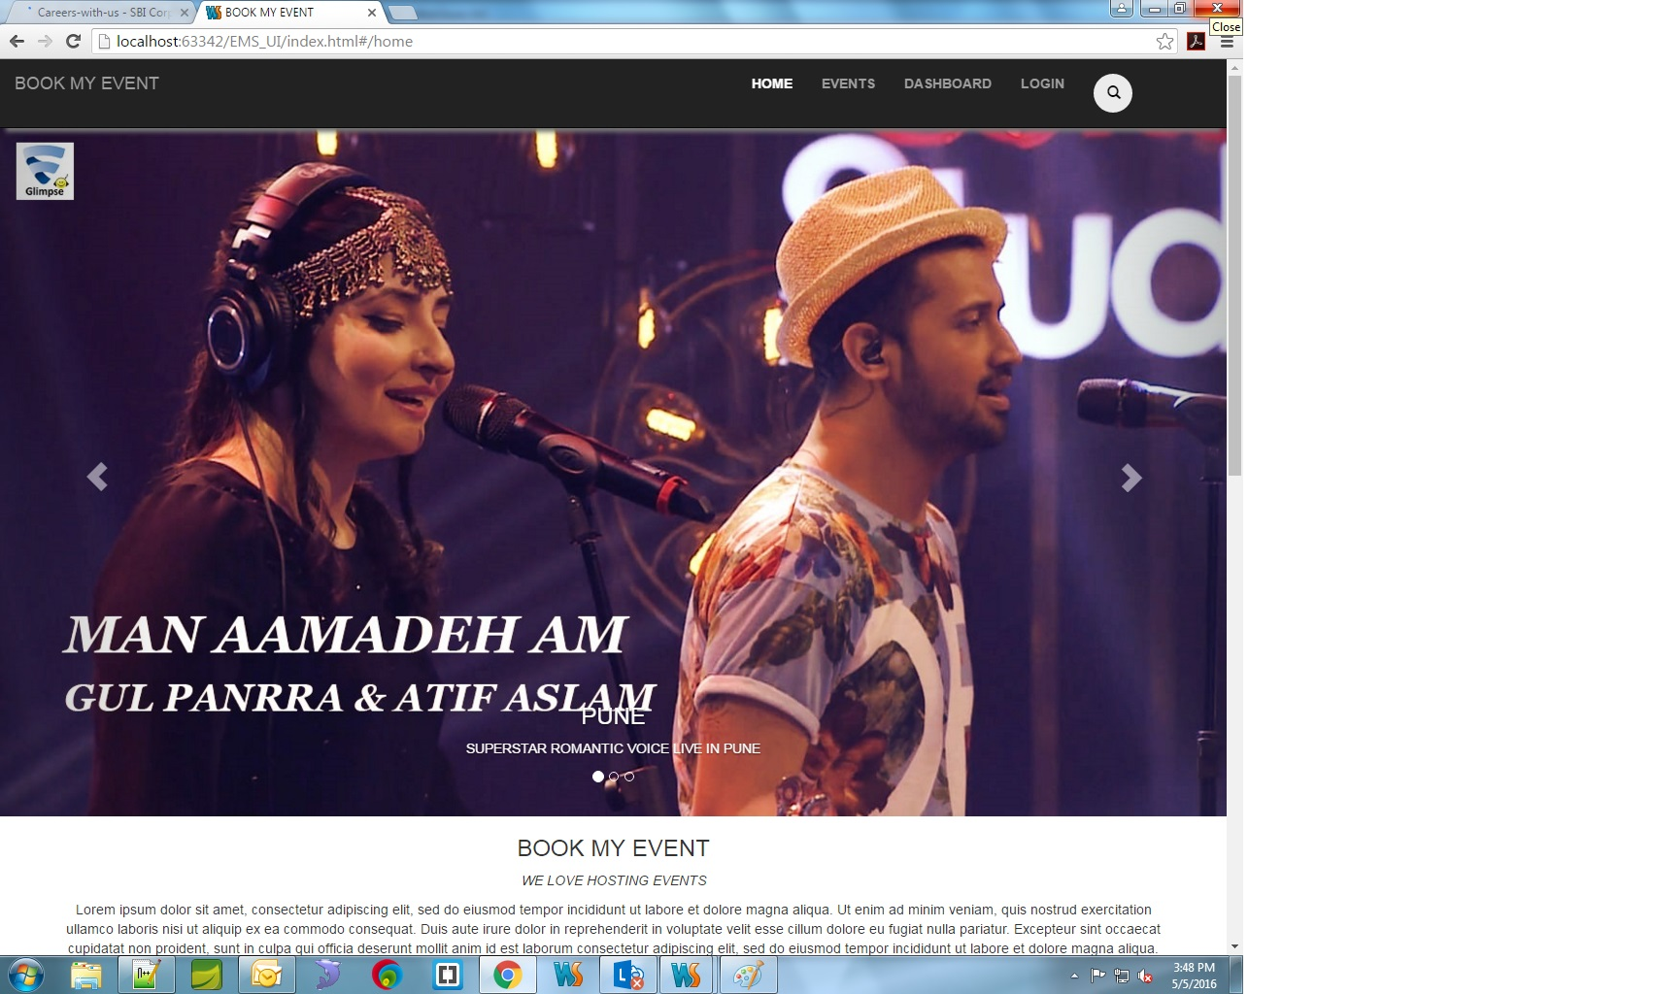
Final Project
ADM JAVA Interns batch
Objectives-
Provides online service for booking tickets for various types of events.

Slide 2
Project Kick off
4/29/2016
Integrated, Testing
User Story
Mentor Review
Database Entry
Evaluation
4/30/2016
5/2/2016
5/4/2016
5/7/2016
5/9/2016
Successful Deployment
5/8/2016
Day 1
2
3
4
5
6
7
8
9
10
11
Today
• Project Briefing
• Module distribution
4/29/2016
4/29/2016
• User-story
• Architecture Design
2016
2016
4/30/2016
4/30/2016
• Module Wise Presentation
• Metor ReviewDB model
•page layout
•HTML
•architecture
•package structure
1 day
0 days
5/2/2016
5/2/2016
5/3/2016
•Indivisual Work
5/7/2016
1 day
• Complete Module finalisation
•Testing
•UI Design
5/7/2016
5/7/2016
• Database Entry
• Deployment UAT
•Final Meeting
• Evalutaion Preparation
4 days
0 days
5/9/2016
5/9/2016
1 day

Slide 3
Technologies
Technology | Software | Version | Remarks
Database | My SQL
BACK END
Development Language | JDK | 1.7
Database connection | ORM Hibernarte | 3.2.3.ga
 | SPRING | 3.1.0
SERVER | TOMCAT | 7.0
Aspect Orientation | AspectJ | 1.5.4
FRONT END
 | ANGULAR js
 | BOOTSTRAP
 | HTML | 5
 | CSS | 3
REPOSITRY
 | SVN

Slide 4
Module | Description | Status
Sign up and login | First time user can create account | Completed
Event Module | CRUD operation on EVENT | Completed delivering JSON Object
Search Module | Search Event Details
USER Dashboard | User history and services | Completed delivering JSON Object
ADMIN | Approval and rejection of Events, Record keeping | Completed delivering JSON Object
BOOKING & Cancellation | Book Events , cancel events . | Completed delivering JSON Object
Aspect oriented Programming | Logging user creation and login events. | Completed Logging in DATABASE
BANK Module | Payment Gateway, Transactions | Completed delivering JSON Object
Rating | Like , Dislike | JSON
Comments | User Comments on events | JSON
Help Desk | FAQ , Feedback, Contact Us | JSON
FRONT End | UI Design, Angular JS

