Slide 1




Project Presentation on RECESSION PREDICTION of USA Group No. 27
Group Members
Abhishek Vats - 233503
Harshal Koli – 233519
Sagar Khond 233543

Slide 2
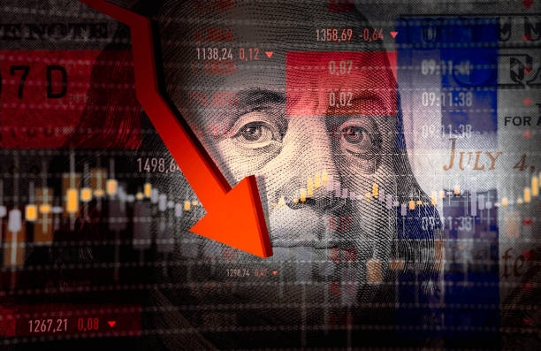

RECESSION

Slide 3
OBJECTIVES
The main objective of this project is to extract patterns from the dataset and use the trained models to predict Recession or No Recession based on the user input.
In this project we have developed four different Machine Learning models.
Best performed model will be used for prediction.

Slide 4

DATASET
We have collected dataset from Federal Reserve Economic Data (FRED). It is a database maintained by the Research division of the Federal Reserve Bank of US.
Dataset contains 75 years of economic data (1947-2022).
The final data set is formed by merging 10 different data sets of key economic indicators.

Slide 5
KEY ECONOMIC INDICATORS
Debt To GDP Ratio : A Debt-to-GDP ratio is an indicator on how much a debt a country owes and how much it produces to pay off its debts.
2. Consumer Confidence Index : It provides an indication of future developments of households consumption and saving, based on their expected financial situation, unemployment and capability of savings.
3. Federal Funds : Fed funds are excess reserves that commercial banks and other financial institutions deposit at regional Federal Reserve banks; these funds can be lent to other market participants like businesses and people.
4. Housing Price : Housing prices include housing rent prices, real and nominal house prices, and ratios of price to rent and price to income.
5. Infliation CPI : It is defined as the change in the prices of a basket of goods and services that are typically purchased by specific groups of households.

Slide 6
6. M2 velocity : The velocity of money is the frequency at which one unit of currency is used to purchase domestically- produced goods and services within a given time period.
7. Manufacturing Output : It is the result of an economic process that has used inputs to produce a product or service that is available for sale or use somewhere else within a year.
8. Market cap to GDP ratio : The stock market cap-to-GDP ratio is used to determine whether an overall market is undervalued or overvalued compared to a historical average.
9. Treasury Yield Curve : This curve refers to a line chart that depicts the yields of short-term Treasury bills compared to the yields of long-term Treasury notes and bonds.
10. Unemployment Rate : The unemployed are people of working age who are without work, are available for work

Slide 7

DATA CLEANING
The date column in each individual dataframe is split to get month and year columns separately.
The whole is converted into a single format, with each month per year.
For quarterly datasets, this was achieved by using the quarterly value for every month of that quarter.
Since most of the values before 1987 are NaN values, so we decided to drop those values.
We filled the missing values after 1987 with the mean of that particular column.

Slide 8
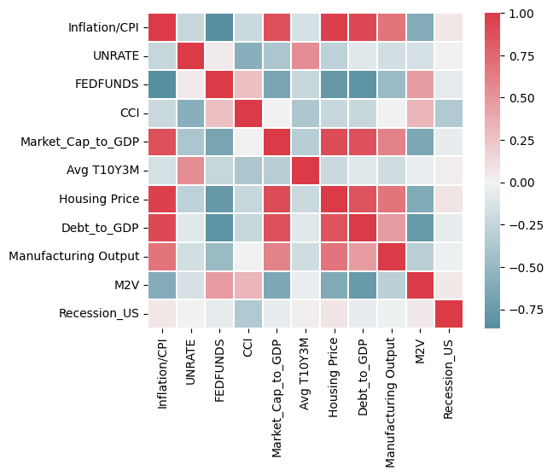
EXPLORATORY DATA ANALYSIS
Exploratory data analysis is an approach to analyzing data sets to summarize their main characteristics, often with visual methods.
We have used Histogram and Box Plot.
Correlation Heat Map

Slide 9
MODELS
Machine Learning Models
Logistic Regression
Random Forest
Gradient Boosting
SVM

Slide 10

MODEL ACCURACIES
Model | F1
Logistic Regression | 48
Random Forest | 85
Gradient Boosting | 85
SVM | 53

Slide 11

CONCLUSION
Found out Random Forest and Gradient Boosting models performing best for this dataset.
So we kept Gradient Boosting model for prediction.

Slide 12
REFERENCES
• Dataset Link-
https://fredhelp.stlouisfed.org/#fred-data-how-can-i-download-data-from-fred
• SKlearn documentation-
https://scikit-learn.org/0.21/documentation.html

Slide 13
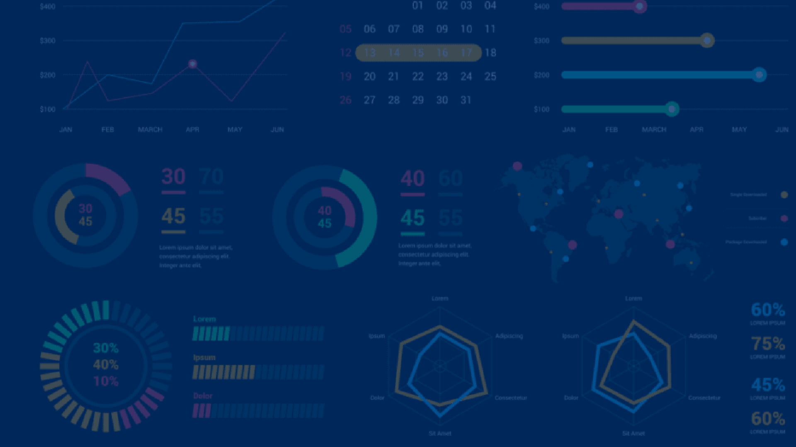





Thank You

