Slide 1
BLOG 1 • EXECUTIVE ARCHITECTURE BRIEFING
VISUAL ARCHITECTURE STORYBOARD
Multi-Tenant Agentic AI
on Google Cloud
01
The Problem & 80/20 Concept
Why shared pools leak & silos bankrupt margins (Slides 2–3)
02
5-Hop Zero-Trust Process & Logic
How to serve commercial SaaS customers and regulated banks from one shared AI codebase—with 5-hop cryptographic isolation, sub-5s key revocation, and 74% lower infrastructure cost.
~42ms security pipeline & 3-tier isolation selector (Slides 4–6)
03
Technical Blueprints & Sequence
80 / 20
74%
0 Rows
Hub-and-spoke VPC-SC & <5s key revocation (Slides 7–9)
Shared AI Core vs.
Tenant Perimeter
Portfolio TCO
Cost Reduction
Cross-Tenant
Data Leakage
04
Live Proofs, ROI & 90-Day Plan
107/107 tests, Before/After UIs & 30-60-90 CTA (Slides 10–12)
Google Cloud FDE & AI Platform Architecture Team • Vertex AI Agent Engine & ADK

Slide 2
THE REAL PROBLEM
2 Failure Extremes
02 / 12
Naive Shared Pools Leak Private AI Tools; Dedicated Silos Destroy SaaS Margins
FAILURE MODE A • NAIVE SHARED POOL (HIGH BREACH RISK)
FAILURE MODE B • SILOS FOR EVERY TENANT (MARGIN COLLAPSE)
FinVault Bank
(600 RPM • Regulated)
RetailStream Corp
(120 RPM • Commercial)
Tenant 1 Stack
Tenant 2 Stack
Tenant 500 Stack
Own VPC-SC
Own VPC-SC
Own VPC-SC
Own KMS Key
Own KMS Key
Own KMS Key
Unisolated Shared Agent Runtime & Memory
Own AlloyDB
Own AlloyDB
Own AlloyDB
Confused Deputy
Wrong OAuth Token
Schema Bleed
Private Tools Exposed
Quota Starvation
1 Burst Blocks All
Cold AI Cache
Cold AI Cache
Cold AI Cache
RESULT: FAIL COMPLIANCE AUDIT
RESULT: 3.8x COST & 6-WEEK ONBOARDING
• Regulated banks reject shared pools without cryptographic isolation.
• One tenant burst exhausts regional Vertex AI token quotas for everyone.
• 500 tenants = 500 VPC-SC perimeters, 500 KMS keys & 500 AlloyDB clusters.
• Zero prompt-cache sharing means every tenant pays full cold-prompt token cost.
Google Cloud Architecture Center • Blog 1: Multi-Tenant Agentic AI Reference Architecture & 5-Hop Governance • Verified on GCP & AWS

Slide 3
CONCEPTUAL DIAGRAM
80% Shared Core
03 / 12
Decoupling One 80% Reusable AI Core from 20% Per-Tenant Security Perimeters
TIER 1 • FEDERATED ENTERPRISE CALLERS (ZERO-TRUST IDENTITY PROOF)
FinVault Bank (Google OIDC + DPoP • 600 RPM)
RetailStream Corp (Entra ID + DPoP • 120 RPM)
Enterprise SaaS Fleet (950+ Federated Tenants)
TIER 2 • 80% REUSABLE 5-HOP AGENTIC CORE (ONE PYTHON ADK CODEBASE • ~42ms P95)
HOP 1
HOP 2
HOP 3
HOP 4
HOP 5
Edge Auth & STS
Agent Catalog
Valkey Guard
Model Armor
AlloyDB & OTel
<0.15ms JWKS
Tenant Tool Filter
<5s Key Eviction
~22ms DLP Screen
Row-Level Lock
Feature-Flagged Native GCP Adapters (GAP-01..05) • Zero Application Rewrite When Early-Access Features Reach GA
PATTERN A • SHARED POOL (950 TENANTS)
PATTERN B • SOVEREIGN SILOS (50 TENANTS)
PATTERN C • HYBRID PSC BRIDGE (MIXED)
84.7% Token Cost Savings
<60s Customer Key Kill-Switch
0ms Live Tier Upgrade
Shared Cloud Run + AlloyDB Row-Level Security + 32k shared prompt cache.
Dedicated VPC-SC perimeter, Customer-Managed KMS keys & Vertex PT / GKE.
Central shared hub + Private Service Connect spoke for instant enterprise promotion.
Google Cloud Architecture Center • Blog 1: Multi-Tenant Agentic AI Reference Architecture & 5-Hop Governance • Verified on GCP & AWS

Slide 4
PROCESS DIAGRAM
~42ms Total p95
04 / 12
Every Request Traverses 5 Synchronous Security Gates in ~42ms (or Fails Closed)
HOP 1 • ~8ms
HOP 2 • ~4ms
HOP 3 • ~3ms
HOP 4 • ~22ms
HOP 5 • ~5ms
ASYNC • 0ms
Edge Identity
& Token Mint
Agent Catalog
& OAuth Scope
Valkey Memory
& Quota Guard
Model Armor
DLP & Policy
AlloyDB Lock
& AI Inference
OTel FinOps
Chargeback
Strip spoofed headers;
verify OIDC + DPoP;
sign KMS P-256 JWT.
Filter private tools;
bind {tenant}:{user}
3LO token vault.
Check key deny-list &
120/600 RPM bucket;
<5s cache purge.
Block prompt injection
& redact PII/PHI
before LLM call.
SET LOCAL tenant_id;
invoke Gemini 2.5 Pro
or Gemma 3 27B.
Stream SHA-256 hash
& token counters to
BigQuery ledger.
DETERMINISTIC FAIL-CLOSED CIRCUIT BREAKERS (ZERO CROSS-TENANT FALLBACK)
HTTP 401 / 403
HTTP 429
HTTP 422
HTTP 423 Locked
Hop 1 & 2 • Identity / Scope
Hop 3 • Quota Protection
Hop 4 • Prompt & Data Safety
Hop 3 & 5 • Key Kill-Switch
Spoofed X-Tenant-Id header, DPoP mismatch, or unauthorized private agent tool call.
Tenant exceeds 120 RPM (Commercial) or 600 RPM (Enterprise) token bucket.
Model Armor detects prompt injection, PII/PHI leakage, or regulatory policy breach.
Customer disables KMS encryption key -> <5s Valkey cache purge & instant lock.
Google Cloud Architecture Center • Blog 1: Multi-Tenant Agentic AI Reference Architecture & 5-Hop Governance • Verified on GCP & AWS

Slide 5
LOGICAL ARCHITECTURE (L1)
<0.15ms Token Verify
05 / 12
Three Logical Trust Boundaries Isolate Untrusted Callers from Tenant Data Planes
ZONE 1 • UNTRUSTED EDGE
ZONE 2 • 5-HOP CONTROL PLANE
ZONE 3 • ISOLATED DATA PLANES
External Callers -> Verified Identity
Shared 80% ADK Governance Core
Maps to 4 Physical VPC-SC Perimeters
Cloud Armor L7 WAF
Hop 2: ARD Catalog Filter
Pattern A: AlloyDB RLS
Strips spoofed X-Tenant-Id headers
Chrooted agent/{tenant}/* visibility
FORCE ROW LEVEL SECURITY (0 leaks)
IAP OIDC + Entra ID
Hop 3: Valkey Memory Guard
Pattern B: Sovereign Silo
Federated enterprise SSO login
~3ms JTI check & RPM rate buckets
Dedicated VPC-SC, KMS & Vertex PT
RFC 8693 + DPoP Proof
Hop 4: Model Armor DLP
Pattern C: Hybrid PSC Spoke
Cryptographic sender-constrained token
~22ms inline PII/PHI & NLC guardrails
Unidirectional /28 NAT spoke
KMS ECDSA P-256 Signer
32k Shared Prompt Cache
BigQuery OTel Ledger
Mints 5-min TenantContext JWT
84.7% token savings across tenants
Zero-PII SHA-256 FinOps chargeback
Google Cloud Architecture Center • Blog 1: Multi-Tenant Agentic AI Reference Architecture & 5-Hop Governance • Verified on GCP & AWS

Slide 6
DECISION FLOWCHART
950 Pool / 50 Silos
06 / 12
Per-Tenant Configuration (Not Code Forks) Routes Each Customer to Pattern A, B, or C
START
New Enterprise Tenant
Onboarding
GATE 1: COMPLIANCE
Requires Dedicated VPC-SC &
Customer-Held KMS Key?
GATE 2: GROWTH PATH
Needs Live Zero-Downtime
Upgrade to Enterprise Tier?
NO (95% SaaS)
YES (Hybrid)
YES (5% Regulated)
NO (Standard)
PATTERN B • SOVEREIGN SILOS
PATTERN A • HIGH-DENSITY POOL
PATTERN C • HYBRID PSC BRIDGE
<60s KMS Key Kill-Switch
84.7% Token Cost Savings
0ms Live Tier Promotion
Target: Banking / Federal (600 RPM)
Target: Commercial SaaS (120 RPM)
Target: Mixed SaaS + Enterprise Fleet
Compute: Dedicated Vertex PT / GKE
Compute: Shared Cloud Run + gVisor
Compute: Shared Hub + PSC Spoke
Data: Dedicated AlloyDB + VPC-SC
Data: AlloyDB FORCE ROW SECURITY
Data: Dual-key vault + 3-phase cutover
Footprint: 1 dedicated project / bank
Footprint: 1 shared GCP project
Footprint: Hub + 50 spokes (74% TCO)
Google Cloud Architecture Center • Blog 1: Multi-Tenant Agentic AI Reference Architecture & 5-Hop Governance • Verified on GCP & AWS

Slide 7
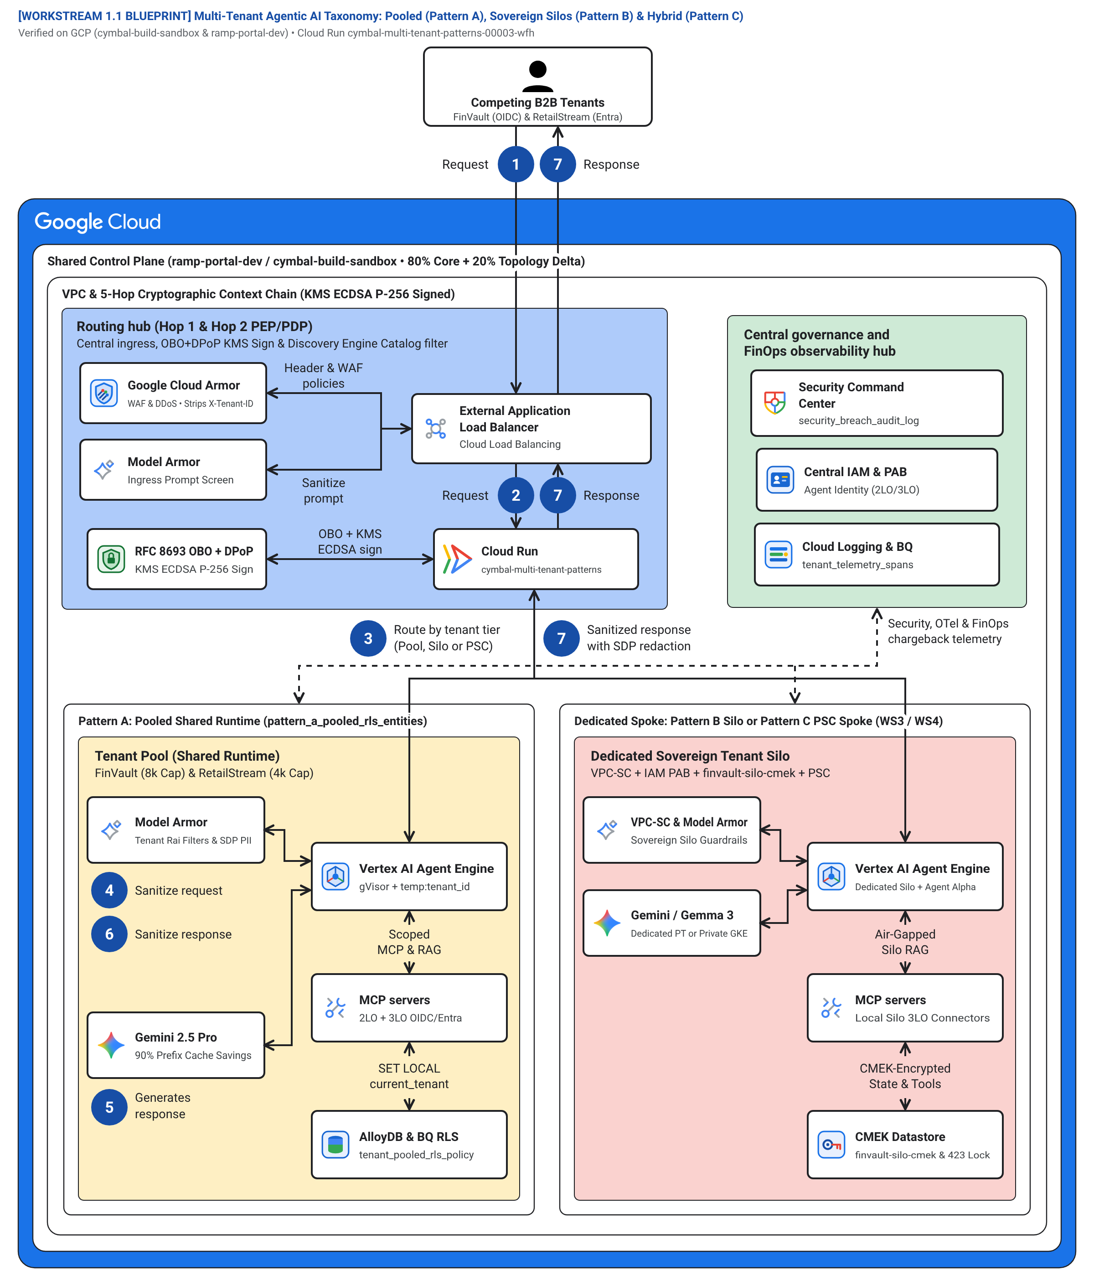
TECHNICAL BLUEPRINT 1 (L2)
56 Shapes • 23 Edges
07 / 12
4-Zone Hub-and-Spoke Topology Isolates Routing, Governance, Shared Pool & Silos
Blue Routing Hub
Cloud Armor WAF, External ALB & IAP STS token exchange (Hops 1–2).
Green Security Hub
Central Cloud KMS, IAM PAB & BigQuery OTel FinOps telemetry.
Yellow Shared Spoke
Pattern A: gVisor sandboxes, 32k prefix cache & AlloyDB RLS.
Red Sovereign Spoke
Pattern B/C: Dedicated VPC-SC, customer KMS & Vertex PT / GKE.
Google Cloud Architecture Center • Blog 1: Multi-Tenant Agentic AI Reference Architecture & 5-Hop Governance • Verified on GCP & AWS

Slide 8
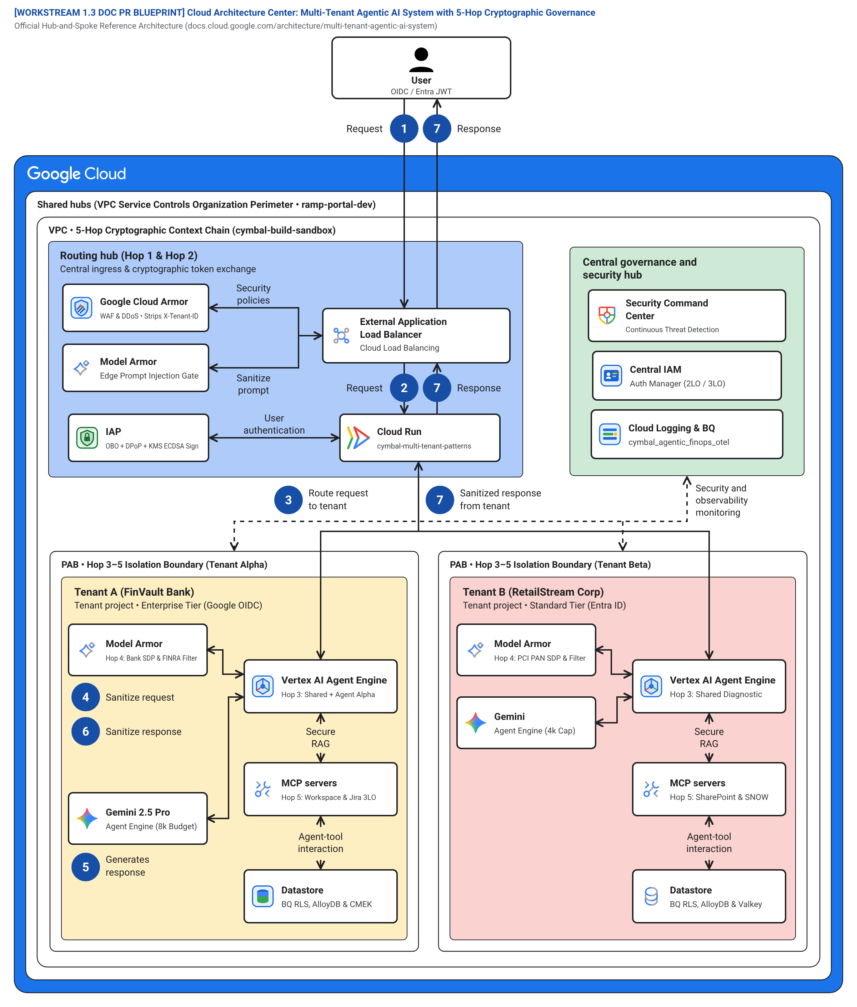
TECHNICAL BLUEPRINT 2 (L2)
5 Zero-Trust Hops
08 / 12
Cryptographic Context Chain Carries Verified Tenant Identity Across Every Spoke
1. Signed JWT Identity
KMS ECDSA P-256 token verified locally in <0.15ms per hop.
2. gVisor Kernel Sandbox
Each tenant turn executes inside an isolated user-space kernel.
3. Composite Memory Keys
{tenant}:{user}:{session} blocks cross-tenant memory reads.
4. Scoped MCP Connectors
2LO telemetry & 3LO OAuth vaults prevent Confused Deputy replay.
Google Cloud Architecture Center • Blog 1: Multi-Tenant Agentic AI Reference Architecture & 5-Hop Governance • Verified on GCP & AWS

Slide 9
SEQUENCE DIAGRAM (L3)
<5 sec Key Eviction
09 / 12
Sub-5s Cache Eviction & Single-Flight Locking Protect Both Security and Database Load
Tenant Caller
Hop 1: Edge STS
Hops 2–3: ARD / Valkey
Hop 4: Model Armor
Hop 5: AlloyDB RLS
1. OIDC JWT + DPoP Proof (~8ms)
2. KMS P-256 JWT + Catalog Filter (~4ms)
3. ~3ms Key Check + RPM Quota Pass
4. ~22ms Inline DLP + 90% Prefix Cache Hit
5. SET LOCAL tenant_id -> 0 Foreign Rows + OTel Span (HTTP 200)
1. INSTANT KEY REVOCATION (<5 SEC KILL-SWITCH)
2. SINGLE-FLIGHT STAMPEDE RECOVERY (ZERO DB SPIKE)
When a bank disables its Cloud KMS key, Hop 3 immediately purges cache:{tenant}:* in Valkey (<5s) and returns HTTP 423 Locked—eliminating the 60s storage propagation window.
When the key is restored, the first worker acquires a SET NX PX 5000 lock, re-hydrates from AlloyDB RLS once, and broadcasts to waiting callers with zero database stampede.
Google Cloud Architecture Center • Blog 1: Multi-Tenant Agentic AI Reference Architecture & 5-Hop Governance • Verified on GCP & AWS

Slide 10
SOLUTION APPROACH
5 / 5 Gaps Closed
10 / 12
Five Feature-Flagged Adapters Close Today’s Platform Gaps with Zero-Rewrite GA Sunset
1. PLATFORM BOUNDARY GAP
2. PRODUCTION ADAPTER (TODAY)
3. 1-CLICK NATIVE GA SWITCH
GAP-01 • Shared Agent Catalog
Hop 2 Registry PDP filters ListAgents by signed JWT tenant_id
CYMBAL_NATIVE_ARD_GA
GAP-02 • Per-Tenant Memory Keys
Envelope encryption + <5s Valkey purge on KMS key disable
CYMBAL_NATIVE_KMS_PROBE_GA
GAP-03 • Sub-Project Quota Fairness
Atomic Valkey Lua token buckets (120 vs. 600 RPM)
CYMBAL_NATIVE_MEM_TTL_GA
GAP-04 • Multi-IdP 3LO Token Vault
DPoP-bound {tenant}:{user} vault + step-up consent
CYMBAL_NATIVE_PSC_CUTOVER_GA
GAP-05 • Zero-PII Token Chargeback
SHA-256 prompt hashes + OTel spans to BigQuery FinOps
CYMBAL_NATIVE_OTEL_FINOPS_GA
Google Cloud Architecture Center • Blog 1: Multi-Tenant Agentic AI Reference Architecture & 5-Hop Governance • Verified on GCP & AWS

Slide 11




VERIFICATION PROOF
107 / 107 PASS
11 / 12
Verified on Live GCP & AWS Infrastructure: 107/107 Assertions & Zero Leaked UI Rows
20 / 20
Live GCP Runtime Suites
30 / 30
10-SaaS AWS AgentCore MCP
13 / 13
Deep Forensic Audit Gates
43 / 43
2880x1800 Retina UI Proofs
Metabase Enterprise BI v0.50.26 • Live Before vs. After 5-Hop RLS
Trino Distributed SQL v440 • Live Before vs. After Catalog Guard
BEFORE: All Tenants Exposed
BEFORE: Cross-Tenant Enumeration
AFTER: FinVault Only (0 Leaks)
AFTER: Scoped Query (0 Leaks)
Google Cloud Architecture Center • Blog 1: Multi-Tenant Agentic AI Reference Architecture & 5-Hop Governance • Verified on GCP & AWS

Slide 12
BENEFITS & CALL TO ACTION
<30 sec HA RTO
12 / 12
Deploy the 27-File Reference Workbench in 90 Days to Cut TCO by 74%
84.7%
74%
~42ms
<5 sec
Token Cost Savings
Portfolio TCO Savings
5-Hop Governance
Key Kill-Switch SLA
90% hit rate on shared 32k system prompt cache
950 pooled tenants + 50 PSC spokes vs. 1,000 silos
<0.15ms local JWKS verify + ~22ms Model Armor
Targeted Valkey cache purge + HTTP 423 lock
30-60-90 DAY ENTERPRISE ROLLOUT ROADMAP
DAYS 1–30 • FOUNDATION
DAYS 31–60 • SOVEREIGNTY
DAYS 61–90 • SCALE & FINOPS
Deploy 5-Hop Core & Shared Pool
Add Dedicated Silos & Key Kill-Switch
Launch Hybrid PSC & Automated CI/CD
• Clone core-cymbal-agent/ & Terraform 2.6
• Enable <0.15ms STS JWT + DPoP binding
• Pass 10/10 red-team isolation tests
• Apply Terraform 3.6 for regulated banks
• Certify <60s KMS HTTP 423 + <5s Valkey purge
• Verify single-flight stampede recovery
• Apply Terraform 4.6 for 0ms tier upgrades
• Enable BigQuery OTel FinOps chargeback
• Gate releases on 13/13 Forensic CI/CD audit
Google Cloud Architecture Center • Blog 1: Multi-Tenant Agentic AI Reference Architecture & 5-Hop Governance • Verified on GCP & AWS

