Slide 1
Cloud Architecture Center › Part 1 of 6 • Foundations & Identity
DOC-MT-01
· 12 min read · Last reviewed 2026-10-15
Building Multi-Tenant Agents: Core Challenges, Cryptographic Identity & Token Propagation
Independent software vendors are moving agents out of pilots and into products. The engineering question is no longer whether an agent can complete a task, but whether one platform can serve thousands of customers with agents without leaking data across accounts, eroding gross margin, or failing an enterprise security review.
That is a multi-tenancy problem, and it is not the multi-tenancy problem ISVs have already solved. In conventional SaaS, isolation is enforced at a small number of predictable choke points: an authenticated request, a scoped query, a row filter. The code path is deterministic, so it can be enumerated, tested, and demonstrated to an auditor. An agent removes that guarantee. It decides at runtime which tools to call, what to retrieve, how many turns to take, and which sub-agents to spawn. The execution path is generated rather than written, and every architectural assumption that depended on knowing the path in advance has to be re-established somewhere else.
To reason rigorously about multi-tenant isolation, map the three core agentic primitives onto CS101 operating-system kernel abstractions: Google ADK acts as the OS syscall scheduler, the Model Context Protocol (MCP) acts as the POSIX tool driver ABI, and Agent Registry Discovery acts as a chrooted virtual file system catalog. Together with five feature-flagged compensating controls, this guide sets out the ten components where isolation happens, how cryptographic identity is bound at ingress, and how tenant context survives every hop across the enterprise agent platform.
Architecture
The first challenge is that the isolation boundary moves inward. Tenant identity can no longer be validated once at the edge and then assumed for the remainder of the request. It has to survive every hop the agent takes—through the planner, into each sub-agent, across every tool call and retrieval, and down to the model invocation itself. It also has to be immutable once set, because an agent that can rewrite its own tenant context is an agent with no tenancy at all. Isolation stops being a perimeter and becomes a property that each hop has to carry.
The topology separates centralized ingress and governance from isolated execution spokes (Pattern A: Pooled Shared Runtime and Pattern B & Pattern C), ensuring deterministic policy enforcement and unified observability across the Google Cloud organization.
Notes:
Welcome everyone. In this six-slide executive and technical briefing, we are walking through Building Multi-Tenant Agents (Part 1): Core Challenges, Cryptographic Identity & Token Propagation.
In Part 1 of our Google Cloud Architecture Center series, we establish the cryptographic identity foundation for multi-tenant AI agents—eliminating ambient IAM credentials, header spoofing, and confused-deputy tool calls across ID-1 through ID-4.
With our business goal and architectural thesis set, let's turn to Slide 2 to examine the complete Figure 1 Google Cloud Hub-and-Spoke blueprint.

Slide 2



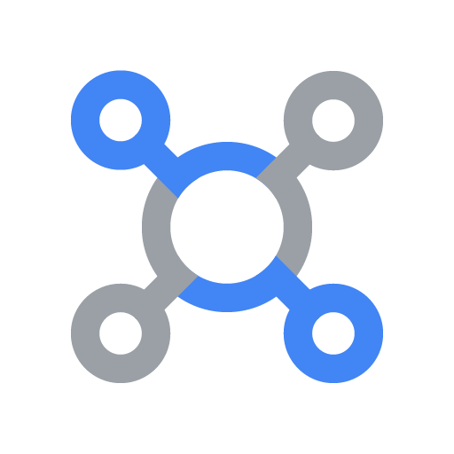
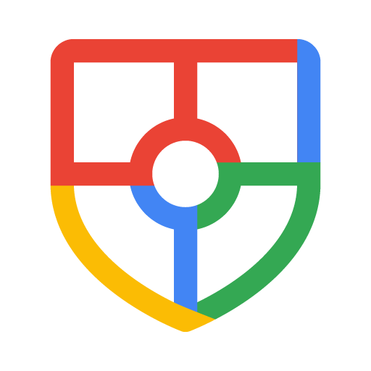

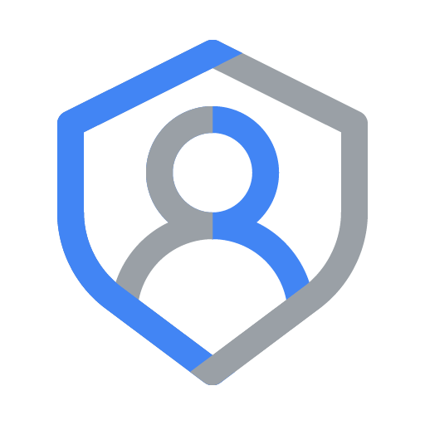

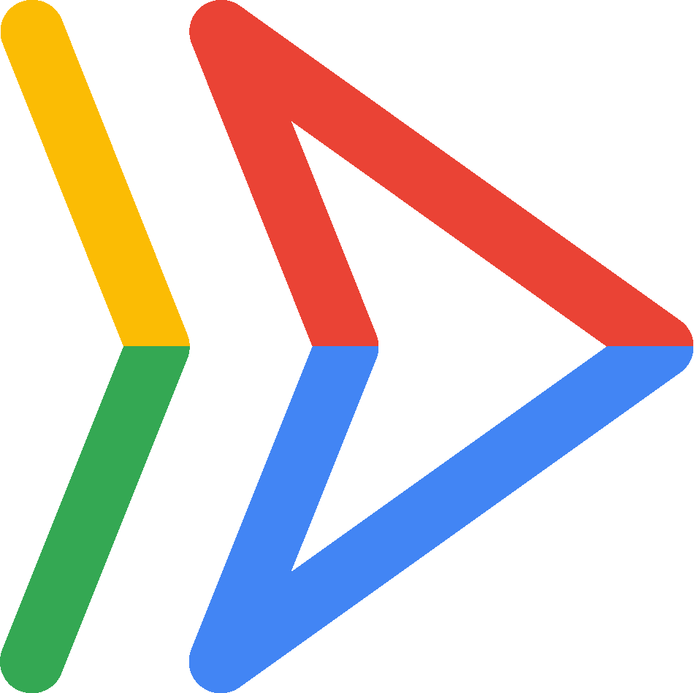



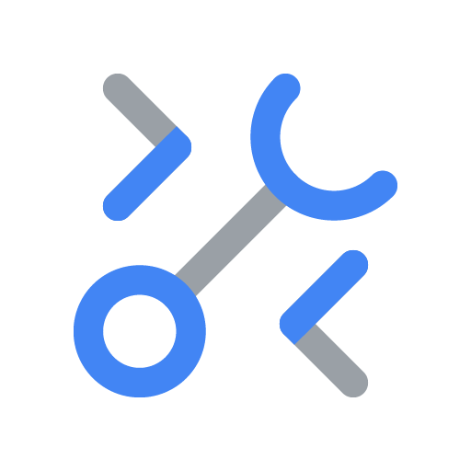
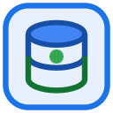

Cloud Architecture Center › Part 1 of 6 • Foundations & Identity › Architecture › Figure 1
DOC-MT-01 · Page 2 of 6
Figure 1: Multi-Tenant Agentic AI System — The 10 Stack Components & Zero-Trust Planes
Competing B2B Tenants
FinVault (OIDC) & RetailStream (Entra)
Request
1
7
Response
Shared Control Plane & Multi-Tenant Governance Perimeter
VPC & 5-Hop Cryptographic Context Chain
Routing hub (Hop 1 & Hop 2 PEP/PDP)
Central ingress, OBO+DPoP & Discovery Engine Agent Catalog filter
Central governance and FinOps observability hub
Google Cloud Armor
WAF & IAP Header Strip
Header & WAF policies
Security Command Center
Cross-Pattern Breach Alerts
External Application Load Balancer
Cloud Load Balancing
Model Armor
Ingress Prompt Screen
Central IAM & PAB
Agent Identity (2LO/3LO)
Sanitize prompt
Request
2
7
Response
RFC 8693 OBO + DPoP
Sender-Constrained JWT
OBO + DPoP verification
Cloud Run
Topology Router & Agent Catalog PDP
Cloud Logging & BQ
Zero-PII OTel & Chargeback
3
Route by tenant tier (Pool, Silo or PSC)
7
Sanitized response with SDP redaction
Security, OTel & FinOps chargeback telemetry
Pattern A: Pooled Shared Runtime
Pattern B (Sovereign Silos) & Pattern C
Tenant Pool (Shared Runtime)
FinVault (8k Cap) & RetailStream (4k Cap)
Dedicated Sovereign Tenant Project
VPC-SC + IAM PAB + CMEK Kill-Switch + PSC
Model Armor
Tenant Rai Filters & SDP PII
VPC-SC & Model Armor
Sovereign Silo Guardrails
4
Sanitize request
Vertex AI Agent Engine
gVisor + temp:tenant_id
Vertex AI Agent Engine
Dedicated Silo + Agent Alpha
6
Sanitize response
Gemini / Gemma 3
Private GKE or PT Endpoint
Scoped MCP & RAG
Air-Gapped Silo RAG
MCP servers
2LO + 3LO OIDC/Entra
MCP servers
Local Silo 3LO Connectors
Gemini 2.5 Pro
90% Prefix Cache Savings
5
Generates response
SET LOCAL current_tenant
CMEK-Encrypted State & Tools
Shared AlloyDB
FORCE Row-Level Security
CMEK Datastore
AlloyDB, BQ & KMS 423 Lock
Figure 1. The ten architectural components where pooled-versus-siloed tenancy decisions are enforced across the Routing Hub, Central Governance Hub, Pooled Runtime, and Sovereign Spoke.
Notes:
Building on the executive overview we just covered on Slide 1, this diagram gives us the complete end-to-end physical map of the system on Google Cloud.
Figure 1 maps out our canonical Google Cloud Hub-and-Spoke blueprint. Tenant requests enter the blue Routing Hub via Cloud Armor and Identity-Aware Proxy, undergo RFC 8693 OBO token exchange and RFC 9449 DPoP proof binding in the green Governance Hub, and execute inside isolated spokes.
Now that we see where each component sits in Figure 1, let's move to Slide 3 to walk through how a live request flows across these services step by step.

Slide 3
Cloud Architecture Center › Part 1 of 6 • Foundations & Identity › Architecture › Components & Agentic flow
DOC-MT-01 · Page 3 of 6
The architecture consists of the following components:
Component
Description
Shared Control Plane & Multi-Tenant Governance Perimeter
Outer security and governance boundary that prevents unauthorized data.
• Shared Control Plane & Multi-Tenant Governance Perimeter: Enforces VPC Service Controls service perimeters around hub and spoke projects to block unauthorized cross-perimeter data movement.
Routing hub
Centralized ingress and control plane managing edge security, identity verification, and request routing.
• External Application Load Balancer: Acts as the unified global entry point for incoming requests.
• Google Cloud Armor: Enforces edge policy rules before reaching the runtime.
• Model Armor: Screens incoming prompts and verifies policy constraints at the routing hub.
• RFC 8693 OBO + DPoP: Authenticates callers and binds cryptographic identity and scope claims before routing.
Central governance and FinOps observability hub
Dedicated governance plane providing unified security posture, cryptographic key management, and OpenTelemetry observability.
• Security Command Center: Provides centralized threat detection, posture management, and continuous compliance verification.
• Central IAM & PAB: Manages access policies, cryptographic signing keys, and entitlement registries.
• Cloud Logging & BQ: Aggregates audit logs, execution traces, and OpenTelemetry FinOps telemetry into BigQuery.
Principal Access Boundary Policy
Identity and resource isolation boundary restricting principal access so workloads.
• VPC & 5-Hop Cryptographic Context Chain: Binds IAM Principal Access Boundary (PAB) policies to spoke principals so credentials and tool calls remain strictly scoped to their authorized boundary.
Tenant Pool & Dedicated Sovereign Tenant Project
Isolated Google Cloud execution spokes.
• Vertex AI Agent Engine: Core execution environments orchestrating reasoning, memory, and tool execution across left and right spokes.
• Model Armor / VPC-SC & Model Armor: Screens prompts and model outputs within each spoke boundary to enforce safety and DLP policies.
• MCP servers: Serverless tool interfaces providing standardized, scoped access to enterprise systems.
• Shared AlloyDB / CMEK Datastore: Isolated persistence layers enforcing access boundaries, vector namespaces, and encryption at rest.
Agentic flow
1. A caller sends a request to External Application Load Balancer in the Routing hub.
2. After passing policy and security checks across Google Cloud Armor, Model Armor, and RFC 8693 OBO + DPoP, the request is forwarded to Cloud Run.
3. Cloud Run verifies the caller's identity claims, attaches scoped execution metadata, and routes the request to the target execution spoke.
4. Within Tenant Pool, the runtime orchestrates execution across four deterministic sub-steps.
4a. Input policy validation: Screens the incoming payload against safety and DLP policies.
4b. Grounded context retrieval: Queries the datastore via Scoped MCP & RAG.
4c. Scoped tool invocation: Executes external tool operations via SET LOCAL current_tenant.
4d. Transactional state persistence: Commits verified state updates under strict isolation boundaries.
5. Vertex AI Agent Engine sends the validated, context-enriched prompt to Gemini 2.5 Pro to synthesize a grounded response.
6. Vertex AI Agent Engine passes the generated output through Model Armor for final output sanitization and policy enforcement.
7. The verified response returns to the caller through the Routing hub, while structured OpenTelemetry audit and FinOps spans stream to the Central governance and FinOps observability hub.
Notes:
Taking the physical components from the Figure 1 blueprint on Slide 2, this slide unpacks the exact step-by-step runtime workflow.
Walking through the agentic execution flow on this slide shows how a single KMS-signed TenantSecurityContext propagates from edge ingress through Agent Registry filtering, Valkey quota checks, Gemini reasoning, and PostgreSQL Row-Level Security.
Having seen how the components interact step by step on Slide 3, let's turn to Slide 4 to see how this architecture solves a concrete enterprise customer use case.

Slide 4
Cloud Architecture Center › Part 1 of 6 • Foundations & Identity › Products used & Use case
DOC-MT-01 · Page 4 of 6
Products used
This reference architecture uses the following Google Cloud services and open-source frameworks to implement Building Multi-Tenant Agents: Core Challenges, Cryptographic Identity & Token Propagation.
• Vertex AI Agent Engine: Managed runtime environment to host, scale, and govern AI agents with managed Sessions, Memory Bank, and Context Caching.
• Google ADK: Open-source Agent Development Kit for building, orchestrating, and testing hierarchical multi-agent systems with deterministic callbacks.
• Cloud Identity / Workforce Identity Federation: Core Google Cloud service used in DOC-MT-01 to enforce production security, scalability, and observability.
• Cloud Armor & IAP: Provides edge DDoS protection, WAF rules, and header sanitization on the global External Application Load Balancer.
• Vertex AI Model Armor: Screens incoming prompts, retrieved RAG chunks, and model responses against prompt injection, jailbreaks, and sensitive data leakage.
• Cloud Audit Logs: Core Google Cloud service used in DOC-MT-01 to enforce production security, scalability, and observability.
Use case
Foundational Component 1: The Four Distinct Identities (ID-1 to ID-4)
Second, untrusted input now reaches the control path. In deterministic software, user input is passive data that code acts upon. In an agentic system, user input is partly instruction, which makes the model a legitimate attack surface rather than a passive component.
For this use case, the architecture provides the following benefits:
• Strict data isolation: Enforces deterministic tenant and domain boundaries via VPC & 5-Hop Cryptographic Context Chain and Shared AlloyDB, preventing cross-spoke state or credential leakage.
• User Identity: The authenticated human principal initiating the session, verified and issued by the enterprise IdP.
• Agent Identity: The platform-issued workload identity—a unique, lifecycle-bound SPIFFE ID backed by an auto-provisioned X.509 certificate—that acts directly as an IAM principal in Principal Access Boundary (PAB) policies, VPC Service Controls, and Cloud Audit Logs.
• On-Behalf-Of / Delegated Identity: The user-delegated credential allowing the agent to perform actions against external systems strictly within the user’s personal permission envelope.
Notes:
Following our step-by-step technical workflow on Slide 3, this slide connects the architecture directly to tangible business value and the managed Google Cloud services that power it.
For SaaS security and platform architects, this slide maps the four identity primitives—Workforce Identity Federation, OBO token exchange, SPIFFE workload identity, and composite tenant-user 3LO vaults—directly onto Google Cloud managed services.
Once business and technical leaders see how the use case works on Slide 4, the natural next question is: how does this compare to alternative designs, and what are the trade-offs? Let's look at Slide 5.

Slide 5
Cloud Architecture Center › Part 1 of 6 • Foundations & Identity › Design alternatives & Design considerations
DOC-MT-01 · Page 5 of 6
Design alternatives
Private access deployment & network isolation — The baseline topology routes traffic through External Application Load Balancer and Cloud Run under Shared Control Plane & Multi-Tenant Governance Perimeter.
• External vs. internal private ingress: For internet-facing workloads, retain the global External Application Load Balancer with Google Cloud Armor and Model Armor.
Vertex AI Agent Engine & MCP servers placement — Each execution spoke pairs Vertex AI Agent Engine with MCP servers and Shared AlloyDB.
• Dedicated spoke vs. shared tool gateways: Spoke-local MCP servers: Maximizes blast-radius containment by keeping credentials, service accounts, and data access strictly inside Pattern A: Pooled Shared Runtime.; Shared enterprise tool gateway: Consolidates stateless, non-tenant-specific MCP tools into a central hub project via Private Service Connect.
CS101 operating-system primitives & feature-flagged compensating controls — Across Pooled, Hybrid Bridge, and Sovereign Silo topologies, the shared application runtime maps agentic orchestration onto three deterministic operating-system primitives: Google ADK.
• Compensating controls for preview product boundaries: GAP-01: Hop2RegistryPDP filters catalog discovery predicates by signed JWT tenant_id and prunes unentitled tool schemas in before_agent_callback.; GAP-02: Enforces envelope encryption plus <5s tenant-prefixed Memorystore Valkey SCAN+UNLINK eviction and <60s HTTP 423.
Design considerations
This section aligns the reference architecture with the Google Cloud Well-Architected Framework across security, reliability, operational excellence, and cost optimization, alongside production failure-mode mitigations.
Well-Architected pillar
Component
Design considerations and recommendations
Security, privacy, and compliance
• VPC Service Controls & Access Boundaries
• Google Cloud Armor & Model Armor
• Shared AlloyDB & Central IAM & PAB
• VPC Service Controls & Access Boundaries: Enforce VPC Service Controls perimeters around hub and spoke projects to block unauthorized data exfiltration, and bind Principal Access Boundary (PAB) policies to spoke principals.
• Google Cloud Armor & Model Armor: Strip client-supplied privilege headers at the edge, verify caller identity claims, and screen prompts and completions with Model Armor.
• Shared AlloyDB & Central IAM & PAB: Encrypt state at rest with Customer-Managed Encryption Keys and enforce least-privilege access scopes on Shared AlloyDB.
Reliability
• External Application Load Balancer & Cloud Run
• Vertex AI Agent Engine & MCP servers
• Shared AlloyDB
• External Application Load Balancer & Cloud Run: Deploy Cloud Run across multi-region serverless Network Endpoint Groups (NEGs) with minimum warm instances to eliminate cold-start latency spikes.
• Vertex AI Agent Engine & MCP servers: Enforce bounded retry budgets with exponential backoff, per-tool execution timeouts, and stateless horizontal scaling on MCP servers.
• Shared AlloyDB: Enable regional high availability and Point-in-Time Recovery on Shared AlloyDB with automated backup verification.
Operational efficiency
• Infrastructure as Code
• Security Command Center & Cloud Logging & BQ
• Automated CI/CD & Red-Team Gates
• Infrastructure as Code: Provision Tenant Pool and Dedicated Sovereign Tenant Project spokes through versioned Terraform modules that atomically bind perimeters, IAM roles, and runtime configurations.
• Security Command Center & Cloud Logging & BQ: Stream structured OpenTelemetry traces and zero-PII audit logs to Cloud Logging & BQ and monitor posture drift in Security Command Center.
• Automated CI/CD & Red-Team Gates: Gate every prompt, model, or tool change on automated Vertex AI Gen AI Evaluation Service benchmarks and security regression checks before production rollout.
Cost optimization
• Gemini 2.5 Pro Context Caching
• RFC 8693 OBO + DPoP & MCP servers
• Cloud Logging & BQ FinOps Attribution
• Gemini 2.5 Pro Context Caching: Enable Vertex AI Context Caching on shared system instructions, tool schemas, and reference rubrics to reduce repeated input token costs by up to 90%.
• RFC 8693 OBO + DPoP & MCP servers: Reject malformed or adversarial requests at the edge before invoking downstream models, and scale idle stateless tool containers down to zero.
• Cloud Logging & BQ FinOps Attribution: Export OpenTelemetry token usage spans and Cloud Billing records to BigQuery to enforce per-spoke quota budgets and automated spend alerts.
Notes:
Building on the customer use case from Slide 4, this slide evaluates our architectural trade-offs so decision-makers have full confidence in why this design is recommended.
This comparison matrix evaluates cryptographic OBO/DPoP propagation against ambient service accounts and client-supplied headers across spoofing resistance, audit non-repudiation, and cached-JWKS verification latency under 0.15 milliseconds.
With the architectural trade-offs clear here on Slide 5, let's turn to our final slide—Slide 6—to walk through the deployment checklist and next steps.

Slide 6
Cloud Architecture Center › Part 1 of 6 • Foundations & Identity › Deployment, What's next & Contributors
DOC-MT-01 · Page 6 of 6
Deployment
To deploy and verify the Building Multi-Tenant Agents: Core Challenges, Cryptographic Identity & Token Propagation pattern on Google Cloud, use the following production implementation reference.
src/ingress/security_middleware.py
PYTHON
def bind_verified_tenant_intent_token(raw_headers: dict, verified_oidc_jwt: dict) -> dict:
# 1. Strip any client-supplied X-Tenant-ID header to prevent header spoofing
raw_headers.pop("X-Tenant-ID", None)
raw_headers.pop("x-tenant-id", None)
# 2. Extract cryptographically verified User (ID-1) and Tenant (ID-4) claims from IdP JWT
user_sub = verified_oidc_jwt["sub"] # e.g. "alice@tenant-a.com"
tenant_id = verified_oidc_jwt["tenant_id"] # e.g. "tenant_a"
org_id = verified_oidc_jwt["organization_id"] # e.g. "12345678"
# 3. Mint short-lived, DPoP-bound Intent Token with immutable tenant scope
return {
"iss": "https://gateway.agentengine.goog",
"sub": user_sub,
"aud": "urn:google:adk:finance-agent-v2",
"tenant_id": tenant_id,
"organization_id": org_id,
"scopes": f"patient/mcp:read tenant:{tenant_id} group:Analyst"
}
What's next
• Multi-tenant agentic AI system on Google Cloud: Read the canonical Google Cloud Architecture Center reference architecture.
• Agent Development Kit (ADK) Documentation: Build hierarchical multi-agent systems, deterministic callbacks, and MCP toolsets.
• Vertex AI Agent Engine Overview: Explore managed runtime deployment, Sessions, Memory Bank, and Context Caching.
• Google Cloud Well-Architected Framework: AI and ML perspective: Review best practices for security, reliability, operational efficiency, and cost optimization.
Contributors
Except as otherwise noted, the content of this page is licensed under the Creative Commons Attribution 4.0 License, and code samples are licensed under the Apache 2.0 License.
Authors: Principal AI Architect • Cloud Solutions Architecture • Enterprise AI Field Engineering
Other contributors: Principal AI Architect & Field Deployment Engineering • Google Cloud Architecture Center Engineering Team
Last updated 2026-10-15 UTC.
Notes:
Rounding out the design trade-offs from Slide 5, our closing slide transitions from architecture into hands-on production deployment.
Finally, here is the production Python token-exchange implementation and Well-Architected security checklist so your team can enforce Hop 1 cryptographic identity immediately.
That concludes our six-slide briefing—let's open the floor for your questions or launch the interactive codebase workbench to inspect the implementation files directly.

