Slide 1
WORKSTREAM 2 • PATTERN A — HIGH-DENSITY POOLED ARCHITECTURE
Pattern A — Pooled Architecture: One Shared Runtime, Two Competing Tenants, Zero Bleed
High-Density Pooled Multi-Tenancy on GEAP & ADK 2.0 — 5-Hop Cryptographic Context Chain, 10-point breach suite, 90% ContextCacheConfig save
Multi-Tenant Agentic AI on Google Cloud • Gemini Enterprise Agent Platform (GEAP) & ADK 2.0
Every diagram slide is 100% native editable (PromptCanvas Vision Decompiler → Draw.io → PowerPoint / Google Slides)
Anchor reference: https://docs.cloud.google.com/architecture/multi-tenant-agentic-ai-system
Notes:
Pattern A — Pooled Architecture: One Shared Runtime, Two Competing Tenants, Zero Bleed
High-Density Pooled Multi-Tenancy on GEAP & ADK 2.0 — 5-Hop Cryptographic Context Chain, 10-point breach suite, 90% ContextCacheConfig save
Series: Multi-Tenant Agentic AI on Google Cloud • Gemini Enterprise Agent Platform (GEAP) & ADK 2.0

Slide 2
WS2 | Executive TL;DR
Executive TL;DR
Problem: dedicated projects per Standard-tier SaaS customer destroy gross margin, but naive shared runtimes leak agents, tools, caches and PII.
Solution: one shared project (cymbal-pooled-saas-prod) governed by the 5-Hop Cryptographic Context Chain from edge PEP to AlloyDB RLS.
FinVault Bank (Enterprise, Google OIDC/Jira) and RetailStream Corp (Standard, Entra ID/ServiceNow) share one runtime with 10/10 breach vectors blocked.
ContextCacheConfig READ_ONLY_IMMUTABLE_PREFIX bills the 32,000-token operator prefix at a 90% discount for ~84.7% net input COGS reduction.
Ships as Milestone 1 (Week 4) with a Terraform starter, 90-minute codelab, and locally runnable run_breach_simulations.py.
Workstream 2 • Pattern A — High-Density Pooled Architecture • Multi-Tenant Agentic AI on Google Cloud • Gemini Enterprise Agent Platform (GEAP) & ADK 2.0
Notes:
Executive TL;DR
• Problem: dedicated projects per Standard-tier SaaS customer destroy gross margin, but naive shared runtimes leak agents, tools, caches and PII.
• Solution: one shared project (cymbal-pooled-saas-prod) governed by the 5-Hop Cryptographic Context Chain from edge PEP to AlloyDB RLS.
• FinVault Bank (Enterprise, Google OIDC/Jira) and RetailStream Corp (Standard, Entra ID/ServiceNow) share one runtime with 10/10 breach vectors blocked.
• ContextCacheConfig READ_ONLY_IMMUTABLE_PREFIX bills the 32,000-token operator prefix at a 90% discount for ~84.7% net input COGS reduction.
• Ships as Milestone 1 (Week 4) with a Terraform starter, 90-minute codelab, and locally runnable run_breach_simulations.py.

Slide 3
WS2 | The Pooled Economics Paradox
The Pooled Economics Paradox
Security teams demand absolute isolation of agents, runbooks, 3P OAuth credentials, memories and regulated PII.
CFOs demand density: a project, VPC, AlloyDB cluster and endpoint per $500–$2,000/month tenant exhausts quotas and margin.
Gateway-level WHERE tenant_id = ? fails for agents: mid-turn MCP discovery, confused-deputy credentials, cache bleed, noisy neighbors.
Pattern A is the lowest-unit-cost pattern, fit for Standard B2B tiers and high-volume tasks.
Workstream 2 • Pattern A — High-Density Pooled Architecture
Notes:
The Pooled Economics Paradox
• Security teams demand absolute isolation of agents, runbooks, 3P OAuth credentials, memories and regulated PII.
• CFOs demand density: a project, VPC, AlloyDB cluster and endpoint per $500–$2,000/month tenant exhausts quotas and margin.
• Gateway-level WHERE tenant_id = ? fails for agents: mid-turn MCP discovery, confused-deputy credentials, cache bleed, noisy neighbors.
• Pattern A is the lowest-unit-cost pattern, fit for Standard B2B tiers and high-volume tasks.

Slide 4
WS2 | Cymbal Anchor Case Study
Cymbal Anchor Case Study
Cymbal publishes the Shared Incident Diagnostic Agent on Gemini 2.5 Pro with Firestore + Memorystore dynamic config and 2LO telemetry MCP.
FinVault Bank: Enterprise tier, 8,000 thinking tokens, 600 RPM, Google Workspace OIDC + Jira 3LO, CMEK memory namespace.
RetailStream Corp: Standard tier, 4,000 thinking cap, 120 RPM Redis bulkhead, Entra ID + SharePoint/ServiceNow inline 3LO consent.
Agent Alpha: FinVault's private Claude 3.7 Sonnet regulatory agent on Model Garden, hot-swappable, invisible to RetailStream (403).
Workstream 2 • Pattern A — High-Density Pooled Architecture
Notes:
Cymbal Anchor Case Study
• Cymbal publishes the Shared Incident Diagnostic Agent on Gemini 2.5 Pro with Firestore + Memorystore dynamic config and 2LO telemetry MCP.
• FinVault Bank: Enterprise tier, 8,000 thinking tokens, 600 RPM, Google Workspace OIDC + Jira 3LO, CMEK memory namespace.
• RetailStream Corp: Standard tier, 4,000 thinking cap, 120 RPM Redis bulkhead, Entra ID + SharePoint/ServiceNow inline 3LO consent.
• Agent Alpha: FinVault's private Claude 3.7 Sonnet regulatory agent on Model Garden, hot-swappable, invisible to RetailStream (403).

Slide 5
WS2 | The 5-Hop Chain in Pattern A
The 5-Hop Chain in Pattern A
Hop 1 hop1_edge_identity_pep.py: Cloud Armor/IAP strip X-Tenant-ID, verify IdP JWT, mint RFC 8693 OBO token bound to DPoP jkt.
Hop 2 hop2_registry_pdp_callbacks.py: Registry PDP + ARD catalog filter + ADK before_agent_callback tool pruning (403).
Hop 3 hop3_compute_finops_bulkhead.py: gVisor temp:tenant_id, 5-Level Memory Bank, ContextCacheConfig 90%, Redis 429 and token clamp.
Hop 4 hop4_model_armor_guardrails.py: Model Armor ingress 400, Semantic NLC 422, tenant-scoped SDP egress redaction.
Hop 5 hop5_data_rls_and_otel.py: AlloyDB RLS via SET LOCAL app.current_tenant, 2LO/3LO Auth Manager, BigQuery OTel spans.
Workstream 2 • Pattern A — High-Density Pooled Architecture
Notes:
The 5-Hop Chain in Pattern A
• Hop 1 hop1_edge_identity_pep.py: Cloud Armor/IAP strip X-Tenant-ID, verify IdP JWT, mint RFC 8693 OBO token bound to DPoP jkt.
• Hop 2 hop2_registry_pdp_callbacks.py: Registry PDP + ARD catalog filter + ADK before_agent_callback tool pruning (403).
• Hop 3 hop3_compute_finops_bulkhead.py: gVisor temp:tenant_id, 5-Level Memory Bank, ContextCacheConfig 90%, Redis 429 and token clamp.
• Hop 4 hop4_model_armor_guardrails.py: Model Armor ingress 400, Semantic NLC 422, tenant-scoped SDP egress redaction.
• Hop 5 hop5_data_rls_and_otel.py: AlloyDB RLS via SET LOCAL app.current_tenant, 2LO/3LO Auth Manager, BigQuery OTel spans.

Slide 6
WS2 | 10-Point Breach Simulation Suite
10-Point Breach Simulation Suite
Vectors 1–3 (Hops 1–2): forged header stripped, Agent Alpha 403, FinVault pruned from RetailStream ServiceNow MCP.
Vectors 4, 5, 8 (Hop 4): prompt injection 400, OCC escalation suppression 422, IBAN/SWIFT/PAN masked on egress.
Vectors 6, 7, 9 (Hops 3 & 5): 16,000 tokens clamped to 4,000, 250 RPM throttled 429, cross-tenant memory PermissionError, RLS 0 rows.
Vector 10 (Hop 5): 401 CHALLENGE_3LO_OAUTH for ServiceNow, resumed to 200 after inline Entra ID consent.
All 10 pass locally with no cloud credentials; every denial lands as a BigQuery OTel security span.
Workstream 2 • Pattern A — High-Density Pooled Architecture
Notes:
10-Point Breach Simulation Suite
• Vectors 1–3 (Hops 1–2): forged header stripped, Agent Alpha 403, FinVault pruned from RetailStream ServiceNow MCP.
• Vectors 4, 5, 8 (Hop 4): prompt injection 400, OCC escalation suppression 422, IBAN/SWIFT/PAN masked on egress.
• Vectors 6, 7, 9 (Hops 3 & 5): 16,000 tokens clamped to 4,000, 250 RPM throttled 429, cross-tenant memory PermissionError, RLS 0 rows.
• Vector 10 (Hop 5): 401 CHALLENGE_3LO_OAUTH for ServiceNow, resumed to 200 after inline Entra ID consent.
• All 10 pass locally with no cloud credentials; every denial lands as a BigQuery OTel security span.

Slide 7
WS2 | FinOps, Terraform, Codelab & Product Gaps
FinOps, Terraform, Codelab & Product Gaps
Per-turn input drops from 34,000 full-price tokens to ~5,200 billable with zero cross-tenant cache bleed.
Terraform starter: cymbal-pooled-edge-waf, cymbal-tenant-bulkhead-redis, cymbal-pooled-tenant-kr, cymbal-pooled-agent-gateway, OTel dataset.
90-minute L300–L400 codelab runs all four breach modules plus a BigQuery chargeback audit.
Four prioritized gaps: GEAP-POOL-01 Registry tenant claim, -02 Entra DPoP/3LO, -03 Memory Bank CMEK, -04 unified ContextCacheConfig.
Workstream 2 • Pattern A — High-Density Pooled Architecture
Notes:
FinOps, Terraform, Codelab & Product Gaps
• Per-turn input drops from 34,000 full-price tokens to ~5,200 billable with zero cross-tenant cache bleed.
• Terraform starter: cymbal-pooled-edge-waf, cymbal-tenant-bulkhead-redis, cymbal-pooled-tenant-kr, cymbal-pooled-agent-gateway, OTel dataset.
• 90-minute L300–L400 codelab runs all four breach modules plus a BigQuery chargeback audit.
• Four prioritized gaps: GEAP-POOL-01 Registry tenant claim, -02 Entra DPoP/3LO, -03 Memory Bank CMEK, -04 unified ContextCacheConfig.

Slide 8
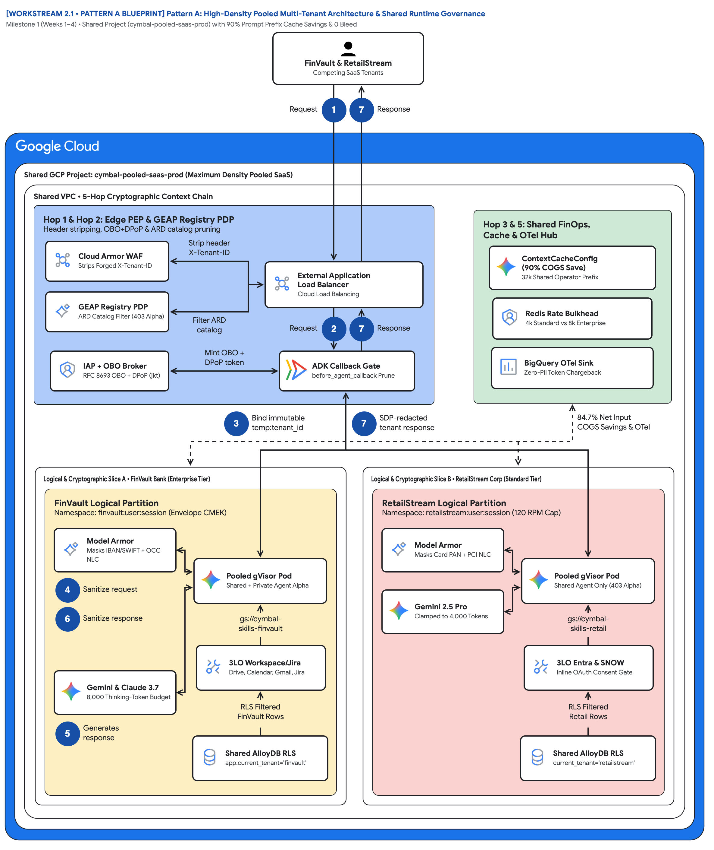
FIGURE 1 — PATTERN A: HIGH-DENSITY POOLED MULTI-TENANT ARCHITECTURE & SHARED RUNTIME GOVERNANCE | ID: VIS-WS2-PATTERN-A-POOLED-5HOP-ARCHITECTURE • 1:1 Master High-Resolution Widescreen Architecture (Slide 2 contains Decomposed Vector Shapes)
Notes:
Figure 1 — Pattern A: High-Density Pooled Multi-Tenant Architecture & Shared Runtime Governance
Milestone 1 (Weeks 1–4) • Shared Project (cymbal-pooled-saas-prod) with 90% Prompt Prefix Cache Savings & 0 Bleed
• One actor, 'FinVault & RetailStream Competing SaaS Tenants', enters one 'Shared GCP Project: cymbal-pooled-saas-prod'.
• Routing hub 'Hop 1 & Hop 2: Edge PEP & GEAP Registry PDP': strip X-Tenant-ID, filter ARD catalog, mint OBO + DPoP token.
• Governance hub 'Hop 3 & 5: Shared FinOps, Cache & OTel Hub': ContextCacheConfig 90%, Redis Rate Bulkhead, BigQuery OTel Sink.
• Trunk badge 3 'Bind immutable temp:tenant_id' before any tenant code runs; badge 7 returns 'SDP-redacted tenant response'.
• Slice A FinVault: Model Armor masks IBAN/SWIFT + OCC NLC, Gemini & Claude 3.7, 3LO Workspace/Jira, Shared AlloyDB RLS.
• Slice B RetailStream: Card PAN + PCI NLC, Gemini 2.5 Pro clamped to 4,000 tokens, 3LO Entra & SNOW inline consent gate.
Editable source: diagrams/ws2-pattern-a-pooled-5hop-architecture.drawio (PromptCanvas Vision Decompiler)

Slide 9










FIGURE 1 — PATTERN A: HIGH-DENSITY POOLED MULTI-TENANT ARCHITECTURE & SHARED RUNTIME GOVERNANCE | ID: VIS-WS2-PATTERN-A-POOLED-5HOP-ARCHITECTURE • 100% Decomposed Native Editable Vector Shapes, Icons & Arrows (Click any element to move or edit)
[WORKSTREAM 2.1 • PATTERN A BLUEPRINT] Pattern A: High-Density Pooled Multi-Tenant Architecture & Shared Runtime Governance
Milestone 1 (Weeks 1–4) • Shared Project (cymbal-pooled-saas-prod) with 90% Prompt Prefix Cache Savings & 0 Bleed
FIGURE 1
FinVault & RetailStreamCompeting SaaS Tenants
Pattern A: High-Density Pooled Multi-Tenant Architecture & Shared Runtime Governance
Request
1
7
Response
Shared GCP Project: cymbal-pooled-saas-prod (Maximum Density Pooled SaaS)
Shared VPC • 5-Hop Cryptographic Context Chain
One actor, 'FinVault & RetailStream Competing SaaS Tenants', enters one 'Shared GCP Project: cymbal-pooled-saas-prod'.
Routing hub 'Hop 1 & Hop 2: Edge PEP & GEAP Registry PDP': strip X-Tenant-ID, filter ARD catalog, mint OBO + DPoP token.
Governance hub 'Hop 3 & 5: Shared FinOps, Cache & OTel Hub': ContextCacheConfig 90%, Redis Rate Bulkhead, BigQuery OTel Sink.
Trunk badge 3 'Bind immutable temp:tenant_id' before any tenant code runs; badge 7 returns 'SDP-redacted tenant response'.
Slice A FinVault: Model Armor masks IBAN/SWIFT + OCC NLC, Gemini & Claude 3.7, 3LO Workspace/Jira, Shared AlloyDB RLS.
Slice B RetailStream: Card PAN + PCI NLC, Gemini 2.5 Pro clamped to 4,000 tokens, 3LO Entra & SNOW inline consent gate.
Hop 1 & Hop 2: Edge PEP & GEAP Registry PDP
Header stripping, OBO+DPoP & ARD catalog pruning
Hop 3 & 5: Shared FinOps,
Cache & OTel Hub
Cloud Armor WAF
Strips Forged X-Tenant-ID
Strip header
X-Tenant-ID
ContextCacheConfig
(90% COGS Save) • 32k Shared Operator Prefix
External Application
Load Balancer • Cloud Load Balancing
GEAP Registry PDP
ARD Catalog Filter (403 Alpha)
Redis Rate Bulkhead
4k Standard vs 8k Enterprise
Filter ARD
catalog
Request
2
7
Response
IAP + OBO Broker
RFC 8693 OBO + DPoP (jkt)
Mint OBO +
DPoP token
ADK Callback Gate
before_agent_callback Prune
BigQuery OTel Sink
Zero-PII Token Chargeback
3
Bind immutable
temp:tenant_id
7
SDP-redacted
tenant response
84.7% Net Input
COGS Savings & OTel
Logical & Cryptographic Slice A • FinVault Bank (Enterprise Tier)
Logical & Cryptographic Slice B • RetailStream Corp (Standard Tier)
FinVault Logical Partition
Namespace: finvault:user:session (Envelope CMEK)
RetailStream Logical Partition
Namespace: retailstream:user:session (120 RPM Cap)
Model Armor
Masks IBAN/SWIFT + OCC NLC
Model Armor
Masks Card PAN + PCI NLC
Pooled gVisor Pod
Shared + Private Agent Alpha
Pooled gVisor Pod
Shared Agent Only (403 Alpha)
4
Sanitize request
Gemini 2.5 Pro
Clamped to 4,000 Tokens
6
Sanitize response
gs://cymbal-
skills-finvault
gs://cymbal-
skills-retail
3LO Workspace/Jira
Drive, Calendar, Gmail, Jira
3LO Entra & SNOW
Inline OAuth Consent Gate
Gemini & Claude 3.7
8,000 Thinking-Token Budget
RLS Filtered
FinVault Rows
RLS Filtered
Retail Rows
56 native shapes • 23 connectors • click any box, icon or arrow to edit
5
Generates
response
Shared AlloyDB RLS
app.current_tenant='finvault'
Shared AlloyDB RLS
current_tenant='retailstream'
Zones: Routing hub • Central governance & security hub • Left spoke • Right spoke | Source: diagrams/ws2-pattern-a-pooled-5hop-architecture.drawio
Notes:
Figure 1 — Pattern A: High-Density Pooled Multi-Tenant Architecture & Shared Runtime Governance
Milestone 1 (Weeks 1–4) • Shared Project (cymbal-pooled-saas-prod) with 90% Prompt Prefix Cache Savings & 0 Bleed
• One actor, 'FinVault & RetailStream Competing SaaS Tenants', enters one 'Shared GCP Project: cymbal-pooled-saas-prod'.
• Routing hub 'Hop 1 & Hop 2: Edge PEP & GEAP Registry PDP': strip X-Tenant-ID, filter ARD catalog, mint OBO + DPoP token.
• Governance hub 'Hop 3 & 5: Shared FinOps, Cache & OTel Hub': ContextCacheConfig 90%, Redis Rate Bulkhead, BigQuery OTel Sink.
• Trunk badge 3 'Bind immutable temp:tenant_id' before any tenant code runs; badge 7 returns 'SDP-redacted tenant response'.
• Slice A FinVault: Model Armor masks IBAN/SWIFT + OCC NLC, Gemini & Claude 3.7, 3LO Workspace/Jira, Shared AlloyDB RLS.
• Slice B RetailStream: Card PAN + PCI NLC, Gemini 2.5 Pro clamped to 4,000 tokens, 3LO Entra & SNOW inline consent gate.
Editable source: diagrams/ws2-pattern-a-pooled-5hop-architecture.drawio (PromptCanvas Vision Decompiler)

Slide 10
FIGURE 1 — PATTERN A: HIGH-DENSITY POOLED MULTI-TENANT ARCHITECTURE & SHARED RUNTIME GOVERNANCE | Editable Architecture Component & Topology Specification Table
Object ID | Component Name | Architectural Role / Details | Type
OBJ-01 | Shared GCP Project: cymbal-pooled-saas-prod (Maximum Density Pooled SaaS) | Core Architecture Node | Enclave / Tier
OBJ-02 | Shared VPC • 5-Hop Cryptographic Context Chain | Core Architecture Node | Enclave / Tier
OBJ-03 | Logical & Cryptographic Slice A • FinVault Bank (Enterprise Tier) | Core Architecture Node | Enclave / Tier
OBJ-04 | Logical & Cryptographic Slice B • RetailStream Corp (Standard Tier) | Core Architecture Node | Enclave / Tier
OBJ-05 | FinVault Logical Partition | Namespace: finvault:user:session (Envelope CMEK) | Enclave / Tier
OBJ-06 | RetailStream Logical Partition | Namespace: retailstream:user:session (120 RPM Cap) | Enclave / Tier
OBJ-07 | Hop 1 & Hop 2: Edge PEP & GEAP Registry PDP | Header stripping, OBO+DPoP & ARD catalog pruning | Enclave / Tier
OBJ-08 | Hop 3 & 5: Shared FinOps, | Cache & OTel Hub | Enclave / Tier
OBJ-09 | [WORKSTREAM 2.1 • PATTERN A BLUEPRINT] Pattern A: High-Density Pooled Multi-Tenant Archit… | Milestone 1 (Weeks 1–4) • Shared Project (cymbal-pooled-saas-prod) with 90% Prompt Prefix Cache Savings & 0 B… | Service Node
OBJ-10 | FinVault & RetailStreamCompeting SaaS Tenants | Core Architecture Node | Service Node
OBJ-11 | External Application | Load Balancer • Cloud Load Balancing | Service Node
OBJ-12 | ContextCacheConfig | (90% COGS Save) • 32k Shared Operator Prefix | Service Node
OBJ-13 | BigQuery OTel Sink | Zero-PII Token Chargeback | Service Node
OBJ-14 | Redis Rate Bulkhead | 4k Standard vs 8k Enterprise | Service Node
Notes:
Figure 1 component inventory for Pattern A: High-Density Pooled Multi-Tenant Architecture & Shared Runtime Governance

Slide 11

FIGURE 2 — PATTERN A: 10-POINT CROSS-TENANT BREACH SIMULATION & CRYPTOGRAPHIC DEFENSE MATRIX | ID: VIS-WS2-PATTERN-A-BREACH-DEFENSE-SEQUENCE • 1:1 Master High-Resolution Widescreen Architecture (Slide 2 contains Decomposed Vector Shapes)
Notes:
Figure 2 — Pattern A: 10-Point Cross-Tenant Breach Simulation & Cryptographic Defense Matrix
Workstream 2.2 & 2.5 (run_breach_simulations.py) • 10/10 Adversarial Vectors Neutralized Across Hops 1–5
• Same geometry as Figure 1, relabeled as gates: 'Red-Team Attacker Spoofed Headers & Injections' probes, badge 7 returns 'Blocked / Safe'.
• 'Hop 1 & Hop 2 Gates (Vectors 1, 2, 3 & 10)': header strip, Agent 403, tool prune of FinVault Jira MCP.
• 'Hop 3 & 5 FinOps &' hub: Vector 6 Redis 429 & 4k clamp, Vector 10 inline 3LO, BigQuery OTel logs every blocked vector.
• 'Hop 4 Guardrail Gates (Vectors 4, 5 & 8)': HTTP 400 SQLi/cache dump, HTTP 422 NLC, SDP mask IBAN/SWIFT/PAN, zero raw PII egress.
• 'Hop 3 & Hop 5 Storage Gates (Vectors 7 & 9)': L4 memory, GCS skills, READ_ONLY_IMMUTABLE_PREFIX cache, AlloyDB RLS SET LOCAL.
• Dashed governance line: 'Real-time security violation spans' — every denial is a queryable audit record.
Editable source: diagrams/ws2-pattern-a-breach-defense-sequence.drawio (PromptCanvas Vision Decompiler)

Slide 12

FIGURE 2 — PATTERN A: 10-POINT CROSS-TENANT BREACH SIMULATION & CRYPTOGRAPHIC DEFENSE MATRIX | ID: VIS-WS2-PATTERN-A-BREACH-DEFENSE-SEQUENCE • 100% Decomposed Native Editable Vector Shapes, Icons & Arrows (Click any element to move or edit)
[WORKSTREAM 2.5 • BREACH SUITE BLUEPRINT] Pattern A: 10-Point Cross-Tenant Breach Simulation & Cryptographic Defense Matrix
Workstream 2.2 & 2.5 (run_breach_simulations.py) • 10/10 Adversarial Vectors Neutralized Across Hops 1–5
FIGURE 2
Red-Team AttackerSpoofed Headers & Injections
Pattern A: 10-Point Cross-Tenant Breach Simulation & Cryptographic Defense Matrix
Attack Probe
1
7
Blocked / Safe
Adversarial Breach Verification Harness (10/10 Deterministic Security Gates PASS)
VPC • Zero-Trust 5-Hop Enforcement Pipeline
Same geometry as Figure 1, relabeled as gates: 'Red-Team Attacker Spoofed Headers & Injections' probes, badge 7 returns 'Blocked / Safe'.
'Hop 1 & Hop 2 Gates (Vectors 1, 2, 3 & 10)': header strip, Agent 403, tool prune of FinVault Jira MCP.
'Hop 3 & 5 FinOps &' hub: Vector 6 Redis 429 & 4k clamp, Vector 10 inline 3LO, BigQuery OTel logs every blocked vector.
'Hop 4 Guardrail Gates (Vectors 4, 5 & 8)': HTTP 400 SQLi/cache dump, HTTP 422 NLC, SDP mask IBAN/SWIFT/PAN, zero raw PII egress.
'Hop 3 & Hop 5 Storage Gates (Vectors 7 & 9)': L4 memory, GCS skills, READ_ONLY_IMMUTABLE_PREFIX cache, AlloyDB RLS SET LOCAL.
Dashed governance line: 'Real-time security violation spans' — every denial is a queryable audit record.
Hop 1 & Hop 2 Gates (Vectors 1, 2, 3 & 10)
Neutralizes header spoofing, Agent Alpha & MCP leaks
Hop 3 & 5 FinOps &
Audit Gates (Vectors 6 & 9)
Vector 1: Header Strip
Drops Forged X-Tenant-ID
Strip spoofed
header
Vector 6: Redis 429
& 4k Token Clamp • Blocks 250 RPM Flood & 16k
External Application
Load Balancer • Cloud Armor Edge PEP
Vector 2: Agent 403
Blocks Retail -> Agent Alpha
Vector 10: Inline 3LO
HTTP 401 Entra OAuth Challenge
Return HTTP
403 Forbidden
Probe
2
7
403 / 200
Vector 3: Tool Prune
Prunes FinVault Jira MCP
Prune 3LO
MCP tools
Hop 2 Registry PDP
ARD Catalog + ADK Callback
BigQuery OTel Audit
Logs Every Blocked Vector
3
Verified context
enters Hop 3–5
7
Zero cross-tenant
data/cache bleed
Real-time security
violation spans
Hop 4 Guardrail Gates (Vectors 4, 5 & 8) • Prompt, NLC & SDP DLP
Hop 3 & Hop 5 Storage Gates (Vectors 7 & 9) • Memory, Skills & RLS
Model Armor & Semantic NLCs
Ingress Injection Screen & Egress SDP Redaction
Memory Bank, Skills & AlloyDB RLS
Cryptographic Namespace & Storage-Engine Isolation
Vector 4: HTTP 400
Blocks SQLi & Cache Dump
Vector 7A: L4 Memory
PermissionError on Cross-Read
Agent Runtime
Executes Only Clean Turns
Vector 9: Prefix Cache
READ_ONLY_IMMUTABLE_PREFIX
4
Screen prompt
Vector 7B: GCS Skills
Blocks gs://cymbal-skills-fv
6
Redact PII
DLP Egress
Filter
Isolated
Prefix Cache
Vector 8: SDP Mask
Redacts IBAN, SWIFT & PAN
Auth Manager Vault
Tenant-Scoped OAuth Tokens
Vector 5: HTTP 422
Blocks OCC Escalation Suppress
Zero PII in
Completion
SET LOCAL
current_tenant
56 native shapes • 23 connectors • click any box, icon or arrow to edit
5
Evaluate
NLC rules
Zero Raw PII Egress
[REDACTED-FINVAULT-*]
Vector 7C: AlloyDB RLS
0 Cross-Tenant Rows Returned
Zones: Routing hub • Central governance & security hub • Left spoke • Right spoke | Source: diagrams/ws2-pattern-a-breach-defense-sequence.drawio
Notes:
Figure 2 — Pattern A: 10-Point Cross-Tenant Breach Simulation & Cryptographic Defense Matrix
Workstream 2.2 & 2.5 (run_breach_simulations.py) • 10/10 Adversarial Vectors Neutralized Across Hops 1–5
• Same geometry as Figure 1, relabeled as gates: 'Red-Team Attacker Spoofed Headers & Injections' probes, badge 7 returns 'Blocked / Safe'.
• 'Hop 1 & Hop 2 Gates (Vectors 1, 2, 3 & 10)': header strip, Agent 403, tool prune of FinVault Jira MCP.
• 'Hop 3 & 5 FinOps &' hub: Vector 6 Redis 429 & 4k clamp, Vector 10 inline 3LO, BigQuery OTel logs every blocked vector.
• 'Hop 4 Guardrail Gates (Vectors 4, 5 & 8)': HTTP 400 SQLi/cache dump, HTTP 422 NLC, SDP mask IBAN/SWIFT/PAN, zero raw PII egress.
• 'Hop 3 & Hop 5 Storage Gates (Vectors 7 & 9)': L4 memory, GCS skills, READ_ONLY_IMMUTABLE_PREFIX cache, AlloyDB RLS SET LOCAL.
• Dashed governance line: 'Real-time security violation spans' — every denial is a queryable audit record.
Editable source: diagrams/ws2-pattern-a-breach-defense-sequence.drawio (PromptCanvas Vision Decompiler)

Slide 13
FIGURE 2 — PATTERN A: 10-POINT CROSS-TENANT BREACH SIMULATION & CRYPTOGRAPHIC DEFENSE MATRIX | Editable Architecture Component & Topology Specification Table
Object ID | Component Name | Architectural Role / Details | Type
OBJ-01 | Adversarial Breach Verification Harness (10/10 Deterministic Security Gates PASS) | Core Architecture Node | Enclave / Tier
OBJ-02 | VPC • Zero-Trust 5-Hop Enforcement Pipeline | Core Architecture Node | Enclave / Tier
OBJ-03 | Hop 4 Guardrail Gates (Vectors 4, 5 & 8) • Prompt, NLC & SDP DLP | Core Architecture Node | Enclave / Tier
OBJ-04 | Hop 3 & Hop 5 Storage Gates (Vectors 7 & 9) • Memory, Skills & RLS | Core Architecture Node | Enclave / Tier
OBJ-05 | Model Armor & Semantic NLCs | Ingress Injection Screen & Egress SDP Redaction | Enclave / Tier
OBJ-06 | Memory Bank, Skills & AlloyDB RLS | Cryptographic Namespace & Storage-Engine Isolation | Enclave / Tier
OBJ-07 | Hop 1 & Hop 2 Gates (Vectors 1, 2, 3 & 10) | Neutralizes header spoofing, Agent Alpha & MCP leaks | Enclave / Tier
OBJ-08 | Hop 3 & 5 FinOps & | Audit Gates (Vectors 6 & 9) | Enclave / Tier
OBJ-09 | [WORKSTREAM 2.5 • BREACH SUITE BLUEPRINT] Pattern A: 10-Point Cross-Tenant Breach Simulat… | Workstream 2.2 & 2.5 (run_breach_simulations.py) • 10/10 Adversarial Vectors Neutralized Across Hops 1–5 | Service Node
OBJ-10 | Red-Team AttackerSpoofed Headers & Injections | Core Architecture Node | Service Node
OBJ-11 | External Application | Load Balancer • Cloud Armor Edge PEP | Service Node
OBJ-12 | Vector 6: Redis 429 | & 4k Token Clamp • Blocks 250 RPM Flood & 16k | Service Node
OBJ-13 | BigQuery OTel Audit | Logs Every Blocked Vector | Service Node
OBJ-14 | Vector 10: Inline 3LO | HTTP 401 Entra OAuth Challenge | Service Node
Notes:
Figure 2 component inventory for Pattern A: 10-Point Cross-Tenant Breach Simulation & Cryptographic Defense Matrix

Slide 14
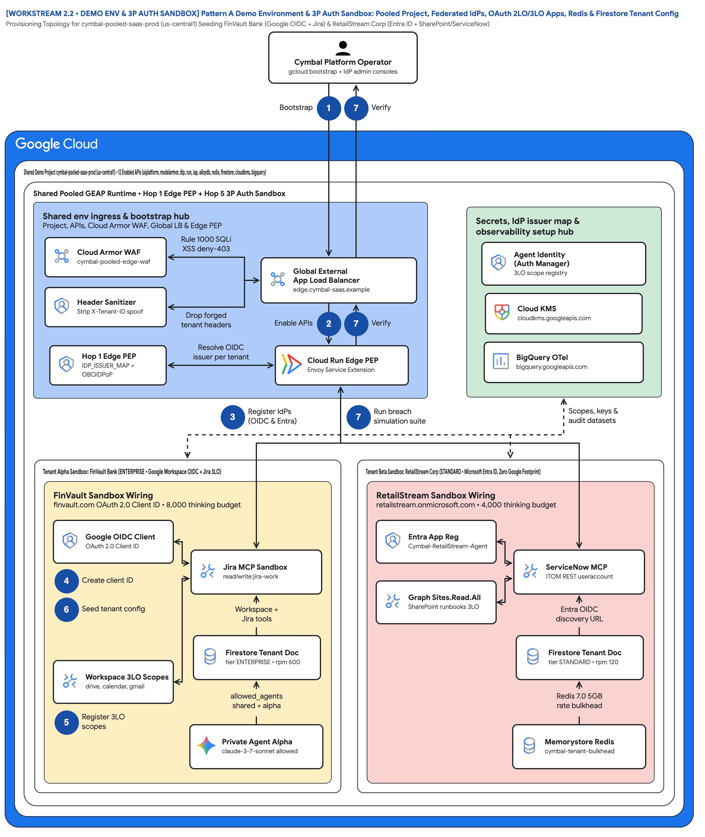
FIGURE 3 — PATTERN A DEMO ENVIRONMENT & 3P AUTH SANDBOX: POOLED PROJECT, FEDERATED IDPS, OAUTH 2LO/3LO APPS, REDIS & FIRESTORE TENANT CONFIG | ID: VIS-WS2-DEMO-ENV-AND-3P-AUTH-SANDBOX-TOPOLOGY • 1:1 Master High-Resolution Widescreen Architecture (Slide 2 contains Decomposed Vector Shapes)
Notes:
Figure 3 — Pattern A Demo Environment & 3P Auth Sandbox: Pooled Project, Federated IdPs, OAuth 2LO/3LO Apps, Redis & Firestore Tenant Config
Provisioning Topology for cymbal-pooled-saas-prod (us-central1) Seeding FinVault Bank (Google OIDC + Jira) & RetailStream Corp (Entra ID + SharePoint/ServiceNow)
• One shared project (cymbal-pooled-saas-prod, us-central1) with 12 enabled APIs hosts both demo tenants; isolation is logical, not per-project.
• Routing hub is the Hop 1 front door: Cloud Armor cymbal-pooled-edge-waf (rule 1000 SQLi/XSS deny-403) plus the Edge PEP that strips forged X-Tenant-ID headers.
• Left spoke wires FinVault Bank: a Google OAuth 2.0 Client ID on finvault.com, Workspace 3LO scopes (drive, calendar, gmail) and Jira read/write:jira-work.
• Right spoke wires RetailStream Corp with zero Google footprint: Entra app Cymbal-RetailStream-Agent-Client, Graph Sites.Read.All, ServiceNow useraccount.
• Governance hub holds the shared setup: Agent Identity (Auth Manager) scope registry, Cloud KMS for CMEK and BigQuery for OpenTelemetry audit.
• Firestore seeds tier, thinking budget (8000 vs 4000), Redis rpm (600 vs 120) and allowed_agents per tenant; the 2.5 breach suite verifies the whole sandbox.
Editable source: diagrams/ws2-demo-env-and-3p-auth-sandbox-topology.drawio (PromptCanvas Vision Decompiler)

Slide 15
FIGURE 3 — PATTERN A DEMO ENVIRONMENT & 3P AUTH SANDBOX: POOLED PROJECT, FEDERATED IDPS, OAUTH 2LO/3LO APPS, REDIS & FIRESTORE TENANT CONFIG | ID: VIS-WS2-DEMO-ENV-AND-3P-AUTH-SANDBOX-TOPOLOGY • 100% Decomposed Native Editable Vector Shapes, Icons & Arrows (Click any element to move or edit)
[WORKSTREAM 2.2 • DEMO ENV & 3P AUTH SANDBOX] Pattern A Demo Environment & 3P Auth Sandbox: Pooled Project, Federated IdPs, OAuth 2LO/3LO Apps, Redis & Firestore Tenant Config
Provisioning Topology for cymbal-pooled-saas-prod (us-central1) Seeding FinVault Bank (Google OIDC + Jira) & RetailStream Corp (Entra ID + SharePoint/ServiceNow)
FIGURE 3
Cymbal Platform Operatorgcloud bootstrap + IdP admin consoles
Pattern A Demo Environment & 3P Auth Sandbox: Pooled Project, Federated IdPs, OAuth 2LO/3LO Apps, Redis & Firestore Tenant Config
Bootstrap
1
7
Verify
Shared Demo Project cymbal-pooled-saas-prod (us-central1) • 12 Enabled APIs (aiplatform, modelarmor, dlp, run, iap, alloydb, redis, firestore, cloudkms, bigquery)
Shared Pooled GEAP Runtime • Hop 1 Edge PEP + Hop 5 3P Auth Sandbox
One shared project (cymbal-pooled-saas-prod, us-central1) with 12 enabled APIs hosts both demo tenants; isolation is logical, not per-project.
Routing hub is the Hop 1 front door: Cloud Armor cymbal-pooled-edge-waf (rule 1000 SQLi/XSS deny-403) plus the Edge PEP that strips forged X-Tenant-ID headers.
Left spoke wires FinVault Bank: a Google OAuth 2.0 Client ID on finvault.com, Workspace 3LO scopes (drive, calendar, gmail) and Jira read/write:jira-work.
Right spoke wires RetailStream Corp with zero Google footprint: Entra app Cymbal-RetailStream-Agent-Client, Graph Sites.Read.All, ServiceNow useraccount.
Governance hub holds the shared setup: Agent Identity (Auth Manager) scope registry, Cloud KMS for CMEK and BigQuery for OpenTelemetry audit.
Firestore seeds tier, thinking budget (8000 vs 4000), Redis rpm (600 vs 120) and allowed_agents per tenant; the 2.5 breach suite verifies the whole sandbox.
Shared env ingress & bootstrap hub
Project, APIs, Cloud Armor WAF, Global LB & Edge PEP
Secrets, IdP issuer map &
observability setup hub
Cloud Armor WAF
cymbal-pooled-edge-waf
Rule 1000 SQLi
XSS deny-403
Agent Identity
(Auth Manager) • 3LO scope registry
Global External
App Load Balancer • edge.cymbal-saas.example
Header Sanitizer
Strip X-Tenant-ID spoof
Cloud KMS
cloudkms.googleapis.com
Drop forged
tenant headers
Enable APIs
2
7
Verify
Hop 1 Edge PEP
IDP_ISSUER_MAP + OBO/DPoP
Resolve OIDC
issuer per tenant
Cloud Run Edge PEP
Envoy Service Extension
BigQuery OTel
bigquery.googleapis.com
3
Register IdPs
(OIDC & Entra)
7
Run breach
simulation suite
Scopes, keys &
audit datasets
Tenant Alpha Sandbox: FinVault Bank (ENTERPRISE • Google Workspace OIDC + Jira 3LO)
Tenant Beta Sandbox: RetailStream Corp (STANDARD • Microsoft Entra ID, Zero Google Footprint)
FinVault Sandbox Wiring
finvault.com OAuth 2.0 Client ID • 8,000 thinking budget
RetailStream Sandbox Wiring
retailstream.onmicrosoft.com • 4,000 thinking budget
Google OIDC Client
OAuth 2.0 Client ID
Entra App Reg
Cymbal-RetailStream-Agent
Jira MCP Sandbox
read/write:jira-work
ServiceNow MCP
ITOM REST useraccount
4
Create client ID
Graph Sites.Read.All
SharePoint runbooks 3LO
6
Seed tenant config
Workspace +
Jira tools
Entra OIDC
discovery URL
Firestore Tenant Doc
tier ENTERPRISE • rpm 600
Firestore Tenant Doc
tier STANDARD • rpm 120
Workspace 3LO Scopes
drive, calendar, gmail
allowed_agents
shared + alpha
Redis 7.0 5GB
rate bulkhead
56 native shapes • 23 connectors • click any box, icon or arrow to edit
5
Register 3LO
scopes
Private Agent Alpha
claude-3-7-sonnet allowed
Memorystore Redis
cymbal-tenant-bulkhead
Zones: Routing hub • Central governance & security hub • Left spoke • Right spoke | Source: diagrams/ws2-demo-env-and-3p-auth-sandbox-topology.drawio
Notes:
Figure 3 — Pattern A Demo Environment & 3P Auth Sandbox: Pooled Project, Federated IdPs, OAuth 2LO/3LO Apps, Redis & Firestore Tenant Config
Provisioning Topology for cymbal-pooled-saas-prod (us-central1) Seeding FinVault Bank (Google OIDC + Jira) & RetailStream Corp (Entra ID + SharePoint/ServiceNow)
• One shared project (cymbal-pooled-saas-prod, us-central1) with 12 enabled APIs hosts both demo tenants; isolation is logical, not per-project.
• Routing hub is the Hop 1 front door: Cloud Armor cymbal-pooled-edge-waf (rule 1000 SQLi/XSS deny-403) plus the Edge PEP that strips forged X-Tenant-ID headers.
• Left spoke wires FinVault Bank: a Google OAuth 2.0 Client ID on finvault.com, Workspace 3LO scopes (drive, calendar, gmail) and Jira read/write:jira-work.
• Right spoke wires RetailStream Corp with zero Google footprint: Entra app Cymbal-RetailStream-Agent-Client, Graph Sites.Read.All, ServiceNow useraccount.
• Governance hub holds the shared setup: Agent Identity (Auth Manager) scope registry, Cloud KMS for CMEK and BigQuery for OpenTelemetry audit.
• Firestore seeds tier, thinking budget (8000 vs 4000), Redis rpm (600 vs 120) and allowed_agents per tenant; the 2.5 breach suite verifies the whole sandbox.
Editable source: diagrams/ws2-demo-env-and-3p-auth-sandbox-topology.drawio (PromptCanvas Vision Decompiler)

Slide 16
FIGURE 3 — PATTERN A DEMO ENVIRONMENT & 3P AUTH SANDBOX: POOLED PROJECT, FEDERATED IDPS, OAUTH 2LO/3LO APPS, REDIS & FIRESTORE TENANT CONFIG | Editable Architecture Component & Topology Specification Table
Object ID | Component Name | Architectural Role / Details | Type
OBJ-01 | Shared Demo Project cymbal-pooled-saas-prod (us-central1) • 12 Enabled APIs (aiplatform,… | Core Architecture Node | Enclave / Tier
OBJ-02 | Shared Pooled GEAP Runtime • Hop 1 Edge PEP + Hop 5 3P Auth Sandbox | Core Architecture Node | Enclave / Tier
OBJ-03 | Tenant Alpha Sandbox: FinVault Bank (ENTERPRISE • Google Workspace OIDC + Jira 3LO) | Core Architecture Node | Enclave / Tier
OBJ-04 | Tenant Beta Sandbox: RetailStream Corp (STANDARD • Microsoft Entra ID, Zero Google Footpr… | Core Architecture Node | Enclave / Tier
OBJ-05 | FinVault Sandbox Wiring | finvault.com OAuth 2.0 Client ID • 8,000 thinking budget | Enclave / Tier
OBJ-06 | RetailStream Sandbox Wiring | retailstream.onmicrosoft.com • 4,000 thinking budget | Enclave / Tier
OBJ-07 | Shared env ingress & bootstrap hub | Project, APIs, Cloud Armor WAF, Global LB & Edge PEP | Enclave / Tier
OBJ-08 | Secrets, IdP issuer map & | observability setup hub | Enclave / Tier
OBJ-09 | [WORKSTREAM 2.2 • DEMO ENV & 3P AUTH SANDBOX] Pattern A Demo Environment & 3P Auth Sandbo… | Provisioning Topology for cymbal-pooled-saas-prod (us-central1) Seeding FinVault Bank (Google OIDC + Jira) &… | Service Node
OBJ-10 | Cymbal Platform Operatorgcloud bootstrap + IdP admin consoles | Core Architecture Node | Service Node
OBJ-11 | Global External | App Load Balancer • edge.cymbal-saas.example | Service Node
OBJ-12 | Agent Identity | (Auth Manager) • 3LO scope registry | Service Node
OBJ-13 | BigQuery OTel | bigquery.googleapis.com | Service Node
OBJ-14 | Cloud KMS | cloudkms.googleapis.com | Service Node
Notes:
Figure 3 component inventory for Pattern A Demo Environment & 3P Auth Sandbox: Pooled Project, Federated IdPs, OAuth 2LO/3LO Apps, Redis & Firestore Tenant Config

Slide 17
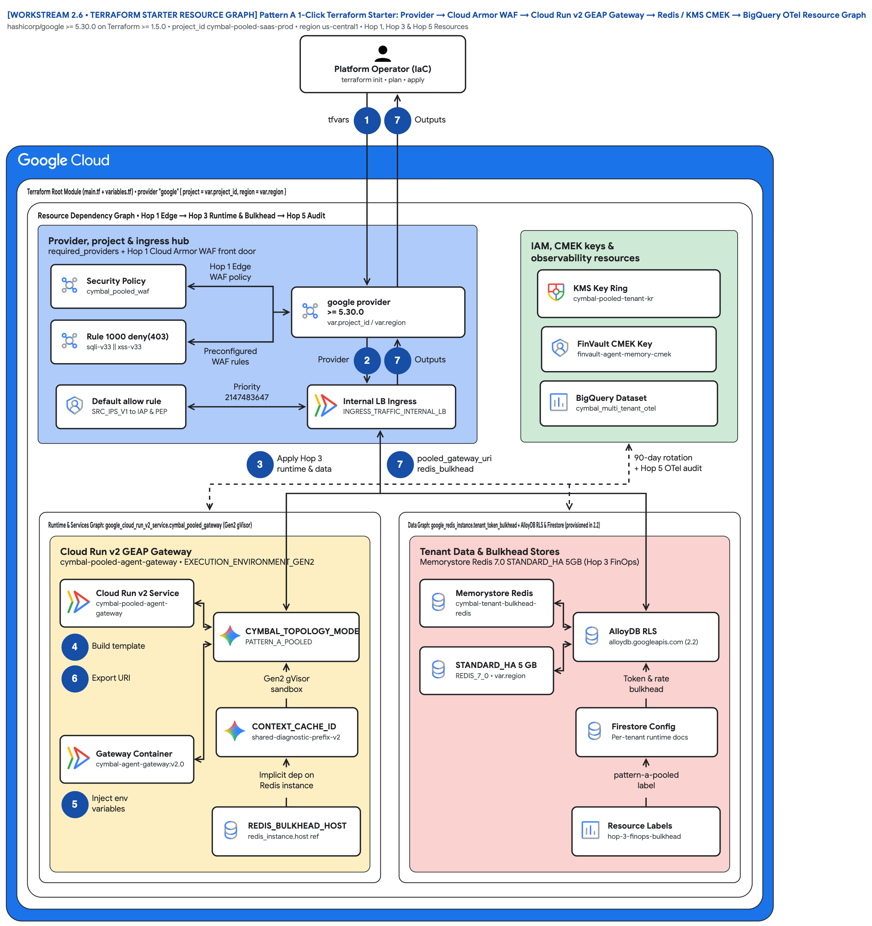
FIGURE 4 — PATTERN A 1-CLICK TERRAFORM STARTER: PROVIDER → CLOUD ARMOR WAF → CLOUD RUN V2 GEAP GATEWAY → REDIS / KMS CMEK → BIGQUERY OTEL RESOURCE GRAPH | ID: VIS-WS2-TERRAFORM-STARTER-RESOURCE-GRAPH • 1:1 Master High-Resolution Widescreen Architecture (Slide 2 contains Decomposed Vector Shapes)
Notes:
Figure 4 — Pattern A 1-Click Terraform Starter: Provider → Cloud Armor WAF → Cloud Run v2 GEAP Gateway → Redis / KMS CMEK → BigQuery OTel Resource Graph
hashicorp/google >= 5.30.0 on Terraform >= 1.5.0 • project_id cymbal-pooled-saas-prod • region us-central1 • Hop 1, Hop 3 & Hop 5 Resources
• A single root module (main.tf + variables.tf) on Terraform >= 1.5.0 with hashicorp/google >= 5.30.0 deploys the pooled Pattern A core in one apply.
• Routing hub is Hop 1: google_compute_security_policy.cymbal_pooled_waf with a deny(403) SQLi/XSS rule at priority 1000 and a default SRC_IPS_V1 allow.
• Left spoke is the runtime graph: google_cloud_run_v2_service.cymbal_pooled_gateway, Gen2 gVisor, internal-LB ingress and env vars referencing other resources.
• Right spoke is the data graph: google_redis_instance.tenant_token_bulkhead (REDIS_7_0, STANDARD_HA, 5 GB); AlloyDB RLS and Firestore are provisioned in 2.2.
• Governance hub covers keys and audit: cymbal-pooled-tenant-kr key ring, finvault-agent-memory-cmek (90-day rotation), BigQuery dataset cymbal_multi_tenant_otel.
• Two outputs close the loop — pooled_gateway_uri and redis_bulkhead_host — so downstream workstreams can bind to the deployed resources without hardcoding.
Editable source: diagrams/ws2-terraform-starter-resource-graph.drawio (PromptCanvas Vision Decompiler)

Slide 18
FIGURE 4 — PATTERN A 1-CLICK TERRAFORM STARTER: PROVIDER → CLOUD ARMOR WAF → CLOUD RUN V2 GEAP GATEWAY → REDIS / KMS CMEK → BIGQUERY OTEL RESOURCE GRAPH | ID: VIS-WS2-TERRAFORM-STARTER-RESOURCE-GRAPH • 100% Decomposed Native Editable Vector Shapes, Icons & Arrows (Click any element to move or edit)
[WORKSTREAM 2.6 • TERRAFORM STARTER RESOURCE GRAPH] Pattern A 1-Click Terraform Starter: Provider → Cloud Armor WAF → Cloud Run v2 GEAP Gateway → Redis / KMS CMEK → BigQuery OTel Resource Graph
hashicorp/google >= 5.30.0 on Terraform >= 1.5.0 • project_id cymbal-pooled-saas-prod • region us-central1 • Hop 1, Hop 3 & Hop 5 Resources
FIGURE 4
Platform Operator (IaC)terraform init • plan • apply
Pattern A 1-Click Terraform Starter: Provider → Cloud Armor WAF → Cloud Run v2 GEAP Gateway → Redis / KMS CMEK → BigQuery OTel Resource Graph
tfvars
1
7
Outputs
Terraform Root Module (main.tf + variables.tf) • provider "google" { project = var.project_id, region = var.region }
Resource Dependency Graph • Hop 1 Edge → Hop 3 Runtime & Bulkhead → Hop 5 Audit
A single root module (main.tf + variables.tf) on Terraform >= 1.5.0 with hashicorp/google >= 5.30.0 deploys the pooled Pattern A core in one apply.
Routing hub is Hop 1: google_compute_security_policy.cymbal_pooled_waf with a deny(403) SQLi/XSS rule at priority 1000 and a default SRC_IPS_V1 allow.
Left spoke is the runtime graph: google_cloud_run_v2_service.cymbal_pooled_gateway, Gen2 gVisor, internal-LB ingress and env vars referencing other resources.
Right spoke is the data graph: google_redis_instance.tenant_token_bulkhead (REDIS_7_0, STANDARD_HA, 5 GB); AlloyDB RLS and Firestore are provisioned in 2.2.
Governance hub covers keys and audit: cymbal-pooled-tenant-kr key ring, finvault-agent-memory-cmek (90-day rotation), BigQuery dataset cymbal_multi_tenant_otel.
Two outputs close the loop — pooled_gateway_uri and redis_bulkhead_host — so downstream workstreams can bind to the deployed resources without hardcoding.
Provider, project & ingress hub
required_providers + Hop 1 Cloud Armor WAF front door
IAM, CMEK keys &
observability resources
Security Policy
cymbal_pooled_waf
Hop 1 Edge
WAF policy
KMS Key Ring
cymbal-pooled-tenant-kr
google provider
>= 5.30.0 • var.project_id / var.region
Rule 1000 deny(403)
sqli-v33 || xss-v33
FinVault CMEK Key
finvault-agent-memory-cmek
Preconfigured
WAF rules
Provider
2
7
Outputs
Default allow rule
SRC_IPS_V1 to IAP & PEP
Priority
2147483647
Internal LB Ingress
INGRESS_TRAFFIC_INTERNAL_LB
BigQuery Dataset
cymbal_multi_tenant_otel
3
Apply Hop 3
runtime & data
7
pooled_gateway_uri
redis_bulkhead
90-day rotation
+ Hop 5 OTel audit
Runtime & Services Graph: google_cloud_run_v2_service.cymbal_pooled_gateway (Gen2 gVisor)
Data Graph: google_redis_instance.tenant_token_bulkhead + AlloyDB RLS & Firestore (provisioned in 2.2)
Cloud Run v2 GEAP Gateway
cymbal-pooled-agent-gateway • EXECUTION_ENVIRONMENT_GEN2
Tenant Data & Bulkhead Stores
Memorystore Redis 7.0 STANDARD_HA 5GB (Hop 3 FinOps)
Cloud Run v2 Service
cymbal-pooled-agent-gateway
Memorystore Redis
cymbal-tenant-bulkhead-redis
CYMBAL_TOPOLOGY_MODE
PATTERN_A_POOLED
AlloyDB RLS
alloydb.googleapis.com (2.2)
4
Build template
STANDARD_HA 5 GB
REDIS_7_0 • var.region
6
Export URI
Gen2 gVisor
sandbox
Token & rate
bulkhead
CONTEXT_CACHE_ID
shared-diagnostic-prefix-v2
Firestore Config
Per-tenant runtime docs
Gateway Container
cymbal-agent-gateway:v2.0
Implicit dep on
Redis instance
pattern-a-pooled
label
56 native shapes • 23 connectors • click any box, icon or arrow to edit
5
Inject env
variables
REDIS_BULKHEAD_HOST
redis_instance.host ref
Resource Labels
hop-3-finops-bulkhead
Zones: Routing hub • Central governance & security hub • Left spoke • Right spoke | Source: diagrams/ws2-terraform-starter-resource-graph.drawio
Notes:
Figure 4 — Pattern A 1-Click Terraform Starter: Provider → Cloud Armor WAF → Cloud Run v2 GEAP Gateway → Redis / KMS CMEK → BigQuery OTel Resource Graph
hashicorp/google >= 5.30.0 on Terraform >= 1.5.0 • project_id cymbal-pooled-saas-prod • region us-central1 • Hop 1, Hop 3 & Hop 5 Resources
• A single root module (main.tf + variables.tf) on Terraform >= 1.5.0 with hashicorp/google >= 5.30.0 deploys the pooled Pattern A core in one apply.
• Routing hub is Hop 1: google_compute_security_policy.cymbal_pooled_waf with a deny(403) SQLi/XSS rule at priority 1000 and a default SRC_IPS_V1 allow.
• Left spoke is the runtime graph: google_cloud_run_v2_service.cymbal_pooled_gateway, Gen2 gVisor, internal-LB ingress and env vars referencing other resources.
• Right spoke is the data graph: google_redis_instance.tenant_token_bulkhead (REDIS_7_0, STANDARD_HA, 5 GB); AlloyDB RLS and Firestore are provisioned in 2.2.
• Governance hub covers keys and audit: cymbal-pooled-tenant-kr key ring, finvault-agent-memory-cmek (90-day rotation), BigQuery dataset cymbal_multi_tenant_otel.
• Two outputs close the loop — pooled_gateway_uri and redis_bulkhead_host — so downstream workstreams can bind to the deployed resources without hardcoding.
Editable source: diagrams/ws2-terraform-starter-resource-graph.drawio (PromptCanvas Vision Decompiler)

Slide 19
FIGURE 4 — PATTERN A 1-CLICK TERRAFORM STARTER: PROVIDER → CLOUD ARMOR WAF → CLOUD RUN V2 GEAP GATEWAY → REDIS / KMS CMEK → BIGQUERY OTEL RESOURCE GRAPH | Editable Architecture Component & Topology Specification Table
Object ID | Component Name | Architectural Role / Details | Type
OBJ-01 | Terraform Root Module (main.tf + variables.tf) • provider "google" { project = var.projec… | Core Architecture Node | Enclave / Tier
OBJ-02 | Resource Dependency Graph • Hop 1 Edge → Hop 3 Runtime & Bulkhead → Hop 5 Audit | Core Architecture Node | Enclave / Tier
OBJ-03 | Runtime & Services Graph: google_cloud_run_v2_service.cymbal_pooled_gateway (Gen2 gVisor) | Core Architecture Node | Enclave / Tier
OBJ-04 | Data Graph: google_redis_instance.tenant_token_bulkhead + AlloyDB RLS & Firestore (provis… | Core Architecture Node | Enclave / Tier
OBJ-05 | Cloud Run v2 GEAP Gateway | cymbal-pooled-agent-gateway • EXECUTION_ENVIRONMENT_GEN2 | Enclave / Tier
OBJ-06 | Tenant Data & Bulkhead Stores | Memorystore Redis 7.0 STANDARD_HA 5GB (Hop 3 FinOps) | Enclave / Tier
OBJ-07 | Provider, project & ingress hub | required_providers + Hop 1 Cloud Armor WAF front door | Enclave / Tier
OBJ-08 | IAM, CMEK keys & | observability resources | Enclave / Tier
OBJ-09 | [WORKSTREAM 2.6 • TERRAFORM STARTER RESOURCE GRAPH] Pattern A 1-Click Terraform Starter:… | hashicorp/google >= 5.30.0 on Terraform >= 1.5.0 • project_id cymbal-pooled-saas-prod • region us-central1 •… | Service Node
OBJ-10 | Platform Operator (IaC)terraform init • plan • apply | Core Architecture Node | Service Node
OBJ-11 | google provider | >= 5.30.0 • var.project_id / var.region | Service Node
OBJ-12 | KMS Key Ring | cymbal-pooled-tenant-kr | Service Node
OBJ-13 | BigQuery Dataset | cymbal_multi_tenant_otel | Service Node
OBJ-14 | FinVault CMEK Key | finvault-agent-memory-cmek | Service Node
Notes:
Figure 4 component inventory for Pattern A 1-Click Terraform Starter: Provider → Cloud Armor WAF → Cloud Run v2 GEAP Gateway → Redis / KMS CMEK → BigQuery OTel Resource Graph

Slide 20
WS2 | Key Takeaways
Key Takeaways
Pooled density and zero-bleed isolation are compatible when tenant identity is cryptographic and enforced at every hop, not just the gateway.
Shared compute (gVisor pods) and shared storage (AlloyDB RLS) plus tenant-scoped policy is the whole Pattern A picture.
Read-only immutable prefix caching is both the FinOps lever (90% prefix discount) and a security control (no suffix write-back).
Verify architecture with a deterministic red-team suite that asserts status codes, decisions and payloads for all 10 vectors.
Graduate tenants to Pattern B Sovereign Silos only when they mandate VPC-SC, project separation, CMEK kill-switch or air-gapped Gemma 3.
Run run_breach_simulations.py, apply the 2.6 Terraform starter, complete the 90-minute codelab, then continue to Workstream 3 — Pattern B Sovereign Silos.
Notes:
Key Takeaways
• Pooled density and zero-bleed isolation are compatible when tenant identity is cryptographic and enforced at every hop, not just the gateway.
• Shared compute (gVisor pods) and shared storage (AlloyDB RLS) plus tenant-scoped policy is the whole Pattern A picture.
• Read-only immutable prefix caching is both the FinOps lever (90% prefix discount) and a security control (no suffix write-back).
• Verify architecture with a deterministic red-team suite that asserts status codes, decisions and payloads for all 10 vectors.
• Graduate tenants to Pattern B Sovereign Silos only when they mandate VPC-SC, project separation, CMEK kill-switch or air-gapped Gemma 3.

Slide 21
WS2 | Assets, Editable Diagrams & Source Documents
Assets & Editable Diagrams
Diagram | Editable Draw.io | Draw.io Render | Vision AST
WORKSTREAM 2.1 • PATTERN A BLUEPRINT Pattern A: High-Density Pooled Multi-Tenant Architecture & Shared Runtime Governance | diagrams/ws2-pattern-a-pooled-5hop-architecture.drawio | diagrams/ws2-pattern-a-pooled-5hop-architecture.drawio.png | diagrams/vision_metadata/ws2-pattern-a-pooled-5hop-architecture.vision.json
WORKSTREAM 2.5 • BREACH SUITE BLUEPRINT Pattern A: 10-Point Cross-Tenant Breach Simulation & Cryptographic Defense Matrix | diagrams/ws2-pattern-a-breach-defense-sequence.drawio | diagrams/ws2-pattern-a-breach-defense-sequence.drawio.png | diagrams/vision_metadata/ws2-pattern-a-breach-defense-sequence.vision.json
WORKSTREAM 2.2 • DEMO ENV & 3P AUTH SANDBOX Pattern A Demo Environment & 3P Auth Sandbox: Pooled Project, Federated IdPs, OAuth 2LO/3LO Apps, Redis & Firestore Tenant Config | diagrams/ws2-demo-env-and-3p-auth-sandbox-topology.drawio | diagrams/ws2-demo-env-and-3p-auth-sandbox-topology.drawio.png | diagrams/vision_metadata/ws2-demo-env-and-3p-auth-sandbox-topology.vision.json
WORKSTREAM 2.6 • TERRAFORM STARTER RESOURCE GRAPH Pattern A 1-Click Terraform Starter: Provider → Cloud Armor WAF → Cloud Run v2 GEAP Gateway → Redis / KMS CMEK → BigQuery OTel Resource Graph | diagrams/ws2-terraform-starter-resource-graph.drawio | diagrams/ws2-terraform-starter-resource-graph.drawio.png | diagrams/vision_metadata/ws2-terraform-starter-resource-graph.vision.json
Blog: blogs/ws2-pattern-a-pooled-architecture.md
Source: workstream-2-pattern-a-pooled/2.1-case-study-and-solution-architecture.md
Source: workstream-2-pattern-a-pooled/2.5-breach-simulation-suite/run_breach_simulations.py
Source: workstream-2-pattern-a-pooled/2.7-blog-pooled-architecture-governance.md
Anchor reference: https://docs.cloud.google.com/architecture/multi-tenant-agentic-ai-system
GitHub: https://github.com/nitinaggarwal-12/blogs
Notes:
Run run_breach_simulations.py, apply the 2.6 Terraform starter, complete the 90-minute codelab, then continue to Workstream 3 — Pattern B Sovereign Silos.

