Slide 1
WORKSTREAM 3 • PATTERN B — ZERO-TRUST SOVEREIGN SILOS
Pattern B — Sovereign Silos: One Project, One Perimeter, One Key per Tenant
Reusing the 80% 5-Hop Cymbal core inside dedicated VPC-SC / PAB / CMEK tenant projects with air-gapped Gemma 3 on GKE
Multi-Tenant Agentic AI on Google Cloud • Gemini Enterprise Agent Platform (GEAP) & ADK 2.0
Every diagram slide is 100% native editable (PromptCanvas Vision Decompiler → Draw.io → PowerPoint / Google Slides)
Anchor reference: https://docs.cloud.google.com/architecture/multi-tenant-agentic-ai-system
Notes:
Pattern B — Sovereign Silos: One Project, One Perimeter, One Key per Tenant
Reusing the 80% 5-Hop Cymbal core inside dedicated VPC-SC / PAB / CMEK tenant projects with air-gapped Gemma 3 on GKE
Series: Multi-Tenant Agentic AI on Google Cloud • Gemini Enterprise Agent Platform (GEAP) & ADK 2.0

Slide 2
WS3 | Executive TL;DR
Executive TL;DR
Regulated tenants (OCC/FDIC, DORA, HIPAA, public sector) often prohibit shared compute, shared databases, and platform-owned keys.
Pattern B keeps core-cymbal-agent unchanged and adds a 20% delta: mTLS SPIFFE pinning, IAM PAB, VPC-SC perimeter, CMEK kill-switch, Gemma 3 on GKE.
Each tenant gets a dedicated project: cymbal-finvault-silo-prod and cymbal-retailstream-silo-prod, each with its own agent-memory-cmek key.
Revoking the tenant CMEK halts every agent turn at Hop 3 with HTTP 423 KMS_KEY_DISABLED; all 6 sovereign security tests pass.
Trade-off: zero noisy neighbours and simple per-project quotas versus a higher per-tenant infrastructure floor and multi-project operations.
Workstream 3 • Pattern B — Zero-Trust Sovereign Silos • Multi-Tenant Agentic AI on Google Cloud • Gemini Enterprise Agent Platform (GEAP) & ADK 2.0
Notes:
Executive TL;DR
• Regulated tenants (OCC/FDIC, DORA, HIPAA, public sector) often prohibit shared compute, shared databases, and platform-owned keys.
• Pattern B keeps core-cymbal-agent unchanged and adds a 20% delta: mTLS SPIFFE pinning, IAM PAB, VPC-SC perimeter, CMEK kill-switch, Gemma 3 on GKE.
• Each tenant gets a dedicated project: cymbal-finvault-silo-prod and cymbal-retailstream-silo-prod, each with its own agent-memory-cmek key.
• Revoking the tenant CMEK halts every agent turn at Hop 3 with HTTP 423 KMS_KEY_DISABLED; all 6 sovereign security tests pass.
• Trade-off: zero noisy neighbours and simple per-project quotas versus a higher per-tenant infrastructure floor and multi-project operations.

Slide 3
WS3 | Why Pooled Isolation Is Not Enough
Why Pooled Isolation Is Not Enough
Auditors ask whether any other customer could ever touch your compute, storage, or key — not just whether data is logically separated.
Four drivers: zero physical blast radius, customer-revocable encryption key, hard identity boundary, no multi-tenant model endpoints.
FinVault Bank (Google OIDC, Workspace + Jira) and RetailStream Corp (Entra ID, SharePoint + ServiceNow) each receive a sovereign silo.
Pattern A remains the right answer for Standard SaaS tiers thanks to ContextCacheConfig prefix caching (up to 90% COGS savings).
Workstream 3 • Pattern B — Zero-Trust Sovereign Silos
Notes:
Why Pooled Isolation Is Not Enough
• Auditors ask whether any other customer could ever touch your compute, storage, or key — not just whether data is logically separated.
• Four drivers: zero physical blast radius, customer-revocable encryption key, hard identity boundary, no multi-tenant model endpoints.
• FinVault Bank (Google OIDC, Workspace + Jira) and RetailStream Corp (Entra ID, SharePoint + ServiceNow) each receive a sovereign silo.
• Pattern A remains the right answer for Standard SaaS tiers thanks to ContextCacheConfig prefix caching (up to 90% COGS savings).

Slide 4
WS3 | The Sovereign Silo Model
The Sovereign Silo Model
PatternBSiloedService wraps CymbalMultiTenantRuntime and checks mTLS SPIFFE, PAB, and VPC-SC egress before the 5-Hop pipeline runs.
VPC-SC restricts aiplatform, discoveryengine, modelarmor, alloydb, storage, and bigquery APIs so valid credentials cannot exfiltrate.
Dedicated CMEK AlloyDB, 5-Level Memory Bank, BigQuery audit, GKE disks, and runtime all depend on one tenant key: agent-memory-cmek.
FinVault runs air-gapped gemma-3-27b-it-vllm on private GKE; RetailStream runs Gemini 2.5 Pro with dedicated Provisioned Throughput.
Workstream 3 • Pattern B — Zero-Trust Sovereign Silos
Notes:
The Sovereign Silo Model
• PatternBSiloedService wraps CymbalMultiTenantRuntime and checks mTLS SPIFFE, PAB, and VPC-SC egress before the 5-Hop pipeline runs.
• VPC-SC restricts aiplatform, discoveryengine, modelarmor, alloydb, storage, and bigquery APIs so valid credentials cannot exfiltrate.
• Dedicated CMEK AlloyDB, 5-Level Memory Bank, BigQuery audit, GKE disks, and runtime all depend on one tenant key: agent-memory-cmek.
• FinVault runs air-gapped gemma-3-27b-it-vllm on private GKE; RetailStream runs Gemini 2.5 Pro with dedicated Provisioned Throughput.

Slide 5
WS3 | 5-Hop Chain Inside a Silo
5-Hop Chain Inside a Silo
Hop 1 strips forged X-Tenant-ID headers, verifies IdP JWT, performs RFC 8693 OBO + DPoP, and mints PATTERN_B_SILOED context.
Hop 2 registry PDP and before_agent_callback pruning become defence-in-depth behind PAB and VPC-SC.
Hop 3 resolves silo_cmek_key_uri; a disabled key returns DENY 423 KMS_KEY_DISABLED before any Memory Bank or model call.
Hop 4 Model Armor and Hop 5 AlloyDB RLS + BigQuery OTel run unchanged, inside dedicated CMEK-encrypted resources.
Workstream 3 • Pattern B — Zero-Trust Sovereign Silos
Notes:
5-Hop Chain Inside a Silo
• Hop 1 strips forged X-Tenant-ID headers, verifies IdP JWT, performs RFC 8693 OBO + DPoP, and mints PATTERN_B_SILOED context.
• Hop 2 registry PDP and before_agent_callback pruning become defence-in-depth behind PAB and VPC-SC.
• Hop 3 resolves silo_cmek_key_uri; a disabled key returns DENY 423 KMS_KEY_DISABLED before any Memory Bank or model call.
• Hop 4 Model Armor and Hop 5 AlloyDB RLS + BigQuery OTel run unchanged, inside dedicated CMEK-encrypted resources.

Slide 6
WS3 | Verification: 6 Sovereign Security Tests
Verification: 6 Sovereign Security Tests
TEST 1: spoofed SPIFFE cert at FinVault ingress → 401 MTLS_CERTIFICATE_MISMATCH.
TEST 2: FinVault principal targets RetailStream project → 403 PAB_BOUNDARY_VIOLATION.
TEST 3: export to external-attacker-exfil-proj → 403 VPC_SERVICE_CONTROLS_PERMISSION_DENIED.
TEST 4A/4B/5: CMEK revoke → 423; restore → 200 with AirGapped-GKE-Gemma3-27B response prefix.
TEST 6: RetailStream silo CMEK revoke/restore parity verified; suite reports 100% VERIFIED.
Workstream 3 • Pattern B — Zero-Trust Sovereign Silos
Notes:
Verification: 6 Sovereign Security Tests
• TEST 1: spoofed SPIFFE cert at FinVault ingress → 401 MTLS_CERTIFICATE_MISMATCH.
• TEST 2: FinVault principal targets RetailStream project → 403 PAB_BOUNDARY_VIOLATION.
• TEST 3: export to external-attacker-exfil-proj → 403 VPC_SERVICE_CONTROLS_PERMISSION_DENIED.
• TEST 4A/4B/5: CMEK revoke → 423; restore → 200 with AirGapped-GKE-Gemma3-27B response prefix.
• TEST 6: RetailStream silo CMEK revoke/restore parity verified; suite reports 100% VERIFIED.

Slide 7
WS3 | Provisioning, Sign-Off & Blueprint
Provisioning, Sign-Off & Blueprint
3.2 runbook: create projects, enable 7 APIs, create finvault-kr/agent-memory-cmek (90-day rotation), bind finvault-sovereign-pab at org level.
3.4 sign-off: VPC-SC, PAB, CMEK kill-switch, and mTLS + air-gapped Gemma 3 all SIGNED OFF by GCP Security and GEAP Product Engineering.
3.6 Terraform blueprint provisions CMEK key, perimeter_<tenant>_sovereign, sovereign VPC, and <tenant>-airgapped-gemma3-gke per apply.
3.8 codelab (90 min, 5 modules) and 3.9 go/demos video script reuse the same verification gates.
Workstream 3 • Pattern B — Zero-Trust Sovereign Silos
Notes:
Provisioning, Sign-Off & Blueprint
• 3.2 runbook: create projects, enable 7 APIs, create finvault-kr/agent-memory-cmek (90-day rotation), bind finvault-sovereign-pab at org level.
• 3.4 sign-off: VPC-SC, PAB, CMEK kill-switch, and mTLS + air-gapped Gemma 3 all SIGNED OFF by GCP Security and GEAP Product Engineering.
• 3.6 Terraform blueprint provisions CMEK key, perimeter_<tenant>_sovereign, sovereign VPC, and <tenant>-airgapped-gemma3-gke per apply.
• 3.8 codelab (90 min, 5 modules) and 3.9 go/demos video script reuse the same verification gates.

Slide 8
WS3 | Trade-Offs & What Comes Next
Trade-Offs & What Comes Next
Pattern B is a different economic contract: dedicated quotas and zero noisy neighbours at a higher per-tenant floor.
The GKE GPU floor dominates cost when air-gapped inference is mandated — offer it as an explicit option, not a default.
Rehearse CMEK restoration with each customer SOC; revocation is immediate and total.
Workstream 4 (Pattern C) blends pooled and sovereign tiers via Private Service Connect spokes and zero-downtime tier migration.
Workstream 3 • Pattern B — Zero-Trust Sovereign Silos
Notes:
Trade-Offs & What Comes Next
• Pattern B is a different economic contract: dedicated quotas and zero noisy neighbours at a higher per-tenant floor.
• The GKE GPU floor dominates cost when air-gapped inference is mandated — offer it as an explicit option, not a default.
• Rehearse CMEK restoration with each customer SOC; revocation is immediate and total.
• Workstream 4 (Pattern C) blends pooled and sovereign tiers via Private Service Connect spokes and zero-downtime tier migration.

Slide 9
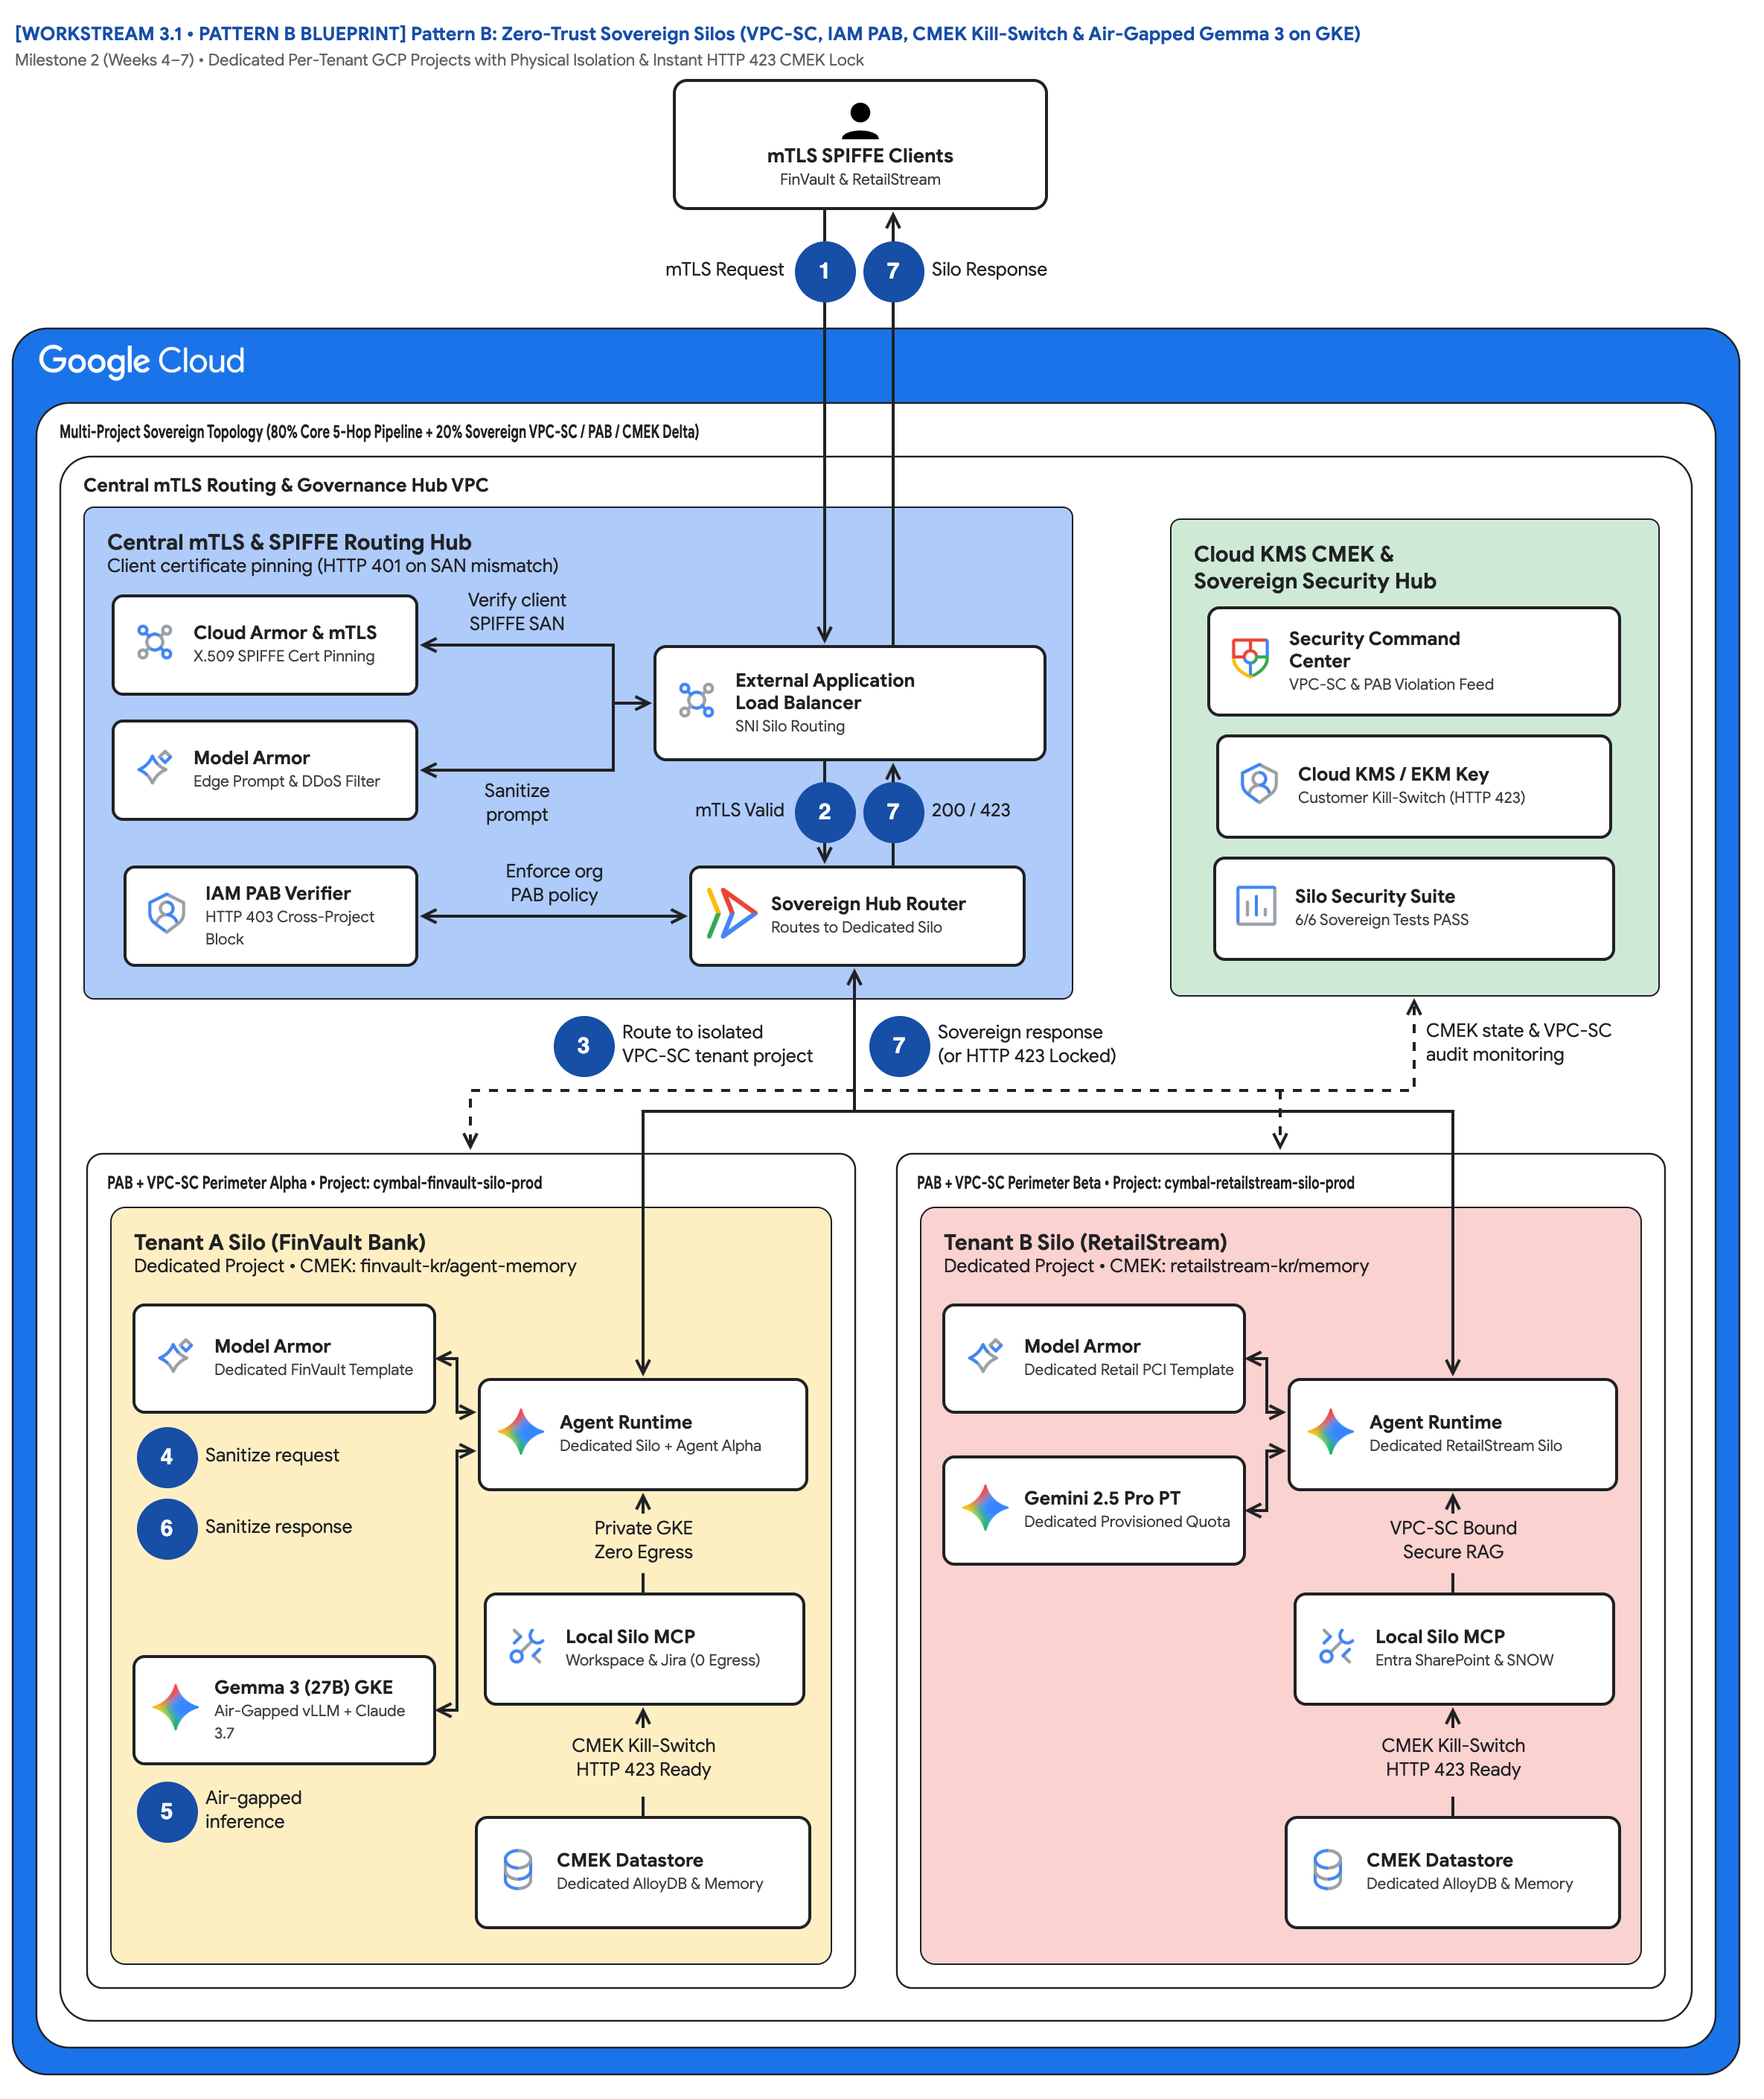
FIGURE 1 — PATTERN B: ZERO-TRUST SOVEREIGN SILOS (VPC-SC, IAM PAB, CMEK & AIR-GAPPED GEMMA 3 ON GKE) | ID: VIS-WS3-PATTERN-B-SOVEREIGN-SILOS-ARCHITECTURE • 1:1 Master High-Resolution Widescreen Architecture (Slide 2 contains Decomposed Vector Shapes)
Notes:
Figure 1 — Pattern B: Zero-Trust Sovereign Silos (VPC-SC, IAM PAB, CMEK & Air-Gapped Gemma 3 on GKE)
Milestone 2 (Weeks 4–7) • Dedicated Per-Tenant GCP Projects with Physical Isolation & Instant HTTP 423 CMEK Lock
• Follow badges 1→7: mTLS Request enters from the SPIFFE clients; Silo Response or HTTP 423 Locked returns on the same trunk.
• Routing hub: Cloud Armor SPIFFE pinning, Model Armor edge filter, IAM PAB Verifier, External ALB, Sovereign Hub Router.
• Governance hub: Security Command Center, Cloud KMS / EKM Key, and the Silo Security Suite 6/6 Sovereign Tests PASS card.
• Dashed line 'CMEK state & VPC-SC audit monitoring' feeds both silos — the signal Hop 3 uses to refuse work instantly.
• Left spoke: Perimeter Alpha / cymbal-finvault-silo-prod with Gemma 3 (27B) GKE air-gapped inference and Private GKE Zero Egress.
• Right spoke: Perimeter Beta / cymbal-retailstream-silo-prod with Gemini 2.5 Pro PT and Local Silo MCP Entra SharePoint & SNOW.
Editable source: diagrams/ws3-pattern-b-sovereign-silos-architecture.drawio (PromptCanvas Vision Decompiler)

Slide 10











FIGURE 1 — PATTERN B: ZERO-TRUST SOVEREIGN SILOS (VPC-SC, IAM PAB, CMEK & AIR-GAPPED GEMMA 3 ON GKE) | ID: VIS-WS3-PATTERN-B-SOVEREIGN-SILOS-ARCHITECTURE • 100% Decomposed Native Editable Vector Shapes, Icons & Arrows (Click any element to move or edit)
[WORKSTREAM 3.1 • PATTERN B BLUEPRINT] Pattern B: Zero-Trust Sovereign Silos (VPC-SC, IAM PAB, CMEK Kill-Switch & Air-Gapped Gemma 3 on GKE)
Milestone 2 (Weeks 4–7) • Dedicated Per-Tenant GCP Projects with Physical Isolation & Instant HTTP 423 CMEK Lock
FIGURE 1
mTLS SPIFFE ClientsFinVault & RetailStream
Pattern B: Zero-Trust Sovereign Silos (VPC-SC, IAM PAB, CMEK & Air-Gapped Gemma 3 on GKE)
mTLS Request
1
7
Silo Response
Multi-Project Sovereign Topology (80% Core 5-Hop Pipeline + 20% Sovereign VPC-SC / PAB / CMEK Delta)
Central mTLS Routing & Governance Hub VPC
Follow badges 1→7: mTLS Request enters from the SPIFFE clients; Silo Response or HTTP 423 Locked returns on the same trunk.
Routing hub: Cloud Armor SPIFFE pinning, Model Armor edge filter, IAM PAB Verifier, External ALB, Sovereign Hub Router.
Governance hub: Security Command Center, Cloud KMS / EKM Key, and the Silo Security Suite 6/6 Sovereign Tests PASS card.
Dashed line 'CMEK state & VPC-SC audit monitoring' feeds both silos — the signal Hop 3 uses to refuse work instantly.
Left spoke: Perimeter Alpha / cymbal-finvault-silo-prod with Gemma 3 (27B) GKE air-gapped inference and Private GKE Zero Egress.
Right spoke: Perimeter Beta / cymbal-retailstream-silo-prod with Gemini 2.5 Pro PT and Local Silo MCP Entra SharePoint & SNOW.
Central mTLS & SPIFFE Routing Hub
Client certificate pinning (HTTP 401 on SAN mismatch)
Cloud KMS CMEK &
Sovereign Security Hub
Cloud Armor & mTLS
X.509 SPIFFE Cert Pinning
Verify client
SPIFFE SAN
Security Command
Center • VPC-SC & PAB Violation Feed
External Application
Load Balancer • SNI Silo Routing
Model Armor
Edge Prompt & DDoS Filter
Cloud KMS / EKM Key
Customer Kill-Switch (HTTP 423)
Sanitize
prompt
mTLS Valid
2
7
200 / 423
IAM PAB Verifier
HTTP 403 Cross-Project Block
Enforce org
PAB policy
Sovereign Hub Router
Routes to Dedicated Silo
Silo Security Suite
6/6 Sovereign Tests PASS
3
Route to isolated
VPC-SC tenant project
7
Sovereign response
(or HTTP 423 Locked)
CMEK state & VPC-SC
audit monitoring
PAB + VPC-SC Perimeter Alpha • Project: cymbal-finvault-silo-prod
PAB + VPC-SC Perimeter Beta • Project: cymbal-retailstream-silo-prod
Tenant A Silo (FinVault Bank)
Dedicated Project • CMEK: finvault-kr/agent-memory
Tenant B Silo (RetailStream)
Dedicated Project • CMEK: retailstream-kr/memory
Model Armor
Dedicated FinVault Template
Model Armor
Dedicated Retail PCI Template
Agent Runtime
Dedicated Silo + Agent Alpha
Agent Runtime
Dedicated RetailStream Silo
4
Sanitize request
Gemini 2.5 Pro PT
Dedicated Provisioned Quota
6
Sanitize response
Private GKE
Zero Egress
VPC-SC Bound
Secure RAG
Local Silo MCP
Workspace & Jira (0 Egress)
Local Silo MCP
Entra SharePoint & SNOW
Gemma 3 (27B) GKE
Air-Gapped vLLM + Claude 3.7
CMEK Kill-Switch
HTTP 423 Ready
CMEK Kill-Switch
HTTP 423 Ready
56 native shapes • 23 connectors • click any box, icon or arrow to edit
5
Air-gapped
inference
CMEK Datastore
Dedicated AlloyDB & Memory
CMEK Datastore
Dedicated AlloyDB & Memory
Zones: Routing hub • Central governance & security hub • Left spoke • Right spoke | Source: diagrams/ws3-pattern-b-sovereign-silos-architecture.drawio
Notes:
Figure 1 — Pattern B: Zero-Trust Sovereign Silos (VPC-SC, IAM PAB, CMEK & Air-Gapped Gemma 3 on GKE)
Milestone 2 (Weeks 4–7) • Dedicated Per-Tenant GCP Projects with Physical Isolation & Instant HTTP 423 CMEK Lock
• Follow badges 1→7: mTLS Request enters from the SPIFFE clients; Silo Response or HTTP 423 Locked returns on the same trunk.
• Routing hub: Cloud Armor SPIFFE pinning, Model Armor edge filter, IAM PAB Verifier, External ALB, Sovereign Hub Router.
• Governance hub: Security Command Center, Cloud KMS / EKM Key, and the Silo Security Suite 6/6 Sovereign Tests PASS card.
• Dashed line 'CMEK state & VPC-SC audit monitoring' feeds both silos — the signal Hop 3 uses to refuse work instantly.
• Left spoke: Perimeter Alpha / cymbal-finvault-silo-prod with Gemma 3 (27B) GKE air-gapped inference and Private GKE Zero Egress.
• Right spoke: Perimeter Beta / cymbal-retailstream-silo-prod with Gemini 2.5 Pro PT and Local Silo MCP Entra SharePoint & SNOW.
Editable source: diagrams/ws3-pattern-b-sovereign-silos-architecture.drawio (PromptCanvas Vision Decompiler)

Slide 11
FIGURE 1 — PATTERN B: ZERO-TRUST SOVEREIGN SILOS (VPC-SC, IAM PAB, CMEK & AIR-GAPPED GEMMA 3 ON GKE) | Editable Architecture Component & Topology Specification Table
Object ID | Component Name | Architectural Role / Details | Type
OBJ-01 | Multi-Project Sovereign Topology (80% Core 5-Hop Pipeline + 20% Sovereign VPC-SC / PAB /… | Core Architecture Node | Enclave / Tier
OBJ-02 | Central mTLS Routing & Governance Hub VPC | Core Architecture Node | Enclave / Tier
OBJ-03 | PAB + VPC-SC Perimeter Alpha • Project: cymbal-finvault-silo-prod | Core Architecture Node | Enclave / Tier
OBJ-04 | PAB + VPC-SC Perimeter Beta • Project: cymbal-retailstream-silo-prod | Core Architecture Node | Enclave / Tier
OBJ-05 | Tenant A Silo (FinVault Bank) | Dedicated Project • CMEK: finvault-kr/agent-memory | Enclave / Tier
OBJ-06 | Tenant B Silo (RetailStream) | Dedicated Project • CMEK: retailstream-kr/memory | Enclave / Tier
OBJ-07 | Central mTLS & SPIFFE Routing Hub | Client certificate pinning (HTTP 401 on SAN mismatch) | Enclave / Tier
OBJ-08 | Cloud KMS CMEK & | Sovereign Security Hub | Enclave / Tier
OBJ-09 | [WORKSTREAM 3.1 • PATTERN B BLUEPRINT] Pattern B: Zero-Trust Sovereign Silos (VPC-SC, IAM… | Milestone 2 (Weeks 4–7) • Dedicated Per-Tenant GCP Projects with Physical Isolation & Instant HTTP 423 CMEK L… | Service Node
OBJ-10 | mTLS SPIFFE ClientsFinVault & RetailStream | Core Architecture Node | Service Node
OBJ-11 | External Application | Load Balancer • SNI Silo Routing | Service Node
OBJ-12 | Security Command | Center • VPC-SC & PAB Violation Feed | Service Node
OBJ-13 | Silo Security Suite | 6/6 Sovereign Tests PASS | Service Node
OBJ-14 | Cloud KMS / EKM Key | Customer Kill-Switch (HTTP 423) | Service Node
Notes:
Figure 1 component inventory for Pattern B: Zero-Trust Sovereign Silos (VPC-SC, IAM PAB, CMEK & Air-Gapped Gemma 3 on GKE)

Slide 12
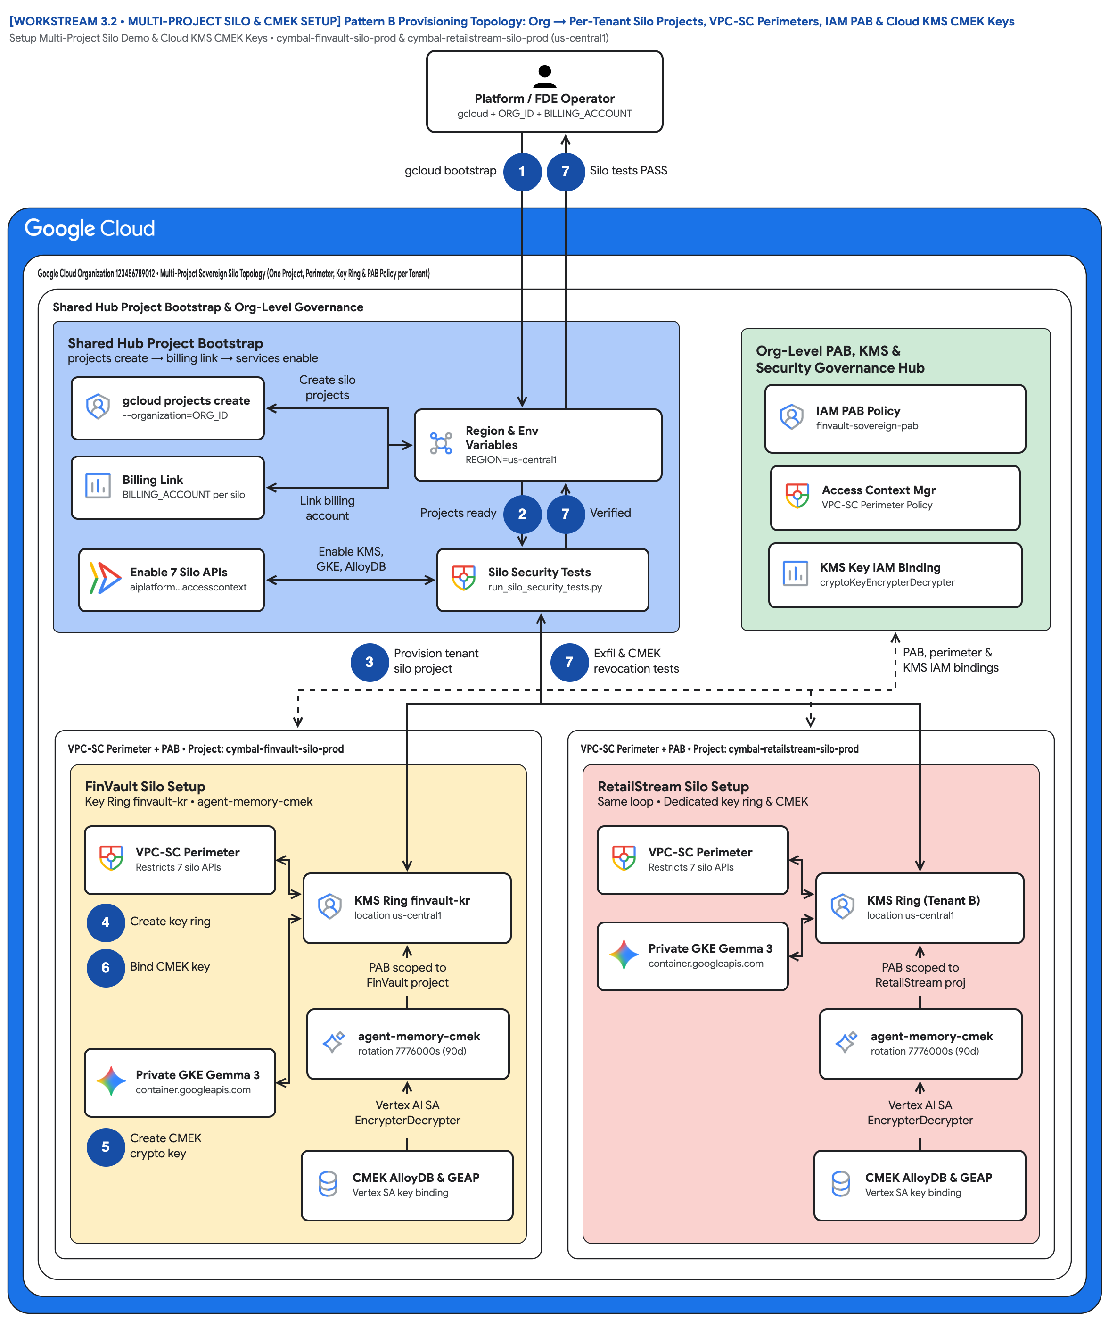
FIGURE 2 — PATTERN B PROVISIONING TOPOLOGY: ORG → PER-TENANT SILO PROJECTS, VPC-SC PERIMETERS, IAM PAB & CLOUD KMS CMEK KEYS | ID: VIS-WS3-MULTI-PROJECT-SILO-AND-CMEK-SETUP-TOPOLOGY • 1:1 Master High-Resolution Widescreen Architecture (Slide 2 contains Decomposed Vector Shapes)
Notes:
Figure 2 — Pattern B Provisioning Topology: Org → Per-Tenant Silo Projects, VPC-SC Perimeters, IAM PAB & Cloud KMS CMEK Keys
Setup Multi-Project Silo Demo & Cloud KMS CMEK Keys • cymbal-finvault-silo-prod & cymbal-retailstream-silo-prod (us-central1)
• One org, two dedicated tenant projects — cymbal-finvault-silo-prod and cymbal-retailstream-silo-prod — created under ORG_ID and linked to one billing account.
• Bootstrap enables seven silo APIs per project: aiplatform, discoveryengine, modelarmor, container, cloudkms, alloydb and accesscontextmanager.
• Per-tenant Cloud KMS: key ring finvault-kr in us-central1 with crypto key agent-memory-cmek, purpose encryption, 90-day (7776000s) rotation.
• The Vertex AI service agent (service-<PROJECT_NUMBER>@gcp-sa-aiplatform) receives roles/cloudkms.cryptoKeyEncrypterDecrypter on the tenant key only.
• Org-level IAM Principal Access Boundary finvault-sovereign-pab restricts FinVault principals strictly to the FinVault silo project resource.
• Step 7 closes the loop: run_silo_security_tests.py replays perimeter exfiltration and CMEK revocation checks before the silo is declared live.
Editable source: diagrams/ws3-multi-project-silo-and-cmek-setup-topology.drawio (PromptCanvas Vision Decompiler)

Slide 13
FIGURE 2 — PATTERN B PROVISIONING TOPOLOGY: ORG → PER-TENANT SILO PROJECTS, VPC-SC PERIMETERS, IAM PAB & CLOUD KMS CMEK KEYS | ID: VIS-WS3-MULTI-PROJECT-SILO-AND-CMEK-SETUP-TOPOLOGY • 100% Decomposed Native Editable Vector Shapes, Icons & Arrows (Click any element to move or edit)
[WORKSTREAM 3.2 • MULTI-PROJECT SILO & CMEK SETUP] Pattern B Provisioning Topology: Org → Per-Tenant Silo Projects, VPC-SC Perimeters, IAM PAB & Cloud KMS CMEK Keys
Setup Multi-Project Silo Demo & Cloud KMS CMEK Keys • cymbal-finvault-silo-prod & cymbal-retailstream-silo-prod (us-central1)
FIGURE 2
Platform / FDE Operatorgcloud + ORG_ID + BILLING_ACCOUNT
Pattern B Provisioning Topology: Org → Per-Tenant Silo Projects, VPC-SC Perimeters, IAM PAB & Cloud KMS CMEK Keys
gcloud bootstrap
1
7
Silo tests PASS
Google Cloud Organization 123456789012 • Multi-Project Sovereign Silo Topology (One Project, Perimeter, Key Ring & PAB Policy per Tenant)
Shared Hub Project Bootstrap & Org-Level Governance
One org, two dedicated tenant projects — cymbal-finvault-silo-prod and cymbal-retailstream-silo-prod — created under ORG_ID and linked to one billing account.
Bootstrap enables seven silo APIs per project: aiplatform, discoveryengine, modelarmor, container, cloudkms, alloydb and accesscontextmanager.
Per-tenant Cloud KMS: key ring finvault-kr in us-central1 with crypto key agent-memory-cmek, purpose encryption, 90-day (7776000s) rotation.
The Vertex AI service agent (service-<PROJECT_NUMBER>@gcp-sa-aiplatform) receives roles/cloudkms.cryptoKeyEncrypterDecrypter on the tenant key only.
Org-level IAM Principal Access Boundary finvault-sovereign-pab restricts FinVault principals strictly to the FinVault silo project resource.
Step 7 closes the loop: run_silo_security_tests.py replays perimeter exfiltration and CMEK revocation checks before the silo is declared live.
Shared Hub Project Bootstrap
projects create → billing link → services enable
Org-Level PAB, KMS &
Security Governance Hub
gcloud projects create
--organization=ORG_ID
Create silo
projects
IAM PAB Policy
finvault-sovereign-pab
Region & Env
Variables • REGION=us-central1
Billing Link
BILLING_ACCOUNT per silo
Access Context Mgr
VPC-SC Perimeter Policy
Link billing
account
Projects ready
2
7
Verified
Enable 7 Silo APIs
aiplatform…accesscontext
Enable KMS,
GKE, AlloyDB
Silo Security Tests
run_silo_security_tests.py
KMS Key IAM Binding
cryptoKeyEncrypterDecrypter
3
Provision tenant
silo project
7
Exfil & CMEK
revocation tests
PAB, perimeter &
KMS IAM bindings
VPC-SC Perimeter + PAB • Project: cymbal-finvault-silo-prod
VPC-SC Perimeter + PAB • Project: cymbal-retailstream-silo-prod
FinVault Silo Setup
Key Ring finvault-kr • agent-memory-cmek
RetailStream Silo Setup
Same loop • Dedicated key ring & CMEK
VPC-SC Perimeter
Restricts 7 silo APIs
VPC-SC Perimeter
Restricts 7 silo APIs
KMS Ring finvault-kr
location us-central1
KMS Ring (Tenant B)
location us-central1
4
Create key ring
Private GKE Gemma 3
container.googleapis.com
6
Bind CMEK key
PAB scoped to
FinVault project
PAB scoped to
RetailStream proj
agent-memory-cmek
rotation 7776000s (90d)
agent-memory-cmek
rotation 7776000s (90d)
Private GKE Gemma 3
container.googleapis.com
Vertex AI SA
EncrypterDecrypter
Vertex AI SA
EncrypterDecrypter
56 native shapes • 23 connectors • click any box, icon or arrow to edit
5
Create CMEK
crypto key
CMEK AlloyDB & GEAP
Vertex SA key binding
CMEK AlloyDB & GEAP
Vertex SA key binding
Zones: Routing hub • Central governance & security hub • Left spoke • Right spoke | Source: diagrams/ws3-multi-project-silo-and-cmek-setup-topology.drawio
Notes:
Figure 2 — Pattern B Provisioning Topology: Org → Per-Tenant Silo Projects, VPC-SC Perimeters, IAM PAB & Cloud KMS CMEK Keys
Setup Multi-Project Silo Demo & Cloud KMS CMEK Keys • cymbal-finvault-silo-prod & cymbal-retailstream-silo-prod (us-central1)
• One org, two dedicated tenant projects — cymbal-finvault-silo-prod and cymbal-retailstream-silo-prod — created under ORG_ID and linked to one billing account.
• Bootstrap enables seven silo APIs per project: aiplatform, discoveryengine, modelarmor, container, cloudkms, alloydb and accesscontextmanager.
• Per-tenant Cloud KMS: key ring finvault-kr in us-central1 with crypto key agent-memory-cmek, purpose encryption, 90-day (7776000s) rotation.
• The Vertex AI service agent (service-<PROJECT_NUMBER>@gcp-sa-aiplatform) receives roles/cloudkms.cryptoKeyEncrypterDecrypter on the tenant key only.
• Org-level IAM Principal Access Boundary finvault-sovereign-pab restricts FinVault principals strictly to the FinVault silo project resource.
• Step 7 closes the loop: run_silo_security_tests.py replays perimeter exfiltration and CMEK revocation checks before the silo is declared live.
Editable source: diagrams/ws3-multi-project-silo-and-cmek-setup-topology.drawio (PromptCanvas Vision Decompiler)

Slide 14
FIGURE 2 — PATTERN B PROVISIONING TOPOLOGY: ORG → PER-TENANT SILO PROJECTS, VPC-SC PERIMETERS, IAM PAB & CLOUD KMS CMEK KEYS | Editable Architecture Component & Topology Specification Table
Object ID | Component Name | Architectural Role / Details | Type
OBJ-01 | Google Cloud Organization 123456789012 • Multi-Project Sovereign Silo Topology (One Proje… | Core Architecture Node | Enclave / Tier
OBJ-02 | Shared Hub Project Bootstrap & Org-Level Governance | Core Architecture Node | Enclave / Tier
OBJ-03 | VPC-SC Perimeter + PAB • Project: cymbal-finvault-silo-prod | Core Architecture Node | Enclave / Tier
OBJ-04 | VPC-SC Perimeter + PAB • Project: cymbal-retailstream-silo-prod | Core Architecture Node | Enclave / Tier
OBJ-05 | FinVault Silo Setup | Key Ring finvault-kr • agent-memory-cmek | Enclave / Tier
OBJ-06 | RetailStream Silo Setup | Same loop • Dedicated key ring & CMEK | Enclave / Tier
OBJ-07 | Shared Hub Project Bootstrap | projects create → billing link → services enable | Enclave / Tier
OBJ-08 | Org-Level PAB, KMS & | Security Governance Hub | Enclave / Tier
OBJ-09 | [WORKSTREAM 3.2 • MULTI-PROJECT SILO & CMEK SETUP] Pattern B Provisioning Topology: Org →… | Setup Multi-Project Silo Demo & Cloud KMS CMEK Keys • cymbal-finvault-silo-prod & cymbal-retailstream-silo-pr… | Service Node
OBJ-10 | Platform / FDE Operatorgcloud + ORG_ID + BILLING_ACCOUNT | Core Architecture Node | Service Node
OBJ-11 | Region & Env | Variables • REGION=us-central1 | Service Node
OBJ-12 | IAM PAB Policy | finvault-sovereign-pab | Service Node
OBJ-13 | KMS Key IAM Binding | cryptoKeyEncrypterDecrypter | Service Node
OBJ-14 | Access Context Mgr | VPC-SC Perimeter Policy | Service Node
Notes:
Figure 2 component inventory for Pattern B Provisioning Topology: Org → Per-Tenant Silo Projects, VPC-SC Perimeters, IAM PAB & Cloud KMS CMEK Keys

Slide 15
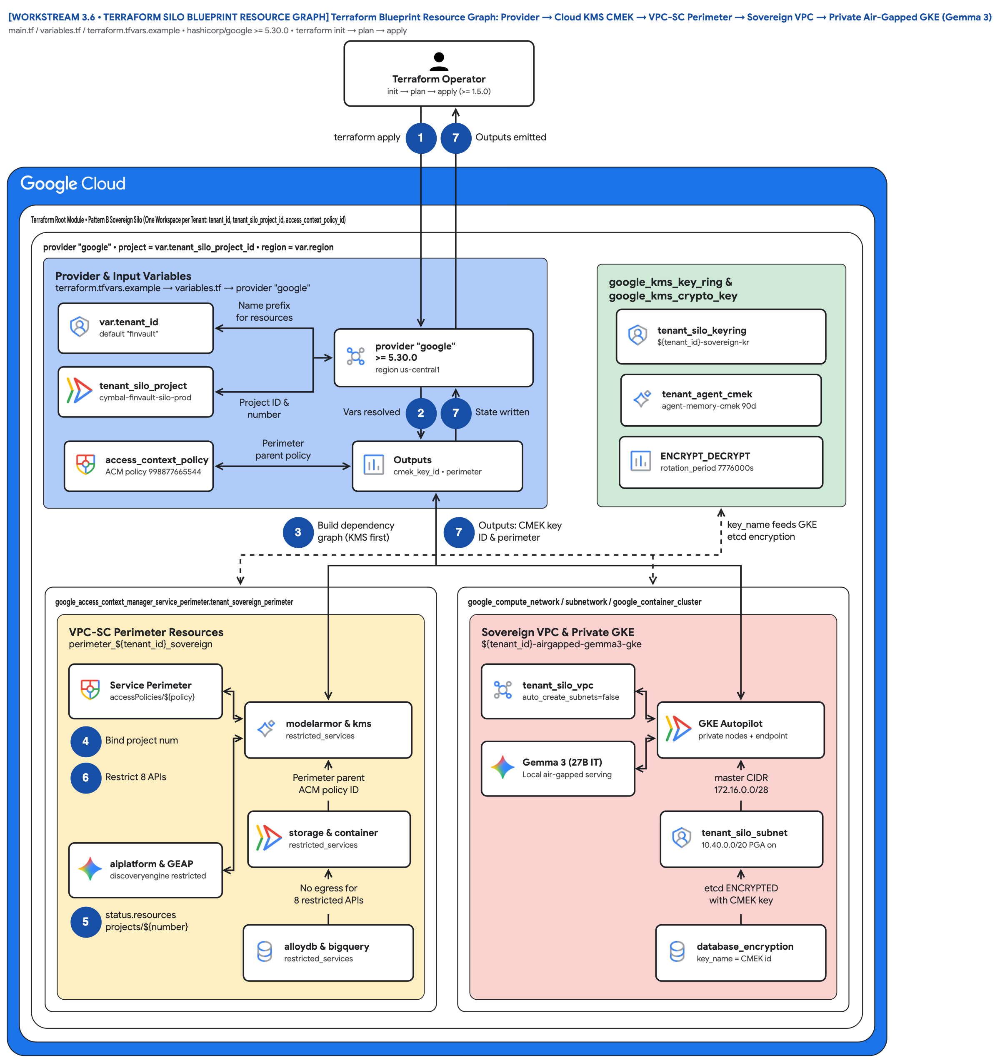
FIGURE 3 — TERRAFORM BLUEPRINT RESOURCE GRAPH: PROVIDER → CLOUD KMS CMEK → VPC-SC PERIMETER → SOVEREIGN VPC → PRIVATE AIR-GAPPED GKE (GEMMA 3) | ID: VIS-WS3-TERRAFORM-SILO-BLUEPRINT-RESOURCE-GRAPH • 1:1 Master High-Resolution Widescreen Architecture (Slide 2 contains Decomposed Vector Shapes)
Notes:
Figure 3 — Terraform Blueprint Resource Graph: Provider → Cloud KMS CMEK → VPC-SC Perimeter → Sovereign VPC → Private Air-Gapped GKE (Gemma 3)
main.tf / variables.tf / terraform.tfvars.example • hashicorp/google >= 5.30.0 • terraform init → plan → apply
• A single root module (Terraform >= 1.5.0, hashicorp/google >= 5.30.0) provisions one sovereign silo per tenant from five variables in terraform.tfvars.
• google_kms_key_ring.tenant_silo_keyring (${tenant_id}-sovereign-kr) and google_kms_crypto_key.tenant_agent_cmek (agent-memory-cmek, 90-day rotation) come first.
• google_access_context_manager_service_perimeter.tenant_sovereign_perimeter binds projects/${tenant_silo_project_number} and restricts eight APIs.
• Restricted services: aiplatform, discoveryengine, modelarmor, alloydb, bigquery, storage, cloudkms and container — no path out of the perimeter.
• google_compute_network.tenant_silo_vpc and tenant_silo_subnet (10.40.0.0/20, Private Google Access) host the private GKE Autopilot cluster.
• google_container_cluster.airgapped_gemma3_cluster uses private nodes/endpoint and database_encryption.key_name = the CMEK key, surfaced via two outputs.
Editable source: diagrams/ws3-terraform-silo-blueprint-resource-graph.drawio (PromptCanvas Vision Decompiler)

Slide 16
FIGURE 3 — TERRAFORM BLUEPRINT RESOURCE GRAPH: PROVIDER → CLOUD KMS CMEK → VPC-SC PERIMETER → SOVEREIGN VPC → PRIVATE AIR-GAPPED GKE (GEMMA 3) | ID: VIS-WS3-TERRAFORM-SILO-BLUEPRINT-RESOURCE-GRAPH • 100% Decomposed Native Editable Vector Shapes, Icons & Arrows (Click any element to move or edit)
[WORKSTREAM 3.6 • TERRAFORM SILO BLUEPRINT RESOURCE GRAPH] Terraform Blueprint Resource Graph: Provider → Cloud KMS CMEK → VPC-SC Perimeter → Sovereign VPC → Private Air-Gapped GKE (Gemma 3)
main.tf / variables.tf / terraform.tfvars.example • hashicorp/google >= 5.30.0 • terraform init → plan → apply
FIGURE 3
Terraform Operatorinit → plan → apply (>= 1.5.0)
Terraform Blueprint Resource Graph: Provider → Cloud KMS CMEK → VPC-SC Perimeter → Sovereign VPC → Private Air-Gapped GKE (Gemma 3)
terraform apply
1
7
Outputs emitted
Terraform Root Module • Pattern B Sovereign Silo (One Workspace per Tenant: tenant_id, tenant_silo_project_id, access_context_policy_id)
provider "google" • project = var.tenant_silo_project_id • region = var.region
A single root module (Terraform >= 1.5.0, hashicorp/google >= 5.30.0) provisions one sovereign silo per tenant from five variables in terraform.tfvars.
google_kms_key_ring.tenant_silo_keyring (${tenant_id}-sovereign-kr) and google_kms_crypto_key.tenant_agent_cmek (agent-memory-cmek, 90-day rotation) come first.
google_access_context_manager_service_perimeter.tenant_sovereign_perimeter binds projects/${tenant_silo_project_number} and restricts eight APIs.
Restricted services: aiplatform, discoveryengine, modelarmor, alloydb, bigquery, storage, cloudkms and container — no path out of the perimeter.
google_compute_network.tenant_silo_vpc and tenant_silo_subnet (10.40.0.0/20, Private Google Access) host the private GKE Autopilot cluster.
google_container_cluster.airgapped_gemma3_cluster uses private nodes/endpoint and database_encryption.key_name = the CMEK key, surfaced via two outputs.
Provider & Input Variables
terraform.tfvars.example → variables.tf → provider "google"
google_kms_key_ring &
google_kms_crypto_key
var.tenant_id
default "finvault"
Name prefix
for resources
tenant_silo_keyring
${tenant_id}-sovereign-kr
provider "google"
>= 5.30.0 • region us-central1
tenant_silo_project
cymbal-finvault-silo-prod
tenant_agent_cmek
agent-memory-cmek 90d
Project ID &
number
Vars resolved
2
7
State written
access_context_policy
ACM policy 998877665544
Perimeter
parent policy
Outputs
cmek_key_id • perimeter
ENCRYPT_DECRYPT
rotation_period 7776000s
3
Build dependency
graph (KMS first)
7
Outputs: CMEK key
ID & perimeter
key_name feeds GKE
etcd encryption
google_access_context_manager_service_perimeter.tenant_sovereign_perimeter
google_compute_network / subnetwork / google_container_cluster
VPC-SC Perimeter Resources
perimeter_${tenant_id}_sovereign
Sovereign VPC & Private GKE
${tenant_id}-airgapped-gemma3-gke
Service Perimeter
accessPolicies/${policy}
tenant_silo_vpc
auto_create_subnets=false
modelarmor & kms
restricted_services
GKE Autopilot
private nodes + endpoint
4
Bind project num
Gemma 3 (27B IT)
Local air-gapped serving
6
Restrict 8 APIs
Perimeter parent
ACM policy ID
master CIDR
172.16.0.0/28
storage & container
restricted_services
tenant_silo_subnet
10.40.0.0/20 PGA on
aiplatform & GEAP
discoveryengine restricted
No egress for
8 restricted APIs
etcd ENCRYPTED
with CMEK key
56 native shapes • 23 connectors • click any box, icon or arrow to edit
5
status.resources
projects/${number}
alloydb & bigquery
restricted_services
database_encryption
key_name = CMEK id
Zones: Routing hub • Central governance & security hub • Left spoke • Right spoke | Source: diagrams/ws3-terraform-silo-blueprint-resource-graph.drawio
Notes:
Figure 3 — Terraform Blueprint Resource Graph: Provider → Cloud KMS CMEK → VPC-SC Perimeter → Sovereign VPC → Private Air-Gapped GKE (Gemma 3)
main.tf / variables.tf / terraform.tfvars.example • hashicorp/google >= 5.30.0 • terraform init → plan → apply
• A single root module (Terraform >= 1.5.0, hashicorp/google >= 5.30.0) provisions one sovereign silo per tenant from five variables in terraform.tfvars.
• google_kms_key_ring.tenant_silo_keyring (${tenant_id}-sovereign-kr) and google_kms_crypto_key.tenant_agent_cmek (agent-memory-cmek, 90-day rotation) come first.
• google_access_context_manager_service_perimeter.tenant_sovereign_perimeter binds projects/${tenant_silo_project_number} and restricts eight APIs.
• Restricted services: aiplatform, discoveryengine, modelarmor, alloydb, bigquery, storage, cloudkms and container — no path out of the perimeter.
• google_compute_network.tenant_silo_vpc and tenant_silo_subnet (10.40.0.0/20, Private Google Access) host the private GKE Autopilot cluster.
• google_container_cluster.airgapped_gemma3_cluster uses private nodes/endpoint and database_encryption.key_name = the CMEK key, surfaced via two outputs.
Editable source: diagrams/ws3-terraform-silo-blueprint-resource-graph.drawio (PromptCanvas Vision Decompiler)

Slide 17
FIGURE 3 — TERRAFORM BLUEPRINT RESOURCE GRAPH: PROVIDER → CLOUD KMS CMEK → VPC-SC PERIMETER → SOVEREIGN VPC → PRIVATE AIR-GAPPED GKE (GEMMA 3) | Editable Architecture Component & Topology Specification Table
Object ID | Component Name | Architectural Role / Details | Type
OBJ-01 | Terraform Root Module • Pattern B Sovereign Silo (One Workspace per Tenant: tenant_id, te… | Core Architecture Node | Enclave / Tier
OBJ-02 | provider "google" • project = var.tenant_silo_project_id • region = var.region | Core Architecture Node | Enclave / Tier
OBJ-03 | google_access_context_manager_service_perimeter.tenant_sovereign_perimeter | Core Architecture Node | Enclave / Tier
OBJ-04 | google_compute_network / subnetwork / google_container_cluster | Core Architecture Node | Enclave / Tier
OBJ-05 | VPC-SC Perimeter Resources | perimeter_${tenant_id}_sovereign | Enclave / Tier
OBJ-06 | Sovereign VPC & Private GKE | ${tenant_id}-airgapped-gemma3-gke | Enclave / Tier
OBJ-07 | Provider & Input Variables | terraform.tfvars.example → variables.tf → provider "google" | Enclave / Tier
OBJ-08 | google_kms_key_ring & | google_kms_crypto_key | Enclave / Tier
OBJ-09 | [WORKSTREAM 3.6 • TERRAFORM SILO BLUEPRINT RESOURCE GRAPH] Terraform Blueprint Resource G… | main.tf / variables.tf / terraform.tfvars.example • hashicorp/google >= 5.30.0 • terraform init → plan → apply | Service Node
OBJ-10 | Terraform Operatorinit → plan → apply (>= 1.5.0) | Core Architecture Node | Service Node
OBJ-11 | provider "google" | >= 5.30.0 • region us-central1 | Service Node
OBJ-12 | tenant_silo_keyring | ${tenant_id}-sovereign-kr | Service Node
OBJ-13 | ENCRYPT_DECRYPT | rotation_period 7776000s | Service Node
OBJ-14 | tenant_agent_cmek | agent-memory-cmek 90d | Service Node
Notes:
Figure 3 component inventory for Terraform Blueprint Resource Graph: Provider → Cloud KMS CMEK → VPC-SC Perimeter → Sovereign VPC → Private Air-Gapped GKE (Gemma 3)

Slide 18
WS3 | Key Takeaways
Key Takeaways
Choose Pattern B only when a contract demands a dedicated blast radius, a customer-revocable key, or no multi-tenant model endpoints.
Keep the governance code identical across patterns; pay for infrastructure, not for a second engineering team.
PAB answers 'which projects may this principal ever reach?' — it blocks lateral movement even when another project's IAM is wrong.
Make the tenant CMEK the single dependency for runtime, memory, data, and audit so one key disable is a complete kill-switch.
Prove every control with the 6-test suite before onboarding, and keep the results visible on the architecture diagram.
Run run_silo_security_tests.py, apply the 3.6 Terraform silo blueprint for one tenant, and book the 90-minute Pattern B codelab with your security team.
Notes:
Key Takeaways
• Choose Pattern B only when a contract demands a dedicated blast radius, a customer-revocable key, or no multi-tenant model endpoints.
• Keep the governance code identical across patterns; pay for infrastructure, not for a second engineering team.
• PAB answers 'which projects may this principal ever reach?' — it blocks lateral movement even when another project's IAM is wrong.
• Make the tenant CMEK the single dependency for runtime, memory, data, and audit so one key disable is a complete kill-switch.
• Prove every control with the 6-test suite before onboarding, and keep the results visible on the architecture diagram.

Slide 19
WS3 | Assets, Editable Diagrams & Source Documents
Assets & Editable Diagrams
Diagram | Editable Draw.io | Draw.io Render | Vision AST
WORKSTREAM 3.1 • PATTERN B BLUEPRINT Pattern B: Zero-Trust Sovereign Silos (VPC-SC, IAM PAB, CMEK Kill-Switch & Air-Gapped Gemma 3 on GKE) | diagrams/ws3-pattern-b-sovereign-silos-architecture.drawio | diagrams/ws3-pattern-b-sovereign-silos-architecture.drawio.png | diagrams/vision_metadata/ws3-pattern-b-sovereign-silos-architecture.vision.json
WORKSTREAM 3.2 • MULTI-PROJECT SILO & CMEK SETUP Pattern B Provisioning Topology: Org → Per-Tenant Silo Projects, VPC-SC Perimeters, IAM PAB & Cloud KMS CMEK Keys | diagrams/ws3-multi-project-silo-and-cmek-setup-topology.drawio | diagrams/ws3-multi-project-silo-and-cmek-setup-topology.drawio.png | diagrams/vision_metadata/ws3-multi-project-silo-and-cmek-setup-topology.vision.json
WORKSTREAM 3.6 • TERRAFORM SILO BLUEPRINT RESOURCE GRAPH Terraform Blueprint Resource Graph: Provider → Cloud KMS CMEK → VPC-SC Perimeter → Sovereign VPC → Private Air-Gapped GKE (Gemma 3) | diagrams/ws3-terraform-silo-blueprint-resource-graph.drawio | diagrams/ws3-terraform-silo-blueprint-resource-graph.drawio.png | diagrams/vision_metadata/ws3-terraform-silo-blueprint-resource-graph.vision.json
Blog: blogs/ws3-pattern-b-sovereign-silos.md
Source: workstream-3-pattern-b-siloed/3.1-case-study-and-solution-architecture.md
Source: workstream-3-pattern-b-siloed/3.5-exfiltration-and-cmek-revocation-tests/run_silo_security_tests.py
Source: workstream-3-pattern-b-siloed/3.7-blog-sovereign-silos.md
Anchor reference: https://docs.cloud.google.com/architecture/multi-tenant-agentic-ai-system
GitHub: https://github.com/nitinaggarwal-12/blogs
Notes:
Run run_silo_security_tests.py, apply the 3.6 Terraform silo blueprint for one tenant, and book the 90-minute Pattern B codelab with your security team.

